Slide 1
PORTFOLIO COMMITTEE ON TRANSPORT – ANNUAL REPORT 2018/19

Slide 2
PRESENTATION
BACKGROUND
THE BUSINESS
THE YEAR AT A GLANCE
2018/19 OUTCOMES
FINANCIAL STATUS
  Historical Financial Information for the period 01/04/2014 – 31/03/2019
  Funding Model for the period 01/04/2019 – 31/03/2022
CHALLENGES & MITIGATIONS
CONCLUSION

Slide 3
BACKGROUND

Slide 4
MANDATE OF THE ENTITY
Corporate and Statutory Form
Road Accident Fund Act, 1996 (Act No. 56 of 1996) & RAF Amendment Act, 2005 (Act No. 19 of 2005)
National Public Entity (Schedule 3A of the PFMA).
Constitutional Court Rulings and legal precedents have shaped the mandate.
Objective of the Fund
    Section 3 of the RAF Act
    Payment of compensation for loss or damage wrongfully caused by the driving of motor vehicles
    Limited to bodily injury or death
    Excludes secondary emotional shock
    Material damages not covered (non personal damages)
    Section 17(4) of the RAF Act
    Provides support in respect of future treatment and rehabilitation (future medical expenses i.e. rehabilitation centre costs, assistive devices, home modification, treatment and other related goods and services)

Slide 5
COMPENSATION
    :
    Section 17 of the RAF Act
    General damages (serious injury)
    Past medical expenses
    Future medical expenses (undertaking)
    Past loss of earnings / earning capacity
    Future loss of earnings / earning capacity
    Past loss of support
    Future loss of support
    Section 18 of the RAF Act
    Necessary actual costs of funeral / cremation
    (Coffin, Transportation, storage and the grave / cremation costs)

Slide 6
MANDATE OF THE ENTITY
    Section 21 of the RAF Act
    Indemnifies the wrongdoer (for as long as the RAF can pay claims)
    Indemnification limited to civil claims
The Fund is called on to:
    Indemnify the wrongdoer and compensate the injured and dependents of the deceased breadwinners.

Slide 7
THE BUSINESS

Slide 8
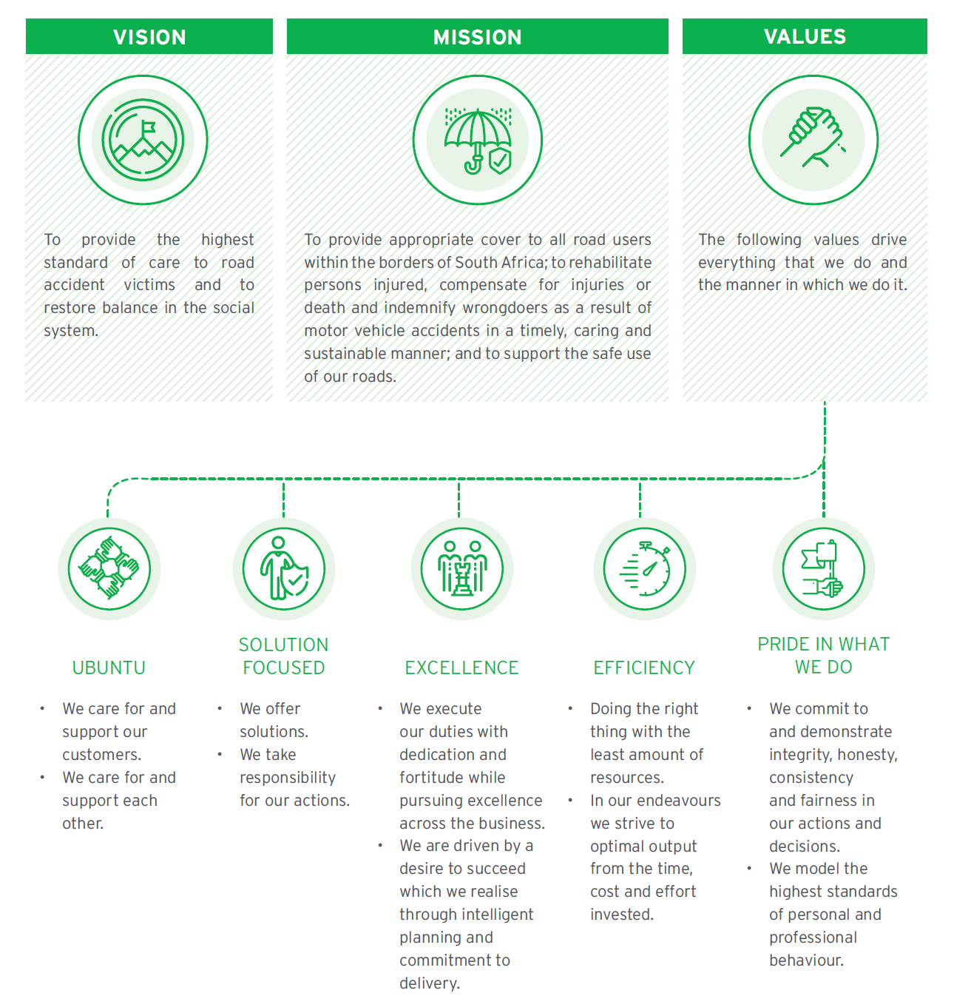
The Business
Vision, Mission and Values

Slide 9
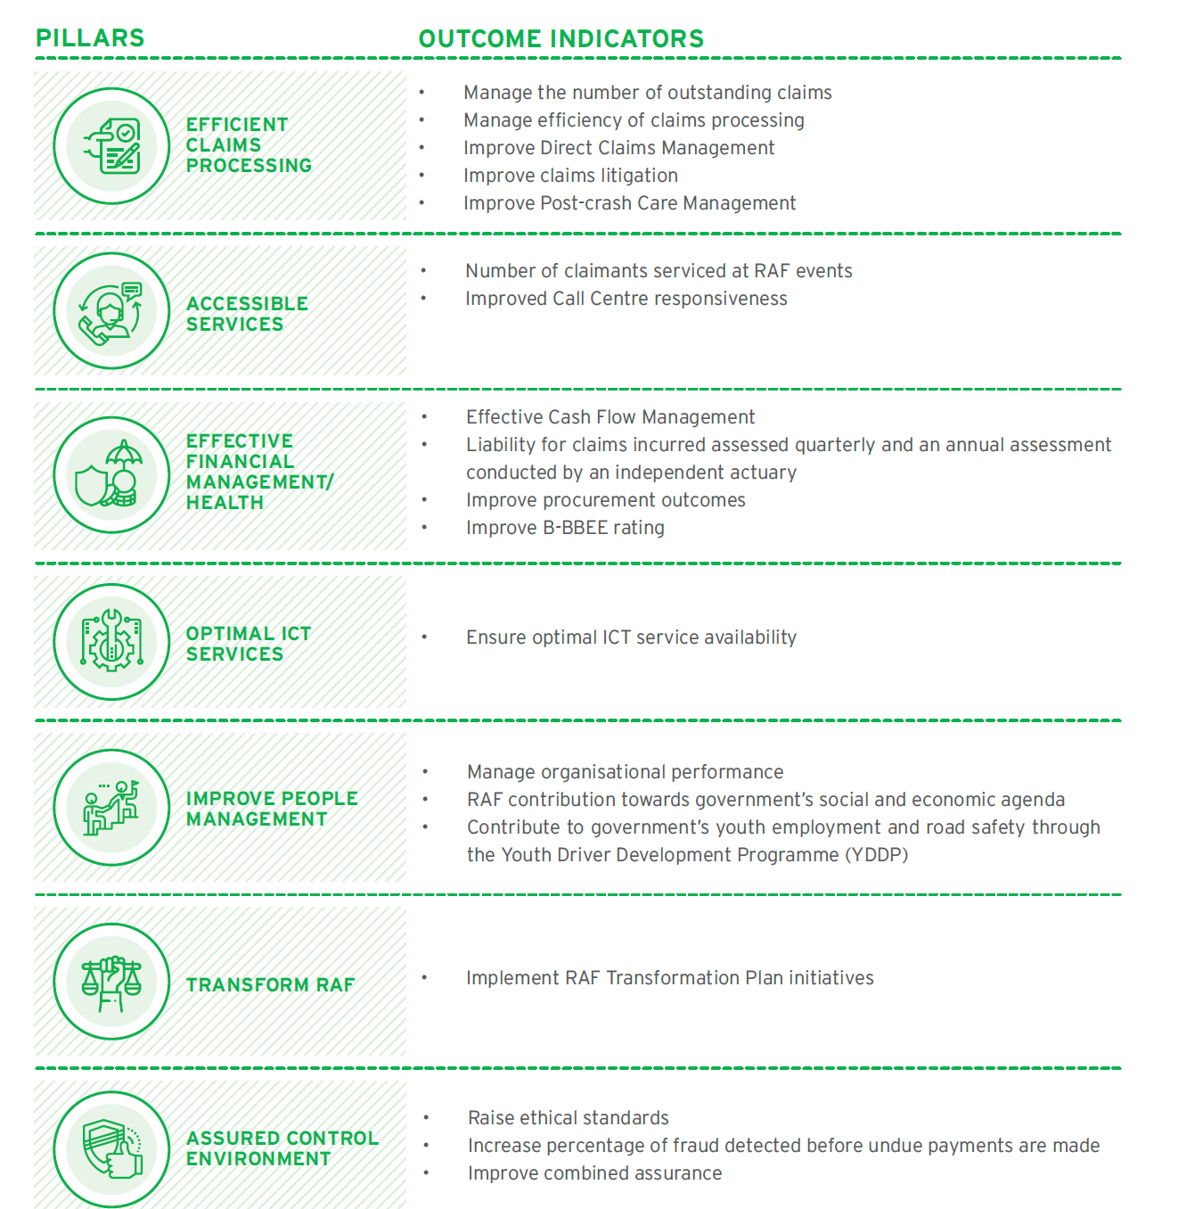
THE BUSINESS: STRATEGIC OUTCOMES

Slide 10
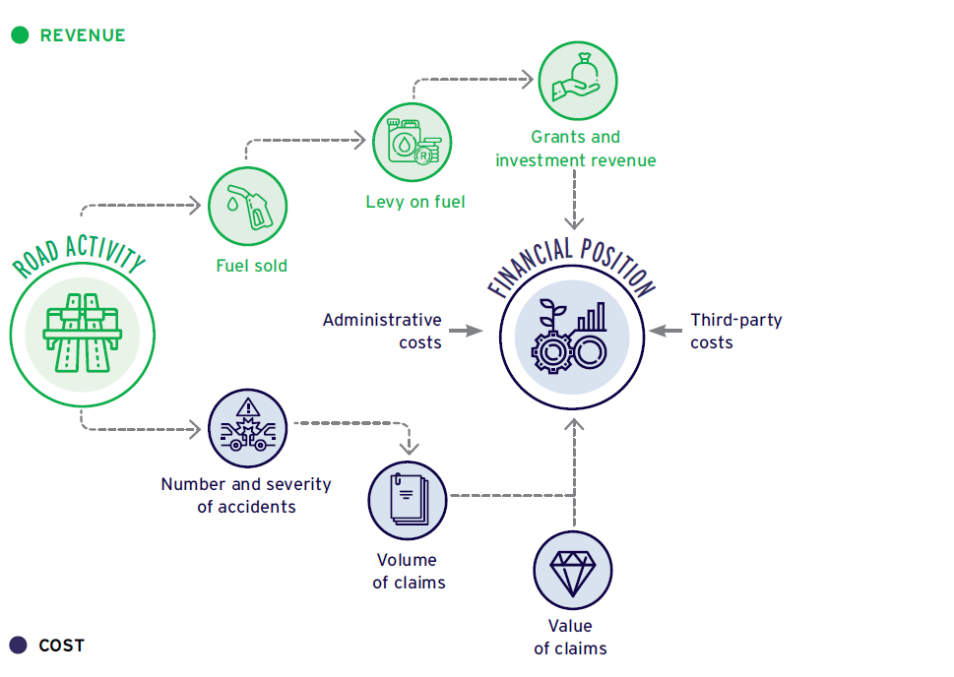
The Business
Business Model

Slide 11
The Business
Operations
Human Capital
Risk Management
Forensics
Marketing
Stakeholder Management
Project Management
Monitoring and Assurance
Origination
Determination
Litigation
Finalisation
Post -Finalisation
Direct Claims

Slide 12
ORGANISATIONAL STRUCTURE

Slide 13
THE YEAR AT A GLANCE

Slide 14
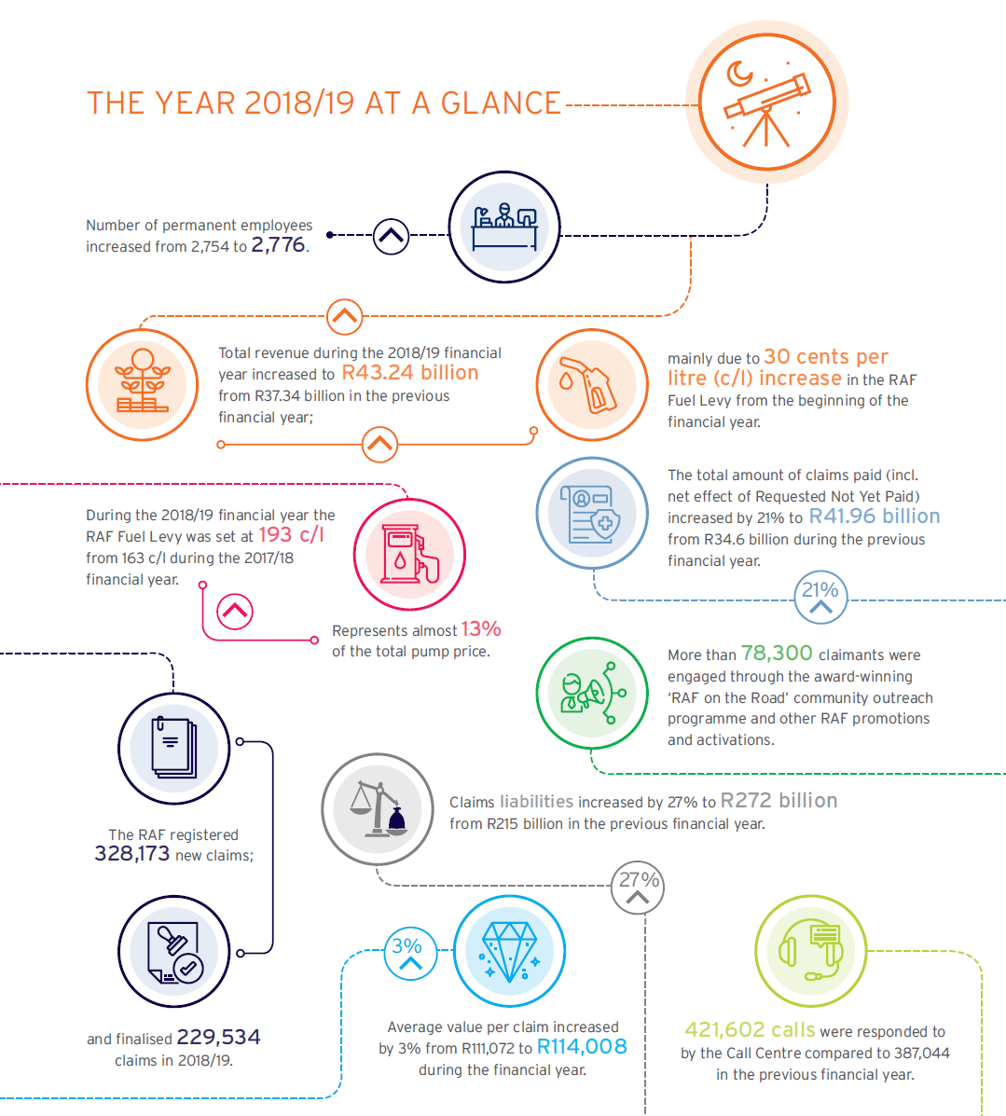

THE YEAR AT A GLANCE
Highlights

Slide 15
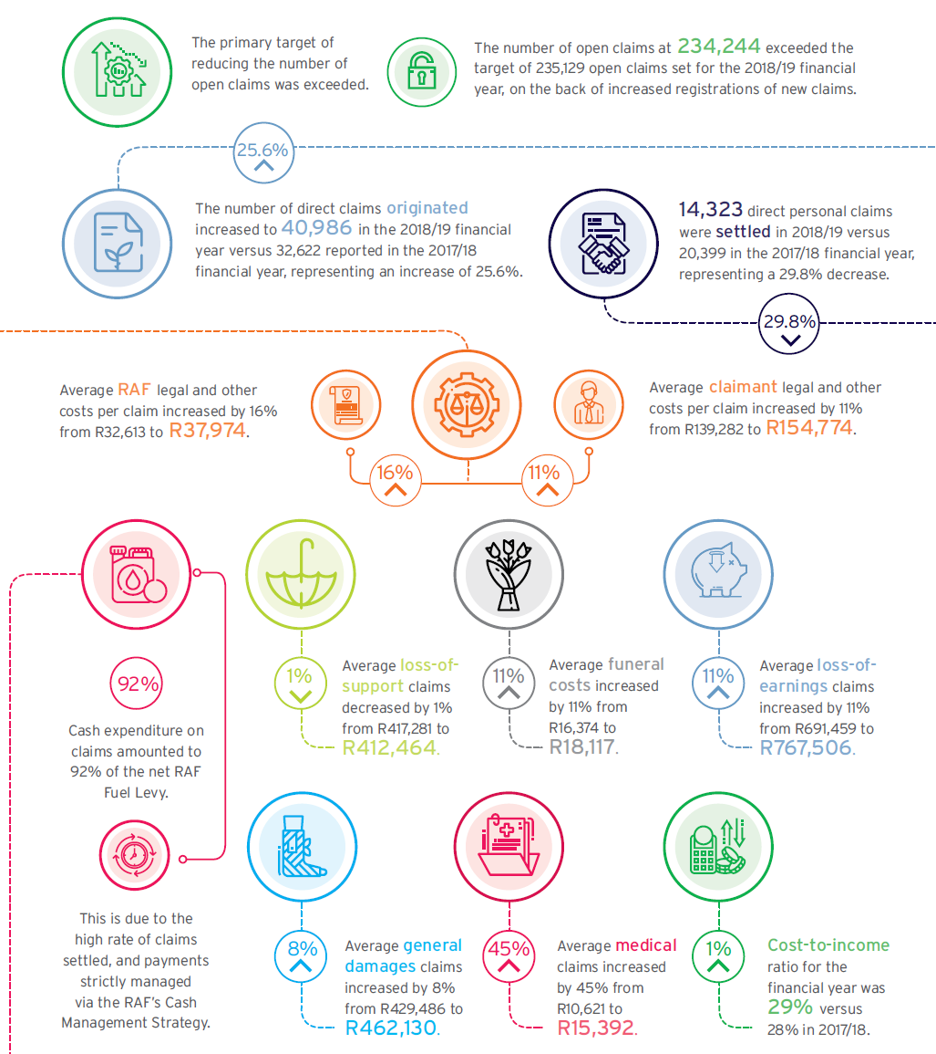
THE YEAR AT A GLANCE
Highlights (continued)

Slide 16
2018/19 OUTCOME

Slide 17
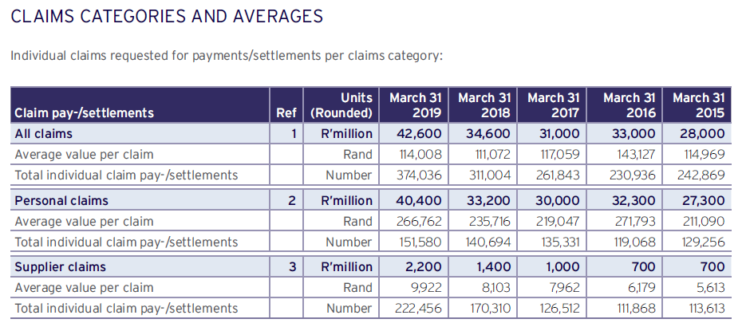
2018/19 OUTCOMES
Indicators

Slide 18
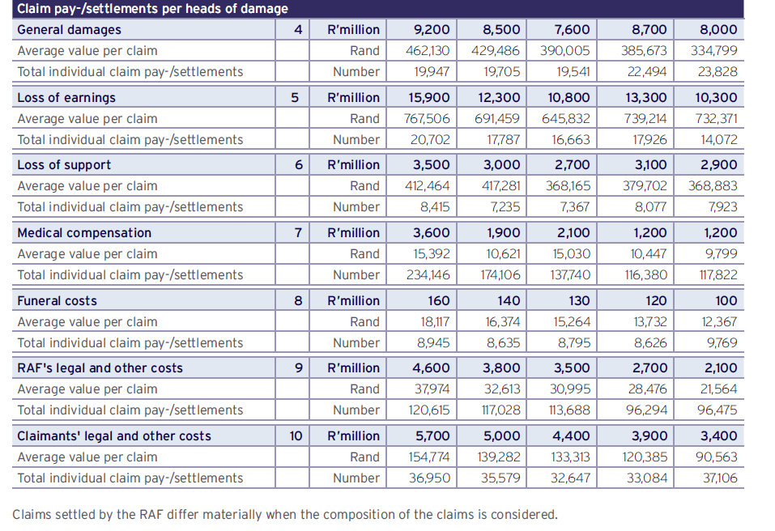
2018/19 OUTCOMES
Indicators (continued)

Slide 19
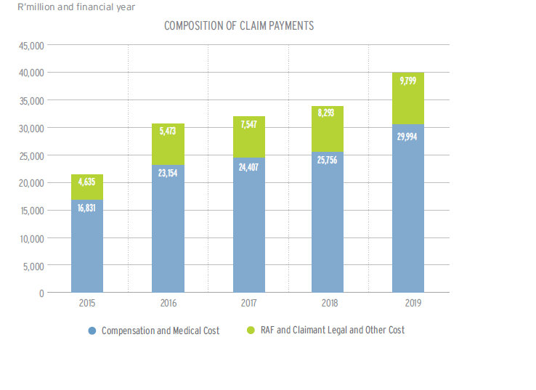
2018/19 OUTCOMES
Indicators (continued)

Slide 20
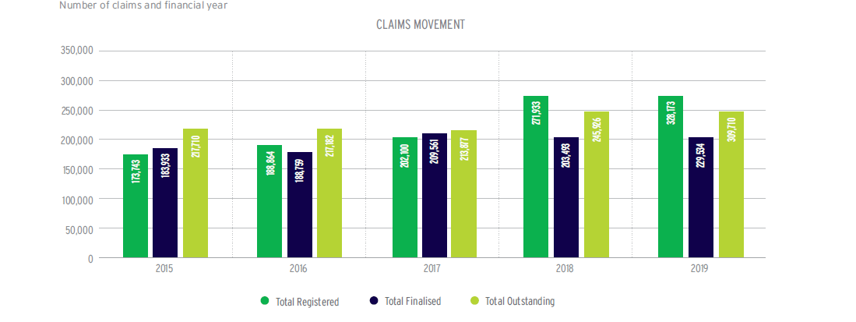
2018/19 OUTCOMES
Indicators (continued)

Slide 21
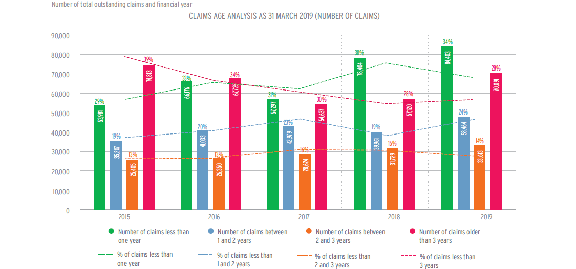
2018/19 OUTCOMES
Indicators (continued)

Slide 22
2018/19 OUTCOMES
Pillar | 2018/2019 | 2017/2018
Strategic Objectives Achieved | 77% | 91%
Staff Count | 2,776 | 2,754
Open Claims | 234 244 (excl. RNYP) | 245,926 (excl. RNYP)
Claims settled and paid | 229,534 | 203,493
Claim Expenditure | R39.8bn (RNYP R11.2bn) | R34.0bn (RNYP R9.1bn)
Legal and other Costs as % of Claims | 24.6% | 17%
Reopened Claims | 2,420 | 3,489
National Footprint – Offices No. of Offices No. of Hospitals No. of Consultations | 10 99 132 560 | 12 100 156,607
Average value of a claim | R114,008 | 111,072
Direct Claims Originated | 25.6% | 39.6%

Slide 23
2018/19 OUTCOMES
Pillar | 2018/2019 | 2017/18
ROTR Events No. of Claimants (All Events) | 10 78,373 | 9 66,819
Writs | 9,964 | 12,525
Call Centre Agents Calls Received Calls Answered % Abandoned calls | 31 421,602 408,675 3.06% | 31 395,841 387,044 2.22%
Fraud Arrests Convictions Repudiations | 13 7 2 095 | 10 11 1 203

Slide 24
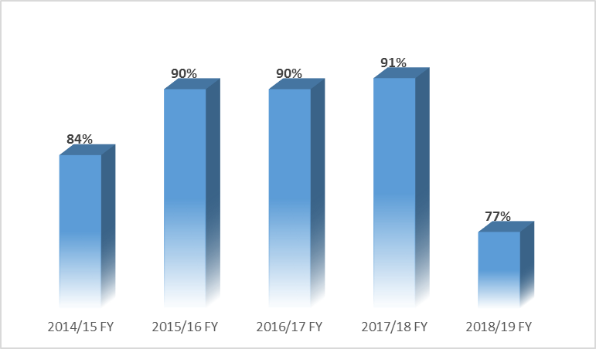
ENTITY PERFORMANCE
2014/15 FY – 2018/19 FY

Slide 25
2018/19 OUTCOMES
  Annual Audit by Auditor-General
  Unqualified Audit with Material Findings
Clean Audit lost due to a finding on the Annual Performance Report. The finding related to target 9 of Objective 1 – “Reduce the percentage of direct personal claims to represented”. The AGSA could not verify that conversions reported were valid conversions for the 2018/19 financial year, due to incomplete supporting documents i.e. Power of Attorney to change mandate was not on file. This did not affect the reported performance of the target.
The RAF’s financial statements present fairly, in all material respects, the financial position of the Road Accident Fund as at 31 March 2019. No findings were raised on the Annual Financial Statements in the management report.
Emphasis of matter on the net deficit retained, as in prior years, as our current liabilities exceeded total assets by R262,114,730,000.
Management letter confirms a stable control environment, with improvement in the Supply Chain Management control environment and regression in the audit of predetermined objectives classified as misstatement of annual performance information.
  20 of an immaterial nature classified as:
  - 3 Non Compliance with Legislation (Procurement and Contract Management;
  - 4 Non Compliance with Legislation (Compliance);
  - 5 Misstatement in annual performance report (Audit of pre-determined objectives)
  - 1 Internal control deficiency (Information Technology Governance)
  - 2 Internal control deficiency (User Access Management)
  - 5 Internal control deficiency (Security Management)
  1 of a material nature classified as:
    - Misstatement of annual performance information and rated as matters affecting the audit report.

Slide 26
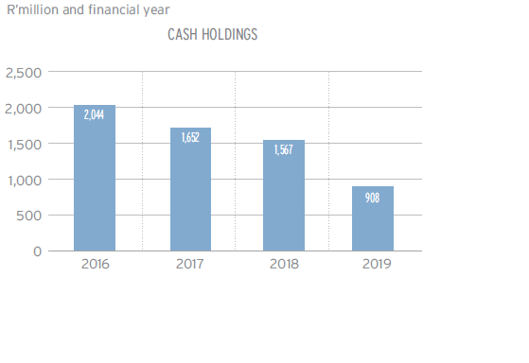
2018/19 OUTCOMES
Cash Holdings

Slide 27
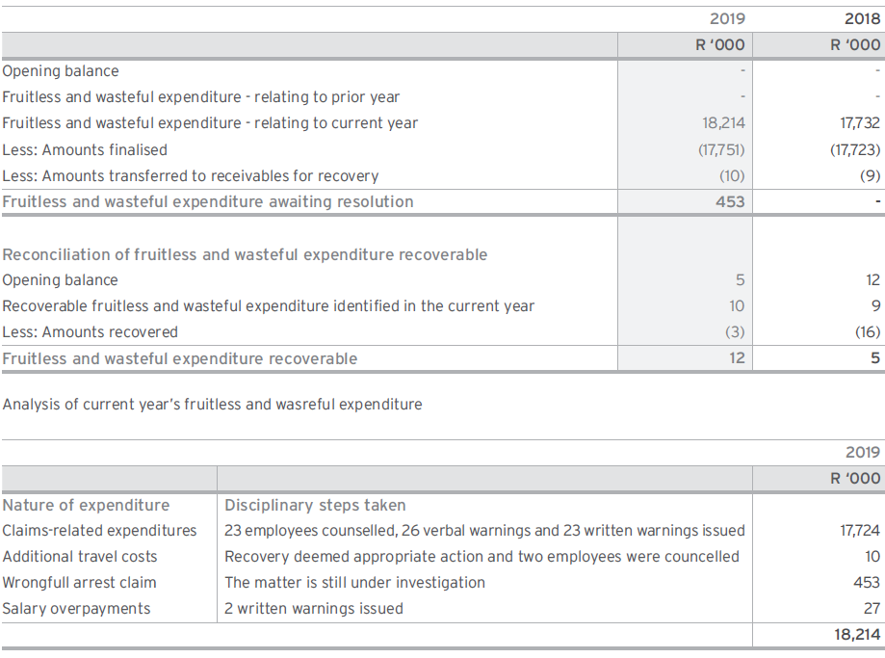
2018/19 OUTCOMES
Fruitless and Wasteful Expenditure

Slide 28
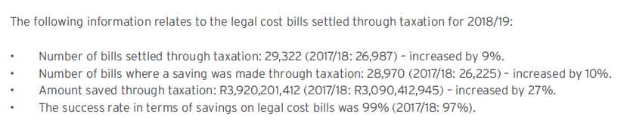
2018/19 OUTCOMES
Fruitless and Wasteful Expenditure (continued)

Slide 29
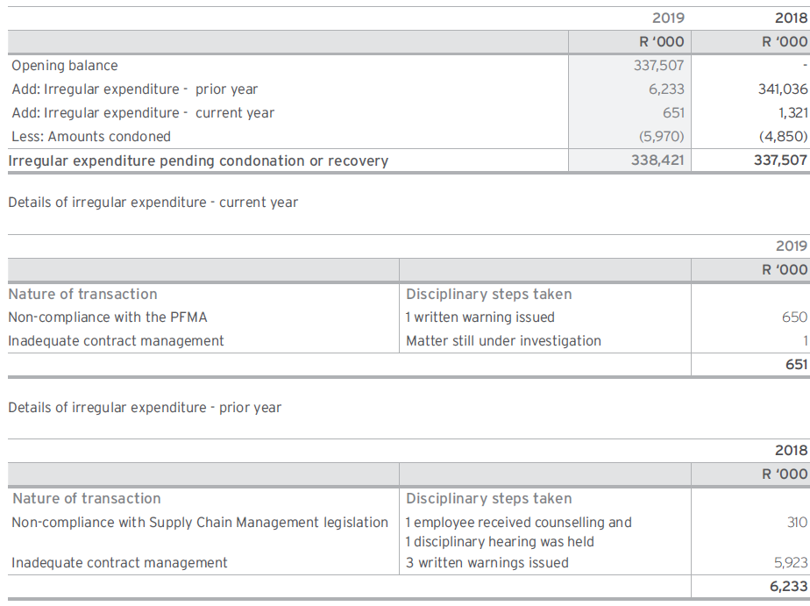
2018/19 OUTCOMES
Irregular Expenditure

Slide 30
FINANCIAL INFORMATION 2014-2019

Slide 31
INCOME STATEMENT
YEAR ENDED 31 MARCH | 2018/2019 R’m | 2017/2018 R’m | 2016/2017 R’m | 2015/2016 R’m | 2014/2015 R’m
INCOME | 43 239 | 37 341 | 33 342 | 33 206 | 22 680
1.1 Net Fuel Levies | 43 139 | 37 251 | 33 230 | 33 113 | 22 614
1.2 Investment Income | 99 | 90 | 109 | 89 | 66
1.3 Reinsurance Income | - | - | 1 | 1 | -
1.4 Other Income | 1 | - | 2 | 3 | -
2. EXPENDITURE | (99 019) | (63 692) | (68 083) | (68 164) | (42 132)
2.1 Claims Expenditure | (96 405) | (61 346) | (65 955) | (66 266) | (40 456)
2.2 Employee Costs | (1 735) | (1 605) | (1 435) | (1 280) | (1 164)
2.3 General Expenses | (515) | (454) | (420) | (398) | (377)
2.4 Reinsurance Premiums | (22) | (22) | (22) | (22) | (23)
2.5 Depreciation&Amortisation | (51) | (41) | (43) | (47) | (45)
2.6 Finance Costs | (291) | (224) | (209) | (151) | (67)
3. DEFICIT FOR THE YEAR | (55 780) | (26 351) | (34 741) | (34 958) | (19 452)

Slide 32
BALANCE SHEET
YEAR ENDED 31 MARCH | 2018/2019 R’m | 2017/2018 R’m | 2016/2017 R’m | 2015/2016 R’m | 2014/2015 R’m
ASSETS
1.1 Current Assets | 10 947 | 9 563 | 8 982 | 9 569 | 7 085
1.2 Non-Current Assets | 273 | 243 | 216 | 227 | 282
Total Assets | 11 220 | 9 806 | 9 198 | 9 796 | 7 367
2. LIABILITIES AND RESERVES
2.1 Current Liabilities | 41 981 | 39 045 | 35 299 | 47 486 | 35 586
2.2 Non-Current Liabilities | 231 354 | 177 102 | 153 892 | 107 562 | 82 028
2.3 Reserves | (262 115) | (206 341) | (179 993) | (145 252) | (110 247)
Total Liabilities and Reserves | 11 220 | 9 806 | 9 198 | 9 796 | 7 367

Slide 33
CASH FLOW STATEMENT
FINANCIAL PERIOD ENDED 31 MARCH | 2018/2019 R’m | 2017/2018 R’m | 2016/2017 R’m | 2015/2016 R’m | 2014/2015 R’m
OPERATING ACTIVITIES | (585) | (19) | (362) | 1 034 | (1 399)
2. INVESTING ACTIVITIES | (74) | (66) | (30) | (38) | (58)
3. FINANCING ACTIVITIES | - | - | - | - | -
4. NET INCREASE/(DECREASE) | (659) | (85) | (392) | 996 | (1 457)
5. AT THE BEGINNING OF PERIOD | 1 567 | 1 652 | 2 044 | 1 048 | 2 505
6. AT THE END OF PERIOD | 908 | 1 567 | 1 652 | 2 044 | 1 048

Slide 34
CLAIMS LIABILITY
FINANCIAL YEAR ENDED 31 MARCH | 2018/2019 R’m | 2017/2018 R’m | 2016/2017 R’m | 2015/2016 R’m | 2014/2015 R’m
A. Claims Requested But Not Yet Paid | 11 232 | 9 061 | 8 516 | 10 636 | 6 940
B. Claims Reported But Not Yet Settled | 173 559 | 139 204 | 119 830 | 99 152 | 78 491
C. Claims Incurred But Not Yet Reported | 87 124 | 67 013 | 59 633 | 44 182 | 30 807
D. Handover Costs | - | 24 | 27 | 37 | 131
 | 271 915 | 215 302 | 188 006 | 154 007 | 116 369
NOTES:
A. Claims Requested But Not Yet Paid | This represents claims that are due and payable.
B. Claims Reported But Not Yet Settled | This represents insurance liability. It is not known when these will be paid and how much will be paid.
C. Claims Incurred But Not Yet Reported | Claims have not been lodged nor has an assessment been made in terms of RAF Act to determine whether RAF has an obligation or not.
D. Handover Costs | Big tender in 2015 - New panel attorneys appointed (R181m provision).

Slide 35
CLAIMS EXPENDITURE
FINANCIAL YEAR ENDED 31 MARCH | 2018/2019 R’m | 2017/2018 R’m | 2016/2017 R’m | 2015/2016 R’m | 2014/2015 R’m
A. Claims Paid | 39 793 | 34 049 | 31 955 | 28 628 | 21 470
B. Increase/(Decrease) in RNYP | 2 171 | 546 | (2 119) | 3 696 | 6 557
C. Increase in Claims Provision | 54 441 | 26 751 | 36 119 | 33 942 | 12 429
 | 96 405 | 61 346 | 65 955 | 66 266 | 40 456
NOTES:
A. Claims Paid | This represents actual payments during the period
B. Increase in RNYP | In the absence of cash, RNYP increased
C. Increase in Claims Provision | Increase due valuation performed

Slide 36
BREAKDOWN OF CLAIMS PAID
FINANCIAL YEAR ENDED 31 MARCH | 2018/2019 R’m | 2017/2018 R’m | 2016/2017 R’m | 2015/2016 R’m | 2014/2015 R’m
A. Claimant Compensation | 26 473 | 23 258 | 22 287 | 21 644 | 15 525
B. Claimant Medical Costs | 3 521 | 2 498 | 2 120 | 1 510 | 1 306
C. Claimant and RAF Legal and Other Costs | 9 799 | 8 293 | 7 547 | 5 473 | 4 635
 | 39 793 | 34 049 | 31 954 | 28 627 | 21 466
NOTES:
A. Claimant Compensation |  | This is made up of Loss of Earnings and Support, General Damages and Funeral Costs

Slide 37
FUNDING MODEL
2019 -2022

Slide 38
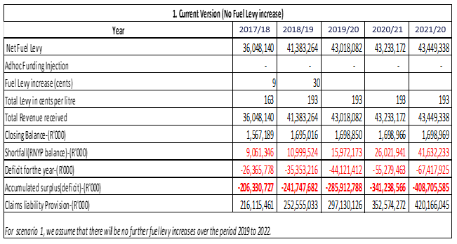
FUNDING
Assumption: No Levy Increase

Slide 39
INCOME STATEMENT
YEAR ENDED 31 MARCH | 2021/2022 R’m | 2020/2021 R’m | 2019/2020 R’m | 2018/2019 R’m | 2017/2018 R’m
INCOME | 43 594 | 43 377 | 43 459 | 42 309 | 37 342
1.1 Net Fuel Levies | 43 495 | 43 278 | 43 360 | 42 214 | 37 251
1.2 Investment Income | 99 | 99 | 99 | 95 | 90
1.3 Other Income | - | - | - | - | 1
2. EXPENDITURE | (111 012) | (98 656) | (87 580) | (77 662) | (63 708)
2.1 Claims Expenditure | (107 064) | (95 016) | (84 304) | (74 747) | (61 346)
2.2 Employee Costs | (2 670) | (2 451) | (2 165) | (1 881) | (1 598)
2.3 General Expenses | (809) | (766) | (726) | (690) | (476)
2.4 Reinsurance Premiums | (30) | (29) | (27) | (26) | (22)
2.5 Depreciation and Amortisation | (53) | (53) | (56) | (51) | (41)
2.6 Finance Costs | (386) | (341) | (302) | (267) | (224)
2.7 Loss on disposal of assets | - | - | - | - | (1)
3. DEFICIT FOR THE YEAR | (67 418) | (55 279) | (44 121) | (35 353) | (26 366)

Slide 40
BALANCE SHEET
YEAR ENDED 31 MARCH | 2021/2022 R’m | 2020/2021 R’m | 2019/2020 R’m | 2018/2019 R’m | 2017/2018 R’m
ASSETS
1.1 Current Assets | 10 976 | 10 920 | 10 865 | 10 509 | 9 542
1.2 Non-Current Assets | 485 | 416 | 353 | 298 | 243
Total Assets | 11 461 | 11 336 | 11 217 | 10 807 | 9 785
2. LIABILITIES AND RESERVES
2.1 Current Liabilities | 109 695 | 84 801 | 66 640 | 54 589 | 39 033
2.2 Non-Current Liabilities | 310 471 | 267 774 | 230 490 | 197 966 | 177 095
2.3 Reserves | (408 705) | (341 239) | (285 913) | (241 748) | (206 343)
Total Liabilities and Reserves | 11 461 | 11 336 | 11 217 | 10 807 | 9 785

Slide 41
CHALLENGES AND MITIGATIONS

Slide 42
CHALLENGES AND MITIGATIONS
    CHALLENGE :Inadequate Funding
    Cash constraints leading to non payment of finalised claims.
    Attachment of the RAF’s bank account and assets by Sheriffs.
    Mitigation Measures
    Stringent Cash Flow Management
    Improve efficiencies across business
    CHALLENGE : RAF founding legislation
    Continuation of the RAF dispensation based on unsustainable funding model
    Mitigation Measures:
    Support DoT with proposed policy changes

Slide 43
CONCLUSION

Slide 44
CONCLUSION
  Despite its challenges and limitation, the RAF continues to transform itself, to record successes and to drive the evolution of the business into a new dispensation which addresses the weaknesses of the present model and which will benefit considerably more South Africans for decades to come
  The 2015-2020 Strategic Plan and the 2019/2020 APP are focused on preparing for the future with a keen emphasis on:
  Processing claims, doing so in less time and enhancing the quality of claim processing
  Prudently managing available cash
  Ensuring good governance and management of the business
  Motivating for additional funding to meet real, current demand
  Great effort is and will be placed on:
  Fulfilling the Strategic Plan and APP deliverables;
  Addressing the challenges and risks;
  Preventing the catastrophic socio-economic effects of accidents in our society; and
  Continue supporting the transition from RAF to new sustainable dispensation.

Slide 45
Thank You

