Slide 1
OHSC ANNUAL REPORT
2018/2019

Slide 2
Purpose
The purpose of the presentation is to:
Outline performance progress with regard to the 2018/19 annual performance plan
Outline the 2018/19 financial performance
Indicate some of the constraints faced by the OHSC

Slide 3
Introduction
The OHSC was established in terms of the National Health Amendment (Act No. 12 of 2013) as a juristic person under the oversight control and leadership of a Board appointed by the Minister of Health. The entity is further governed through the PFMA and is listed under Schedule 3A as a public entity.
The Mandate
The main objects of the OHSC as outlined in the Act are: to protect and promote the health and safety of users of health services by;
Monitoring and enforcing compliance by health establishments with norms and standards prescribed by the Minister in relation to the national health system; and
Ensuring consideration, investigation and disposal of complaints relating to non-compliance with prescribed norms and standards in a procedurally fair, economical and expeditious manner.
The mandate contributes to two distinct but interdependent regulatory outcomes, which are:
Reduction in avoidable mortality, morbidity and harm within health establishments through reliable and safe health services; and
Improvements in the availability, responsiveness and acceptability of health services for users.

Slide 4
Introduction..Cont
Our Mandate implies that we shall:
Act as the champion of the public and of healthcare users so as to restore credibility and trust;
Respect healthcare users and their families as well as healthcare personnel;
Push for effectiveness in achieving health system change and social impact;
Strive for excellence, innovation and efficiency in our operations;
Be truthful, fair and committed to intellectual honesty;
Practice transparency, but respect confidentiality;
Achieve the highest standards of ethical behaviour, teamwork and collaboration; and
Promote professionalism, compassion, diversity and social responsibility.

Slide 5
Introduction..Cont
Our Mandate implies that we shall:
Act as the champion of the public and of healthcare users so as to restore credibility and trust;
Respect healthcare users and their families as well as healthcare personnel;
Push for effectiveness in achieving health system change and social impact;
Strive for excellence, innovation and efficiency in our operations;
Be truthful, fair and committed to intellectual honesty;
Practice transparency, but respect confidentiality;
Achieve the highest standards of ethical behaviour, teamwork and collaboration; and
Promote professionalism, compassion, diversity and social responsibility.

Slide 6
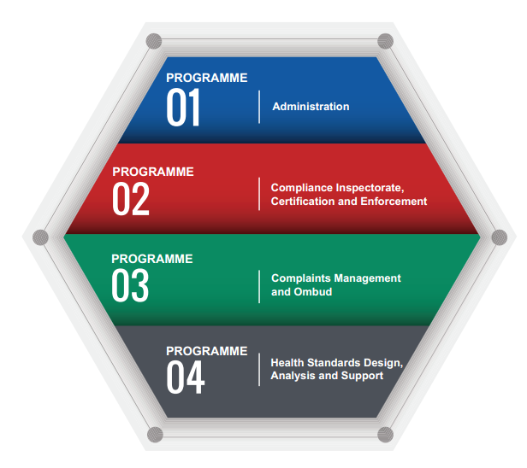
Programmes
Four programes

Slide 7
Strategic Goals
Publicly demonstrate responsiveness and accountability as an effective and efficient high-performance organisation
Inspect health establishments (HEs) for compliance with quality norms and standards
Patient and community complaints regarding poor care and situations of concern are investigated and responded to
Progressively improve the quality and safety of healthcare through effective communication and collaboration with users, providers and other relevant stakeholders

Slide 8
Comprises finance, supply chain management, human resource management, information technology, communication and stakeholder relations, governance and legal The purpose is to provide the leadership and administrative support necessary for the OHSC to deliver on its mandate and comply with all relevant legislative requirements.
Progr. 1 - Administration

Slide 9
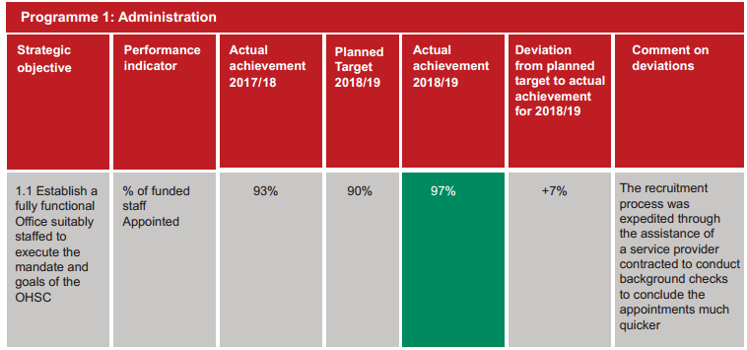
Performance Against Targets

Slide 10
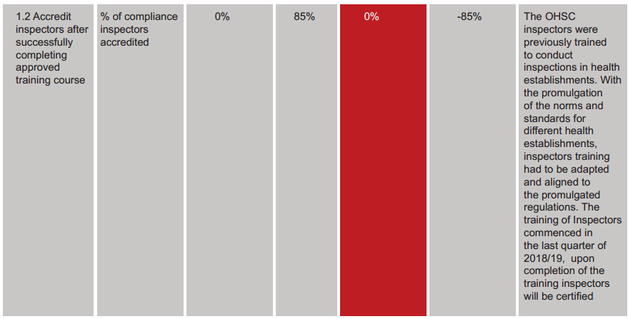
Performance Against Objectives..Cont

Slide 11
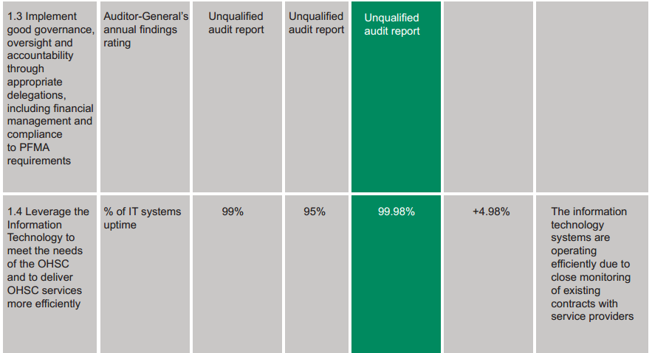
Performance Against Objectives..Cont

Slide 12
Performance Against Objectives..Cont

Slide 13
Performance Against Objectives..Cont

Slide 14
Highlights to Note
Conclusion of office space lease agreement, with National Treasury approval.
The training curriculum aligned to the promulgated regulations was developed by Fort Hare University in collaboration with the OHSC.
Clean audit achieved
Country-wide consultative sessions
Anonymous fraud hotline in place

Slide 15
Challenges
Inadequacy of funding remained one of the major challenges facing the OHSC.
Following the promulgation of the norms and standards and increased visibility of the OHSC, it is envisaged that the volume of work will continue to increase.
This requires corresponding financial resources to keep pace with the increase in the volume of activities.
Fully developed information systems require additional funding
Feasibility for the generation of revenue from services rendered will be considered.

Slide 16
The purpose is to manage the inspection of health establishments in order to assess compliance with National Health System’s norms and standards as prescribed by the Minister, certify health establishments as compliant or non-compliant with prescribed norms and standards, and take enforcement action against non-compliant health establishments.
PROGR. 2: Compliance Inspection, Certification and Enforcement

Slide 17
PERFORMANCE AGAINST OBJECTIVES

Slide 18
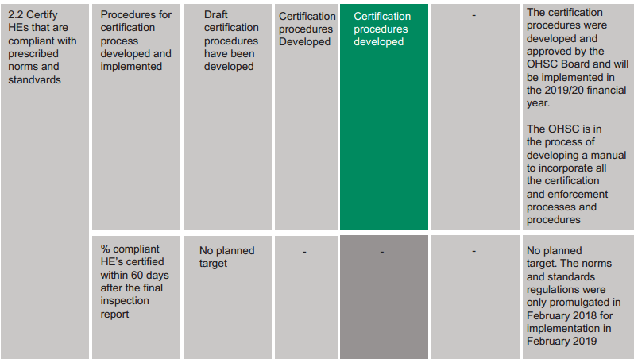
PERFORMANCE AGAINST OBJECTIVES..Cont

Slide 19
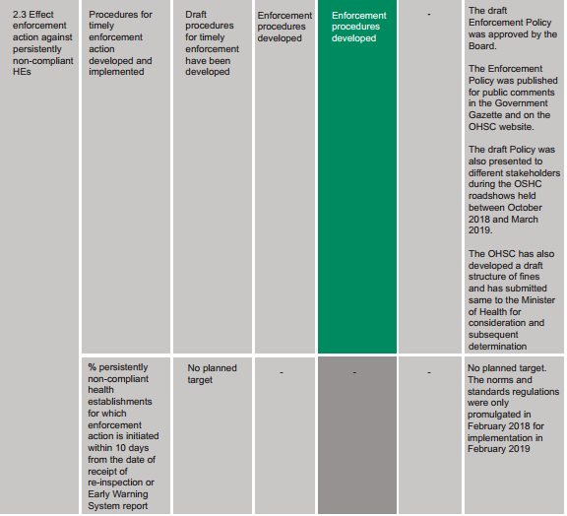
PERFORMANCE AGAINST OBJECTIVES..Cont

Slide 20
PERFORMANCE AGAINST OBJECTIVES..Cont

Slide 21
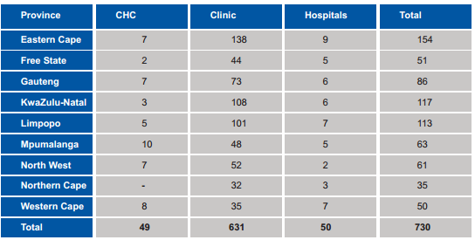
Inspection Coverage

Slide 22
Healthcare Risk Management Audits

Slide 23
Highlights to Note
A total of 730 (19%) public sector health establishments were inspected in the 2018/19 financial year.
The public health establishments inspected were selected clinics, community health centres and hospitals in all nine provinces.
Inspections were conducted based on the national core standards
Draft enforcement policy was developed and published for public comments.
Enforcement policy was also presented to different stakeholders, as well as the Technical Committee of the National Health Council
Health establishments found to be compliant with the regulations will be certified and provided with a certificate of compliance which will be valid for a period of four years.

Slide 24
Challenges
Limited number of inspectors to conduct inspections, due to funding constraints
No inspections were conducted in the private sector, as the regulations became effective in February 2019.
Similarly, certification and enforcement action could not be effected

Slide 25
The purpose is to consider, investigate and dispose of complaints relating to the non-compliance with prescribed norms and standards in a procedurally fair, economical and expeditious manner.
PROGR. 3: Complaints Management

Slide 26
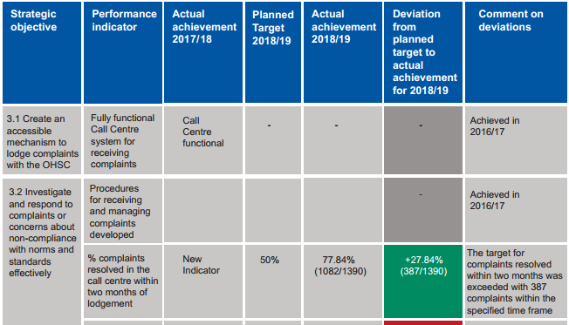
Performance Against Objectives

Slide 27
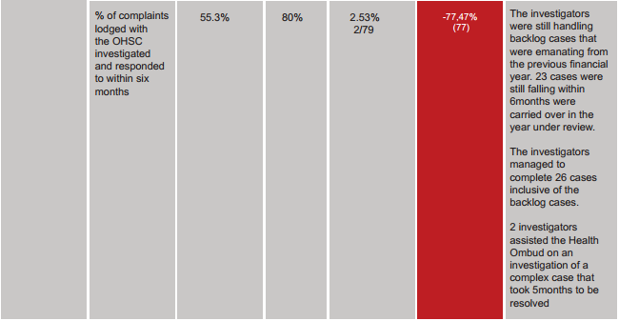
Performance Against Objectives

Slide 28
Performance Against Objectives..Cont

Slide 29
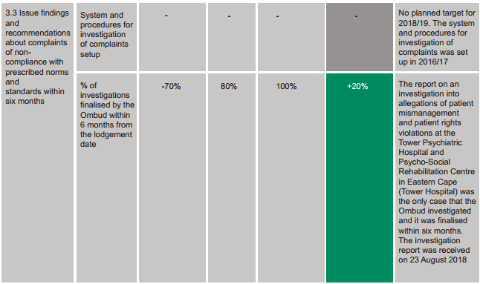
Performance Against Objectives..Cont

Slide 30
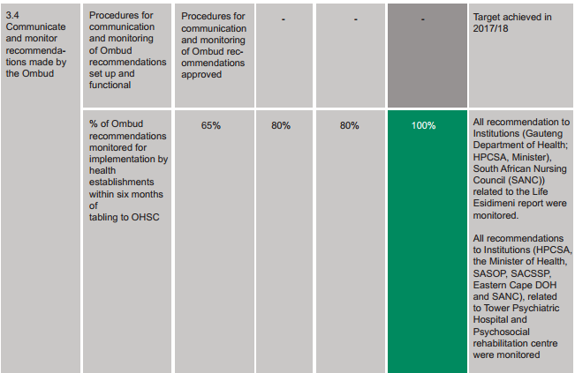
Performance Against Objectives..Cont

Slide 31
Highlights to Note
Fully functional call centre for receiving complaints
Increase in number of complaints received
Limited capacity to fully dispose of all complaints
High vacancy rate due to unfunded posts
Increased ratio of investigators to number of investigations to be finalised

Slide 32
NUMBER OF COMPLAINTS PER PROVINCE

Slide 37
HSDAS - Health Standards Design, Analysis And Support The purpose is to provide high-level technical, analytical and educational support to the work of the OHSC in relation to research of norms and standards; guidance on compliance with norms and standards, analysis of data collected and the establishment of communication networks with other stakeholders.
PROGRAMME 4:HSDAS

Slide 38
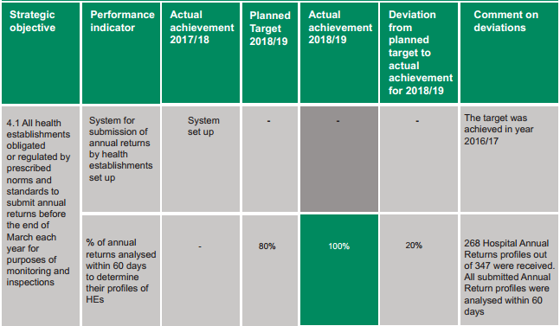
OVERVIEW DELIVERABLES

Slide 39
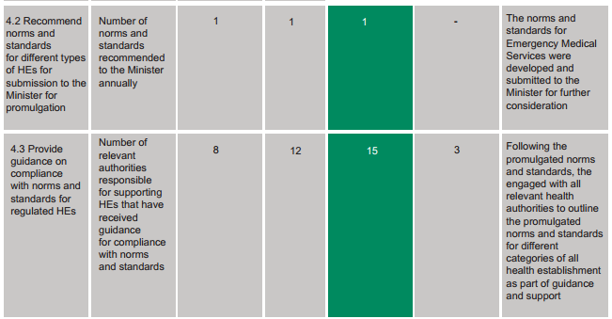
OVERVIEW DELIVERABLES..Cont

Slide 40
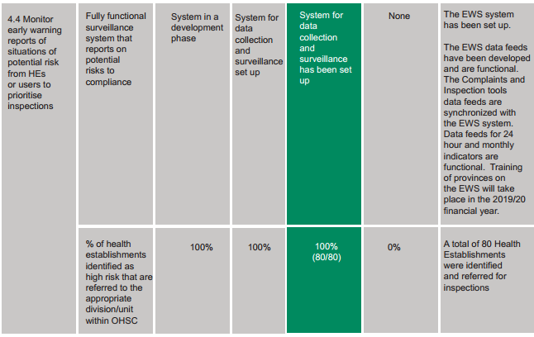
OVERVIEW DELIVERABLES..Cont

Slide 41
Highlights to Note
The draft Norms and Standards for Emergency Medical Services were developed and submitted to the Minister of Health for consideration in the last quarter of the financial year.
Commencement with the development of regulatory inspection tools for Hospitals, Community Health Centres and Clinics to enable the implementation of Regulation of Different Categories of HEs in the 2019/20 financial year.
Consultative workshops with the public and private sector hospitals and primary care clinics.
Implementation of the annual return system
Limited expertise in the development of standards as a result of funding inadequacies
Implementation of the early warning system which assist the OHSC and institutions in identifying potential risks to patient safety and respond appropriately before any undesired incidents occur, and for the HEs to prevent recurrence by implementing corrective measures.
.

Slide 42
Submissions By Province

Slide 43
Summary of performance

Slide 44
Financial Information
Audited financial information

Slide 45
Financial Performance

Slide 46
Comments On Financial Performance
AUDIT OUTOMES
- Clean audit achieved
REVENUE
3% increase in allocation from the National Treasury
Short term investment with the OHSC bankers
EXPENDITURE
Increase in staff complement and salaries, as well as interns and temporary staff members
Increase in board fees as per National Treasury, and Board activities
Increase in asset base of the OHSC
Increase in scope of activities including move to new office premises

Slide 47
Deficit
Main contributors to deficit:
Deficit funded from prior year surplus
Temporary staff members and interns
Inspection-related costs such as travelling and accommodation
Country-wide consultative sessions on OHSC mandate
Increase in rental costs due to bigger office space
Information technology infrastructure for new offices

Slide 48
Total Expenditure Per Division

Slide 49
% Share of Expenditure per Division

Slide 50
% Share of Expenditure per Division

Slide 51
Compensation expenditure per division

Slide 52
Share of Compensation Expenditure per Division

Slide 53
Compensation Costs By Employee Level

Slide 54
Staff Complement

Slide 55
% Share - Staff Complement

Slide 56
Acknowledgements
OHSC Board
OHSC Team
Department of Health – Province, Districts, Facilities
National Department of Health
Portfolio Committee on Health
Users of Health services

