Slide 1
ANNUAL REPORT 2018/19
FEBRUARY
DIRECTOR-GENERAL: ARTS AND CULTURE
DATE: 09 OCTOBER 2019

Slide 2
PRESENTATION OUTLINE
STRATEGIC OVERVIEW
PERFORMANCE OVERVIEW
AREAS WHERE TARGETS WERE ACHIEVED
AREAS WHERE THE DEPARTMENT UNDERPERFORMED
REPORT BY THE AUDITOR-GENERAL
EXPLANATION OF AUDIT OUTCOMES
BUDGET VS EXPENDITURE
EXPLANATION OF EXPENDITURE VARIANCE PER ECONOMIC CLASSIFICATION
2018/19 HIGHLIGHTS

Slide 3
STRATEGIC OVERVIEW

Slide 4
Vision
A creative and inclusive nation.

Slide 5
MISSION
Develop, preserve, protect and promote arts, culture and heritage.

Slide 6
STRATEGIC GOALS
A transformed and productive ACH sector
An integrated and inclusive society
An efficient and effective ACH sector
A professional and capacitated ACH sector

Slide 7
Performance overview

Slide 8
PERFORMANCE IN 2018/19
In the period under review, the Department planned to achieve a total of thirty nine (39) performance targets.
However, eight (8) targets could not be achieved and this translates to 79% achievement
The reasons for non-achievement, including planned measures to improve performance are provided below

Slide 9
Performance trends
A steady increase in performance was recorded from 2015/16 to 2017/18 financial year, following a 5% decline in performance in 2015/16 compared to 2014/15 financial year.
The year 2018/19 has seen 3% decline in performance compared to the 2017/18 financial year. The details for targets that were not achieved will be provided in slide 24-29.

Slide 10
PERFORMANCE OVERVIEW
The financial years from 2015/16 to 2017/18 have seen a steady improvement in the performance of the Department as depicted in the graph above. Some of the contributing factors to the improvement are:
Improved understanding and compliance with the Frameworks for Strategic Plans and Annual Performance Plans, thus resulting to improved planning, budgeting and reporting process;
Over the last three years, the Department has focused on the key strategic initiatives other than to commit on activities that will not be possible to deliver;
Improved synergy and alignment between the quality assurance providers e.g. Internal Audit, Monitoring and Evaluation, Finance, and Risk Management Unit;
More internal controls were implemented as per recommendations from the Internal Audit Unit and Auditor General thus improving the standard operating procedures and subsequent achievement of the planned targets;

Slide 11
PERFORMANCE OVERVIEW
The period of 2018/19 saw a slight decline in performance by 3% when compared to 2017/18. Some of the contributing factors to the observed decline include:
Inadequate corroborating evidence to support achievements e.g. outstanding reports from beneficiaries
Prolonged consultations to enable adequate buy-in from stakeholders. This is more applicable to the Work-Study conducted to inform a new DAC organisational structure and the feasibility study on the amalgamation of public entities.
Urgent request to reprioritise other initiatives. For example, the planned digitisation of the Treason Trial Records could not be pursued as result of a special request by the NPA to prioritise the digitisation of the dictabelt of Ahmed Timol Court Case. As such, funds were redirected to the latter project.
Insufficient budget to fund some of the planned projects. For example, funds had to be directed away from some of the planned projects to pay litigation costs i.e. court order settlement of OPICONSIVIA matter.

Slide 12
PERFORMANCE OVERVIEW
In order to enhance performance further, the Department will be institutionalising the following instruments in the 2019/20 financial year:
Service Delivery Charter;
Service Delivery Model;
Map processes for each target / service;
Service standards;
Tighten the monitoring and compliance of beneficiaries and effect punitive measures as per the conditions of the contract.
The department intends to tighten all the internal deficiency controls identified by the quality assurance providers.

Slide 13
areas WHERE TARGETS WERE ACHIEVED in the 2018-19 financial year

Slide 14
ADMINISTRATION
PERFORMANCE INDICATOR | 2018/19 ANNUAL TARGET | ACTUAL ACHIEVEMENT AS AT 31 MARCH 2019 | DEVIATION FROM PLANNED TARGET
No. of communication and marketing campaigns implemented to profile the Department | 8 | 8 communication and marketing campaigns were implemented to profile the Department | -
No. of services modernized (processes automated) | 3 | 3 services were modernized (processes automated) | -
% of total value of procurement awarded to BBBEE-compliant service providers | >70% | 77.86% total value of procurement awarded to BBBEE compliant service providers | +7.86%. More procurement awarded to BBBEE compliant service providers.
No. of izimbizo held | 20 | 38 izimbizo were held | +18. The overachievement was as a result of the Minister and the Deputy Minister responding to the flair-ups in the sector that required their urgent and immediate engagements .e.g. the engagement with the Rastafarians

Slide 15
ADMINISTRATION
PERFORMANCE INDICATOR | 2018/19 ANNUAL TARGET | ACTUAL ACHIEVEMENT AS AT 31 MARCH 2019 | DEVIATION FROM PLANNED TARGET
Approved Workplace Skills Plan | WSP approved by DG by 30 April 2018 | The workplace skills plan was approved by DG on 25 April 2018 | -
Number of quarterly monitoring reports approved | 4 | 4 quarterly monitoring reports were approved | -
% of interns enrolled against funded posts | 5% (of approved funded posts establishment) of Interns | 6.8% interns were enrolled against funded posts (28 interns against 408 funded posts) | 1.8%. Some Directorates submitted additional requests for Interns

Slide 16
INSTITUTIONAL GOVERNANCE
PERFORMANCE INDICATOR | 2018/19 ANNUAL TARGET | ACTUAL ACHIEVEMENT AS AT 31 MARCH 2019 | DEVIATION FROM PLANNED TARGET
Number of departmental and entities’ performance information reports or documents approved | 15 | 11 departmental and 4 entities’ performance information reports or documents were approved | -
Approved governance tools for DAC public entities | Approved governance framework for DAC public entities | Governance framework was approved by DG on 28 March 2019 | -
Number of CEO’s forum held | 2 | 2 CEOs forums were held as follows: 26 August 2018 and 28 February 2019 | -
No. of cultural diplomacy engagements coordinated | 20 | 20 cultural diplomacy engagements were coordinated | -

Slide 17
INSTITUTIONAL GOVERNANCE
PERFORMANCE INDICATOR | 2018/19 ANNUAL TARGET | ACTUAL ACHIEVEMENT AS AT 31 MARCH 2019 | DEVIATION FROM PLANNED TARGET
No. of national days commemorated | 6 | 6 national days were held | -
No. of social cohesion projects implemented | 12 | 17 social cohesion projects were implemented | +5. It must be noted that Social Cohesion Advocates platforms are created by the Department, in which case, the Department can then predict on the quantum to create and support. However, Social Cohesion Advocates also lodge requests for assistance intermittently and given availability of resources, they almost always receive assistance. Hence, the over-achievement.
No. of target-group programmes supported | 3 | 3 target-group programmes were supported | -

Slide 18
ARTS AND CULTURE PROMOTION AND DEVELOPMENT
PERFORMANCE INDICATOR | 2018/19 ANNUAL TARGET | ACTUAL ACHIEVEMENT AS AT 31 MARCH 2019 | DEVIATION FROM PLANNED TARGET
No. of professional artists' projects supported | 6 | 6 professional artist's projects were supported financially | -
No. of cultural and creative sector projects supported through MGE work streams | 30 | 32 cultural and creative sector projects supported through MGE work streams | +2. More deserving projects were adjudicated and funded during the reporting period
No. of domains in which terminologies are developed | 4 | Terminologies were developed in 4 domains as follows: 400 Road Safety terminologies were developed | -
 |  | 400 Pharmaceutical terminologies were developed
 |  | 400 Engineering and Construction terminologies were developed
 |  | 400 Indigenous Plants and Animals terminologies were developed

Slide 19
ARTS AND CULTURE PROMOTION AND DEVELOPMENT
PERFORMANCE INDICATOR | 2018/19 ANNUAL TARGET | ACTUAL ACHIEVEMENT AS AT 31 MARCH 2019 | DEVIATION FROM PLANNED TARGET
No. of multi-year HLT projects supported | 6 | 6 multi-year HLT projects were supported | -
% of documents received and accepted that are translated and/or edited | 100% | 100% (731) of documents received and accepted were translated and/or edited | -
No. of bursaries awarded for development of qualified language practitioners | 300 | 536 bursaries were awarded for the development of qualified language practitioners | +236. In some universities the cost for studies is lower and allows for additional intakes

Slide 20
HERITAGE PRESERVATION AND PROMOTION
PERFORMANCE INDICATOR | 2018/19 ANNUAL TARGET | ACTUAL ACHIEVEMENT AS AT 31 MARCH 2019 | DEVIATION FROM PLANNED TARGET
No. of Gazette notices on standardisation of geographical names published | 3 | 4 gazette notices on standardisation of geographical names were published | +1. Due to public interest generated during consultations and recommendations by the Council, one more gazette was published
No. of living human treasures documented per annum | 2 | 2 living human treasures were documented | -
No. of heritage infrastructure projects financially supported | 4 | 4 heritage infrastructure projects were financially supported | -
Feasibility study report on Resistance and Liberation Movements Museum completed | Draft feasibility study report on Resistance and Liberation Movements Museum | Draft feasibility study report on resistance and liberation movements museum was completed | -

Slide 21
HERITAGE PRESERVATION AND PROMOTION
PERFORMANCE INDICATOR | 2018/19 ANNUAL TARGET | ACTUAL ACHIEVEMENT AS AT 31 MARCH 2019 | DEVIATION FROM PLANNED TARGET
No. of flags installed in schools | 1 000 | 1 114 flags were installed in schools | +114. More flags were installed with assistance from the Northern Cape Young Patriots and KwaZulu Natal Provincial Government
No. of newly built and/or modular libraries supported financially | 29 | 29 newly built and /or modular libraries were financially supported | -
Legislative framework (SALIS Bill) developed | SALIS Bill submitted to Cabinet for approval | The South African Public Library and Information Services Bill was submitted to Cabinet for approval | -
No. of policies developed | 1 policy on Underwater Cultural Heritage developed | 1 Policy on Underwater Cultural Heritage was developed | -

Slide 22
areas WHERE THE DEPARTMENT underperformed in the 2018-19 financial year

Slide 24
ADMINISTRATION
PERFORMANCE INDICATOR | 2018/19 ANNUAL TARGET | ACTUAL ACHIEVEMENT AS AT 31 MARCH 2019 | REASON FOR DEVIATION | CORRECTIVE ACTIONS
Work Study Report approved | Work study report Approved | The work study report was approved by the DG on the 29 March 2019 | The consultation process on the work-study took longer than expected in order to obtain more inputs to inform the DAC organisational structure | Following reconfiguration of Government departments, the process regarding the ultimate structuring of the department will be informed by the National Macro Organisation of Government (NMOG)

Slide 25
INSTITUTIONAL GOVERNANCE
PERFORMANCE INDICATOR | 2018/19 ANNUAL TARGET | ACTUAL ACHIEVEMENT AS AT 31 MARCH 2019 | REASON FOR DEVIATION | CORRECTIVE ACTIONS
Approved feasibility and due diligence reports on amalgamation of DAC public entities | Approved feasibility and due diligence reports on amalgamation of DAC public entities | Consultations with entities were conducted during the fourth quarter which culminated in an interim report which was submitted to the DAC on 29 March 2019. | Delays in finalizing the procurement processes led to the late appointment of a service provider. The Service Provider has since been appointed and according to the revised plan, the project will be completed in the 4th quarter of the 2019/20 financial year | According to the plan, the project will be completed in the 4th quarter of the 2019/20 financial year

Slide 26
ARTS AND CULTURE PROMOTION AND DEVELOPMENT
PERFORMANCE INDICATOR | 2018/19 ANNUAL TARGET | ACTUAL ACHIEVEMENT AS AT 31 MARCH 2019 | REASON FOR DEVIATION | CORRECTIVE ACTIONS
No. of flagship projects supported | 20 | 10 flagship projects were supported | Ten (10) of the projects were declared as not achieved due to inadequate corroborating evidence during the assessment period | Eight outstanding flagships were all paid in the new financial year It is anticipated that the other two remaining flagship projects will be paid by end of the third quarter.
No. of market access platforms supported | 13 | 10 market access platforms were supported | Three (3) of the projects were declared as not achieved due to inadequate corroborating evidence during the assessment period | The 3 projects were done during the time of assessment however it was done through processes other than the one indicated on the TID. No corrective action is needed.

Slide 27
ARTS AND CULTURE PROMOTION AND DEVELOPMENT
PERFORMANCE INDICATOR | 2018/19 ANNUAL TARGET | ACTUAL ACHIEVEMENT AS AT 31 MARCH 2019 | REASON FOR DEVIATION | CORRECTIVE ACTIONS
No. of community arts projects supported | 150 | 86 community arts projects were supported | The other projects were declared as not achieved due to inadequate corroborating evidence during the assessment period. | All outstanding projects (63) were financially supported and (1) project will be paid by end of September 2019. As such all community arts projects (150) projects would have been supported.
No. of sector organisations supported | 10 | 6 sector organisation were supported | Four (4) of the projects were declared as not achieved due to inadequate corroborating evidence during the assessment period | 3 projects were subsequently supported: 2 projects were fully supported and 1 project was done through a different process from the one indicated in the TID. 1 project is still pending due to money embezzlement. Court case still underway.

Slide 28
ARTS AND CULTURE PROMOTION AND DEVELOPMENT
PERFORMANCE INDICATOR | 2018/19 ANNUAL TARGET | ACTUAL ACHIEVEMENT AS AT 31 MARCH 2019 | REASON FOR DEVIATION | CORRECTIVE ACTIONS
No. of capacity-building programmes supported | 23 | 11 capacity building programmes were supported | Insufficient budget to support capacity building projects | The outstanding projects not funded were carried over to 2019/20 APP for funding in the new financial year . This will be done by end of the 4th quarter as per the APP.

Slide 29
HERITAGE PRESERVATION AND PROMOTION
PERFORMANCE INDICATOR | 2018/19 ANNUAL TARGET | ACTUAL ACHIEVEMENT AS AT 31 MARCH 2019 | REASON FOR DEVIATION | CORRECTIVE ACTIONS
No. of collections digitised | 3 | 2 collections were digitised: 1. Truth and Reconciliation Commission Audio Tapes 2. The Bloke Modisane project | Treason Trial Dictabelts: The actual work on the digitisation of the Treason Trial Records did not start as a result of a special request by the NPA to prioritise the digitisation of the dictabelts of Ahmed Timol Court case | The digitisation of the Treason Trial Dictabelts is in progress

Slide 30
REPORT BY THE AUDITOR-GENERAL

Slide 31
2018/19 Audit Outcomes
 | 2011/12 | 2012/13 | 2013/14 | 2014/15 | 2015/16 | 2016/17 | 2017/18 | 2018/19
Clean
Unqualified | X | X |  | X | X | X | X | X
Qualified |  |  | X
Adverse
Disclaimer
31.

Slide 32
2018/19 Audit Outcomes (Cont…)
Report on the Audit of the Financial Statements
Opinion:
Unqualified Audit Opinion
No material adjustments to Annual Financial Statements
Findings on the audit of the Annual Performance Report
Findings on the audit of Compliance with Legislation
Report on the Audit of the Annual Performance Report
Findings:
Programme 2: Institutional Governance
Number of cultural diplomacy engagements coordinated. The planned target for this indicator was not specific in clearly identifying the nature and required level of performance.
Number of social cohesion projects implemented. AGSA was unable to obtain sufficient audit evidence for the reported achievement of number of social cohesion projects implemented. This was due to the fact that there was no evidence that the social cohesion advocates were appointed and or approved by the department therefore AGSA was unable to verify whether the platforms created and or supported were conducted by appointed social cohesion advocates. AGSA was unable to confirm the reported achievement by alternative means. Consequently, AGSA was unable to determine whether any adjustments were required to the achievement of 17 as reported in the annual performance report.
32.

Slide 33
2018/19 Audit Outcomes (Cont…)
Programme 3: Arts, Culture , Promotion and Development
Various indicators. The reported achievement in the annual performance report did not agree to the supporting evidence provided for the indicators.
Programme 4: Heritage Preservation and Promotion
The achievement for number of newly built and/or modular libraries supported financially reported in the annual performance report was 29. However, the supporting evidence provided did not agree to the reported achievement and indicated an achievement of 38.
Report on the Audit of Compliance with Legislation
Findings:
Effective and appropriate steps were not taken to prevent unauthorised expenditure amounting to R5 million, as required by section 38(1)(c)(ii) of the PFMA and treasury regulation 9.1.1.
Effective and appropriate steps were not taken to prevent irregular expenditure, as required by section 38(1)(c)(ii) of the PFMA and treasury regulation 9.1.1. The majority of the irregular expenditure was caused by deviating from the normal procurement processes where the reasons for such deviations were not justifiable.
Payments were not made within 30 days or an agreed period after receipt of an invoice, as required by treasury regulation 8.2.3.
33.

Slide 34
2018/19 Audit Outcomes (Cont…)
Findings:
Some of the goods and services with a transaction value below R500 000 were procured without obtaining the required price quotations, as required by treasury regulation 16A6.1.
No sufficient appropriate audit evidence that disciplinary steps were taken against officials who had incurred irregular, fruitless and wasteful expenditure as required by section 38(1)(h)(iii) of the PFMA. This was due to proper and complete records that were not maintained as evidence to support the investigations into irregular and fruitless and wasteful expenditure.
34.

Slide 35
BUDGET VS EXPENDITURE

Slide 36
Summary of Appropriation Per Programme
 | Final Appropriation | Actual Expenditure | Variance | % Spent
 | R’000 | R’000 | R’000
Administration | 315 312 | 308 865 | 6 447 | 98.0%
Institutional Governance | 260 391 | 226 079 | 34 312 | 86.8%
Arts and Culture Promotion and Development | 1 171 600 | 1 132 471 | 39 129 | 96.7%
Heritage Promotion and Preservation | 2 591 434 | 2 570 570 | 20 864 | 99.2
Grand Total | 4 338 737 | 4 237 985 | 100 752 | 97.7%
36.

Slide 37
Appropriation Per Programme illustrated on a graph
37.

Slide 38
Final Appropriation vs Expenditure Per Economic Classification
 | Final Appropriation | Actual Expenditure | Variance | % Spent
 | R’000 | R’000 | R’000
Compensation of employees | 253 530 | 238 841 | 14 689 | 94.2%
Goods and Services | 379 464 | 375 907 | 3 557 | 99.1%
Provinces & Municipalities (Conditional Grant) | 1 423 686 | 1 423 686 | - | 100.0%
Dept. Agencies & Accounts (Cur/Cap) | 1 779 016 | 1 760 575 | 18 441 | 99.0%
Non Profit Institutions | 199 202 | 188 353 | 10 849 | 94.6%
Foreign Government & International Organisations | 4 809 | 4 265 | 544 | 88.7%
Higher Education Institutions | 6 941 | 5 440 | 1 501 | 78.4%
Households | 24 559 | 24 197 | 362 | 98.5%
Public corporations and private enterprises | 124 814 | 120 134 | 4 680 | 96.3%
Heritage Assets | 58 256 | 32 827 | 25 429 | 56.3%
Machinery & equipment | 17 858 | 17 858 | - | 100.0%
Software & other Intangible assets | 994 | 994 | - | 100.0%
Payments for Financial Assets (Theft & Losses) | 221 | 221 | - | 100.0%
Interest and rent on land | 8 887 | 8 887 | - | 100.0%
Buildings and other fixed structures | 56 500 | 35 800 | 20 700 | 63.4%
Grand Total | 4 338 737 | 4 237 985 | 100 752 | 97.7%
38.

Slide 39
EXPLANATION OF EXPENDITURE VARIANCE PER ECONOMIC CLASSIFICATION

Slide 40
Expenditure Variance Per Economic Classification
(Compensation of Employees)
The variance of R14.7 million is due to underspending caused by vacant posts that are in the process of being filled.
 | Final Appropriation | Actual Expenditure | Variance | Expenditure as a % of final appropriation
 | R’000 | R’000 | R’000
Administration | 107 118 | 100 671 | 6 447 | 94.0%
Institutional Governance | 40 356 | 37 012 | 3 344 | 91.7%
Arts and Culture Promotion and Development | 51 801 | 47 598 | 4 203 | 91.9%
Heritage Promotion and Preservation | 54 255 | 53 560 | 695 | 98.7%
Total | 253 530 | 238 841 | 14 689 | 94.2%
40.

Slide 41
Expenditure Variance Per Economic Classification
(Goods and Services)
The variance of R3.6 million was mainly due to the (i) Resignation of one community library consultant, including travel and subsistence costs.
 | Final Appropriation | Actual Expenditure | Variance | Expenditure as a % of final appropriation
 | R’000 | R’000 | R’000
Administration | 187 725 | 187 725 | - | 100%
Institutional Governance | 79 327 | 79 327 | - | 100.0%
Arts & Culture Promotion & Development | 66 985 | 66 985 | - | 100.0%
Heritage Promotion &Preservation | 45 427 | 41 870 | 3557 | 92.2%
Total | 379 464 | 375 907 | 3 557 | 99.1%
41.

Slide 42
Expenditure Variance Per Economic Classification Provinces and Municipalities (Conditional Grant)
An amount of R1,4 billion has been transferred to various Provinces .
The detail of spending per Province is as follows:
Name of Province | Division of Revenue Act | Adjustments | Total available | Actual transfer by National | % Transferred by National
 | R’000 | R’000 | R’000 | R’000
Eastern Cape | 160 584 | - | 160 584 | 160 584 | 160 584
Free State | 159 504 | - | 159 504 | 159 504 | 159 504
Gauteng | 168 530 | - | 168 530 | 168 530 | 168 530
KwaZulu-Natal | 174 397 | - | 174 397 | 174 397 | 174 397
Limpopo | 125 643 | - | 125 643 | 125 643 | 125 643
Mpumalanga | 162 479 | - | 162 479 | 162 479 | 162 479
Northern Cape | 159 554 | - | 159 554 | 159 554 | 159 554
North West | 136 369 | - | 136 369 | 136 369 | 136 369
Western Cape | 176 624 | - | 176 624 | 176 624 | 176 624
Total | 1 423 684 | - | 1 423 684 | 1 423 684 | 1 423 684
Municipal Agencies & Funds (Vehicle license registration) | - | - | 2 | 2
Grand Total | 1 423 684 | - | 1 423 686 | 1 423 686 | 100.0%
42.

Slide 43
Expenditure Variance Per Economic Classification
(Departmental Agencies & Accounts)
The variance of R18.4 million under-expenditure is mainly due to (i) Artscape and the State Theatre, which did not submit the Incubator Trade Fair report on time to enable payment processing, and (ii) Capital works projects and payments made on claims from DPW based on work done at entities.
Name of Institution | Final Appropriation | Actual transfer | % of Available funds transferred
Performing Arts Institutions (Cur/Cap) | R’000 | R’000
Artscape | 60 912 | 60 912 | 100.0%
Market Theatre Foundation | 46 303 | 46 303 | 100.0%
National Arts Council | 109 677 | 109 677 | 100.0%
National Film and Video Foundation | 133 472 | 133 472 | 100.0%
Performing Arts Centre of the Free State | 45 322 | 45 322 | 100.0%
Playhouse Company | 49 632 | 49 632 | 100.0%
State Theatre | 55 453 | 55 453 | 100.0%
Capital Transfer -Playhouses | 65 290 | 65 289 | 100.0%
Mzansi Golden Economy Projects | 41 933 | 37 253 | 89.0%
Total | 607 994 | 603 313 | 99.2%
43.

Slide 44
Expenditure Variance Per Economic Classification
(Departmental Agencies & Accounts)
Name of Institution | Final Appropriation | Actual transfer | % of Available funds transferred
Heritage Institutions (Cur/Cap) | R’000 | R’000
Northern Flagship/Ditsong Museums | 87 212 | 87 212 | 100.0%
Iziko Museums of Cape Town | 86 886 | 86 886 | 100.0%
War Museum of the Boer Republics | 12 710 | 12 710 | 100.0%
KwaZulu-Natal Museum | 35 224 | 35 225 | 100.0%
National Museum | 54 281 | 54 281 | 100.0%
Die Afrikaanse Taalmuseum | 9 419 | 9 419 | 100.0%
The National English Literary Museum | 11 493 | 11 493 | 100.0%
UMsunduzi/Voortrekker Museum | 18 296 | 18 296 | 100.0%
Robben Island Museum | 80 451 | 80 451 | 100.0%
William Humphreys Arts Gallery | 10 383 | 10 383 | 100.0%
Nelson Mandela Museum | 27 103 | 27 103 | 100.0%
44.

Slide 45
Expenditure Variance Per Economic Classification
(Departmental Agencies & Accounts)
Name of Institution | Final Appropriation | Actual transfer | % of Available funds transferred
Heritage Institutions(Cur/Cap) | R’000 | R’000
Freedom Park | 97 275 | 97 275 | 100.0%
Luthuli Museum | 14 828 | 14 828 | 100.0%
South African Heritage Resources Agency | 55 650 | 55 650 | 100.0%
National Heritage Council | 68 493 | 68 493 | 100.0%
Capital Transfer – Heritage Institutions | 200 654 | 188 558 | 94.0%
Total | 870 358 | 858 263 | 99.0%
45.

Slide 46
Expenditure Variance Per Economic Classification
(Departmental Agencies & Accounts)
Name of Institution | Final Appropriation | Actual transfer | % of Available funds transferred
 | R’000 | R’000
Libraries (Cur/Cap)
National Library of South Africa | 99 328 | 99 328 | 100.0%
South African Library for the Blind | 22 323 | 22 323 | 100.0%
National Library of SA (Community Libraries) | 18 477 | 18 477 | 100.0%
Capital transfer - Libraries | 37 338 | 35 683 | 96.0%
Total | 177 466 | 175 811 | 99.1%
46.

Slide 47
Expenditure Variance Per Economic Classification
(Departmental Agencies & Accounts)
 | Final Appropriation | Actual transfer | % of Available funds transferred
 | R’000 | R’000
Other:
Constitutional Institution:
Pan South African Language Board | 113 587 | 113 587 | 100.0%
National Youth Development Agency | 9 000 | 9 000 | 100.0%
TV Licences | 1 | 1 | 100.0%
Constitutional Hill Development | 610 | 600 | 98.0%
Total | 123 198 | 123 188 | 100.0%
47.

Slide 48
Expenditure Variance Per Economic Classification
(Foreign Government & International Organisations)
The variance of R544 000 is due to the exchange rate, which was lower than the estimated transfer to the Commonwealth Foundation.
 | Final Appropriation | Actual transfer | % of Available funds transferred
 | R’000 | R’000
African World Heritage Fund | 1 944 | 1 944 | 100.0%
Sub-fees: Commonwealth Foundation | 2 265 | 2 162 | 95.0%
UNESCO | 600 | 159 | 27.0%
Total | 4 809 | 4 265 | 88.7%
48.

Slide 49
Expenditure Variance Per Economic Classification
(Households)
The variance of R362 000 is attributed to less than projected transfers made due to changed funding strategy for heritage bursaries as a result of challenges experienced with the previous implementation strategy. Transfers were only made to renewed bursaries with existing universities.
 | Final Appropriation | Actual transfer | % of Available funds transferred
Households | R’000 | R’000
Employee social benefits | - | 2 400
Language development projects | 6 000 | 6 000 | 100.0%
Cultural and Creative Industries | 4 726 | 4 716 | 100.0%
Mzansi Golden Economy projects | 7 910 | 7 822 | 99.0%
Heritage promotion (Professional Bursaries) | 5 923 | 3 259 | 55.0%
Total | 24 559 | 24 197 | 98.5%
49.

Slide 50
Expenditure Variance Per Economic Classification
(Public Corporations and Private Enterprises)
The variance of R4.7 million under-expenditure is due to (i) delays in concluding the memorandum of agreement (MOA), and (ii) compliance documents that were not submitted on time for the upgrading of public spaces.
 | Final Appropriation | Actual transfer | % of Available funds transferred
 | R’000 | R’000
Private Enterprises (Cur/Cap)
Heritage Projects | 500 | -
Human Language Technology | 1 009 | 1 009 | 100.0%
Mzansi Golden Economy Projects | 99 874 | 99 156 | 99.3%
Capital Works of Performing Arts Projects | 4 000 | 2 045 | 51.1%
Cultural and Creative Industries | 7 566 | 7 304 | 96.5%
Sub Total | 112 949 | 109 514 | 97.0%
50.

Slide 51
Expenditure Variance Per Economic Classification
(Public Corporations)
 | Final Appropriation | Actual transfer | % of Available funds transferred
 | R’000 | R’000
Public Corporations (Cur):
Human Language Technology (CSIR) | 3 764 | 3 329 | 88.4%
MPU Economic Growth Agency | 8 101 | 7 291 | 90.0%
Sub Total | 11 865 | 10 620 | 89.5%
Total | 124 814 | 120 134 | 96.3%
51.

Slide 52
Expenditure Variance Per Economic Classification
(Non-Profit Institutions)
The variance or R10.8 million is due to the under-expenditure relating to: (i) transfer not made to Dennis Goldberg Foundation due to non-compliance with tax clearance certificate, and (ii) late enactment of the Adjusted Appropriation Bill, which had an impact on the facilitation process for transfer of funds to the Albany Museum for the management of Ingquza Hill Museum and to Barberton Museum for the management of operations of Samora Machel and Matola Monuments and Interpretative Centre.
 | Final Appropriation | Actual transfer | % of Available funds transferred
Non Profit Institutions (Cur/Cap) | R’000 | R’000
Arts social development and youth | 14 202 | 11 957 | 84.0%
!Kauru African Contemporary Art | 497 | 497 | 100.0%
Gcwala Ngamasiko Cultural Festival | 2 000 | 2 000 | 100.0%
Cultural and Creative Industries | 27 047 | 26 880 | 99.0%
Mzansi Golden Economy Projects | 101 952 | 101 952 | 100.0%
Steve Biko Foundation | 3 410 | 3 410 | 100.0%
Library and Information Association of SA | 2 000 | 1 800 | 90.0%
Caiphus Katse Semenya Foundation | 2 000 | 2 000 | 100.0%
Capital Works of Performing Arts projects | 12 112 | 6 914 | 57.0%
Moral Regeneration Movement | 4 000 | 4 000 | 100.0%
Heritage Projects Capital | 3 060 | 7 069 | 231.0%
Heritage Projects | 8 308 | 1 260 | 15.0%
Sub Total | 180 588 | 169 739 | 94.0%
52.

Slide 53
Expenditure Variance Per Economic Classification
(Non Profit Institutions)
 | Final Appropriation | Actual transfer | % of Available funds transferred
Subsidies | R’000 | R’000
Business Arts South Africa (BASA) | 9 946 | 9 946 | 100.0%
Engelenburg House Art Collection: Pretoria | 353 | 353 | 100.0%
Blind SA | 8 315 | 8 315 | 100.0%
Sub Total | 18 614 | 18 614 | 100.0%
Total | 199 202 | 188 353 | 94.5%
53.

Slide 54
Expenditure Variance Per Economic Classification
(Buildings and other fixed structures)
The variance of R20.7 million is due to approval granted by National Treasury to re-classify funds from non-profit institutions to buildings and other fixed structures, necessitating that DAC make payments to DBSA on recoverable basis.
 | Final Appropriation | Actual transfer | % of Available funds transferred
 | R’000 | R’000
National Archives (HVAC) | 35 800 | 35 800 | 100.0%
SARA House | 20 700 | - | 0%
Total | 56 500 | 35 800 | 63.4%
54

Slide 55
Expenditure Variance Per Economic Classification
(Higher Education Institutions)
The variance of R1.5 million is due to funds for the implementation of the Chief Tyali project at the University of Fort Hare and the family not having finalized the concept document before the end of 2018/19 financial year.
 | Final Appropriation | Actual transfer | % of Available funds transferred
 | R’000 | R’000
Human Language Technologies | 5 441 | 5 440 | 100.0%
Capital Works of Heritage Legacy Projects | 1 500 | - | 0%
Total | 6 941 | 5 440 | 78.4%
55

Slide 56
Expenditure Variance Per Economic Classification
(Heritage Assets)
The variance of R25.4 million is attributed to late submission of claims from the Department of Public Works for the construction of Sarah Baartman Centre of Remembrance.
 | Final Appropriation | Actual expenditure | Expenditure as % of final appropriation
 | R’000 | R’000
National Archives (Old Library) | 13 546 | 11 986 | 88.5%
OR Tambo/Khananda Memorial | 5 798 | 4 198 | 72.4%
Sarah Baartman Centre | 37 739 | 15 470 | 41.0%
Nelson Mandela Statue | 1 173 | 1 173 | 100.0%
Total | 58 256 | 32 827 | 56.3%
56

Slide 57
EXPLANATION OF THE AUDIT OUTCOMES

Slide 58
INSTITUTIONAL GOVERNANCE
INDICATOR | TARGET | ACTUAL PEFORMANCE | AGSA FINDING | TID 2018-19
No. of cultural diplomacy engagements coordinated | 20 | 20 cultural diplomacy engagements coordinated | The planned target for this indicator was not specific in clearly identifying the nature and required level of performance and was thus not measurable. | Approved submissions and Reports approved by DG
Comment 1: | The Department takes note of the finding raised by the Auditor General and it will tighten the description of the indicators to ensure that they meet the SMART principle criteria as required.

Slide 59
INSTITUTIONAL GOVERNANCE
INDICATOR | TARGET | ACTUAL PEFORMANCE | AGSA FINDING | TID 2018-19
Number of social cohesion projects implemented | 12 | 17 social cohesion projects implemented | There was no evidence that the social cohesion advocates were appointed and or approved by the department | Approved Submissions by DDG, Reports approved by DDG, Appointment letters of social cohesion advocates
Comment 2: | The Department takes note of the finding raised by the Auditor General and it will tighten the internal control regarding the collection and storage of the evidence to support achievement.

Slide 60
ARTS AND CULTURE PROMOTION AND DEVELOPMENT
INDICATOR | TARGET | ACTUAL PERFORMANCE | AGSA FINDING | TID 2018-19
Number of flagship projects supported | 20 | 10 | The reported achievement in the annual performance report did not agree to the supporting evidence provided for the indicator. Auditors found 14 instead of 10 reported by management | Submission approved by the delegated authority, MoA for direct grant funding or Z59 for interdepartmental transfers, grant letters, reports as per requirements of MoA or amended agreement document and payment stub as per MoA
Comment 3: | The DAC is not in agreement with the finding and the internal control deficiency for the following reasons: The Standard Bank Joy of Jazz was listed as a flagship and was reported. The other two namely Rapid Lion and Abantu Book Festival fell on the “any other” as it appeared on the TID. The DAC did not report on it on the APR because of budget constraints at the time of reporting.

Slide 61
ARTS AND CULTURE PROMOTION AND DEVELOPMENT
INDICATOR | TARGET | ACTUAL PEFORMANCE | AGSA FINDING | TID 2018-19
No. of community arts projects supported | 150 | 86 | The reported achievement in the annual performance report did not agree to the supporting evidence provided for the indicator. Auditors found 69 instead of 86 reported by management | Submission approved by delegated authority, MoA, grant letter; reports as per requirements of the MoA or amended agreement documentation, payment stubs and register of open call proposals received
Comment 4: | The Department takes note of the finding raised by the Auditor General and it will tighten the internal control regarding the collection and storage of the evidence to support achievement.

Slide 62
ARTS AND CULTURE PROMOTION AND DEVELOPMENT
INDICATOR | TARGET | ACTUAL PEFORMANCE | AGSA FINDING | TID 2018-19
No. of sector organisations supported; | 10 | 6 | The reported achievement in the annual performance report did not agree to the supporting evidence provided for the indicator. Auditors found 5 instead of 6 reported by management | MoA, grant letter; reports as per requirements of MoA or amended agreement documentation, payment stubs and register of proposals received
Comment 5: | The Department is not in agreement with the finding and the internal control deficiency for the following reasons: The Department’s academy programme is informed by the understanding that Art plays a pivotal role in social cohesion. Creativity has become an increasingly valued attribute in modern society where information is available at the touch of a keyboard. Despite this, the majority of young people in South Africa have little or no exposure to curricula that foster creativity and artistic ability. To that end, the Department supported Mzansi Broadcasting Academy (MBA) for accredited skills training programme to contribute to the provision of relevant skills in the creative economy to ensure that the arts respond to the demands of the 4th industrial revolution. The skills the MBA offers cut across all disciplines.

Slide 63
ARTS AND CULTURE PROMOTION AND DEVELOPMENT
INDICATOR | TARGET | ACTUAL PEFORMANCE | AGSA FINDING | TID 2018-19
No. of capacity-building programmes supported; | 23 | 11 | The reported achievement in the annual performance report did not agree to the supporting evidence provided for the indicator. Auditors found 8 instead of 11 reported by management | Submission approved by delegated authority, MoA, grant letter; reports as per requirements of MoA or amended agreement documentation and payment stub
Comment 6: | The Department is in agreement with the finding and the internal control deficiency for the following reasons: The whole APP target for capacity building was not achieved. Management has indicated such in the checklist of verification that was submitted as part of the evidence. Management accepts that only 8 projects from the 23 for capacity building had adequate verification information.

Slide 64
HERITAGE PRESERVATION AND PROMOTION
INDICATOR | TARGET | ACTUAL PEFORMANCE | AGSA FINDING | TID 2018-19
Number of newly built and/or modular libraries supported financially | 29 | 29 | The supporting evidence provided did not agree to the reported achievement of 29 and indicated an achievement of 38. | Payment stubs and quarterly progress reports approved by the DDG.
Comment 7: | The Department is not in agreement with the finding and the internal control deficiency for the following reasons : The number of libraries included in the APP is not an exhaustive list. The projects listed under the APP are earmarked to be completed in a financial year. However, provinces report on infrastructure projects that are in the backlog emanating from the previous financial years. The Department is obligated to report on these projects when they are completed. All projects reported in the 2018 /19 annual performance report have reached practical completion. The inclusion of Hafuleni Modular library in the list is an error because the project is on the APP and has been reported on the annual performance report. It is not clear why it is part of the list.

Slide 65
2018/19 HIGHLIGHTS

Slide 66
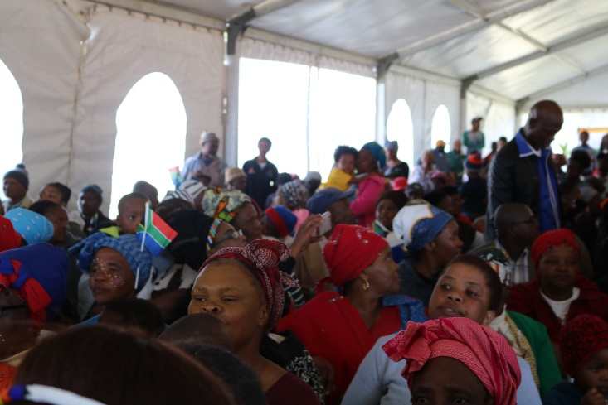
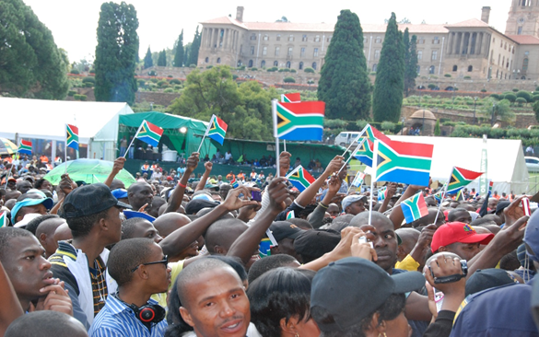
IZIMBIZO AND #I AM THE FLAG CAMPAIGN
The Deputy Minister of Arts and Culture and the Acting King, Azenathi Zanelizwe Dalindyebo, handed over the sewing machines that will be placed in the Community Arts Centre for crafters. The machines are expected to enhance the productivity and ability to generate income for the crafters. The Deputy Minister emphasised that the sewing machines belonged to the community and that every community member should have access to them.
The Minister of Arts and Culture launched the #I am the flag campaign to promote national consciousness, social cohesion, nation building and patriotism for all citizens of South Africa. The campaign, done in partnership with the South African National Taxi Association (SANTACO), was launched at the Randburg Taxi Rank, in Johannesburg.

Slide 67
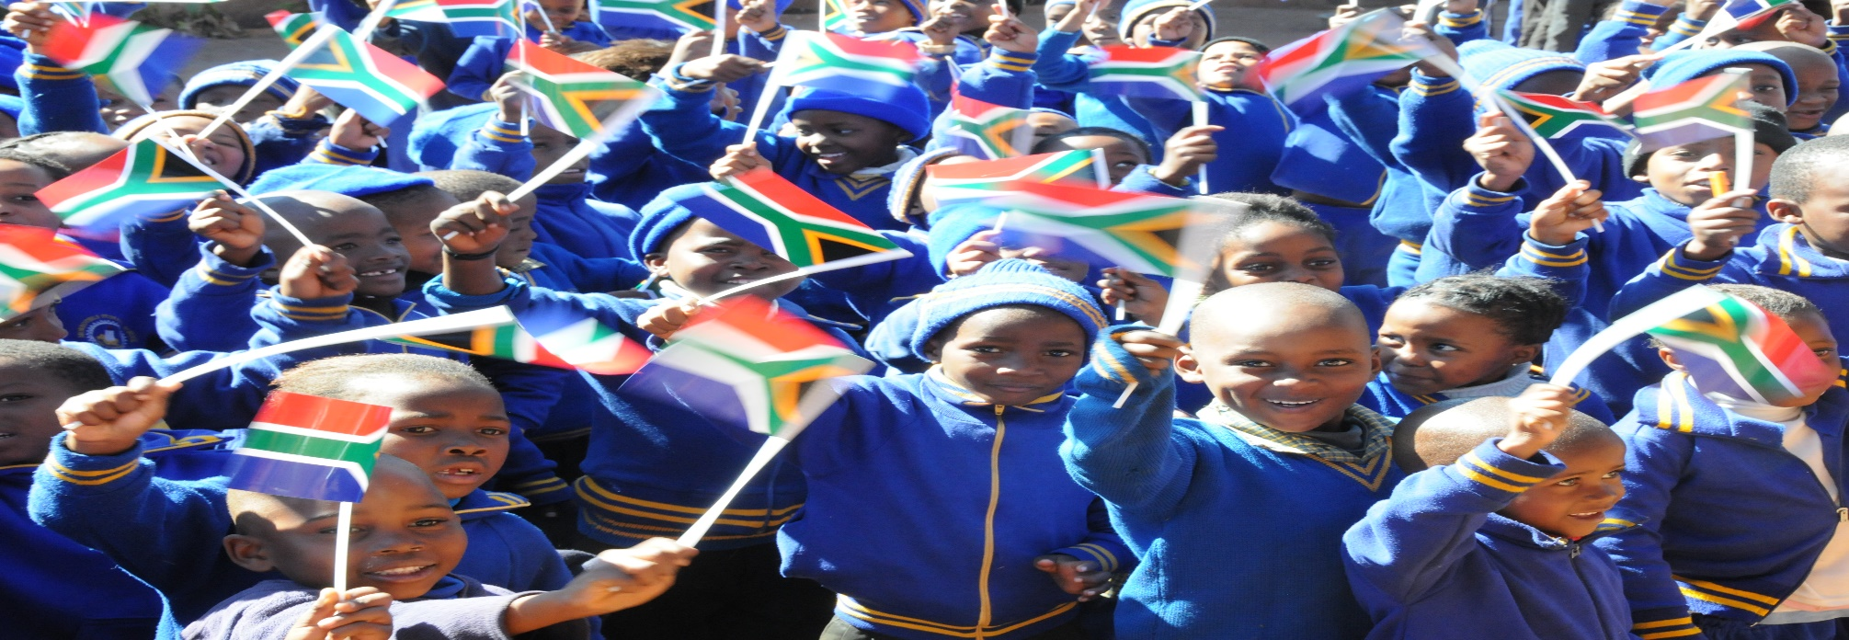

Slide 68
ADDRESSING THE SCOURGE OF GENDER-BASED VIOLENCE (GBV)
The DAC is implementing different models to contribute to socio-economic transformation where artists, especially the Legends and Divas participate in campaigns against Gender Based Violence. This is a four-pronged model of taking theatre to the people which includes the use of Industrial Theatre, Cultural Performance, dialogue and media interviews and social media platforms to convey messages of “No Violence against Women and Children ”. The Legends and Divas are Ambassadors of the campaign within the arts to change mind sets of communities on issues of how to take care and to respect women and children.
More than 30 artists are participating in the programme. A CD and a Video has been produced to create awareness on GBV. Campaigns were hosted in Evaton on Mandela Day where killings of women were reported, the Cape Town Peninsula University of Technology together with Limpopo Merit Awards After School Programme to support the launch of the university GBV Policy during Women’s Month (16 August 2018); and also supported the Ministerial imbizo in Acornhoek, Mpumalanga, on, 23 November 2018. Minister Mthethwa interacted with community members, who raised challenges on GBV and made recommendations. This imbizo sought to create social partnerships and including initiatives aimed at good governance, improved stakeholder morale, and public confidence.

Slide 69
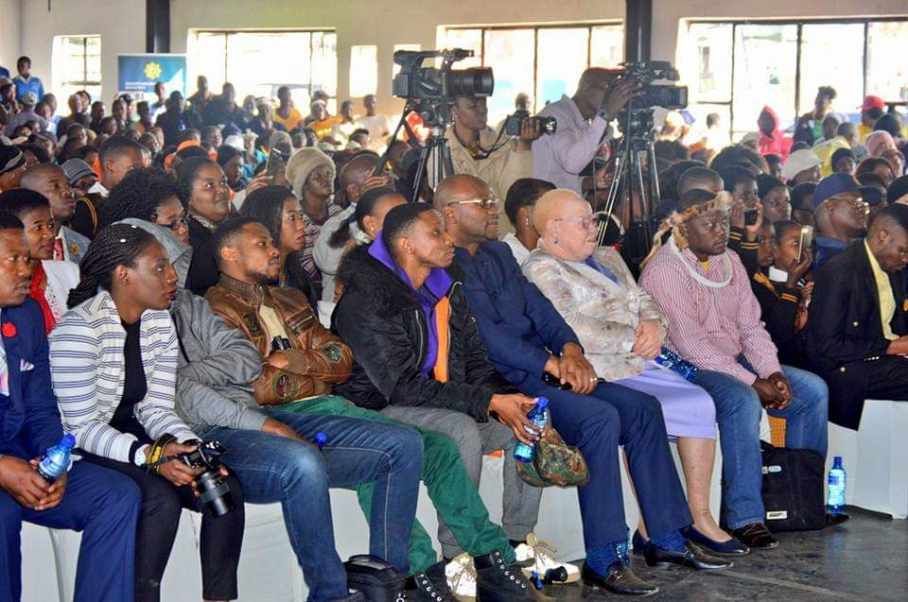
RECOGNISING THE PLIGHT OF PEOPLE WITH DISABILITY
The Minister is committed to addressing the plight of people with disabilities especially people with albinism. On 13 June 2018, the Minister launched International Albinism Awareness Day under the theme SHINE YOUR LIGHT. The launch was held in Hlalakahle in Mpumalanga where two (2) girls were killed and their body parts removed. The Minister also had the opportunity to meet with the affected family.
There was also a performance on the DAC funded drama: “MAMA I WANT TO BE THE BLACK THAT YOU ARE” highlighting issues affecting people with albinism.
Legends with disabilities host workshops and events in various theatres and at special schools nationally. The project also empowers people with disabilities including people with albinism to express their artistic abilities, liberation from stigma and rejection.
The “I Can Campaign Programme” is implemented through dialogues and workshops in all special schools.

Slide 70
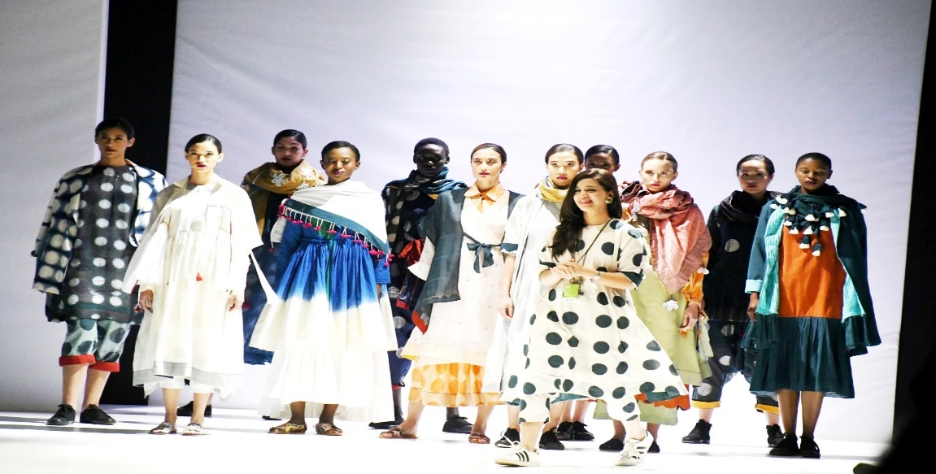
BRICS SUMMIT
The event formed part of the 10th BRICS Summit hosted under the theme, "BRICS in Africa: Collaboration for Inclusive Growth and Shared Prosperity in the 4th Industrial Revolution". Minister Mthethwa held a gala dinner as part of the networking session, and also to showcase South African music. The BRICS fashion show and fashion business forum showcased some of the best local and international designs. The fashion extravaganza was aimed at showcasing textile and retail opportunities within BRICS countries; creating a platform for fashion designers to participate in each others’ premier fashion shows; discussing and collaborating on fashion-related issues; creating market access; and promoting the consumption of fashion among BRICS countries. The fashion show concluded with a business forum on 26 October 2018 at the Lesedi Cultural Village.

Slide 71
WINNIE MADIKIZELA-MANDELA'S HOUSE IN BRANDFORT
On 26 September 2018, the Deputy Minister held an event to express government’s intention to declare the house of Mama Winnie Madikizela-Mandela in Majwemasweu Township, Brandfort, as a national heritage site, and to unveil an artistic impression of the museum design. This heritage house will be converted into a museum together with the bombed clinic that Mama Winnie used as a clinic. A multipurpose centre with Wi-Fi connectivity will also be constructed on the museum site.

Slide 72
SARAH BAARTMAN CENTRE OF REMEMBRANCE
The progress on the Sarah Baartman Centre of Remembrance construction site at Hankey, Eastern Cape is 75% complete in terms of funds payable for construction of the Centre which spans both sides of the R300 at Vergaderingskop, Hankey. Sarah Baartman’s grave is situated on the sacred side of the Centre, at the apex of Vergaderingskop. The administrative side is situated on the secular or northern side of the R300. By February 2019, the construction created 2 580 days of employment for Hankey residents, which is above the target of 1 850 days. The target is calculated as a percentage (R0,6 million) of the construction value.

Slide 73
ABBREVIATIONS/ACRONYMS
ABBREVIATION | DEFINITION | ABBREVIATION | DEFINITION
ACH | ARTS, CULTURE AND HERITAGE | CUR | CURRENT
AFS | ANNUAL FINANCIAL STATEMENT | DAC | DEPARTMENT OF ARTS AND CULTURE
AGSA | AUDITOR GENERAL OF SOUTH AFRICA | DEPT | DEPARTMENT
AO | ACCOUNTING OFFICER | DORA | DIVISION OF REVENUE ACT
AU | AFRICAN UNION | DPW | DEPARTMENT OF PUBLIC WORKS
BASA | BUSINESS AND ARTS SOUTH AFRICA | EU | EUROPEAN UNION
BBBEE | BROAD-BASED BLACK ECONOMIC EMPOWERMENT | EXP | EXPENDITURE
CAC | COMMUNITY ARTS CENTRE | G&S | GOODS AND SERVICES
CAP | CAPITAL | HSEMS | HUMAN, SOCIAL, ECONOMIC AND MANAGEMENT SCIENCES
CAPS | CURRICULUM ASSESSMENT POLICY STATEMENT | HVAC | HEATING, VENTILATION AND AIR CONDITIONING

Slide 74
ABBREVIATIONS/ACRONYMS
ABBREVIATION | DEFINITION | ABBREVIATION | DEFINITION
ICT | INFORMATION COMMUNICATION TECHNOLOGY | RLHR | RESISTANCE AND LIBERATION HERITAGE ROUTE
ITD | INTERNATIONAL TRANSLATION DAY | SA | SOUTH AFRICA
LLLP | LIVING LEGENDS LEGACY PROGRAMME | SAGNC | SOUTH AFRICAN GEOGRAPHICAL NAMES COUNCIL
MCS | MODIFIED CASH STANDARD | SAHRA | SOUTH AFRICAN HERITAGE RESOURCES AGENCY
MGE | MZANSI GOLDEN ECONOMY | SANCB | SOUTH AFRICAN NATIONAL COUNCIL FOR THE BLIND
MIL | MILLION | SARA | SOUTH AFRICAN ROADIES ASSOCIATION
MTEF | MEDIUM TERM EXPENDITURE FRAMEWORK | UAMP | USER ASSET MANAGEMENT PLAN
NAAIRS | NATIONAL AUTOMATED ARCHIVAL INFORMATION RETRIEVAL SYSTEM | UNESCO | UNITED NATIONS EDUCATIONAL, SCIENTIFIC AND CULTURAL ORGANIZATION

Slide 75
THANK YOU

