Slide 1
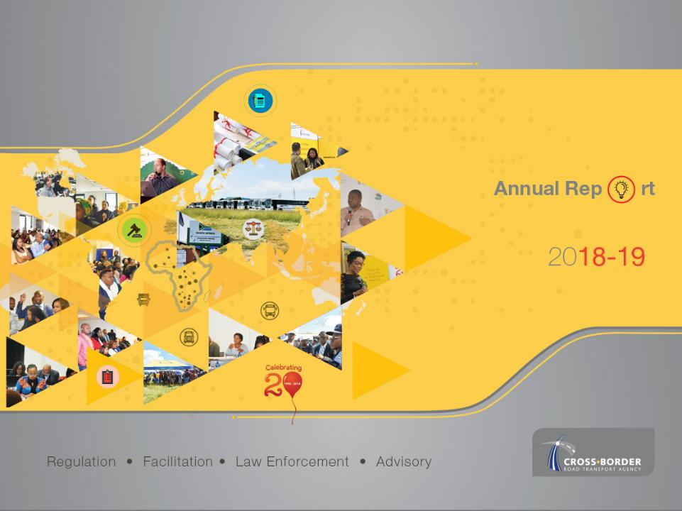
Presented by Collins Letsoalo
PORTFOLIO COMMITTEE OF TRANSPORT
Annual General Meeting for 2019

Slide 2
TABLE OF CONTENTS
  Mandate of the C-BRTA
  Core Functions and Structure
  Operating Environment
  Strategic Overview
  Organisational Performance
  Social Responsibility Initiatives
  Annual Financial Statements – March 2018/19
  Audit Outcomes
  Conclusion

Slide 3
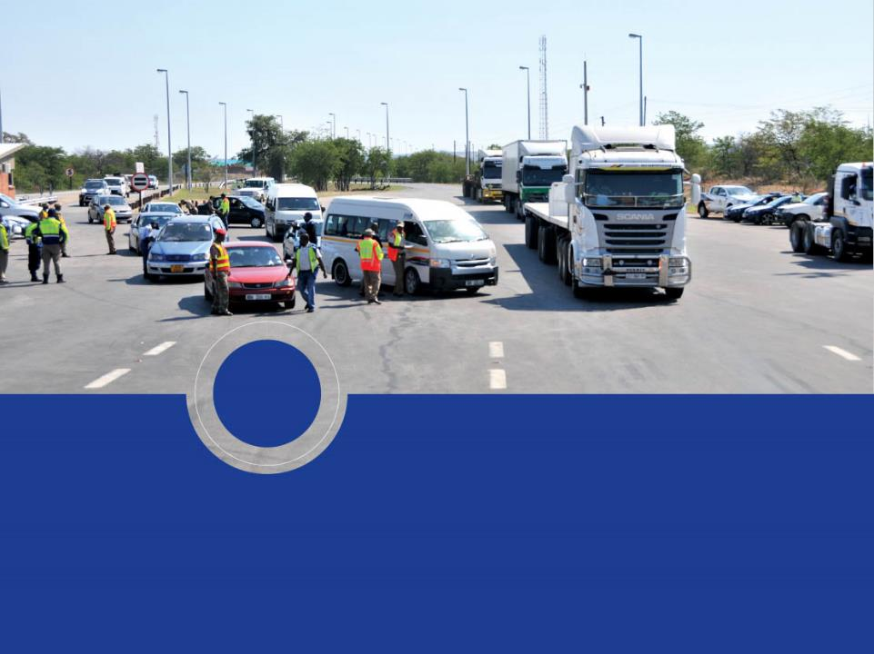
  1
  MANDATE OF THE C-BRTA

Slide 4
WHO ARE WE
WHY WE EXIST?
The C-BRTA exists primarily for the purpose of enhancing regional integration, trade and economic development through licensing and regulating commercial cross-border transport operations.
OUR VISION
The champion of free-flowing inter-state operations.
An integrated SADC region characterized by high intra-trade and economic development

Slide 5
MANDATE AS PER THE C-BRT ACT
The C-BRTA is established in terms of C-BRT Act No. 4 of 1998 to provide for co-operative and co-ordinated provision of advice, regulation, facilitation and law enforcement in respect of cross-border road transport to enhance regional integration, trade flows and economic development by:
  improving the unimpeded flow by road of freight and passengers in the region;
  liberalising market access progressively in respect of cross-border freight road transport;
  introducing regulated competition in respect of cross-border passenger road transport;
  reducing operational constraints for the cross-border road transport industry as a whole;
  enhancing and strengthen the capacity of the public sector in support of its strategic planning, enabling and monitoring functions; and
  empowering the cross-border road transport industry to maximise business opportunities and to regulate themselves incrementally to improve safety, security, reliability, quality and efficiency of services.

Slide 6
OTHER INSTRUMENTS FOR C-BRTA MANDATE
National Development Plan | SADC Protocol on Transport, Communications and Meteorology
Chapter 4 of the NDP identifies transport as one of the key economic infrastructures required for: Enhancing economic development by bridging geographic distances affordably, reliably and safely; Economic development by supporting transportation of goods, facilitating regional trade and regional integration; Aggressive expansion of trade and investment underpinned by the development of hard infrastructure, unlocking trade systems and enhancing performance of supply chains; Reducing red tape, corruption and delays at border posts; Chapter 7 of the NDP also requires South Africa to harmonize border policies with regional trading partners. | Article 3.5 provides institutional framework and enables member states to facilitate unimpeded access and travel between territories of member states; Article 5.2 requires harmonisation of road transport policy which provides for equal treatment, non-discrimination, reciprocity, fair competition to cross-border transport operators; Article 5.3 requires each country and the region collectively to introduce measures to liberalise cross-border market access policies in respect of cross-border carriage of goods; Article 5.4 requires member states to conclude bilateral or multilateral agreements for regulation of cross-border road transport operations; and Article 5.5 requires member states to ensure domestic measures shall conform to regional policies and coordinate their efforts in this regard.

Slide 7
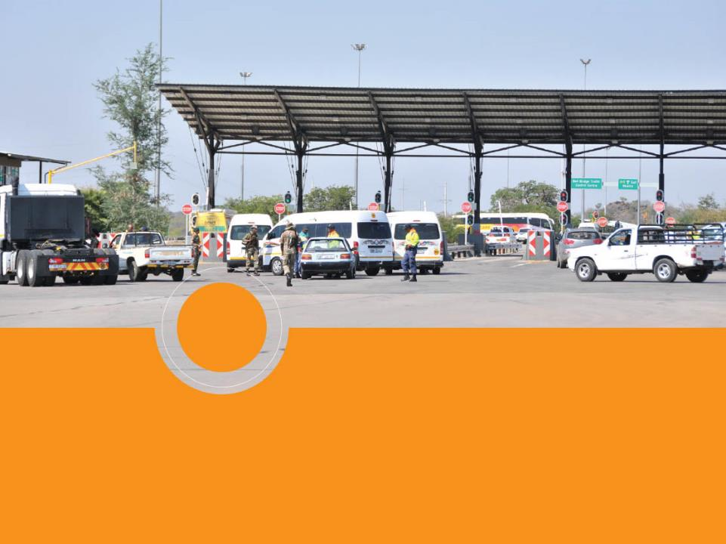
  2
  CORE FUNCTIONAL AREAS AND ORGANIZATIONAL STRUCTURE

Slide 8
CORE FUNCTIONAL AREAS
Advisory | Monitoring and counteracting any restrictive measures that may be implemented by other member states in the SADC region and advising the Minister of Transport on regional transport imperatives and challenges
Facilitation | Developing partnerships with SADC counterparts and fostering positive relationships aimed improving transport facilitation and development of trade among SADC countries
Regulatory | Responsible for the issuing and managing processes pertaining to cross border permits
Law Enforcement | Monitoring carriers’ adherence to the law by carrying out law enforcement operations.

Slide 9
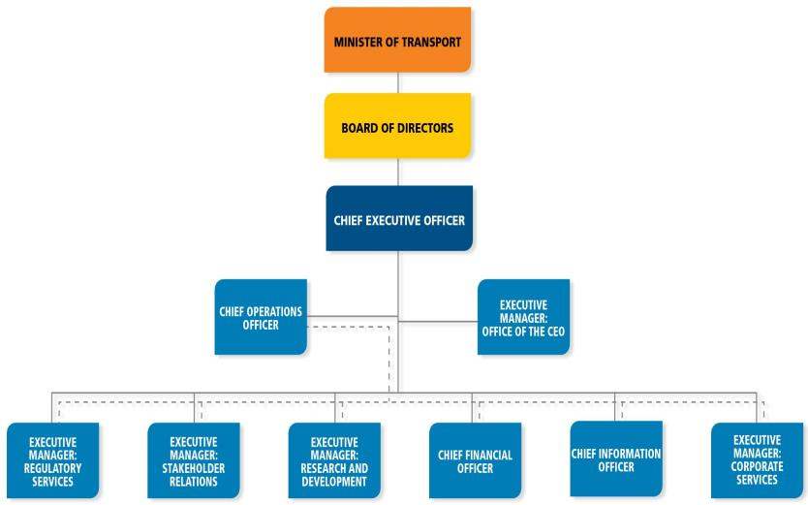
ORGANISATIONAL STRUCTURE
Notes:
As at 31 March 2019,
The Agency has a staff complement of 164 with a vacancy rate of 33.87%
Top Management Total 9: - Male = 5 and Female = 4
Senior Management Total 18: – Male = 10 and Female = 8
Professional qualified Total 35: – Male = 20 & Female = 15
Skilled Total 58: – Male = 15 & Female = 43
Semi-Skilled Total 38: – Male = 10 & - Female = 28
Unskilled Total 6: – Male = 2 African & Female = 4 African

Slide 10
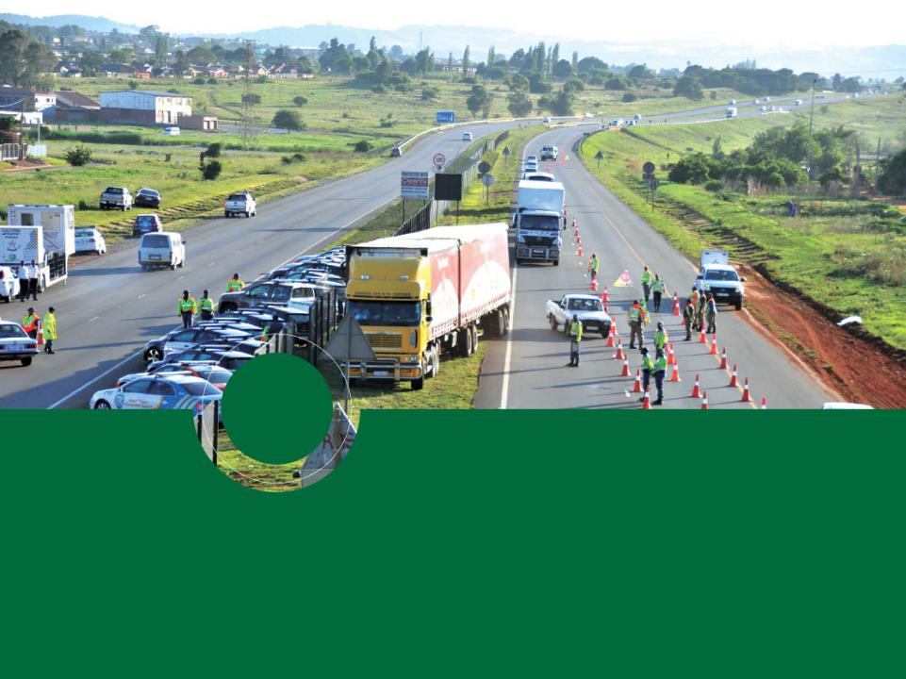
  3
  OPERATING ENVIRONMENT

Slide 11
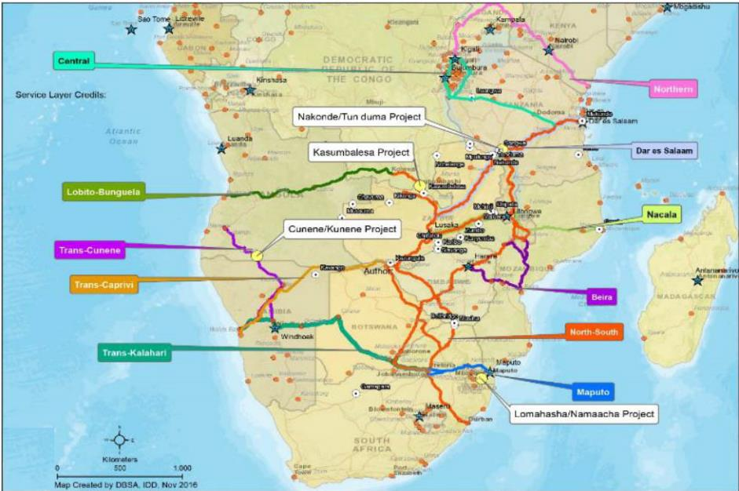
CROSS BORDER ROUTES AND BORDER POSTS
Notes:
There are 53 land border posts between South Africa and neighbouring countries -19 designated as commercial border posts;
There are 4 border posts that carry over 70% of the commercial traffic, namely Beitbridge, Lebombo, Maseru and Skilpadshek.
These border posts are located in the busiest corridors linking South Africa to the SADC region namely the North-South Corridor, Maputo/ N4 Corridor and Trans-Kalahari Corridor.
The cost of doing business for operators is impacted on by:
Delays at the border posts;
Inadequate infrastructure (road, parking) at the border posts ;
Frequency of stoppages for law enforcement along the transport corridors;
Key role players at border posts are:
DHA (Immigration/ Border management Agency);
SARS (Customs);
SAPS (Border Police);
DAFF (Agriculture, Forestry and Fisheries);
DOH (Port Health); and
State Security Agency.

Slide 12

  4
  STRATEGIC OVERVIEW

Slide 13
CORE VALUES - ‘ITREES’
Integrity, Transparency, Reliability, Efficiency, Effectiveness, Social Responsibility
STRATEGIC OVERVIEW
GOALS
Goal 1. Facilitate unimpeded flow of cross border transport
GOAL 2: Strategic positioning to promote integration of the African continent
Goal 3: Promote safe and reliable cross-border transport
Goal 4: Enhance organisational performance in order to improve sustainability
STRATEGIC OBJECTIVES
1: To introduce and implement regulated competition of cross border movements
2: To improve compliance with road transport legislation
3: To establish and sustain strategic partnerships with stakeholders so as to enable the Agency to achieve its objectives
4: To proactively provide value added advisory services to the Minister of Transport and other relevant stakeholders on cross border matters in the transport sector
5: To proactively promote transformation and development of the cross-border industry
6: To ensure the financial viability and sustainability
7: To introduce and implement regulated competition of cross border movements as pertaining to cross border movements
Notes:
The C-BRTA is established in terms of C-BRT Act No. 4 of 1998 to primarily issue permits and regulate cross border industry through:
Eliminating impediments that constrain the flow of passengers and freight across regional borders
Regulating competition of passenger transport operators
Regulating market access for freight transport operators
Reducing operational constraints that have a negative impact on cross-border road transport industry
Enhancing and strengthen the capacity of public sector; and
Building industry partnerships in order to empower the cross-border road transport industry.
The values, abbreviated “ITREES” are the core priorities of the Agency’s culture.
Integrity – we are professional, honest, fair and so not tolerate crime, fraud and corruption
Transparency – we are open and accountable in our interactions with our stakeholders and amongst ourselves as staff
Reliability – we are dependable, trustworthy and value our customers
Efficiency – we are innovative and passionate about performance
Effectiveness - we achieve our set goals and objectives with desired outcomes
Social responsibility – we seek to contribute towards the greater good of our country and continent by supporting social development and economic growth

Slide 14

  5
  ORGANISATIONAL PERFORMANCE

Slide 15
5- YEAR PERFORMANCE OVERVIEW: MTSF 2014-19
Notes:
The Agency has maintained the same performance level that was achieved in 2017/18.

Slide 16
2018/19 PERFORMANCE AGAINST APP TARGETS
92.31% of the predetermined targets (12 out of 13 targets) for the financial year were achieved
KPI not achieved
KPI: Developed and implemented new cross-border management system Target: Implemented prioritised interventions as per the approved EA Roadmap Reason for non-achievement: Scope of the project revised due to financial constraints Progress : The specifications and terms of references for the iCBMS were reviewed and the tender was re-advertised in November and adjudicated in March 2019.

Slide 17
ORGANISATIONAL PERFORMANCE: ACHIEVED TARGETS Cont./…
ORGANISATIONAL PERFORMANCE: ACHIEVED TARGETS Cont./…
NO. | KEY PERFORMANCE INDICATOR | 2018/19 ANNUAL TARGET | ACTUAL ACHIEVEMENT
1. | Developed and implemented new revenue streams | Developed Business Case on the 'Sale of Information' revenue stream | Business case was developed and approved
2. | Developed Permit fee Regulations | Submitted Draft Permit Fee Regulations to DoT | The draft permit fee tariff regulations were submitted to DOT
Notes:
In order to ensure financial viability and sustainability of the organisation, the Agency is pursuing the idea of developing and implementing new revenue streams. One of the identified possibilities is Sale of information and as the target for the year was to develop a business case on the project. The target was achieved as relevant information was gathered and the business case was compiled and approved.

Slide 18
ORGANISATIONAL PERFORMANCE: ACHIEVED TARGETS Cont./…
ORGANISATIONAL PERFORMANCE: ACHIEVED TARGETS Cont./…
NO. | KEY PERFORMANCE INDICATOR | 2018/19 ANNUAL TARGET | ACTUAL ACHIEVEMENT
3. | Percentage of temporary permits issued within pre-determined turnaround times | 90% of compliant applications for temporary permits processed and issued in front office within 8 working hours 90% of compliant applications for temporary permits processed and issued in back office within 1 day | 99.73% of compliant temporary permits applications processed and issued in front office within 8 working hours 98.96% of compliant temporary permits applications processed and issued from the bank office within 1 day
4. | Implemented scientific tool used by the Regulatory Committee to manage supply and demand of cross-border passenger transport | Post implementation assessment of MAR conducted | MAR implementation reports were produced and used by Regulatory Committee in decision-making. Post implementation assessment of the model was also conducted.
Notes:
As the Agency strives to be efficient in the administration of permits, the percentage of temporary permits issued within pre-determined turnaround times
serves as a good measure of efficiency and assist the Agency to continuously improve its services.
MAR is a model used to balance supply and demand of cross-border passenger road transport. This model is calibrated with immigration data, route specific parameters (i.e. border processing times, vehicle speed, etc) and vehicle seating capacity.
The project objectives are;-
Provide reliable baseline supply and demand information to use in the adjudication of passenger permit applications
Ensure routes are properly capacitated to avoid over saturation of routes

Slide 19
ORGANISATIONAL PERFORMANCE: ACHIEVED TARGETS Cont./…
NO. | KEY PERFORMANCE INDICATOR | 2018/19 ANNUAL TARGET | ACTUAL ACHIEVEMENT
5. | Developed and Implemented Operator Compliance Accreditation Scheme (OCAS) | OCAS Implementation Manuals developed | OCAS Implementation Manuals developed and approved
6. | Number of operator and corridor profiling reports for decision making | 4 Operator and Corridor Profiling (Section 39) reports submitted to EXCO for recommendation to Regulatory Committee | Four (4) Operator and Corridor Profiling (Section 39) reports were considered by the Executive Committee and recommended to the Regulatory Committee and used in consideration of permit applications
Notes:
OCAS is an intelligent risk based regulatory and road safety tool for certifying and licensing commercial road transport operators. The scheme is also intended to serve as a safety and quality management mechanism for regulating market access for all commercial vehicles across borders.
The main objective of the project is to;-
Ensure proactive compliance by all stakeholders in the value chain in discharging safety and regulatory requirements.
Improve compliance to road transport regulatory requirements and reduce road carnage in support of the National Road Safety Strategy and the UN Global Plan for the Decade of Action for Road Safety 2011-2020.
Introduce an effective and harmonized regulatory system that will lead to unimpeded flow of cross-border road transport, reduction in operational constraints, improved reliability and predictability and regional integration.
Section 39 reports are used by the Regulatory Committee in making decisions on the permit applications. After migration of the Law Enforcement Unit to RTMC, the Agency continues to exercise law enforcement through gathering of law enforcement compliance intelligence that profiles the permit holders. The report includes information that is collected through vehicle inspections, prosecutions, passenger lists, consignment notes and other information gathering approaches. The operator profiles are based on their operational conduct against regulatory requirements.

Slide 20
ORGANISATIONAL PERFORMANCE: ACHIEVED TARGETS Cont./…
NO. | KEY PERFORMANCE INDICATOR | 2018/19 ANNUAL TARGET | ACTUAL ACHIEVEMENT
7. | Developed and implemented stakeholder management plan | Implemented Stakeholder Management Plan | The Stakeholder Management Plan was implemented during the year and the consolidated stakeholder engagements outcomes report was approved by the Board.
8. | Facilitated the implementation of the SADC protocol and regional agreements | Monitored compliance by member states to the SADC Protocol and regional agreements | Assessment on the level of compliance with the SADC Protocol and regional agreements was conducted and report approved.
Notes:
As the Agency strives to establish and sustain strategic partnerships with stakeholders, the Agency continued with the planned stakeholder engagements that were targeted in line with the approved Stakeholder Management Plan.
Outcomes for 2018/19 were summarised into a report that including but not limited to outcomes of the following engagements;-
National Stakeholder Consultative Forum, Border Management Authority (BMA) Meetings, Operators’ Fora (freight, minibus, tourist and bus operator’s), Corridor meetings (Trans Kalahari Corridor, Maputo Corridor Logistics Initiative, Maputo Development Corridor Working Groups), the Joint Route Management Group and Route Committees. The report also covers engagements outcomes with the International Cross-Border Transport Organisation (ICBTO), Freight Associations (i.e. South African Association of Freight Forwarders) and the Bus Associations Amalgamation (SABOA, SACBOA & SAIPFA).
In terms of the facilitation of the implementation of SADC Protocol, the Agency made reasonable milestone with regard to tracking compliance by member states to the SADC Protocol. A report was compiled with a view of assisting in terms of pointing areas that need improvement as the level of compliance by member states is very poor. This initiative is in line with the mandate of the Agency to enhance and strengthen the capacity of the public sector in support of its strategic planning, enabling and monitoring functions.
The Agency further championed the establishment of the Cross-Border Road Transport Regulators Forum, which consist of regulators from SADC member states, as a platform to pursue harmonization and regional integration.

Slide 21
ORGANISATIONAL PERFORMANCE: ACHIEVED TARGETS Cont./…
NO. | KEY PERFORMANCE INDICATOR | 2018/19 ANNUAL TARGET | ACTUAL ACHIEVEMENT
9. | Developed model to calculate transit delays at commercial border posts | Piloted Cross-border Flow calculator model at 3 border posts (Beitbridge, Lebombo and Martin Drift) | Pilots of the model were conducted at the three border posts and the reports were approved
10. | Developed and implemented Industry Development Strategy | Implemented Industry Development strategy | Interventions as per the IDS project plan were implemented and the implementation report was approved by the Executive Committee.
Notes:
The calculator is a tool to identify delays and bottlenecks at key commercial border posts and corridors and quantify transit costs and costs of delays. The main objectives are to;-
Provide invaluable data to regulatory authorities, travellers, traders and the business community for decision making.
Enable cross-border travellers to make informed decisions regarding which border post to use and when to use it, thus saving time and resources by deploying vehicles less likely to encounter congestion and delays.
Assist industry and border stakeholders (customs, immigration, etc.) to make informed operational decisions such as the assignment of staff or the opening of additional lanes/counters to accommodate surges in demand.
Support improved planning both at the border and for the transport network that provides access through South Africa and its neighbours. Planning decisions would include facility design or layout modification that would ease the congestion at a particular border post.
Make a case for needed improvements in areas such as infrastructure upgrades and increased staffing.
Industry Development Strategy
As part of its efforts to make meaningful contribution towards transformation and the development of the cross-border industry, the Agency progressed with implementation of the Industry Development Strategy that was developed in 2017/18. Among initiatives that were carried out are: -
Developed a database of over 390 clearing and forwarding agents.
Transferred invaluable skills to 132 young people in specific border towns through training and fixed period employment.
Increased the Agency’s visibility to communities around the country, particularly those communities that are located along regional road transport corridors leading to the borders and beyond.

Slide 22
ORGANISATIONAL PERFORMANCE: ACHIEVED TARGETS Cont./…
NO. | KEY PERFORMANCE INDICATOR | 2018/19 ANNUAL TARGET | ACTUAL ACHIEVEMENT
11. | Number of Annual State of Cross-border operations reports (ASCBOR) submitted to the Minister and other relevant stakeholders | Annual State of Cross Border Operation Report produced and submitted to the Minister and other stakeholders | The ASCBOR was produced and approved by the Board and submitted to the Minister of Transport, DoT and shared with relevant stakeholders.
12. | Number of country profiles developed | 2 country (Zambia and Namibia) Profiles developed | Zambia and Namibia country profile reports were compiled and approved
Notes:
ASCBOR is a tool to proactively provide value added advisory services to the Minister of Transport and other stakeholders since it provides advice and consolidated information to the Minister of Transport, the Department of Transport and other key stakeholders in the trade and transport value chains.
This report articulates the current state of cross-border road transport infrastructure (covering both hard and soft infrastructure issues), constraints facing cross-border operations in the Common Market for Eastern and Southern Africa (COMESA), Eastern African Community (EAC) and Southern African Development Community (SADC) Tripartite (or COMESA-EAC-SADC Tripartite), the state of regional integration and progress made towards integrating transport in the Tripartite region, progress on implementation of continental and regional programmes with a bearing on cross-border road transport, the state of corridor performance monitoring in the Tripartite region, recommended reforms and action plans aimed at addressing identified challenges and to improve trade and transport in the region, amongst others.
Apart from compiling a report for 2018/19, the Agency also conducted an ASCBOR Seminar to discuss the 2017/18 ASCBOR with key stakeholders in the industry.
Country Profiles - The Agency compiled country profiles for both Zambia and Namibia in 2018/19. The profiles are useful in providing a consolidated platform for the dissemination of information on a specific country that is useful to key stakeholders in the cross-border environment, particularly cross-border road transport operators, regulatory authorities and trading parties with a view to improve business opportunities, operational efficiency, productivity and sustainability.

Slide 23
ORGANISATIONAL PERFORMANCE: PERMIT STATS
MODE | 2017/18 | 2018/19 | Increase/ (Decrease) | % Movement
Freight | 63 695 | 62 995 |  | (1.1)
Buses | 2 581 | 1 999 |  | (22.5)
Taxi | 22 500 | 22 494 |  | (0.03)
Tourist | 2 853 | 2 729 |  | (4.3)
TOTAL | 91 629 | 90 217 |  | (1.54)

Slide 24
ORGANISATIONAL PERFORMANCE: Bus Permit Stats
Bus Permits issued per Country
Notes:
The highest number of permits issued were to Zimbabwe, a total of 1 183 which is 59.18%, followed by Mozambique with a total of 252 permits which is 12.61%.
This could possibly imply either of the following;-
that there is a high demand for bus operations between South Africa and Zimbabwe, or
that a bus is the passenger’s travel mode of choice between the two countries.
A study has been commissioned to determine the reason for these permit stats.

Slide 25
ORGANISATIONAL PERFORMANCE: Taxi Permits Stats
Taxi permits issued per country
Notes:
A total of 11 092 taxi permits were issued to Zimbabwe (49.31%), followed by Mozambique at 8 741 permits.
A study has been commissioned to determine the reason for these permit stats.

Slide 26
ORGANISATIONAL PERFORMANCE: Freight Permit Stats
Freight Permits issued per country
Notes:
Legislation: Still focusing on quantity instead of quality regulations making it difficult to design and implement high impact regulatory programme ( e, g. Road Adherence Regulations, Points Demerit System, OCAS)
Top 3 Countries for Goods Permits:
Zambia 11 268
Zimbabwe 10 822
Mozambique 8 843
A study has been commissioned to determine the reason for these permit stats.

Slide 27
ORGANISATIONAL PERFORMANCE: Law Enforcement
Law Enforcement Statistics
Work Activity | 2017/18 | 2018/19 | Difference | % Movement | Year-on-year movement
Vehicle Inspections | 276 197 | 278 318 | 2 121 | (0.77%)
Prosecutions | 19 417 | 24 386 | 4 969 | 25.59%
Compliance Rate | 93% | 91% |  | (2%)
Notes:
There is 1% improvement on vehicle inspection since the RTI migrated to RTMC with an improvement of 26% on prosecution.
Compliance rate has declined by 2%, a situation that is currently speculated to be related to perceptions that migration of Law Enforcement to RTMC might imply that there is no more monitoring measures in place.

Slide 28

  6
  SOCIAL RESPONSIBILITY INITIATIVES

Slide 29
SOCIAL RESPONSIBILITY
Campaign to attract new entrants into the cross-border market was held in Makgobistad in the North West Province.
Road Safety Education session held with two Primary Schools in Hartebeeskop.
Participated in career exhibitions organized by the National Department of Transport and other sister entities in Limpopo, North West and Mpumalanga Province.
Knowledge Seminar was conducted for the University of Johannesburg students focusing on cross-border and transport related matters.
Youth Empowerment Workshop was conducted in collaboration with Musina Municipality to empower young people and to create awareness on opportunities available within the cross-border space.
Women and Youth Information Sharing Seminar hosted in collaboration with Chief Albert Luthuli Local Municipality targeting communities around Oshoek Border Post.

Slide 30

  7
  ANNUAL FINANCIAL STATEMENTS
  31 March 2019

Slide 31
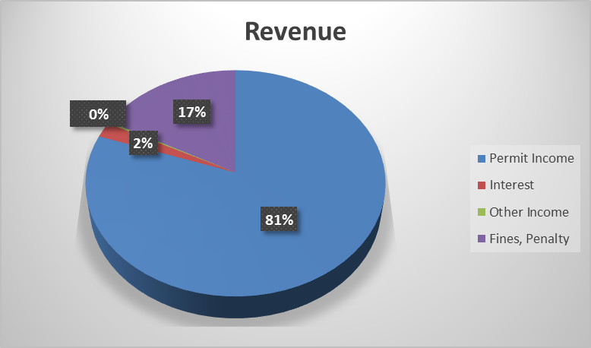
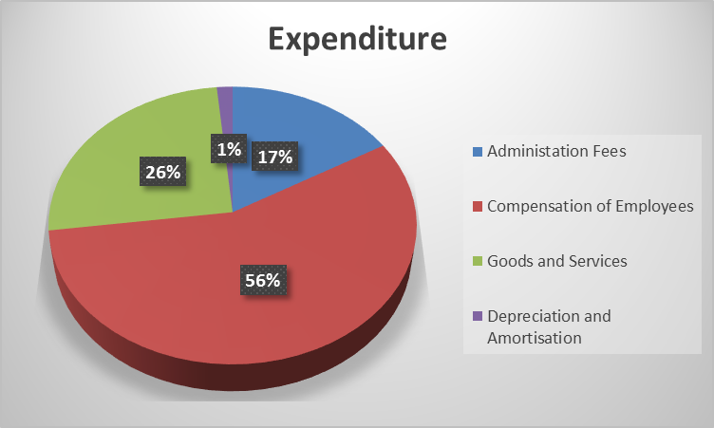
STATEMENT OF FINANCIAL PERFORMANCE
Notes:
Note the ratio changes
Compensation reduced from 69% current year to 55% as most of the staff compliment was from the RTI

Slide 32
FINANCIAL PERFORMANCE TRENDS
Permit revenue remains the main funding stream for the C-BRTA constituting 81% of the total revenue. The year-on-year decrease by 9% on permit revenue is due to decrease in the number of permits issued.
An amount of R162 million was written back to income as the provision for claim refunds prescribed during the financial year. The provision was initially raised after the Agency lost the constitutional court judgement brought by some carriers relating to 2011 permit tariff regulations.
Penalty revenue constitutes 17% of the total income for the year and has increased by 39% compared to the same period in the previous year. The number of and prosecutions increased by 25% from the previous year, while the inspections increased marginally by 1%.

Slide 33
FINANCIAL PERFORMANCE TRENDS
Employee costs constitute 56% of the total expenditure for the year ended March 2019 and expenditure on goods and services is at 26%.
The overall saving on expenditure is in line with the financial strategy (which includes the implementation of cost containment measures and strict expenditure management) to conserve cash and generate surpluses to enable the Agency to fund its capital expenditure.
To that effect, the Agency report a surplus of R180.990 million for the year ended March 2019, of which R18, 274 million represent surplus from normal operations.

Slide 34
STATEMENT OF FINANCIAL POSITION
Notes:
Note the ratio changes
Compensation reduced from 69% current year to 55% as most of the staff compliment was from the RTI

Slide 35
FINANCIAL POSITION TRENDS
The financial health of the Agency has improved significantly during the year under review. This was mainly due to the reversal of some R162 million claims provision following the application of the Prescription Act.
The financial position was further enhanced by further R18 million surplus generated for the year under review.
The working capital, which is represented by the degree to which the current assets of the agency exceeds its current liabilities, improved during the year under review. The Agency will be able to pay its suppliers as well as employees in the ordinary course of the business.

Slide 36

  8
  AUDIT OUTCOMES

Slide 37
AUDIT OUTCOMES OVER PAST FIVE YEARS
The Agency has achieved a Clean Audit for four consecutive years
2014/15 Unqualified Audit
2015-16
Clean Audit
2016-17
Clean Audit
2017-18 Clean Audit
2018/19 Clean Audit

Slide 38
AUDIT OUTCOMES 2018/19
AUDIT OUTCOMES 2018/19
Conclusion on Annual Financial Statements | AFS present fairly, in all material respects, the financial position of the entity, its financial performance and cash flows for the year ended
Conclusion on pre-determined objectives | There were no material findings on the usefulness and reliability of reported performance information
Conclusion on Compliance with legislation | No material findings on non-compliance with applicable key legislation No significant deficiencies identified in internal controls
Other Matters | Investigation being conducted by the Accounting Authority relating to the alleged conduct of the Chief Executive Officer

Slide 39
9. CONCLUSION
Cross-Border Transport is an indispensable element to
trade facilitation, regional integration
and socio-economic development.

Slide 40

Glen Manor Office Park
Building 3
138 Frikkie de Beer Street
Menlyn, Pretoria
South Africa
PO Box 560
Menlyn, 0063
Pretoria
South Africa
Tel: +27 12 471 2000
Fax: +27 12 369 8485
www.cbrta.co.za

