Slide 1



Portfolio Committee on Trade and Industry the dti 2018/19 Annual and 2019/20 First Quarter Reports
Mr Lionel October
Director-General
08 October 2019

Slide 2
PRESENTATION OUTLINE
PURPOSE
INTRODUCTION
STRATEGIC IMPERATIVES
ECONOMIC OVERVIEW
2018/19 ANNUAL REPORT
2019/20 FIRST QUARTER REPORT

Slide 3
PURPOSE
To request the Portfolio Committee to:
Note and discuss the 2018/19 Annual Report of the dti; and
Note and discuss the 2019/20 first quarter report of the dti.

Slide 4
INTRODUCTION
Section 40(1)(d) of the Public Finance Management Act, 1999 (Act No. 1 of 1999 as amended) requires the accounting officer for a department to submit within five (5) months of the end of a financial year to the relevant treasury and to the executive authority responsible for that department or trading entity -
  an annual report on the activities of that department, trading entity or constitutional institution during that financial year;
  the financial statements for that financial year after those statements have been audited; and
  the Auditor-General’s report on those statements.
Annual Report Guidelines remain the same as last year- as confirmed by National Treasury.

Slide 5
STRATEGIC IMPERATIVES
Objectives
Goals
Grow the manufacturing sector to promote industrial development, job creation, investment and exports.
To facilitate transformation of the economy to promote industrial development, investment, competitiveness and employment creation.
Vision
A dynamic industrial, globally competitive South African economy, characterised by inclusive growth and development, decent employment and equity, built on the full potential of all citizens.
2. Build mutually beneficial regional and global relations to advance South Africa’s trade, industrial policy and economic development objectives.
Improved conditions for consumers, artists and opening up of markets for new patents players.
3. Facilitate broad-based economic participation through targeted interventions to achieve more inclusive growth.
4. Create a fair regulatory environment that enables investment, trade and enterprise development in an equitable and socially responsible manner.
Strengthened capacity to deliver on the dti mandate.
5. Promote a professional, ethical, dynamic, competitive and customer-focused working environment that ensures effective and efficient service delivery.

Slide 6
2018/19 ANNUAL REPORT

Slide 7
ECONOMIC OVERVIEW

Slide 8
ECONOMIC OVERVIEW
Global growth remains subdued & the forecast in July 2019 is revised 0.1 percentage point lower than it was in April 2019.
Risks to the forecast are mainly to the downside which include:
Further increased tariffs on certain Chinese imports by US;
Threat to global technology supply chains by the prospect of US sanctions;
Rising geopolitical tensions roiled energy prices;
Brexit uncertainty weighing on EU growth; and
Erosion of business and consumer confidence are all contributing to the downside risk.
 |  | July 2019 Forecast
% y-o-y | 2018 | 2019 | 2020
Global GDP | 3.6 | 3.3 | 3.6
Advanced economies | 2.2 | 1.9 | 1.7
Emerging economies | 4.5 | 4.1 | 4.7
Sub-Saharan Africa | 3.0 | 3.4 | 3.6
United States | 2.9 | 2.6 | 1.9
Euro Area | 1.8 | 1.3 | 1.6
Japan | 0.8 | 0.9 | 0.4
China | 6.6 | 6.2 | 6.0
South Africa | 0.8 | 0.6 | 1.5
Source: IMF-WEO July 2019 &
The SA GDP forecast by SARB
2017
2018

Slide 9
SA GROWTH MOMENTUM REMAINS WEAK
The weakness of the South African economy in the opening quarter of the year was much worse than anticipated;
The sharp 3.2% (revised to 3.1%) contraction in real GDP, on a quarter-on-quarter (q-o-q), seasonally adjusted and annualised (saar) basis was the worst quarterly performance since the 2009 recession;
However, that was reversed when the economy avoided a recession and grew by 3.1% in the second quarter;
The major drivers behind the rebound in growth include the Mining sector (14.4%); Finance (4.1%); Trade (3.9%) and Manufacturing (2.1%).
Sectors that recorded declines include Agriculture (-4.2%); Construction
(-1.6%) and Transport (-0.3%).
Notes:
Largest contributors to GDP was manufacturing (7.5%), Agriculture (6.5%), Transport (5.7%) while mining declined by (8.8%), Construction (-2.7%) and electricity (-0.9%)

Slide 10
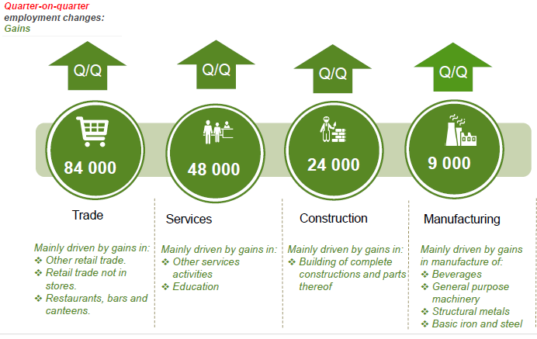
The unemployment rate worsens in Q2
The number of employed persons in South Africa increased by 21 000, from 16.29 to 16.31 million (q-on-q) in 2019Q2 but the rate of unemployment worsens to reach 29%.
The increase in the number of jobs was mainly driven by four sectors:
Source: Stats SA
10

Slide 11
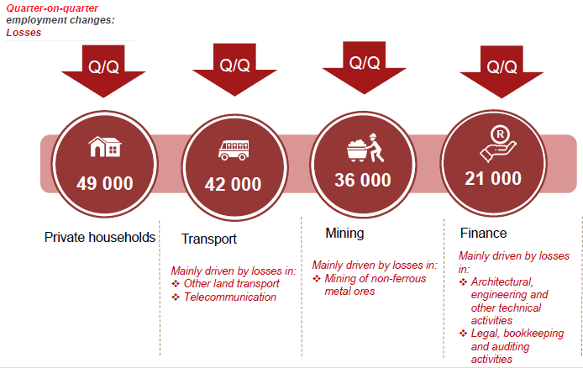
However, some sectors suffered job losses
Despite the number of jobs created in 2019Q2, four sectors lost employment.
Private household (-49 000); Transport (-42 000); Mining (-36 000) and Finance (-21 000).
Source: Stats SA
11

Slide 12
SA TRADE RECORDED DEFICIT WITH THE WORLD
SA recorded trade deficit with the rest of the world in Q1 of 2019 - moving from R14.6 billion surplus recorded in Q4 of 2018 to –R4 billion deficit recorded in Q1 of 2019.
Negative trade balance was as a result of contraction in exports across the key sectors of the economy:
Mining exports contracted driven by decline in exports volumes of precious metals & base metals;
Volume of manufacturing exports decline as vehicles & transport equipment contracted; and
Agriculture exports also decline as export volumes of vegetables receded.
Real imports of goods & services contracted in Q1 of 2019 due to weak domestic demand in particular of mineral products & adverse contraction of chemical products, food & beverages in the manufacturing sector.
The overall trading environment remain challenging & the expected slowdown in global growth momentum will weigh heavily on SA’s trade volumes in the near future.
Notes:
In Q3 of 2018, the country posted a trade surplus of R550 million less than the R18 billion recorded in Q2 of 2018 due to exponential increase in the value of imports.

Slide 13
MANUFACTURING TRADE DEFICIT WIDEN SHARPLY
The conditions in the manufacturing sector remain largely unfavourable as businesses experienced difficult conditions in the past years.
Several manufacturing sub-sectors are operating well below production capacity largely due to insufficient demand (particularly in the domestic market), and strong competition from foreign producers both in local and export markets.
This factors have an impact on the competitiveness of the sector in particular manufacturing exports.
In Q1 of 2019 manufacturing exports contracted leading to widening in the trade deficit. Contraction in the export volumes of vehicles & transport equipment, machinery & equipment, prepared foodstuff & beverages were amongst the manufacturing sub-sectors which contributed to widening of trade deficit in Q1 of 2019.
Notes:
SA manufacturing recorded a trade deficit amounting to R73 billion in Q3 of 2018 compared to R56 billion in Q2 of 2018.

Slide 14
SA TRADE SURPLUS WITH AFRICA NARROWS
Exports to Africa decreased by R15 billion to reach R77 billion in Q1 of 2019 from R92 billion in Q4 of 2018.
Despite the decline in export, trade balance with the rest of Africa remains positive at R45 billion in Q1 of 2019.
However, South African exports to the continent are largely destined for the SADC region, principally other SACU member states.
With opening of markets in Africa through Continental Free Trade Area export penetration to other sub Saharan African economies is anticipated.
Despite the favourable trade balance with Africa, our approach to regional integration is to prioritised developmental trade with investment-led industrial and infrastructure development as key levers to unlock the potential of African countries. This will rebalance trade with fellow African countries & ensure that the benefits of integration are spread across the continent.
Notes:
At the end of Q3 of 2018, South Africa’s exports to Africa amounted to R86 billion with imports from the region totalling R39 billion resulting in trade surplus of R47 billion.
SADC appears to be the most significant trading bloc for South Africa for both exports and imports. The region alone accounts for more than 70% of all South Africa’s exports to Africa. Key markets in SADC are Botswana, Namibia, Mozambique, Zambia and Zimbabwe.

Slide 15
SA TRADE DEFICIT WITH BRIC NARROWED
South Africa’s trade response has been remarkable since joining the group.
At the country level within BRICS, SA has recorded huge trade deficit with China ( -R26 billion), followed by Brazil (-R1.9 billion) & Russia (-R500 million). The only trade surplus with BRIC is recorded with India at R649 million.
The increase in imports particularly manufactured products from BRIC remains three times greater than that of the exports on average. This disparity is reflected in the country’s trade balance, which has been consistently negative.
However, the on-going engagements at BRICS Business Council will address some of the inequalities in trade by developing programmes that support industrialisation amongst member states.
Notes:
Total trade with BRIC amounted to over R120 billion at the end of Q3 of 2018. The phenomenal growth of trade with the BRICS has allowed South Africa to diversify its export markets beyond traditional partners such as Europe Union and the United States
In terms of the current trade patterns, South Africa’s exports with its BRICS counterparts has increased from R40 billion in Q1 of 2018 to reach R48 billion in Q3 of 2018.
South Africa’s imports from the BRIC countries have largely been manufactured goods, with China having the biggest weighting in the import basket compared to India, Brazil and Russia. At the end of Q3 of 2018, the total imports from BRIC stood at R83 billion resulting in trade deficit of R34 billion
Efforts are underway to rebalance trade, the BRICS Summit held in SA in July 2018, adopted measures that will support greater participation, rebalancing of trade, value addition and upward mobility of countries in the Global Value Chains amongst other

Slide 16
SUMMARY OF DEPARTMENTAL PERFORMANCE

Slide 17
Key Achievements
INDUSTRIAL DEVELOPMENT
SG 1: Facilitate transformation of the economy to promote industrial development, investment, competitiveness and employment creation
Automotive Sector
110 000
Direct jobs in manufacturing
Exports grew from 1% to 10% of total goods exports (R165bn in 2017) .
3,6% p.a in real terms (1994 – 2017)
Fastest growing manufacturing industry since 1994
R41.3bn
Total investment by the sector between 2015 to 2018
SA has become Africa’s auto assembler
Median employee earnings in 2016 was R5633 a month, compared to R4000 in the rest of manufacturing & R3300 in other sectors
Notes:
BMW Group South Africa (BMW SA) started production of the new BMW X3 at its Rosslyn plant in Tshwane. BMW X models account for more than 30% of the group’s global worldwide sales.
Launched the newly established Toyota Wessels Institute for Manufacturing Studies (TWIMS) to develop world-class capabilities and drive African industrialisation in Kloof, Durban, KwaZulu-Natal, where the Institute will be based.
Komatsu Africa Holdings, the Southern African division of global capital equipment player Komatsu, opened a new industrial hub, built to the value of R985 million, in Germiston, Johannesburg.

Slide 18
Key Achievements
INDUSTRIAL DEVELOPMENT
SG 1: Facilitate transformation of the economy to promote industrial development, investment, competitiveness and employment creation
Automotive Sector
Ford Motor Company of Southern Africa (FMCSA) expanded its Struandale engine plant in Port Elizabeth, Eastern Cape, as part of a R3-billion investment in its South African operations.
Mercedes Benz invested R10 billion into an expansion of its East London plant. The upgrade extended the production space of the existing plant by up to two-thirds to produce the next generation of the C-Class and also manufacture the GLC SUV.
Notes:
BMW Group South Africa (BMW SA) started production of the new BMW X3 at its Rosslyn plant in Tshwane. BMW X models account for more than 30% of the group’s global worldwide sales.
Launched the newly established Toyota Wessels Institute for Manufacturing Studies (TWIMS) to develop world-class capabilities and drive African industrialisation in Kloof, Durban, KwaZulu-Natal, where the Institute will be based.
Komatsu Africa Holdings, the Southern African division of global capital equipment player Komatsu, opened a new industrial hub, built to the value of R985 million, in Germiston, Johannesburg.

Slide 19
INDUSTRIAL DEVELOPMENT
SG 1: Facilitate transformation of the economy to promote industrial development, investment, competitiveness and employment creation
Plastics, Pharmaceuticals, Chemicals and Cosmetics
Launched Aspen’s R1-billion high containment facility, which will create more than 500 jobs, in Port Elizabeth. The facility was established as a result of a partnership between the dti and Aspen.
Exports of approximately R16m were achieved in the last financial year.

Slide 20
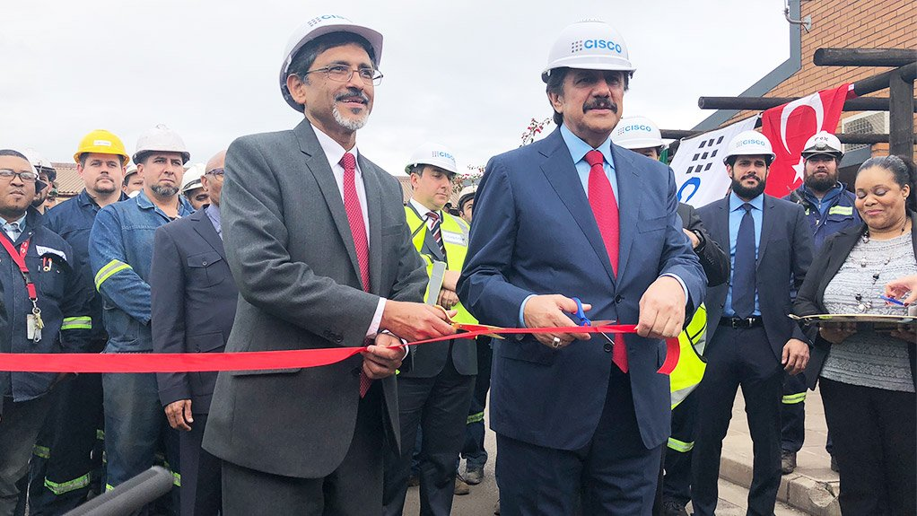

Key Achievements
INDUSTRIAL DEVELOPMENT
SG 1: Facilitate transformation of the economy to promote industrial development, investment, competitiveness and employment creation
Mineral Beneficiation
The Cape Town Iron and Steel works (Cisco) plant was officially opened in Kuils River near Cape Town. The plant created 300 direct and 120 indirect jobs.
SA’s steel sector remains under significant pressure due to the global steel glut and weak local infrastructure demand.

Slide 21
Key Achievements
INDUSTRIAL DEVELOPMENT
SG 1: Facilitate transformation of the economy to promote industrial development, investment, competitiveness and employment creation
Sugar
Gazetted the sugar regulation transitional arrangements which recognises SA Farmers Development Association (representing small, Black farmers) into the industry association.
In August 2018, Minister endorsed ITAC recommendations to increase the Dollar Reference Price (sugar tariff) to $680.
Masterplan for Sugar
Changing consumer demand due to health levy on sugar as well as insufficient investment in the past.
New opportunities identified:
    Industrial diversification (bio-plastics and bio-fuels)
    Agricultural diversification (crop rotation/nuts, hemp, cannabis)
    New markets (EU/UK and AfCFTA)
  - Key challenge will be the transition costs to shift the industry, particularly for small-scale farmers.

Slide 22
Key Achievements
INDUSTRIAL DEVELOPMENT
SG 1: Facilitate transformation of the economy to promote industrial development, investment, competitiveness and employment creation
Poultry
Government has intervened to save the sector:
These include implementation of anti-dumping measures.
Safeguard measures have been implemented where import surges have occurred.
Duties on imports on ‘whole birds’ have been increased to 82% which is the maximum duty allowable under WTO commitments.
Current duty on ‘bone-in’ portions is 37%.
Market development for exports is taking place focusing on Gulf and EU member states.
Masterplan for Poultry
Process involves established and emerging players, domestic producers, importers and labour
Address changing structure of global industry: premium cuts (breast) and discount cuts (bone-in/leg); brining practices
Combine supply-side measures (investment, training, new entrants) with demand-side (tariffs and export opportunities) and economic transformation

Slide 23
Key Achievements
INDUSTRIAL DEVELOPMENT
SG 1: Facilitate transformation of the economy to promote industrial development, investment, competitiveness and employment creation
Business Process Services (BPS)
Launched the Global Business Services (GBS) Incentive at SA House in London, UK.
The sector has grown significantly over the last decade with domestic market growth averaging 10.7% per annum.
Film & Video Sector
The SA film & video sector has become an important source of growth. For every Rand spent by the sector, economic value of R2.89 is created.

Slide 24
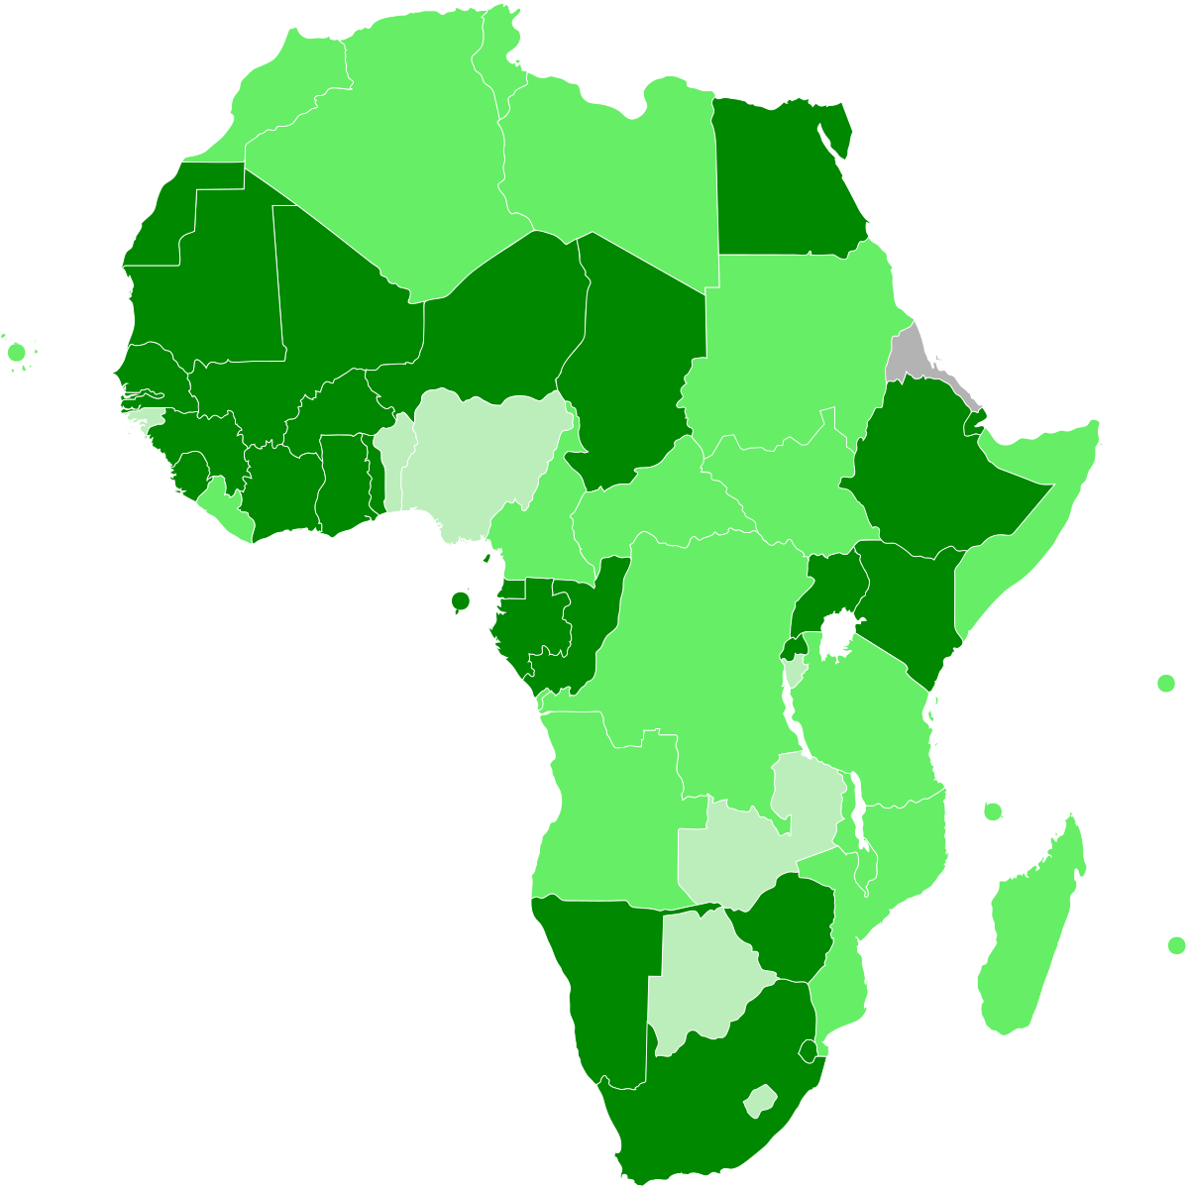
Key Achievements
INDUSTRIAL DEVELOPMENT
SG 1: Facilitate transformation of the economy to promote industrial development, investment, competitiveness and employment creation
Regional Integration
South Africa has signed the African Continental Free Trade Area Agreement (CFTA) with the African Union (AU).
The African Export- Import Bank (Afreximbank) and the Export Credit Insurance Corporation of South Africa (ECIC) signed a Memorandum of Understanding (MoU) for a $1-billion financing programme to promote and expand trade and investments between South Africa and the rest of Africa.

Slide 25
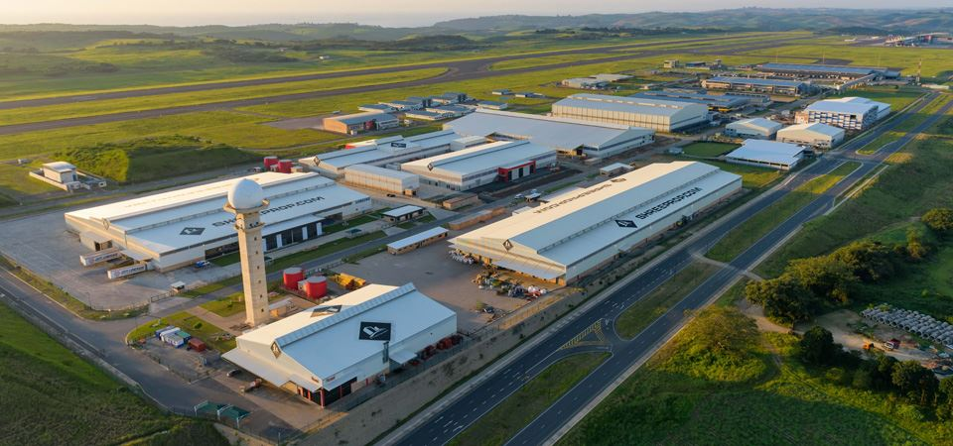
Diversifying the Economy through Special Economic Zones

Slide 26
INDUSTRIAL DEVELOPMENT
10 SEZs are in place.
New model is being developed, with partnership with national agencies and private sector to attract investors and support SEZs.
Building on existing strengths: developing Auto-Supplier parks through zone expansions.
Scaling-up: Durban aerotropolis - Dube Trade Port SEZ as a base.
Top 3 SEZs: Coega, East London & Dube Trade Port
R15.23bn Investment 14,619 Current employment 116 Number of investors R15,37bn Secured but not operational investment
Notes:
Data has been sourced from the SEZ Cab Memo and presentation, dated August 2019. Largest SEZs by value of investment are confirmed to be Coega, East London and Dube TradePort.

Slide 27
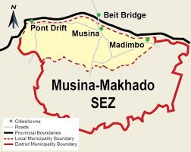
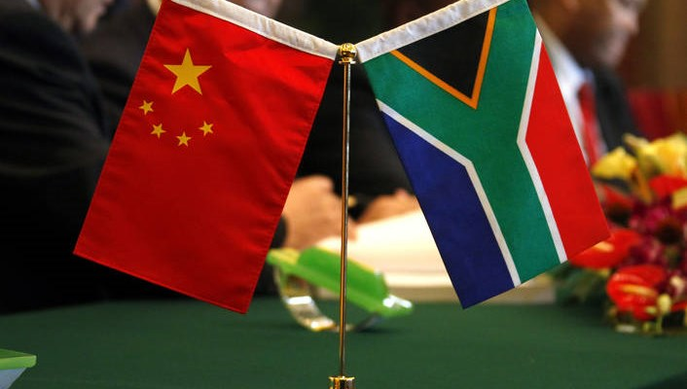
Key Achievements
INDUSTRIAL DEVELOPMENT
SG 1: Facilitate transformation of the economy to promote industrial development, investment, competitiveness and employment creation
  the dti facilitated and witnessed the signing of a MoU between Musina-Makhado SEZ and 10 potential investors from China, with a value of $10 billion.
  the dti in partnership with the Chinese Government trained 50 South African government officials on Special Economic Zone (SEZ) planning and development. The training took place in Tianjing, China, in May 2018.

Slide 28


Key Achievements
INDUSTRIAL DEVELOPMENT
SG 1: Facilitate transformation of the economy to promote industrial development, investment, competitiveness and employment creation
  The SEZ Advisory Board recommended the approval of the Gauteng Industrial Development Zone (IDZ) application on land expansion.
  The Atlantis SEZ was designated in May 2018 and launched in December 2018.
Notes:
The Special Economic Zone (SEZ) planning guidelines were finalised.
Regulations on the composition of SEZ entities and operators were developed to enable SOEs to function as operators and entities.
The Framework Agreement was signed between the dti and the National Development Reform Commission (NDRC) for partnership in the undertaking of industrial development projects in South Africa, with a special focus on Musina- Makhado SEZ.

Slide 29

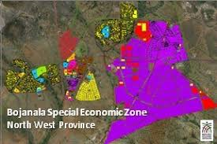
Key Achievements
INDUSTRIAL DEVELOPMENT
SG 1: Facilitate transformation of the economy to promote industrial development, investment, competitiveness and employment creation
  The Nkomazi SEZ was designated in December 2018.
  Application for the designation of the Bojanala SEZ was recommended by the SEZ Advisory Board on 29 March 2019 for approval by the Minister. In consultation with major stakeholders.

Slide 30
Key Achievements
INDUSTRIAL DEVELOPMENT
SG 1: Facilitate transformation of the economy to promote industrial development, investment, competitiveness and employment creation
Rural and Township Industrial Economy (RTIE) programme A Rural and Township Economy Summit was convened in East London in July 2018. The resolutions from the Summit included Government and all stakeholders acknowledging the need for a major infrastructure response across Departments and spheres of government to unlock the township economy’s potential. Discussions are ongoing to establish a township infrastructure fund. Revitalisation of Industrial Parks The Phuthaditjaba Industrial Park was launched on 30 October 2018. Siyabuswa, Kabokweni, Madadeni and Ezakheni were added to the Industrial Park Revitalisation Programme (IPRP), bringing to 16 the total number of Industrial Parks revitalised.

Slide 31
INDUSTRIAL DEVELOPMENT
793
projects
Over 82% projects are B-BBEE level 1-4 compliant
R8 billion
of approvals
277 black-owned,
193 female-owned and
22 youth-owned projects supported
38 366
jobs retained
29 735
new jobs to created
R5,1 billion disbursed
R31,3 billion investment leveraged

Slide 32

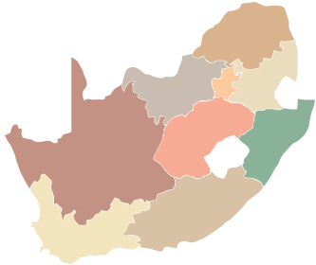
Key Achievements
INDUSTRIAL DEVELOPMENT
Provincial performance incentives
Gauteng
Limpopo
R3,6 billion
Approval
R15 billion
Investment leveraged
R246 million
Approval
R2,2 billion
Investment leveraged
Jobs to be created
4 321
Jobs to be retained
147
Jobs to be created
4 321
Jobs retained
147
North West
Mpumalanga
R132 million
Approval
R341 million
Investment leveraged
R155 million
Approval
R1 billion
Investment leveraged
Jobs to be created
455
Jobs retained
391
Jobs to be created
1 491
Jobs retained
18
Northern Cape
KwaZulu-Natal
R523 thousand
Approval
R1,9 million
Investment leveraged
R1,3 billion
Approval
R5,2 billion
Investment leveraged
Jobs to be created
5
Jobs retained
0
Jobs to be created
5 127
Jobs retained
9 559
Western Cape
Free State
Eastern Cape
R1 billion
Approval
R1,4 billion
Investment leveraged
R198 million
Approval
R1,7 billion
Investment leveraged
R2 billion
Approval
R3,9 billion
Investment leveraged
Jobs to be created
4 492
Jobs retained
2 416
Jobs to be created
1 331
Jobs retained
361
Jobs to be created
1 199
Jobs retained
13 755

Slide 33

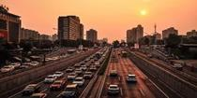

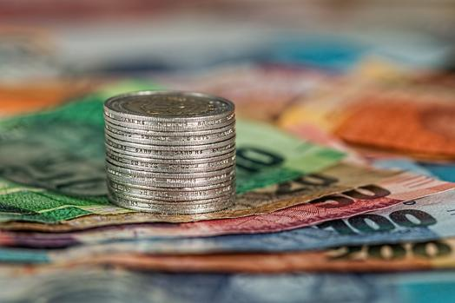
TRADE, INVESTMENT AND EXPORT
SG 2: Build mutually beneficial regional & global relations to advance South Africa’s trade, industrial policy & economic development objective
The department continues to engage within Southern African Development Community (SADC) through bilateral engagements on outstanding commitments in the implementation of the Free-Trade Agreement (FTA). In relation to trade in services, negotiations were concluded on four(4) sectors, namely: Communication, Tourism, Transport and Financial Services. Negotiations continue in the area of energy-related services and construction.

Slide 34
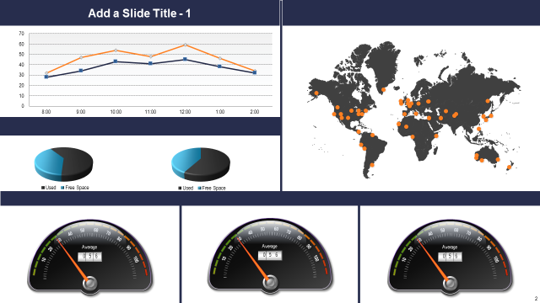
TRADE, INVESTMENT AND EXPORT
SG 2: Build mutually beneficial regional & global relations to advance South Africa’s trade, industrial policy & economic development objective
Significant progress was made beyond the adoption of the legal framework to operationalise the FTA.
Tariff negotiations commenced between the parties, with the key bilateral negotiations for South Africa being the Southern African Customs Union – East African Community (SACU-EAC) tariff negotiations, as well as with Egypt.
Significant progress achieved in the SACU-EAC negotiations, with a few remaining issues in relation to tariffs and rules of origin.
The Annex on Movement of Business People was also finalised. The Annex seeks to facilitate the movement of business persons between the TFTA countries and commits to the issuing of long-term visas in line with domestic legislation.

Slide 35
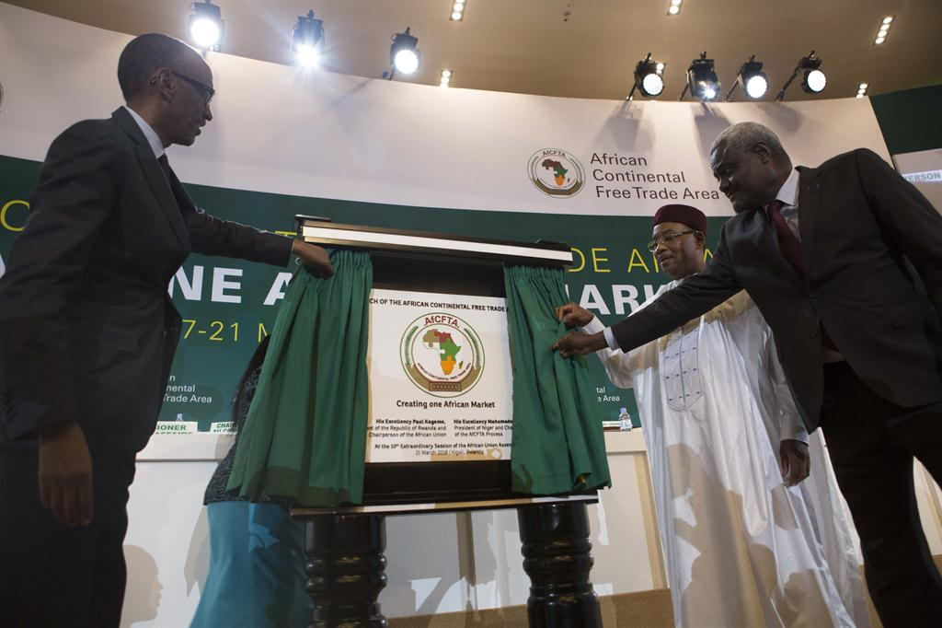

TRADE, INVESTMENT AND EXPORT
SG 2: Build mutually beneficial regional & global relations to advance South Africa’s trade, industrial policy & economic development objective
South Africa became the fourth(4th) country to ratify the TFTA Agreement and deposited its instrument of ratification in December 2018. The Agreement requires 14 ratifications to enter into force.
The envisaged African Continental Free Trade Area (AfCFTA) is expected to build an integrated market in Africa that will culminate in a market of more than one-billion people and a GDP of approximately US$3.3 trillion.

Slide 36

TRADE, INVESTMENT AND EXPORT
SG 2: Build mutually beneficial regional & global relations to advance South Africa’s trade, industrial policy & economic development objective
Export sales of R4.425 billion recorded against a target of R4 billion.
A total of 1 023 companies assisted into international markets.
Achieved investment pipeline of R 249.656 billion.

Slide 37
TRADE, INVESTMENT AND EXPORT
SG 2: Build mutually beneficial regional & global relations to advance South Africa’s trade, industrial policy & economic development objective
49 export awareness-raising and capacity-building initiatives were undertaken in all nine provinces of the country.
610 companies benefitted under the Global Exporters Passport Programme (GEPP) intervention.
644 clients were assisted with export information through Export Help Desk services.
729 trade leads were disseminated to exporters for supply of goods to global markets.
the dti-Export Council quarterly engagement was held in August 2018.

Slide 38
SPECIAL ECONOMIC ZONES & ECONOMIC TRANSFORMATION
SG3: Facilitate broad-based economic participation through targeted interventions to achieve more inclusive growth
A MoU between the dti and the CIPC was extended to allow the CIPC to issue B-BBEE Certificates for Exempted Micro Enterprises through self-service terminals. In February 2019, the Online CIPC Platform was expanded to ensure that the statistics for black unemployed ownership, black youth ownership, black people living in rural areas ownership, black disabled ownership and black military veterans ownership was captured. The National B-BBEE Rural and Township Economy Summit was held in July 2018. The Defence Sector Code Gazette No. 42021 aligned to the B-BBEE Act No. 53 of 2003 as amended was published in November 2018. In March 2019, the department submitted the final amendments to B-BBEE Statements 000, 300, 400 and Schedule 1 to the Minister for approval and gazetting.
Notes:
The reopening of the B-BBEE Management Development Programme for SANAS Technical Signatories took place in June 2018.
During the period between April 2018 and March 2019, 122 278 B-BBEE certificates were issued by the CIPC.

Slide 39

SPECIAL ECONOMIC ZONES & ECONOMIC TRANSFORMATION
SG3: Facilitate broad-based economic participation through targeted interventions to achieve more inclusive growth
On 28 August 2018, the Youth Employment Service (YES) initiative was gazetted for implementation through Section 9(1) of the B-BBEE Act.
The YES initiative committed activation of R522 million in personal income to youth previously unemployed and unable to contribute to the South African economy.
Since November 2018 15 715 jobs have been created under the initiative.

Slide 40
SPECIAL ECONOMIC ZONES & ECONOMIC TRANSFORMATION
SG3: Facilitate broad-based economic participation through targeted interventions to achieve more inclusive growth
the dti signed strategic partnerships (MoUs) with the Central Energy Fund Group and the Mpumalanga Provincial Department of Economic Development and Tourism under the Black Industrialist Programme.

Slide 41
Key Achievements
LEGISLATION AND REGULATION
SG 4:Create a fair regulatory environment that enables investment, trade and enterprise development in an equitable and socially responsible manner
32 education and awareness workshops were convened in all nine (9) Provinces with the aim of educating members of the communities on departmental legislation and gathering potential policy issues to be considered by the dti. the dti concluded three (3) research studies in the areas of consumer protection and credit. The department introduced an online application system to improve the registration of liquor licenses.

Slide 42
Key Achievements
LEGISLATION AND REGULATION
SG 4:Create a fair regulatory environment that enables investment, trade and enterprise development in an equitable and socially responsible manner
The National Liquor Authority facilitated the signing of the Guidelines for good practice to encourage companies to align their involvement and practices with the South African governments integration and development objectives on the continent and build mutual confidence.

Slide 43
ADMINISTRATION AND CO-ORDINATION
SG 5: Promote a professional, ethical, dynamic and competitive and customer–focused working environment that ensures effective and efficient services delivery
All eligible creditor payments processed well within 30 days.
Female SMS
  Women in SMS at 54% against annual target of 50%.
⬆
  The number of people with disabilities employed was at 3.8% against annual target of 3.6%.
People with Disabilities

Slide 44
FINANCIAL PERFORMANCE

Slide 45
FINANCIAL PERFORMANCE
The department spent 99.6% of its allocated budget of R9.5 billion.
This spending pattern should be considered in the context of the Departmental cost drivers, comprising of:
66.55% or R6.3 billion transferred to beneficiaries across the various incentive scheme programmes;
15.41% or R1.5 billion to other transfer payments – comprising of departmental agencies, foreign governments and international organisations, and others;
The remaining 17.85% was utilised for operational expenditure.

Slide 46
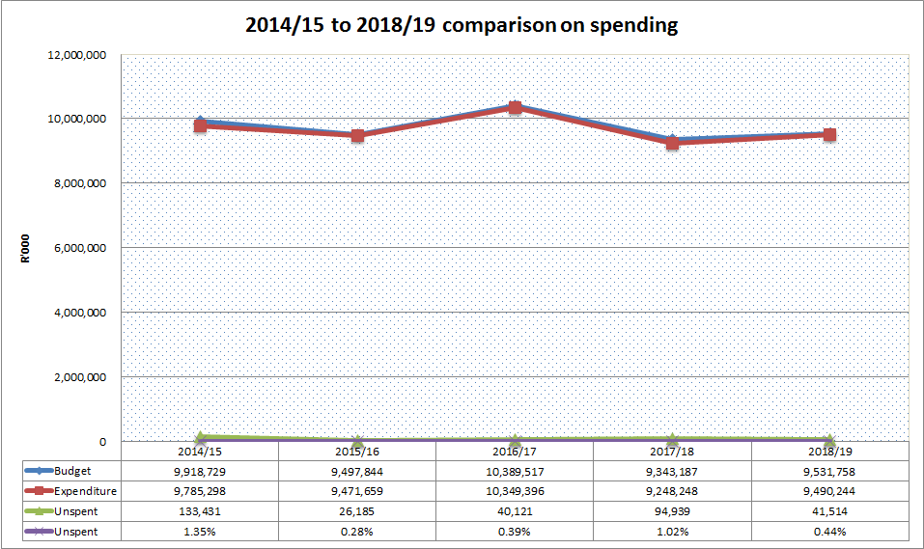
FINANCIAL PERFORMANCE…..Cont
As depicted in the graph above, there has been consistency in the spending pattern of the department against its budgetary allocation over the past five years, where the under-spending has been below 2% of the allocated budget for each specific year.

Slide 47
FINANCIAL PERFORMANCE…..Cont
Programme | Final Appropriation | Actual Expenditure | Variance | Expenditure as % of final appropriation
 | R'000 | R'000 | R'000 | %
1. Administration | 819 163 | 813 518 | 5 645 | 99.3%
2. International Trade and Economic Development | 122 093 | 122 075 | 18 | 99.9%
3. Special Economic Zones and Economic Transformation | 136 100 | 121 963 | 14 137 | 89.6%
4. Industrial Development | 2 018 645 | 2 018 625 | 20 | 99.9%
5. Consumer and Corporate Regulation | 324 443 | 323 846 | 597 | 99.8%
6. Incentive Development and Administration | 5 571 701 | 5 560 651 | 11 050 | 99.9%
7. Trade and Investment South Africa | 460 818 | 460 194 | 624 | 99.9%
8. Investment South Africa | 78 795 | 69 372 | 9 423 | 88.0%
Total | 9 531 758 | 9 490 244 | 41 514 | 99.6%

Slide 48

Audit Report
the dti achieved a financially unqualified opinion with no findings, commonly known as a “clean audit” opinion. This means that the Department's 2018/2019 financial statements were free from material misstatements and there were no material findings reported on performance objectives or non-compliance with legislation.

Slide 49
2019/20 FIRST QUARTER REPORT

Slide 50
Key Achievements
INDUSTRIAL DEVELOPMENT
SG 1: Facilitate transformation of the economy to promote industrial development, investment, competitiveness and employment creation
Electro-Technical
As a critical vote of confidence in the SA economy, Defy committed to investing R1 billion in the next five (5) years.
Defy Top Loader washing machine was launched by the dti in April 2019.
Plastics
Volkswagen Group South Africa has invested R70.9-million towards the development of black-owned component suppliers and one of the funded companies produce plastic automotive components.

Slide 51
Key Achievements
INDUSTRIAL DEVELOPMENT
SG 1: Facilitate transformation of the economy to promote industrial development, investment, competitiveness and employment creation
Pharmaceuticals and Medical Devices
Johnson and Johnson signed a MoU with Chemical Process Technologies (CPT) to enhance the synthesis pathway for the manufacture of the Active Pharmaceutical Ingredient (API) to treat Multi-Drug Resistant Tuberculosis (MDR-TB) opening up the opportunity for further collaborative projects.
Notes:
First new Antiretroviral (ARV) regime manufactured in SA for supply from July 2019.

Slide 52
Key Achievements
INDUSTRIAL DEVELOPMENT
SG 1: Facilitate transformation of the economy to promote industrial development, investment, competitiveness and employment creation
Textiles, Clothing, Leather and Footwear
Edcon introduced a Sustainable Cotton Cluster (SCC) programme which brings together the entire cotton value chain and was formed as a coordinated platform for cotton, textile and retail value chain stakeholders to formulate strategies which would ensure growth and stability in the sector.
Notes:
Committed to 2200 tons of cotton lint for the 2019/20 year which will in turn serve as a catalyst for major economic activity, employment and social development in the Mpumalanga and KwaZulu-Natal (KZN) regions.

Slide 53
Key Achievements
INDUSTRIAL DEVELOPMENT
SG 1: Facilitate transformation of the economy to promote industrial development, investment, competitiveness and employment creation
Incentives
the dti leveraged R18.06 billion of investment, with R9.1 billion towards Industrial Infrastructure and R43.93 million towards Innovation/Technology Development.
158 enterprises/projects were approved for financial support across all incentives to a value of R2.8 billion.
Number of jobs supported from approved projects is 19 638 with 15 962 being jobs to be retained and 3 676 is new jobs created.

Slide 54
TRADE, INVESTMENT AND EXPORT
SG 2: Build mutually beneficial regional & global relations to advance South Africa’s trade, industrial policy & economic development objective
11 Technical Working Group sessions conducted on the Ease of Doing Business. Technical Working Group on Construction Permits established. Participated in the Annual Investment Meeting in Dubai in April 2019 and awarded Best Investment Project Award. Presidential launch of R3 billion Navara production plant in April 2019 in Rosslyn.

Slide 55
TRADE, INVESTMENT AND EXPORT
SG 2: Build mutually beneficial regional & global relations to advance South Africa’s trade, industrial policy & economic development objective
Inward Japanese Mission in May 2019 and SA-UAE Business Forum in June 2019. Participated in SADC Business Forum and presented at Investment Forum in Portugal in May 2019. Technical Mission on Electronics & Clothing & Textile to Turkey in April 2019 and Brazil & Investment Presentation in Sao Paulo in June 2019. Launch of BPS and investor targeting meetings in New York & Las Vegas, USA in June 2019.

Slide 56
TRADE, INVESTMENT AND EXPORT
SG 2: Build mutually beneficial regional & global relations to advance South Africa’s trade, industrial policy & economic development objective
Entry into force of the African Continental Free Trade Agreement (AfCFTA).
Conclusion of Tripartite Free Trade Agreement (TFTA) bilateral tariff negotiations between Southern African Customs Union (SACU) and the East African Community (EAC).
Implementation of South Africa-China Joint Economic and Trade Committee consensus in June 2019.
Notes:
Analytical Skills Development Course for African States Parties was held from in May 2019 in conjunction with the Non-Proliferation Council; trained 22 scientists from 14 countries on basic analytical techniques, and use of certain laboratory equipment required for the analysis of toxic chemicals.
South Africa’s key positions were reflected in the joint statement of the G20 Trade Ministers and Digital Economy Ministers meetings.
In April 2019, the United State (US) Trade Representative’s Office excluded South Africa from watch list it deems intellectual property rights violators.
In May 2019, facilitated exchange with US on US concerns with Copyrights and Performers Protection Bills to avoid negative outcome on review SA’s Generalised System of Preferences (GSP) eligibility.
In June 2019, the Ambassador of Japan to South Africa announced Japan’s intention to extend the Automotive Supplier Development Training Program in SA for another 2 years.
Implementation of consensus of the SA-Japan Joint Study on Economic Cooperation: Extension of Automotive Supplier Development Program: On 13 June 2019 the Ambassador of Japan to South Africa announced Japan’s intention to extend the Automotive Supplier Development Training Program in SA for another 2 years.
Implementation of South Africa-China Joint Economic and Trade Committee consensus: in June 2019, South Africa held a bilateral meeting with People’s Republic of China, in Cape Town.
Technical visit to Saudi Arabia to negotiate an Investment Facilitation Framework MOU.
United Arab Emirates (UAE) Minister of Economy led a high-level business delegation to SA to implement their $10 billion investment pledge.
Facilitated export sales of R1,282 bn

Slide 57
TRADE, INVESTMENT AND EXPORT
SG 2: Build mutually beneficial regional & global relations to advance South Africa’s trade, industrial policy & economic development objective
A Study on Policy Options for a Future Trade and Investment Relationship between South Africa and USA was completed. A Memorandum on the Study and its recommendations was submitted to Cabinet.
Export sales of R1.282 billion recorded against a target of R1.1 billion.
A total of 304 companies assisted under EMIA.
Achieved investment pipeline of R59.123 billion.
Notes:
Hosted a National Pavilion at Latin American Aerospace and Defence (LAAD) Exhibition in April 2019, in collaboration with the Aerospace, Maritime and Defense (AMD) Association. Participants reported R71million in projected sales after 6 months as a result of engagements and positive trade leads received.
Participated at Offshore Technology Conference (OTC) in Houston in May 2019. 222 trade leads were gathered and anticipated export sales reported by the respective companies is estimated at R175,5m, with R3m committed at the National Pavilion.
the dti led and hosted a Procurement Delegation of about 30 Chinese companies in Cape Town in June 2019. The procurement mission resulted in contracts to the value of about R27 billion being signed between Chinese and South African companies.
In collaboration with United Arab Emirates Ministry of Economy and the Embassy of UAE in South Africa coordinated and participated in the South Africa – UAE Business Forum held in June 2019 in which 65 UAE companies and more than 200 South African companies from sectors such as agriculture, mining, tourism, construction, energy and defence participated. This event was held on the side line of the Africa Big Seven Exhibition.
Facilitated a National Pavilion to DRC for DRC Mining Week in June 2019. The export sales reported after the event were R 1 542 226,76 and estimated export sales 6 months after the event is estimated at R278,140,000.
Facilitated a National Pavilion at Africa Big 7, one of the largest food and beverage shows on the African continent which took place at Gallagher Conference Centre at Midrand in June 2019. The companies which were financially supported by Export Marketing & Investment Assistance scheme (EMIA) to participate at this pavilion were 23, 2 of which were women-owned companies and 4 black- owned.

Slide 58
TRADE, INVESTMENT AND EXPORT
SG 2: Build mutually beneficial regional & global relations to advance South Africa’s trade, industrial policy & economic development objective
20 emerging exporters graduated from the GEPP to participate later in the year as a pilot in the German Managers’ Programme.
A total of 107 trade leads were disseminated to exporters.
Successful Outward Trade and Investment Mission to Uganda in May 2019. The mission resulted in R180m worth of export sales reported after the mission and an estimated R208m of export sales projected after six months.
Notes:
Hosted a National Pavilion at Latin American Aerospace and Defence (LAAD) Exhibition in April 2019, in collaboration with the Aerospace, Maritime and Defense (AMD) Association. Participants reported R71million in projected sales after 6 months as a result of engagements and positive trade leads received.
Participated at Offshore Technology Conference (OTC) in Houston in May 2019. 222 trade leads were gathered and anticipated export sales reported by the respective companies is estimated at R175,5m, with R3m committed at the National Pavilion.
the dti led and hosted a Procurement Delegation of about 30 Chinese companies in Cape Town in June 2019. The procurement mission resulted in contracts to the value of about R27 billion being signed between Chinese and South African companies.
In collaboration with United Arab Emirates Ministry of Economy and the Embassy of UAE in South Africa coordinated and participated in the South Africa – UAE Business Forum held in June 2019 in which 65 UAE companies and more than 200 South African companies from sectors such as agriculture, mining, tourism, construction, energy and defence participated. This event was held on the side line of the Africa Big Seven Exhibition.
Facilitated a National Pavilion to DRC for DRC Mining Week in June 2019. The export sales reported after the event were R 1 542 226,76 and estimated export sales 6 months after the event is estimated at R278,140,000.
Facilitated a National Pavilion at Africa Big 7, one of the largest food and beverage shows on the African continent which took place at Gallagher Conference Centre at Midrand in June 2019. The companies which were financially supported by Export Marketing & Investment Assistance scheme (EMIA) to participate at this pavilion were 23, 2 of which were women-owned companies and 4 black- owned.

Slide 59
SPECIAL ECONOMIC ZONES & ECONOMIC TRANSFORMATION
SG3: Facilitate broad-based economic participation through targeted interventions to achieve more inclusive growth
Broad-Based Black Economic Empowerment (B-BBEE) B-BBEE Sector Codes of Good Practice were re-gazetted for implementation in April 2019. The change means that entities in the defence sector will be measured in terms of the Defence Sector Code and not the Generic Codes. Changes to the Amended B-BBEE Codes of Good Practice with a six (6) month Transitional Period gazetted in May 2019.
Notes:
Changes to the Amended B-BBEE Codes of Good Practice with a 6 Month Transitional Period gazetted in May 2019. The changes are in Statement 000, Statement 300, Statement 400 and Schedule 1 of the Amended Codes of Good Practice.
Draft Chartered Accountancy Sector Codes of Good Practice for 60 day public commentary period gazetted in April 2019.
A total of 26 389 Companies and Intellectual Property Commission (CIPC) B-BBEE Exempted Micro Enterprise (EME) Certificates have been issued through the different CIPC channels during the quarter under review.

Slide 60
SPECIAL ECONOMIC ZONES & ECONOMIC TRANSFORMATION
SG3: Facilitate broad-based economic participation through targeted interventions to achieve more inclusive growth
Equity Equivalent Investments Programme (EEIP) Samsung EEIP was launched in May 2019 for a total investment of R280 million. the dti approved the EEIP for Mediterranean Shipping company SA for a total investment of R116 million which will focus on critical skills development and enterprise & supplier development for black beneficiaries.
Notes:
Changes to the Amended B-BBEE Codes of Good Practice with a 6 Month Transitional Period gazetted in May 2019. The changes are in Statement 000, Statement 300, Statement 400 and Schedule 1 of the Amended Codes of Good Practice.
Draft Chartered Accountancy Sector Codes of Good Practice for 60 day public commentary period gazetted in April 2019.
A total of 26 389 Companies and Intellectual Property Commission (CIPC) B-BBEE Exempted Micro Enterprise (EME) Certificates have been issued through the different CIPC channels during the quarter under review.

Slide 61
SPECIAL ECONOMIC ZONES & ECONOMIC TRANSFORMATION
SG3: Facilitate broad-based economic participation through targeted interventions to achieve more inclusive growth
Cabinet Progress Report on the Implementation of the Special Economic Zones (SEZs) in SA was developed and presented to the Economic Cluster in April 2019. Ekandustria and Nkowankowa Industrial Parks were launched in April 2019. Draft Industrial Parks policy framework developed.

Slide 62
SPECIAL ECONOMIC ZONES & ECONOMIC TRANSFORMATION
SG3: Facilitate broad-based economic participation through targeted interventions to achieve more inclusive growth
21 (non-financial) interventions to support BIs in the IPAP Sectors. The department in partnership with Sandvik took five (5) Black Industrialists to Finland in June 2019 to explore mining opportunities. Approval of Pick n Pay & Nedbank Black Industrialist Program to assist Mini-Black Industrialists that are in the agro-processing space with both financial and non-financial support. This programme will cater for Black Industrialists that are below R30 million current threshold.

Slide 63
Key Achievements
LEGISLATION AND REGULATION
SG 4: Create a fair regulatory environment that enables investment, trade and enterprise development in an equitable and socially responsible manner
A Research Forum on current practices in the motor sales industry was held in June 2019. The Credit Socio-economic Impact Assessment (SEIAS) study has been concluded. The Patent Examination Board (PEB) examinations have been successfully completed. The examinations were written from 26 June to 09 July 2019.

Slide 64
ADMINISTRATION AND CO-ORDINATION
SG 5: Promote a professional, ethical, dynamic and competitive and customer–focused working environment that ensures effective and efficient services delivery
All eligible creditor payments processed well within 30 days.
Female SMS
  Women in SMS at 54% against quarterly target of 49%.
⬆
  The number of people with disabilities employed was at 3.9% against quarterly target of 3.55%.
People with Disabilities

Slide 65
FINANCIAL PERFORMANCE 30 JUNE 2019

Slide 66
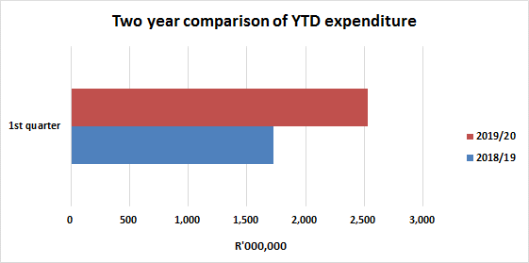
FINANCIAL PERFORMANCE
30 June 2019 marks the end of the first quarter of the 2019/20 financial year, where expenditure compared with the actual drawings of R2.7 billion is R2.5 billion or 93.6 per cent. When compared with the same period of the 2018/19 financial year, expenditure was R1.7 billion or 81.4 per cent of the actual drawings of R2.1 billion.
Notes:
At the end of the third quarter of the 2018/19 financial year, expenditure compared with the year-to-date projections of R6.2 billion stood at R6.1 billion or 99.1%. During the same period of the 2017/18 financial year, expenditure was R6.2 billion or 87% against the projected budget of R7.1 billion.
Spending on other programmes is on track, however, a lag in the projections continues on programme 3 due to delays in the listing of the B-BBEE Commission. Spending in this area is being monitored on a continuous basis.
It should be noted that although for some programmes and economic classification, the recorded expenditure is more than the YTD projections - spending is still within the allocated budget.

Slide 67
FINANCIAL PERFORMANCE
Financial performance per economic classification
Of the R2.5 billion spent by the department, other transfer payments, which includes transfers to departmental entities to aid in the fulfilment of the set mandates accounted for 53 per cent (R1.3 billion), followed by 32 per cent (R810.3 million) disbursed to the beneficiaries across the various incentive scheme programmes.
Operational spending, which comprises mainly of compensation of employees, and goods and services accounted for 9 per cent (R230.5 million) and 6 per cent (R146.5 million) respectively.
Notes:
Economic classification: Reasons for variance
Compensation of employees. As at 31 December 2018, the department’s expenditure on Compensation of Employees was R725,4 million or 98 percent of the YTD projections of R739,6 million resulting in a variance of R14,3 million or 1,9 percent. This is a positive indication that spending is on track.
Goods and services. As at 31 December 2018, expenditure on Goods and Services, compared to the YTD projections was R488,8 million or 101,8 percent of the YTD projections of R480,4 million. However, it should be noted that although expenditure is more than the YTD projections, it is still within the allocated budget.
Transfers and subsidies. As at 31 December 2018, the department’s expenditure on transfers and subsidies was R4,9 billion or 98,9 percent of the YTD projections of R5 billion resulting in a variance of R54,3 million or 1,1 percent. This is a positive indication that spending is on track.
Payments for capital assets. As at 31 December 2018, the department’s spending on payments for capital assets was R10,1 million against the YTD projections of R6,8 million. However, it should be noted that although expenditure is more than the YTD projections it is still within the allocated budget.
The spending on incentives as at 30 September 2018 was R1.2 billion or 59.2% of the YTD projections of R2.1 billion.
A lag in the projections is mainly due to non-compliant claims which were agreed at application and formed part of the approval, but not met when the claims were received from claimants.
Another reason is outstanding compliance documentation (i.e. BEE and tax clearance certificates) from claimants.
On a brighter note, the reprioritization of funds to performing incentive programmes, was carried out as part of the mid-term budget review.
This will result in increased support for the clothing, textile, footwear, leather and leather goods manufacturing industries as well as the film industry in its contribution towards employment opportunities in South Africa.
Managed through the Investment South Africa (ISA) division, funding has been provided for the implementation of 3 additional provincial One Stop Shops in Mpumalanga, Free State and Eastern Cape.
On the front of department’s entities, support was provided for the NRCS, NCC, SABS and NCT for activities planned to be delivered by March 2019.
In line with the budget processes, these adjustments will come into effect once the Adjusted Appropriation Act is assented to by the President.

Slide 68
FINANCIAL PERFORMANCE
Financial performance per programme
Programme | Adjusted Budget 2018/19 | Year-to-date (YTD) |  |  |  | Available budget | % budget available
 |  | Actual Drawings | YTD Expenditure | Variance (Budget less expenditure) | % variance
 | R’000 | R’000 | R’000 | R’000 | % | R’000 | %
Administration | 803,475 | 191,846 | 185,112 | 6,734 | 3.51% | 618,363 | 76.96%
International Trade and Economic Development | 130,405 | 25,768 | 25,672 | 96 | 0.37% | 104,733 | 80.31%
Special Economic Zones and Economic Transformation | 171,458 | 28,508 | 24,681 | 3,827 | 13.42% | 146,777 | 85.61%
Industrial Development | 2,100,814 | 1,273,638 | 1,272,036 | 1,602 | 0.13% | 828,778 | 39.45%
Consumer and Corporate Regulation | 328,319 | 258,896 | 259,048 | (152) | (0.06%) | 69,271 | 21.10%
Incentive Development Administration | 6,026,061 | 661,306 | 509,077 | 152,229 | 23.02% | 5,516,984 | 91.55%
Trade and Investment South Africa | 440,456 | 251,612 | 240,239 | 11,373 | 4.52% | 200,217 | 45.46%
Investment South Africa | 58,039 | 11,683 | 13,406 | (1,723) | (14.75%) | 44,633 | 76.90%
Total | 10,059,027 | 2,703,257 | 2,529,272 | 173,985 | 6.44% | 7,529,755 | 74.86%
Notes:
Incentives performance
The spending on incentives as at 30 September 2018 was R1.2 billion or 59.2% of the YTD projections of R2.1 billion.
A lag in the projections is mainly due to non-compliant claims which were agreed at application and formed part of the approval, but not met when the claims were received from claimants.
Another reason is outstanding compliance documentation (i.e. BEE and tax clearance certificates) from claimants.
On a brighter note, the reprioritization of funds to performing incentive programmes, was carried out as part of the mid-term budget review.
This will result in increased support for the clothing, textile, footwear, leather and leather goods manufacturing industries as well as the film industry in its contribution towards employment opportunities in South Africa.
Managed through the Investment South Africa (ISA) division, funding has been provided for the implementation of 3 additional provincial One Stop Shops in Mpumalanga, Free State and Eastern Cape.
On the front of department’s entities, support was provided for the NRCS, NCC, SABS and NCT for activities planned to be delivered by March 2019.
In line with the budget processes, these adjustments will come into effect once the Adjusted Appropriation Act is assented to by the President.

Slide 69
FINANCIAL PERFORMANCE
As depicted on previous slides, expenditure is largely on track with most Divisions spending within a 10% variance of actual drawings. This is an improvement as compared with the same period of the 2018/19 financial year.
In line with prior years expenditure trends, spending on the incentive programmes is lower at the beginning of a financial year and improves as the year progresses.
Spending is closely monitored and there are continuous engagements with Divisions to ensure that spending is largely on track in line with performance objectives.

Slide 70
Thank you
Ngiyathokoza
Ke a leboha
Ke a leboga
Siyabonga
Inkomu
Ndo livhuwa
Enkosi
Ngiyabonga
Dankie

