Slide 1
Expenditure trends (2013/14-2018/19)
&
Expenditure for
Quarter 1 of 2019/20
Portfolio Committee meeting
08 October 2019

Slide 2
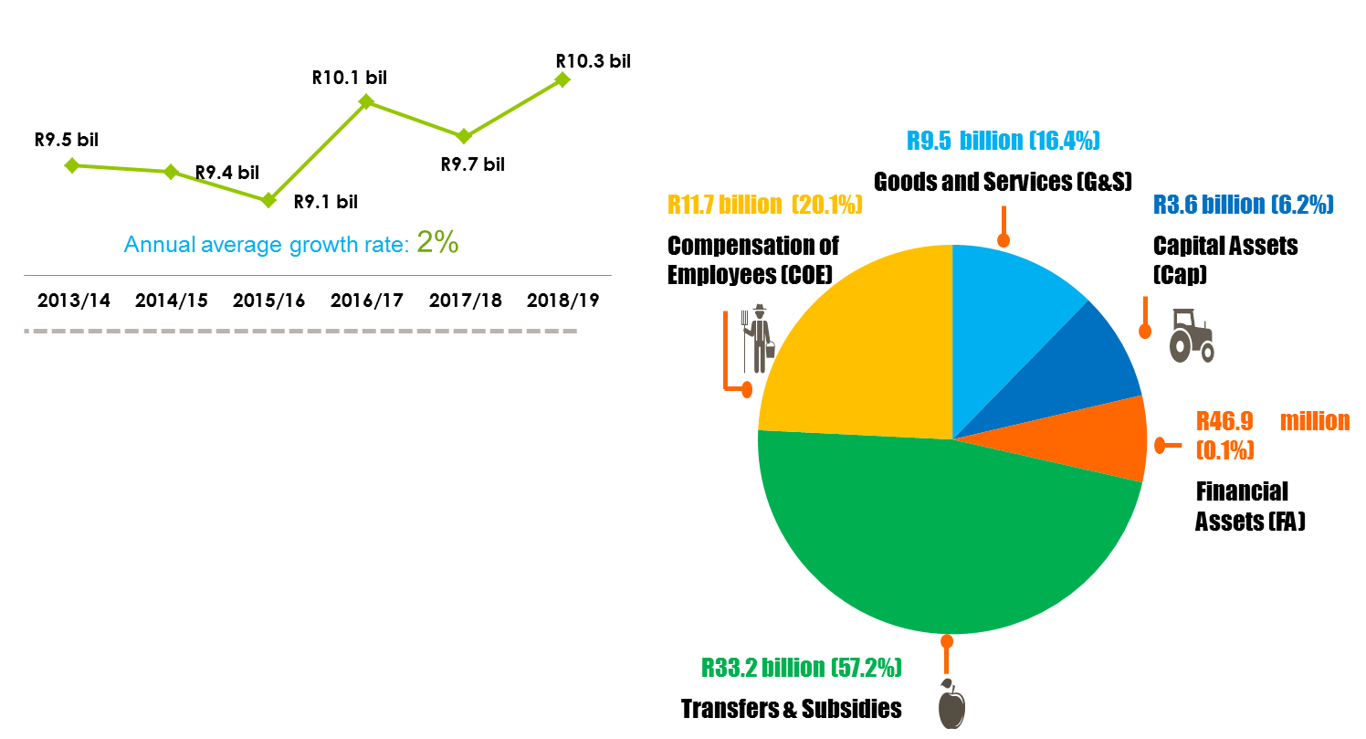
Expenditure by financial year
Total expenditure & percentage share by econ class
2013/14- 2018/19
(2013/14-2018/19)
2015/16: Unspent funds were mainly due to delays experienced in the rural development projects.
2016/17: Unspent funds were due to vacant posts.
2017/18 & 2018/19: Unspent funds due to vacant posts and delays experienced in the commencement of new office building construction.
Corrective measures;
Priorities and fast track implementation of rural development project (e.g. FPSUs)
Vacant posts- fast track of recruitment process (reconfiguration might hinder this measure during 2019/20);
Bilateral meeting between the Department’s Minister and the Minister of Finance to approve concurrence letter to start with construction of the new office building

Slide 3
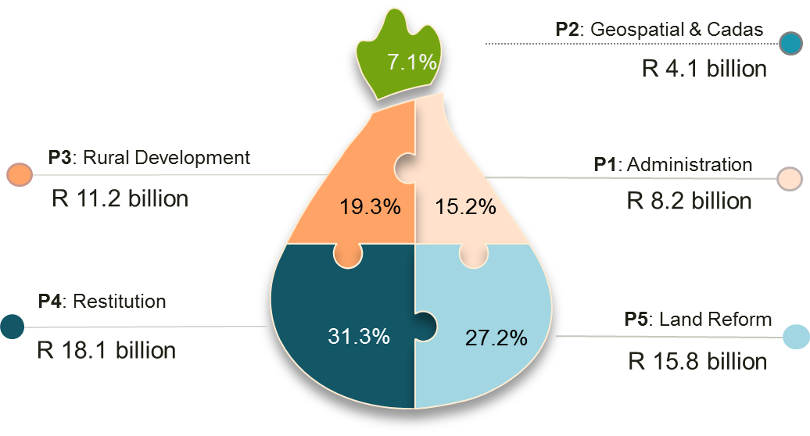
Expenditure & percentage share by programme (2013/14-2018/19)
Total Spent: R58 million
Stats SA

Slide 4
2018/19 Performance Progress
2018/19 Performance Progress
Against annual targets
Against annual targets
& expenditure
73% achieved
(26 targets achieved)
27% not achieved
(19 targets not achieved)
4

Slide 5
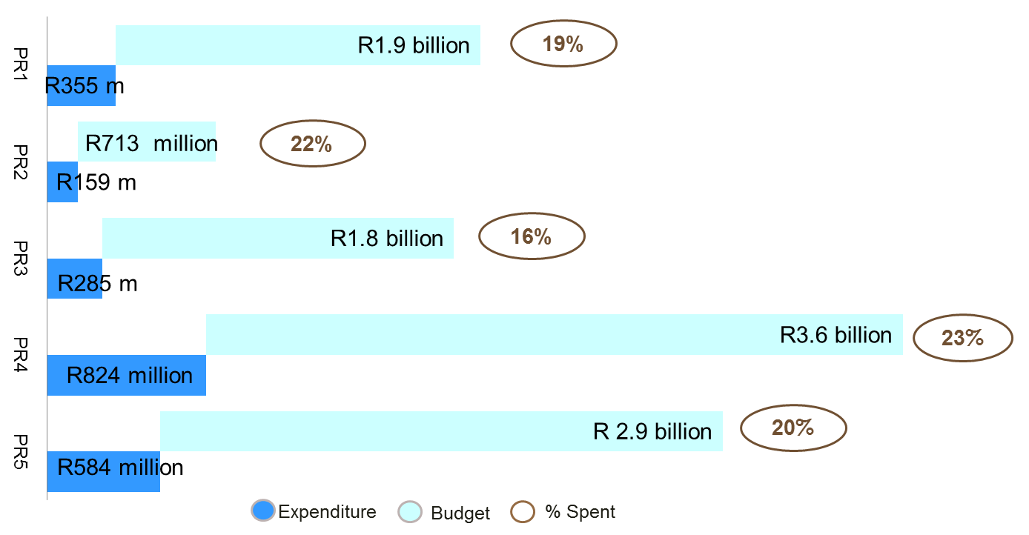
Q1 of 2019/20: Expenditure by Programme
Budget:R10.9 billion
Actual: R2.2 billion
Available: R8.7 billion
% Spent: 20%

Slide 6
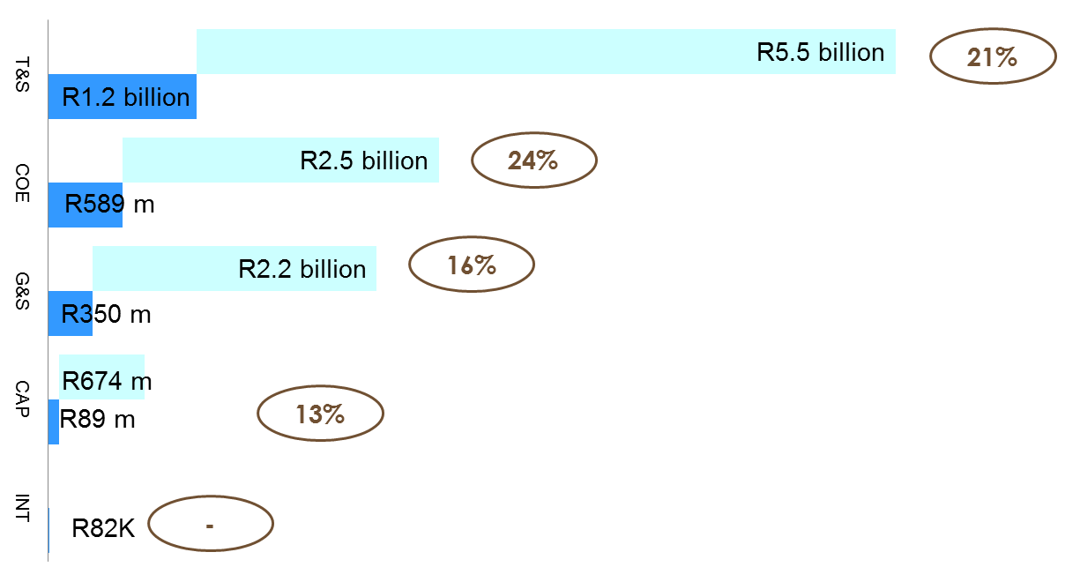
Q1: Expenditure by Economic Class
Total Spent: R2.2 billion

Slide 7
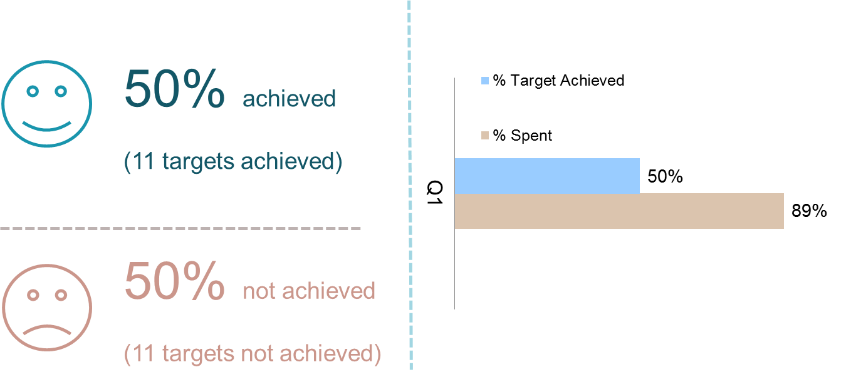
Q1 Performance Progress
Q1 Performance Progress
Against quarterly targets
Performance against quarterly targets
&
Expenditure against quarterly drawings
7

Slide 8

Q1: Key achievement
Support programmes
Core services programmes
A total of 1 479 jobs (RID: 390 plus REID: 1 089) were created in rural development initiatives
Rural infrastructure projects that were facilitated included Construction of Park Homes, Drainage System and Installation of New Sub-soil Pipes & Fencing;
A total of 31 496.2804 hectares were acquired;
Eight (8) smallholder farmers beneficiaries were allocated land;
Seventy one (71) land claims were finalised; and 59 claims were settled.
95% of valid invoices were paid within 30 days;
Synthesis report for the Land Use Master Plan for Land Reform and conduct stakeholder engagement through the National Spatial Development Framework (NSDF) indaba;
Notes:
C

Slide 9
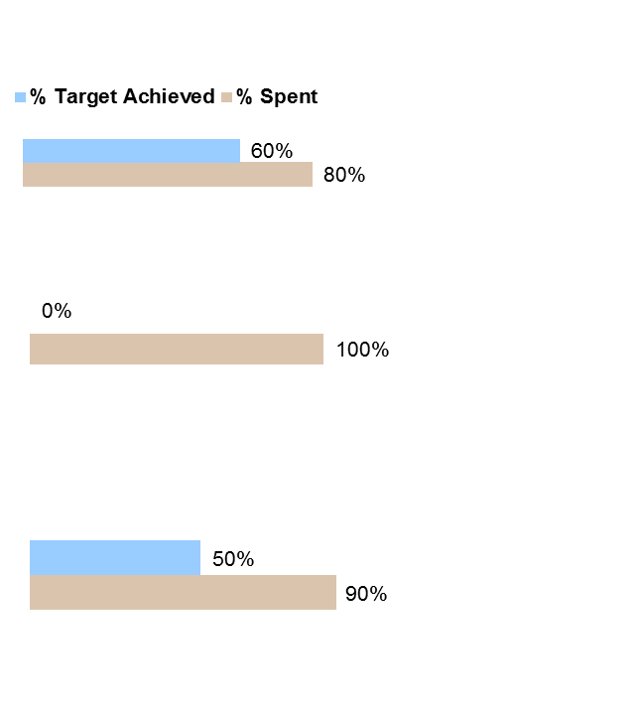
Q1: Performance Progress
Q1: Challenges
Core Service programmes against quarterly targets & expenditure
Potential Impact on Service delivery
Rural Development
Compared to drawings, spending at 80%;
Re-advertising of tenders due to abnormally high pricing escalations; and delays in confirmation of land ownership by some local municipalities before start infrastructure construction
Stats SA
Restitution
Compared to drawings, spending was on track;
Delays in obtaining outstanding documents due to tracing of beneficiaries and rejected offers had impact on service delivery.
Land Reform
Compared to drawings, spending at 90%;
Transfer to Agricultural Land Holding Account (ALHA), R351 million;
50 per cent of the quarterly targets achieved;
Prolonged consultation with affected 1Household 1Hectare stakeholders; untraceable labour tenant applicants had impact on service delivery.
58,1%

Slide 10
AUDITOR GENERAL : 5 YEAR PERIOD AUDIT REPORTS
2014/15- 2018/19 - DRDLR
2014/15
UNQUALIFIED
2015/16
UNQUALIFIED
2016/17
UNQUALIFIED
2017/18
UNQUALIFIED
2018/19
UNQUALIFIED

Slide 11
OVERVIEW OF 2018/19 MANAGEMENT REPORT: DRDLR
OVERVIEW OF MANAGEMENT REPORT
RESPONSES TO THE REPORT OF THE AUDITOR - GENERAL
DRDLR had 63 audit findings during the 2018/19 statutory audit all of which relate to programmes of the department
16 of the 2018/19 audit finding are repeat findings from prior years and 24 out of 63 of the 2018/2019 audit findings have been resolved.
The only findings not yet fully resolved is because of following reason:
  Management is in process of developing management action plan to address root cause or either the implementation is still in progress.

Slide 12
REPEAT AUDIT FINDINGS
Finding Name | Number of repeats | Management Action Plans
Expenditure: Payments made after 30 days of receipt of invoice | 1 | Training of role players on the system in Provinces and national Enforce the nodal point of receiving invoices Order to reflect the email or physical address where invoices should be submitted No client office should receive or accept invoices from suppliers. Issue circular setting turnaround times as follows; one day to upload an invoice, 3days for client to certify the invoice
Expenditure: Payments made after 30 days of receipt of invoice | 1 | Training of role players on the system in Provinces and national Apply consequence management Create and enforce one nodal invoice receipt point for both BAS and Logis payments Order to reflect the email or physical address where invoices should be submitted No client office should receive or accept invoices from suppliers Engage Invoice Tracking system developer to resolve system errors/functionality

Slide 13
REPEAT AUDIT FINDINGS
Finding Name | Number of repeats | Management Action Plans
Expenditure: Payments made after 30 days of receipt of invoice | 1 | Training of role players on the system in Provinces and national Apply consequence management Create and enforce one nodal invoice receipt point for both BAS and Logis payments Order to reflect the email or physical address where invoices should be submitted No client office should receive or accept invoices from suppliers Engage Invoice Tracking system developer to resolve system errors/functionality. issue circular setting turnaround times as follows; one day to upload an invoice, 3days for client to certify the invoice
Disclosure: Unrecorded Principle-Agent Considerations | 1 | The internal review process of the annual financial statements will be strengthened. The annual financial statements will be reviewed by Internal Audit are finalised and submitted to the AG and National Treasury. There will be continuous engagement with the National Treasury and the AG on the correct interpretation of the accounting standards to avoid Misstatement,
Assets: Non-disclosure of prior period errors on RID assets WIP | 1 | The Branch to ensure Prior Period Error Notes on RID Asset WIP are disclosed during the Interim and Final Audit Reporting.

Slide 14
REPEAT AUDIT FINDINGS
Finding Name | Number of repeats | Management Action Plans
Commitment: Incomplete disclosure of Commitment | 1 | Perform quarterly review sessions Perform month / quarterly / annual reconciliations Provided quarterly and annual feedbacks on reports & reconciliations Recons should be reviewed and signed off by the relevant senior manager
Disclosure: Misstatement on commitments | 1 | Perform quarterly review sessions Perform month / quarterly / annual reconciliations Provided quarterly and annual feedbacks on reports & reconciliations Recons should be reviewed and signed off by the relevant senior manager
Commitment: Overstatement of commitment | 1 | Perform quarterly review sessions Perform month / quarterly / annual reconciliations Provided quarterly and annual feedbacks on reports & reconciliations Recons should be reviewed and signed off by the relevant senior manager
Irregular expenditure: Unrecorded irregular expenditure and lack of consequence management | 1 | Roll-out of policies awareness on the quarterly basis by internal control Detected cases of Non –compliance will be referred to FCC by QC FCC will investigate non-compliance further Where officials were negligence disciplinary action will be taken in line with Labour relation Where officials were found not to be negligence FCC will recommend condonment of expenditure by AO.

Slide 15
REPEAT AUDIT FINDINGS
Finding Name | Number of repeats | Management Action Plans
Good and services: Financial statements for the Commission for Restitution of Land Rights were not submitted | 1 | 1. Finance to follow up with CFO regarding the memorandum for the application of exception of submission of AFS for Commission as an Entity. It must be noted as related party on AFS and not an Entity
AOPO: Programme 2 - Average number of working days taken to process registerable diagrams, sectional plans and general plans (Accuracy) | 1 | PPM to seek clarity on the report template to avoid future errors during transcription.
Inadequacies identified within the Network (Active Directory) and EPMO user access management processes | 2 | Development of SOPs will be done for linking of user account forms to the user for better reporting. Development of SOPs for the monitoring of accounts will be done.
PERSAL policy in draft format only | 1 | PERSAL Policy consulted and tabled at DBC for concurrence. At last DBC meeting Labour concurred with draft policy. In process to compile memorandum to request ADGs approval for policy. Draft Policies submitted for possible discussion at NJSC planned for 14 October 2019
Identified vulnerabilities on the internal network | 1 | Although the patches have been deployed, a vulnerability tool will be procured so as to validate the implementation of the patches. The unsupported technologies are being migrated to new versions of software and the older technologies will be decommissioned.

Slide 16
REPEAT AUDIT FINDINGS
Finding Name | Number of repeats | Management Action Plans
Inadequacies identified in the firewall management process and insecure firewall rule configurations | 1 | Management is currently implementing a new firewall which will cater for the additional rule requirements. A process is currently underway to test and delete unused rules.
Eastern Cape: Assets could not be physically verified | 1 | Loss Control report to be provided quarterly to clients on all reported incidents Loss Control Committee to finalise all reported losses within 3-months after the reported incidents Quarterly asset spot checks to be performed Annual full asset verification Amend policy accordingly; upon receipt of a loss report asset management can adjust a balance on Baud System, then forward a copy of report to loss control committee to determined liability in terms of chapter 12 of Treasury Regulations Asset Management Forums to be held annually BAUD training to be held by 31 March 2020

Slide 17

AGRICULTURAL LAND HOLDING TRADING ACCOUNT (ALHA)
PORTFOLIO COMMITTEE ON ALRRD: BRIEFING ON 2018/19 ANNUAL REPORTS: 08 OCTOBER 2019

Slide 18
TABLE OF CONTENTS
Financial/ expenditure reports
  Spending trends linked to performance
  Corrective measures and actions taken to address over & under spending
  The requested adjustment for 2019/20 and explanation for the request
  The motivated forward funding requirements for 2020/21 and entire MTEF period,
Implementation of AG recommendations where there are repeat findings from AG including reasons and corrective measures to address root causes.
Implementation of Budget Review Recommendations
Performance and expenditure information for the 1st quarter of 2019/20

Slide 19
2014/15 - 2021/22 EXPENDITURE & MTEF BUDGET ALLOCATION
PER STANDARD ITEMS
STANDARD ITEMS | 2014/15 | 2015/16 | 2016/17 | 2017/18 | 2018/19 | 2019/20 | 2020/21 | 2021/22
 | AUDITED |  |  |  | AUDITED | CURRENT-MTEF PERIOD
 | R '000 | R '000 | R '000 | R '000 | R '000 | R '000 | R '000 | R '000
SLA: NORMAL | 1,203,023 | 808,504 | 481,979 | 397,028 | 583,648 | 695,593 | 625,373 | 656,643
SLA: SRR | - | - | 114,260 | 33,735 | 115,890 | - | - | -
RECAP | 219,269 | 396,050 | 344,051 | 207,832 | 109,204 | - | - | -
1HH1HA: | - | - | - | 21 173 | 44, 577 | - | - | -
SRR: GRANT | - | - | 46,951 | 89,682 | 42,537 | - | - | -
DROUGHT | - | 59,781 | 81,557 | 5,548 | - | - | - | -
LDS | - | - | - | - | 60,017 | 706,292 | 270,469 | 315,965
PLANNING COSTS | 5,595 | 29,568 | 19,156 | 5,175 | 10,541 | 10,086 | 21,211 | 22,378
ALHA GOODS AND SERVICES | 25,852 | 52,654 | 68,586 | 111,991 | 45,783 | 135 302 | 71 272 | 72 931
TOTAL | 1,453,739 | 1,346,557 | 1,156,540 | 872,164 | 1,012,197 | 1 547 373 | 983,325 | 1,064,838
ALHA GOODS AND SERVICES RELATES TO PROPERTY MANAGEMENT COSTS WHICH INCLUDES RATES AND TAXES, MAINTENANCE & REPAIRS, WATER RIGHTS

Slide 20
5 YEAR TREND ON STARTAEGIC LAND ACQUISITION
BUDGET VS EXPENDITURE (R’000)
PERCENTAGE SPEND
The downward slope on land acquisition over the years is due to the following,
rejections of offers resulting from discrepancies in the valuations of the OVG and contracted Valuers.
Redirecting of the funds to other programmes such as RADP

Slide 21
5 YEAR TREND ON RECAPITALISATION AND DEVELOPMENT
BUDGET VS EXPENDITURE (R’000)
PERCENTAGE SPEND
The steady decline in RADP ( including 1H1HH) disbursements on projects is attributed to the failure of the beneficiaries to account for the disbursed trenches, leading into delays in the release of subsequent trenches and further to account for the expenditure.

Slide 22
9.REPRIORITISATION FOR AENE 2019/20
STANDARD ITEM – EXPENDITURE | 2019/20 BUDGET | ADJUSTMENT | ADJUSTMENT BUDGET
 | R'000 | R'000 | R'000
Strategic Land Acquisition | 695,593 | 288,476 | 984,069
Land Development Support | 706,292 | 515,796 | 1,222,088
Recapitalisation and Development | - | 130,911 | 130,911
1H1H | - | 31,488 | 31,488
SRR | - | 32,327 | 32,327
ALHA IT Application solution | 25,000 | - | 25,000
Maintenance & Repairs | 15,000 | - | 15,000
Water Rights | 800 | - | 800
Rates & Taxes ALHA | 35,014 | 45,826 | 80,840
Project Management Unit | 42,514 | - | 42,514
Forensic Audit | 5,000 | - | 5,000
Curator Costs | 6,915 | - | 6,915
Planning | 10,086 | - | 10,086
Interest Expense | 5,000 | - | 5,000
Bank Charges | 59 | - | 59
Total Expenditure | 1,547,273 | 1,044,824 | 2,592,097
The department submitted a request to National Treasury to retain committed surplus funds. The implementation of the above adjustments are subject to National Treasury approval.

Slide 23
CORRECTIVE MEASURES AND ACTIONS TAKEN TO ADDRESS OVER & UNDER SPENDING
EXPLANATIONS FOR THE VARIANCES
REMEDIAL ACTIONS AND MEASURES
STRATEGIC LAND ACQUISITION: Number of hectares acquired: (Target: 14 108 : Achieved 31 490 hectares)
Target on hectares acquired for Quarter 1 on land acquisition was over achieved due to implementation of commitments.
LAND DEVELOPMENT SUPPORT (LDS): Number of farms supported through LDS (Target 24: Achieved 7)
The variance was due to the slow pace of implementation due to delays in the finalization of the opening of grant holding accounts with financial institutions and tripartite agreements.
One Household One Hectare (1HH1HA): (Target: 473: Achieved 0 )
The variance was due to the prolonged consultation process with affected stakeholders, households and finalization of production plans for the release of funds from Provincial offices.
Expedite the finalization of the remaining land acquisition commitments and transfer of farms at conveyancing phase amounting to 20 000 hectares to maintain the good performance.
A catch up plan has been developed with a redefined funds disbursement approach through the Commodity Organisations while the Hold Accounts is yet to be finalized to improve performance in this programme.
AA catch up plan will be developed to improve performance in this programme.

Slide 24
AUDITOR GENERAL : 5 YEAR PERIOD AUDIT REPORTS
2014/15- 2018/19
2014/15
UNQUALIFIED
2015/16
UNQUALIFIED
2016/17
CLEAN AUDIT
2017/18
CLEAN AUDIT
2018/19
UNQUALIFIED

Slide 25
OVERVIEW OF MANAGEMENT REPORT;

Slide 26
OVERVIEW OF 2018/19 MANAGEMENT REPORT:
OVERVIEW OF MANAGEMENT REPORT
RESPONSES TO THE REPORT OF THE AUDITOR - GENERAL
ALHA had 4 audit findings during the 2018/19 statutory audit all of which relate to submission at 1st June instead of 31 May.
1 of the 2018/19 audit finding is repeat findings from prior years and 11 out of 12 of the 2018/2019 audit findings have been resolved.
The only findings that was not yet fully resolved at year end was :
  Weakness on user access management process on ABSA Electronic Funds Transfer system. This audit finding has been addressed in the current year.

Slide 27
SIGNIFICANT ACCOUTNING POLICIES AND OTHER MATTERS
SIGNIFICANT ACCOUNTING POLICIES
OTHER MATTERS
Financial Statements are prepared in accordance with effective Standards of Generally Accepted Accounting Practice (GRAP).
The audited annual financial statements have been prepared on an accrual basis of accounting and incorporated the historical cost conventions as the basis of measurement except where specified otherwise.
The annual financial statements have been prepared n the expectation that the entity will continue to operate as a going concern for at least the next 12 months.
For prior period errors and changes in accounting policies, the corrections are made retrospectively as far as is practicable and the prior year comparatives are restated accordingly.
Management has made and disclosed estimates and assumption that affect the amounts represented in the annual financial statements and related disclosures.
The following financial statement items have accounting policies that are specific in accordance with the relevant standard of GRAP.
The GRAP on Accounting by Principles and Agents has been early adopted by the entity.

Slide 28
AGRICULTURAL LAND HOLDING ACCOUNT
(ALHA)
QUARTER 1
FINANCIAL PERFORMANCE AS AT 30 JUNE 2019

Slide 29
2019/20 EXPENDITURE PER CATEGORY AS AT 30 JUNE 2019
R’000
The total expenditure for Quarter 1 is R R276, 588 million against R1.4 billion budget for the year 2019/20 representing 19% spending with a variance of 6% against the linear target of 25%.
Variances
Land Acquisition: variance is due to the outstanding transfers and rejections of offers during negotiations.
Land development support variance is due to the opening of the farmers hold accounts to transfer funds for spending. Awaiting National Treasury for clarification of PFMA section 66 compliance.
Planning variance is linked to the land acquisition rejection of offers
RADP and 1HH1HA commitments variance is due to the submission of invoices to release subsequent trenches

Slide 30
2019/20 EXPENDITURE PER PROVINCE AS AT 30 JUNE 2019
CONSOLIDATION | BUDGET | EXPENDITURE | UNDER /(OVER) SPENT | % SPENT
Eastern Cape | 153,696 | 13,985 | 139,711 | 9%
Free State | 207,475 | 4,223 | 203,252 | 2%
Gauteng | 146,307 | 13,275 | 133,032 | 9%
KwaZulu-Natal | 150,385 | 341 | 150,044 | 0%
Limpopo | 168,135 | 6,271 | 161,864 | 4%
Mpumalanga | 101,123 | 24,458 | 76,665 | 24%
Northern Cape | 126,463 | 36,506 | 89,958 | 29%
North West | 122,947 | 94,520 | 28,427 | 77%
Western Cape | 94,148 | - | 94,148 | 0%
Head Office (Funded from Grant) | 165,289 | 83,009 | 52,259 | 50%
TOTAL ALLOCATION | 1,435,968 | 276,588 | 1,129,359 | 19%

Slide 31
PLANNING– PROVINCIAL
PROVINCE | ENE BUDGET 2019/20 | CURRENT YEAR EXPENDITURE | UNDER/OVER SPENT | % SPENT
 | R’000 | R’000 | R’000 | %
Eastern Cape | 2,617 | 681 | 1,936 | 26%
Free State | 3,260 | 72 | 3,188 | 2%
Gauteng | 2,181 | 234 | 1,947 | 11%
KwaZulu-Natal | 2,763 | 341 | 2,422 | 12%
Limpopo | 2,846 | 142 | 2,704 | 5%
Mpumalanga | 1,822 | 189 | 1,633 | 10%
Northern Cape | 2,936 | 233 | 2,703 | 8%
North West | 1,534 | - | 1,534 | 0%
Western Cape | 1,428 | - | 1,428 | 0%
Total | 21,386 | 1,891 | 19,495 | 9%

Slide 32
HEAD OFFICE EXPENDITURE
DESCRIPTION | ENE BUDGET 2019/20 | CURRENT YEAR EXPENDITURE | UNDER/OVER SPENT | % SPENT
 | R’000 | R’000 | R’000 | %
Curator | 6,915 | - | 6,915 | 0%
PMU | 42,514 | 10,469 | 32,045 | 25%
Forensic Audit | 5,000 | - | 5,000 | 0%
Property Management (Rates & Taxes, Maintenance & Repairs, Water Rights) | 80,840 | 72,540 | 8,300 | 90%
Funded from Grant Income | 135,268 | 83,009 | 52,259 | 61%
Property Management | 4,960 | - | 4,960 | 0%
Bank Charges | 60 | - | 60 | 0%
ALHA IT | 25,000 | - | 25,000 | 0%
Funded from own revenue | 30,021 | - | 30,021 | 0%
Total Head Office | 165,290 | 83,009 | 82,281 | 50%

Slide 33
DEEDS REGISTRATION TRADING ACCOUNT
2018/19 ANNUAL FINANCIAL STATEMENT PRESENTATION
TO PORTFOLIO COMMITTEE ON RURAL DEVELOPMENT & LAND REFORM

Slide 34
FINANCIAL REPORTING

Slide 35
AUDITOR GENERAL : 5 YEAR PERIOD AUDIT REPORTS
2014/15- 2018/19
2014/15
UNQUALIFIED
2015/16
UNQUALIFIED
2016/17
CLEAN AUDIT
2017/18
CLEAN AUDIT
2018/19
CLEAN AUDIT

Slide 36
OVERVIEW OF MANAGEMENT REPORT;
DASH BOARD REPORT

Slide 37
OVERVIEW OF MANAGEMENT REPORT:
OVERVIEW OF MANAGEMENT REPORT
RESPONSES TO THE REPORT OF THE AUDITOR - GENERAL
Deeds had 16 audit findings during the 2018/19 statutory audit all of which relate to other administrative matters and IT. The findings were all immaterial.
4 of the 2018/19 audit findings are repeat findings from prior years and 15 out of 18 of the 2017/2018 audit findings have been resolved.
Corresponding figures disclosed in the 2018/19 financial years were restated as a result of an error in the financial statements.
The trading entity is a defendant in disputes. Claims instituted against the entity resulting in litigation amount to R525 million.
The only findings not yet resolved resulting in control deficiencies at year end relates to passwords and logs on the financial system that is no longer supported an is under review for change.
Some IT controls pertaining to user access management and programme change management are not effectively designed. These are currently being reviewed and implemented.

Slide 38
SIGNIFICANT ACCOUTNING POLICIES AND OTHER MATTERS
SIGNIFICANT ACCOUNTING POLICIES
OTHER MATTERS
Financial Statements are prepared in accordance with effective Standards of Generally Accepted Accounting Practice (GRAP).
The audited annual financial statements have been prepared on an accrual basis of accounting and incorporated the historical cost conventions as the basis of measurement except where specified otherwise.
The annual financial statements have been prepared n the expectation that the entity will continue to operate as a going concern for at least the next 12 months.
For prior period errors and changes in accounting policies, the corrections are made retrospectively as far as is practicable and the prior year comparatives are restated accordingly.
Management has made and disclosed estimates and assumption that affect the amounts represented in the annual financial statements and related disclosures.
The following financial statement items have accounting policies that are specific in accordance with the relevant standard of GRAP.

Slide 39

Annual Financial Statement Analysis
Financial Performance: Revenue
Financial Performance: Expenditure per programme
Total Revenue of R667, 760 mil and R680,203 mil for 2018/19 and 2017/18 respectively. The increase is due to increase in gazetted fees.
The grant refers to the allocation received from DRDLR. 2018/19 – nil: 2017/18 – R22,818 mil– all the amounts have been spent for IT related infrastructure maintenance as required by the condition of the Grant.
Expenditure amounted to R683,699 million for 2018/19.
The expenditure reflects a 3% increase for 2018/2019 due to salary increases and general price inflation.

Slide 40
Annual Financial Statement Analysis
Financial position
Changes in Net Assets
Total Assets of R518, 859mil in 2018/19 and R629, 858mil in 2017/18;
Total Liabilities of R196,267 mil in 2018/19 and R131, 132 mil in 2017/18
Net Assets amount to R309, 382mil in 2018/19 and R498, 722mil in 2017/18.
The accumulated surplus increase is as a result of the increase in cash reserves due to improved collection of revenue from Debtors. The decrease in net assets is due to the surrendered funds of R173,4 million to the National Revenue Fund.

Slide 41

Annual Financial Statement Analysis
Cash Flow 18/19
Cash Flow 17/18
Net Cash Outflow from Operating Activities is R77,359 mil.
Net Cash Outflows from Investing Activities is R6, 158 mil.
Net Cash Outflows from Financing Activities is R1, 828 mil.
Net Decree in cash and cash equivalents is R85,335 mil.
Cash and Cash Equivalents for the financial year are R307, 071mil.
Net Cash Inflow from Operating Activities is R82, 536 mil.
Net Cash Outflows from Investing Activities is R6, 556 mil.
Net Cash Outflows from Financing Activities is R1, 825 mil.
Net Increase in cash and cash equivalents is R74,155 mil.
Cash and Cash Equivalents for the financial year are R392, 406 mil.

Slide 42
Annual Financial Statement Analysis
Commitment Disclosure Note
Major items on Financial Disclosure

Slide 43
SIGNIFICANT DISCLOSURE NOTES
COMMITMENT DISCLOSURE
OTHER DISCLOSURE NOTES
Commitments relate to contracts of which payments are due in future years and the related services have not been rendered.
Capital commitments relate to those of capital expenditure and an amount of R1, 026 mil (2017/18: R1,356) is due within 1 year.
Operational commitments relate to goods and services provided to the entity in the normal course of its operations and an amount of R54, 942 mil (2017/18: R22, 294 mil) is due between 1 and 5 years.
Inter-departmental receivable relates to services render by the entity to the department and other related entities within the department at no cost and amounts to R142,986 mil in 2017/2018 and was R4,3 mil in 2017/2018.
Fruitless and Wasteful incurred in 2018/2019 financial year is R99, 000 and R5, 331 mil for 2017/18 financial year.
Irregular expenditure in 2018/2019 is R186, 000 and in 2017/2018 was R3,181 mil.
Contingent liabilities relate to litigation against the trading entity and amounts to R525,936 mil in 2018/2019 as opposed to R525,997 mil in 2017/2018.

Slide 44




Service Delivery and Financial Performance
2017/18 Budgeted Revenue:
R749 million
Revenue:
R465 mil
Registrations
2018/19 Budgeted Revenue :
R789 million
Revenue:
R475 mil
Registrations
Revenue:
R169mil
Sale of Information
Revenue:
R173 mil
Sale of Information
2017/18
Expenditure:
R480, 253 mil
Compensation of Employees
2018/19 Target Achieved
Deeds and Documents Registered:
937 708
2017/18 Target Achieved
Deeds and Documents Registered:
946 790
2018/19
Expenditure:
R508, 303 mil
Compensation of Employees
Expenditure:
R146, 621 mil
General Expenses
Expenditure:
R136, 884 mil
General Expenses

Slide 45
2019/20 QUARTERLY PERFORMANCE INFORMATION

Slide 46
QUARTER 1

Slide 47
Consolidated : Economic Classification
R’000 | Annual Projected Revenue | Revenue Generated Q1 | Variance | Generated %
Revenue | 917 757 | 174 041 | 743 716 | 19.0%
Interest | 20 890 | 3 740 | 17 150 | 17.9%
Total Revenue | 938 647 | 177 781 | 760 866 | 18.9%
R’000 Economic Classification | Annual Projected Expenditure | Q1 Expenditure (01 April - 30 June 2019) | Variance | Spent %
Compensation of Employees | 619 010 | 139 377 | 479 633 | 22.5%
Goods and services | 271 780 | 46 576 | 225 204 | 17.1%
Depreciation | 47 857 | 8 285 | 39 572 | 17.3%
Total Operating Expenditure | 938 647 | 194 239 | 744 409 | 20.7%
Assets | 41 143 | 777 | 40 366 | 1.9%
Surplus/ (Deficit) |  | (16 457)

Slide 48
Expenditure per office- Economic Classification
R’000 Name of Office | Annual Projected Revenue | Annual Projected Spending | Revenue Generated ( Billed) Q1 | Revenue collected Q1 | Comp of Employees Q1 | Goods and Services Q1 | Assets Q1 | Total Expenditure Q1 | Variance: Revenue & Expenditure Q1 | % spent Q1
OCRD | 356 823 | 389 408 | 35 918 | 33 059 | 24 385 | 38 943 | - | 63 328 | (27 410) | 176%
PTA | 167 632 | 113 079 | 40 257 | 39 307 | 25 117 | 1 267 | - | 26 384 | 13 873 | 66%
JHB | 100 021 | 86 649 | 23 065 | 22 614 | 18 643 | 1 019 | - | 19 662 | 3 403 | 85%
CPT | 158 281 | 94 847 | 34 304 | 33 779 | 20 088 | 1 275 | - | 21 363 | 12 941 | 62%
PMB | 72 939 | 76 345 | 16 670 | 16 624 | 16 315 | 893 | 13 | 17 208 | (538) | 103%
BLM | 21 636 | 52 907 | 5 423 | 5 105 | 10 122 | 808 | 266 | 10 930 | (5 507) | 202%
KIM | 6 237 | 19 847 | 1 332 | 1 331 | 3 348 | 454 | 498 | 3 802 | (2 470) | 285%
VRY | 4 564 | 18 843 | 1 109 | 1 109 | 3 797 | 313 | - | 4 110 | (3 001) | 371%
KWT | 12 242 | 22 736 | 7 345 | 7 164 | 4 771 | 471 | - | 5 242 | 2 103 | 71%
UMT | 1 352 | 13 769 | 387 | 374 | 2 681 | 262 | - | 2 943 | (2 556) | 760%
NEL | 22 451 | 34 690 | 4 923 | 4 906 | 7 024 | 542 | - | 7 566 | (2 613) | 153%
LMP | 14 469 | 18 527 | 3 278 | 3 232 | 3 086 | 329 | - | 3 415 | (137) | 104%
Total | 938 647 | 938 647 | 174 041 | 168 604 | 139 377 | 46 576 | 777 | 185 953 | - 11 912 | 107%

Slide 49
Executive summary-
The Deeds Registration Trading Account is a self-funding trading entity generating its own income, mainly from the registration of deeds and the sale of deeds registration information, of which revenue generated represents budget.
In terms of PFMA Trading entities are not allowed to budget for deficit unless there are special arrangements, as a result of these the expenditure projected was aligned to the revenue projected.
Deeds Trading Account generated R177,8 million revenue, which includes R3,7 million interest received as at 30 June and represent 18,8% of the R938,6 million annual projected revenue. The entity collected 96% of the billed amount which is over 95% set target on collection. R47 million relates to the portion not collected within 30 days.
Revenue generated is for the month of March to May 2019 invoices.
Debtors are given 30 days after billing to settle their accounts and are suspended after 30 days and handed to debt collector after 90 days.
Revenue generated (billed) amounted to R174 million vs. expenditure of R185,9 million which represents 107% of expenditure vs revenue generated, leaving negative balance of (R11,9)million. However 80% of revenue generated goes to compensation of employees.
The negative balance was as the result of once-off payment of R29.3 million for Oracle Hardware and Software maintenance and support.
Some offices do not generate enough revenue to cover operational cost, hence they are subsidized by others for compensation of employees.
Bank balance as at 30 June 2019 is R259 million including R123 million for OVG funds.

Slide 50
Non-Financial Performance
Performance Indicator | 1st Quarter Target as per APP | 1ST Quarter Achievement(Actual Performance) | Variance on Actual Performance | Reasons for Variance | Planned Interventions to address the challenges and variance
Number of deeds and documents registered | 230 928 | 228 823 | -2105 (99%) | Not Applicable | The number of deeds lodged in an office by conveyancers is beyond registrars’ control.
% of Deeds made available within 7 days from lodgement for execution | 95% within 7 days | 91% within 7 days | 4% | The three main contributing factors to the reason for variance are: Examiners taking leave (study and annual) between May and June. System downtimes. The Pretoria Deeds Office experienced backlog at section during May and part of increase in lodgement. | File Director will be stabilized in CPT. Deeds ICT attended to the Deedsview system problems. Examination posts will be filled for the affected office. Lodgement is beyond the office control.

Slide 51
Non-Financial Performance
Performance Indicator | 1st Quarter Target as per APP | 1ST Quarter Achievement(Actual Performance) | Variance on Actual Performance | Reasons for Variance | Planned Interventions to address the challenges and variance
Deeds transformation policy approved | Policy discussion document | Target not achieved. The Policy discussion document is not in place. However a Central task Team that will be responsible for policy development was established on 20 May 2019 to discuss broader framework of the policy | -100% | Policy guidance was managed externally by the Presidential advisory Panel on Land Reform and Agriculture. The report was due in March and signed in May 2019 by the Chairperson of the panel. The report was released on the 28 July 2019. | A working concept paper and task team is in place It will assess and improve on it from Panel Report guidance; The new Administration needed to give guidance with amongst others recordals prioritised; will have draft concept consulted and improved upon into draft Policy by Sept 2019. workshop planned for 22 and 23 July 2019 to be attended by managers to discuss the broader framework of the policy with a view to then be in a position to prepare a first draft Policy document.

Slide 52
Thank you

