Slide 1
EDD Presentation on the
1st Quarter 2019/209
Presentation to the Portfolio Committee
Economic Development
8 October 2019
The report covers the period from 1 April 2019 to 30 June 2019 unless otherwise stated. Quarter 1 refers to the same period

Slide 2
Focus Areas
Economic Overview: Q1
Highlights from the Department’s report for the quarter:
  Institutional Requirements for the Competition Amendments Act, 2018
  Edcon financial difficulties: Prevention of job losses
  Tourism Fund
  Steel Industry: Sale of AMSA/Highveld Steel Mill
  Poultry Industry: Lekwa investment unblocking
  Nine Months PPS Extension
  Provisional Market Inquiries Reports – Data and Grocery Retail Market Inquiries
Report on KPIs
Report on Human Resources
Report on Finances

Slide 3
A. ECONOMIC AND EMPLOYMENT OVERVIEW
Economic context
Employment review

Slide 4
Economic Context: GDP for Q1 2019/20
Real GDP increased by 3.1% in the first quarter of 2019/20, recovering from the 3.2% contraction in the previous quarter
Sectors that gained the most are mining (14.4%), business services (4.1%) and trade (3.9%)
The main contractors were agriculture (-4.2), construction (-1.6) and transport (-0.3)
Real GDP % change since 2015

Slide 5
Economic context: GDP by Industry
 | Q2 2018 | Q3 2018 | Q4 2018 | Q1 2019 | Q2 2019
Agriculture | -42.3 | 13.7 | 7.9 | -16.8 | -4.2
Mining | 8.1 | -8.9 | -3.8 | -10.8 | 14.4
Manufacturing | 1.4 | 7.5 | 4.5 | -8.8 | 2.1
Utilities | 0.7 | 0.8 | 0.2 | -7.4 | 3.2
Construction | 1.5 | -1.7 | -0.7 | -2.0 | -1.6
Trade | -1.2 | 3.4 | -0.7 | -3.6 | 3.9
Transport | -3.8 | 6.8 | 7.7 | -4.4 | -0.3
Business Services | 1.7 | 2.1 | 2.7 | 1.1 | 4.1
Government | 0.2 | 1.9 | -0.6 | 2.4 | 3.4
Personal services | 0.8 | 0.6 | 1.7 | 1.1 | 0.8

Slide 6
Economic context: GDP Expenditure Side
Capital spending (‘gross fixed capital formation’) increased by 6.1%, following a contraction of 4.1% in the first quarter of 2019
Exports of goods and services experienced a decline of 0.7%.
Imports of goods and services expanded from a contraction of 5.1% in Q1 2019 to a 18.8% increase in Q2 2019.
 | 2018 - Q2 | 2018 - Q3 | 2018 - Q4 | 2019 - Q1 | 2019 - Q2
Households final expenditure | 0.1 | 0.6 | 3.2 | -0.6 | 2.8
General government | 2.1 | 0.4 | 0.6 | 2.0 | 2.8
Gross fixed capital formation | -3.8 | -0.7 | -2.5 | -4.1 | 6.1
Exports of goods and services | 4.0 | 26.0 | 11.1 | -27.0 | -0.7
Imports of goods and services | 0.9 | 22.3 | -16.0 | -5.1 | 18.8
Expenditure on GDP | -0.5 | 2.1 | 1.6 | -3.4 | 3.0

Slide 7
Employment Review: Quarter 1 2019/20
The unemployment rate for Q2 2019 was 29.0%, 1.4 percentage points higher than Q1 2019
Although 21 000 jobs were created, the labour force increased by 476 000
There were 455 000 more unemployed; 268 000 more women and 187 000 more men
By industry, trade gained 84 000 jobs, government 48 000, and construction 24 000
Strong job losses in private households (49 000), transport (42 000 ), mining (36 000) and business services (21 000)

Slide 8
Jobs by Industry
Over the past year, trade has seen the largest number of jobs created (210 000), followed by business services (96 000) and manufacturing (45 000).
The largest job losses occurred in mining (54 000), government (70 000) and construction (113 000).
Jobs by Industry for the Year, 2018:Q2 – 2019:Q2
Industry | Year-on-year change
Trade | 210 000
Business Services | 96 000
Manufacturing | 45 000
Agriculture | - 1 000
Utilities | - 9 000
Transport | - 32 000
Private households | - 45 000
Mining | - 54 000
Government | - 70 000
Construction | - 113 000

Slide 9
Jobs by Province over the year to June 2019
The main job creators over the 12 months ending June 2019 were Mpumalanga (31 000), Limpopo (20 000) and Free State (20 000)
Of the three provinces lost jobs, North West the hardest hit
Province | Jobs
Mpumalanga | 31 000
Limpopo | 20 000
Free State | 20 000
Western Cape | 18 000
KZN | 15 000
Gauteng | 11 000
Eastern Cape | -15 000
Northern Cape | -16 000
North West | -59 000

Slide 10
B. HIGHLIGHTS FROM DEPARTMENT’S REPORT
  Institutional Requirements for the Competition Amendments Act, 2018
  Edcon financial difficulties: Prevention of job losses
  Tourism Fund
  Steel Industry: Sale of AMSA/Highveld Steel Mill
  Poultry Industry: Lekwa investment unblocking
  Nine Months PPS Extension
  Provisional Market Inquiries Reports – Data and Grocery Retail Market Inquiries

Slide 11
Focus 1: Institutional Requirements for the Competition Amendments Act, 2018
Status Update
Implementation of State of Readiness to rollout the Comp. Amend. Act
The Minister established an Expert Panel to advise him on the Institutional Requirements associated with the Amendment of the Act; report submitted May 2019:
Resource and System Requirements
The panel considered the current organisational structure of the Commission and various iterations to address the changes flowing from the Amendment Act.
They proposed the removal of the inefficiencies in the current structure
Caseload Bottlenecks
The caseload management system be revised to optimise functioning.
Funding Model
The panel analysed the model and made up of three revenue streams, government grant as a primary source of funding; merger filing fees; and interest earned on penalties levied.

Slide 12
KPI 16
Focus 2: Edcon Financial Difficulties
New Holdco/Edgars Consolidated Stores Limited Merger
Merger approved 9 May 2019, with Public Interest Conditions relating to:
  Increase in local procurement through continuation of the Import Replacement Programme, engage various stakeholders and suppliers to build capacity as well as help improve standards
  BEE participation through a scheme to replace the devalued Edcon Staff Empowerment Trust
  No job losses as a result of the merger by, among other initiatives, avoiding involuntary retrenchments, particularly among non-management related store staff

Slide 13
Focus 3: Tourism - Hole in the Wall
Status Update
Reported under KPI 16 Q4 18/19
KPI 16
Industrial Development Corporation (IDC), Incopho Wild Coast Development Projects (Pty) Ltd (“Incopho”) and National Department of Tourism collaborating to develop a tourism resort:
EDD facilitate interaction between National Department of Tourism and Industrial Development Corporation (IDC),
Industrial Development Corporation (IDC), Incopho Wild Coast Development Projects (Pty) Ltd (“Incopho”) and National Department of Tourism collaborated to support development of the Hole-in-the-wall, tourism resort.
Planned Resort Details:
  Lease 4.22 hectare site
  Area: Hole-in-the-Wall, near Coffee Bay, in King Sabata Dalindyebo Municipality, EC. 94 Kilometres from Mthatha – 288 kilometres from East London
  Estimated Development Cost: approximately R200million
  Proposed scope of development:
    22 en-suite 5-star hotel (44 pax)
    30 units 2 bedroom chalets (160 pax)
    30 units 1 bedroom chalets (60 pax)
    Conference facilities (500pax)
    Restaurant, lounge & sundowner terrace
    Pool, health spa & fitness centre
    Craft market.
President Ramaphosa visited OR Tambo District Municipality during Q2 – 17 September 2019

Slide 14
Focus 3: Tourism - Hole in the Wall
Status Update
Reported under KPI 16 Q4 18/19
KPI 16
Status Update as at 3 September2019
  Expression of Interest (“EOI”) issued – 24 potential operators responded, site visit held 3 April 2019
  IDC and National Department of Tourism implementing a Tourism Equity Fund (TEF) – initially capitalized at R120million
    Once launched, Hole-in-the-Wall will be first project funded
    Successful bids will contribute reasonable percentage of total project cost, IDC will provide debt funding to be determined through the TEF
    The Fund will be launched in October 2019.
  Funding engagement terms finalized by IDC and National Department of Tourism – to assist qualifying project with equity funding
President Ramaphosa visited OR Tambo District Municipality during Q2 – 17 September 2019

Slide 15
KPI 12
Focus 4: Sale of Highveld Steel Mill
Unblocking sale of Highveld Structural Steel Mill
Parties could not agree during negotiations, threatening the extended bloom supply agreement as well – 220 jobs at risk and resumption of imports of structural steel.
Minister successfully acted as Arbitrator during April 2019 between parties involved in sale of Highveld Structural Steel Mill – leading to deal and saving the 220 jobs.

Slide 16
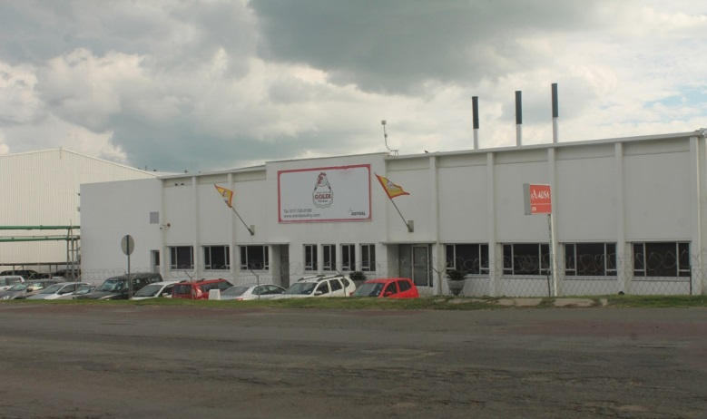
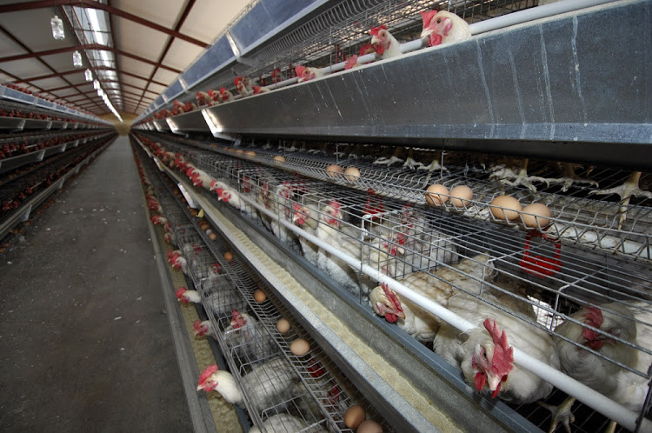
KPI 13
Focus 5: Lekwa water supply unblocking
The Department unlocked the water supply challenges for Goldi Chickens in Lekwa Municipality
EDD received a complaint from Goldi that water supply to their chicken processing plant was discontinued by the Lekwa Municipality which will result in serious environmental, financial and labour problems.
After EDD held a meetings with stakeholders, and arranged the following:-
  Municipality agreed to provide some of the required water
  Water Affairs agreed that Goldi could extract water directly from the Vaal River, until such time that the municipal infrastructure is fully operational
  MISA, COGTA and PICC are in discussion with the municipality to refurbishment of the water treatment plant
EDD’s intervention resulted in production resuming at the chicken processing plant and around 3 200 workers taken out of short-time.

Slide 17
KPI 16
Focus 6: PPS 9 Month Extension
PPS Extension
PPS introduced in 2013 to ensure that waste and scrap metal should not be exported unless first offered to domestic users at a discount price.
During the quarter work was done to extend the PPS for the second time so that it was extended from 1 July to 31 March 2020.
A technical team is undertaking work on the introduction of an export duty on scrap metal to replace the PPS.

Slide 18
KPI 21
Focus 7: Provisional Market Inquiries Reports – Data and Grocery Retail Market Inquiries
Status Update
Entity
26 July 2019: Minister of Communications issued Policy on high demand spectrum and policy direction on the
Licensing of a wireless open access network
Data Market Inquiry
The provisional Data Market Inquiry was released on the 24th April 2019: The inquiry was set up as a result of persistent concerns expressed by the public about the high level of data prices and the importance of data affordability for the South African economy and consumers.
The purpose of the Inquiry is to understand what drives the cost of data.
The EDD collaborated with DTPS in terms of providing funding for the inquiry as well as discussing the implications of the provisional recommendations.
Grocery Retail Market
The Provisional report was released on the 29th May 2019: the purpose is to remove hindrances to SMEs and historically disadvantaged firms participation. The Inquiry also determine the impact of the expansion, diversification and consolidation of national supermarket chains on small and independent retailers in townships, peri-urban areas and rural areas and the informal economy.
The EDD held a discussion of the draft recommendations with National Treasury in terms of their Townships and Villages programme in the Eastern Cape.
30 September 2019: Healthcare Market Inquiry Final Report issued

Slide 19
B. REPORT ON KPIs

Slide 20
Programme 2: Growth Path and Social Dialogue
Strategic Objective 2: Coordinate jobs drivers and implementation of the New Growth Path economic strategy in support of the National Development Plan
Key Performance Indicators
KPI 2: Analytical and public policy advocacy KPI 3: NGP jobs drivers and coordination structures KPI 6: Support to provinces
1 product targeted for KPI 2 commenced in Q1 to be reported in Q2

Slide 21
KPI 2
Advocacy
Analytical and public policy advocacy
Social Economy Policy Update
11 June 2019: Interaction in a Technical MINMEC with Provinces on Social Economy Policy Framework as part of their Socio-Economic Development Programme and collaboration with National Government on policy related matters:
Update on Draft Green Paper
Joint Planning for Social Economy Provincial Consultations sessions
  Provincial Consultations currently under way. All provinces are being visited and discussions held with community organisations on the content of the Draft Social Economy Green Paper.
  Provinces already visited are as at 3 October 2019: North West (17 to 18 September), Limpopo (11 to 12 September), Eastern Cape (19 to 23 August), Northern Cape (1 and 3 October), Free State (26 to 27 September).
  Still to be visited during Oct and Nov 2019: KZN (9 to 10 October), Gauteng (16 to 17 October), 29 to 30 October), Mpumalanga (4 to 5 November),

Slide 22
Programme 2: Growth Path and Social Dialogue
Strategic Objective 3: : Facilitate social dialogue and implementation of social accords
Key Performance Indicators
KPI 4: Implementation of the green economy accord KPI 5: Employment and entrepreneurship for black women and youth KPI 7: Social dialogue interventions to save and create jobs & reports on implementation of Social Accords
No products were expected for Q1

Slide 23
Programme 3: Investment, Competition & Trade
Strategic Objective 4: Coordinate infrastructure development and strengthen its positive impact on the economy and citizens
Key Performance Indicator
KPI 8: Quarterly Cabinet-level progress reports of infrastructure SIPs KPI 9: Cabinet and PICC infrastructure decisions implemented KPI 10: PICC meetings held and facilitated KPI 11: Coordination actions to drive implementation of SIP 5 of the National Infrastructure Plan KPI 12: Initiatives to increase localisation in the infrastructure and industrialisation programmes KPI 13: Investment and Infrastructure projects evaluated, unblocked, fast tracked or facilitated

Slide 24
KPI 8
Infrastructure Cabinet Reports: SIPs
Progress reports to Cabinet on the 18 Strategic Integrated projects (SIPs)
Work Completed: Cabinet Level Reports
18 Construction Update Reports were prepared for Cabinet which provided information on financial, employment, localisation and construction activities; and identified progress and actions that Cabinet needed to consider to ensure the infrastructure build programme was implemented and able to boost jobs and growth.
Note: Implementation of the projects and operational responsibility, funding and reporting remains with the relevant line Departments.

Slide 25
KPI 10
PICC meetings facilitated
Number of PICC meetings held and facilitated
Work completed: PICC meetings held and facilitated
During the quarter, EDD provided technical, secretariat and coordinating support for the hosting of PICC structures through the PICC Unit
These structures prepared and finalised the submissions discussed in the meetings held
PICC held four meetings supported by the EDD
  SIP Coordinators Forum- 3rd May 2019
  SIP Coordinators Forum- 31st May 2019
  SIP Coordinators Forum- 28th June 2019
  Tirisano Construction Fund Board of Trustees Meeting- 17th May 2019

Slide 26
KPI 11
Implementation of SIP 5
Coordination of actions to drive implementation of SIP 5 of the National Infrastructure Plan
Work completed: Action minute on OTMS
Strategic Integrated Projects 5 (SIP 5) consists of work along the Saldanha-Northern Cape Development Corridor including projects on roads, energy and industrial infrastructure, falling within the legal mandate of the Ministers of Transport, Water and Sanitation, Energy, Public Enterprises and Trade and Industry respectively.
The Minister of Economic Development chairs SIP 5
  Processes to update SIP Chairs is currently underway, through the Minister now responsible for the PICC – Minister of Public Works and Infrastructure
The coordination work undertaken for this purpose includes site visits and site reports; Ministerial Imbizos; press briefings; technical investigations; and preparation of meeting agendas, reports and minutes.
This work is done to support line Ministers to implement SIP projects according to project time frames and budget

Slide 27
KPI 11
Implementation of SIP 5
Coordination of actions to drive implementation of SIP 5 of the National Infrastructure Plan
This quarter EDD produced an action minute focused on lessons learned on the impact of disruption on construction sites.
Oiltanking MOGS Saldanha (RF) (Pty) Ltd (OTMS) project is establishing an open access commercial crude oil blending and storage terminal.
Strike action occurred on the project during March 2019, with work commencing 25 March 2019.
  Over R100 million direct and indirect cost impact of the disruption.
Lessons learned:
  Clarify what “Local” means – considering legislation; with a transparent employment regime
  Identify, and link with, key community stakeholders and community leaders
  Involve community during planning stage, explaining project timelines clearly
  Develop a well consulted Social and Labour Agreement during planning, working with Unions
  Involve Public Order Police during planning of large projects
PICC working on Social Facilitation Plan drawing on lessons from this and other similar events

Slide 28
KPI 12
Localisation
Initiatives to increase localisation in the infrastructure and industrialisation programmes
Unblocking sale of Highveld Structural Steel Mill
Minister Patel facilitated the sale of Highveld Structural Steel Mill leading to the continued operation of a unique Steel Mill in Africa and saving 220 jobs
Background
EDD has a long background in supporting the metals industry – with support for Highveld Steel as one example
In April 2015 Highveld Steel had filed for voluntary business rescue
See Highlights Focus Area 4: Sale of Highveld Steel Mill

Slide 29
KPI 12
Localisation
Initiatives to increase localisation in the infrastructure and industrialisation programmes
EDD brought AMSA (ArcelorMittal) and Highveld Steel together in 2016/17 to re-establish the Highveld Structural Steel Mill that had previously closed.
During April 2017, the steel-mill started production and Highveld Steel began to turn the old complex into a multi-purpose industrial hub.
EDD also assisted with unblocking a tariff investigation that would support the production of steel, and following an independent investigation, ITAC recommended duties to be approved – this recommendation was later accepted It also helped to fast-track the implementation of the duty by National Treasury
See Highlights Focus Area 4: Sale of Highveld Steel Mill

Slide 30
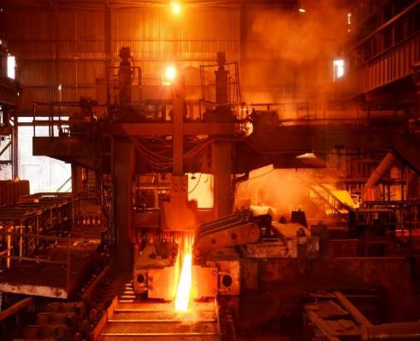
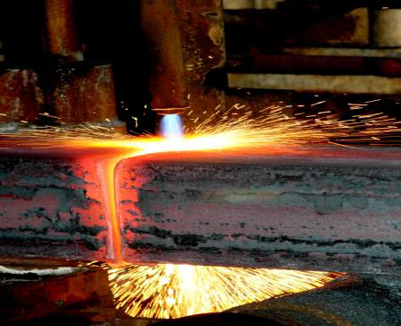
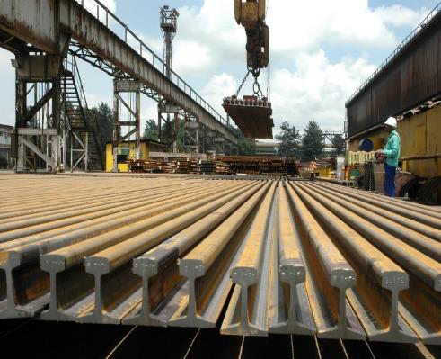
KPI 12
Localisation
Initiatives to increase localisation in the infrastructure and industrialisation programmes
In January 2019 EDD was informed that AMSA was terminating its contract with Highveld Steel to supply blooms. EDD’s engagement and facilitation resulted in a supply agreement being extended – so that Highveld would be able to continue production using blooms from AMSA
In this quarter – EDD facilitated discussions between parties that resulted in the sale of Highveld Steel to AMSA
Highveld Steel continues to be the only structural steel mill of its kind in Africa with the ability to produce steel for construction and railway lines.
See Highlights Focus Area 4: Sale of Highveld Steel Mill
Notes:
Since its reestablishment, Highveld pioneered the development of locally produced main line rail which for decades have been imported from Europe

Slide 31
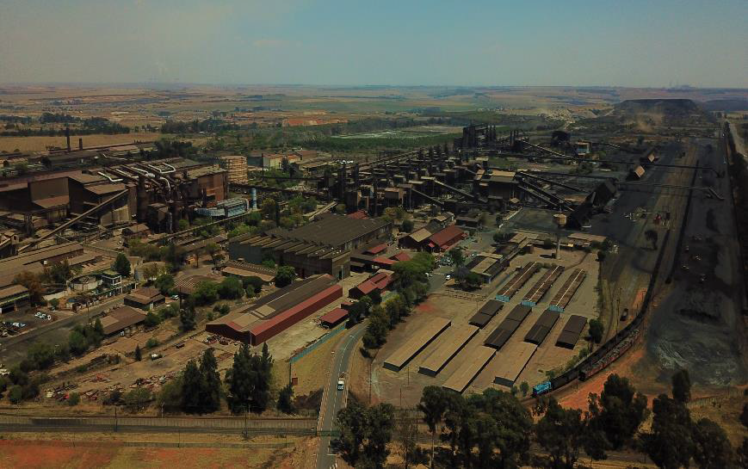
Arial view of Highveld Industrial Park

Slide 32
KPI 13
Investment and infrastructure
Investment and Infrastructure projects evaluated, unblocked, fast tracked or facilitated
During the quarter EDD undertook 5 unblockings/ facilitations:
Dube Trade Port application granted for use of agricultural land for development purposes.
Facilitated an agreement with Ekhurhuleni Municipality that helped prevent the eviction of 3 SMMEs owned by Ortive/Kusile Brands Company from the KwaThema Business Park, with a payment arrangement to settle rent payment arrears.
Unlocking water supply to Lekwa/Goldi Chickens – see Highlights Focus 5.
Facilitation of access to market for Watertainer (a local company) water tanks (modular 1500 litre water collection storage system) into the Massmart (Builders Warehouse) value chain.
Facilitation of a request from dti to SARS/National Treasury for extension of existing safeguard duty on certain Flat Hot Rolled Steel products to include products from Chinese Taipei Taiwan.

Slide 33
KPI 13
Investment and infrastructure
Investment and infrastructure projects evaluated, unblocked, fast tracked or facilitated
Unblocking of Dube Trade Port application for Subdivision of Agricultural Land Act 70 of 1970 at the Department of Agriculture, Forestry and Fisheries
PICC successfully helped unlock and fast track an application to develop land for the Dube TradePort, which facilitates economic development in the region and for South Africa.
Dube TradePort (DTP), north of Durban, is intended to serve as an airfreight orientated logistics hub for SA and KwaZulu-Natal.
It comprises the King Shaka International Airport together with supporting commercial, industrial and agricultural precincts.
The Dube TradePort Company (DTPC) is responsible for the development of the TradeZone, and AgriZone.
The land on which the Tradezones are to be developed on is former agricultural land.
The Agricultural Land Act requires approval from the Minister of Agriculture for a change in the use for agricultural land. However, Section 3 exempts statutory bodies from the Act, of which DTP one.

Slide 34
KPI 13
Infrastructure
Infrastructure projects evaluated, unblocked, fast tracked or facilitated
Unblocking of Dube Trade Port application for Subdivision of Agricultural Land Act 70 of 1970 at the Department of Agriculture, Forestry and Fisheries (cont.)
DTP requested the PICC to help unblock the approval of the application.
PICC engaged with DAFF and the application was unblocked and fast-tracked.
Impact expected:
Increase in investment in the Dube Trade Port: Tradezone 2, through the erection of factories and warehouses, as is currently the case of Tradezone 1
Increase in the number of jobs created by the factories and warehouses
Increased taxes for the fiscus from company and personal taxes

Slide 35
KPI 13
Investment and infrastructure
Investment and infrastructure projects evaluated, unblocked, fast tracked or facilitated
Unblocking of a request by SMME’s to the Ekurhuleni Municipality, for eviction from the KwaThema Business Park.
EDD’s intervention with a Municipality over 3 SMMEs being in arrears on rents has resulted in creating a supportive environment for SMMEs – enabling them to survive and retain jobs, while also helping secure an agreement on payment to the Municipality.
EDD received a request to intervene on the eviction of a tenants (an SMME) from the KwaThema Business Park in Ekurhuleni Municipality premises as a result of falling into arrears with rent for several months.
EDD met with key stakeholders including the Municipality to help facilitate a solution to the problem.
The outcome was that the Municipality agreed to suspend the eviction of these SMMEs from its Business Park while the SMMEs have been provided with an opportunity to make arrangements for payment and still operate.

Slide 36
KPI 13
Investment and infrastructure
Investment and infrastructure projects evaluated, unblocked, fast tracked or facilitated
Access to market for Watertainer water tanks
EDD received request for assistance from Watertainer – a local South African company to access markets for their 1500 litre water tanks
EDD developed a product profile and presented it to Massmart’s Builders Warehouse
Product placed on Builders Warehouse shelves on a trial basis, with demand then reported to have increased.

Slide 37
KPI 13
Investment and infrastructure
Investment and infrastructure projects evaluated, unblocked, fast tracked or facilitated
Extension of existing safeguard duty on certain Flat Hot Rolled Steel products
Dti requested SARS/National Treasury to extend existing safeguard duties on certain Flat Hot Rolled Steel products, to include imports from Chinese Taipei Taiwan.
EDD engaged SARS and National Treasury to finalise.
Amendment granted, providing better support to steel industry.

Slide 38
Programme 3: Investment, Competition & Trade
Strategic Objective 5: Promote productive investment, industrial financing and entrepreneurship for jobs and inclusive growth
Key Performance Indicators
KPI 14:Level and impact of industrial finance by DFIs and departments including on township enterprises KPI 15: Ministerial or departmental oversight engagements with the IDC

Slide 39
KPI 14
Industrial Finance
Report on the level and impact of industrial finance by DFIs and departments including on township enterprises
Report of IDC funding for Q1
R394.5 million approvals for Q1 after cancellations of previously approved funding
  This include R955.0 million of new approvals and R560.2 million of cancellations
  Highest levels of new approvals in:
    Industrial Infrastructure (R319.1 million)
    Machinery and Equipment (R235.4 million)
    Light Manufacturing and Tourism (R100.0 million)
  Significant cancellations included:
    Cancellation of funding for a grape and citrus project (R316 million) after the promoters changed the scope of the project resulting in a smaller funding requirement
    Cancellation of funding for a black-owned business to purchase an IT company after another purchaser emerged as a preferred buyer
R2.43 billion disbursements
  Highest disbursements in:
    Basic and Speciality Chemicals received the largest share (33.9%)
    Basic Metals and Mining (19.7%)
    Clothing and Textiles (11.3%).
IDC expects 975 jobs to be created/saved through new approvals.
  Cancellations of previously approved funding resulted in 1 175 jobs being cancelled and a net negative number of -200 for the quarter.
Notes:
12 months Apr - Mar

Slide 40
KPI 15
Improve performance: IDC
Ministerial or departmental oversight engagements with the IDC held
During the quarter the Minister engaged the IDC on a strategic level through:
IDC Quarter 4 Report
PFMA compliance quarterly report for period ending March 2019
IDC Oversight Meeting 7 May 2019
Quarterly oversight meeting

Slide 41
Programme 3: Investment, Competition & Trade
Strategic Objective 6: Promote competition, trade and economic regulation in support of job creation, industrialisation and economic inclusion
Key Performance Indicators
KPI 16: Work of the economic regulators

Slide 42
KPI 16
Quarterly Oversight
Oversight meetings and reports
Meetings and Reports
Quarter 4 Reports of the Competition Commission, Competition Tribunal and ITAC
Quarterly entities meeting on 11 June 2019
Approval and tabling of Annual Performance Plans 2019/20 for the Competition Commission, Competition Tribunal and ITAC – tabled 28 June 2019

Slide 43
KPI 16
Initiatives on Mergers and acquisitions
Initiatives on market inquiries or abuse of dominance
The Competition Commission informed the Minister about the proposed merger between New Holdco (NewCo), as the primary acquiring firm, and Edgars Consolidated Stores Limited, as primary target firm.
The following shareholders would hold the issued share capital in NewCo:
  OpCo Facility Lenders;
  OpCo Cash Landlors
  BEE Trust;
  Existing Investors; and
  Public Investment Corporation
The proposed transaction will require the restructuring of the debt and equity structure of the OpCo with a view of to providing the Edcon group with a platform to maximise its prospects of avoiding being forced into the business rescue or insolvency proceedings
EDD filed a Notice of Intention to Participate on 18 March 2019 and stressed the importance of putting measures in place to avoid any retrenchments.
Following engagements between EDD and the merging parties, EDD took note of the undertakings made by Edcon to address employment and local procurement concerns.
See Highlights Focus Area 2: Edcon

Slide 44
KPI 16
Initiatives on Mergers and acquisitions
Initiatives on market inquiries or abuse of dominance
The Competition Commission expedited the assessment of the proposed merger due to the financial position of the Edcon Group and recommended to the Competition Tribunal on the 30th April 2019 subject to the conditions agreed to between EDD and the merging parties
The CT approved the merger on 9 May 2019 subject to the following conditions:
  Commitment to fostering and developing a more competitive production environment in South Africa Edgars Consolidated Stores Limited and Edcon Limited through –
    Continuation of the Import Replacement Programme which entails expanding OpCo’s procurement from South African suppliers (including small, medium and large enterprises);
    Building relationships with South African suppliers of products for re-sale in OpCo’s stores to inter alia mitigate the risk of exchange rate fluctuation, secure faster supply chain turnaround and cater for local consumer preferences; and
    Participation in intiatives by inter alia Government, IDC and NGOs aimed at improving capacity and competitiveness and to create jobs in the textile and apparel industry value chains in South Africa.
  Quality assurance information sessions by OpCo with South African producers to assist them in manufacturing world class products at competitive local prices; and Orientation sessions with Small Enterprises in South Africa to assist them in doing business with OpCo.
See Highlights Focus Area 2: Edcon

Slide 45
KPI 16
Initiatives on Mergers and acquisitions
Initiatives on market inquiries or abuse of dominance
3. Exploration of opportunities with South African suppliers and manufacturers relevant to the Edcon Group’s operations in South Africa –
  To expand production for the domestic market;
  To accelerate OpCo’s local procurement; and
  For partnerships, initiatives and programs to build the capacity, technological capabilities (including equipment and intellectual property requirements) and competitiveness of those local suppliers and manufacturers, including, where appropriate, working with Government, IDC and/or NGOs.
4. Commitment to a bi-annual meeting with representatives of EDD and other public entities that may be invited by EDD from time to time over a five year period to help identify local sourcing opportunities and measures that can improve the competitiveness of local suppliers and manufacturers.
Broad-Based Black Economic Empowerment
Introduction of replacement scheme for Edcon Staff Empowerment Trust to safeguard the rights and interests of the beneficiaries of the previous scheme whose value has been wholly eroded by Edcon financial challenges.
Employment
The Edcon Group will use its best endeavours to implement measures aimed at avoiding involuntary retrenchments, particularly amongst non-management related store staff, including offering employees of stores that are closed down equivalent positions in alternate stores.
See Highlights Focus Area 2: Edcon

Slide 46
KPI 16
Price Preference System on Scrap Metal
Ferrous and Non-Ferrous Scrap Metal Gazette
Gazetting activities
Extension of Price Preference System policy directive on ferrous and non-ferrous waste and scrap metal (PPS)
PPS introduced in 2013 to ensure that waste and scrap metal should not be exported unless first offered to domestic users at a discount price.
The PPS has been extended twice – after receiving comments that strongly supported its extension and the positive impact it is having on the industry and employment.
During the quarter work was done to extend the PPS for the second time so that it was extended from 1 July to 31 March 2020.
A technical team is undertaking work on the introduction of an export duty on scrap metal to replace the PPS.
See Highlights Focus Area 6: PPS

Slide 47
C. REPORT ON HUMAN RESOURCES

Slide 48
Human Resource Management
The Department employs staff on a permanent basis, as well as through-fixed term contracts for specific projects and secondments to access specific scarce skills and knowledge for its programmes, including the PICC Technical Unit.
The EDD had a ratio of 51,5% women in Senior Management positions as at 30 June 2019.

Slide 49
EDD Personnel Expenditure by Programme for Q1
Programme | Total expenditure (R’000) | Personnel expenditure (R’000) | Training expenditure (R’000) | Professional and special services expenditure (R’000) | Personnel expenditure as a % of total expenditure | Average personnel cost per employee (R’000)
Administration | 21 115 | 10 482 | 0 | 2 620 | 49.6% | 178
Growth Path and Social Dialogue | 8 157 | 7 691 | - | 48 | 94.3% | 334
Investment, Competition & Trade | 2 918 | 2 822 | - | 0 | 96.7% | 157
Total | 32 190 | 20 995 |  | 2 668 | 65.2% | 210
Political Office Bearers are excluded
Notes:
Personnel expenditure is compensation of employees

Slide 50
EDD Personnel Costs by Salary Bands
Salary band | Personnel expenditure (R’000) | As % of total personnel costs | Number of employees | Average personnel cost per employee (R’000)
Levels 3-5 | 570 | 2.7% | 9 | 63
Levels 6-8 | 2 825 | 13.5% | 27 | 105
Levels 9-12 | 6 192 | 29.5% | 33 | 188
Levels 13-16 | 11 408 | 54.3% | 33 | 346
Total | 20 995 | 100% | 100 | 206
Political Office Bearers are excluded

Slide 51
Gender Equity
The Department has exceeded the target of 50% in the filled and funded posts overall.
SMS | Male | Female | Total
Headcount | 16 | 17 | 33
Percentage | 48,5% | 51,5% | 100%
Non-SMS | Male | Female | Total
Headcount | 22 | 47 | 69
Percentage | 32% | 68% | 100%
EDD | Male | Female | Total
Headcount | 38 | 64 | 102
Percentage | 37% | 63% | 100%
Political Office Bearers are excluded

Slide 52
People with Disabilities
The Department has achieved the national target for people with disabilities of 2%

Slide 53
D. REPORT ON FINANCIALS

Slide 54
Summary of expenditure for Q1
As at 30 June 2019 the department spent R282.7 million out of an adjusted allocation of R1.1 billion i.e. 27% of the total allocated budget.
As at 30 June 2019 expenditure excluding transfers amounts to R32.2 million (Core R11.1 million, Support R21.1 million) out of an allocated budget of R147.4 million i.e. 22% of the baseline allocation.
For Q1 ending 30 June 2019 the Department spent R282.7 million made up of transfers of R250.5 million to entities and R32.2 million spent directly by the Department.
The department achieved a total expenditure of 100% (R282.7 million) of the Q1 targeted spent of R282.2 million.
The following tables reflect the expenditure against the budget per programme and per economic classification.

Slide 55
Cumulative Financial Performance per Programme - 30 June 2019
Programmes | 2019/20 Budget | YTD actual Expenditure | Variance | Spent
 | R’000 | R’000 | R’000 | %
Administration | 90 334 | 21 115 | 69 219 | 23
Growth Path and Social Dialogue | 37 009 | 8 157 | 28 852 | 22
Investment, Competition and Trade | 20 059 | 2 918 | 17 141 | 15
Transfers and Subsidies | 918 050 | 250 523 | 667 527 | 27
Total including Transfers | 1 045 393 | 282 713 | 762 680 | 27
Total excluding Transfers | 147 402 | 32 190 | 115 212 | 22

Slide 56
Cumulative Financial Performance per Programme - 30 June 2019
Expenditure per Economic Classification | 2018/19 Budget | YTD actual Expenditure | Variance | Spent
 | R’000 | R’000 | R’000 | %
Compensation of Employees | 97 693 | 22 073 | 75 620 | 23
Goods and Services | 44 971 | 9 944 | 35 027 | 22
Transfers to Entities | 897 991 | 250 511 | 647 480 | 28
Households | - | 12 | -12 | 0
Payment of Capital Assets | 4 738 | 173 | 4 565 | 4
Total including Transfers | 1 045 393 | 282 713 | 762 680 | 27
Total excluding transfers to entities | 147 402 | 32 190 | 115 212 | 22

Slide 57
Quarter 1: Analysis of spending by Programme
Programme 1 | Q1 Projected Spend | Q1 actual Expenditure | Variance | Spent
 | R’000 | R’000 | R’000 | %
Compensation of Employees | 11 402 | 11 561 | -159 | 101
Goods and Services | 7 617 | 9 381 | -1 764 | 123
Payments for Capital Assets | 187 | 173 | 14 | 93
Total | 19 206 | 21 115 | -1 909 | 110
The main cost drivers in non-core functions are: Office accommodation costs in Corporate services Legal fees in Corporate services Travel and subsistence Audit costs in Financial management for Auditor General

Slide 58
Quarter 1: Analysis of spending by Programme
Programme 2 and Programme 3 | Q1 Projected Spend | Q1 actual Expenditure | Variance | Spent
 | R’000 | R’000 | R’000 | %
Salary: Compensation of Employees | 11 771 | 10 513 | 1 258 | 89
Non Salary: Goods and Services | 751 | 564 | 187 | 75
Payments for Capital Assets | 0 | 0 | 0 | 0
Total | 12 522 | 11 077 | 1 445 | 88

Slide 59
Quarter 1: Transfers to Entities
ENTITIES | Q1 Amount Budgeted | Q1 Amount Transferred to Entities | Variance | Spent
 | R’000 | R’000 | R’000 | %
Competition Commission | 73 859 | 73 859 | - | 100
Competition Tribunal | 12 057 | 12 057 | - | 100
ITAC | 26 732 | 26 732 | - | 100
IDC:
- Sefa | 60 363 | 60 363 | - | 100
- PICC | 60 000 | 60 000 | - | 100
- Steel Development Fund | 17 500 | 17 500 | - | 100
- Tirisano Construction Fund | - | - | - | -
Total | 250 511 | 250 511 | - | 100

Slide 60
Q1 Financial Performance: Reasons for Variances
Compensation of employees: Spending less than projected due to some resignations
Goods and services: Increase in spending due to accruals
  Transfers and Subsidies: Spending according to projections
  Capital assets: Spending according to projections

Slide 61
SIYABONGA

