Slide 1


Slide 2

Contents
Organisational overview
Organisational performance
Financial performance
Looking ahead

Slide 3

Organisational overview
Vision
The South Africa I know the home I understand
Our Goal
Mission
To lead and partner in statistical systems and products for evidence based decisions
Values
Integrity
Service excellence
Empowering partnership

Slide 4

Organisational overview
Stats Act
Statistical production
Statistical coordination
Provides for independence
Our Goal
Role players
Minister in the Presidency
Statistics Council
Statistician-General
Strategic Outcomes
An informed nation
Trusted statistics
Partners in statistics
A capable organisation
Statistical leadership

Slide 5
Organisational performance
Targets achieved: 2018/19
Our Goal

Slide 6
Organisational performance
Highlights: 2018/19
Statistical outputs:
Published 277 statistical releases and reports on the economy & society
Our Goal
Digitalisation:
Rolled out CAPI for GPSJS, GHS, and DTS
QLFS parallel surveys commenced
Service delivery:
Responded to 95% of user requests
2,2 million website visitors
375 thousand documents downloaded
Clean audit
No audit finding on predetermined objectives

Slide 7
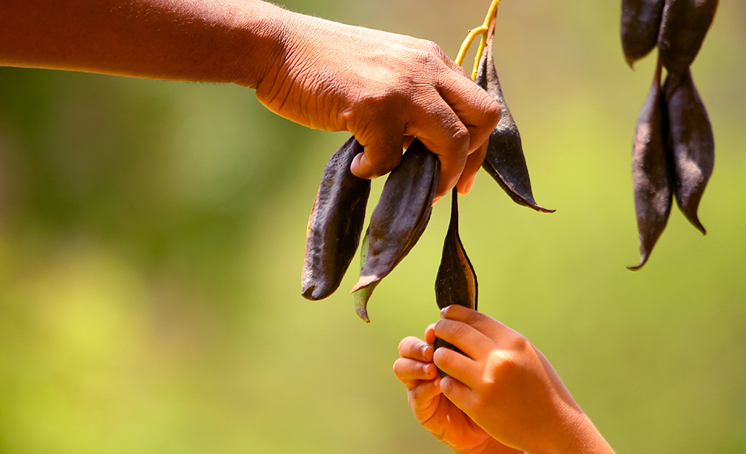
Financial performance
R2,272 Billion
allocation
Our Goal
R2,311 Billion
expenditure
1,7%
Over-expenditure
Clean Audit Opinion

Slide 9
Financial performance
Actual spending
Other operational costs
R 10 million
Compensation of Employees (overspent)
R 49 million
Total
(overspent –1,7%)
R39 million

Slide 10
Financial performance
Unauthorised expenditure
2017/18 | 2018/19
R64 mil | R121 mil
Mainly as a result of CoE overspending
Due to budgets cuts on COE resulting in warm bodies not being affordable

Slide 11
Human Resource performance
Total employees: 2 906
SMS posts filled: 77,8% (207/266)
Vacancy rate: 17,2%
(605/3511)
Women in SMS: 41,5%
Terminations: 103
Staff with disability: 1,4%
9 average sick leave days per staff member
New appointments: 0

Slide 12
Vacancy rate per salary band

Slide 13
Vacancy rate per Programme

Slide 15

Stats SA at risk
1
DEMAND
1
2
BUDGET
Increasing demand for statistical information
National
Continental
Global
Other
Severe budget cuts
Warm bodies not affordable
IES/LCS not funded
  Poverty estimates impacted
  CPI basket
  GDP estimate
4
2
4
SUPPLY
3
3
PEOPLE
Basic statistics at risk – declining quality over time
Discontinued value add products
17,2% vacancy rate
103 staff left in 2018/19
Staff over-stretched – may cause errors

Slide 16
Stats SA at risk
Finalise legislative reform
Maintain quality of basic statistics
Census 2021
Census of Commercial
Agriculture
Next
3-years
Integrated indicator framework
Integrate, innovate & modernize
business processes
Strategy, resource and structure alignment

Slide 17
Ndzi Hela Kwala!

