Slide 1

2018/19 ANNUAL REPORT
PORTFOLIO COMMITTEE
8 OCTOBER 2019

Slide 2

TABLE OF CONTENTS
LEGISLATIVE MANDATE
MISSION STATEMENT
REGULATORY APPROACH
2018/19 PERFORMANCE HIGHLIGHTS
HR OVERVIEW
FINANCIAL OVERVIEW
RISK MANAGEMENT

Slide 3
LEGISLATIVE MANDATE
The Railway Safety Regulator (RSR) was established in terms of the National Railway Safety Regulator Act 16 of 2002 (“The Act”) as amended.
In terms of The Act, Operators are primarily responsible and accountable for ensuring the safety of their railway operations.

Slide 4
DUTIES AND RESPONSIBILITIES
Issue and manage Safety Permits in accordance with the Safety Management System Determination;
Continuously monitor improvements in safety targets by assessing operators Safety Improvement plans (ASIP);
Conduct safety inspections and audits;
Monitor, investigate and report railway occurrences;
Develop Regulations, Safety Standards and guidelines;

Slide 5
DUTIES AND RESPONSIBILITIES CONT.
Enforce Compliance by:
Issuing notices of non-conformance and non-compliance;
Imposing penalties for non-compliance with the Act and/or the Safety Standards adopted by the RSR’s Board of Directors
Revocation or Suspension of the Safety Permit (Section 26 of the Act)

Slide 6
MISSION STATEMENT
Vision
ZERO OCCURENCES
Underlying philosophy:
“Safety is everybody's responsibility"
Mission
To oversee and promote safe railway operations through appropriate support, monitoring and enforcement, guided by an enabling regulatory framework
Values
Integrity & Trust
Transparency
Fairness & Equity
Innovation
Speed of Execution
Respect & Diversity

Slide 7

REGULATORY APPROACH

Slide 8
RISK BASED APPROACH
RSR has adopted a Risk Based approach towards the regulation of safety within the railway environment.
The aim is to guide the industry towards excellence in railway safety management by creating an enabling environment for the reduction of operational risks to as low as reasonably practical (ALARP), which requires:
  RSR to be able to accurately and empirically measure risk reduction in the railway sphere using risk data.
  Moving away from the use of lagging indicators in setting the strategic goals and targets to using leading indicators.
Promote collaboration between RSR and the industry in improving safety of railways in South Africa

Slide 9
BASIS FOR INTERVENTIONS
Technical Assessments of Operators’ SMS & SMSR
Compliance Monitoring : Audits, Inspections, Occurrence data
Risks :
* Human Factors (Vacancies in safety critical grades, Work Load Planning, Competencies)
* Risk Assessments
*Interface Arrangements

Slide 10
2018/19 PERFORMANCE HIGHLIGHTS

Slide 11

AUDITOR GENERAL OPINION
UNQUALIFIED with
Non - Compliance: Expenditure Management

Slide 12

AUDIT OUTCOMES - 5 YEAR PERSPECTIVE
FINANCIAL STATEMENTS
FINANCIAL YEAR | OUTCOME | NUMBER OF FINDINGS | NUMBER OF RECURRING FINDINGS
2016/17 | Unqualified | 11 | 1
2017/18 | Unqualified | 16 | 4
2018/19 | Unqualified | 15 | 1
Nature of Findings
- Non-compliance with SCM prescripts
- Performance Information

Slide 13
PERFORMANCE TREND

Slide 14
ACHIEVEMENTS
STRATEGIC OUTCOME 1: SAFER RAILWAYS
RISK-BASED APPROACH
Safety Risk Model framework
Determination for Occurrence Reporting
Common Safety Method for Conformity Assessments
Common Safety Method for Risk Assessments
Railway Management Maturity Model
Human Factor Management Capacity Building program
Interface Agreement Framework
Verbal Safety Critical Communication Protocol

Slide 15
ACHIEVEMENTS
STRATEGIC OUTCOME 2: SUSTAINABLE INSTITUTIONAL GROWTH AND DEVELOPMENT

Slide 16
ACHIEVEMENTS
STRATEGIC OUTCOME 2: SUSTAINABLE INSTITUTIONAL GROWTH AND DEVELOPMENT

Slide 17
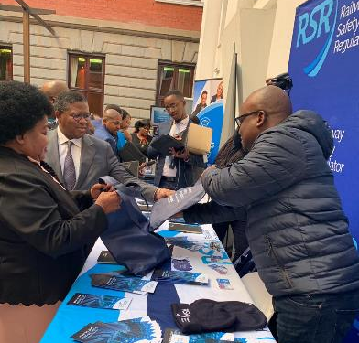
ACHIEVEMENTS
STRATEGIC OUTCOME 3: IMPROVED STAKEHOLDER SERVICE
Public Service Announcement
20 Safety promotion initiatives conducted
Industry-organized labour forum established
Picture

Slide 18
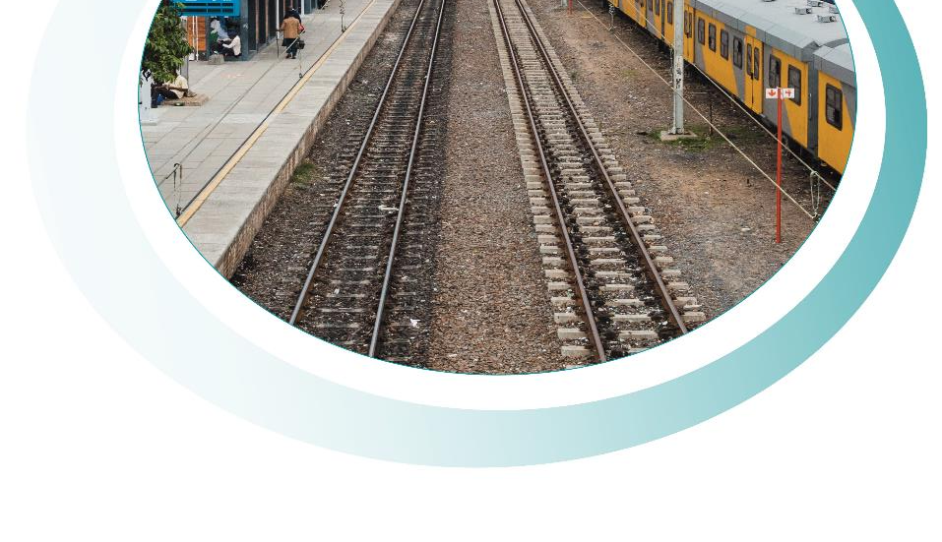
HUMAN RESOURCES

Slide 19
HR OVERVIEW
Total number of employees 160
125
Head Office and Gauteng Region
4
13
4
14

Slide 20
VACANCY RATE

Slide 21
EMPLOYMENT EQUITY
ETHNICITY | FEMALE | MALE
AFRICAN | 85 | 88
COLOURED | 7 | 3
INDIAN | 0 | 1
WHITE | 4 | 8
TOTALS | 79 | 81

Slide 22
WOMEN EMPOWERMENT

Slide 23

FINANCE

Slide 24
YEAR-ON-YEAR REVENUE (R’000)
FY 2016/17
FY 2017/18
FY 2018/19
Government grant
55 987
87 864
63 018
Safety permit and
128 782
150 429
164 048
application Fee
Technology audit
59 834
23 386
1 729
Other regulatory fees
500
5 271
6 000
Other income
5 917
6 584
9 168
TOTAL
251 020
273 534
243 963

Slide 25
REVENUE VS EXPENDITURE (R’000)
290 000
190 000
90 000
-10 000
FY 2016/17
FY 2017/18
FY 2018/19
Revenue
251 020
273 534
243 963
Expenditure
256 932
274 564
224 475
Surplus/(Deficit)
-5 912
-1 030
19 488
Revenue
Expenditure
Surplus/(Deficit)

Slide 26
BBBEE SPEND
100
96,3
89,1
82,0
50
30,8
13,0
11,6
4,3
5,4
1,5
0
% spent on BBBEE
% spent on women
% spent on youth
FY 2016/17
FY 2017/18
FY 2018/19

Slide 27
REVENUE PROJECTIONS (R’000)

Slide 28
RISK MANAGEMENT

Slide 29
HIGH STRATEGIC RISKS
Almost certain
1
Highly likely
Possible
5
4
2
3
Remote
7
6
8
Unlikely
1. Loss of key personnel
5. Loss of critical data
2. Financial sustainability
6. Inadequate and incomplete safety information
3. Lack of independence
7. Rapid technological advancements
4. Inaccurate and incomplete safety information
8. Excessive cost of regulation

Slide 30
RISK MITIGATIONS
At year end only 1 risk was outside of the Risk Tolerance level set by the Board:
RISK | INHERENT RATING | RESIDUAL RATING | MITIGATIONS | RISK OUTLOOK
Loss of key personnel | Very High | High | Performance incentives for good performers and increased focus on staff wellness initiatives
 |  |  | Implementation of the approved staffing plan to fill vacancies.
 |  |  | A renewed focus on good governance and clean administration
Improving

Slide 31


THANK YOU
THANK YOU
THANK YOU

