Slide 1
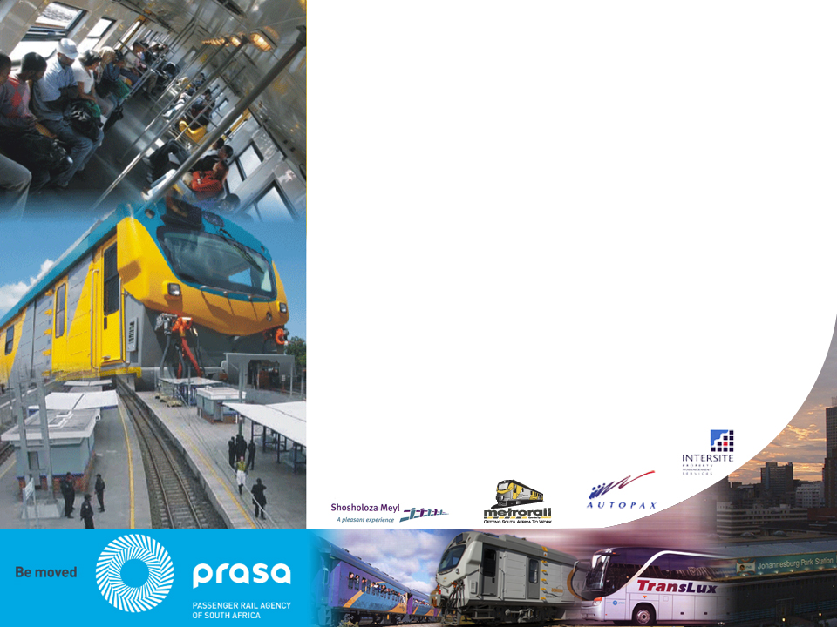
  Presentation of
  2018/19 Annual Financial Statements
  - PCoT -
  8 October 2019
Notes:
----- Meeting Notes (2015/02/18 14:38) -----
customer satisfaction at 75%
cable theft
shareholders
learnings
state of readiness

Slide 2
Content
  Introduction
  A Perspective on Performance
  A Perspective on Financial Performance
  Performance against Pre-Determined Objectives

Slide 3
The 2018/19 Annual Report
The Board of Control presents this Annual Report fully aware of the massive challenges faced by the Agency during the 2018/19 financial year, pertaining to the following:
  Adherence to good corporate governance and ensuring organisational and leadership stability,
  Arresting the decline in the business performance, particularly the Rail business,
  Ensuring the availability, reliability, predictable and safe commuter and passenger service,
  Resolving organisational inefficiencies in the manner in which it deploys and manages its resources,
  Addressing and fixing massive irregularities as reported by the Public Protector, the Auditor General, and National Treasury, and
  Dealing with a declining stakeholder confidence and a high rate of customer dissatisfaction against the service PRASA provided during this period.
The Annual Report confirms that PRASA still faces a massive cash shortfall on its operational expenditure budget, which has accumulated over several years, caused by rising operational costs, declining revenues, and a stagnant operational subsidy.
Whilst the Board ensured that management implemented strict cost containment measures over the years by curbing and cutting costs where absolutely necessary, this has not yet improved the Group’s financial position.

Slide 4
The 2018/19 Annual Report - Highlights
Whilst the Board ensured that management implemented strict cost containment measures over the years by curbing and cutting costs where absolutely necessary, this has not yet improved the Group’s financial position.
This is as a result of operating costs increasing at a rate higher than own revenue generated and subsidy.
Total revenue was at R13.7 billion at the end of the financial year, compared to total expenses which stood at R15.5 billion.
The subsidy has been increasing by inflation while own revenue has been on the decline due to the lack of maintenance, vandalism and theft of assets and the open nature of the rail system.

Slide 5
The 2018/19 Annual Report - Highlights
To achieve the above, the Board instituted mechanisms that would ensure that the business focused on:
The protection of people, infrastructure and assets to ensure availability, reliability of the service
  A Security Strategy was developed and approved
  A Safety Management Framework that guarantees the safety of commuters and passengers
An engineering and technical service that ensures reliability and availability of infrastructure and rolling stock –
  A Rail Engineering and Technical department were consolidated into one unit focusing on quick turnaround in the maintenance of both infrastructure and rolling stock
Supply chain management policy that is timely and responds to the demand of the business
  A new Procurement Policy was approved and procurement committees established at both management and board level
Modernisation programme that should transform the rail product
  An accelerated capital management program that should result in increased spend on CAPEX has been instituted

Slide 6
A Perspective on Performance

Slide 7
A Perspective on Performance
In the last 8 years, PRASA has not been able to reach 60% of its performance targets. Only during the financial year 2015/16 did PRASA exceeded 50% of its pre-determined objectives by meeting 55% of its performance targets.
The fact that PRASA still performs below 60% against its pre-determined objectives remains a worrying factor, as this suggests that the organisation is far from delivering on its mandate.
The 2018/19 financial year fell short of expectations, where only 26% of the performance targets were met, even though this was better than 2017/18 where only 21% of the objectives were met.
This suggests that PRASA continues to offer a service that is poor, unreliable, unpredictable and that is not safe, thus resulting in the decline in customer and stakeholder confidence.
Overall customer satisfaction rating where PRASA has only scored 48.11% across the business, compared to 56.14% the previous year.

Slide 8
A Perspective on Performance
During this financial year the inability of the business to meet its objectives, particularly Rail which is the core of PRASA’s business, was mainly due to the following factors:
Availability of train sets which were drastically reduced due to vandalism and theft that required Ad hoc maintenance and services to increase availability;
Coaches out of service awaiting components due to non-availability of long term national supply of material and components refurbishment contracts;
Cable theft and trains set alight which contributes negatively to coaches’ availability;
Consequentially the poor performance is reflected in fare revenue collected for year ending March 2019.
Both commuter and long distance passenger rail and bus services failed to meet the revenue target of R2.9 billion.
The total fare revenue collected for the 2018/19 period amounted to R1.5 billion – a 15.9% below budget.

Slide 9
Response to Below Par Performance
In response to the above below average performance, it is clear that PRASA has to contend with the question:
  “How does PRASA plan on working towards ‘retaining existing customers whilst striving recovering lost customers”?
The current state of the business and the organisation’s failure to deliver on its primary mandate to ensure that rail ultimately becomes the backbone of public transport and the mode of choice now informs PRASA’s Get-On-Track Turnaround Plan for execution during the 2019/20 financial year.
The work in the War Room focuses giving life to the Get-On-Track Rescue Plan through improving service performance for both the commuter and passenger service. The entire organisation has been mobilised around the three (3) work streams (i) Service Recovery, (ii) Safety Management, and (iii) Accelerated Capital Programme, that will ensure:
  Improving On-time Performance;
  Reducing train cancellations;
  Ensuring reliability of infrastructure and assets;
  Ensuring safety of passengers, public and staff;
  Protecting infrastructure and assets; and
  Fast-tracking the modernisation programme;
Restoring customer confidence and recovering the lost patronage, through improving customer experience, is our ultimate objective.
Modernisation will be a game changer in transforming passenger rail travel experience and this is a course we have embarked upon and which we have no intention to abandon.

Slide 10
A Perspective on Financial Performance

Slide 11
The Year 2018/19 at a Glance
R13.7b
R5.7b
4%
5%
Total revenue
Employee Costs
Total revenue is down R504m compared to the previous financial year 14.2Bn.
Employee costs which is the single biggest expenditure line item is up R245m.
R1.5b
R1.7b
16%
217%
Fare revenue
Deficit
Fare revenue is a major concern as it is down R286m.
The deficit for the year is R1.7b and comparable surplus is R1.4b.
R15.5b
21%
R78.5b
7%
Total expenditure
Assets
Total expenditure continues to rise. It is up R2.7b from R12.8b the previous year. Major contributor is impairment of Swifambo Receivable.
The growth in assets was mainly driven by expenditure in rolling stock and signalling and unspent capital grant.

Slide 12
Five Year Income Trend (Rm)

Slide 13
Five-Year Expenditure Trend (Rm)

Slide 14
Statement of Financial Position (R’000)
2019
2018
7%
Total Assets
R78.5b
Total assets are up mainly due to expenditure on rolling stock and signalling and unspent capital grant.
R73.5b
14%
Total Liabilities
R55.5b
R48.8b
Total liabilities are up as a result of receipt of unspent capital grant and non payment of operational expenses.
7%
Total Net Assets
R23.0b
R24.7b
Reduction in net assets due to a deficit.

Slide 15
Operational Challenges
The entity is experiencing severe cash constraints. Payables from exchange transactions amounted to R7.0 billion (2018 – R6.0 billion) at Year-End and R4.6 billion of this balance comprise payables from operations which the entity is not able to settle. The injection of cash is required if the entity is to continue as going concern.
Fare revenue continues to be major a concern. Fare revenue is on a downward trajectory while expenditure continues to rise. We have seen a decline of 16% in fare revenue compared to the previous Financial Year.
Capital funds are not spent at a sufficient rate. Furthermore capital spending has not translated into a higher return for the entity.
The entity incurred irregular expenditure of R3.0 billion (2018 – R3.9 billion) in the current Financial Year. However most of it relates to transgressions committed in the previous Financial Years. The accumulative balance as at 31 March 2019 is R27.3 billion.

Slide 16
Operational Challenges (cont.....)
Fruitless and wasteful expenditure of R51 million (2018 – R56 million) was incurred during the Financial Year.
The entity is sitting with a potential liability of R3.0 billion in a form of contingent liability cases. These cases are currently being defended.
Insurance claims are on the rise as a result of train accidents. The provision for claims increased by an additional R843 million during the Financial Year taking the provision balance to R2.1 billion.

Slide 17
Audit Outcomes
The entity received a disclaimer of audit opinion from the Auditor-General of South Africa (AGSA). The audit report contains qualification paragraphs on Property, Plant and Equipment, Change in Accounting Policy – First Time Adoption, Irregular and Fruitless and Wasteful expenditure amongst others.
There were also material findings on performance information in respect of the usefulness and reliability of selected objectives.
AGSA also highlighted weaknesses in our internal controls and compliance mainly due to the instability in various positions at executive level and lack of discipline amongst management.
A number of material irregularities in the procurement space were also highlighted.
Management is immediately focusing on internal control weaknesses identified during the audit process.

Slide 18
Performance against Pre-Determined Objectives

Slide 19
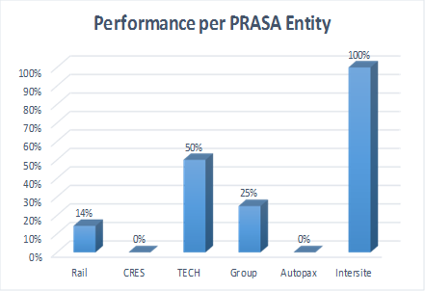
Performance against Pre-determined Objectives

Slide 20
PRASA Performance: Rail Services

Slide 21
PRASA Performance: Capex Spend

Slide 22
PRASA Performance: Other Indicators

Slide 23
