Slide 1
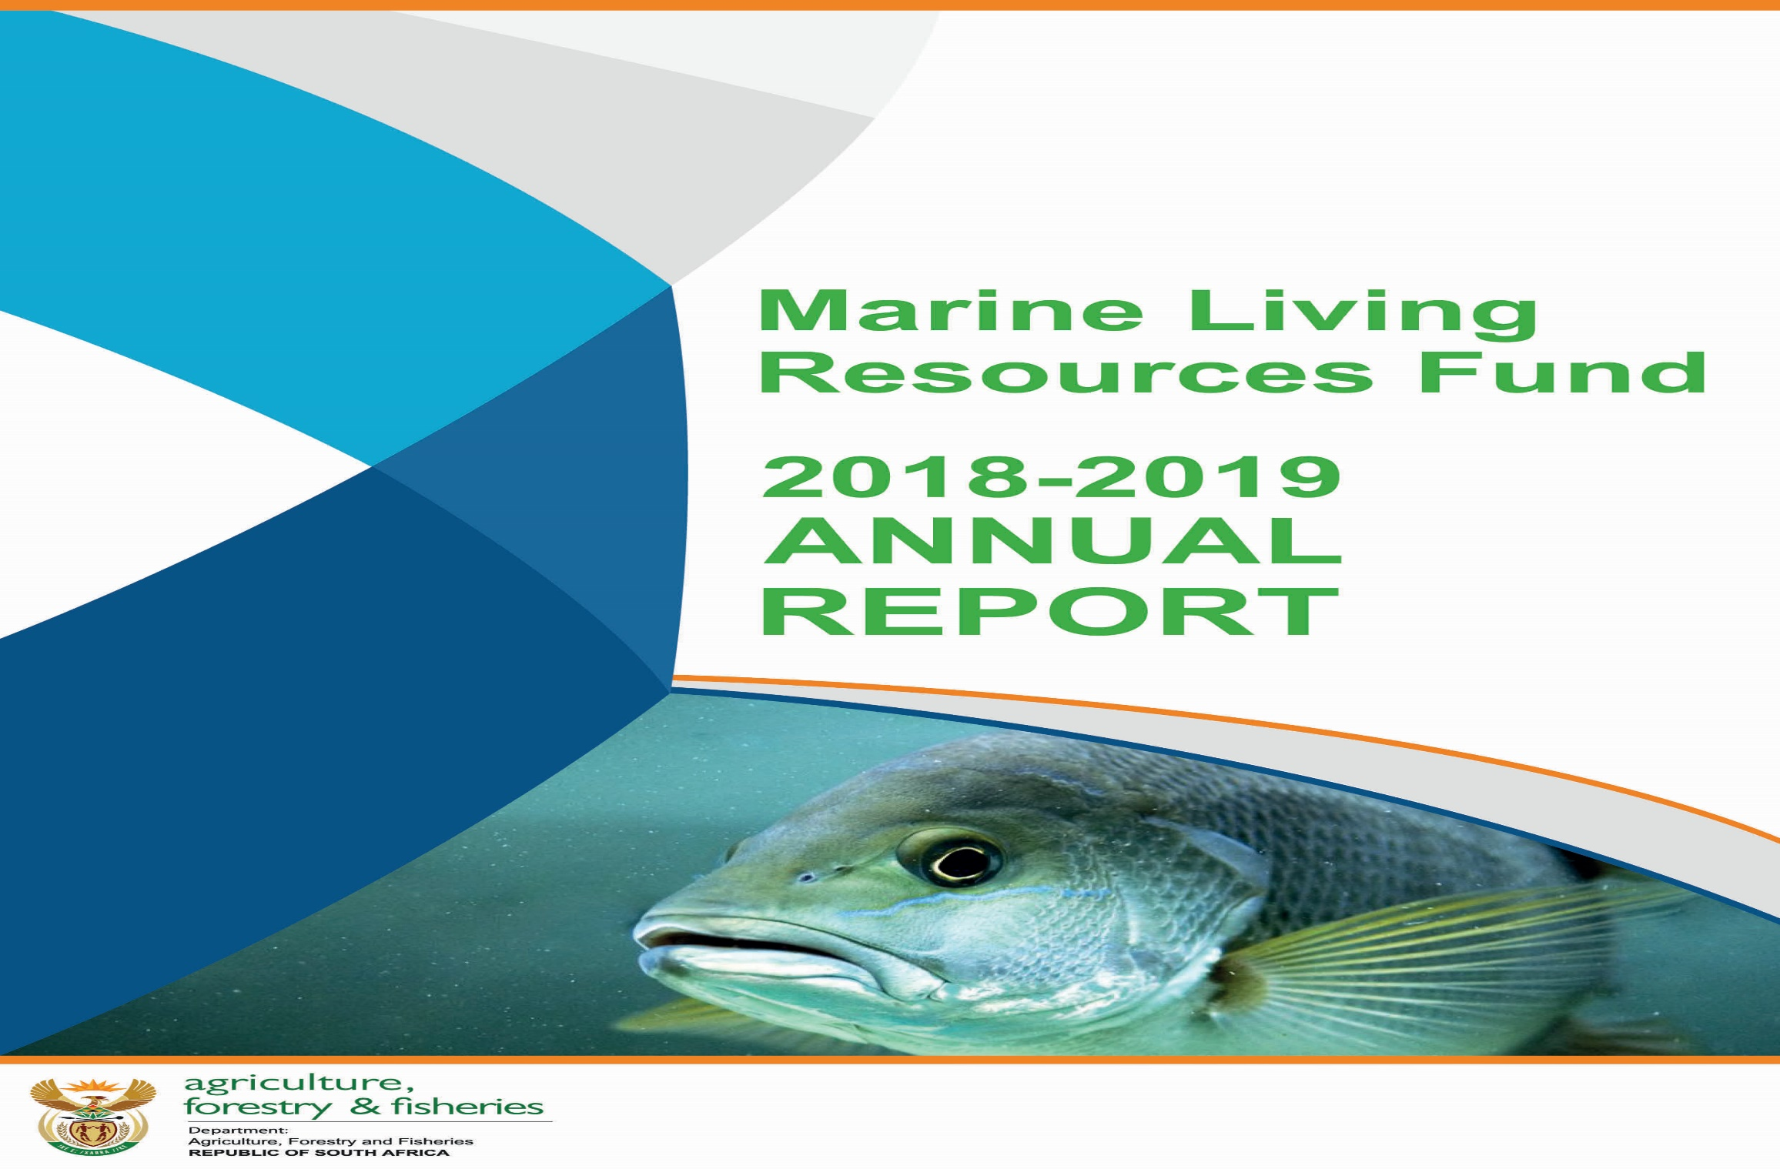
Marine Living Resources Fund Annual Report 2018 – 2019
Presentation to Portfolio Committee October 2019

Slide 2
Presentation Outline
List of Acronyms
Introduction & Background
Audit Outcomes for 2018-2019
Strategic Goals and Objectives
Summary of Achievements of the MLRF per Chief Directorate
Performance Against Targets
Financial Achievements (Statements)
Statement of Financial Position
Statement of Financial Performance
Statement of Changes in Net Assets
Cash Flow Statement
Statement of Comparison of Budget and Actual Information
Recommendation
Photographs: Fisheries Library

Slide 3
List of Acronyms
AED = Aquaculture and Economic Development
AGSA = Auditor-General of South Africa
CD = Chief Director
DAFF = Department of Agriculture, Forestry and Fisheries
DDG = Deputy Director-General
DG = Director-General
EXCO = Executive Committee
FAO = Food and Agricultural Organisation
FOS = Fisheries Operations Support
FPE = Fish Processing Establishment
FPV = Fisheries Protection Vessel
EPWP – Extended Public Works Programme
FRAP = Fishing Rights Allocation Process
FRD = Fisheries Research and Development
G&S = Goods and Services
MCS = Monitoring, Control and Surveillance

Slide 4
List of Acronyms (cont…)
M&E = Monitoring and Evaluation
MLRA = Marine Living Resources Act
MLRF = Marine Living Resources Fund
MRM = Marine Resources Management
MTEF = Medium Term Expenditure Framework
MTSF = Medium Term Strategic Framework
PFMA = Public Finance Management Act
RFMO = Regional Fisheries Management Organisation
SAMSA = South African Maritime Safety Association
SG = Strategic Goal
SO = Strategic Objective
TAC = Total Allowable Catch
TAE = Total Allowable Effort
WCRL = West Coast Rock Lobster
WFFP = Working for Fisheries Programme

Slide 5
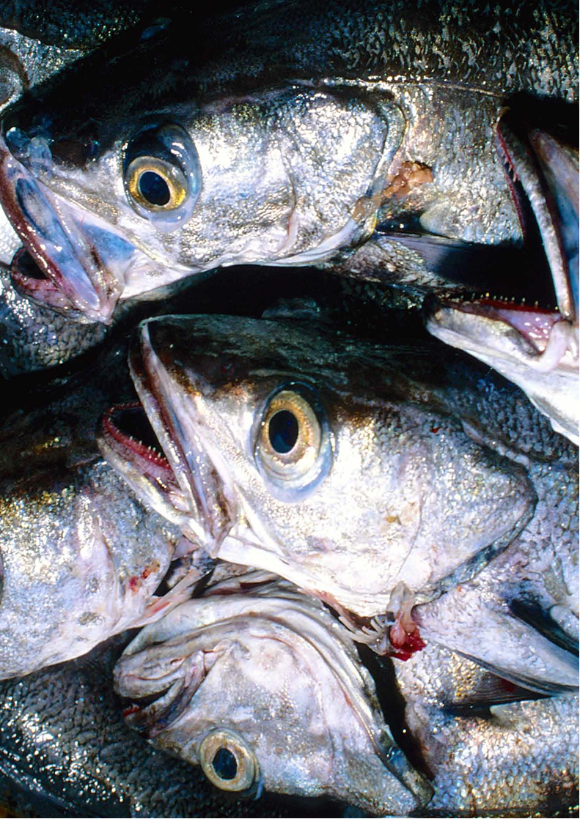
Introduction and Background

Slide 6
Introduction and Background
The 2018-2019 Annual Audited Report for the Marine Living Resources Fund (MLRF) was tabled by Department of Agriculture, Forestry and Fisheries as the Director-General of DAFF was the Accounting Authority of the Fund for the period under review
The Marine Living Resources Fund (MLRF) is a Schedule 3 A Public Entity, registered in 2001.
In terms of Section 10 of the MLRA
Director-General is the accounting officer of the MLRF
Minister approves revenue and expenditure budget
Financial year ends 31 March
Auditors: Auditor-General of South Africa
Any unexpended cash balances at the end of the financial year are carried forward to next year

Slide 7
Introduction and Background (cont)
Section 10 of the MLRA:
Monies to be paid into the MLRF:
  Fines, penalties, interest for any contraventions in relation to the Act
Proceeds from sale of seized/forfeited vessels, vehicles, aircraft, gear or fish
Interest and Fees collected
Interest on cash investments
Donations received
Levies on fish, fish products, aquatic plants or other marine resources ito this Act or any other law

Slide 8
Introduction and Background (cont)
The 2018-2019 Annual Audited Report for the Marine Living Resources Fund (MLRF) was tabled by Department of Agriculture, Forestry and Fisheries as the Director-General of DAFF was the Accounting Authority of the Fund for the period under review.
The MLRF comprises of six sub-programmes namely
  Aquaculture and Economic Development;
  Fisheries Research and Development;
  Marine Resource Management;
  Monitoring Control and Surveillance
  Fisheries Operations Support
  Financial Management (MLRF).
  Aquaculture and Economic Development which promotes the growth of the aquaculture sector by providing public support and an integrated platform for the management of aquaculture. The Chief Directorate also facilitates the development of alternative livelihoods for coastal communities and the management of the 12 proclaimed fishing harbours.

Slide 9
Introduction and Background (cont)
Fisheries Research and Development which promotes the sustainable development of fisheries resources and ecosystems by conducting and supporting appropriate research.
Marine Resource Management which fosters the sustainable use and the equitable and orderly access to marine living resources through improved management and regulation.
Monitoring, Control and Surveillance which ensures the protection and promotion of sustainable use of marine living resources by intensifying enforcement and compliance efforts.
Fisheries Operations Support provides support services to the Chief Directorate Financial Management for the MLRF and the support components of Communications, Human Resources, Information Technology, Legal Services, International Relations, Stakeholder Relations; and Customer Services.
Financial Management is responsible for the financial management of the MLRF.

Slide 10
Audit Outcomes for 2018-2019
The MLRF received a disclaimed audit opinion. This is a further regression in terms of audit outcomes from previous financial years.
The Auditor-General found that significant internal control deficiencies exist within the entity which resulted in the disclaimed audit opinion. The AG also found that leadership did not provide adequate oversight in the implementation of mitigation plans to address prior year findings, and that critical vacancies in key positions, particularly in the Chief Directorate: Financial Management, resulted in non-compliance with the PFMA and other applicable legislation, and that the entity needs to strengthen its management of risk, consequence management and its internal control environment.
It will therefore be incumbent on the new Accounting Authority and Executive of DEFF to oversee the implementation of a Turn-Around Strategy and Action Plan to address the audit findings and control deficiencies mentioned in the Auditor-General’s report, with particular attention to be given to prior year findings.

Slide 11
DAFF Strategic Goals and Objectives
STRATEGIC GOALS | STRATEGIC OBJECTIVES
Strategic Goal 1: Effective and efficient strategic leadership, governance and administration | Strategic Objective 1.1: Ensure compliance with statutory requirements and good governance practices Strategic Objective 1.2: Strengthen the support, guidance and interaction with stakeholders Strategic Objective 1.3: Strengthen institutional mechanism for integrated policy, planning, monitoring and evaluation in the sector
Strategic Goal 2: Enhanced production, employment and economic growth in the sector | Strategic Objective 2.1: Ensure increase production and productivity in prioritised areas as well as value chains Strategic Objective 2.2: Effective management of bio-security and related sector risks Strategic Objective 2.3: Ensure support for market access and processing of Agriculture, Forestry and Fisheries products
Strategic Goal 3: Enabling environment for food security and sector transformation | Strategic Objective 3.1: Lead and coordinate government food security initiatives Strategic Objective 3.2: Enhance capacity for efficient delivery in the sector Strategic Objective 3.3: Strengthen comprehensive support systems and programmes
Strategic Goal 4: Sustainable use of natural resources in the sector | Strategic Objective 4.1: Ensure the conservation, protection, rehabilitation and recovery of depleted and degraded natural resources Strategic Objective 4.2: Ensure adaptation and mitigation to climate change through effective implementation of prescribed frameworks

Slide 12
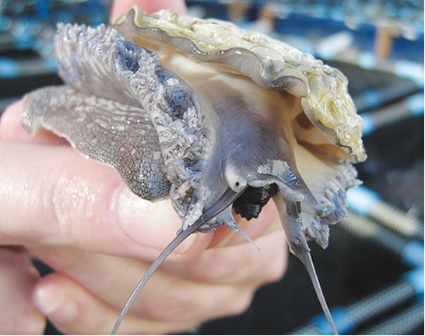
Summary of Achievements of the MLRF

Slide 13
Summary of Achievements of the MLRF
The MLRF had eighteen annual targets in its 2018-2019 Annual Performance Plan and one target falling under the Working for Fisheries Programme. The MLRF achieved nine of the eighteen targets.
The performance highlights are as follows:
16 aquaculture projects were supported under Operation Phakisa (Ocean’s Economy).
3 new aquaculture research studies were successfully conducted, namely a study on the economics of Sea Urchins; a study on animal health (Epizootic Ulcerative Syndrome) and a project on the assessment of temperature, deoxygenation and acidification on aquaculture.
The Fishing Rights Allocation Process (FRAP) appeals processes in the Netfish, KZN Beach-Seine; Seaweed; Hake Inshore Trawl, Horse Mackerel and West Coast Rock Lobster (Nearshore and Offshore) were completed and Regulation 5(3) reports were compiled.

Slide 14
Summary of Achievements of the MLRF (cont)
Research reports to indicate stock levels and TAC/TAE recommendations were compiled for abalone and West Coast Rock Lobster.
A total of 91 joint operations were conducted with partners, including under Initiative 5 of Operation Phakisa.
A total of 4 698 compliance and enforcement measures were implemented in the six prioritised fisheries sectors, namely hake, abalone, rock lobster, linefish, pelagic and squid. A total of 281 investigations were conducted in terms of the Marine Living Resources Act.
Although the MLRF was not able to meet its target of allocating fishing rights to small-scale cooperatives in all four coastal provinces, rights were successfully allocated in the Northern Cape, and rights will be allocated in the Western Cape, KZN and Eastern Cape in the coming financial year.

Slide 15
Summary of Achievements of the MLRF (cont)
The MLRF was also not able to achieve its objective of developing an Implementation Plan for the Aquaculture Development Bill/Act, as this piece of legislation has not yet been signed into law. The Bill is currently within the parliamentary process where it will hopefully be approved by the Sixth Administration.
The MLRF did not realise its objectives of allocating commercial fishing rights in the abalone fishery or of revising the policies and application forms for the 12 fishing sectors in which rights expire during the course of 2020 (FRAP 2020). The Branch, has however, granted an exemption in the abalone fishery to allow harvesting to continue and has completed Phase 1 of the Socio-Economic Impact Analysis for the General Policy on the Management and Allocation of Fishing Rights.

Slide 16
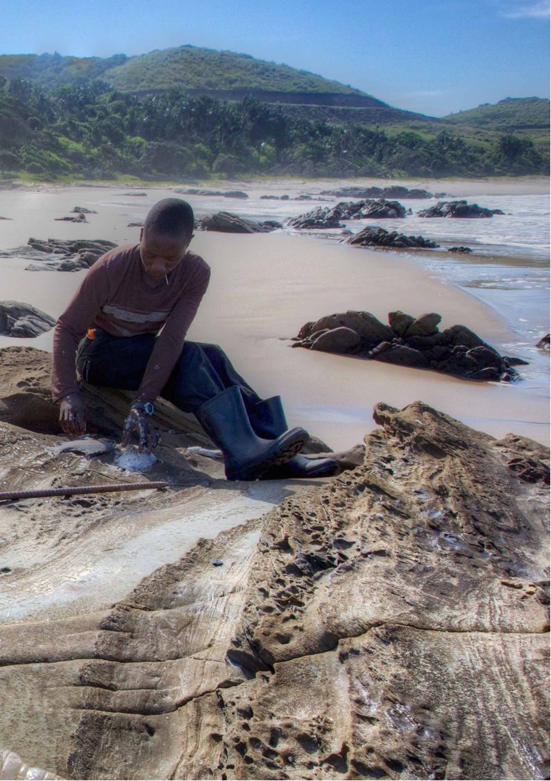
Performance Against Targets

Slide 17
Performance Indicator | Actual Achievement 2017/2018 | Planned Target 2018/2019 | Actual Achievement 2018/2019 | Deviation from Planned Target to Actual Achievement 2018/2019 | Comment on deviation
2.1 Ensure increased production and productivity in prioritised areas as well as value chains | 162.27 FTEs (1 706 jobs) were created | 1 092 jobs (544 FTEs) 597 female jobs (328 female youths and 12 females with disabilities) 488 male jobs (268 male youths and 10 males with disabilities | Not achieved. 30 jobs (27.72 FTEs) 16 female jobs (3 female youths and 0 females with disabilities; 14 male jobs (2 male youths and 0 males with disabilities | 1062 jobs -516.28 FTEs | Only 1 project (Hamburg Aquaculture project) was active during the financial year. The WfFP did not have staff during the reporting period and as a result, no new projects could be initiated.
 | 9 Aquaculture projects were supported: Richardsbay Kob Requa Mussels Chapmans Mussels | 4 Aquaculture projects supported | Achieved. 16 Aquaculture projects were supported | +12 | Exceeded annual target due to the increased demand as a result of the EIA that was approved in Saldanha Bay during the financial year

Slide 18
Achievement against Strategic Objectives
Performance Indicator | Actual Achievement 2017/2018 | Planned Target 2018/2019 | Actual Achievement 2018/2019 | Deviation from Planned Target to Actual Achievement 2018/2019 | Comment on deviation
 | Xesibe Salmar Trading Oystercatcher Southern Atlantic Sea farms Blue Ocean Mussels Saldanha Bay Oyster

Slide 19
Achievement against Strategic Objectives (cont)
Performance Indicator | Actual Achievement 2017/2018 | Planned Target 2018/2019 | Actual Achievement 2018/2019 | Deviation from Planned Target to Actual Achievement 2018/2019 | Comment on deviation
3.1 Lead and coordinate government food security initiatives. | Review policies and application forms for fishing sectors which have fishing rights that expire by 2020 | Allocate fishing rights to 12 fishing sectors which expire in 2020 | Not achieved. Fishing rights will only be allocated in the 2019/2020 financial year. During this period the policies and application forms were reviewed and a 1st Draft of General Policy on the Allocation of Commercial Fishing Rights completed | -12 | Allocation of fishing rights in 12 fishing sectors which expire in 2020 was not concluded. The revision of the policy that guides the allocation is still in draft phase and allocation of rights is dependent on its approval. The Entity is on track to allocate the 2020 fishing rights before they expire in December 2020

Slide 20
Achievement against Strategic Objectives (cont)
Performance Indicator | Actual Achievement 2017/2018 | Planned Target 2018/2019 | Actual Achievement 2018/2019 | Deviation from Planned Target to Actual Achievement 2018/2019 | Comment on deviation
4.1 Ensure the conservation, protection, rehabilitation and recovery of depleted and degraded natural resources. | Recovery plans of prioritised fish stocks were compiled | Recovery plans for the 2 sectors: Abalone and West Coast rock lobster | Not Achieved. Recovery plan for the West Coast rock lobster sector was compiled. | -1 Recovery plan for the abalone will be developed in the revised abalone fishing season | The Minister upheld the 2018/19 Abalone TAC appeal and reset the fishing season from 9 April 2019 to 9 January 2020

Slide 21
Achievements against Performance Indicators
Performance Indicator | Actual Achievement 2017/2018 | Planned Target 2018/2019 | Actual Achievement 2018/2019 | Deviation from Planned Target to Actual Achievement 2018/2019 | Comment on deviation
Increase the number of FTE job opportunities (WfFP) | 1 085 jobs (544 FTEs | 1 092 jobs (544 FTEs) 597 female jobs (328 female youths and 12 females with disabilities) 488 male jobs (268 male youths and 10 males with disabilities) | Not achieved. 30 jobs (27.72 FTEs) 16 female jobs (3 female youths and 0 females with disabilities; 14 male jobs (2 male youths and 0 males with disabilities. | -1062 jobs -516.28 FTEs | Only 1 project (Hamburg Aquaculture project) was active during the financial year. The WfFP did not have staff during the reporting period and as a result, no new projects could be initiated.

Slide 22
Achievements against Performance Indicators (cont)
Performance Indicator | Actual Achievement 2017/2018 | Planned Target 2018/2019 | Actual Achievement 2018/2019 | Deviation from Planned Target to Actual Achievement 2018/2019 | Comment on deviation
2.1.1 Number of aquaculture catalyst projects (iden­tified and listed under Operation Phakisa) supported | 9 Aquaculture projects were supported: Richardsbay Kob Requa Mussels Chapmans Mussels Xesibe Salmar Trading Oystercatcher Southern Atlantic Sea farms Blue Ocean Mussels Saldanha Bay Oyster | 4 Aquaculture projects supported | Achieved. 16 Aquaculture projects were supported | +12 | Exceeded annual target due to the increased demand as a result of the EIA that was approved in Saldanha Bay during the financial year

Slide 23
Achievements against Performance Indicators (cont)
Performance Indicator | Actual Achievement 2017/2018 | Planned Target 2018/2019 | Actual Achievement 2018/2019 | Deviation from Planned Target to Actual Achievement 2018/2019 | Comment on deviation
2.1.2 Small-scale Aquaculture Support Programme developed and implemented |  | Small-scale Aquaculture Support Programme concept note | Not achieved. Small-scale Aquaculture Support Programme Inception report was developed | Small-scale Aquaculture Support Programme concept note was not done | Delays in Supply Chain processes on the appointment of the service provider to develop the concept note

Slide 24
Achievements against Performance Indicators (cont)
Performance Indicator | Actual Achievement 2017/2018 | Planned Target 2018/2019 | Actual Achievement 2018/2019 | Deviation from Planned Target to Actual Achievement 2018/2019 | Comment on deviation
2.1.3 Aquaculture Development Act developed and implemented as per Operation Phakisa | The department of Planning, Monitoring and Evaluation (DPME) has assessed the Socio-Economic Impact Assessment (SEIAS) of the Aquaculture Development Bill and granted permission to the department to proceed with the submission of the Bill to Cabinet. | Aquaculture Development Bill/Act implementation plan | Not achieved. The Aquaculture Development Bill was introduced in Parliament on the 15th June 2018 | Aquaculture Development Bill/Act implementation plan was not developed. | The implementation plan can only be developed once the President has signed off on the Bill into Act. The process is currently under Parliament processes

Slide 25
Achievements against Performance Indicators (cont)
Performance Indicator | Actual Achievement 2017/2018 | Planned Target 2018/2019 | Actual Achievement 2018/2019 | Deviation from Planned Target to Actual Achievement 2018/2019 | Comment on deviation
2.1.4 Number of aquaculture research projects con­ducted | 2 new studies on production systems for new candidate species for aquaculture were conducted and report has been compiled. |  | The Entity achieved 3 of the 4 planned aquaculture research projects as outlined below.
 |  | One new research on economics of new candidate species for aquaculture conducted (Sea urchin) | Achieved. One new research on economics of new candidate species for aquaculture was conducted (Sea urchin) and report has been compiled and approved. | N/A | N/A

Slide 26
Achievements against Performance Indicators (cont)
Performance Indicator | Actual Achievement 2017/2018 | Planned Target 2018/2019 | Actual Achievement 2018/2019 | Deviation from Planned Target to Actual Achievement 2018/2019 | Comment on deviation
2.1.4 Number of aquaculture research projects con­ducted | 2 new studies on production systems for new candidate species for aquaculture were conducted and report has been compiled. | One new research project on production systems for new candidate species for aquaculture conducted (Scallops) | Not achieved. An exploratory survey of Algoa Bay was conducted in April 2018 by contracted divers to establish the population density and to collect 30 scallops parentstock/broodstock, as no live scallops could be found in False Bay. During the survey in April 2018, no live parentstock/broodstock was found in Algoa Bay and only empty shells were found. The natural populations of scallops will need to recover and timeframes for recovery could span a number of years unless a population is detected elsewhere along the South African coast | -1 | Research project on production systems for new candidate species for aquaculture was not conducted (Scallops) due to parentstock/broodstock which could not be obtained for experimental purposes

Slide 27
Achievements against Performance Indicators (cont)
Performance Indicator | Actual Achievement 2017/2018 | Planned Target 2018/2019 | Actual Achievement 2018/2019 | Deviation from Planned Target to Actual Achievement 2018/2019 | Comment on deviation
2.1.4 Number of aquaculture research projects con­ducted | 2 new studies on production systems for new candidate species for aquaculture were conducted and report has been compiled. | One aquatic animal health research project (Epizootic Ulcerative Syndrome) | Achieved. One aquatic animal health research project (Epizootic Ulcerative Syndrome) was conducted | N/A | N/A
 |  | One research project on climate change: Assessment of temperature, deoxygenation and acidification on aquaculture | Achieved. One research project on climate change: Assessment of temperature, deoxygenation and acidification on aquaculture was conducted and report has been compiled | N/A | N/A

Slide 28
Achievements against Performance Indicators (cont)
Performance Indicator | Actual Achievement 2017/2018 | Planned Target 2018/2019 | Actual Achievement 2018/2019 | Deviation from Planned Target to Actual Achievement 2018/2019 | Comment on deviation
3.1.1 Commercial fishing rights allocated and appeals process managed | Final list of successful WCRL Nearshore applicants published 31 July 2017. Provisional list of successful WCRL Offshore applicants published 31 July 2017. The applications forms for abalone fishing rights were assessed by the Abalone Assessment Team. | Allocate rights in the abalone sector | Not achieved. Rights in the abalone sector were not allocated however exemption was granted to existing long term abalone right holders for the 2018/19 abalone season, starting 1 November 2018 until 31 July 2019 | Abalone rights were not allocated | The Delegated Authority decided not to allocate rights in the abalone sector during 2018/19. Rights in the abalone sector will be allocated with the 12 fishing sectors due for re-allocation in 2020

Slide 29
Achievements against Performance Indicators (cont)
Performance Indicator | Actual Achievement 2017/2018 | Planned Target 2018/2019 | Actual Achievement 2018/2019 | Deviation from Planned Target to Actual Achievement 2018/2019 | Comment on deviation
3.1.1 Commercial fishing rights allocated and appeals process managed | Appeals only finalised in four newly allocated fishing sectors (Hake Inshore, Fish Processing Establishment, Large Pelagic and Patagonian Toothfish) | Revised policies and application forms for 12 fishing sectors which expire in 2020 | Not achieved. 1st Draft General Policy on the Allocation of Commercial Fishing Rights completed and consulted internally. | -12 | Revision of the policies and application forms could not be completed. The new requirement to conduct Socio-Economic Impact Assessment System (SEIAS) by the DPME included additional requirements that resulted in planned milestones not being achieved. The Revised Application forms are dependent on the finalisation of the policy

Slide 30
Achievements against Performance Indicators (cont)
Performance Indicator | Actual Achievement 2017/2018 | Planned Target 2018/2019 | Actual Achievement 2018/2019 | Deviation from Planned Target to Actual Achievement 2018/2019 | Comment on deviation
3.1.1 Commercial fishing rights allocated and appeals process managed | - | Support the FRAP 2015/16 appeals process | Achieved. Regulation 5(3) Reports were drafted for Netfish, KZN Beach-Seine, Seaweed, Hake Inshore Trawl; Horse Mackerel; West Coast Rock Lobster (Nearshore and Offshore). The appeals in the Netfish and KwaZulu-Natal Sardine Beach-Seine, Seaweed, WCRL Offshore and WCRL Nearshore and Hake Inshore Trawl were finalised. | N/A | N/A

Slide 31
Achievements against Performance Indicators (cont)
Performance Indicator | Actual Achievement 2017/2018 | Planned Target 2018/2019 | Actual Achievement 2018/2019 | Deviation from Planned Target to Actual Achievement 2018/2019 | Comment on deviation
3.1.2 Small-scale Fisheries Policy implemented | Small-scale Fisheries Co-operative Training Manual was developed and training provided to communities in NC and KZN. | Rights allocated to registered small-scale fisheries cooperatives | Not achieved. The small-scale fishing rights were allocated in Northern Cape | No rights were allocated to EC, KZN and WC co-operatives | The tip-off process caused delays in finalizing the list of small scale fishers in the Western Cape and there were delays in the registration of co-operatives with CIPC for the EC and KZN

Slide 32
Achievements against Performance Indicators (cont)
Performance Indicator | Actual Achievement 2017/2018 | Planned Target 2018/2019 | Actual Achievement 2018/2019 | Deviation from Planned Target to Actual Achievement 2018/2019 | Comment on deviation
4.1.1 Sustainable management of fish stock | Recovery plans for the 2 sectors: Abalone and West Coast rock lobster were compiled. | Recovery plans for the 2 sectors: Abalone and West Coast rock lobster | Not achieved. The inter-area schedule was finalised in consultation with the exemption holders. Applications for permits for the 2018/19 fishing season received, considered. WCRL Inter-area schedule was signed off on 07 November 2018, and the permits issued thereafter | Recovery plan for abalone was not developed | The Minister upheld the 2018/19 Abalone TAC appeal and reset the fishing season from 9 April 2019 to 9 January 2020 Permits for the Abalone sector are currently being processed

Slide 33
Achievements against Performance Indicators (cont)
Performance Indicator | Actual Achievement 2017/2018 | Planned Target 2018/2019 | Actual Achievement 2018/2019 | Deviation from Planned Target to Actual Achievement 2018/2019 | Comment on deviation
4.1.1 Sustainable management of fish stock | Research report to indicate fish stock levels compiled for: West Coast Rock Lobster, deep-water hake and abalone | Research reports and TAC/TAE recommendations compiled for two sectors: Abalone and WCRL | Achieved. Research reports and TAC/TAE recommendations compiled for the Abalone and WCRL sectors | N/A | N/A

Slide 34
Achievements against Performance Indicators (cont)
Performance Indicator | Actual Achievement 2017/2018 | Planned Target 2018/2019 | Actual Achievement 2018/2019 | Deviation from Planned Target to Actual Achievement 2018/2019 | Comment on deviation
4.1.2 Number of inspections conducted | A total of 6 486 compli­ance and enforcement measures in 6 prioritised fisheries sectors were implemented (hake, abalone, rock lobster, linefish, pelagic and squid) | 4 500 compliance and enforcement measures in the six prioritised fisheries sectors: hake, abalone, rock lobster, linefish, pelagic and squid implemented | Achieved. A total of 4 698 compliance and enforcement measures in the six prioritised fisheries sectors: hake, abalone, rock lobster, linefish, pelagic and squid were implemented | +198 | The over- achievement was due to the Fishery Control Officers (FCOs) performing the function of the catch data monitors which resulted in additional inspections being conducted.

Slide 35
Achievements against Performance Indicators (cont)
Performance Indicator | Actual Achievement 2017/2018 | Planned Target 2018/2019 | Actual Achievement 2018/2019 | Deviation from Planned Target to Actual Achievement 2018/2019 | Comment on deviation
4.1.3 Number of joint operations conducted with partners including Operation Phakisa Imitative 5 | 65 joint operations were conducted (compliance = 28; monitoring and surveillance = 13; and fisheries protection vessels = 24) | 40 operations | Achieved. A total of 91 operations conducted | +51 | Operation Phakisa Oceans Economy activities were initiated with the other Law Enforcement Agencies. MCS participated in a number of smaller operations to address illegal activities which led to an over-achievement
4.1.4 Number of investigations conducted in terms of the Marine Living Resources Act | A total of 318 investigations conducted | 280 investigations | Achieved. A total of 281 investigations were conducted | +1 | There was an over achievement as a result of responding to and investigating additional MLRA transgressions that occurred

Slide 36
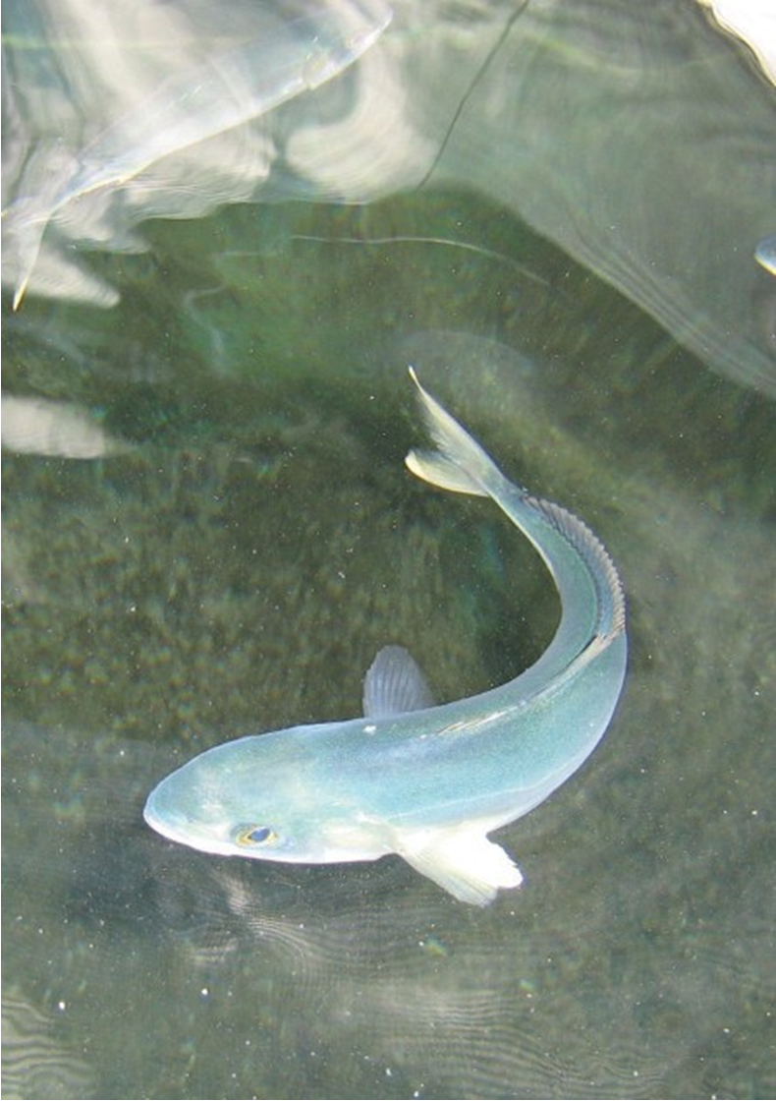
Financial Statements

Slide 37
Statement of Financial Position 31 March 2018
ASSETS | 2019 (R'000) | 2018 (R'000)
Non-current assets
Plant and equipment | 298 822 | 317 683
Intangible assets | 110 | 144
 | 298 932 | 317 827
Current assets
Inventory | 106 510 | 81 640
Trade and other receivables | 13 161 | 18 786
Cash and cash equivalents | 264 981 | 207 561
 | 384 652 | 307 987
Total assets | 683 584 | 625 814
LIABILITIES
Current liabilities
Deferred income | 247 797 | 177 247
Donor funds | 2 014 | 1 895
Trade and other payables | 83 656 | 48 875
Total liabilities | 333 467 | 228 017
Net assets | 350 117 | 397 797
NET ASSETS
Accumulated surplus | 350 117 | 397 797
Total net assets | 683 584 | 625 814

Slide 38
Statement of Financial Performance
 | 2019 (R’000) | 2018 (R’000)
Revenue
Revenue from exchange transactions
Application Fees | 4 689 | 4 674
Chartering of Departmental Vessels | 1 084 | -
Harbour Fees | 3 746 | 4 801
Licences and Permits | 30 527 | 32 976
Grant of right Fee | 767 | 2 270
Foreign Exchange Surplus | - | 106
Finance Income | 17 593 | 17 298
Total Revenue from Exchange Transactions | 58 406 | 62 125
Revenue from non-exchange transactions
Levy on Fish Products | 59 143 | 70 299
Fines | 1 648 | 20 198
Grants and Other Transfer Payments | 180 713 | 176 411
Realisation of Conditional Grants | 13 470 | 22 244
Confiscated Assets and Fish Products | 24 871 | 49 286
Other income | 854 | 1 498
Service in kind | 368 403 | 380 312
Donations in kind | 4 594 | -
Total Revenue from Non-Exchange Transactions | 653 696 | 720 248
Total Revenue | 712 102 | 782 373
Expenses
Consumables used | -3 702 | -6 364
Depreciation and amortisation | -26 720 | -27 033
Transportation costs | -46 073 | -41 860
Advertising costs | -364 | -590
Operating lease payments | -2 698 | -2 789
Other deficits | -23 | -24
Vessel operating costs | -179 069 | -168 263
Financial contributions | -5 394 | -11 151
Other operational costs | -127 124 | -125 277
Foreign exchange loss | -211 | -
Service in kind | -368 403 | -380 312
Surplus/(Deficit) for the year | -47 679 | 18 710

Slide 39
Statement of Changes in the Assets for year end
31 March 2018
 | Accumulated surplus | Total net assets
 | R’000 | R’000
 | 2019 | 2019
Balance at 1 April 2017 | 379 086 | 379 086
Reinstated surplus for the year | 18 710 | 18 710
Surplus for the year 2018 | 18 296 | 18 296
Prior period error: | 414 | 414
Realisation of deferred income | 414 | 414
Government grants | 16 197 | 16 197
Vessel operating costs | -16 197 | -16 197
Legal fees | -978 | -978
Other income | 978 | 978
Balance at 1 April 2018 | 397 796 | 397 796
Surplus/(Deficit) for the year | -47 679 | -47 679
Balance at 31 March 2019 | 350 117 | 350 117

Slide 40
Cash Flow Statement
 | 2019 (R’000) | 2018 (R’000)
Cash flows from operating activities
Cash receipts from customers | 114 608 | 189 228
Cash paid to suppliers | -327 640 | -413 213
Net cash utilised by operations | -213 032 | -223 985
Finance cost | - | -
Finance income | 17 593 | 17 298
Net cash outflow from operating activities | -195 439 | -206 687
Cash flows from investing activities
Purchases of plant and equipment | -3 243 | -4 866
Purchases of plant and equipment funded by
Government grants
Proceeds from disposal of plant and equipment | - | -
Purchases of intangible assets | -10 | -155
Net cash outflow from investing activities | -3 253 | -5 021
Cash flows from financing activities
Proceeds from grant received | 256 112 | 259 818
Net cash inflow from financing activities | 256 112 | 259 818
Net decrease in cash and cash equivalents | 57 420 | 48 110
Cash and cash equivalents at the beginning of the year
 | 207 561 | 159 451
Cash and cash equivalents at the end of the year | 264 981 | 207 561

Slide 41
Statement of Comparison of Budget and Actual Information
 | Original Approved Budget | Adjustment | Final Budget | Actual | Difference Final budget and Actual
 | 2018/19 R’000 | 2018/19 R’000 | 2018/19 R’000 | 2018/19 R’000 | 2018/19 R’000
Revenue from exchange transactions
Application fee | 6 050 |  | 6 050 | 4 689 | (1 361)
Chartering of departmenta; vessels | - |  | - | 1 084 | 1 084
Harbor fees | 5 500 |  | 5 500 | 3 746 | (1 754)
Licenses and permits | 41 270 |  | 41 270 | 30 527 | (10 743)
Grant of right fee | - |  | - | 767 | 767
Finance income | 10 000 |  | 10 000 | 17 593 | 7 593
Total revenue from exchange transactions | 62 820 |  | 62 820 | 58 406 | (4 414)
Revenue from non-exchange transactions
Fines | 3 000 |  | 3 000 | 1 648 | (1 352)
Levy on fish products | 62 000 |  | 62 000 | 59 143 | (2 875)
Grant and other transfer payments | 269 467 | (9 734) | 259 733 | 180 713 | (79 320)
Realisation of deferred income | 154 000 |  | 154 000 | 13 471 | -140 529
Other income | 20 212 |  | 20 212 | 25 725 | 5 513
Donations in kind |  |  |  | 4 594 | 4 594
 | 508 679 | (9 734) | 498 945 | 285 294 | -213 651
Total revenue | 571 499 | (9 734) | 561 765 | 343 700 | -218 065
Expenditure
Consumable used | 9 565 |  | 9 565 | 3 702 | (5 863)
Depreciation | - |  | - | 26 720 | 26 720
Transportation costs | 26 784 |  | 26 784 | 46 073 | 19 289
Advertising costs | 4 978 |  | 4 978 | 364 | (4 614)
Operating lease payments | 2 487 |  | 2 487 | 2 698 | 211
Foreign exchange loss |  |  |  | 212 | 212
Other deficit | - |  | - | 24 | 24
Other operational costs | 121 101 |  | 121 101 | 127 124 | 6 976
Vessel operation costs | 172 093 |  | 172 093 | 179 069 | 6 023
Financial contribution | 226 704 | (9 734) | 216 970 | 5 394 | (211 576)
 | 563 712 | (9 734) | 553 978 | 391 380 | -162 600
Surplus/ (deficit) for the year | 7 787 | - | 7 787 | -47 679 | -55 465

Slide 42
Recommendation
That the Portfolio Committee approves the 2018/19 Annual Report of the Marine Living Resources Fund

