Slide 1
PROGRESS ON THE ENERGY SECURITY GAME CHANGER
Presentation to the Standing Committee:
Finance, Economic Opportunities & Tourism
2 October 2019

Slide 2
Energy Security Game Changer
Enough power for growth in the Western Cape that is sustainable and low carbon
Enhanced uptake of Solar PV
Diversifying our energy mix
through alternative low
carbon supply & energy efficiency measures
Roll out of Independent Power Producers (IPPs)
Reduced energy consumption in both public and private buildings
Importation of Liquefied Natural Gas (LNG)
The development of a grid management system that facilitates wheeling and manages peak demand
Aligned with the NDP and national priorities

Slide 3
What have we been doing?

Slide 4
What have we been doing to encourage solar PV?
Regular engagement with all Local Municipalities to assist them to enable residents and businesses to install rooftop solar PV
To allow rooftop PV, a Municipality needs to put a policy, by-law, and approved tariff in place; a draft policy and by-law was developed
Visits to all Municipalities and presentations to key stakeholders, e.g. Municipal CFOs
One-on-one- engagements with CEOs of businesses interested in rooftop PV
Over 60 businesses visited, and over 60% of them have subsequently decided to install rooftop PV
Communications campaigns aimed at businesses, demonstrating that there is an excellent business case for installing rooftop PV

Slide 5
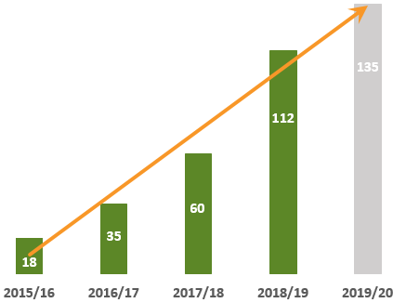
Achievements: Uptake of Small Scale Embedded Generation (SSEG*)
On Track To Reach 2020 Target Of 135MW
*Small -scale Embedded Generation: private renewable energy systems, often solar PV, that are less than 1 MW

Slide 6
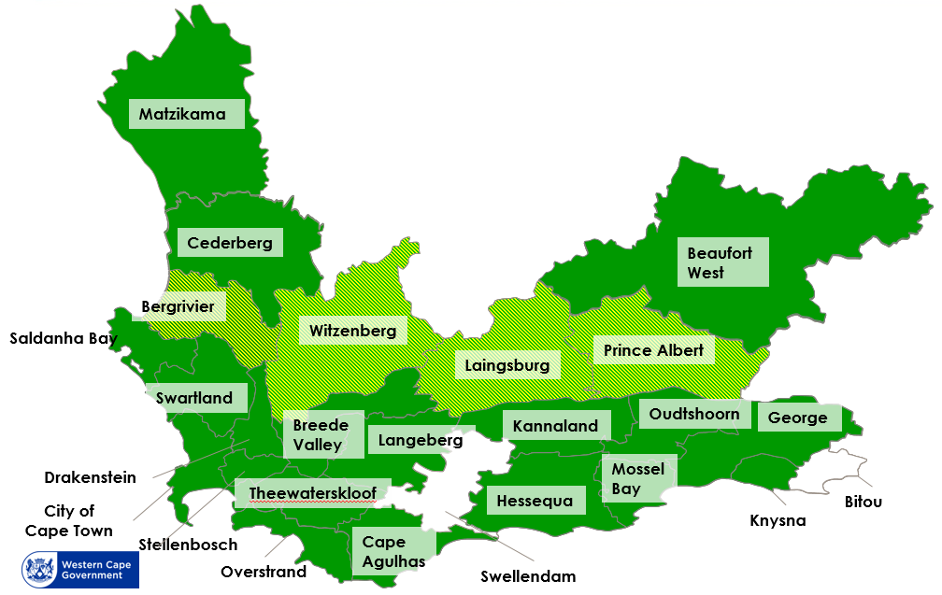
Achievements: Uptake of Small Scale Embedded Generation (SSEG)
In 2015, there were 2 municipalities that allowed SSEG.
As of September 2019, there are 23 allowing SSEG and 19 with NERSA-approved feed-in tariffs. This can be found at www.switchandsave.co.za

Slide 7
What have we done to encourage energy efficiency?
Convening of an “energy efficiency” task team comprising key departments (Health, Education, Public Works & Transport, City of Cape Town)
Shared programmes and best practices
Developed an energy efficiency programme in the Province, with the leadership of the Department of Transport & Public Works
Completed several communications campaigns aimed at encouraging businesses and households to save electricity (“Switch and Save” campaign)

Slide 8
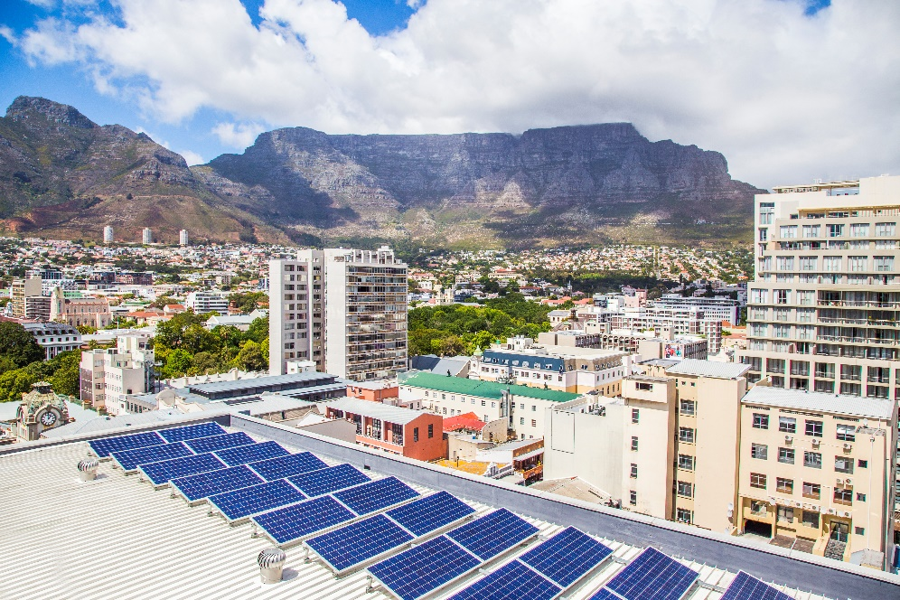
Energy Efficiency in Government Buildings
The Western Cape Government is leading by example
631
Electricity meters installed since 2016
145
kWh/m²/yr
Total electricity consumption down 13% from 2015. The current consumption is 38% below industry benchmark
13
PV installations completed with R42.6 million invested & an expected saving of 10%/yr

Slide 9
What have we done to promote
the development of smart grids in Municipalities?
Through our partner GreenCape, significant work was done with a national task team to develop a “smart meter” standard
This will form the basis for mass production of one kind of meter, thereby bringing down the price
The Game Changer has engaged with four Municipalities (Witzenberg, Stellenbosch, Drakenstein, and the City of Cape Town) to develop a “wheeling framework” that would allow businesses to provide electricity to each other

Slide 10
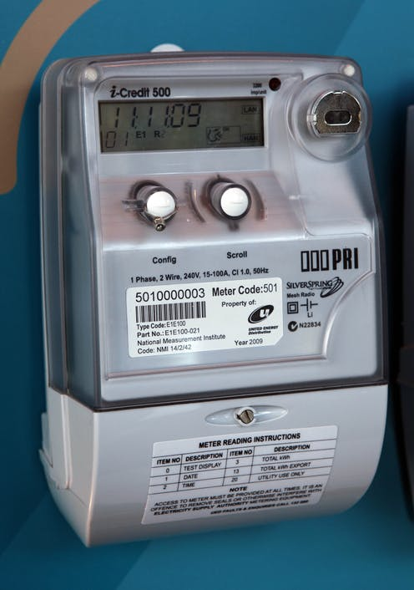
Achievements:
Development of a Smart Grid
Smart Meters:
Smart Meter Standard published in 2016 - this allows two-way communication, remote control, and more control for customers.
Energy Trading:
Wheeling framework under development in City of Cape Town, Stellenbosch and Drakenstein. Each of these municipalities has had a wheeling tariff in place.

Slide 11
What have we done to promote
the importation of natural gas into the Western Cape?
LNG will drive industrialisation in the Province: it will provide gas for industrial processes and gas for power.
Natural gas is much cleaner than its alternatives.
The Department has just completed a comprehensive feasibility study for the importation of natural gas (funded by the US Trade & Development Agency)
The Department has a Memorandum of Cooperation with Transnet to progress work into the development of appropriate infrastructure to facilitate a National Gas economy in the Western Cape.

Slide 12
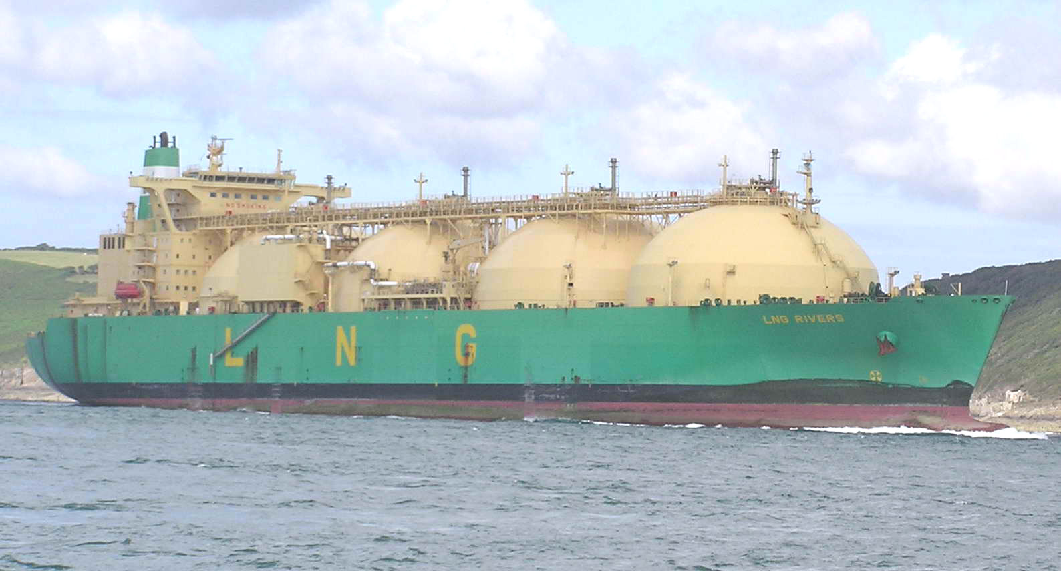
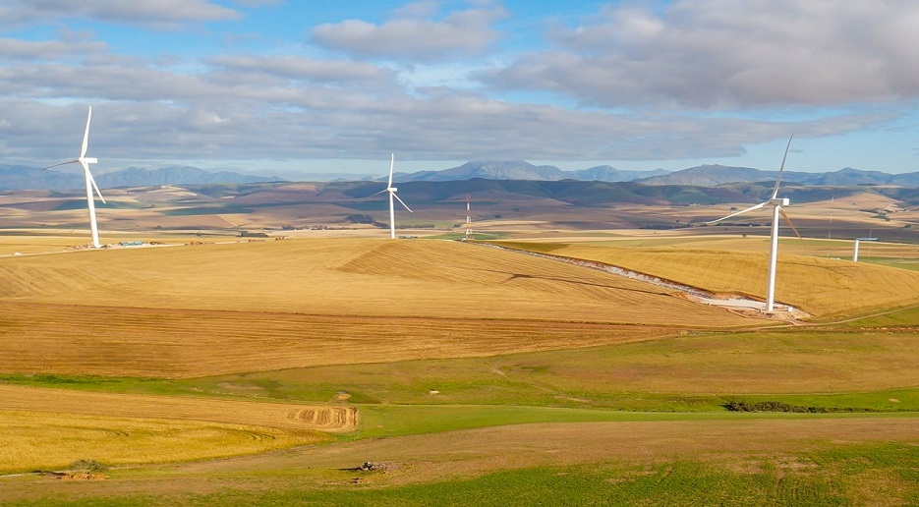
Achievements: Promoting the Importation of Natural Gas
Importation of Liquefied Natural Gas (LNG):
Province has completed 7 detailed studies to date, and is working with national stakeholders on this initiative.
Procuring energy from Independent Power Producers (IPPs):
City of Cape Town proceeding with the court action against Department of Energy(awaiting court date)

Slide 13
Initiatives under way

Slide 14
Encouraging the uptake of solar PV (SSEG)
Objective: to encourage municipal customers to install solar PV systems up to 1MW (requires no licence)
Through three channels:
Ensure the enabling environment is in place in municipalities for grid-tied solar PV (23 municipalities allow, 19 have Nersa approved feed-in tariffs)
Introduce a financing model to support investment in solar PV, namely the Property Assessed Clean Energy (PACE) model
PACE is an innovative mechanism for financing energy efficiency, water and renewable energy improvements on a private property. These are financed by an external loan via a PACE Entity and paid back through the municipal rates bill. No public funding is involved.
Engage with businesses to demonstrate that there is a clear business case for solar PV while remaining connected to the grid.

Slide 15
Implement municipal wheeling
What is Energy Wheeling: Company A sells power from a generation system it owns – such as a rooftop solar PV system – via the electricity grid to Company B, and pays a fee to the municipality or Eskom for use of the network.
Potential with Wheeling:
Opportunities for large private investment in solar PV
Can be beneficial in energy-constrained municipalities
Work Under Way:
GreenCape has developed a wheeling framework which can be adjusted to suit each municipality – at the moment working with Drakenstein & Stellenbosch.
The City of Cape Town is busy testing wheeling within their system
Wheeling should be possible in some Municipalities within the next two years

Slide 16
Procure energy from Independent Power Producers
Objective: to obtain permission for local municipalities to procure energy from IPPs
The City of Cape Town has a court case against the DoE and NERSA to be allowed to procure electricity directly from Independent Power Producers (IPPs).
The WCG is engaging with national government to authorise municipalities to procure energy from IPPs systems between 1-10MW embedded in the municipal network.
The Draft IRP 2018 (March 2019 update) has no cap up to 2022 and allows for 500 MW of Distributed Generation per year (presumed to be systems under 10 MW) from 2022 to 2030.

Slide 17
City of Cape Town Own Generation
As part of their commitment to diversifying energy sources, the City is investigating:
10 MW City-Owned solar PV plant
40 MW City-Owned solar PV plant
These two are based on approval from DoE
The potential role it could play with respect to development of Natural Gas – including up to 300MW of gas to power and gas distribution
Expansion of rooftop PV on City Buildings
60 buildings have been identified / shortlisted as potential rooftop PV sites. Initial plan is for 3 sites over the next year.

Slide 18
Dr Hildegarde Fast
DDG: Energy Security Game Changer
021 483 0848
Hildegarde.Fast@westerncape.gov.za
Website: www.switchandsave.co.za

