Slide 1
STANDING COMMITTEE ON LOCAL GOVERNMENT
CORRECTIVE MEASURES AT UNDERPERFORMING MUNICIPALITIES
Graham Paulse |
Head of Department

Slide 2
Audit Outcomes: 2017/18
26 out of 30 municipalities obtained an unqualified audit.
Notwithstanding the drop in the number of clean audits, unqualified opinions increased year-on-year.
In addition, no Disclaimers or Adverse opinions were issued for the 2017/18 financial year.
SUMMARY – AUDIT OPINION | 2017/18 | 2016/17 | 2015/16
Unqualified with no findings (clean audits) | 12 | 21 (22) | 23
Unqualified with findings | 14 | 4 (5) | 5
Qualified opinion | 4 | 2 | 1
Adverse | 0 | 0 | 0
Disclaimer | 0 | 1 | 1
Audit reports not issued | 0 | 2 | 0
TOTAL | 30 | 30 | 30

Slide 3
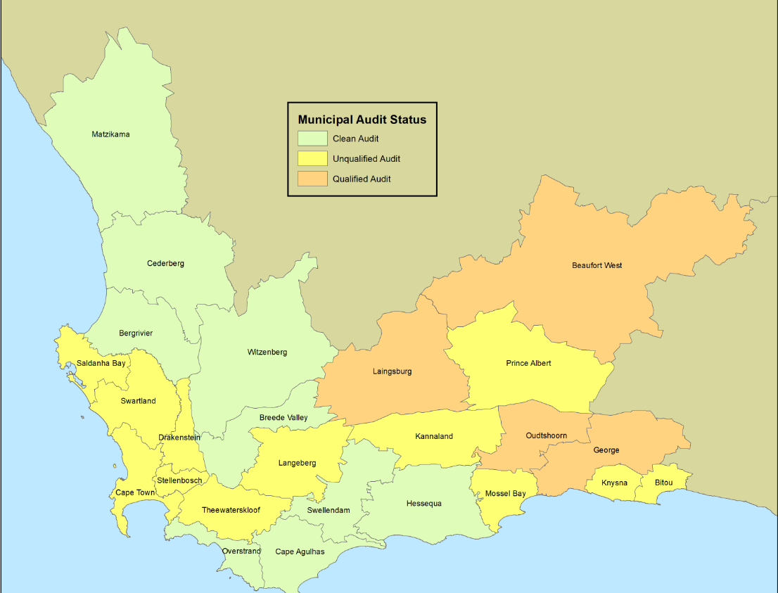
Summary: Audit Outcomes 2017/18

Slide 4
Analysis and Summary of Audit Outcomes
Transversal Governance Related Findings : Information Technology; Human Resources and Leadership
Transversal Financial Related Findings : Disclosures; Procurement and Contract Management, SCM
WESTERN CAPE MUNICIPALITIES- CONSOLIDATED BREAKDOWN OF AUDIT FINDINGS
FINDING | NUMBER OF OCCURANCE
Disclosures | 105
Information Technology | 78
Pre-Determined Objectives | 66
Procurement and Contract Management | 63
Property, Plant and Equipment | 56
Human Resource Management | 37
Supply chain management | 34
Use of consultants & Service Providers | 25
Irregular Expenditure | 21
Preferential Procurement Regulations | 17
AFS Review | 15

Slide 5
DLG Support Response to specific AG Findings
In responding to the analyses, DLG designed support programmes to address some of the specific matters raised by the AG
1) Information Technology
Assistance to municipalities to institutionalise and roll-out the IT Governance Framework, inclusive of all the requirements that speaks to governance, security, disaster preparedness and recovery
Guidance to municipalities on the introduction of ICT controls and risk mitigation measures
Design a data governance framework to assist with the management and utilization of data and knowledge management in the municipal environment
Designed compliant websites for municipalities – (18 developed to date)
DLG introduced an ICT Managers Forum which meets on a quarterly basis – the last 2 meetings dealt exclusively with technical support on how to address audit queries and introduce preventative/corrective measures.

Slide 6
DLG Support Response to specific AG Findings
2) Human Resource Management Practices
DLG is currently developing generic organisational structures for specific categories of municipalities with the assistance of Municipal HR managers – this will be a guideline to enable a more cost effective and efficient approach to the HR practice.
In further strengthening compliance to HR related legislative requirements: DLG,
Hosts a constitutional and legislative task team during which legal interpretations are provided on legislation applicable to senior managers
Develops Circulars based on legal opinions to provide clarity and guidance
Developed Good Governance Practice Notes for practical use by municipalities
Assists with the deployment of officials where municipalities experience capacity constraints, especially at a municipal manager and section 56 manager level

Slide 7
DLG Support Response to specific AG Findings
3) Leadership
Leadership in a Municipality sets the tone for ethical behaviour, accountability and ultimately service delivery.
Where there is an ostensible absence of these factors, municipalities fail/struggle to meet their objectives and their service delivery mandate.
DLG initiatives to strengthen political leadership and oversight, include:
Training and capacity building of councillors through programmes that enhance their personal values, improve their technical capabilities and the understanding of their roles and responsibilities. e.g. councillor summer school with a specific focus on the individual value system of a councillor and integrity management training.
Support the roll out and extensive training of oversight committees e.g. MPAC.
- Through the roll out of a MPAC guide and a tool kit.
- Attendance of MPAC meetings are to assist and advise councillors, to improve the
functionality of these committees.
Provide advisory services to councillors as well as updates and guidance on the interpretation and application of the Code of Conduct for Councillors.

Slide 8
DLG Support Response to specific AG Findings
3) Leadership
DLG initiatives to strengthen political leadership and oversight, include:
Ensure the functionality of ward committees and work on further improving their impact on the cycle of community consultation
Actively supporting the roll out of GovChat to improve consultation with the community through a cell phone application
Although all Districts have functional IGR structures, extensive work is being done to improve their efficacy, strategic intent and positive impact on co-planning, budgeting and implementation in all Districts
Roll out of the Thusong Outreach Programme to ensure that community members can reach government, and all its functional areas

Slide 9
DLG Support Response to specific AG Findings
Strengthening administrative leadership in municipalities
Provide legal advice and training on the understanding of legislation and governance related matters.
The development and roll out of a Good Governance Practice Note.
The implementation of a middle management development and training programme.
The facilitation of a mentoring and coaching programme for middle managers.
Obtain legal opinions and provide legal clarity where the current legal landscape is causing confusion and frustration, e.g. legal opinions on the applicability of the Systems Act and its Regulations after the SAMWU judgement.
Introduction and institutionalisation of shared services and inter-municipal cooperation agreements to secure access to scarce skills and leverage economies of scale.
Improve disaster preparedness through dedicated awareness projects.

Slide 10
Municipal Support Programmes
The Department consistently engages with its municipalities to ensure that support is tailored to strengthening municipal operational capacity, systems and processes
The Back-to-Basics programme was successfully used as vehicle to facilitate tailor-made support to municipalities.
Due to the success of this programme, to date, 6 municipalities exited the programme. Projects include;
Facilitating access to Grant funding to unlock service delivery and water security priorities.
Mobilising the support of key departments to ensure that there is compliance to, amongst others, Waste Management prescripts.
Unblocking key Inter-governmental processes between municipalities and provincial and / or national departments to ensure service delivery.
Putting various systems, process, policies and procedures in place
Ensure access to services through the dedicated support of provincial departments, i.e access to water at a rural school
Improve financial and administrative governance

Slide 11
Departments supporting Provincial Programmes
Other Departments / stakeholders involved in providing support in in terms of the Back-to-Basics and other support programmes
Provincial Treasury;
Department of Environmental Affairs and Development Planning;
Department of Community Safety;
Department of Rural Development and Land Reform;
Department of Water Affairs and Sanitation; and
South African Local Government Association.

Slide 12
Vulnerable Municipalities: Kannaland Municipality
Background
Kannaland Municipality is currently the only Municipality under administration in the Province.
The Municipality has been experiencing political and administrative challenges in excess of 10 years.
This has resulted in a decline in its governance stability impacting on financial sustainability, service delivery, economic growth and the ability to attract suitably skilled staff.
Intervention in terms of Section 139 (5)(c)
The Provincial Executive resolved to assume responsibility of the financial recovery plan in its entirety and appointed an administrator on 1 March 2019 till 31 July 2019.
A further appointment was made for the period 6 September 2019 to 29 February 2020.
The financial recovery plan will be accompanied by the implementation of a Section 154 of the Constitution Support package

Slide 13
Vulnerable Municipalities: Kannaland Municipality
The key priorities found in the Section 154 support package includes: DLG responsible to drive the support package with the support of provincial and national departments
All matters included in the financial recovery plan
Review of the organisational structure and related processes;
Addressing Water Security;
Upgrading the Waste Water Treatment Works;
Complying to Landfill Site Mediation Agreement; and
Enhancing Information and Communication Technologies.
The audit outcome has subsequently improved from a qualified audit opinion (2016/17) to unqualified audit opinion (2017/18)

Slide 14
Conclusion
Joint District Approach
The Department remains committed to continue its support to municipalities to ensure clean governance and a better life for all.

Slide 15
Mr Graham Paulse
Head of Department: Local Government
+ 27 21 483 4999
+27 21 483 3337
Graham.Paulse@westerncape.gov.za

