Slide 1


Frontline Monitoring and Citizen Based Monitoring Tools
Portfolio Committee Public Service & Administration / Planning, Monitoring & Evaluation
18th September 2019
Dr Neeta Behari & Mr Thulani Masilela
Public Sector Monitoring & Capacity Building & Sector Monitoring Services Branches

Slide 2
OUTLINE OF THE PRESENTATION
CONTENT
INTRODUCTION
Frontline Monitoring and Support
AN INTEGRATED APPROACH
BRIEF OVERVIEW 2018/19 FINDINGS
FINDINGS AND BROAD CHALLENGES
PHOTO GALLERY OF IMPROVEMENTS
REFLECTIONS ON POCKETS OF SUCCESS
WAY FORWARD
Case STUDY: North West HEALTH FACILTIES MONITORING VISITS
.

Slide 3
INTRODUCTION
The National Development Plan (NDP) Vision 2030: the country’s overarching plan aimed at ensuring that all attain a decent standard of living through creation of decent employment, elimination of poverty and reduction of gross inequalities.
Critical to the achievement of Vision 2030 is frontline service delivery which is the vehicle through which the outcomes are to be achieved.
Many of the policy options for reducing poverty, inequality and unemployment rely on improving access and quality of public services.

Slide 4
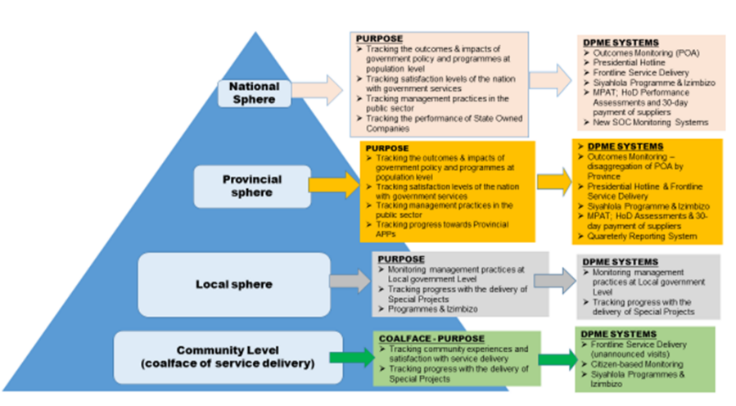
DPME MONITORING SYSTEMS

Slide 5
FRONTLINE MONITORING AND SUPPORT (FM&S)
Strategic Objective: To monitor the quality of the services provided to citizens at institutional and facility level.
Purpose: Facilitate service delivery improvements through frontline, citizen-based monitoring and effective complaints resolution systems.
Functions:
Develop and implement monitoring systems that are responsive to priorities at policy and service delivery level.
Provide support to Political Principals on taking government to the people through the Presidential / Ministerial Izimbizo Programmes.
Establish, coordinate and enhance citizen based monitoring systems.
Manage the Presidential Hotline, coordinate and enhance complaints resolution systems in government.

Slide 6
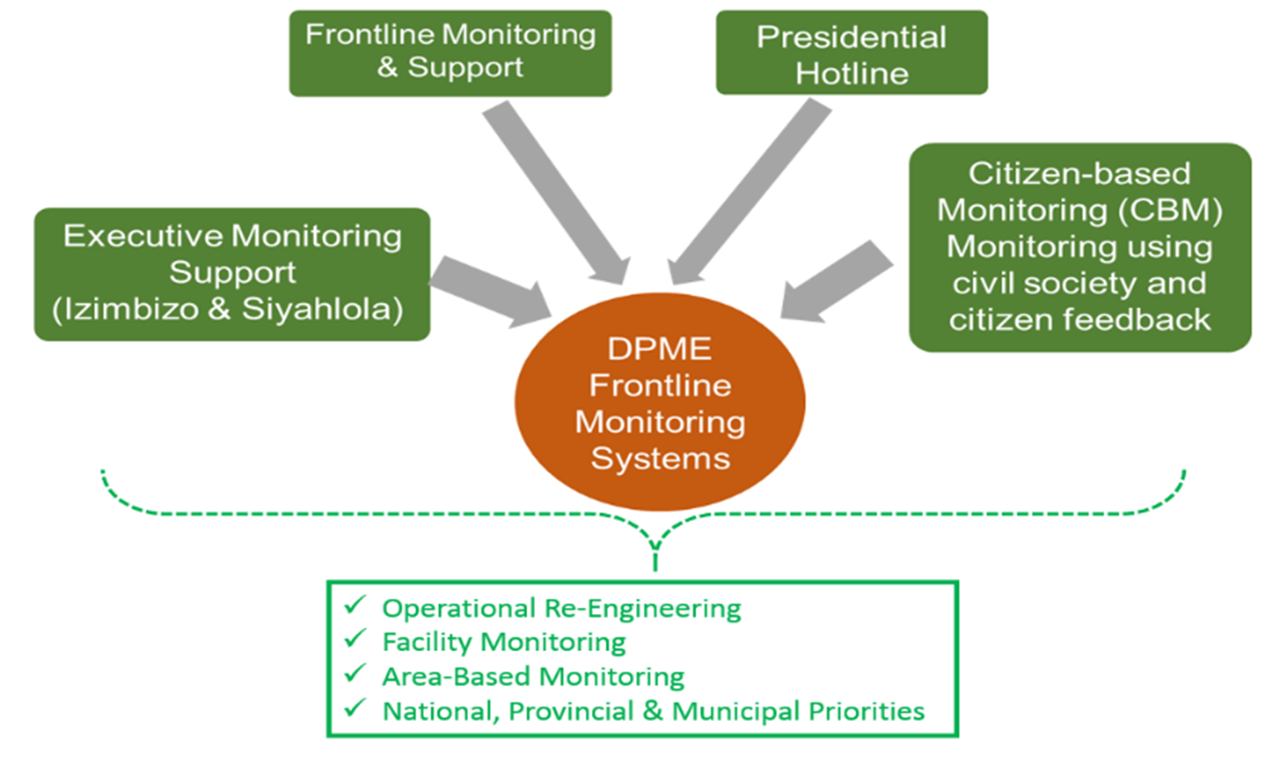
FRONTLINE MONITORING AND SUPPORT SYSTEMS: AN INTEGRATED APPROACH

Slide 7
FRONTLINE MONITORING AND SUPPORT
Integrated approach emerged from a strategic reconfiguration process in the DPME in 2018 / 2019 financial year. The integration brought together the methodologies and tools of the frontline service delivery monitoring (facility-sector based), executive monitoring, citizen based monitoring and the Presidential Hotline into a seamless monitoring system.
The merge was done to extend coverage of frontline monitoring, resource efficiency, enhanced effectiveness, and better coordination of frontline monitoring activities.
Monitoring is done jointly with Office of the Premiers across sectors and the three spheres of government ( National, Provincial and Local).

Slide 8
FRONTLINE MONITORING AND SUPPORT
Approaches Based on the Change
An area-based geographical model of monitoring, which included sector monitoring of facilities and projects, with an emphasis on the coordination of government stakeholders across all spheres of government in identification of challenges facing communities and in improving of services.
Sector based monitoring around national and presidential priorities, based on the executive monitoring approach.
A rapid response approach, in terms of the Interministerial Committees: Comprehensive Social Protection and the North West Intervention 100.

Slide 9
LOGICAL FRAMEWORK COMPONENTS CUTS ACROSS ALL THE FM&S TOOLS
STEP ONE: PLANNING
STEP TWO: IMPLEMENTATION
STEP THREE: COMMUNICATING AND COMMITING ON RESULTS
Conduct: Unannounced/announced on-site monitoring
Site verification monitoring
Community/Citizen based monitoring
Hold feedback sessions to present findings
Finalise improvement plans
Agree on reporting format and timeframe
Communicate monitoring and feedback plans to broader community
conduct root-cause analysis and prioritise areas of improvement
STEP FOUR: SUPPORT IMPROVEMENT PLANNING AND MONITOR PROGRESS
STEP FIVE: PROGRAMME REVIEWS AND REPORTING
Update improvement plan based on the stakeholder engagements
Conduct: Improvement monitoring and site verification based on reported progress
Update site/facility monitoring reports
Provincial Programme Reviews
Annual Review Workshop
Integrated Reporting
Produce Knowledge Products
Programme Review and Reporting Strategy
Develop joint annual implementation plans
Conduct pre-research to identify priority areas for monitoring
Training
Multi- stakeholder engagements
Identify: Areas for facilitated monitoring by DPME and OTP; Governance Structures to monitor commitments
Develop: FM&S programme toolkit; programme review strategy; Monitoring Approach; Targeting Strategy; Training Toolkit; Knowledge Management Strategy

Slide 10
CITIZEN BASED MONITORING (CBM)
CBM aims to strengthen government’s ability to involve communities and citizens in monitoring service delivery and that government is responsive to the experiences, expectations, perceptions and needs of communities.
DPME is not the implementer of citizen-based monitoring: facilitates and builds capacity building of government officials and departments.
DPME serves as an institutional repository for CBM methodology, good practices and approaches; a knowledge partner providing support to government institutions which undertake to implement citizen-based monitoring.

Slide 11
CITIZEN BASED MONITORING (CBM)
FM&S is working towards bringing together the Departments of Cooperative Governance and Traditional Affairs, Public Service and Administration and Offices of the Premier into an integrated frontline service delivery monitoring system.
The Community Development Workers Programme (CDWP) is integral to this work. The aim is to activate ward level information as a critical component of an integrated service delivery reporting and monitoring system that links communities and the three spheres of government.
The work is ongoing with Gauteng testing a collaborative model encompassing all community workers (from all sectors).

Slide 12
CITIZEN BASED MONITORING: NORTHERN CAPE Phokwane
Ward-based community dialogues were conducted. These were spearheaded by the Office of the Premier (NC), DPME, and chaired by ward councilors for respective wards.
This represented the gathering of citizen views, experiences and perceptions about services rendered by government within their municipal area, as a means to stimulating and expanding citizen participation in Integrated Development Planning (IDP) processes.
Findings include: poor roads & infrastructure, weak oversight and accountability mechanisms in the municipality, delayed formalization of settlements, lack of implementation of the IDP and political-administrative tensions hampering service delivery.
Multi-sectoral stakeholder engagements were held to improve the IDP planning processes (Cooperative Governance, Human Settlements and Traditional Affairs (COGHSTA); Officials form the Municipality and the Municipal Infrastructure Support Agent (MISA).

Slide 13
PRESIDENTIAL HOTLINE (PH)
The Presidential Hotline is an apex complaint management tool of government.
PH complaints are received through a toll free call centre, emails, letters and walk-ins and they cut across government institutions, at a national, provincial and local level.
Complaints are captured on an electronic monitoring system and the resolution rates of government departments are tracked and monitored – ‘real time information’ of issues on the ground.
The integration approach allowed for the frontline monitoring team to directly intervene and facilitate complaint resolution in complex cases. This has yielded positive results.

Slide 14
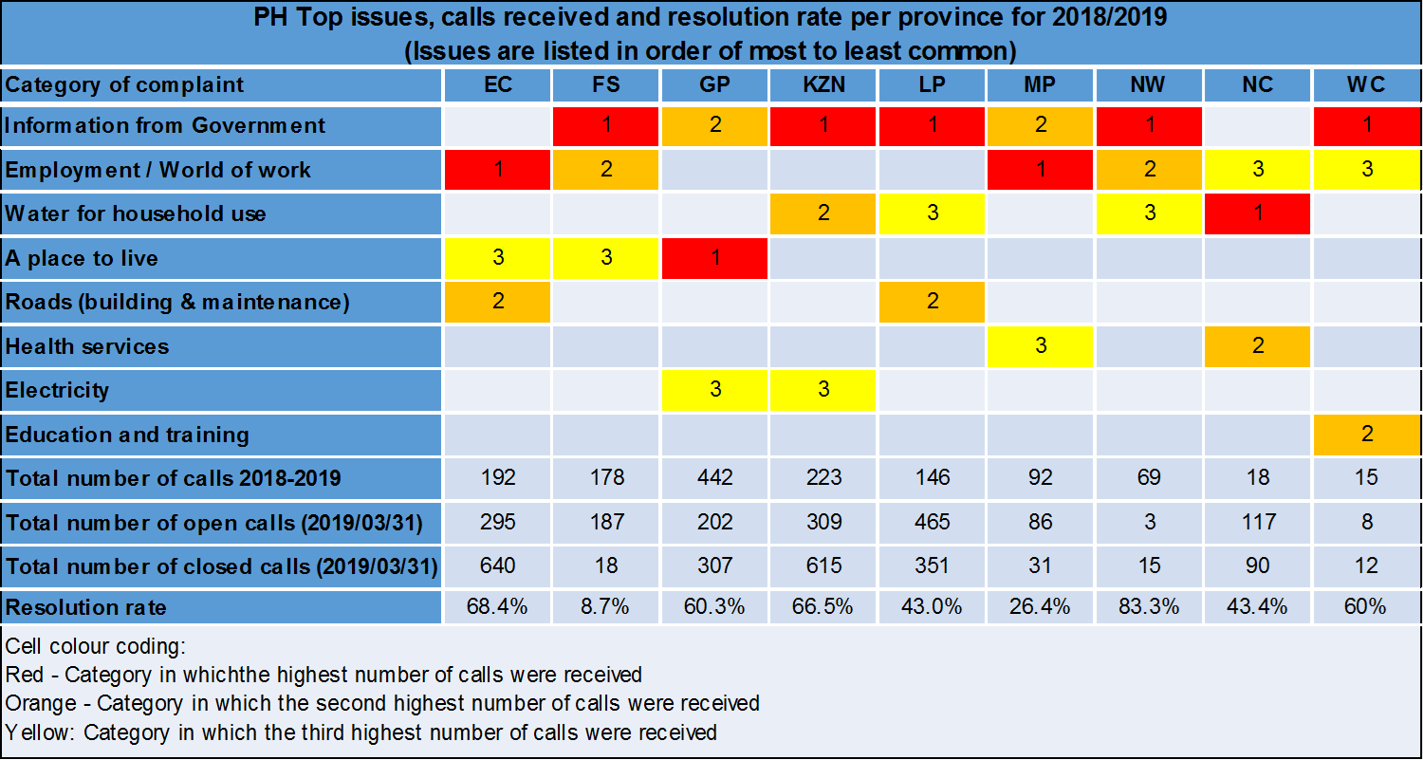
PRESIDENTIAL HOTLINE

Slide 15
TOP TEN SERVICE DELIVERY COMPLAINTS OF NATIONAL DEPARTMENTS

Slide 16
National Departments with high call volumes as at 31 March 2019 (cumulative)

Slide 17
KEY CHALLENGES OF THE PRESIDENTIAL HOTLINE
The toll-free number used for the President’s Hotline is costly, especially the bills from cellular operators.
Case reported are complex, often requiring a coordinated response across many departments which is beyond the scope of the Public Liaison Officers who are responsible for this task.
Unrealistic expectations from citizens.
PH is being redesigned for 2-way engagement and technological changes in partnership with Department of Science & Technology & Centre for Science Innovation and Research (CSIR).

Slide 18
2018/19 Monitoring Coverage

Slide 19
2018/19 Executive Support

Slide 20
2018/19 OVERALL MONITORING FINDINGS
Inadequate maintenance of buildings, as well as inappropriate infrastructure or accommodation for the rendering of services.
Inadequate staff allocation or the long turnaround times for the filling of vacancies, particularly in Health and Education.
Inadequate or malfunctioning equipment that hinders effective service delivery. This ranges from medical equipment in hospitals and clinics to vehicle allocation and maintenance at police stations.
Lack of bulk supplies (water, electricity, waste removal) was found at several service sites monitored.
Water and sanitation service delivery is compromised due to poor infrastructure maintenance and planning.
Unstable/unreliable network connectivity contributes to long downtime of ICT systems, interruptions and non delivery of services.

Slide 21
2018/19 OVERALL MONITORING FINDINGS
Poor contract management with service providers, resulting in service sites not being cleaned, as well as the non-payment of service providers as per government regulations.
Non-implementation of improvement recommendations due to (i) poor intergovernmental relations, (ii) inadequate planning and budget allocation, and (iii) non-communication of findings to executive structures.
Shortage of critical technical skills and capabilities in local municipalities to ensure effective contract management and delivery of bulk service supplies.
Weak working relations between local municipalities and citizens.
Shortage of ambulances and police vehicles poses serious compromises for service delivery.
Ineffective operational management, resulting in delays on the delivery of services, such as the issuing of Identity Documents, and awarding of grants.

Slide 22
SYSTEMIC CHALLENGES
The frontline monitoring findings of conditions on the ground were often not in the IDPs or sector departments Annual Performance Plans reflecting poor planning as well as alignment of plans across government.
Lack of clear understanding of mandates, roles and responsibilities across the three spheres of government and within sector departments themselves to deal with issues resulting in delays and ineffective policy implementation.
Poor project management in infrastructure delivery, difficulty in planning, sequencing of actions across sectors.
Lack of consequence management which could be as a result of lack of knowledge of systemic accountabilities.
Very often national sector departments develop programmes with minimal involvement of provincial counterparts and with implementers at facility level leads to unrealistic commitments, policy failures, unfunded mandates and mechanistic delivery to ensure targets are met.
Service delivery blockages persist due to weak coordination across inter-governmental structures, both vertically and horizontally.
Poor partnerships between departments to maximize resources in order to increase monitoring coverage and visibility.

Slide 23
REFLECTIONS ON POCKETS OF SUCCESS
Adoption of an area-based approach exposed the complexity involved in the implementation of service delivery an a need for a systems approach.
The positional authority of DPME in getting multi-sectoral and intergovernmental decision makers into one room to make concrete commitments on improvements.
Allowing for risk taking and experimentation.
Energetic, passionate and experienced monitoring and support officials driving delivery (both DPME and Offices of Premier).

Slide 24
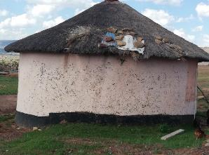
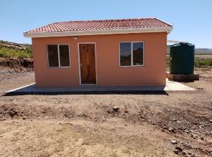
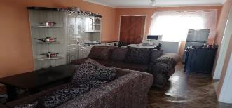

Presidential Hotline
A neighbor called on behalf of a 101 years old resident of Bhoqo village in Emalahleni Municipality in the Eastern Cape. His neighbor's house was destroyed by fire.
The Presidential Hotline engaged with the Office of Premier Eastern Cape who worked with the Department of Human Settlement and the Local Municipality to find a lasting solution. Mrs. Tatas warranted urgent attention because of her age.
Mrs. Tata was found eligible for Mayoral destitute housing. The project built a fully furnished house, toilet and installed a water tank between October and December 2018. After completion it was handed over by the EC Premier on the 06 March 2019. Ms Kiviet applauded the Presidential Hotline for bringing up Mrs Tatas plight to the Provinces attention. She was grateful of the outcomes.
Before: Old house
After: New house with furnisher provided by Dept. of Housing

Slide 25
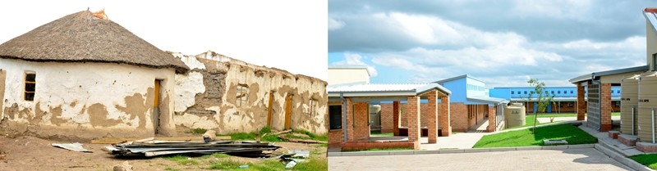
ASIDI VERIFICATION MONITORING: FINDINGS & ANALYSIS
    DPME conducted oversight monitoring visits of ASIDI education facilities in Eastern Cape. This, in rural and other economically depressed areas, is a significant development for communities who constantly refer to ASIDI schools as ‘universities’.

Slide 26
OVERALL FINDINGS AND ANALYSIS
Building Infrastructure… cont
Infrastructure Package | Schools with | Schools without | % With | % Without
Access Road | 73 | 10 | 88% | 12%
Perimeter fence | 83 | 0 | 100% | 0%
Access control | 35 | 48 | 42% | 58%
Admin Block / Offices | 83 | 0 | 100% | 0%
Strong room | 83 | 0 | 100% | 0%
Grade R Block | 75 | 7 | 92% | 8%
Staff Room | 83 | 0 | 100% | 0%
Sick Bay | 83 | 0 | 100% | 0%
Multipurpose centre | 81 | 2 | 98% | 2%
Access to electricity | 77 | 6 | 93% | 7%
Access to water | 83 | 0 | 100% | 0%
Nutrition centre | 83 | 0 | 100% | 0%
Resourced library | 32 | 51 | 39% | 61%
Computer lab | 78 | 5 | 94% | 6%
Science Lab | 82 | 1 | 99% | 1%
Sports facilities | 23 | 60 | 28% | 72%
Access to Sanitation | 83 | 0 | 100% | 0%

Slide 27
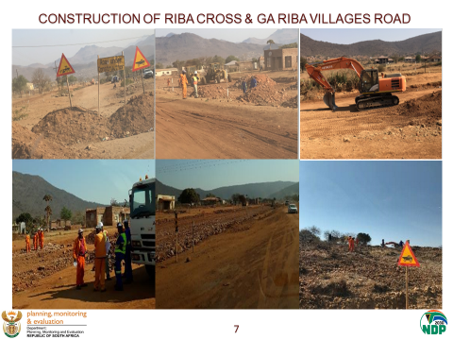
LIMPOPO: Fetakgomo Tubatse Local Municipality.
The State of the Province Address on 23 February 2018, by Premier of Limpopo Province Mr. Stanley Mathabatha pronounced that eight (8) roads will be constructed during 2018/19. The DPME FMS monitored the road in Riba Cross and Ga-Riba villages in Fetakgomo Tubatse Local Municipality. The construction of the road has been postponed several times and was not budgeted for. The facilitation intervention by FM&S through multi-sectoral engagements saw the unlocking of budget and the commencement of the construction of the road.

Slide 28
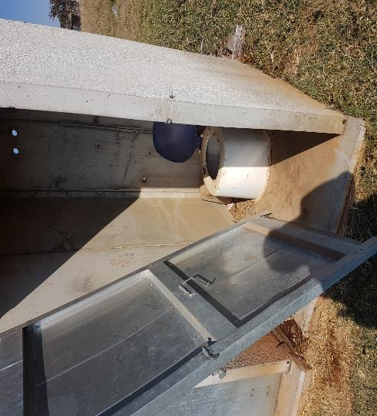
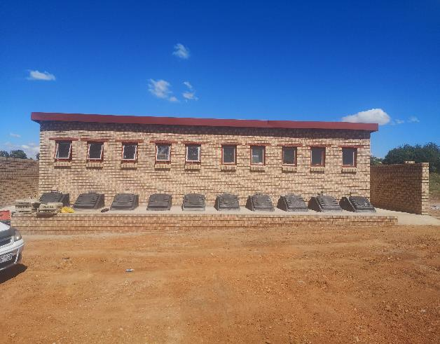
MGIBE SCHOOL MPUMALANGA
BEFORE
AFTER

Slide 29
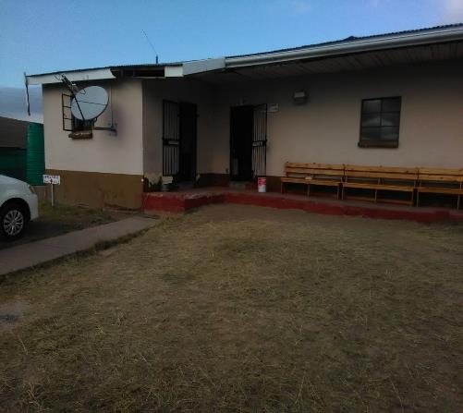
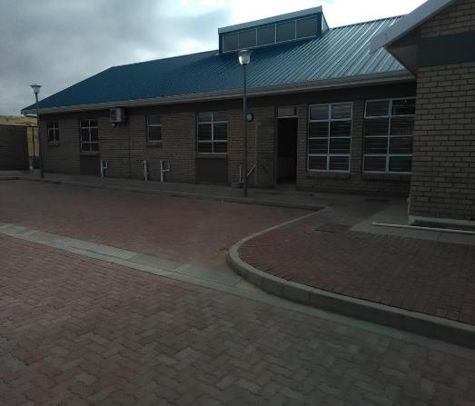
EC: MAXWELE CLINIC – TRANSFORMATION OF INFRASTRUCTURE AS PART OF THE IDEAL CLINIC AND MAINTENANCE PROGRAMME
Infrastructure transformation includes building of new facilities and refurbishment of others.

Slide 30
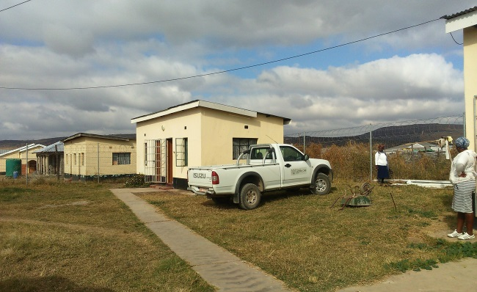
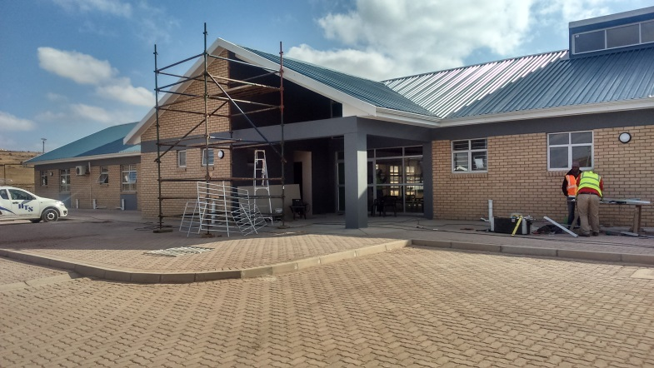
EC: LOTANA CLINIC – TRANSFORMATION OF INFRASTRUCTURE AS PART OF THE IDEAL CLINIC AND MAINTENANCE PROGRAMME

Slide 31
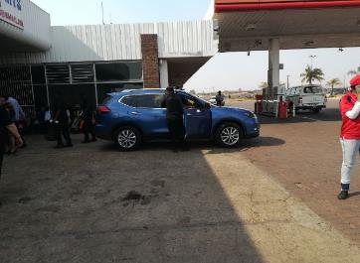
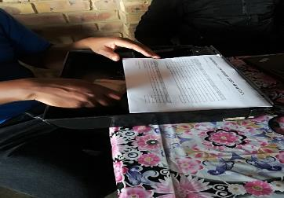
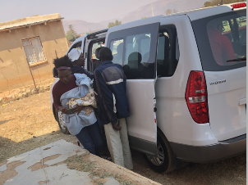
SASSA/SAPO GRANTS TRANSITION MONITORING
Safety & Security
SAPS present at some Paypoints. Fidelity Guards at others
Some cash deliveries done in unmarked, private vehicles
Post offices:
  No security to keep large amounts of cash
  No access control to protect beneficiaries and staff
Manual counting of cash at several Paypoints creates risk for officials and beneficiaries
  Robbery
  Miscounting of cash

Slide 32
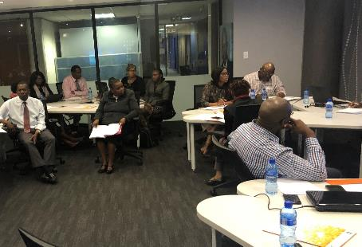
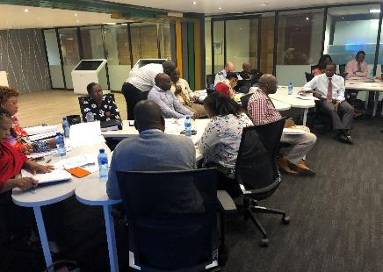
MONITORING GOVERNANCE STRUCTURES - BRINGING STRUCTURES OF LOCAL GOVERNMENT, PROVINCIAL AND NATIONAL DEPARTMENTS TOGETHER
Strengthening Participatory Democracy and Active Citizenship

Slide 33
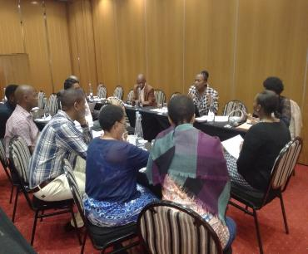
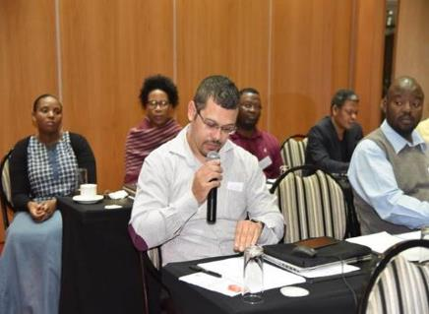
Public Liaison Forum: Potential To Strengthen Networking ACROSS GOVERNMENT AND CITIZENS: FOUNDATION OF HUMAN CAPITAL IN PLACE THROUGH THE PRESIDENTIAL HOTLINE

Slide 34
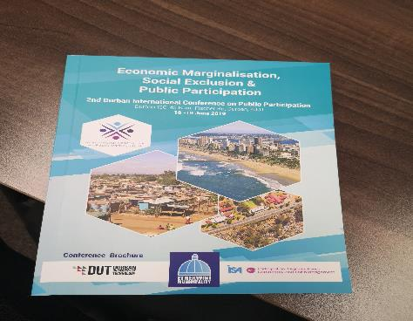

Building Capacity of State: Presentations on Innovative Models of Practice & Indigenous KNOWLEDGE GENERATION BY DPME STAFF

Slide 35
WAY FORWAY 2019/2020
The Public Sector and Capacity Development Branch will drive implementation of MTSF Priority 6 on A Capable, Ethical and Developmental State, which is aligned with Chapter 13 of the NDP. The intended impact is on strengthened state capacity through monitoring and support interventions to facilitate services delivery, empowered citizens, development and transformation.
FM&S will:
Strengthen two-way government-citizen engagement and participatory governance promoted through all the frontline monitoring tools.
Frontline monitoring has been institutionalized across government through the Integrated Monitoring Framework. In this way the findings of the FM&S will ensure the complexities on the ground are considered in policy making and bridge the gap in ‘top-down’ – ‘bottoms-up’ decision making.
The Presidential Hotline is being redesigned to strengthen 2-way communication /Participatory democracy between government and citizens.

Slide 36
DPME VISITS TO HEALTH FACILITIES IN NORTH WEST PROVINCE
CASE STUDY
MAFIKENG PROVINCIAL HOSPITAL,
TLHABANE CHC
TLHAKGAMENG CHC

Slide 37
CASE STUDY – MAFIKENG PROVINCIAL HOSPITAL

Slide 38
DPME VISIT TO MAFIKENG PROVINCIAL HOSPITAL, RAPID RESPONSE, JULY 2017
Reason for the visit: Concerns from residents of the North West, and negative media publicity, alleging that patients slept on the floors of the hospital
Positive findings about service delivery
Mafikeng Provincial Hospital had effective systems to monitor the quality of services it provided and to track feedback from patients.
High resolution rates of complaints.
  Elevation of unresolved complaints to the Provincial DoH.
Collaboration with the Department of Home Affairs (DHA).
DHA Office on premises – produces certificates for newborns within 3-days.
Negative Findings
Serious challenge of infrastructure and its maintenance. 50 year old hospital.
Confirmation that patients were sleeping on the floor – patients in transit to other referral hospitals outside the Province.
Labour unrest on the day of the DPME visit. Non-clinical services affected but clinical services not affected.
Facility operating without permanent Chief Executive Officer and CFO.
Staff shortages.
High institutional Maternal Mortality Ratio (iMMR) reported as 606.39, 426.61 and 596.87 per 100,000 in 2014, 2015 and 2016.
Communication of DPME Findings
DG of DPME formally conveyed to the HoD of the North West DoH the report on the DPME visit, outlining the findings and recommendations.
Up Date: Theater resolved; CEO position not yet filled; Infrastructure challenges not improved; and Institutional Maternal Mortality Ratio (iMMR) still high.

Slide 39
DPME VISIT TO TLHABANE CHC, BOJANALA DISTRICT [EXECUTIVE SUPPORT, DECEMBER 2017]
Reasons for the visit: (1) Health facility review ahead of the visit by Minister in the Presidency for Planning, Monitoring and Evaluation (PME)a the time, Minister JT Radebe (2) Tlhabane CHC was enrolled in Operation Phakisa, ICRM but it had not been successful in attaining ideal clinic status.
Positive Findings
Located in a Mining Area of Rustenburg - Tlhabane CHC demonstrated high levels of vigilance in diagnosing and treating Tuberculosis.
TB cure rate at the facility was 83,5%.
Dedicated Multi Drug Resistant (MDR) TB Clinic in place.
Effective referral system to Klerksdorp Specialised TB Hospital.
No a single maternal death in the 18 months preceding the DPME visit.
Facility provided 24-hour services including on weekends.
Dedicated obstetric ambulance stationed at the facility, which timeously transported pregnant women to Job Shimankana Tabane Hospital.
Negative Findings
No formally appointed permanent Operational Manager at the time of DPME visit. Two professional nurses in acting positions
Resignation of 10 of the 15 professional nurses inherited from Boitekong CHC, a neighboring health facility.
Exit interviews with nurses found that main cause of resignation was the Pension Fund Amendment Bill, announced in 2016.
Government Employee Pension Fund (GEPF) invited to conduct information sessions for nurses.
Only 3 of the original 13 nurses who resigned withdrew their resignations.
Twin problem of nurses aged 50 years and above, who are approaching retirement, and young nurses in their 20s, who are relatively inexperienced.
Slow process of appointing or replacing health care providers.
Communication of DPME Findings
DG of DPME formally conveyed to the HoD of the North West DoH the report on the DPME visit, outlining the findings and recommendations.

Slide 40
DPME VISIT TO TLHAKGAMENG CHC, DR RSM DISTRICT
Reasons for the visit: to investigate the state of service delivery at the facility, following publication of a very disturbing article by the Sowetan Newspaper on the 05th July 2016, about the state of service delivery at Tlakgameng CHC entitled “Horror clinic”.
Positive Findings
Several allegations nurses made in the Sowetan Newspaper were untrue.
Reception area and the sub-waiting areas nearer to the consulting rooms looked clean and well maintained
Adequate lighting in both areas.
Maternity unit was found to have requisite instruments, equipment and linen.
Key question was: what drives health care professionals to report their own health department to the newspapers.
Inadequate communication channels between the health facility and the higher levels of the health system? Mischief?
Negative Findings
Very low levels of staff morale amongst staff members.
Allegedly resulting the resignation of 2 professional nurses between February 2016 and May 2016 - increased the workload of the remaining personnel
Vacant posts had not been filled yet.
High levels of discontent among some of the staff members
They inappropriately invited The Sowetan Newspaper to raise their concern.
Attempt to fix the geyser on the day of DPME Visit, against an allegation by nurses that the facility had experienced a problem of lack of access to hot water.
Communication of DPME Findings
DG of DPME formally conveyed to the HoD of the North West DoH the report on the DPME visit, outlining the findings and recommendations.

Slide 41
SUMMARY OF DPME OBSERVATIONS (North West)
North West Province had historically recorded good progress towards health coverage (output) indicators – especially in PHC services
Independent sources of empirical evidence corroborated this.
However, some regressions appears to have taken place in recent years.
Key impact indicators such as Life Expectancy and Maternal Mortality Ratios are disturbing.
Medico-legal claims have also escalated.
Silence of the community voice in the governance of health facilities is of great concern.
Negative media publicity of health services has increased relative to the past.
DPME Visits have found that service delivery has been impacted upon by management and leadership challenges including prolonged delays by the province in making key management appointments creating leadership vacuum, delaying to address health worker concerns (perceived or real); unintended impact of national policies, resulting in low staff morale, amongst others.
leadership

Slide 42
SUMMARY OF DPME OBSERVATIONS (Overall)
The main challenges that permeated across the health facilities included:
  Limited availability and poor management of existing Human Resources for Health;
  Inadequate financial resources and mismanagement of existing resources;
  Poor Financial Management;
  Poor health outcomes such as High Maternal Mortality Ratios in hospitals;
  Inadequate network of good PHC facilities to support the delivery of hospital services and growing social distance between the users and providers of health care services.

Slide 43
CONCLUSIONS AND RECOMMENDATIONS
Enhance community participation through provided governing structures in health services delivery.
Enhance existing efforts to address health worker concerns.
Create/strengthen forums of communication with health care workers, including health care providers, and discourage the use of national media as the first port of call.
Prioritise filling of management positions in the coalface of health care delivery.
Increase urgency to revitalise the Primary Health Care platform of health care delivery by:
  - Expanding the implementation of the Ideal Clinic Programme
  - Mobilising resources for the implementation of the Community Health Worker Programme.
Implement focused interventions to improve quality of health care across all levels of public sector – e.g. interventions to drastically maternal and child health.
Utilise the results of assessments conducted by the Office of Health Standards Compliance to improve quality of care.
Continue the best practice of intersectoral collaboration – eg. with Department of Home Affairs, Department of Basic Education and Department of Social Development.

Slide 44



