Slide 1
Alexkor governance challenges and financial performance
18 September 2019

Slide 2
TABLE OF CONTENTS
Alexkor and Alexkor RMC PSJV Structure
Governance and Financial Challenges

Slide 3
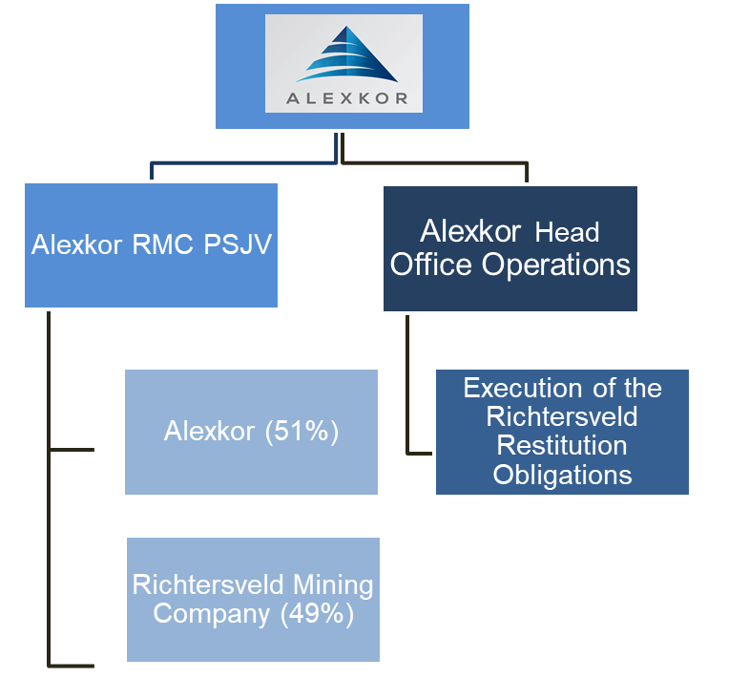
ALEXKOR/ALEXKOR RMC PSJV
Alexkor is a state-owned mining company with a sole asset being a 51% share (the Richtersveld communities own the other 49%) in an alluvial diamond mining company located in the Northern Cape west coast
Alexkor head office operations are located in Woodmead, Johannesburg
Alexkor current operating activities are fulfilling the obligations of the land and mineral settlement agreement reached between the Alexkor, Government and the Richtersveld Community
Alexkor RMC PSJV produces over 50 000 carats per year ( less than 1% contribution to the national diamond production
Closure of number of diamond operations such as DeBeers and Transhex in the Richtersveld area has had negative effect on the socio economic prospects
CONFIDENTIAL

Slide 4
STATE OF SOC (1/3) Governance Challenges – Forensic Investigation
During 2017 and early 2018, the Department received numerous complaints from the mining contractors alleging that they have been unfairly excluded from the 2018 marine mining contracting cycle and alleging victimisation and irregular practises against Alexkor RMC PSJV board and management.
Following the investigation into allegations, the DPE team found that indeed the contractors were excluded from the contracting cycle and the Alexkor RMC PSJV board and management actions were discriminatory and due process was not followed in taking such a decision. This prompted the Department to commission an investigation into allegations brought forward.
Gobodo Forensic and Investigative Accounting Pty Limited has since been appointed to conduct the investigation. The exercise is projected to be concluded by end of October 2019. The scope includes investigation into ;
The validity of the decision taken by Alexkor RMC PSJV to exclude the three marine contractors in the 2018 marine mining services procurement cycle;
The procurement process in the appointment of contractors in particular the appointment of a diamond marketing and sales company;
The process followed in the valuation of diamonds from the mine site to the diamond marketing and sales company offices;
The prices diamonds are realising since the appointment of a diamond marketing and sales company;
The alleged failure to adhere to giving access to the information relating to sales and marketing of diamonds to the contractors;
The legality of coffer dam operations which are allegedly to have an adverse environmental damage.

Slide 5
STATE OF SOC (2/3) Governance Challenges – PSJV Liquidity Crunch
In December 2018, the Alexkor RMC PSJV informed the Department that the Company will be unable to pay salaries for the month of December and urgent financial assistance of an estimated R5 million was requested. The state as part of the settlement agreement, extended a R200 million non-interest bearing loan to the Alexkor RMC PSJV through Alexkor to recapitalise the diamond operations. The recapitalisation was successful and the mine was restored to full operation. The R200 million has since been depleted. The Alexkor RMC PSJV have only been able to repay R10 million since its first draw down in 2012
In March 2019, DPE team met with the community representatives, organised labour and the executive management of the Alexkor RMC PSJV to establish the extent of the financial challenges
The Department established that the financial problems at the mine are primarily a product of poor leadership and bad decision-making. For instance, organised labour highlighted that there was no mine plan to balance the quality of diamond produced. Department also observed that Management seems to have lost the control of workers and command of the business.
The Alexkor RMC PSJV stated that it was pressured to create employment in the areas by the then political principles. This led to the investment of a plant of R60 million and over 150 permanent employment created. Due to design challenges, the plant is performing below capacity

Slide 6
STATE OF SOC (3/3) Governance Challenges – Administrator Intervention
The complex corporate structure between Alexkor and Alexkor-RMC PSJV has made intervention by Alexkor management difficult due to the restrictions of the Deed of Settlement provisions. The Deed of Settlement is a product of a land restitution award in 2007 to the Richtersveld Community. However, the deterioration of the joint venture operations have had a knock on effect on Alexkor, as the business is dependent on proceeds from the mine to sustain itself. The two entities are currently not a going concern and the financial future looks dire.
It has become imperative that Government intervene decisively to address the state of Alexkor and the Alexkor RMC PSJV. In this regard I the previous Alexkor board has been retired and replaced with an Administrator.
The Administrator is not a Business Rescue Practitioner as per Section 138 of the Companies Act, 2008 but an incumbent assigned with the duties to restore normality and stability to the operations of Alexkor and Alexkor RMC PSJV and help maximise the prospects of a successful outcome for Alexkor. The Administrator, will assume the duties and responsibilities in place of the Board of Directors, and is required to prioritise and expedite inter alia the following;
Undertake an extensive review and analysis of the contract mining and revenue-sharing models between the PSJV and the contractors and provide proposed solutions;
Review the Alexkor and the Alexkor RMC PSJV cost structure to ensure procurement of goods and services is at fair value and warranted;
Remove the duplicate functions at Alexkor Head Office and Alexkor RMC PSJV with particular focus on executive and overhead expenses as well as to identify and implement other remedial and cost reduction intervention plans and/or initiatives;
Terminate marketing and sales contract with Scarlet Sky Investments (Pty) Ltd. (SSI) and propose solutions/options for the establishment of own or State Diamond Trader-related diamond marketing and sales channel;
Develop a revenue-enhancing plan with emphasis on contracting for mid and deep water mining operations;
Propose a right-sizing model for Alexkor and Alexkor RMC PSJV in line with the income streams;
Manage the rooting out of corruption and State Capture related practices and individuals at Alexkor and PSJV:

Slide 7
END

