Slide 1
COMMISSION FOR CONCILIATION, MEDIATION AND
ARBITRATION
2018/19 ANNUAL PERFORMANCE
PRESENTATION TO THE PORTFOLIO COMMITTEE ON
EMPLOYMENT & LABOUR
18 SEPTEMBER 2019

Slide 2
NON - FINANCIAL PERFORMANCE

Slide 3
LEGEND
Implication: ACHIEVED
Performance Indicator is on track or reflects complete implementation. Target achieved
100+% Complete
Implication: NOT ACHIEVED
Performance Indicator behind schedule. Target not achieved
0% - 99% Complete

Slide 4
2018/19 NON – FINANCIAL PERFORMANCE RESULTS
ENTITY | 2018/19 PLANNED INDICATORS | ACHIEVED | NOT ACHIEVED | OVERALL % ACHIEVEMENT
CCMA | 19 | 18 | 1 | 95%
4

Slide 5
YEAR ON YEAR PERFORMANCE COMPARISON: 2016/17, 2017/18 AGAINST 2018/19
 | 2016/17 |  |  | 2017/18 |  |  | 2018/19 |  |  | TREND
 | Annual Planned targets | Overall Achieved | % Achieved | Annual Planned targets | Overall Achieved | % Achieved | Annual Planned targets | Overall Achieved | % Achieved | 2016/17-2018/19 THREE YEAR TREND
CCMA | 33 | 30 | 91% | 15 | 13 | 87% | 19 | 18 | 95%

Slide 6
YEAR ON YEAR PERFORMANCE COMPARISON (2015/16, 2016/17, 2017/18, 2018/19)
6

Slide 7
2018/19 NON – FINANCIAL PERFORMANCE RESULTS
STRATEGIC OBJECTIVE PERFORMANCE FOR THE 2018/19 FINANCIAL YEAR
STRATEGIC OBJECTIVES | PLANNED ANNUAL TARGET 2018/2019 | ACTUAL ANNUAL ACHIEVEMENT 2018/2019 | DEVIATION | COMMENT ON DEVIATIONS
ENHANCING THE LABOUR MARKET TO ADVANCE STABILITY AND GROWTH | 5 | 5 | 0 | Not applicable.
ADVANCING GOOD PRACTICES AT WORK AND TRANSFORMING WORKPLACE RELATIONS | 5 | 5 | 0 | Not applicable.
BUILDING KNOWLEDEGE AND SKILLS | 1 | 1 | 0 | Not applicable.
OPTIMISING THE ORGANISATION | 8 | 7 | 1 | Please refer to Slide 8.

Slide 8
UNDER – PERFORMING NON – FINANCIAL TARGETS FOR THE 2018/19
NO. | TARGET | PERFORMANCE | REASON FOR NON - ACHIEVEMENT | CORRECTIVE ACTION
1. | 98% of all registered cases' first event heard within 30 days (excluding agreed extensions) | 88% (136 857 / 155 351) of all registered cases' first event heard within 30 days (excluding agreed extensions) | The Case Management System (CMS) has limited capability to extract and populate the number of conciliations sat down to be heard at first event within 30 days. | The technical indicator has been amended to reflect “all” cases activated for conciliation (concilable cases) at first event within 30 days of the date of receipt of the referral (This excludes agreed extensions). A data string introducing statistics in respect of the number of concilable cases has been developed on the CMS to improve the efficiency and accuracy of measurement if this target and has resulted in significant improvement but has not met the threshold of 98%.

Slide 9
STRATEGIC PRIORITIES OF THE SENZ’UMEHLUKO STRATEGY
PRIORITY 1
Effectively and efficiently implement the legislated mandate of the CCMA with respect to conciliations and arbitrations
PRIORITY 5
PRIORITY 2
Improve governance processes and strive for maximum compliance to prescripts and best practice to improve business processes
Intensify Dispute Management & Prevention interventions to reduce conflict in the workplace and transform workplace relations
2018/19 STRATEGIC PRIORITIES
PRIORITY 4
PRIORITY 3
Source: Letsema Consulting & Advisory Team Analysis
Enhance and expand the Employment Security mechanisms to save jobs and alleviate business distress
Facilitate improved Collective Bargaining to promote orderly and healthy labour relations
Notes:
Are the users ready for an eCCMA?
How do we bring the courts along?

Slide 10
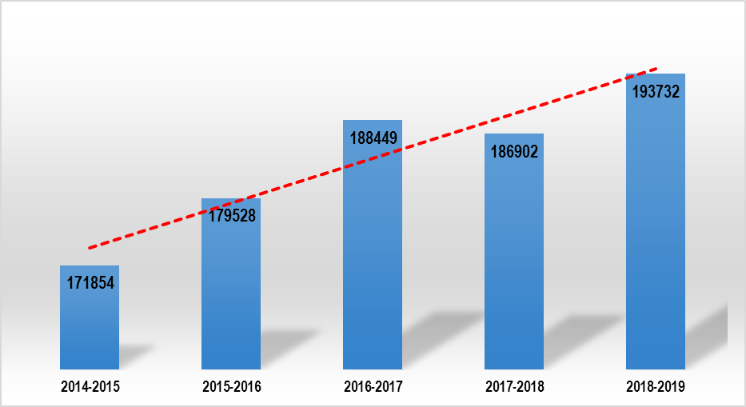
EFFECTIVE AND EFFICIENT DISPUTE RESOLUTION
PRIORITY 1 contributes towards Outcome 14: Transforming society and uniting the country
The CCMA received 193 732 referrals received during the 2018/19 financial year and heard 136 857 conciliations within 30 days, (88% compliance rate). 16 669 of arbitration awards sent to parties by the fourteenth (14th) day after completion of the arbitration process (99% compliance rate). the CCMA conciliated cases within 24 days, and arbitration awards and 68 days to deal with arbitration cases. Through the partnership with the Sheriff’s Board, the CCMA has assisted 3 721 vulnerable workers to enforce and execute CCMA awards.
Approximately 71% of all case referrals related to unfair dismissal (a reduction of four percent (4%), compared to the 2017/18 financial year), with 11% relating to unfair labour practice disputes (an increase of one percent (1%) from the previous financial year).
The Business Professional Services sector remained the highest referring sector at 27% of total referrals. The Retail sector on the other hand, experienced a decrease of one percent (1%) from the 2017/18 financial year, accounting for 11% of the total cases in 2018/19. All other sectors remained consistent compared to the preceding financial year.
The referral percentages are as follows: Safety/Security at 12%; Domestic at seven percent (7%); Building and Construction at seven percent (7%); Agriculture/Farming at four percent (4%); Food and Beverage (manufacturing) at four percent (4%); and Mining at four percent (4%).
the CCMA continued to support the 35 accredited Bargaining Councils and Private Agencies, to ensure the effectiveness and efficiency. More rigorous support will be given to Bargaining Councils and Private Agencies in the 2019/20 financial year, including deploying the CCMA’s Case Management System (CMS) for use. The benefit in this is that from a single system, consolidated statistics of the state of the labour market can be generated for better foresight and planning.
Ever-increasing
Impact of Labour Market factors
New jurisdiction impact

Slide 11
REFERRALS BY ACT 2018/19
ACT | REFERRALS | %
Labour Relations Act | 176 144 | 92.2%
Basic Conditions of Employment Act | 10 525 | 5.5%
Employment Equity Act | 3 765 | 2.0%
National Minimum Wage Act | 619 | 0.3%
Skills Development Act | 72 | 0.0%
Unemployment Insurance Act | 4 | 0.0%
11

Slide 12
REFERRALS BY TYPE 2018/19

Slide 13
REFERRALS BY SECTOR 2018/19

Slide 14
SETTLEMENT RATE 2010/11 – 2017/18

Slide 15
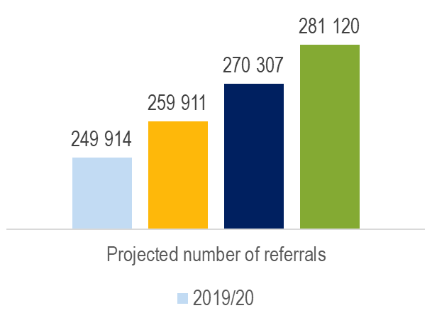
2018/19 NEW JURISDICTION REFERRALS
THE NATIONAL MINUMUM WAGE AND EMPLOYMENT LAW AMENDMENTS
There has been great interest from the public to enquire about their rights relating to the new legislative changes.
Although the projected 15% increase in the case referral linked to the enactment of the NMWA and Employment Law Amendments was not registered during the period 01 January 2019 to 31 March 2019, it is anticipated that the 2019/20 financial year will see an increase in referrals as workers become more aware of their rights. As it stands, NMWA and BCEA cases alone account for 11% of the total caseload, which is 6% more than anticipated in less than nine months (January – September 2019).
It is anticipated that there will be an increase in the referral of compliance orders and written undertakings from the Department of Employment and Labour to be made arbitration awards.
The CCMA had estimated that 5% of its total case load for 2018/19 as a result of the implementation of the National Minimum Wage Act, however,
For 2019/20, an anticipated 25% increase is projected as a result of the expanded jurisdictional mandate.
The caseload is anticipated to increase as follows over the MTEF (especially as a result of the NMWA).

Slide 16
LEGISLATIVE IMPACT AND SOCIAL PROTECTION
PRIORITY 2 contributes towards Outcome 4: Decent employment through inclusive economic growth”, “Outcome 11: Create a better South Africa, a better Africa and a better World”, and “Outcome 14: Transforming society and uniting the country”.
The CCMA Vulnerable Programmes, focused on advocacy, educating and capacitating targeted vulnerable groups (sectors, gender, work arrangements and income streams etc) of their employment law responsibilities and rights, directly contributing towards the realisation of legislative objectives. In the 2018/19 financial year, the CCMA conducted 1 997 outreach services (inclusive of awareness raising activities, capacity building activities and social justice blockages activities, resulting in 60 980 intended beneficiaries being capacitated.
Through dedicated Shop Stewards and Union Officials Training Programmes, the CCMA empowered Shop Stewards and Union Officials to participate effectively in CCMA processes in order to protect vulnerable workers.
The CCMA has delivered 32 Effective Negotiation Skills (ENS) covering the COGP and the Accord as part of the transformation in the workplace interventions, with the aim of improving the workplace relations in strategically targeted workplaces.
Four (4) Collective Bargaining Pre-Bargaining Conferences conducted for strategically identified Users against a target of two (2). Two (2) strategically identified Users subjected to the workplace mediation model against a target of one (1). Over-achievement on these targets is attributed to proactive labour market monitoring, promotions and stakeholder uptake and confidence in CCMA services.
Four (4) transformation of workplace relations projects delivered for strategically identified Users.
One (1) advocacy campaign covering the Minimum Wage, the COGP and the Accord delivered to strategically identified stakeholders. 102 capacity building interventions aligned with the needs of the labour market delivered to Users against a target of 96.
Through the Essential Services Committee, observance of 10 Essential Service Designations (ESDs), Minimum Service Agreements (MSAs), Minimum Service Determinations (MSDs) and/or Maintenance Service Determinations were monitored for compliance. Two (2) self-initiated cases conducted in order to determine whether or not the whole or a part of any service is an essential service. 100% of Section 71 cases investigated (as and when referred).

Slide 17
LABOUR MARKET STABILITY AND ECONOMIC DEVELOPMENT
PRIORITY 3 of contributes towards Outcome 4: Decent employment through inclusive economic growth, Outcome 11: Create a better South Africa, a better Africa and a better World, and Outcome 14: Transforming society and uniting the country.
The CCMA dealt with 5 160 mutual interest disputes during this reporting period, representing a nine point seven percent (9.7%) increase compared to the previous financial year. These figures suggest a high level of labour market trust in and reliance on the CCMA to determine Collective Bargaining disputes. The settlement rate in these matters was recorded at 60%, one percent (1%) higher than the previous year.
Of the 187 public interest matters dealt with, the CCMA settled 160 public interest matters, resulting in 87% settlement rate. This is due to the CCMA’s proactive monitoring, support and guidance provided to labour market in respect of Collective Bargaining matters. The CCMA’s commitment to dispute resolution has resulted in the organisation’s involvement in resolving the following high profile strikes: The Eskom wage dispute; the Gautrain Bombela wage dispute; the National Union of Mineworkers (“NUM”), Association of Mineworkers and Construction Union (“AMCU”), United Association of South Africa (“UASA”) & Solidarity / Mineral Council wage dispute; the AMCU / Murray & Roberts wage dispute; and the National Union of Metal Workers of South Africa (“NUMSA”) / Comair wage dispute, amongst others
A total of 13 Collective Bargaining Support Processes in respect of wage facilitation were proactively conducted with the following institutions: Communication Workers Union (CWU) and MTN; NUMSA and TETI Traffic Pty, LTD; NTM obo member and Globe Flight; NUMSA obo members and Sentech Soc LTD; Food and Allied Workers Union (FAWU) and Pioneer Foods Bakeries; MEIBC lift Engineering Sector; FAWU and Pioneering Foods Grain Division; NTM, UNTU, SATAWU obo Members and PRASA Corporate; FAWU obo members and National Brands Limited; SACCA and Mango Airlines Soc Ltd; South African Society of Bank Officials (SASBO) and Capitec Bank; NUMSA obo Members and Barloworld equipment; and NUMSA obo Members and Swiss Port (PTY) LTD.
Priority 4 contributes towards Outcome 4: Decent employment through inclusive economic growth, Outcome 11: Create a better South Africa, a better Africa and a better World and Outcome 14: Transforming society and uniting the country.
The In the effort to contribute towards the alleviation of the triple crisis of unemployment, poverty and inequality, the CCMA conducted 529 large-scale retrenchment or ‘Section 189A facilitation processes involving 38 588 employees who were facing potential retrenchment.
Of these 38 588 employees, the jobs of 15 787 (41%) were saved, while the rest were either retrenched 14 917 (39%), opted for voluntary retrenchment 6 474 (17%) or had their matters concluded in an alternative way 1 410 (3%). CCMA’s job savings activities which resulted in 41% of jobs saved (15 787) sees performance in this regard exceeding the target of 35%. Actual retrenchments were recorded at 21 391.

Slide 18
GOVERNANCE AND ADMINISTRATION
PRIORITY 5 contributes towards Outcome 12: An efficient, effective and development-oriented public service.
The CCMA Risk Maturity Level is at 5.00.
The CCMA Compliance Maturity Level is at a managed level of 4.00.
During the financial year under review, the CCMA developed its Governance Maturity Model, with the objective of assisting the CCMA reach full governance maturity whilst mitigating the risk of governance failures.
The CCMA is financially stable with cost containment measures being implemented.
382 complaints were received across all platforms for the 2018/19 financial year. All complaints received were investigated, responded to and closed.
From the 45 audit findings raised by the Auditor – General of South Africa (AGSA) for the 2017/18 external audit, 43 findings were closed. For the 2018/19 financial year, 16 audit findings were recorded from the AGSA external audit findings.
As per the CCMA annual Training Plan, as at March 2019, 60 interventions have been delivered to internal staff to capacitate the workforce for efficient and effective delivery of the CCMA mandate.

Slide 19
PRIORITY AND PRESIDENTIAL PROJECTS
Economic Sector Intervention
SMME’s Intervention
Inclusive Growth Intervention
Education and Skills Intervention
Public and Social Inclusion Intervention
01
The Training Layoff Scheme was reconstituted as the Training and Employment Retraining Scheme (TERS) in October 2018, in order to expedite the application processes through a Single Adjudication Committee to consider TERS applications.
This Single Adjudication Committee has resulted in the payment of allowances within 26 days.
The reconstitution of the TLS into the TERS has been well received by the labour market, with 27 applications received during the 2018/19 financial year.
The total funding allocated for the recommended applications is R24.9 million as at the end of the 2018/19 financial year.
With the planned TERS advocacy campaign in the 2019/20 financial year, it is anticipated that there will be greater uptake of this intervention by the labour market.
The CCMA is therefore of the view that the TERS has great potential to save jobs.
01
KEY FOCUS AREAS
02
CCMA CONTRIBUTION - TERS
03
CCMA CONTRIBUTION – CCMA/BUSA WEBTOOL
Approximately 60% of CCMA cases emanate from SMMEs
Focus is also on informal sector
BUSA and CCMA have developed a self-service, web-based tool for SMMEs with the purpose of:
Improving employer and worker understanding and compliance
Reducing red-tape and the associated costs
Contributing to the workplace stability and certainty in the SMME workplaces
Small businesses can utilise the user-friendly CCMA/BUSA WebTool to source information about labour relations and how to recruit, contract and manage employees.

Slide 20
THE CCMA IS MAKING A DIFFERENCE 2018/19 ANNUAL DASHBOARD 1 APRIL 2018 – 31 MARCH 2019
193 732 cases were referred to the CCMA during the period under review, compared to 186 902 cases in the 2017/18 financial year
The CCMA conducted 1 997 outreach services (inclusive of awareness raising activities, capacity building activities and social justice blockages activities
60 980 people were capacitated to better understand the law and their rights through the outreach activities conducted
On average, the CCMA took 24 days to deal with conciliation cases as compared to the legislated target of 30 days
41% of jobs (15 787 out of 38 588 jobs at stake) were saved compared to employees facing retrenchments (cases referred to the CCMA)
On average, the CCMA took 68 days to deal with arbitration cases against a target of 60 days
The CCMA held the following events:
The Director’s User Forum focusing on the Private Security Sector, on 21 June 2018 in Cape Town, Western Cape,
Shopstewards and Union Officials Conference on 27-28 September 2018 in Durban, KwaZulu- Natal
The CCMA Indaba, on 6-8 December 2018 in Cape Town, Western Cape
2nd Annual Labour Conference on 14-15 March 2019 at Birchwood Hotel, Ekurhuleni
Essential Services Stakeholder Symposium on 18 March 2019 in Midrand, Gauteng
The CCMA settled 87% (162 out of 187) public interest matters (Section 150)
The CCMA settlement rate for the period under review is 74%
The CCMA received 382 complaints during this period compared to 414 complaints received during the same period in the 2017/18 financial year.
DASHBOARD

Slide 21
FINANCIAL PERFORMANCE RESULTS

Slide 22
ANNUAL FINANCIAL PERFORMANCE RESULTS FOR PERIOD ENDING MARCH 2019 EXPENDITURE ANALYSIS
ITEM | BUDGET | ACTUALS | VARIANCE | VARIANCE | COMMENTARY
 | R’000 | R’000 | R'000 | %
Compensation of Employees | 538 678 | 521 987 | 16 691 | 3% | Spending in line with budget
Transfer Payments | 6 178 | 5 610 | 568 | 9% | The variance is as a result of lower inflow of claims on settled and awarded cases from bargaining councils.
Goods & Services | 469 793 | 448 810 | 20 983 | 4% | The variance is as a result of software and building maintenance that are demand based and vary from month to month, training and development as well as saving realised from printing and stationery due to the implementation of cost containment measures.
Total OPEX | 1 014 649 | 976 407 | 38 242 | 4%
CAPEX | 30 911 | 11 242 | 19 669 | 64% | The variance is as a result of deferred procurement projects.
Total Expenditure | 1 045 560 | 987 649 | 57 911 | 6%

Slide 23
ANNUAL FINANCIAL PERFORMANCE RESULTS AS AT END OF MARCH 2019 CASE DISBURSEMENT SPEND
CASE DISBURSEMENT | BUDGET | ACTUALS | VARIANCE | VARIANCE | COMMENTARY
 | R’000 | R’000 | R'000 | %
Commissioner Fees | 323 343 | 303 822 | 19 521 | 6% | The variance is as a result of unfilled vacancies and reduced utilisation of Part time Commissioners.
Case Disbursements Travel and Subsistance | 18 735 | 19 591 | -856 | -5% | The variance is a result of travel costs related to the Commissioners in execution of cases to the outlying areas.
Case Disbursement Admin Costs | 7 104 | 5 902 | 1 202 | 17% | The variance due to variable administrative costs
Interpreter fees | 78 479 | 78 915 | -436 | -1% | The variance is a result of absorption of PT interpreters to full time basis.
Total Expenditure | 427 661 | 408 231 | 19 430 | 5%

Slide 24
ANNUAL FINANCIAL PERFORMANCE RESULTS FOR PERIOD ENDING MARCH 2019 SPENDING BY STRATEGIC OBJECTIVE
STRATEGIC OBJECTIVES | BUDGET | ACTUALS | VARIANCE | VARIANCE | COMMENTARY
 | R’000 | R’000 | R'000 | %
SO1: Enhancing the Labour market to advance stability and growth | 12 451 | 11 274 | 1 177 | 9% | The variance is as a result of implementation of cost containment measures on travel and subsistence.
SO2: Advancing good practices at work and transforming workplace relations | 15 448 | 8 232 | 7 216 | 47% | The variance is as a result of unfilled vacancies and timing difference in implementation of dispute management activities
SO3: Building knowledge and skills | 22 631 | 24 008 | (1 377) | -6% | The variance is as a result of need in response to the training Intervention due to changes in LLA .
SO4: Optimising the organisation | 995 030 | 944 135 | 50 895 | 5% | Spending in line with Budget
TOTAL | 1 045 560 | 987 649 | 57 911 | 6%

Slide 25
ANNUAL FINANCIAL PERFORMANCE RESULTS FOR THE PERIOD ENDING MARCH 2019 SPENDING BY PROGRAMME
PROGRAMME | BUDGET | ACTUALS | VARIANCE | VARIANCE | COMMENTARY
 | R’000 | R’000 | R'000 | %
Administration | 557 063 | 522 019 | 46 367 | 8% | The variance is as a result of unfilled vacancies, maintenance and reduction in travel costs.
Institution Development | 29 733 | 29 108 | 625 | 2% | Spending in line with Budget
Corporate Governance | 7 300 | 5 320 | 1 980 | 27% | The variance is as a result of implementation of cost containment measures on travel and subsistence.
Social Services | 451 464 | 431 201 | 20 445 | 5% | The variance is as a result of unfilled vacancies and reduced utilisation of Part time Commissioners and timing difference in implementation of dispute management activities
Total | 1 045 560 | 987 649 | 57 911 | 6%

Slide 26
2018/19 AUDITED RESULTS
AGSA Opinion: Unqualified opinion with a material finding on performance information which is an improvement from the prior year.
Audited financial state as at 31 March 2018/19:
The audited annual financial statements indicated a cash balance of R180 million and total receivables of R1.7 million.
The total short term liabilities and commitments was R172 million.
Cash balance of R9.9 million was at year end. These funds will be utilised to cater the increase in case load and procurement projects that were not completed due to non-responsive and non-conformance of bidders.
The entity continues to be in a financially healthy position. The entity financial key performance ratios was:
Cash and cash equivalents being R180 million, which is equivalent to a 1:1 cash turnover ratio and a liquidity ratio of 1.49:1 as at 31 March 2019.

Slide 27
IRREGULAR EXPENDITURE 2018/19
IRREGULAR EXPENDITURE 2018/19 | R'000
Opening balance | 68 296
Add/ (Less): Prior year adjustments to opening balance | 1 736
Add: Movement from prior years | 8 955
Add: Occurred in current year | 1 030
Less: Irregular expenditure written-off | -
Less: Total amounts condoned | -
Total | 80 017

Slide 28
Thank You…
MAKING A DIFFERENCE

