Slide 1
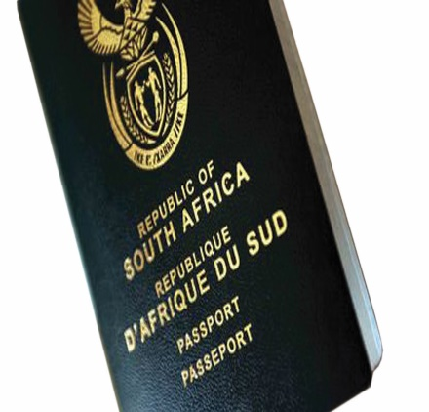
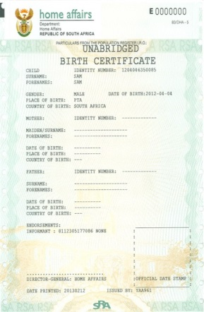
State of the Western Cape Province
As at end June 2019
Presented by Provincial Manager: Yusuf Simons
Notes:
1

Slide 2
Content
Provincial Overview
Geographical layout of the Province
Governance Structure (alignment span of control for DMO structures to enhance service delivery)
High level overview of Western Cape Province: access to clients
Footprint expansion during the past 5 years
Current burning issues: Facilities
Alphabetical list of all facilities
Health facilities
Provincial Highlights 2019
War on Queues
1) Queue Management Strategies implemented
2) Radio bulletins & client engagement
2) Moetapele Rating Cards
Provincial Resources:
Staff compliment
Progress in achievement of equity targets
Training interventions
Vetting
Employee Wellness programmes
Moetapele – reward & recognition
Employee Engagement
Counter Corruption
Provincial Fleet
Budget and cost reduction measures

Slide 3
Content
Stakeholder engagement and integrated governance:
Immigration Services
Civic Services: Outreach programmes
Provincial Performance in relation to APP targets 2019/2020 and strategies developed to achieve
Birth Registration
Late Registration of Births
ID Smart Cards issued
Immigration targets
Payment of invoices within 30 days

Slide 4
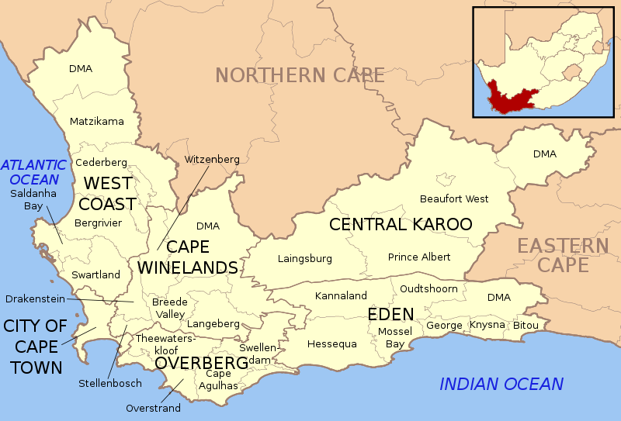
Geographical outlay of Western Cape Province
1x Metro: City of Cape Town, 5 x District Municipalities (West Coast, Cape Winelands, Central Karoo, Overberg, Garden Route) Reporting to Head Office: PoE : 3 x Sea Ports: Cape Town, Saldanha, Mosselbay, 1 x International Airport – Cape Town (National key point), Refugee Reception Centre
4

Slide 5
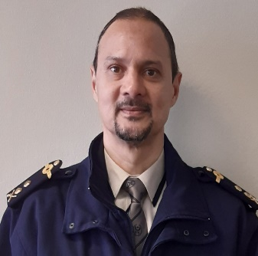
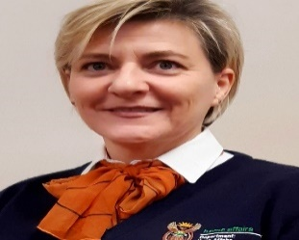
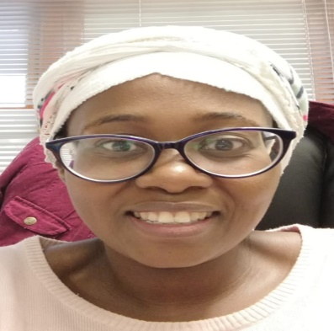
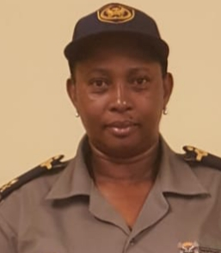
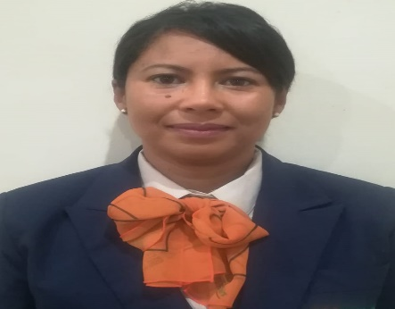
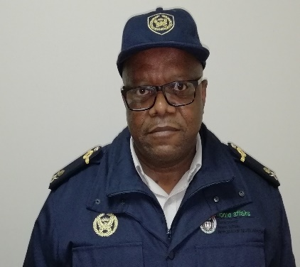
Western Cape Management Team as at end June 2019:
Provincial Manager: WC Mr. Y Simons
Provincial Coordinator Ms A van der Berg
Director Finance & Support: Ms R Tlou
DMO: Cape Metro and Overberg: Ms B Sakawuli
DMO: Cape Winelands & West Coast: Ms I Michaels
DMO: Central Karoo & Garden Route : Dr M Ngaka

Slide 6
Western Cape Management Team as at end June 2019:
DMO: Cape Metro and Overberg: Ms B Sakawuli
DMO: Cape Winelands & West Coast: Ms I Michaels
DMO: Central Karoo & Garden Route : Dr M Ngaka
Cape Metro:
Cape Town Large Office
Bellville Medium Office
Wynberg Medium Office
Mitchells Plain Medium Office
Nyanga Medium Office
Khayelithsa Large Office
1x Bank: STD Canal Walk
Overberg:
Caledon Medium Office
Bredasdorp TSC
Grabouw Small Office
Swellendam TSC
Cape Winelands:
Paarl Large Office
Somerset West Medium Office
Worcester Medium Office
Ceres TSC
Robertson TSC
Stellenbosch Medium Office
West Coast :
Vredendal Medium Office
Malmesbury Medium Office
Vredenburg Small Office
Citrusdal Small Office
Atlantis TSC
Garden Route :
George Large Office
Mosselbay TSC
Plettenbergbay TSC
Oudtshoorn Medium Office
Ladismith Service Point
Central Karoo:
Beaufort West TSC
Prince Albert Small Office
Laingsburg Small Office

Slide 7
WC Governance
Meeting | Frequency | Members | Purpose
EXCO | Weekly | PM, DMOs, Dir Finance &Support, Coordination, Immigration Coordinator | Burning issues Operational challenges Progress reports targets & action log Audit Issues Feedback from meetings attended at HO Direction and strategic guidance
Extended EXCO | Bi- monthly | PM, DMOs, Dir Finance &Support, Coordination, Immigration Coordinator, DD Counter Corruption, DD Vetting, ASD HR, ASD LR, Moetapele Representative | Information sharing Burning issues Progress reports from business units, APP targets and action log Feedback from meetings attended Direction and Strategic guidance
Extended Management Meeting | Bi-monthly | PM, DMOs, Dir Finance &Support, Coordination, Immigration Coordinator, DD Counter Corruption, DD Vetting, ASD HR, ASD LR, All Office Managers, Chairperson of Youth, Chairperson Disability Forum, Representatives from Organized Labour | Information sharing Burning issues Progress reports from business units, APP targets and action log Feedback from meetings attended Direction and guidance on operational issues Round table discussion – inputs on any issue affecting service delivery, Policy, processes

Slide 8
WC Governance
Meeting | Frequency | Members | Purpose
Provincial Consultative Forum (PCF) | Quarterly | Elected Managers Representatives from Organized Labour, ASD: Labour Relations | Feedback from DBC Matter affecting staff in the workplace
Staff meetings | Monthly | Office Managers, Shop stewards, all staff | Feedback from meetings Discussion of new directives Information sharing – issues impacting on service delivery
Provincial Procurement Committee (PPC) | Quarterly | Appointed representatives from business, Counter Corruption, Vetting and SCM | Adjudicate bidders higher than R100 000
Provincial Loss Control Committee (PLC) | Quarterly | Appointed representative from business, Counter Corruption, Vetting, Assets and SCM | Evaluate and make recommendation on Loss and Damage Reports received from Offices
Youth Forum | Quarterly | Appointed representatives form each District | Planning and execution of service delivery programmes, Participation in Provincial programmes
SHE Reps | Quarterly | Chaired by ASD: Asset & Property Management, appointed representatives from Districts | Discuss Occupational Health and Safety Issues prevalent in the workplace.

Slide 9
High level summary: footprint and access to clients
Available | Comments
29 x Front Offices within 5 Districts and 1 Metro 1 x permanent contact point – Ladismith 27 x Connected Health Facilities 1 x Bank - Standard Bank Canal Walk 1 x Provincial Office (sharing space with Cape Town Large Office) Provincial Archive Facility established at Bellville Office | 25 x Modernised Front Offices (11 urban, 14 rural) and 1x Bank 86% of our Offices are modernised Malmesbury Modernised Office temporarily closed due to eviction order (Nov 2017) – new Office space procured by DPW a - office due to become operational by November 2019 Roll out of 2 additional Banks – FNB Port Side and Nedbank St Georges envisaged for 2nd Quarter 2019/2020 Vredenburg- and Citrusdal Offices due for modernization in 4th Quarter 2019/2020 Swellendam- and Laingsburg Offices earmarked for Modernization 4th Quarter 2020/2021

Slide 10
Re-alignment of DMO structure to support service delivery needs w.e.f Feb 2018
3 Directors assumed duty w.e.f February 2018 (Director Finance & Support as well as 2 x District Managers Operations)
District/ Area | Details of assigned DMO | Population
Cape Metro (excluding TSC Atlantis and Somerset West Office) & Overberg District | Ms. Bongiwe Sakawuli | CM – 4 524 111 OB – 212 787
Cape Winelands (inclusive of Somerset West Office and TSC Atlantis) & West Coast District | Ms. Irmgard Michaels | CW – 864 028 WC – 433 445
Garden Route & Central Karoo | Dr. Mosiuoa Ngaka | GR 619 224 CK 75 688
TOTAL |  | * 6 729 283
*Socio Economic Profile WC 21/01/2018
10
Notes:
10

Slide 11
Re-alignment of IMS structure to support service delivery needs w.e.f Feb 2018
District/ Area | Details of assigned ASD: IMS
Cape Metro (Excluding Bellville, Khayelitsha) | ASD Desmond Adams
Bellville, Khayelithsa (excluding Somerset West) and Overberg District | ASD Mr Keith Dilgee
Cape Winelands and West Coast Districts | ASD Ms Rencia Valentine
Garden Route and Central Karoo Districts | ASD Mr M Coko
11
Notes:
11

Slide 12
Footprint expansion over the past years
District | Office name | Type | Modernized (Yes/No) | Reason for establishment
Cape Metro | Atlantis | TSC | Yes | Disadvantaged community No/poor public transport infrastructure More than 50km from nearest DHA facility
Overberg | Bredasdorp | TSC | Yes | Rural farming communities
Cape Winelands | Ceres | TSC | Yes | Rural farming communities
 | Robertson | TSC | Yes | Rural farming communities
 | Prince Albert | TSC | Yes | Proximity to nearest DHA facility
 | Mosselbay | TSC | Yes | Situated within a huge fast growing informal settlement with migrant workers from EC
 | Ladismith | Contact Point | No | Proximity to other DHA facilities Community request to political office bearers
 | Riversdale | Health facility | No | Proximity to other DHA Facilities Huge disadvantaged rural community with high childbirth rates for teenage mothers
 | Vredenburg | Contact Point | No | Proximity to nearest DHA facility Saldanha – economic hub of the West Coast Fast growing informal settlements – migrant workers Earmarked for modernization 2019/2020

Slide 13
Burning issues : Facilities
Vredenburg:
Municipality gave DHA notice for termination of lease at Swemmer & Levine Building w.e.f. 30 June 2017
Municipality provided alternative facility – DHA in process of refurbishing with the view of modernizing the office in 2019/2020
Malmesbury:
Landlord served DHA with an eviction notice w.e.f November 2017
New Office space was procured through DPW and in process of being refurbished by the landlord
Envisaged operational date November 2019
Mitchells Plain:
Office infrastructure not conducive to service delivery – OHS issues & complaints from clients
DPW tendered 3 times - suitable property identified for possible refurbishment

Slide 14
Alphabetical list of WC Offices and classification
PROVINCE | SERVICE POINT NAME | DISTRICT MUNICIPALITY NAME | LOCAL MUNICIPALITY NAME | URBAN / RURAL | OFFICE - STREET ADDRESS
WC | ATLANTIS/ HARTEBEESKRAAL | City of Cape Town MM | City of Cape Town MM | URBAN | Mpcc Hartebeeskraal, 1 Notthingham Street, Atlantis
WC | BEAUFORT WEST | Central Karoo DM | Beaufort West LM | RURAL | 3 De Vries Street, Thusong Centre, Beaufort West, 6970
WC | BELLVILLE | City of Cape Town MM | City of Cape Town MM | URBAN | Old ABSA Bank Building, Voortrekker Road, Bellville,7530
WC | BREDASDORP | Overberg DM | Cape Agulhas LM | RURAL | 109 Park Street, Bredasdorp
WC | CALEDON | Overberg DM | Theewaterskloof LM | RURAL | 11 Haw Street, Caledon
WC | CAPE TOWN | City of Cape Town MM | City of Cape Town MM | URBAN | Faircape Buiding, 56 Barrack Street, Cape Town
WC | CERES | Cape Winelands DM (Boland) | Witzenberg LM | RURAL | Panorama Street, Bellavista, Ceres, Erf no: 2628
WC | GEORGE | Garden Route DM | George LM | URBAN | 109 York Street , Telkom Building ,George 6530
WC | GRABOUW | Overberg DM | Theewaterskloof LM | RURAL | Old Traffic Department, Grabouw 7160
WC | KHAYELITSHA | City of Cape Town MM | City of Cape Town MM | URBAN | C/O Tsolo And Mzala Street, Khayelitsha, 7793
WC | LAINGSBURG | Central Karoo DM | Laingsburg LM | RURAL | Cnr Main & 3Rd Avenue, Goldnerville Laingsburg
WC | MALMESBURY | West Coast DM | Swartland LM | URBAN | Kricket Club, Malmesbury, 7300
WC | MITCHELL'S PLAIN | City of Cape Town MM | City of Cape Town MM | URBAN | 1 Alpha Street ,Beacon Valley,Mitchell'S Plain
WC | MOSSEL BAY | Garden Route DM | Mossel Bay LM | RURAL | Thusong Service Centre, 108 Adriaans Street, KwaNonqaba, Mossel Bay

Slide 15
Alphabetical list of WC Offices and classification
PROVINCE | SERVICE POINT NAME | DISTRICT MUNICIPALITY NAME | LOCAL MUNICIPALITY NAME | URBAN / RURAL | OFFICE - STREET ADDRESS
WC | NYANGA (NONTSUMPA) | City of Cape Town MM | City of Cape Town MM | URBAN | C/O New Eisleben & Miller Street, Crossroads, 7755
WC | OUDTSHOORN | Garden Route DM | Oudtshoorn LM | RURAL | 73 Dassie Road, Bridgton, Oudtshoorn, 6625
WC | PAARL | Cape Winelands DM (Boland) | Drakenstein LM | URBAN | 39 Castle Street, Paarl
WC | PRINCE ALBERT | Central Karoo DM | Prince Albert LM | RURAL | Adderley Street 1, Prince Albert, 6930
WC | ROBERTSON | Cape Winelands DM (Boland) | Breede River/Winelands LM | RURAL | 40 Paddy Street, Robertson Thusong Centre, Robertson
WC | SIMUNYE (PLETTENBERG BAY) | Garden Route DM | Bitou LM | RURAL | Xipula Street,Kwanokuthula,Plettenbergbay
WC | SOMERSET WEST | City of Cape Town MM | City of Cape Town MM | URBAN | Department of Labour building, 117 main Road, Somerset West, 7130
WC | STELLENBOSCH | Cape Winelands DM (Boland) | Stellenbosch LM | URBAN | C/O Ryneveld And Jan Cilliers Street. Stellenbosch
WC | SWELLENDAM | Overberg DM | Swellendam LM | RURAL | 01 Vollenhoven Street, Railton, Swallendam
WC | VICKY ZIMI (CITRUS DAL) | West Coast DM | Cederberg LM | RURAL | Vicky Zimri Thusong Centre,Bohemia Street, 7340
WC | VREDENBURG | West Coast DM | Saldanha Bay LM | RURAL | Main Road, Vredenburg
WC | VREDENDAL | West Coast DM | Matzikama LM | RURAL | C/o Hoerskool and Bult Street, Vredendal Thusong Centre, 8160
WC | WORCESTER | Cape Winelands DM (Boland) | Breede Valley LM | URBAN | 71-73 Adderley Street Worcester 6850
WC | WYNBERG | City of Cape Town MM | City of Cape Town MM | URBAN | Maynard Mall, Level 2, 70 Main Road, Wynberg, 7824

Slide 16
Number of Health facilities
District | Number of Public Health Facilities with Maternity Units | Connected and functional | Permanent capacity available (L5) | Additional Capacity Deployed to service Health Facilities
Cape Metro | 23 | 17 | 6 | * Serviced by staff from local offices - 18 staff members (L6)
Overberg | 5 | 1 | 0 | * Serviced by staff from Caledon Office - 1 staff member (L6)
Cape Winelands | 7 | 4 | 1 | * Serviced by staff from local offices - 3 staff members
West Coast | 7 | 1 | 1 | * 1 x staff member from TSC Atlantis service the facility * Online connectivity at Vredenburg terminated due to lack of space - staff members from Vredenburg service the HF
Graden Route | 7 | 6 | 1 | * Serviced by roaming team from local offices - 5 staff members from local offices
Central Karoo | 4 | 0 | 0 | * Serviced by roaming team 2x staff members * Beaufort West HF no longer connected due to lack of space
 | 53 (61 according to HO) | 29 (41 Connected) | 9 | Some of the HF cannot be visited everyday but by arrangement between office manager and facility manager

Slide 17
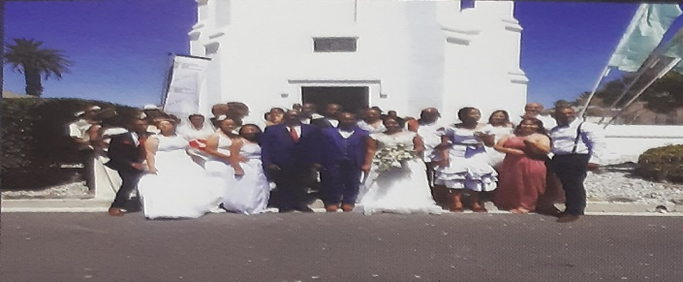
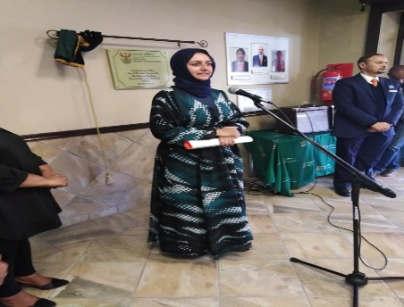
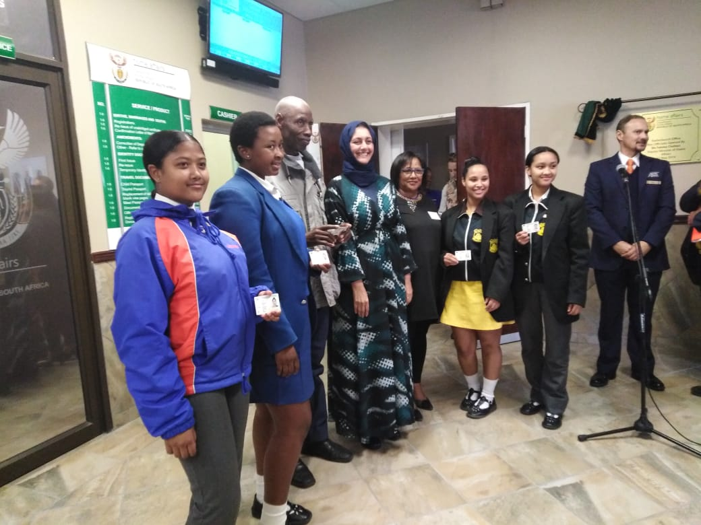
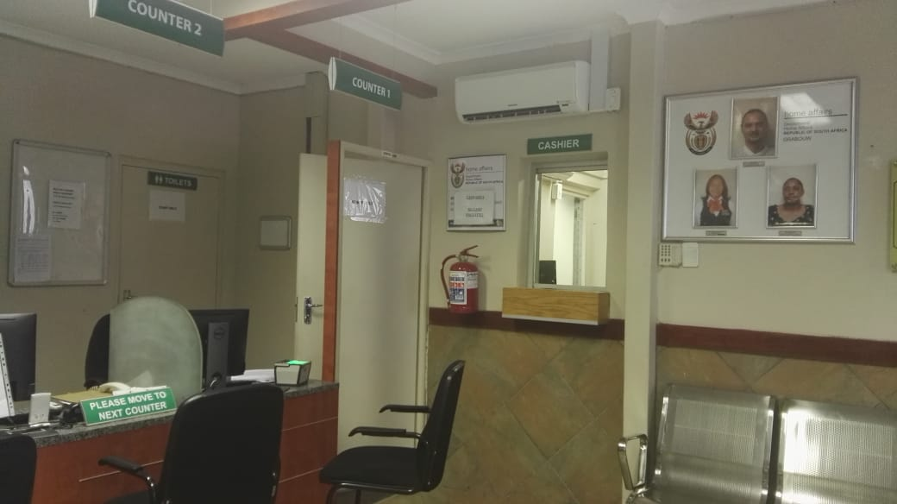
Provincial Highlights 2018/2019
Annual Marriage Solemnization event on Valentines day 2019 – 22 couples got married
Official Opening of the Stellenbosch Office by former Deputy Minister Chohan -2 May 2019
Official Opening of the new modernized Grabouw Office – November 2018

Slide 18
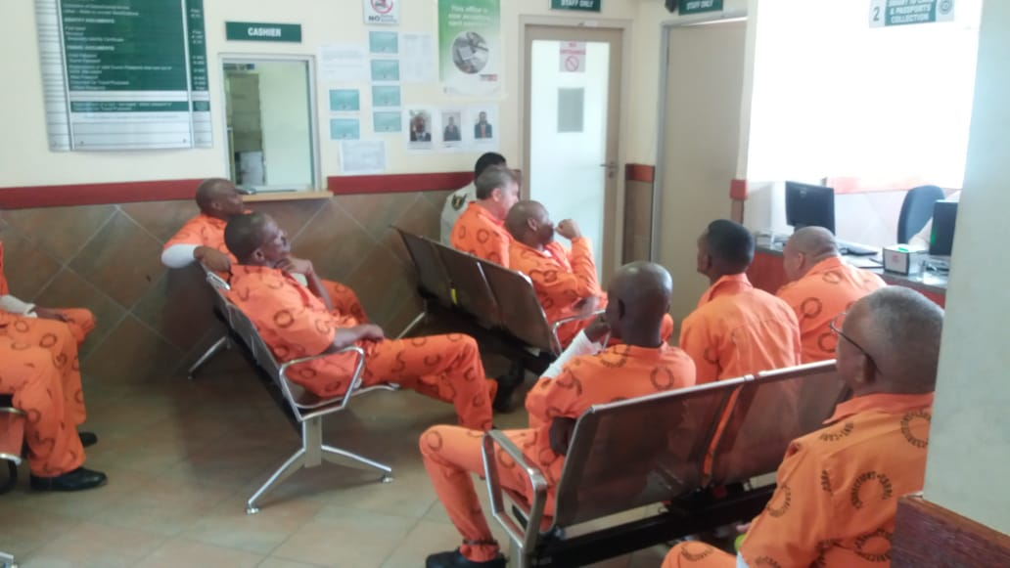
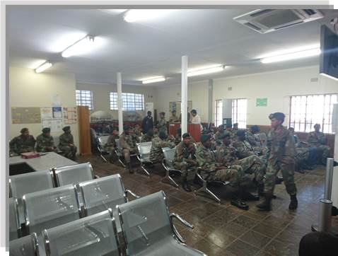
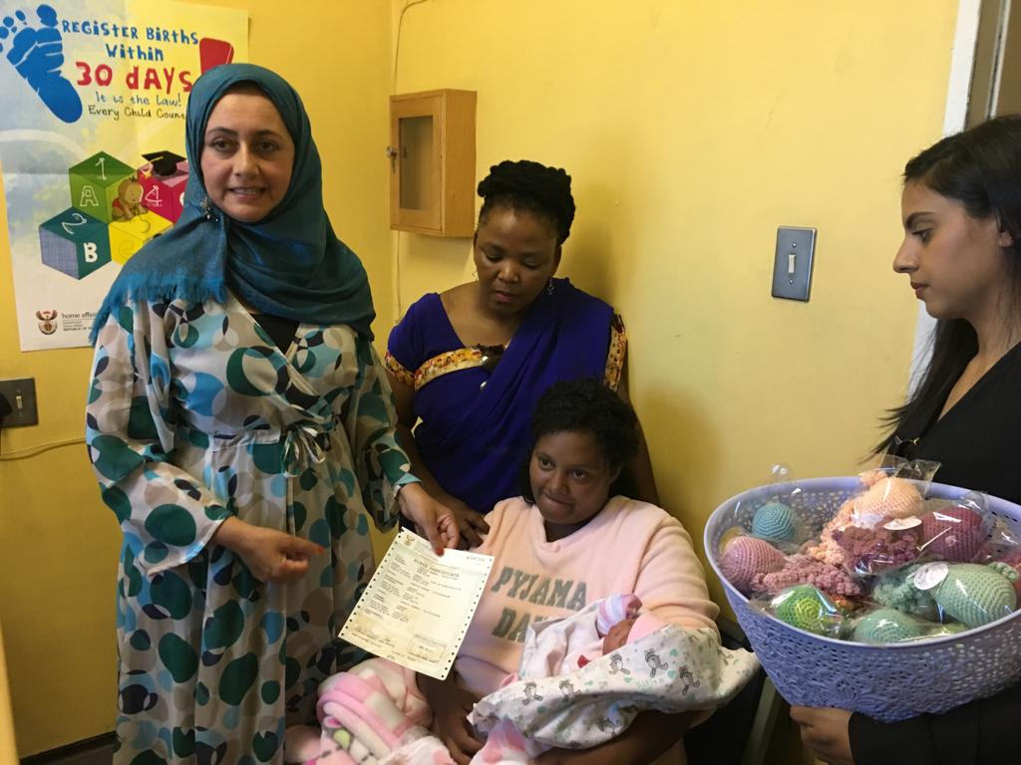
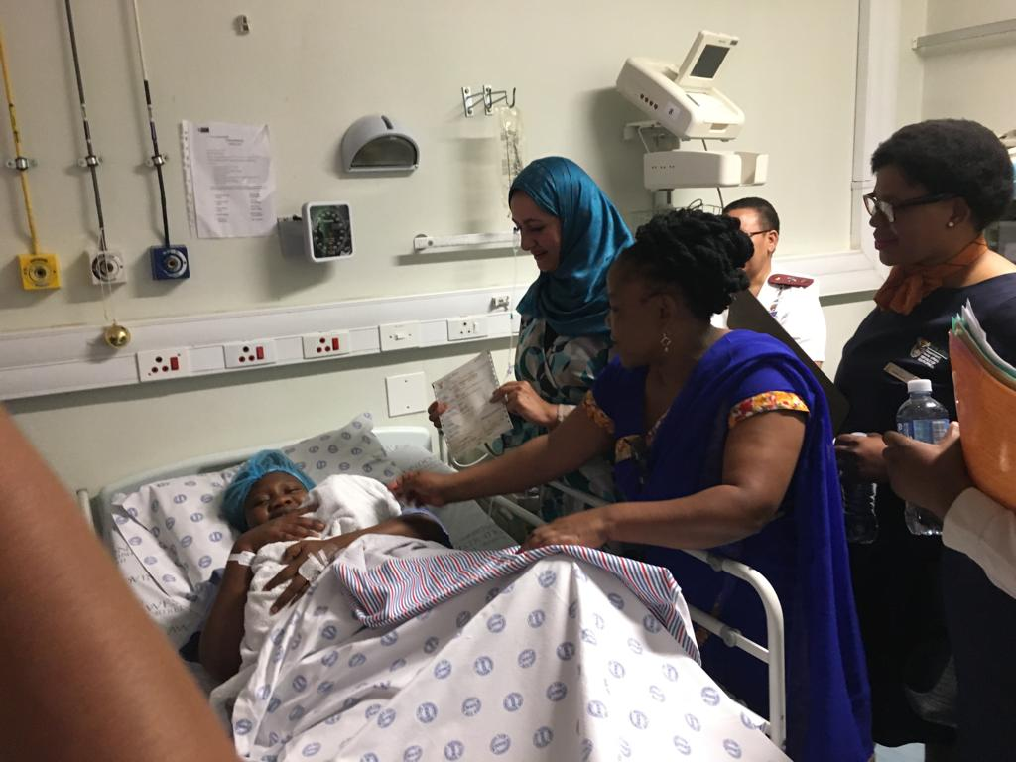
Provincial Highlights 2019
Commended by IEC WC for support during Elections 2019 i.e. projects in prisons, id distribution programmes
Birth Registration on New Years Day 2019 – Tygerberg Hospital
Servicing Dwarsrevier Prison Servicing SANDF Oudtshoorn Office

Slide 19
Client care and War on Queue Strategy

Slide 20
High Volume Offices and queue management strategies
Efforts to reduce waiting times:
1. Improved management capability and leadership with the appointment of 2 x District Managers
2. Signage displayed on queue poles placed outside of the office to categories queues into:
Smart card and passport applications,
Smart card and passport collections,
Legacy system applications (Birth-, Death- registration, Temporary ID Certificates).
3. Prioritize client categories: Elderly, pregnant mothers, mothers with infants
4. Scholars with uniform accompanied by parents are prioritised
5. Compulsory for office managers to engage clients prior to office opening and visit front office areas every 2 hours to interact with clients
6. Floorwalkers direct clients and communicate approximate waiting times to clients inside of the office
7. Radio Bulletins to direct clients to low volume offices (morning & afternoon slots)
8. Moetapele Rating Cards implemented & monitored
9. Continuous communication to clients when high volumes are experienced and redirecting of clients

Slide 21
Radio bulletins and client engagement
Radio bulletins:
Purpose:
Real time information to client intending to visit a DHA Office and provide information on:
System stability
Client volumes
Re- direct to Offices with low client volumes
Marketing DHA priorities
Timeslots : 08h00, 12h00 and 14h00
Challenges: Budgetary constraints “Voice of the Cape” Radio Station willing to do it for free
Voice Clip (Mr Plaatjies)
Video Clip (Ms Madolo)
Video clip – negotiating with GCIS to air on social media platform

Slide 22
Radio bulletins and client engagement continued
Other platforms used for client engagement:
Random appearances on Cape Talk – Keno Kammies, Pippa Hudson. John Maytham Shows
Programmes conducted related to:
ID Smart Card requirements,
Online status of offices and what to do,
LGBTI issues- gender change application requirements
During Election – IDSC & Temporary ID requirements
Late Registration of Birth Processes
Choice of surnames – when women enter into marriage
Undocumented minors & learners in schools
Radio Sonder Grense (RSG)
- Surname changes
- IDSC requirements
Radio Sibonele (as the need arise)
- DHA services
Collaboration with Eden FM and George Herald during the 2019 Elections
ENCA – Duplicate cases (Televised)
Voice of the Cape
- Q&A session general dialed in queries

Slide 23
Moetapele Rating Cards
Moetapele Rating Cards developed in line with WC War on Queue Management Strategy
Reporting- tool and structure developed
Inputs from clients are recorded and attended by Office Managers
Discussed at Extended EXCO meetings for monitoring and possible further interventions

Slide 24
Moetapele Rating Cards continued- example
DHA OFFICE RATING CARD: WESTERN CAPE
Nr | SURVEY QUESTIONS | SERVICE RATING | COMMENTS
1 | Did the attending official serve you with a smile?
2 | Was the official’s conduct professional?
3 | Are you satisfied with our services?
4 | Were you approached by the Office Manager/ Floorwalker when you entered the Office?
COMMENTS/ SUGGESTIONS ON AREAS OF IMPROVEMENT
Client contact details (if feedback is required): …………………………………………..

Slide 25
Moetapele Reporting Tool : Report for July 2019
Days | CLIENT RATING CARD ANALYSIS
 | Did the attending official serve you with a smile | Was the official's conduct professional | Are you satisfied with our services | Were you approached by the Office Manager/ Floorwalker when you entered the Office
Week 1 | RATING CARD ANALYSIS |  |  |  | OVERALL ANALYSIS
TOTAL | 132 | 230 | 294 | 72 | 728
Poor | 0% | 0% | 0% | 0% | 0%
Fair | 3% | 35% | 49% | 44% | 36%
Excellent | 97% | 65% | 51% | 56% | 64%
Week 2 | RATING CARD ANALYSIS |  |  |  | OVERALL ANALYSIS
TOTAL | 164 | 164 | 150 | 46 | 524
Poor | 0% | 20% | 43% | 0% | 18%
Fair | 10% | 20% | 10% | 35% | 15%
Excellent | 90% | 60% | 47% | 65% | 67%
Monthly | RATING CARD ANALYSIS |  |  |  | OVERALL ANALYSIS
TOTAL | 646 | 744 | 794 | 463 | 2647
Poor | 0% | 4% | 8% | 3% | 4%
Fair | 3% | 18% | 24% | 23% | 17%
Excellent | 97% | 78% | 68% | 73% | 79%

Slide 26
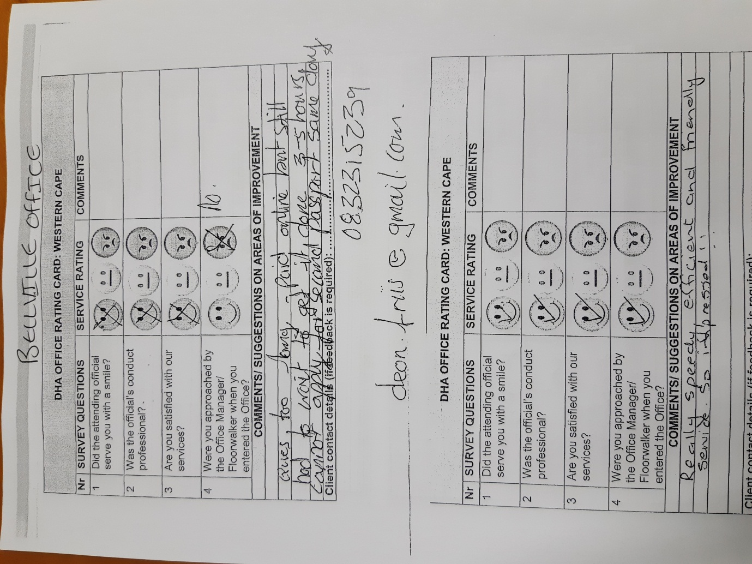
Examples of completed rating cards July 2019

Slide 27
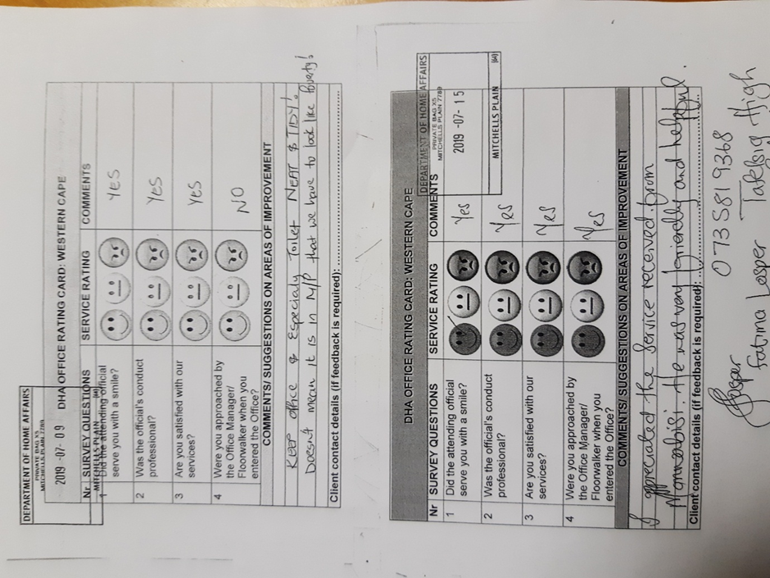
Examples of completed rating cards July 2019

Slide 28
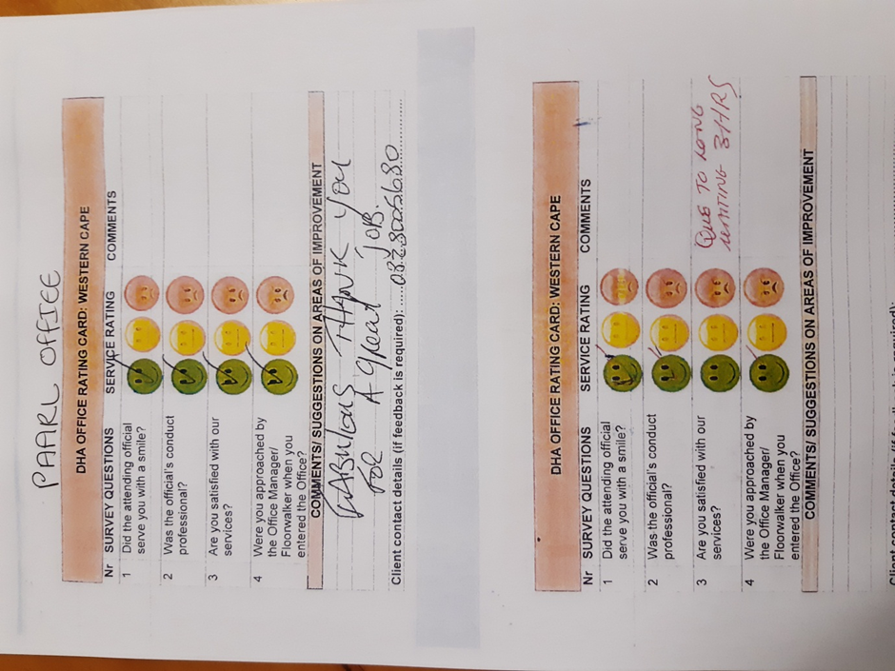
Examples of completed rating cards July 2019

Slide 29
Provincial Resources

Slide 30
Staff breakdown per office continued
District | Office Name | Total number of filled posts as at 30 June 2019 | Number of staff Civic Services | Number of staff for IMS | Support staff (OM, Cleaners, Security, Sate Accountants etc.)
 | DMO Cape Metro | 9 | 5 | 0 | 4
 | Large Office Cape Town | 93 | 70 | 16 | 7
 | Large Office Khayelitsha | 41 | 31 | 6 | 4
 | Medium Office Bellville | 54 | 51 | 0 | 3
 | Medium Office Mitchell's Plain | 23 | 21 | 0 | 2
 | Medium Office Nyanga | 24 | 22 | 0 | 2
 | Medium Office Wynberg | 39 | 37 | 0 | 2
Cape Metro | 54% | 283 | 237 | 22 | 24
 | DMO Cape Winelands | 3 | 0 | 0 | 3
 | Large Office Paarl | 30 | 23 | 5 | 2
 | Medium Office Somerset West | 14 | 13 | 0 | 1
 | Medium Office Stellenbosch | 6 | 5 | 0 | 1
 | Medium Office Worcester | 17 | 13 | 2 | 2
 | PSP Ceres | 6 | 5 | 0 | 1
 | PSP Robertson | 4 | 3 | 0 | 1
Cape Winelands | 15% | 80 | 62 | 7 | 11

Slide 31
Staff breakdown per office continued
District | Office Name | Total number of filled posts as at 30 June 2019 | Number of staff Civic Services | Number of staff for IMS | Support staff (OM, Cleaners, Security, Sate Accountants etc.)
 | DMO Central Karoo | 1 | 0 | 0 | 1
 | Medium Office Beaufort West | 13 | 9 | 3 | 1
 | PSP Prince Albert | 3 | 2 | 0 | 1
 | TH Laignsburg | 3 | 2 | 0 | 1
Central Karoo | 4% | 20 | 13 | 3 | 4
 | Medium Office Oudtshoorn | 14 | 10 | 3 | 1
 | DMO Graden Route | 3 | 0 | 0 | 3
 | Large Office George | 29 | 23 | 4 | 2
 | Medium Office Mosselbay | 7 | 5 | 1 | 1
 | TH Plettenberg Bay | 5 | 4 | 0 | 1
Garden Route | 11% | 58 | 42 | 8 | 8
 | DMO West Coast | 2 | 1 | 0 | 1
 | Medium Office Malmesbury | 18 | 13 | 3 | 2
 | Medium Office Vredendal | 7 | 5 | 1 | 1
 | TH Atlantis | 4 | 3 | 0 | 1
 | PSP Vredenburg | 4 | 3 | 0 | 1
 | TH Citrusdal | 3 | 2 | 0 | 1
West Coast | 6% | 38 | 27 | 4 | 7

Slide 32
Staff breakdown per office continued
District | Office Name | Total number of filled posts as at 30 June 2019 | Number of staff Civic Services | Number of staff for IMS | Support staff (OM, Cleaners, Security, Sate Accountants etc.)
 | DMO Overberg | 1 | 0 | 0 | 1
 | Medium Office Caledon | 13 | 8 | 3 | 2
 | PSP Bredasdorp | 5 | 4 | 0 | 1
 | PSP Grabouw | 3 | 2 | 0 | 1
 | PSP Swellendam | 3 | 2 | 0 | 1
Overberg | 5% | 25 | 16 | 3 | 6
PMO: WC | PMO: WC - 5% | 24 | 0 | 0 | 24
Total number of staff |  | 528 | 397 | 47 | 60
53% of the total staff compliment is within the Cape Metro – contributes 80% to the APP targets

Slide 33
Loss of capacity – impact on service delivery
The WC Province lost 31 posts since February 2018 –
1x Management post,
26 x front office clerks,
1 x Immigration Officer and
3 support posts.
Challenges and impact on service delivery:
Large Office Cape Town without an Office Manager (L12) – lack of management capability, escalation of queries and complaints,
26 Front office clerks - Inability to cope with the demand for services within offices, not all counters have staff, difficult to maintain roaming services Health Facilities,
Challenging to roll out banks without impacting on other key services (PPP is in process)
Immigration Officers – lack of capacity to attend joint operations in rural farming areas where illegal employment is rife

Slide 34
Progress in achieving equity targets June 2019
 | AFRICAN |  |  | COLOURED |  |  | INDIAN |  |  | WHITE
 | FEMALE | MALE | TOTAL | FEMALE | MALE | TOTAL | FEMALE | MALE | TOTAL | FEMALE | MALE | TOTAL
WESTERN CAPE | 187 | 105 | 292 | 107 | 79 | 188 | 5 | 2 | 7 | 36 | 7 | 43
Provincial EAP by Population Group and Gender | 16.1% | 19.9% |  | 22.5% | 26.2% |  | 0.1% | 0.4% |  | 6.6% | 8.2%
DHA Percentage Representation | 35,4 | 19,9 |  | 20,3 | 15 |  | 0.9 | 0.4 |  | 6.8 | 1.3
 | PHYSICALLY CHALLENGES STAFF 2017 | PHYSICALLY CHALLENGED STAFF 2019
Post Level | 13 (2%) | 10 (1,9%) | Reason for decrease
3 | 1 |  | Retirement
5 | 2 |  | 1x Deceased, 1x Resignation
6 | 4 | 5
7 | 3 | 3
8 | 2 | 1 | Resignation
9
10 | 1 | 1
Province lost 4 posts hence the representation for physically challenged persons - reduced to 1,9%
Representation: Males = 37% , Females 63%.
Female representation at Executive Management (SMS) level 60% with 3 females vs 2 males

Slide 35
Status on vetting
Valid clearences | Total 17/18 |  | Total 18/19
To Secret | 14 |  | 18
Secret | 109 |  | 85
Confidential | 273 |  | 270
In process | 127 |  | 253
SUB TOTAL | 523 |  | 626
None | 157 |  | 38
Expired | 10 |  | 18
TOTAL | 690 |  | 682
VETTING TARGETS 2019/20 for secret and top secret clearance
Quarter 1 | Quarter 2 | Quarter 3 | Quarter 4 | Total
6 | 6 | 4 | 4 | 20
Dependency on SSA to issue clearances

Slide 36
Skills Development and training conducted 2019
Programme name | Month presented | Nr trained
Naturalisation Induction | February | 153
DHA Induction (EOH Learners) | April | 84
Naturalisation Induction | May | 48
Cadet Programme | May | 16
Cadet Programme | June | 18
Project Management | June | 20
SDIP | June | 20
Stakeholder Training | Monthly | 198
Interpretation of Immigration legislation for Managers | August 2019 | 13
Counter Corruption Workshops | August 2019 | 35
 | TOTAL | 605
Ongoing in-service training presented on Modernization and National Population Register (NPR) systems

Slide 37
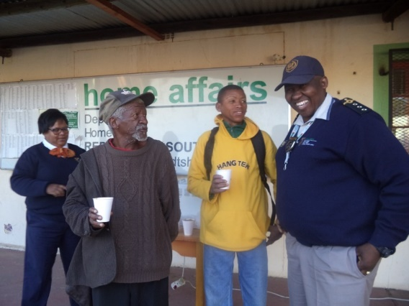
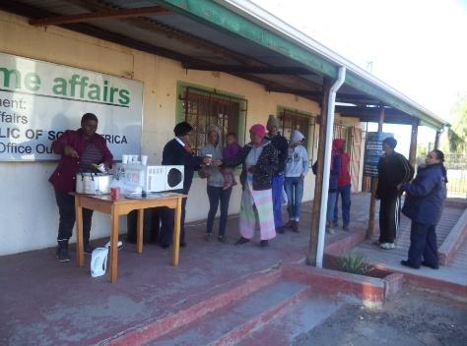
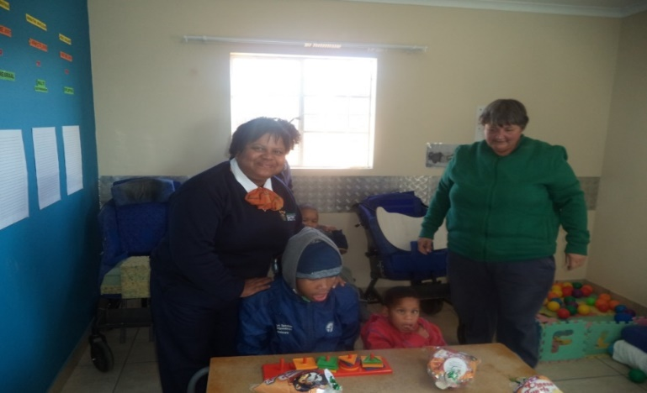
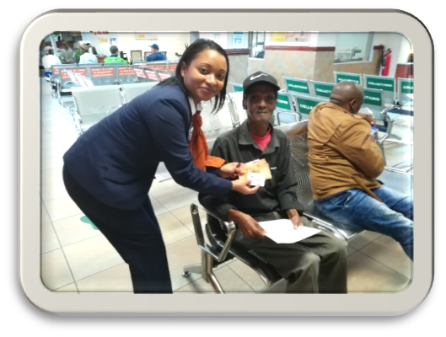
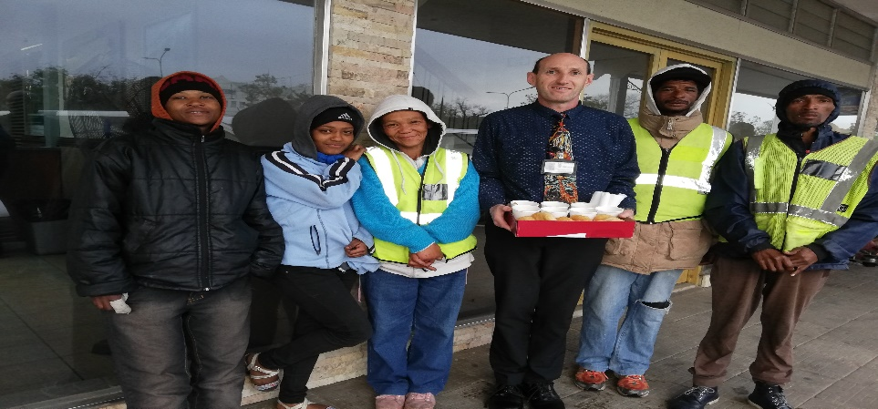
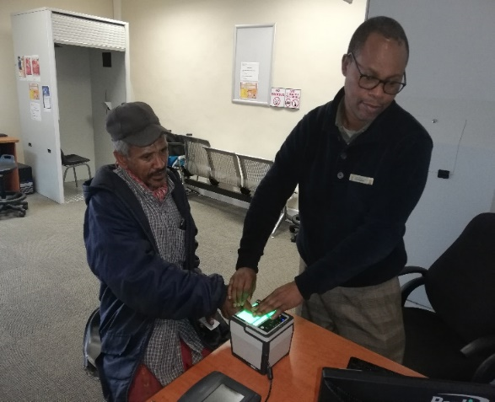
Employee Wellness Activities 2019
Mandela Day Activities: Garden Route:
Staff spoiled clients with coffee and tea
at the Oudtshoorn Office
Staff bought chocolates and chips for children in a Disability Care Centre
George Office staff served homeless people with warm soups and bread.
George Office staff paid fee for IDSC for persons whom could not afford it.

Slide 38
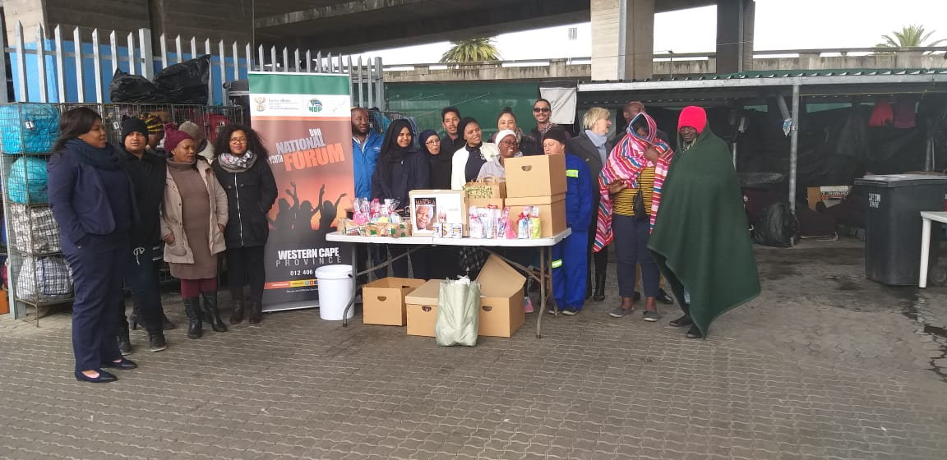
Employee Wellness Activities 2019
Mandela Day Activities: Provincial Office
Made soup and donated toiletries to persons living in a shelter

Slide 39
Workplace Forums Established
Western Cape Youth Forum Established – Director Finance & support appointed as mentor with Chairperson Godfrey Ntsime
Persons With Disability Forum – DMO Cape Winelands appointed as mentor with Chairperson Mr Kr Mpopiya

Slide 40
Moetapele / Reward and Recognition
Provincial Award & Recognition Ceremony
A Provincial Reward ceremony was also conducted to reward employees whom went the extra mile in efforts to achieve the 2018/2019 APP targets (i.e. employees volunteered to work on Saturdays and Sundays) . Categories: Best performing officials Best performing offices Officials willing to work on Saturdays – Birth Registration Best Performing Immigration Inspectorate Unit Dedication & Commitment : District IT Managers SCM Team 100% invoices paid within 30 days Bi monthly recognition of excellent performance during Extended Management Meetings

Slide 41
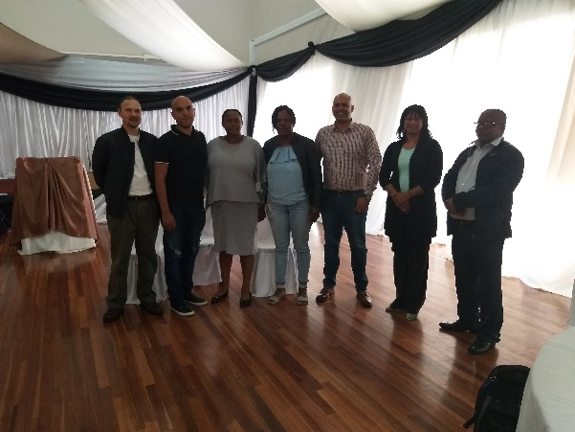
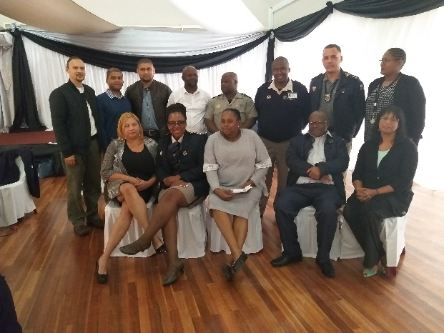
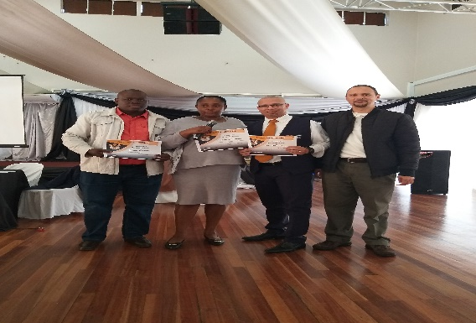
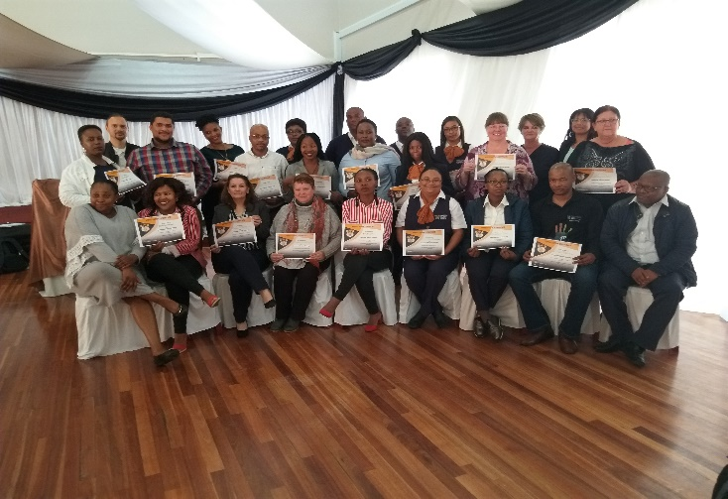
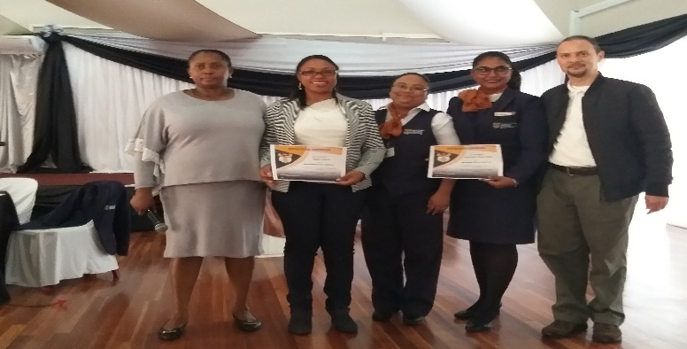
Moetapele / Reward and Recognition
District IT Managers
Immigration Inspectorate Team
Staff Commended by clients
Staff offering their time over weekends to do birth registration
Best Performing Office: Birth Registration

Slide 42
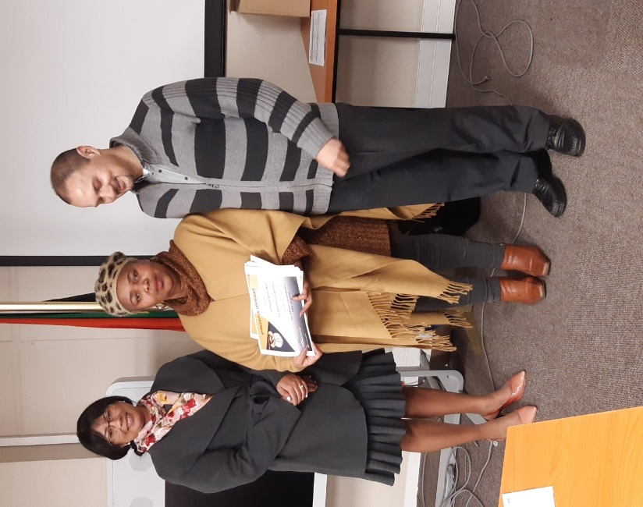
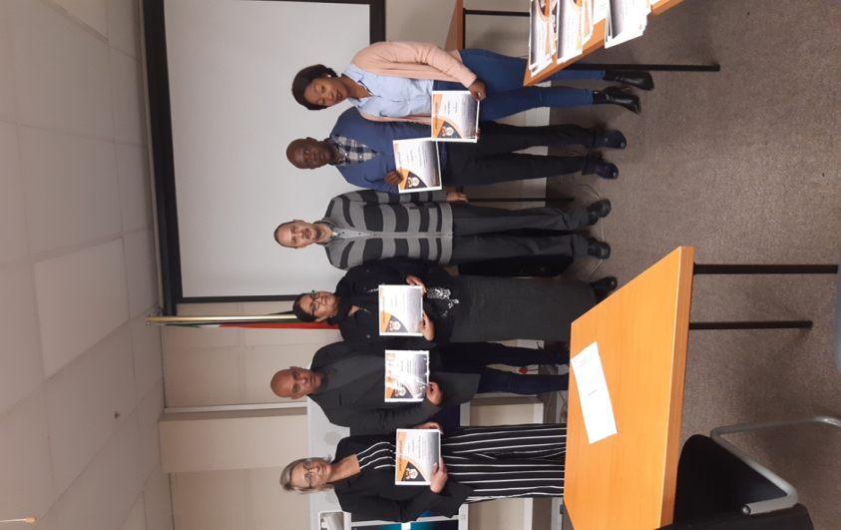
Moetapele / Reward and Recognition
Employees Commended by clients for services rendered: Certificate of Appreciation handed over during Extended Management Meetings

Slide 43
Employee Engagement
MISCONDUCT CASES AS END JUNE 2019
STATUS | TOTALS | SUPPORT SERVICES | CIVIC SERVICES | IMMIGRATION SERVICES | REFUGEE SERVICES
Lodged | 6 | 0 | 6 | 0 | 0
Finalized | 4 | 0 | 4 | 0 | 0
Pending | 2 | 0 | 2 | 0 | 0
2 Cases relating to misuse of government vehicles – sanctions issued
2 Cases for fraud and corruption – 1 case finalized, 1x other case scheduled
1 Case of negligence and dereliction of duty – sanctioned
1 Case of sexual harassment – pending disciplinary hearing

Slide 44
Counter Corruption & Security
 | Number of cases received Q1 | Nature of cases & Outcome
Corruption cases reported | 8 | 1x Identity Fraud – disciplinary action 2x Fraud Death Certificates 1x under investigation, 1x unfounded 1x Corruption – disciplinary action and criminal case opened 2x Aiding & Abetting – under investigation 1x Misuse of GG vehicle – under investigation 1x Non compliance to Policy – under investigation
Investigations finalised | 3 | 2x Disciplinary action 1x Unfounded
Disciplinary Action | 2 | 1x Fraud 1x Corruption
Security Services:
All Offices appointment of Fire Marshals & SHE Reps
Going forward:
Evacuation plans in process of being finalised in collaboration with local municipalities
Fire drills

Slide 45
High level overview of fleet services within the Western Cape
Area under review: | Available | Comments
Transport | Total number of vehicles on WC Asset Register = 101 Vehicles Service providers: 86 Departmental – ABSA Bank 15 GMT | The Province (Civic Services and PMO) returned 6 vehicles to G-Fleet as part of its cost reduction measures. Aging fleet is costly to maintain & becoming risk
Allocation of Provincial Fleet:
Office | Number allocated
Provincial Office | 5
Civic services: Front Offices | 47
Mobile Offices | 12
Immigration customized | 10
Ports of Entry (CTPECC & CTIA) | 11
Refugee Office | 4
Ministries | 12
DGs Office | 0

Slide 46
Western Cape Budget and expenditure as at end June 2019
 | Expenditure | Commitment | Voted | Budget available | PERCENTAGE %
COMPENSATION OF EMPLOYEES | 48 564 295 | 0 | 196 477 000 | 147 912 705 | 25%
GOODS AND SERVICES | 1 868 143 | 3 890 343 | 11 585 000 | 5 826 513 | 16%
PROVINCIAL AND LOCAL GOVERNMENTS | 122 088 | 0 | 317 000 | 194 912 | 39%
HOUSEHOLDS (HH) | 43 281 | 307 340 | 2 390 000 | 2 039 379 | 2%
MACHINERY AND EQUIPMENT | 97 262 | 0 | 130 000 | 32 738 | 75%
TOTAL | 50 695 070 | 4 197 683 | 210 899 000 | 156 006 247 | 24%
Note:
Linear expenditure trend as at end of June 2019 = 24% within 2% prescribed threshold.

Slide 47
Cost reduction measures implemented and impact
Cost reduction measure | Impact on Department/ Service delivery
Extended Management meetings conducted BI monthly | Reduction in traveling cost
Weekly telephone conference with District Manager from far lying area | Reduction in traveling cost
Limited delegations send to Head Office for meetings | Reduction in traveling cost Unable to attend all meetings
Naturalization Ceremony conducted at Provincial Office | Reduction in traveling cost and cost related to the rental of a venue

Slide 48
Stakeholder engagement and integrated governance

Slide 49
Stakeholder engagement
Stakeholder | Nature of co-operation
Dept. of Justice | Court processes regarding Immigration (IMS) case WC Nodal point appointed as member of the Provincial LGBTI Task Team
SAPS | Participate in IMS operations Civic Services taking of affidavits and render support during outreach programmes i.e. fire disasters IMS key stakeholder in Operation Fiella II, Operation Lock Down, Crime Summit
Dept. of Health | Birth registration projects Live birth data Steerco established to improve co-operation amongst Departments
SASSA | Information sharing and attending to referrals from SASSA
Dept. of Labour | Information sharing Participate in IMS operations
Dept. of Social Development | Information sharing and referrals Social Workers reports for late registration of birth
NGOs: Molo Songololo & Child Welfare | - Birth registration of abandoned children
Medi Clinics | - Birth registration

Slide 50
Stakeholder engagement
Stakeholder | Nature of co-operation
Marriage Officers Forum | Discussion / Resolutions on day to day operational issues Discussion and awareness on new developments within the DHA and Marriage legislation Participated in research – Preparation of a White Paper on an all inclusive marriage policy
Funeral Undertakers | Training programmes in place and on going

Slide 51
INSPECTORATE CAPACITY
NAME OF OFFICE | NUMBER OF INSPECTORATE OFFICIALS | LEVEL 6 | LEVEL 8 | Assistant Director
George | 4 | 2 | 1 | 1
Mossel bay | 1 | 0 | 1 | 0
Oudtshoorn | 3 | 2 | 1 | 0
Beaufort West | 3 | 2 | 1 | 0
Cape Town | 12 | 8 | 2 | 1
Bellville | 3 | 3 | 0 | 0
Khayelitsha | 6 | 4 | 1 | 1
Calledon | 3 | 2 | 1 | 0
LO Paarl | 5 | 4 | Vacant | 1
Worcester | 2 | 2 | Vacant | 0
Malmesbury | 3 | 2 | 1 | 0
Vredendal | 2 | 1 | 1 | 0
TOTAL | 44 | 32 | 10 | 4
Capacity constraints experienced within all units – difficult to cope with stakeholder demands
Hospitability industry

Slide 52
IMS STAKEHOLDER MEETINGS ATTENDED
IMS STAKEHOLDER | PURPOSE OF ENGAGEMENT
District Enhancement Efficiency Case Flow Meetings | Discuss procedural issues in criminal courts and administrative procedures at SAPS and DCS – Monthly
Agri Forum
Trafficking in Persons (TIP) | Sharing of information, planning and execution of operations – Chaired by NPA attended by NGOs, SAPS.
Provincial Joints | Provincial IMS performance and impact
JOCS | Joint Operational planning and execution i.e. Operation Fiella II, Tri-lateral Operation (Trucking Industry) – weekly
Provincial Crime Summit
Disaster Management Forum | Joint planning and execution of operations i.e potential disasters and disaster recovery - Monthly
Operation Lock Down | Joint planning and executing - weekly
DEVCOM | High level stakeholder engagement

Slide 53
State of Immigration Inspectorate
Success factors: | Impact
Appointment of Immigration Officers as Peace Officers | Immigration Officers able to make arrests during inspection of Businesses and no longer dependent on SAPS only Training will be conducted through DHA Learning Academy (Sept/ Oct 2019)
Priority Committee on Immigration | Co-ordinate joint operations with stakeholders Focused on deportation of illegal foreigners convicted of offences
Provincial Inspectorate Indaba conducted once a Quarter | Improved stakeholder engagements Uniform interpretation of Case Law Standardization of processes Development/ input to processes existing processes which was not properly applied – Cost recovery for deportation
Immigration ASD Forum | Improved co-ordination and decision making amongst Provincial Inspectorate Units
Establishment of the Provincial Information Co-ordination Unit | Gathering & analysis of information w.r.t arrivals vs over stayers, good cause applications, late registration of births, permitting, information from citizens Analysis presented to Inspectorate Units (Monthly Meeting) planning – information driven operation

Slide 54
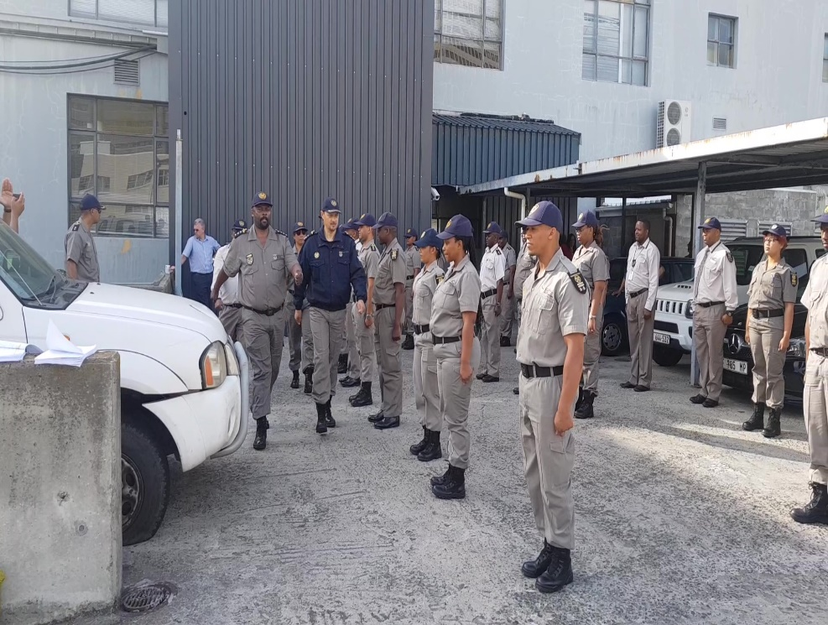
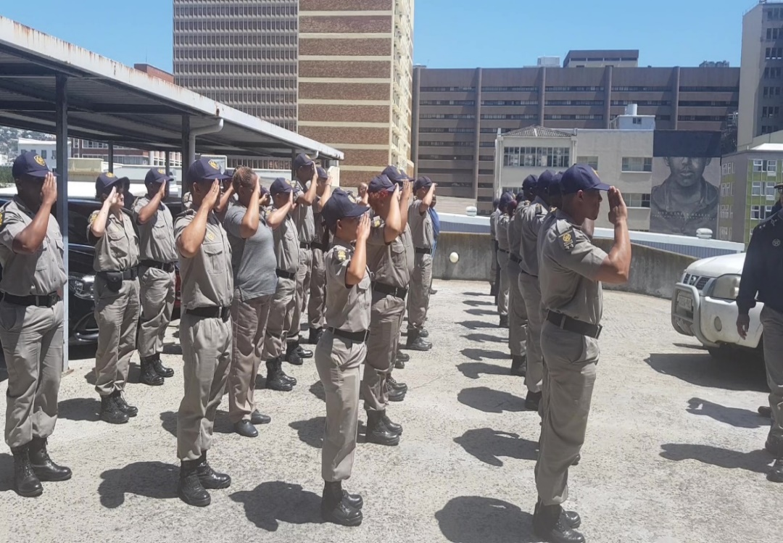
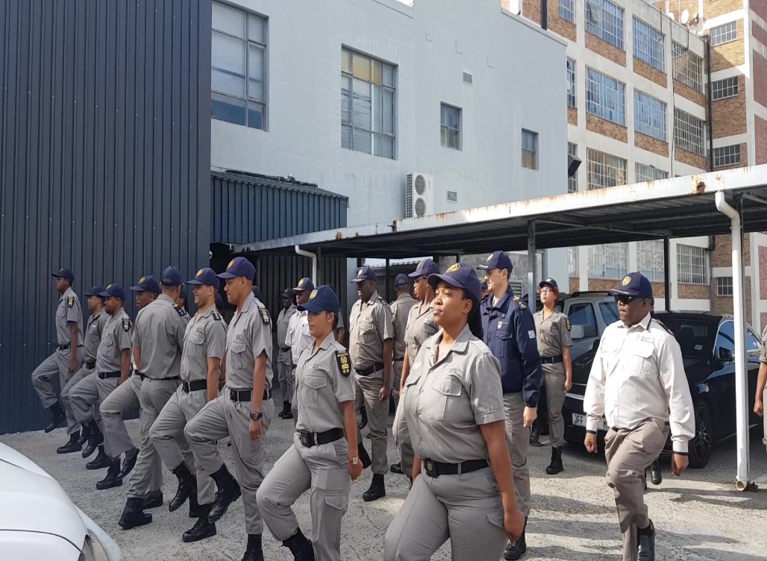
Provincial Inspectorate Indaba – Parade

Slide 55
Challenges & burning issues: Immigration Inspectorate
Challenge | Management intervention
Fraudulent Form 20 letters : numerous cases were brought to the attention of the Provincial Manager emanating from Cape Town office. | Record & database created
Confirmation of detention: Magistrates site RUTA or BULA v Home Affairs case (Judgement). Deportees crying asylum on or before the day of confirmation are released due to the refusal from Magistrates to confirm detentions -Conditions of Police station not suitable for longer period | Attend case flow meetings PM met with NPA to discuss release of illegal foreigners Inconsistent judgements must be presented to Adv De Kock in writing to facilitate the review process DPP convened a meeting with Magistrates of Wynberg in bilateral meeting
NPA – reluctance in enrolling IMS dockets - charging of employers Example: Knysna Lawyer made representation that not the real owner of the business, Reluctance caused by technicalities in distinguishing between the owner from the employers as well as the issue of employment contracts | PM met with NPA to discuss challenges in general

Slide 56
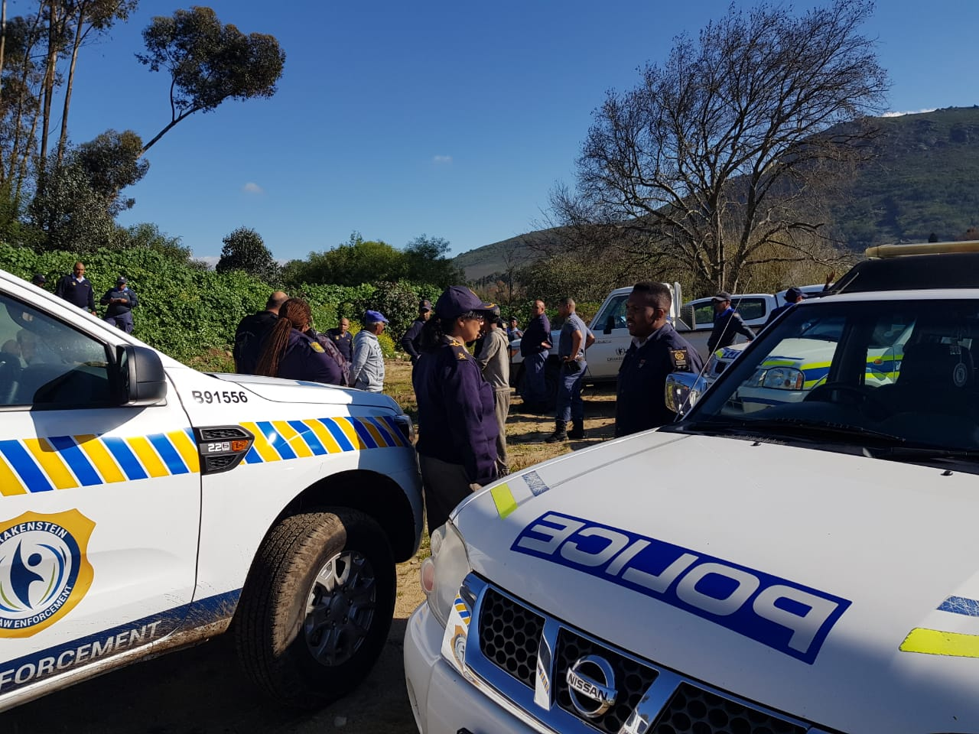
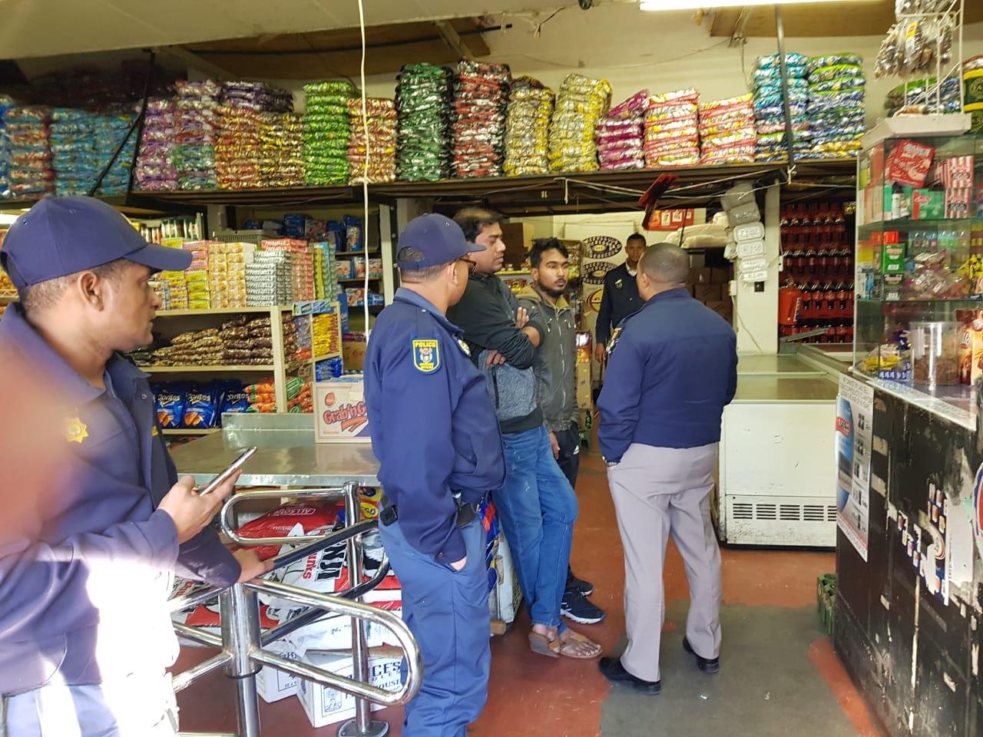
Immigration Operations
Immigration Operation: Paarl August 2019
Immigration Operation: Lockdown Atlantis June 2019

Slide 57
Outreach Programmes Jan 2019 – July 2019
Disaster/ Outreach | Impact
Stellenbosch (5 May 2019) | 5
White City Mbekweni (22 January 2019) | 9
Kosovo, Phillippi (5 May 2019) | 49
West Beach Du Noon (12 February 2019) | 83
Masiphumelele (29 July 2019) | 79
TOTAL | 225

Slide 58
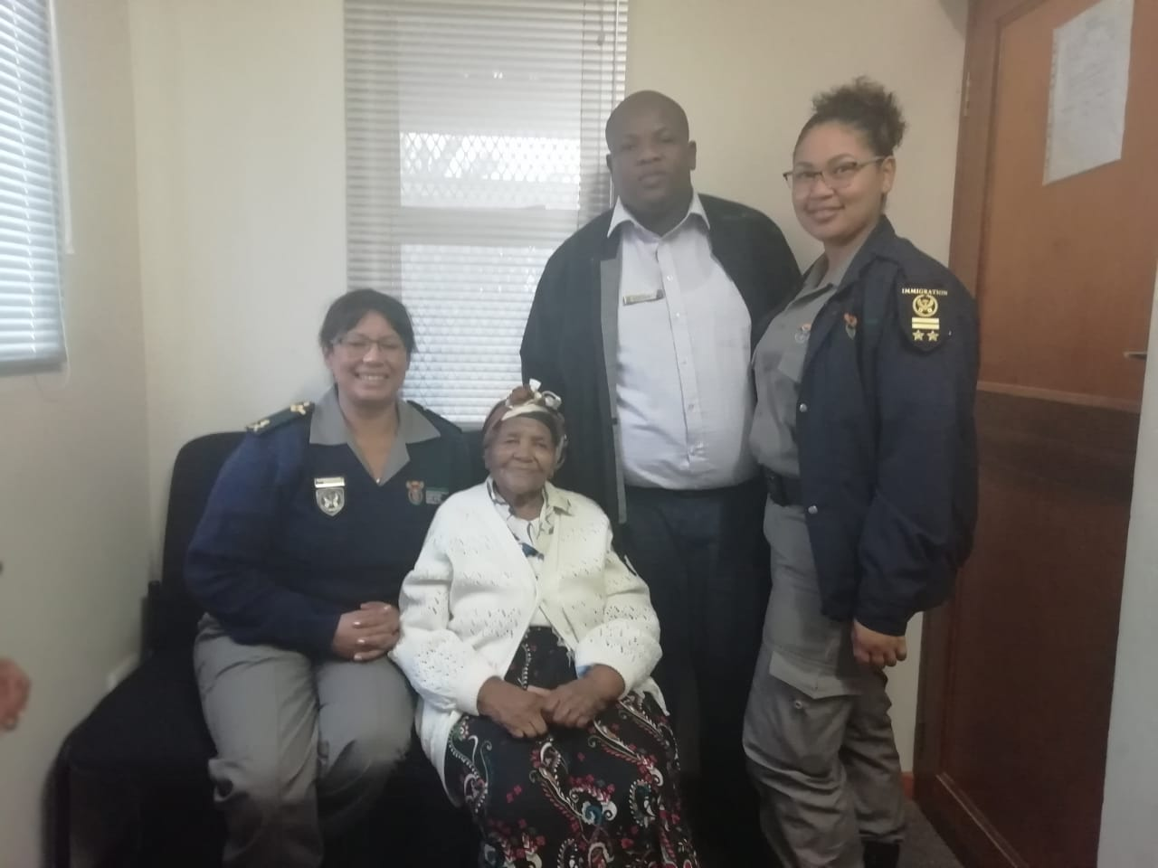
Outreach Programmes Jan 2019 – July 2019
LRB Informant 103 years old: Vredendal
Birth Registration Stellenbosch Hospital May 2019

Slide 59
Progress in relation to APP Targets

Slide 60
Annual Performance Plan performance
Provinces achieved 9 out of the 9 targets (100% for Quarter 1:
Births registered within 30 days
Smart ID Cards issued (received at offices) to citizens 16 years and above
100% Of detected employers in contravention of the Immigration Act (Act 13 of 2002) charged
100% Of detected transgressors in contravention of the Immigration Act (Act 13 of 2002) charged
100% Of Undocumented foreigners deported within 30 calendar days
100% Of Detected undocumented foreigners transferred to Lindela within 20 calendar days
80% of Detected fraudulent marriages & marriage of convenience cases finalised
170 General Inspections conducted
100% of valid invoices settled within 30 days of certification
2018/2019 | Total Quarterly Targets | Achieved | Not Achieved
Q 1 | 8 | 8 | 0
Q 2 | 8 | 7 | 1 (births 602 short)
Q 3 | 8 | 7 | 1 (births 756 short)
Q4 | 8 | 8 | 0
Annual 100% Targets achieved
 | Total Quarterly Targets | Achieved | Not Achieved
Q 1 2019/2020 | 9 | 9 | 0

Slide 61
Births registered within 30 calendar days
2016/17 |  |  | 2017/18 |  |  | 2018/19
T | A | V | T | A | V | T | A | V
80,891 | 81,973 | 1,082 | 80,891 | 84,817 | 3,926 | 87,363 | 88049 | 686
2019/2020 | Annual Target | Target | Actual Performance | Variance | % Achievement
 | 2019/2020 | Q1 | Q1 | Q1 | Q1
Western Cape | 84 012 | 21361 | 21550 | 189 | 101%

Slide 62
Births registered within 30 calendar days
Strategies were implemented:
Additional resources deployed to high volume health facilities
All available resources withdrawn from back office operations and directed to birth registration
Increased capacity with the deployment of:
Work Exposure Learners (EOH) trained on completion of birth registration forms and deployed at high volume health facilities
Identified front Office staff required to report directly to Health Facilities (30 x Front Office Clerks)
All secretaries and back office staff engaged in phoning and tracing mothers from Hospital Registers
Challenges:
Connectivity (VPN Systems)
Lack of dedicated level 5 staff (9x L5 staff members vs 29 Connected Health Facilities)
Lack of biometric scanners to do verification of mothers
Various Health Facilities unable to provide DHA with office space
Mother leaving HF after hours and weekends without registering

Slide 63
Late Registration of Birth: Cases Ready for Adjudication
District | Office | Total nr of applications ready for adjudication | Catogories: 1-7 (DMO) | Category: 7-14 (PM) | Category: 14 and above (PM)
 |  |  | Number of cases ready for adjudication | Number of cases ready for adjudication | Number of cases ready for adjudication
 | Malmesbury | 18 | 16 | 0 | 2
 | Vredendal | 40 | 25 | 2 | 13
 | Vredenburg | 40 | 40 | 0 | 0
West Coast |  | 98 | 81 | 2 | 15
 | Paarl | 137 | 77 | 19 | 41
 | Ceres | 15 | 13 | 2 | 0
 | Worcester | 67 | 23 | 30 | 14
Cape Winelands |  | 219 | 113 | 51 | 55
 | Oudsthoorn | 35 | 22 | 2 | 11
 | George | 18 | 6 | 5 | 7
 | Mosselbay | 33 | 22 | 11 | 0
 | Plettenbergbey | 46 | 20 | 5 | 21
Garden Route |  | 132 | 70 | 23 | 39
 | Beaufirt West | 18 | 13 | 3 | 2
Cemtral Karoo |  | 18 | 13 | 3 | 2
 | Khayelitsha | 292 | 219 | 20 | 53
 | Cape Town | 88 | 47 | 31 | 10
 | Bellville | 842 | 623 | 187 | 32
Cape Metro |  | 1222 | 889 | 238 | 95
 | Caledon | 53 | 25 | 10 | 18
 | Grabouw | 29 | 21 | 2 | 6
 | Swellendam | 10 | 9 | 0 | 1
 | Bredasdorp | 22 | 8 | 5 | 9
Overberg |  | 114 | 63 | 17 | 34
TOTALS WC PROVINCE |  | 1803 | 1229 | 334 | 240
The Province has 1803 LRB cases ready for adjudication
Effort required in promoting the social responsibility to register births within 30 days

Slide 64
Smart ID Cards issued (received at offices)
2016/17 |  |  | 2017/18 |  |  | 2018/19
T | A | %P | T | A | %P | T | A | %P
218966 | 345237 | 157% | 362232 | 359659 | 99% | 279221 | 384730 | 138%
 | Annual Target 2019/2020 | Target Q1 | Actual Performance Q1 | Variance Q1 | % Achievement Q1
WC FRONT OFFICES | 278,017 | 72,284 | 90,562 | 18,278 | 125%
WC BANKS | 12,931 | 3,362 | 2,288 | -1,074 | 68%

Slide 65
Smart ID Cards issued (received at offices): Q1
Strategy implemented to achieve:
Provincial ID Smart Card monitoring system implemented to closely monitor progress
DMOs required to report on targets and strategies to achieve during Extended Management Meetings
Activation of Grabouw and Stellenbosch Office
Revisited and revised front office process flow to achieve optimum performance at high volume offices
Made it compulsory for clients applying for passport to also apply for IDSC
Challenges:
System instability – impact on ability to meet targets
High client volumes at Offices – lack of Mobile Units to service schools and rural communities
Unable to service communities affected by fire disasters at first instance without functional Modernized Mobile Units

Slide 66
Applications lost due to system instability
2018/2019 | Hours lost | Application loss
WC FRONT OFFICES | 2929 | 29103
WC BANKS | 66 | 264
TOTAL | 2995 | 29 367
Q1: 2019/2020 | Hours lost | Applications loss
WC FRONT OFFICES | 1734 | 13059
WC BANKS | 25 | 211
TOTAL | 1759 | 13 270
Formula: hours x FLO / 15 applications per hour

Slide 67
Provincial Target : Immigration Inspectorate Units
 | Actual Performance Q1: 2018/2019 | Actual Performance Q1: 2019/2020
Employers charged | 16 | 22
Transgressors chagred | 330 | 460
Direct deportations | 4 | 9
Transfers to Lindela | 29 | 127
Detect & investigate fraudulent marriages | 9 | 32
General Inspections conducted (businesses) | 73 | 171
Significant increase in performance noted after the strengthening of management capacity i.e. appointment of 2x DMOs and ASD: Cape Town Office

Slide 68
Payment of Invoices
2016/17 |  |  | 2017/18 |  |  | 2018/19
Received | Paid | %P | Received | Paid | %P | Received | Paid | %P
1377 | 1377 | 100% | 1809 | 1798 | 99% | 2101 | 2101 | 100%
Target 2019/2020 | Target Q1 | Actual Performance Q1 | Variance Q1 | % Achievement Q1
100% | 100% | 353/353 | 0 | 100%

Slide 69
Thank you
Questions & Comments

