Slide 1
SEPTEMBER 2019
FEEDBACK REPORT PRESENTATION ON PROJECT VISIT BY PORTFOLIO COMMITTEE ON AGRICULTURE, LAND REFORM AND RURAL DEVLOPMENT
TOGETHER WE HAVE MADE KZN A BETTER PROVINCE TO LIVE IN

Slide 2
OUTLINE
Responses to questions
UMkhanyakude District
Ndumo B Feedback
Jozini Livestock Centre Feedback
Coastal Cashew Feedback
Amandlentuthuko Feedback
Zululand District
Empangisweni Community Trust Feedback
UMzinyathi District
Jabula Zondi trading
Zamokuhle CPA
LETS MAKE AGRICULTURE OUR CULTURE

Slide 3
RESPONSES TO QUESTIONS
NO. | QUESTION | RESPONSE
1. | What kind of interventions are there to deal with 155-drop outs of the extension officers and how much money has been lost because of that? | The department is generally implementing bursary programmes for its employees. In 2005, the National department approved the Norms and Standards for Extension, which stipulated that Agricultural Advisors need to have a minimum of a B.Sc. Agriculture degree or B. Tech in order for them to practice as Agricultural Advisors. Between 2009/10 to 2014/15, through the Extension Recovery Programme, Bursaries were awarded to Extension Practitioners to upgrade their qualifications. Some of the employees who were being upgraded were approaching retirement age and were not willing to try again when they were offered another chance. Those who did not finish their qualifications were then referred to Human Resources to institute recovery of those fees.
LETS MAKE AGRICULTURE OUR CULTURE

Slide 4
RESPONSES TO QUESTIONS
NO. | QUESTION | RESPONSE
4. | On monitoring, evaluation, and the quality management system, are they compliant with the laws of the Republic | The department has an approved policy for funding of projects. Each project is subjected into a vigorous screening exercise to ensure that it is complying with the laws before funds are disbursed for implementation. Projects that are implemented also form part of the Annual Performance Plan of the department. These are reported on quarterly bases and thus monitoring and Evaluation does take place to ensure quality. Furthermore, on the implementation of infrastructure projects, Engineers issue payment certificates after being satisfied with compliance to specifications and quality of work performed. There is also an Internal Control Unit within the department, which performs an audit work to certain programmes of the department as well.
LETS MAKE AGRICULTURE OUR CULTURE

Slide 5
RESPONSES TO QUESTIONS
NO. | QUESTION | RESPONSE
5. | What is the comparative competitive advantage that KZN has in agriculture, as they are 2nd in livestock? | KZN has a varied natural resource especially climate capability which is suitable for a wide range of agricultural commodities. The majority of the provincial landscape is suitable for livestock production which supports many livelihoods especially in rural areas. Although with challenges due to global competiveness, sugarcane farming is prevalent in the province with a number of sugarcane mills which complete the whole sugarcane value chain. Sub-tropical fruits which is a growing sub-sector especially in the coastal and northern part of KZN. Furthermore, amongst the three provinces with harbours, KZN is uniquely positioned as an export and import destination for agricultural commodities.
LETS MAKE AGRICULTURE OUR CULTURE

Slide 6
RESPONSES TO QUESTIONS
No. | QUESTION | RESPONSE
6. | What is the provincial contribution to GDP to assess whether the department is investing adequately? | The province is contributing 4% to the provincial GDP and is amongst the top three provinces with significant contributions to the National Agricultural Gross Value Add owing to its position as an export destination for agricultural commodities.
8. | Who and what is? the support given to sugarcane farmers especially small farmers? | The department has a memorandum of understanding (MoU) with the South African Sugar Association (SASA), which is the organization that supports sugarcane development. Under this MoU, DARD has signed a five year Service Level Agreement (SLA) where 33 Agricultural Advisors from the department have been assigned to work with 6 Sugarcane Specialists from SASRI (South African Research Institute) to render extension and advisory services to small-scale and land reform sugarcane growers. DARD is also paying 50% of the costs of the Sugarcane Specialists. During drought season, DARD supplied small-scale growers with fertilisers for ratoon management and has further assisted with the implementation of the seedcane development for small-scale growers. DARD has also supported land reform sugarcane farmers with R36.5 million worth of fertilizer in March 2019
LETS MAKE AGRICULTURE OUR CULTURE

Slide 7
RESPONSES TO QUESTIONS
No. | QUESTION | RESPONSE
11. | What are the reasons for deviation on CASP? | CASP programme has been implemented under schedule 4 of the Division of Revenue Act (DORA), which was treated as a general-purpose grant, and it has recently been moved to schedule 5 of DORA, which is now treated as a special purpose grant. Under schedule 4, the province was able to change from one project to another if there were challenges experienced. Under schedule 5, DARD has to write to National Department to request even a minor change from the plan and the changes cannot be implemented without approval being granted by the National Department.
14. | What does the farming handbook covers? | Farming handbooks is an agricultural guide on best farming practices which covers different aspects of farming methods for various commodities. E.g. it will tell you when to plant maize in hot or cold climatic areas of the province, how to prepare land for planting and fertilizer application.
LETS MAKE AGRICULTURE OUR CULTURE

Slide 8
RESPONSES TO QUESTIONS
No. | QUESTION | RESPONSE
20. | What is the involvement of the private sector regarding the upskilling of the extension officers? | The department implements through the National conditional grants, mentorship programme which is delivered in partnership with the private sector. The department has a partnership agreement with the sugarcane industry where 33 Agricultural Advisors officials have been assigned to work with 6 Sugarcane Specialists from SASRI in rendering extension and advisory services to small-scale and land reform sugarcane growers. The department also has an MOU with SAMAC and SA Wool Growers Association who upskills extension officers in the macademia production and sheep farming and wool production respectively. Furthermore, the department is in the process of engaging in partnerships with South African Bureau of Standards (SABS) to improve on issues of quality of production by smallholder farmers and Perishable Product Export Control Board (PPECB) for improved access to export market.
22. | What are the offers are there to capacitate farmers by these agricultural colleges, what is the thought process around professionalization of farmers? | The department offers accredited training and non-accredited skills development training courses to farmers with specific priority given to smallholder producers. Every year, the department issues out a green book document which outlines the schedule of short courses offered by the department throughout the year. Furthermore, both Cedara College and OSCA College have FET Units, which offer training programmes.
LETS MAKE AGRICULTURE OUR CULTURE

Slide 9
RESPONSES TO QUESTIONS
No. | QUESTION | RESPONSE
24. | No or poor assistance given to farmers and communal livestock farmers was raised as concern and that was linked to the old dipping tanks that are not working and that they needed to be fixed. | The department noted the concern. However, there are over 449 Agricultural Advisors and 190 Veterinary Services officials who render extension services and related assistance to farmers throughout the province. Furthermore, the department provides services to over 2 053 dip tanks. The department on a yearly basis runs an infrastructure rehabilitation programme which includes amongst others dip tanks. In the current financial year, at least 75 infrastructure projects are earmarked for rehabilitation
25. | Are there and any forms of incentives there to attract young people to join the agricultural sector? | The department in partnership with the National Department of Agriculture, Land Reform and Rural Development runs a two-year work-placement programme for unemployed agricultural graduates mainly benefiting young people. To this end 173 graduates benefited from the department’s graduates placement programme and are placed across the different districts in the province. Furthermore, the department approved an Agricultural Development Funding Policy in 2018 which promotes the development of designated groups which includes youth. Through the policy, there are special provisions and additional grant allocations for agricultural enterprises managed by youth.
LETS MAKE AGRICULTURE OUR CULTURE

Slide 10
RESPONSES TO QUESTIONS
No. | QUESTION | RESPONSE
26. | What qualifications offered by the agricultural colleges so that one can pursue an academic qualification using the certificate received in these colleges and feeder high schools to support the colleges? | NQF level 6 Diplomas in Agriculture for both Plant, Animal Production and Agro Processing. There are 4 agricultural schools in the province, which feed to Cedara and OSCA colleges namely, Weston, James Nxumalo, Shakas Kraal, and Vryheid Landbou.
27. | The amount of 117m spent in Makhathini; what was it for and its impact on food security. | There are 312 individual farmers benefiting from the scheme constituted by 206 male, 106 female, and 22 youth. The scheme has 10 active cooperatives with 786 members constituted by 195 male members, 591 female members, and 93 youth. Through the operations of the scheme, over 5000 people are receiving direct employment. Over 90 000 tons of farm produce is produced generating a revenue of over R100 million. Furthermore, there are other up and down stream industries such as Cane Cutting, Loading, Transport, Mechanical and welding, vegetable hawkers and vendors.
LETS MAKE AGRICULTURE OUR CULTURE

Slide 11
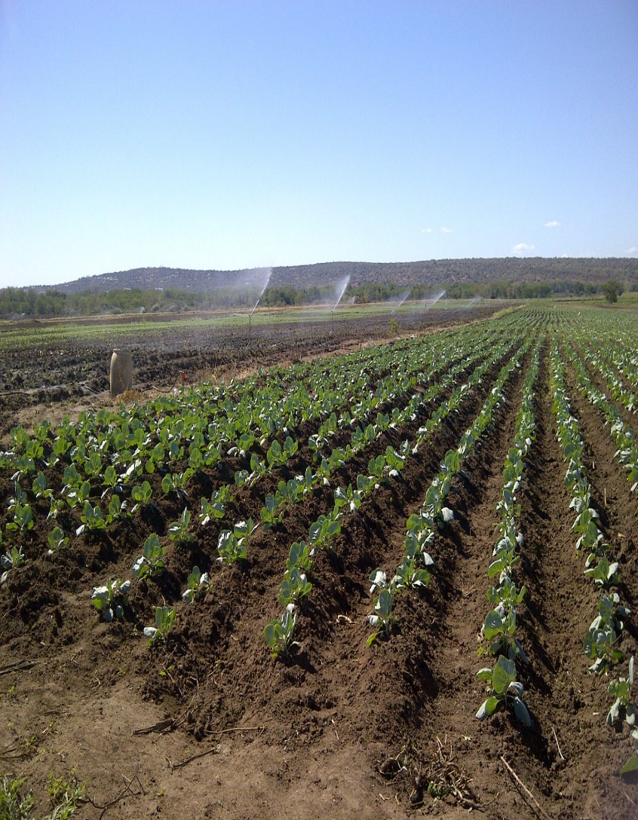
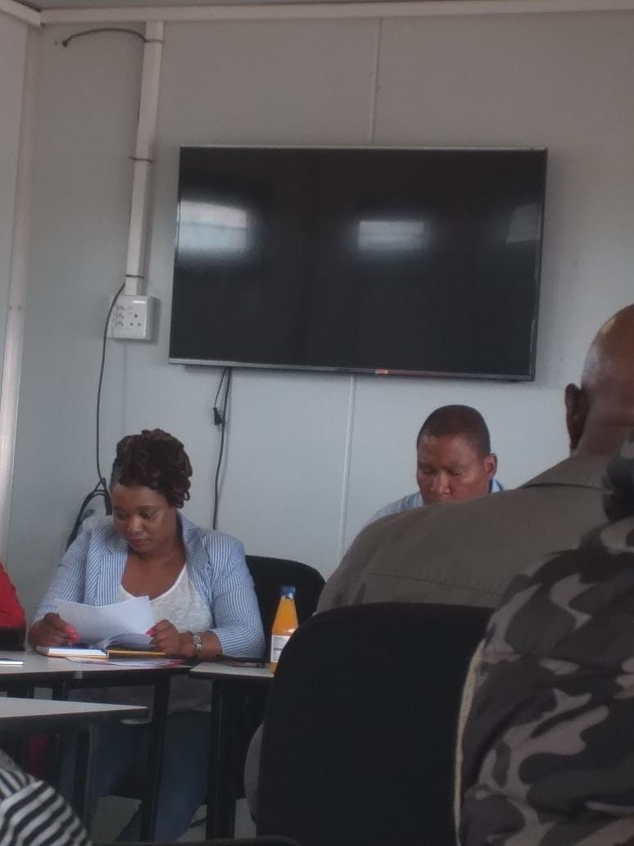
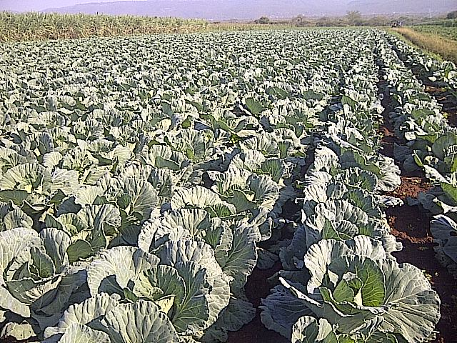
NDUMO B
LETS MAKE AGRICULTURE OUR CULTURE

Slide 12
NDUMO B
Location | Project Activity | No of Beneficiaries | Job opportunities created | Investment by department
Jozini local Municipality Ward 17 , Ndumo | Crop and vegetable production | 49 | 20 permanent jobs | Fencing of 500ha in 2009 Two tractors and implements in 2009
The department is investing R1,5 million in 2019/20 to assist with irrigation maintenance and further provide mechanization support
KEY CHALLENGES
Project challenges which contribute to poor performance of the scheme:
Lack of formal market (RASET programme is not yet effective)
High cost of electricity (ESKOM bill as high as R60 000 to R200 000 per month) change from sprinklers to drip irrigation in order to minimize costs)
LETS MAKE AGRICULTURE OUR CULTURE

Slide 13
NDUMO B
NO. | RECOMMENDATIONS BY PORTFOLIO COMMITTEE | ACTION BY DARD
1. | The Department has to draw-up a turnaround strategy to fix all the challenges raised by project beneficiaries | Establish a task team constituted by the Province and the relevant Departments to convene in the first week of October 2019 to engage beneficiaries. The department is investing R1,5 million in 2019/20 to assist with irrigation maintenance and further provide mechanization support
2 | In terms of the title deed the committee advised that the Department consult the Deeds office to source documentation regarding the utilization of land by farmers of Ndumo. As the land is under Ingonyama Trust, the Lease Agreement should be issued per cooperative to be able to access funding from the bank | The Corporative supported by the Departments to engage Ingonyama Trust Board. The approach will be discussed at the meeting planned with beneficiaries in October 2019.
3 | Alternative sources of energy because electricity / diesel seemed to be too expensive. | The Department has commissioned a team of engineers to investigate the use of solar as an alternative energy source. The report is expected in December 2019
LETS MAKE AGRICULTURE OUR CULTURE

Slide 14
NDUMO B
NO. | RECOMMENDATIONS BY PORTFOLIO COMMITTEE | ACTION BY DARD
4. | Align the produce with Quality Standards that is required by the market. Trainings are needed for those quality standards. | The Department is in the process to enter into a MOU with South African Bureau of Standards (SABS).
5. | The Committee felt that market challenge should not be an excuse since there are various markets e.g. Mozambique, Swaziland, Richard Bay, Durban, so, farmers were encouraged to engage countries other than focusing only on South African Market . Ambassadors of countries should be contacted to secure market in other countries. | The Department is in the process to enter into a MOU with Perishable Product Expert Control Board (PPECB).
LETS MAKE AGRICULTURE OUR CULTURE

Slide 15
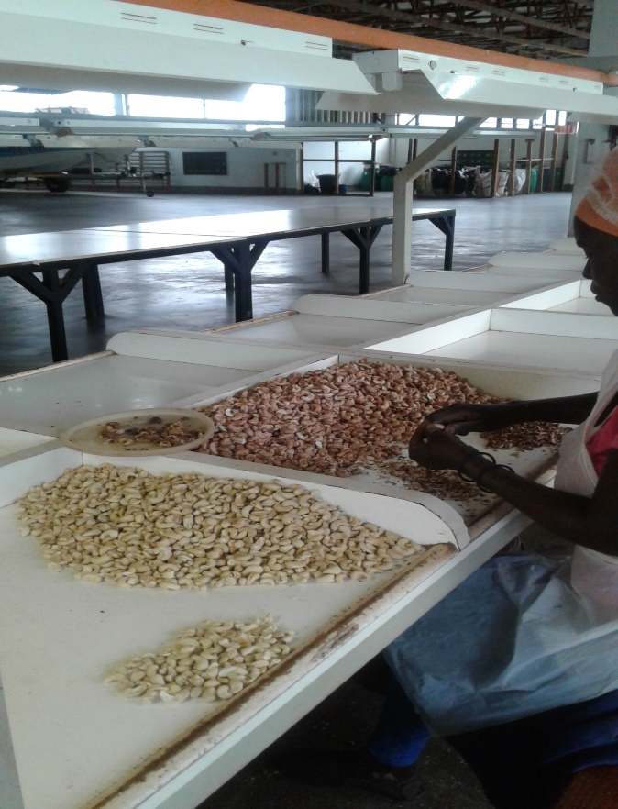
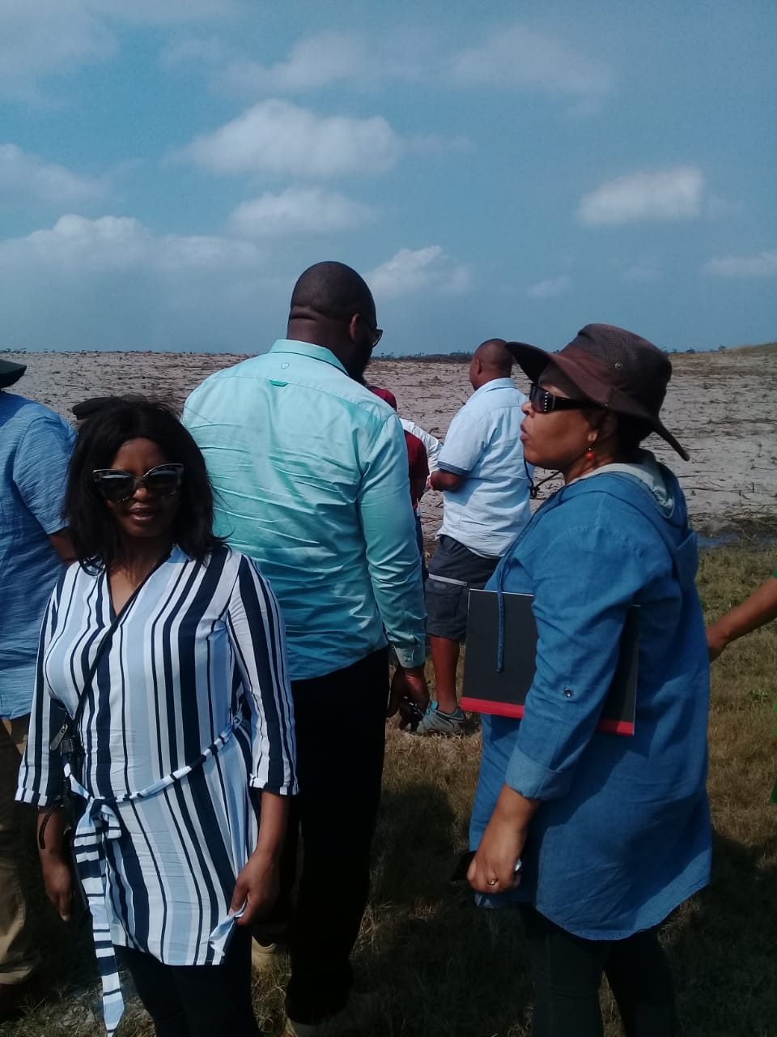
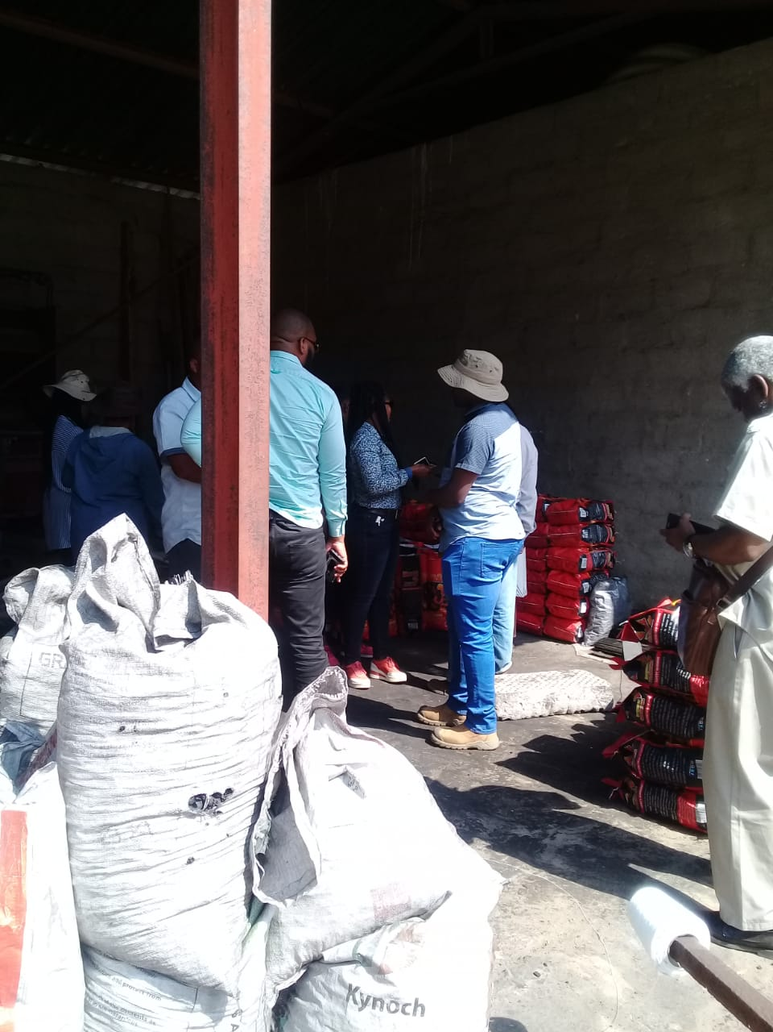
COASTAL CASHEW
LETS MAKE AGRICULTURE OUR CULTURE

Slide 16
COASTAL CASHEW
Location | Project Activity | No of Beneficiaries | Job opportunities created | Investment by department
Umhlabuyalingana | Cashew nuts | 244 | 100 | R6 989 000
The farm was purchased in 2004 for 244 members.
DARD contributed R3,6million (includes R439 000 for purchasing production inputs in 2009, R1 850 000 received from DARD through direct funding in 2018/2019)
Contribution of R9,3million was received from DRDRL in 2016.
project beneficiary owns 80% shares and the strategic partner holds 20% shares.
The average yield per hectare is 300tons. In the previous harvest seasons, production harvested was 60ton/ha. Through government intervention in a form of production inputs provision support, the yield increased to 100tons/ha.
LETS MAKE AGRICULTURE OUR CULTURE

Slide 17
COASTAL CASHEW
KEY CHALLENGES
Lack of capital for farm operations.
Inability to pay good salaries resulted in farm loosing experienced workers.
Poor management of cashew trees thus resulting on yield decline.
There farm was annually receiving financial support when it was still being owned by IDC (former owner).
Despite the challenges outlined above, the farm is still operational with 630ha under production.
LETS MAKE AGRICULTURE OUR CULTURE

Slide 18
COASTAL CASHEW
NO. | RECOMMENDATIONS BY PORTFOLIO COMMITTEE | ACTION BY DARD
1. | Meetings to update beneficiaries on the progress of the farm should be convened | Project members noted the recommendation. DARD will assist in convening meetings
2. | Involvement of youth is compulsory in the project | Project members noted the recommendation. Meeting scheduled for 12 September 2019, DARD to develop a training programme in partnership with project members for implementation in November 2019.
3. | Upgrading the farm up to the level that will assist in-service training students
LETS MAKE AGRICULTURE OUR CULTURE

Slide 19
COASTAL CASHEW
NO. | RECOMMENDATIONS BY PORTFOLIO COMMITTEE | ACTION BY DARD
4. | Government intervention is required on the issue of the farm paying annual fee of R30 000 to Ngonyama trust (the amount was said to be posing financial burden to Project owners) | The matter will be discussed in meeting to be held on 12 September 2019 DARD to invite Ingonyama Trust Board at the next meeting to be held in October 2019.
5. | Development of business plan that will cater for all project requirements | Comprehensive Business Plan will be prepared and finalised by October 2019 to secure funding for improvements through Development Financial Institutions within the Province.
6. | Since the project is unique, of large scale and addresses the issue of job creation in the area, it should be treated as priority project by both National and Provincial government
LETS MAKE AGRICULTURE OUR CULTURE

Slide 20
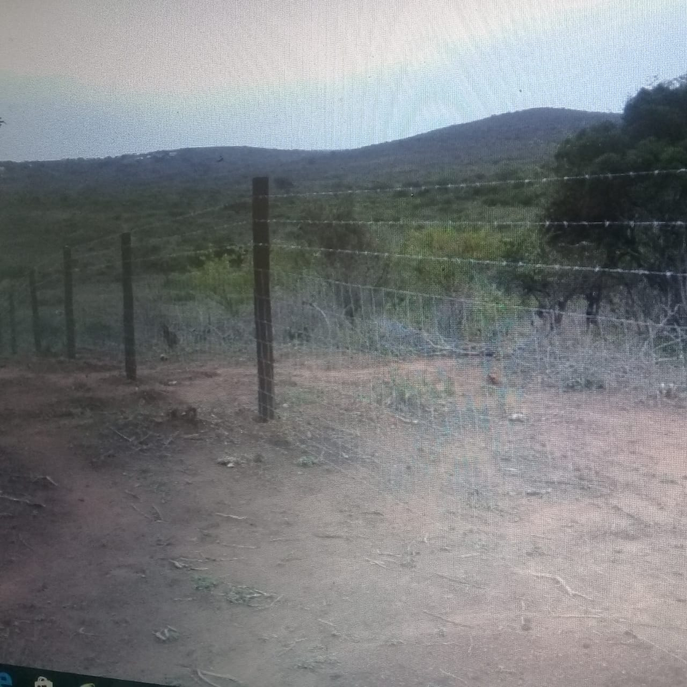
AMANDLENTUTHUKO
LETS MAKE AGRICULTURE OUR CULTURE

Slide 21
AMANDLENTUTHUKO
Location | Project Activity | No of Beneficiaries | Job opportunities created | Investment by department
Mtubatuba/ Somkhele | Feedlot | 7 | 7 | R490 000
KEY CHALLENGES
Project beneficiaries were capable of running the project. But, the project operations had to be put on hold due to the mining development in the area.
LETS MAKE AGRICULTURE OUR CULTURE

Slide 22
AMANDLENTUTHUKO
NO. | RECOMMENDATIONS BY PORTFOLIO COMMITTEE | ACTION BY DARD
1. | DARD to engage the mine and discuss the matter regarding continuation of the project | A meeting with the farmers is scheduled on the 12 September 2019 to determine the approach and reflections following the visit. Community Development Officer at iTendele Mine has been engaged and a meeting in proposed for October 2019. DARD will raise the issue of being involved in community developments with relevant structures
2. | DARD should form part of discussions pertaining to proposed area development projects including mining development
3. | Project implementation should be initiated on site 2 since the site is big enough and is far from the prospective mining operations | Business Plan has been prepared and will be presented on 16 September 2019 to District Project Steering Committee and presented on the 20 September 2019 to Provincial Project Steering Committee
LETS MAKE AGRICULTURE OUR CULTURE

Slide 23
EMPANGISWENI COMMUNITY TRUST
Empangisweni Community Trust Farm is a land reform farm which is owned and managed by Empangisweni Community Trust under the chairpersonship of iNkosi DV Zondo.
The primary objective to support the farm was the establishment and maintenance of a 100ha citrus operation.
The ADA had an agreements with DARD and COGTA for the implementation of various activities on citrus for primary production as well as value adding, which included a processing infrastructure.
The project has received a total of R37, 000, 000 million over the years of implementation since 2010/11.
LETS MAKE AGRICULTURE OUR CULTURE

Slide 24
EMPANGISWENI COMMUNITY TRUST
The production activities undertaken included the citrus establishment, vegetables and grains. The infrastructure development included the purchase of farm equipment and machinery, irrigation infrastructure, construction of a pack-house for citrus. The other enterprises such as grain and vegetables have not performed and ultimately collapsed to a greater extent.
From the 2018/19 projections and state of the farm at the time the estimated requirement for Empangisweni citrus project to be sustainable was R10, 733, 286.00 mainly for capital expenditure, citrus maintenance costs and daily operations of the project.
LETS MAKE AGRICULTURE OUR CULTURE

Slide 25
EMPANGISWENI COMMUNITY TRUST
YEAR | BUDGET | FUNDER | PLANNED ACTIVITIES
2010/11 | R3,000,000 | DARD | Revitalization of vegetable irrigation system 100ha and vegetable production inputs
2011/12 | R2,000,000 | DARD | Establishment of essential oils and vegetable production
2012/13 | R6,000,000 | DARD | Infrastructural development fencing; procurement of farm machineries; production of maize and soya bean
2013/14 | R3,000,000 | DARD | Establishment of citrus orchard
2014/15 | R5,000,000 | DARD | Grain and vegetable production inputs. Citrus establishment continues
2015/16 | R2,500,000 | DARD | DARD allocated funds for Citrus establishment and continued citrus maintenance
LETS MAKE AGRICULTURE OUR CULTURE

Slide 26
EMPANGISWENI COMMUNITY TRUST
YEAR | BUDGET | FUNDER | PLANNED ACTIVITIES
2016/17 | R8, 000,000 R5,000,000 | CoGTA DARD | CoGTA Funds for the establishment of packhouse for citrus, fencing of the packhouse as well as access road. DARD allocated funds for Citrus establishment and continued citrus maintenance
2017/18 | R4,142, 145 R2,5000, 000 | CoGTA Roll over DARD | CoGTA Funds for the establishment of packhouse for citrus, fencing of the packhouse as well as access road. DARD allocated funds for Citrus establishment and continued citrus maintenance
2018/19 | R1, 224,000 R173 500 | CoGTA Roll over DARD Roll over | CoGTA Funds for the establishment of packhouse for citrus, fencing of the packhouse as well as access road. DARD allocated funds for Citrus establishment and continued citrus maintenance
TOTAL ALLOCATION |  | R37, 000, 000
LETS MAKE AGRICULTURE OUR CULTURE

Slide 27
EMPANGISWENI COMMUNITY TRUST
CHALLENGES | MITIGATIONS
Institutional arrangement of the project since inception Poor project governance Lack of project and business management skills Efficient use of financial resources | The farm business hires a professionally qualified and experienced manager for the citrus enterprise; The management of funds be distinctly separate from other farm business activities and regular reporting be mandatory to DARD. Strict management and funding condition be in place such that that the beneficiaries, including Inkosi Zondo be prohibited from direct involvement with technical, financial and day to day management of the business
LETS MAKE AGRICULTURE OUR CULTURE

Slide 28
EMPANGISWENI PROJECT
The forensic investigation has been commissioned at Empangisweni Project following allegations of corruption and maladministration of project funds.
The forensic Service Provider was appointed and has been given four weeks to complete the investigation.
The department will be given the findings once the investigation is concluded.
The forensic investigation will be conducted under the new leadership of the Agribusiness Development Agency.
LETS MAKE AGRICULTURE OUR CULTURE

Slide 29
EMPANGISWENI PROJECT
The terms of reference and the scope of the forensic:
Conduct a preliminary investigation into all approvals / transactions / actions / occurrences
Conduct a forensic investigation on the appointment of service providers; non-compliance with Supply Chain Management prescripts; and other specific cases of financial misconduct in relation to Irregular Expenditure as well as Fruitless and Wasteful expenditure.
Establish how the Project was approved for funding;
Establish if there are contracts signed with the funded beneficiaries, are they followed through the implementation period;
Establish how projects are approved and how deviations form scope is managed and approved;
Establish the monitoring mechanism used by ADA when projects are implemented;
Determine and identify officials of ADA, appointed service providers and/or other external parties involved in irregularities that occurred;
Recommend appropriate course/s of action to be instituted where irregularities have been confirmed.
LETS MAKE AGRICULTURE OUR CULTURE

Slide 30
EMPANGISWENI PROJECT
Interventions following PC Visit:
ITEM | COST ESTIMATE
ESKOM outstanding | R 250 000
ESKOM bill for 8 months till end of March 2020 ± R 85 000 p/m | R 680 000
Chemicals for dying trees R 5 000 – 00 p/ha x 70ha | R 350 000
Fertilizer for the dying trees R 10 000 – 00 p/ha x 70ha | R 700 000
TOTAL | R 1 980 000
LETS MAKE AGRICULTURE OUR CULTURE

Slide 31
GLUCKSTADT PRIMARY COOPERATIVE
Location | Project Activity | No of Beneficiaries | Job opportunities created | Investment by department
Abaqulusi Local Municipality | Grain Production | 45 | 1 permanent tractor driver and 68 seasonal workers | R 2 112 294.00
KEY CHALLENGES
The cooperative manages to produce more than 500 tons of maize per season. But, the lack of storage facilities compels the cooperative to sell all its grain when prices are low.
In dealing with the challenge, all grain producers within Abaqulusi Local Municipality have formed a secondary coop to deal with post harvest challenges.
LETS MAKE AGRICULTURE OUR CULTURE

Slide 32
GLUCKSTADT PRIMARY COOPERATIVE
The department has made the following interventions:
Provided mechanization equipment support (Leased tractors and implements)
Provided Budget to cover operational costs (Diesel, minor repairs & tractor operator salaries)
Provided production inputs (seeds, fertilizer & Chemicals)
Fencing of cropping lands
Extension and advisory support
In the current financial year, DARD will support the project with bags of fertilizer for 50ha.
LETS MAKE AGRICULTURE OUR CULTURE

Slide 33
JABULA ZONDI TRADING
Location | Project Activity | No of Beneficiaries | Farm Size | Investment by department
Umvoti Local Municipality | Cropping; Livestock Farming (Breeding of 100 Ewes); Establishment of Pasture | 02 | 450 ha (with an Arable Land of 8ha) | Mechanization Support Provided cattle feed (2015/16 drought relief programme) 2500 Litres Water Tank
KEY CHALLENGES
No Equipment baler making
No enough arable land for cropping and vegetable production
Area is too dry
LETS MAKE AGRICULTURE OUR CULTURE

Slide 34
JABULA ZONDI TRADING
No. | QUESTIONS AND ISSUES RAISED | RESPONSE
1. | The farmer, Mr Zuma complained about the houses on the farm which had no roof | DARD will assist the farm in sourcing funding for roofing of the houses
2. | The farmer requested assistance with 150 cattle, bailer maker machine and renovation of reservoirs | DARD has prepared the business plan which will be presented to relevant structures for consideration of funding in 2020/21
3. | The farmer requested assistance to plant yellow maize for his livestock. | The farm will be supported through the Mechanisation Services
LETS MAKE AGRICULTURE OUR CULTURE

Slide 35
AMANGCOLOSI COMMUNITY TRUST
Location | Project Activity | No of Beneficiaries | Farm Size | Investment by department
Greytown Local Municipality | Maize Production: 112 ha Timber Production: 3200 ha Sugar Cane Production: 1959 ha Kiwi Production: 10 ha Sweet Potatoes Production: 1 ha Community Gardens: 6 ha (for Cash Crops) | 400 | 5 382ha | Supported with crop production inputs Farmers Day was Organised for processing of Kiwi by DARD
KEY CHALLENGES
Social Issues
Court Interdicts
Shortage of water in the dam
LETS MAKE AGRICULTURE OUR CULTURE

Slide 36
AMANGCOLOSI COMMUNITY TRUST
No. | QUESTIONS AND ISSUES RAISED | RESPONSE
1. | The correct land use pattern was questioned following three commodities (maize, Kiwi and community garden) being farmed. | DARD to commission a natural resources assessment to determine land capability.
3. | One farmer raised the concern of the dam being dry and this negatively affects their community garden | A request memo for Scooping of a Dam has been submitted and awaiting for approval
LETS MAKE AGRICULTURE OUR CULTURE

Slide 37
ZAMOKUHLE CPA
Location | Project Activity | No of Beneficiaries | Farm Size | Investment by department
Endumeni Local Municipality | Projects currently not functional | 68 | 416ha | No government support has been provided
KEY CHALLENGES
Arable lands are not fenced
Lack of skills in agricultural production and marketing of agricultural products
Lack of electricity and reliable drinking water
LETS MAKE AGRICULTURE OUR CULTURE

Slide 38
ZAMOKUHLE CPA
No. | QUESTIONS AND ISSUES RAISED | RESPONSE
1. | Farmers requested fencing for grazing Camps and for their arable land | A Business Plan to source funding for fencing will be developed and presented to relevant structures for 2020/21 funding consideration
2. | Farmers requested Mechanisation Support and Agricultural Inputs | The farmers will be supported with Mechanisation Services including supply of maize seed & fertiliser for 10 ha
3. | Farmers requested a Dip tank and Vaccines | An assessment for a dip tank is planned to take place in October & vaccines will be supplied to farmers
4. | Portfolio members suggested that the beneficiaries should be provided with training or capacity building | Crop Production (maize and Dry Bean Production) training will be provided in November 2019 Furthermore, trainings on Record keeping and Vaccination Programme will be scheduled
LETS MAKE AGRICULTURE OUR CULTURE

Slide 39
Thank you

