Slide 1
PRESENTATION TO the WESTERN CAPE PROVINCIAL PARLIAMENT’S PUBLIC ACCOUNTS COMMITTEE by the Western Cape Gambling and Racing Board BRIEFING presentation 13 SEPTEMBER 2019
Notes:
14

Slide 2
TOPICS OF DISCUSSION
Board’s Remuneration Agreements
Payment of Board Members’ Salaries

Slide 3
Board REMUNERATION AGREEMENTS
Section 9(2) of the Western Cape Gambling and Racing Board (WCGRB) stipulates:
“The staff of the Board shall-
(a) be appointed by the Board on such terms and conditions as it may determine and shall be remunerated by the Board, provided that such remuneration shall, at the establishment of the Board in terms of this Act, be fixed by the Board in consultation with the responsible Member acting in concurrence with the member of the Executive Council responsible for finance,”
At inception, this was done with the then responsible Member which was the same member of the Executive Council responsible for Finance.
The WCGRB undertook a remuneration review to compare its remuneration structure with that of the other eight South African Provincial Gambling Boards and the national remuneration survey.

Slide 4
Board REMUNERATION AGREEMENTS (continued)
On completion of the exercise and after the report was presented, the Western Cape Provincial Deputy Director serving on the Board directed the Board to have the Directorate: Organisational Development in the Office of the Premier rate the WCGRB employees in terms of the equate System
The Board agreed to this directive
This process took approximately four years to complete
It resulted in the Board’s employees being rated on the equate system with ratings between level 4 and level 14
The Minister for Finance signed off on the exercise and the remuneration structures equivalent to the DPSA levels were implemented.

Slide 5
Western Cape gambling and Racing Board Board members’ remuneration
The Western Cape Gambling and Racing Board members are interviewed by the legislature and appointed by the responsible Minister
The terms of appointment are set by the responsible Minister and advised to the WCGRB who implements the terms as advised.
The WCGRB has no input into the appointments or the terms of appointment

Slide 6
Western Cape gambling and Racing Board - Board members’ remuneration
Section 16 of the Western Cape Gambling and Racing Board reads as follows:
“Remuneration and allowances
16. Members of the Board shall be appointed on such terms and conditions and be paid such remuneration and allowances as may be determined by the responsible Member in concurrence with the member of the Executive Council responsible for finance. “
The Board or its office has no insight into the determination of the remuneration of Board Members.
The latest letter advising on the Board's remuneration structure is dated 27 May 2014, thereafter the amounts have been increased by the rate as advised by the Minister for Finance

Slide 7
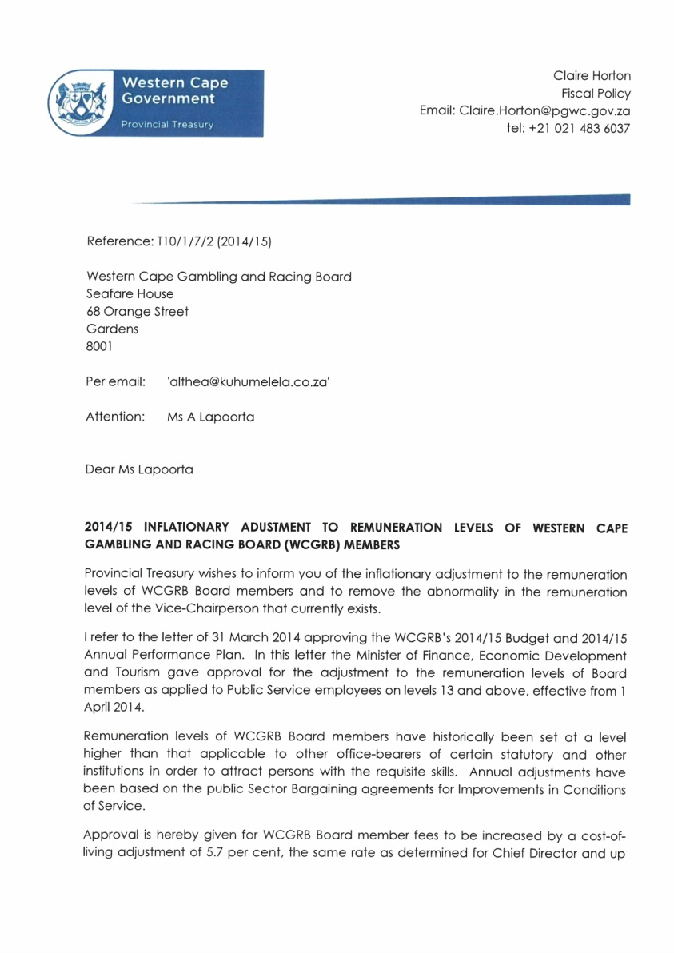
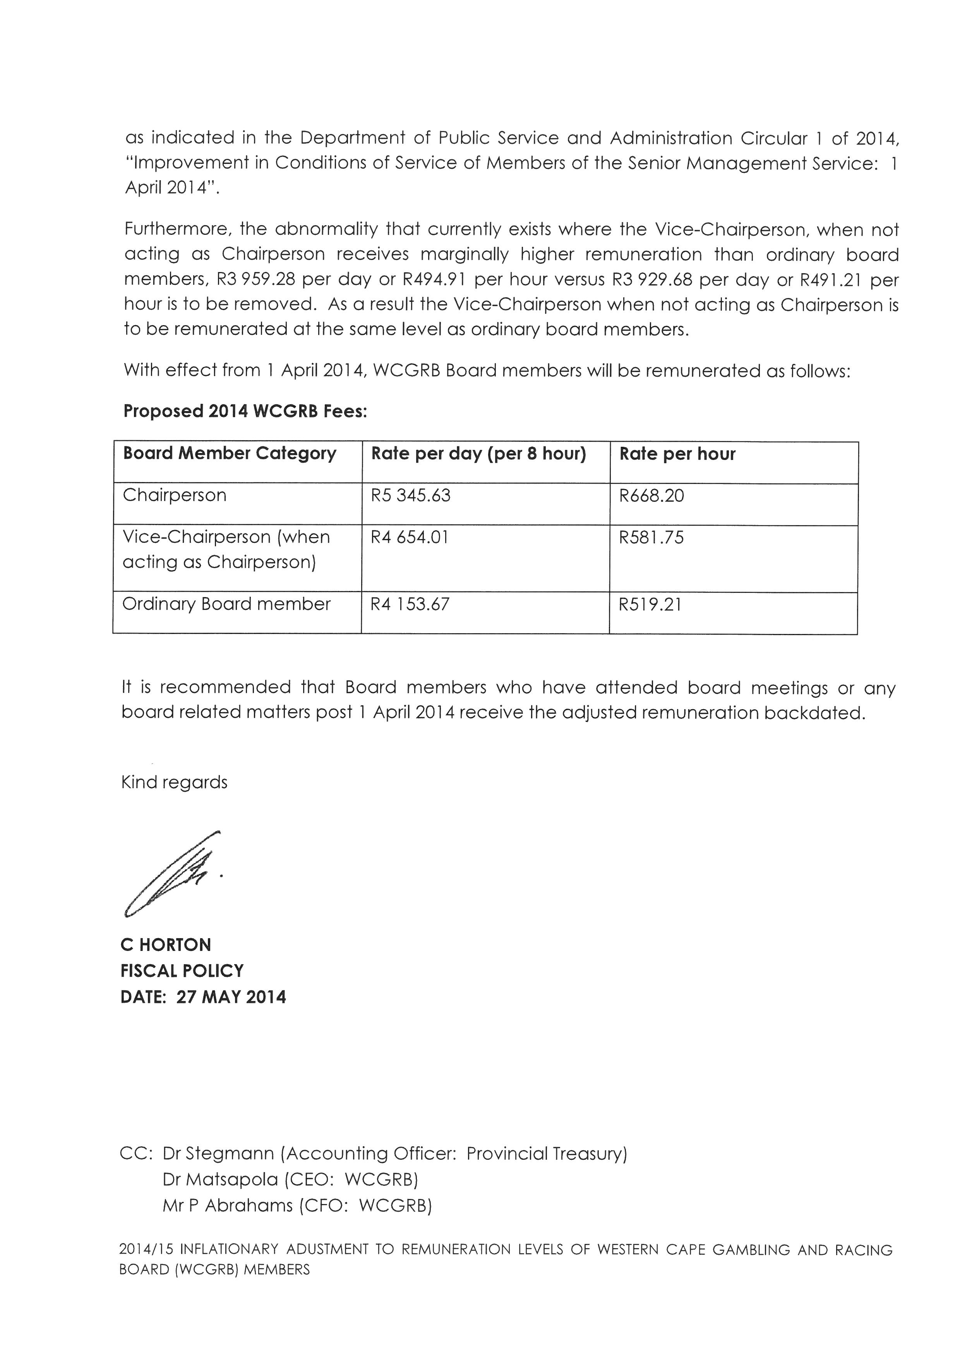
Western Cape gambling and Racing Board - Board members’ remuneration
.

Slide 8
Board Member remuneration

Slide 9
Board Member remuneration

Slide 10
Board meetings : committee meetings
Board Meetings
In practice, generally a one month notice of meeting except when an urgent matter needs resolution;
An agenda for the meeting must be approved;
Quorum of five members must be present;
Binding resolution must be taken; and
Deliberations and resolution must be recorded and minuted.
Matters deliberated at Board meetings include approval of licence applications, punter hearings and oversight of WCGRB operational matters.

Slide 11
Board meetings : committee meetings
Committee Meetings
In practice, at least a one month notice period;
An approved agenda;
A quorum of two members must be present;
Deliberations must be recorded and minuted; and
Recommendations for Board resolution.
Matters deliberated at Committee meetings are relevant to the sector which the committee oversees and in-depth discussion and review of the industry sector and oversight operational section.

Slide 12
Board meetings : committee meetings
 | Board Meeting | Committee Meeting
Number of Committees | 1 (one) | 7 (Seven) (Finance and IT, Audit, Human Capital, Licensing, LPM, Casino, Horse Racing)
Frequency | (13) Thirteen scheduled | One per quarter (28) Licensing has 5 meetings per year therefore (29)
Remuneration | Full Board fee (8 hours) | Hours spent at hourly rate Member from outside of province receives 8 hour fee due to travel time
Actual number of meetings 2018/19 | 14 (fourteen) | 30 (thirty)
Reason for extra meetings | Ad-Hoc to interview Audit Committee candidates | In depth review of PDI trusts’ financial statements and CSI commitment

Slide 13
Board MEMBER ACTUAL FEES 2018/19

Slide 14
Board MEMBER ACTUAL FEES 2018/19
The full complement of Board members are seven
Currently there are five active members
The quorum for a board meeting is five
Committee meetings have three members with a quorum being two
Currently, the active board members must assist by standing in for committees which the two vacant posts would have filled
This results in the current five members having to stand in for the two vacant posts which inflates the actual remuneration per member.

Slide 15
THANK YOU
Notes:
14

