Slide 1
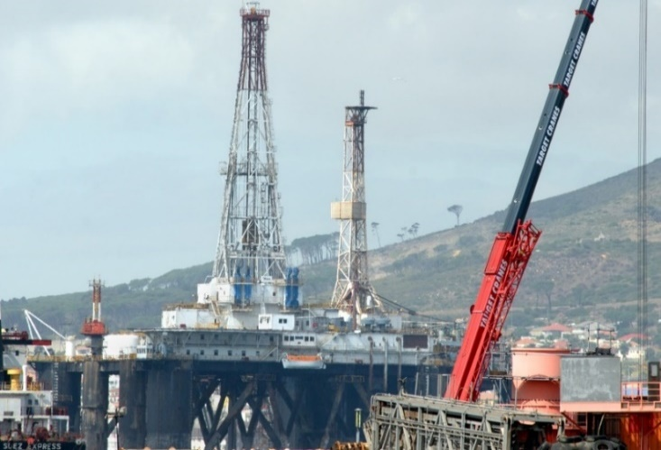
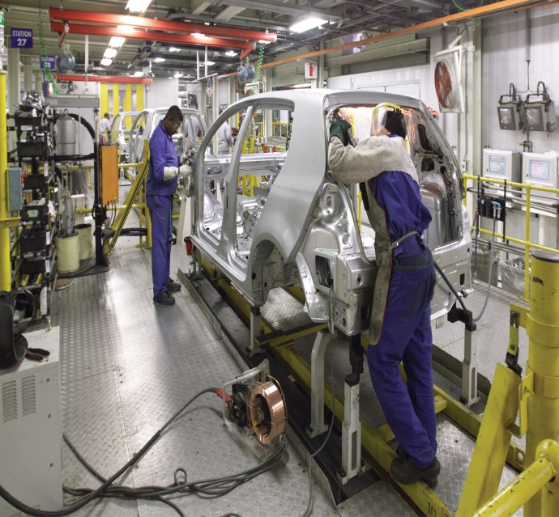
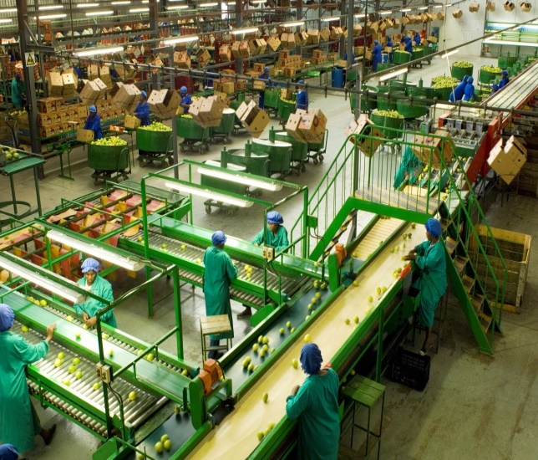
Portfolio Committee on Trade and Industry
Status Report on South Africa’s
Trade Negotiations
11 September 2019
Ambassador Xavier Carim, Deputy Director-General:
International Trade and Economic Development Division - Department of Trade, Industry and Competition

Slide 2
Contents
Negotiating principles and approach
Trade performance and top trading partners
Trade outlook
Update on Negotiations:
World Trade Organisation;
African integration: AfCFTA, TFTA, SADC, SACU;
SADC-EU EPA;
Brexit;
SA-US Trade/AGOA;
EFTA and MERCOSUR; and
Digital Trade Matters.

Slide 3
Principles and Approach
SA trade should support industrial development.
Tariff negotiations should support industrial development.
Trade and tariff negotiating outcomes should enhance SA exports of higher value added products.
Protect sensitive sectors.
Preserve policy space for development.
Regional/continental integration for development, structural transformation and industrialisation.

Slide 4
SA Trade Performance
SA’s share of world trade grew from 0.45% in 2000 to 0.53% in 2018.
Subdued global trade growth, 2013 to 2018: 1% p/a.
SA total trade in 2018: R2.38 trn / US$187.8 bn:
Average annual growth since 2013: -1.1% p/a
(in US$ terms).
SA total exports in 2018: R1.15 trn/US$94.42 bn:
Average annual growth since 2013: -0.1% p/a.
SA export dominated by minerals; resource slump affected SA exports disproportionately.
Mining export values declined more over last 5 years, than manufacturing export values.

Slide 5
SA Trade Performance
SA total imports in 2018: R1.24 trn /US$93.42 bn:
Average annual growth since 2013: -2.0% p/a.
The large decline in the oil price contributed to strong decline in SA imports; oil accounts for ±20% of SA import value.
SA recorded trade surplus of R13bn/$999 mn in 2018.
SA’s top 5 export partners: China, US, Germany, Japan, Namibia.
Top 5 import sources: China, Germany, US, India, Saudi Arabia.
EU - as a block - is the top trade partner.
Namibia, Botswana, Mozambique, Zambia, Zimbabwe, Lesotho and Swaziland in top 20.

Slide 6
SA Trade Summary
Overall, SA trade has declined in $ terms largely due to end of the mineral export super cycle.
Trade is relatively balanced with exception in 2008: moves in a band between approximately -R80bn and +R80bn.
Exports: 56.7% commodities and 42.9% manufactures -
Destinations for SA manufactures: Africa (35.6%,mainly SADC), EU (30%, UK, Belgium, Germany, Netherlands), US (6.8%), Japan (3.9%).
Imports: 40.5% commodities and 59.4% manufactures -
Sources: EU (34%, Germany, UK, France, Italy), China (25.6%), US (6.8%), Thailand (4.7%), Japan (4.5%), India (3.6%).

Slide 7
Economic and Trade Outlook
Weak global demand, sluggish growth with downside risks.
Widespread backlash against trade.
Spike in restrictive trade measures (‘trade war’).
Uncertainty impacts investment.
Low growth in EU (1.3% in 2019 to 1.6% in 2020) and US (2.6% in 2019 to 1.9% in 2020).
Growth in developing Asia expected at 6.2% in 2019-20.
40% of African countries expect growth of +5% in 2019.
Competition for growing markets will intensify.
SA well positioned from growth in Africa through preferential access in SACU and SADC.
New market access anticipated through TFTA and AfCFTA.

Slide 8
SA Trade Balance

Slide 9
SA Export Destinations
Source: Quantec

Slide 10
SA Import Sources
Source: Quantec

Slide 11
WTO: SA’s Broad Approach
WTO sets framework for global trade but is confronting a crisis.
Unbalanced rules and widening backlash against trade.
SA supports rules-based multilateral trading system.
Recognises WTO rules are imbalanced, prejudice developing country interests, and should be reformed.
Reform for a better balance between global rules and space for national policies to advance development.
WTO reform should foster inclusivity and development by advancing agricultural reform, and rules that open space for industrial development and technology transfer.
To this end, we pursue a developmental agenda at the WTO with like-minded countries.

Slide 12
WTO: Recent Developments- Crisis?
In 2018, citing national security, US imposed unilateral tariff increases on steel and aluminium - beyond WTO legal bindings.
Exceptions for some countries violate the WTO MFN rule.
Retaliation, further measures have triggered the ‘trade war’.
US continues to block the selection of new Appellate Body Members, the cornerstone of rules-based trading system.
By Dec 2019 the AB will have no quorum – effectively disabled.
Trade disputes will no longer be resolved through due process but negotiation – where trade power will have stronger sway.

Slide 13
WTO: Recent Developments – Reform?
Developed countries and allies propose a reform agenda that would extend imbalances:
Undermine consensus-decisions by legitimising plurilateral agreements on issues not agreed by all.
Narrow the scope for special and differential treatment (SDT) in favour of developing countries – case-by-case.
Graduate larger developing countries (China, India and SA).
US, EU and Japan propose to narrow scope on policies for industrial development, technology transfer and state-owned enterprises.
Targeted at China but will affect all developing countries.
Narrowing flexibility will make outcomes more difficult.

Slide 14
WTO: Negotiation on Fish Subsidies
Sustainable Development Goal 14: Conserve and sustainably use the oceans, seas and marine resources for sustainable development.
WTO to contribute by establishing rules that:
Prohibit subsidies to Illegal, Unreported and Unregulated (IUU) fishing.
Constrain subsidies that lead to overfishing and overcapacity to fish.
Policy space for Members with low subsidies to develop fishing industries.
Ensure policy space for sustainable fishing (positive subsidies).
Provide policy space to support artisanal, small scale, poor fishing communities.

Slide 15
WTO: Negotiation on Fish Subsidies
SA is negotiating as part of the ACP Group
– Technical co-ordinator.
Little chance of conclusion by deadline of Dec 2019.
Wide differences between Members on definitions, scope of disciplines and exceptions including on SDT for developing countries.

Slide 16
African Integration
Africa accounts for a growing share of SA trade particularly in manufactured products.
Africa must overcome limitations of small, fragmented markets, over dependence on commodities and poor infrastructure.
To address these, we advocate a developmental integration approach that combines:
Market integration (FTAs).
Co-operation on industrial development to build supply capacity, regional value chains, economic diversification.
Development of cross border infrastructure linkages.

Slide 17
African Integration
Africa has a market of 1 bn+ people, a combined GDP of US$3.3 trn with a growing middle class and consumption.
AfCFTA will help integrate African markets, boost intra-Africa trade, create a basis for scale economies, encourage investment, and enhance legal certainty with a rules-based regime underpinned by a dispute resolution mechanism.

Slide 18
AfCFTA- State of Play
54 AU Members (all except Eritrea) have signed the AfCFTA.
27 have been ratified.
SA deposited its instrument of ratification on 10 Feb 2019.
Agreement formally entered into force on 30 May 2019.
Negotiations set in two phases:
Phase I: Trade in Goods covering tariff reduction schedules; Rules of Origin; Rules on non-tariff barriers (SPS, TBT); Co-operation on customs controls, trade facilitation and transit; Trade in Services commitments.

Slide 19
AfCFTA: State of Play
Phase I: Outstanding Issues
Legal texts are completed (technical adjustment needed).
Rules of Origin: negotiations sugar, autos and textiles and clothing should be finalised by Feb 2020.
Tariff negotiations and preparation of tariff schedules:
Members should submit schedules of tariff reduction covering 90% of tariff lines by Sept 2019 and offers on the remaining 10 per cent of the tariff lines by Nov 2019.
Feb 2020 date more likely.
Tariff reductions should commence by 1 July 2020.

Slide 20
AfCFTA- State of Play
The schedules of specific commitments for Trade in Services should be submitted for adoption by AU Summit in Feb 2020.
Phase II Negotiations
Draft Protocols for Intellectual Property Rights, Competition and Investment should be submitted for adoption by the AU Summit in Jan 2021.

Slide 21
AfCFTA: Concerns
Concern at level of ambition of tariff liberalisation and short time.
Constituencies ready to offer just 86% of lines for liberalisation.
Import competing sectors, industrial capacity and employment may be negatively affected.
Risk of transhipment and SARS capacity to monitor and enforce RoO.
Risk of non-implementation by some.
Risk of new NTBs impairing exports.
In general, top-down institutional approaches may not work if benefits of liberalised trade are not shared equitably.

Slide 22
TFTA: State of Play
Based on the 3-pillar development integration: trade liberalisation; industrial cooperation and infrastructure development.
Phase I: trade in goods; and Phase II - trade in services negotiations, cooperation on IPR, investment, competition policy.
Negotiations on the legal texts concluded.
Agreement adopted, and ratified by 5 countries (Egypt, Kenya, Uganda, SA and Rwanda).
Requires 14 ratifications to enter into force.
Countries are in the process of ratifying the Agreement.

Slide 23
TFTA: State of Play
Modalities for tariff negotiations: 60% immediate liberalisation, 25% over 5 to 8 years, and 15 % subject to negotiations.
Tariff negotiations between SACU and EAC finalised in June 2019.
SACU-Egypt tariff negotiations still required.
For others, SADC, EAC, COMESA tariff regimes extended across the TFTA countries.
RoO still to be finalised (sugar, autos and textiles and clothing).
Phase II negotiations on trade in services and competition commenced in July 2019.

Slide 24
SACU Review
SACU remains an important market for SA.
SACU Agreement premised on a longstanding arrangement of a common external tariff, free flow of goods within the Union, and a redistributive revenue sharing arrangement in favour of smaller Members.
Under SACU review, SA has advocated allocation of part of the revenue for industrial and infrastructure development purposes to transform SACU into a developmental project.
Others propose establishment of a SACU Tariff Board that would set SACU tariffs by consensus.
Differences in economic size, policy imperatives and objectives have lead to an impasse.
Status quo is the likely scenario.

Slide 25
SADC: Implementation
13 SADC countries established a FTA in 2000.
Tariff liberalisation program fully implemented.
Angola, DRC and Comoros still to join.
Current focus is implementation and consolidation.
Zimbabwe reversing some commitments: applied for 8 years exemption from tariff liberalisation for 995 products.
Under Trade in Services Protocol, negotiation completed on transport, finance, telecommunications and tourism.
Negotiations in energy and construction services ongoing.
Regional Industrialisation strategy has been approved.

Slide 26
SADC-EU EPA: Implementation
EU-SADC EPA provisionally entered into force on 10 October 2016 and tariff regime between SADC/SA and EU is in place.
Current implementation issues include:
Safeguard imposed on EU poultry imports.
EU requested consultations towards arbitration in Sept.
Tariff treatment of vehicles with engine capacity of 1000cc and below.
Wheat tariff rate quota allocation – “first come first served”.
SPS issues on agriculture products for both parties.
For SA key issues are poultry, beef, lamb, horses, and citrus (CBS).

Slide 27
Implementation
SACU-EFTA FTA
Review on-going.
SACU focus is on additional market access on basic and processed agricultural products.
SACU has submitted a list of priority products for improved market access.
Engagement continues.
SACU-MERCOSUR PTA
Entered into force on 1 April 2016.
The PTA provides preferential tariff access on over 1000 tariff lines on both sides.

Slide 28
BREXIT: A New SACUM-UK EPA?
The UK is SA’s 5th largest trading partner.
Trade between the UK and SA increased from R63.7 billion in 2012 to R106.2 billion in 2018 - under SADC-EU EPA terms.
The UK seeks to leave the EU but the terms are unclear.
A ‘hard’ Brexit would entail, from our view, the UK leaving the EU customs union.
The chances of a hard Brexit appear to have increased – new deadline is 31 October 2019.

Slide 29
BREXIT: A New SACUM-UK EPA?
To avoid trade disruption an ‘in principle’ agreement was reached to roll over trade rules of the SADC-EU EPA into a new SACUM-UK EPA.
Failure to conclude such an arrangement would mean that trade with the UK would be on WTO MFN terms.
This implies new tariffs on 114 tariff lines of export interest to SA, notably on autos, textiles and clothing and sugar.
A great deal of progress on the SACUM-UK EPA has been achieved.
Rules of origin, SPS, transitional arrangements and a built in agenda were subjects of the last round in mid-July.

Slide 30
BREXIT: A New SACUM-UK EPA?
Convergence on:
UK to have full cumulation with the EU for exports to SACUM.
Continued recognition of EU SPS certification and establishment listing for a period of time.
GIs: SA proposal on Irish Cream, Irish Whiskey; wine making practices under consideration.
Key outstanding issue: transitional arrangements on SACU safeguard on EU poultry (UK major exporter).
UK can cumulate with EU, but EU cannot cumulate with UK.
SACUM cannot cumulate with UK and obtain preferential access to EU.
Further engagement to conclude agreement and ratify by
31 October.

Slide 31
SA-US Trade/AGOA
SA exports to US under three regimes:
MFN: in 2018, 72.1% of exports - mainly commodities.
GSP: preferential tariff regime that provides duty free access for some auto and other value-added products: 10.3% of exports.
AGOA – adds 1600 tariff lines to GSP, notably autos, and offered greater certainty by extending review cycle to 10 years (whereas under the GSP it was annually) – 17.4%.
Expansion of SA higher value exports to US, peaking in 2008 at $3.8 billion.

Slide 32
SA-US Trade/AGOA
Since 2008 trade with US has been on a steady decline falling to $2.3bn in 2018.
AGOA now 27% of total SA exports to US - down from 36%.
SA no longer benefits from AGOA certainty - subject to ‘out of cycle’ reviews on any issue US deems of concern.
Reviews are also possible under GSP that underpins AGOA.
Uncertainty from Section 232 investigation on Autos (exports down 51% in 2018).
SPS restrictions on Citrus (CBS).

Slide 33
SA-US Trade/AGOA
With AGOA set to end in 2025, US is proposing a new framework for trade and investment with Africa.
Strengthening intra-governmental engagement with Africa (Prosper Africa).
New Build Act to mobilise US private sector for investment and trade in Africa.
Promise to incentivise US firms to support African development but with commitments that African governments open their economies and reduce restrictions on US firms’ operations.
Recognising the importance of the AfCFTA, the US has signalled an interest in pursuing an FTA with one African country that would be a Model for others.

Slide 34
SA-US Trade/AGOA
At last AGOA Forum, Ministers gave broad response.
Many highlighted that while AGOA was important it had not fulfilled its promise (lack of African productive capacity and stringent US product standards).
Most emphasized priority is now operationalisation and consolidation of the AfCFTA.
Some indicated FTA with third party could undermine AfCFTA or distract from priority work.
US indicated the new USMCA agreement is their ‘gold standard’.
Includes extensive tariff liberalisation, WTO-plus rules for Services, IPR, government procurement, investment etc.

Slide 35
Digital Trade
Rapid but uneven process of digital transformation affecting the way we produce, consume and trade.
Impacts on industrial production, trade and employment.
Need to prepare a considered, comprehensive and coherent response.
The digital economy can be harnessed to advance social and economic development, but technological change on this scale is disruptive with a range of challenges -
persistent digital divide along various dimensions;
lack of adequate and affordable digital infrastructure; and
weak digital skills base.

Slide 36
Digital Trade
Strengthened competition policy to address high concentration in the digital economy and rise of anti-competitive practices.
Tax base erosion aggravated by digitalisation.
The revenue and industrial development implications of the WTO moratorium on customs duties for electronic transmission.
Balancing free data flows with a data policy for privacy, national security and economic development.
‘Data for development’ needed to ensure we are more than a consumer market for digital services produced elsewhere.
We must become innovators and producers, exporting services and building capabilities for economic inclusion and growth.
Need robust dialogue between all stakeholders in SA.

Slide 37
Acronyms
ACP African Caribbean Pacific
AfCFTA African Continental Free Trade Agreement
AGOA Africa Growth and Opportunity Act
CBS Citrus Black Spot
COMESA Common Market for Eastern and Southern Africa
EAC East African Community
EFTA European Free Trade Association
EPA Economic Partnership Agreement
EU European Union
FTA Free Trade Agreement
MFN Most Favoured Nation

Slide 38
Acronyms
MERCOSUR Southern Common Market initially established by Argentina, Brazil, Paraguay and Uruguay, and subsequently joined by Venezuela and Bolivia
NTB Non Tariff Barrier
RoO Rules of Origin
SACU Southern African Customs Union
SADC Southern African Development Community
SPS Sanitary and Phyto sanitary
TBT Technical Barriers to Trade
TFTA Tripartite Free Trade Agreement
USMCA US-Mexico-Canada
WTO World Trade Organisation

Slide 39
Thank You

