Slide 1
MOPANI DISTRICT MUNICIPALITY(DC 33, Grd.4)
STANDING COMMITTEE ON PUBLIC ACCOUNTS
13 SEPTEMBER 2019
THE PARLIAMENT OF SOUTH AFRICA, CAPE TOWN
The Hon. Executive Mayor; Cllr. Shayi P.J

Slide 3
MAIN PRESENTATION

Slide 4
Outline…
Audit History
Umbrella Audit Action Plan progress report

Slide 5
MDM DEMOGRAPHICS

Slide 6
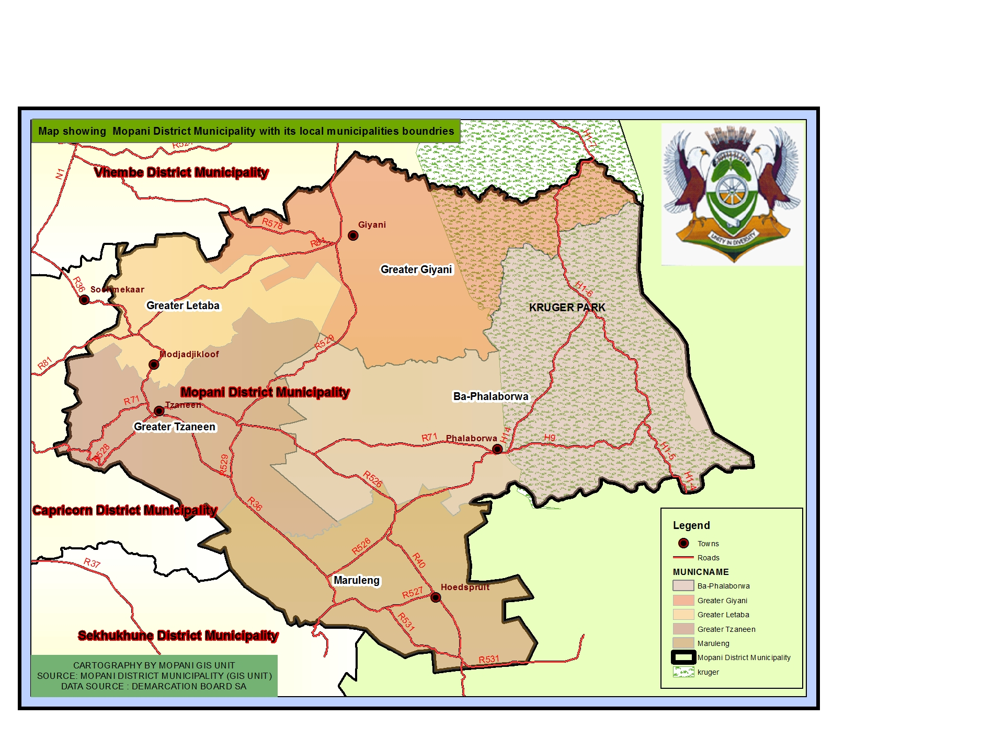

Slide 7
POWERS and FUNCTIONS

Slide 9
GOVERNANCE

Slide 11
CONDITIONAL GRANTS SPENDING

Slide 12
GRANTS

Slide 13
AUDIT HISTORY

Slide 14
Audit History for previous 4 years
Municipality | 2014/15 | 2015/16 | 2016/17 | 2017/18
Mopani District Municipality | Disclaimer | Adverse | Disclaimer | Adverse

Slide 15
TOP 5 ISSUES RAISED BY AG OVER THE LAST 5 YEARS
ISSUES
Property Plant and Equipment
Water Transactions
UIFW
Commitments
Conditional Grants
INTERVENTIONS
Capacity building (including skills transfer and training)
Consequence management
Introduction of a records management system
Discontuation of procurements through SCM regulation 32.

Slide 16
KEY ELEMENTS OF THE ACTION PLAN AND ANTICIPATED RESULTS
KEY ELEMENTS OF THE ACTION PLAN
Full financial year round assets verification (engaged service provider and reviewed the asset register and AFS)
Monthly engagement with the local municipalities on reconciliations of water transactions (reviewed the AFS)
Full disclosure of all known UIFW including prior years (reviewed the AFS)
Reconstruction of the commitment register with the information collated from assets verification (reviewed the AFS)
Review of the grants spent for meeting conditions (reviewed the AFS)
EXPECTED OUTCOMES
Minimal findings on PPE
Findings in the Ba-Phalaborwa municipality on differences on inter-municipal account with Mopani due to late amendments of balances by Ba-Phalaborwa.
No findings on completeness of UIFW, only non-compliance paragraph under emphasis of matters.
No findings on commitments
No findings on grants, except for non-compliance paragraph under emphasis of matters.

Slide 17
OVERSIGHT STRUCTURE AND FUNCTIONALITY
OVERSIGHT STRUCTURES
FUNCTIONALITY AND REPORTING
Functional (Quarterly reporting to council)
Not functional (in resuscitation process)
Function (Reporting to Audit Committee continuously)
Functional (Reporting to council quarterky)
Audit Committee
Disciplinary Board
Internal Audit
Municipal Public Accounts Committee

Slide 18
MASTER AUDIT ACTION PLAN

Slide 19
AUDIT ISSUES ACTION PLAN

Slide 20
AUDIT ISSUES ACTION PLAN Contd…

Slide 21
AUDIT ISSUES ACTION PLAN Contd…

Slide 22
AUDIT ISSUES ACTION PLAN Contd…

Slide 23
AUDIT ISSUES ACTION PLAN Contd…

Slide 24
AUDIT ISSUES ACTION PLAN Contd…

Slide 25
AUDIT ISSUES ACTION PLAN Contd…
# | AUDIT ISSUE | ROOT CAUSE | CORRECTIVE ACTION | PROGRESS REPORT | DUE DATE
2 | Lack of skills transfers when consultants are engaged | No skills transfer plan and agreements | 3.1. No agreed upon skills transfer plan that is monitored for implementation monthly. | The signed SLA with the financial statements service providers dictates that there be skills transfer to the budget and reporting staff. | 30-Sep-19
3 | Weak internal control environment | Lack of consequence management No regular awareness capaigns for officials on importance of complying with internal controls | 4.1. Introduction of consequence management 4.2. Conduct awareness capaigns for officials on importance of complying with internal controls | Consequence management is applied though at a small degree, given that a lot of audit findings qualify for an application of more consequence management measures. There is still room for improvement in making employees aware of the importance of complyng with internal controls | 30-Sep-19

Slide 26
AUDIT ISSUES ACTION PLAN Contd…

Slide 27
AUDIT ISSUES ACTION PLAN Contd…

Slide 28
AUDIT ISSUES ACTION PLAN Contd…

Slide 29
AUDIT ISSUES ACTION PLAN Contd…

Slide 30
AUDIT ISSUES ACTION PLAN Contd…

Slide 31
MPAC vs UIFW EXPENDITURE

Slide 32
MPAC INVESTIGATIONS INTO UIFW EXP.

Slide 33
FUNCTIONALITY OF GOV. STRUCTURES

Slide 34
Structures | Yes/No
Audit Committee | Yes
Internal Audit | Yes
MPAC | Yes
Audit Steering Committee | Yes

Slide 35
CONSEQUENCE MANAGEMENT

Slide 38
------MPAC----- CONSEQUENCE MANAGEMENT ON UIFW 2014/15 to 2016/17 FYs

Slide 40
INVESTIGATIONS

Slide 41
One SIU investigation (Sanitation projects and boreholes works performed)

Slide 42
KEY CHALLENGES AND RECOMMENDATIONS

Slide 43
# | KEY CHALLENGES | SUPPORT REQUIREMENTS
1 | mSCOA slow implementation | Extension of time on mSCOA based submissions
2 | Growing debts | Revenue enhancement strategy development
 |  | Turnaround strategy development
3 | Poor project management | Technical support in terms of ensuring proper monitoring of projects implementation

Slide 44
# | KEY CHALLENGES | SUPPORT REQUIREMENTS
4 | Poor records keeping | Introduction of a sustainable and efficient records management system
5 | Poor audit outcomes | Turnaround startegy on full implementation of audit recoommendations
6 | Aged water and sanitation infrastructure | Securing funding from National Treasury for infrastructure revatilisation
7 | Poor implementation of the WSA//WSP water and sanitation agreements | Introduction of the best model to properly run and account on the WSA//WSP arrangement

Slide 45
PRESENTATION ANNEXURES….

Slide 46
Index….
AGSA 2017-18 Audit Report
Audit Steering Committees
Itemised Audit Action Plan progress report
Audit Steering Committee
Audit Paragraphs
Root causes
Audit Readiness
Turnaround Strategies
Closure

Slide 47
AUDITOR-GENERAL SOUTH AFRICA 2017-18 AUDIT REPORT

Slide 48
BASIS FOR ADVERSE AUDIT OPINION
Property, Plant and Equipment (Past 5 years)
Receivables from exchange transactions (Past 5 years)
Revenue (Past 5 years)
Payables from exchange transactions (Past 5 years)
Value Added Tax (Past 2 years)
Expenditure (Past 5 years)

Slide 49
BASIS FOR ADVERSE AUDIT OPINION Contd…
Employee costs (Past 3 years)
Commitments (Past 3 years)
Employee benefits (Past 2 years)
Statement of budget versus Actual (Past 2 years)
Contingent liabilities (Past 2 years)
Cash Flow Statement (Past 2 years)

Slide 50
BASIS FOR ADVERSE AUDIT OPINION Contd…
Water Losses (Past 2 years)
Unauthorised expenditure (Past 5 years)
Irregular Expenditure (Past 5 years)
Fruitless and wasteful expenditure (Past 5 years)
Related parties (Past 2 years)
Going concern (Past 3 years)

Slide 51
ITEMISED AUDIT ACTION PLAN

Slide 52
2017/18 ITEMISED AUDIT ACTION PLAN progress report…
Municipality | Issues raised | Issues resolved | Issues outstanding | Progress %
Mopani District | 113 | 106 | 7 (overtime, performance cascading and acting allowances) | 93%

Slide 53
AUDIT STEERING COMMITTEE

Slide 54
Audit Steering Committee meeting (during 2019-20 audit cycle)
Municipality | Political involvement on meetings (Mayor/MMC Finance) | Frequency | Functionality ( Yes/No)
MDM | Executive Mayor, All MMCs, CoGHSTA, LPT, SALGA, MANCO, Sectional Heads | Bi-Weekly (06 September 2019) | Yes

Slide 55
AUDIT PARAGRAPHS

Slide 56
PROPERTY PLANT AND EQUIPMENT

Slide 57
RECEIVABLES FROM EXCHANGE TRANSACTIONS

Slide 58
REVENUE

Slide 59
PAYABLES FROM EXCHANGE TRANSACTIONS

Slide 60
VAT

Slide 61
EXPENDITURE

Slide 62
EXPENDITURE

Slide 63
EPLOYEE COSTS

Slide 64
EPLOYEE COSTS

Slide 65
EPLOYEE BENEFITS

Slide 66
COMMITMENTS

Slide 67
CONTINGENT LIABILITIES

Slide 68
BUDGET STATEMENT

Slide 69
CASH FLOW STATEMENT

Slide 70
WATER LOSSES

Slide 71
STATEMENT OF NET ASSETS

Slide 72
UNAUTHORISED EXPENDITURE

Slide 73
IRREGULAR EXPENDITURE

Slide 74
FRUITLESS EXPENDITURE

Slide 75
RELATED PARTIES

Slide 76
GOING CONCERN

Slide 77
FINDINGS ON PERFORMANCE INFORMATION (AoPO)

Slide 78
KPA: Basic Service delivery- Water Services Infrastructure Development

Slide 79
FINDINGS
Targets not achieved
Performance achievement misstated
Limitation of scope
Unauthorised amendments to targets

Slide 80
KPA: Local Economic Development- Support for key Economic Sectors

Slide 81
FINDINGS
Performance achievement misstated
Targets not achieved
Unauthorised amendments to targets

Slide 82
FINDINGS ON COMPLIANCE WITH LAWS AND REGULATIONS

Slide 83
FINDINGS
Inadequate performance management system and internal control
AFS not compliant to GRAP and contradicting s122(1) of the MFMA
Annual Reporting not comply with s129(1) and 127(5)(a) to MFMA
Ineffective system of internal control for assets- s63(2)(c) to the MFMA
Non-compliance with conditional grant conditions (WSIG)- s17(1) to DoRA
Performance of contractors and providers not monitored- s116(2)(b) to MFMA

Slide 84
FINDINGS Contd…
UIFW expenditures not investigated- s32(2) to MFMA
Poor expenditure management- s65(1) and (2) to MFMA
Poor debtors and revenue management- s64(2)(f) to MFMA

Slide 85
OVERALL ROOT CAUSES

Slide 86
General Root Causes
Inadequate overtight by Accounting Officer on financial and performance reporting and compliance with laws and regulations
Lack of consequence management
Lack of daily and monthly accounting and recording of transactions
No review of AFS and Annual Performance report
No monitoring of compliance with laws and regulations
No monitoring of functionality of internal controls before audit

Slide 87
ROOT CAUSES FOR UIFW EXPENDITURE

Slide 88
Root causes for irregular expenditure
Incorrect Composition of Bid Committees
Poor planning of SCM activities resulting in unjustified deviations
Abuse of regulation 32 of the SCM regulations
Poor contract management resulting in contracting with expired contracts.
Lack of consequence management

Slide 89
Root causes for unauthorized expenditure
Incorrect budget assumptions
Poor in-year budget monitoring
Unintegrated financial reporting and budget systems resulting late detection of overspending
Lack of consequence management

Slide 90
Root causes for fruitless expenditure
Poor revenue collection in case of unplanned cash requirements
Late payment of suppliers
Poor planning resulting in cancellation of financially committed activities
Lack of consequence management

Slide 91
2019-20 AUDIT READINESS

Slide 92
AUDIT READINESS REPORT
AFS and APR submitted to AGSA by 31 August 2019
Audit File submitted to AGSA by 31 August 2019
Fixed Asset Register submitted to AGSA by 31 December 2019
Audit Steering Committee to monitor the audit established and ready to sit

Slide 93
TURNAROUND STRATEGIES

Slide 94
MEDIUM TO LONG TERM STRATEGIES
Meeting with AGSA to resolve on historing
1. Full implementation of mSCOA to assist with in-year monitoring and annual preparation of GRAP compliant AFS
2. Intensification of the IGR forums to early detect misstatements related to water and sanitation transactions
3. Support to local municipalities on water and sanitation transactions on revenue collection, cost recovery, bi-laws, cost containment and audit preparations
4. Improve capacity internally to prepare AFS
5. Improve internal controls to regulate financial and performance reporting as well as compliance with legislation
6. Skills transfer by contractors and providers

Slide 95
MEDIUM TO LONG TERM STRATEGIES Contd…
7. Improve internal controls to regulate financial and performance reporting as well as compliance with legislation
8. Source a permanent solution on records keeping from the Provincial Government
9. Preparation and review of quarterly AFS
10. Preparation of audits through internal audit processes
11. Interim audits
12. Training and workshopping of budget and reporting personnel on GRAP
13. Quarterly reporting to council on effectiveness of internal controls
14. All rounder advertisement of key vacancy to ensure capacity in all areas of audit interest (e.g. Financial reporting, PMS, contract management, etc.)

Slide 96
MEDIUM TO LONG TERM STRATEGIES Contd…
15. Ensure stability in the of the Accounting Officer
16. Application of consequence management
17. Quarterly Budget Lekgotla engagement sessions
18. Discontinuation of regulation 32 appointments
19. Preparation of credible budgets in consultation and assistance of the Provincial Treasury.
20. Benchmarking best practices in areas of audit improvement with other municipalities in the country.

Slide 97
SUPPORT FROM PROVINCILA GOVERNMENT

Slide 98
PROVINCIAL SUPPORT STRUCTURE

Slide 99
MEDIUM TO LONG TERM STRATEGIES Contd…
15. Ensure stability in the of the Accounting Officer
16. Application of consequence management
17. Quarterly Budget Lekgotla engagement sessions
18. Discontinuation of regulation 32 appointments
19. Preparation of credible budgets in consultation and assistance of the Provincial Treasury.
20. Benchmarking best practices in areas of audit improvement with other municipalities in the country.

