Slide 1
JOE MOROLONG LOCAL MUNICIPALITY
PRESENTATION TO THE STANDING COMMITTEE ON PUBLIC ACCOUNTS
Cllr D. Leutlwetse
(Mayor)
10 September 2019
Cape Town

Slide 2
PRESENTATION OUTLINE
BACKGROUND
GEOGRAPHICAL MAP
MUNICIPAL OVERVIEW
AUDIT OPINION HISTORY
AUDIT FINDINGS
REMEDIAL ACTION
WAY FORWARD

Slide 3
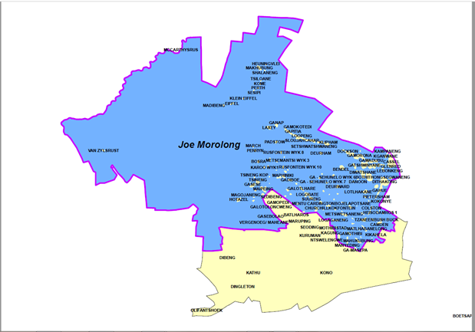
GEOGRAPHICAL MAP OF THE MUNICIPALITY

Slide 4
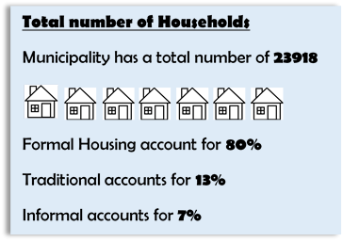
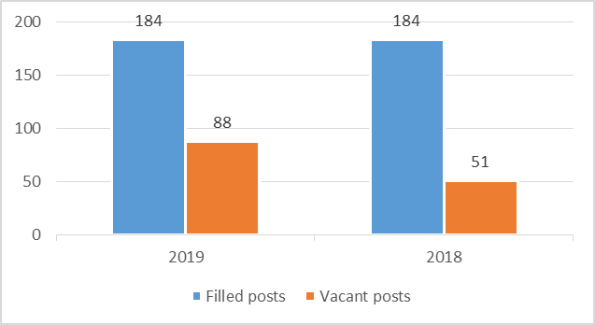
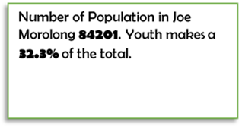
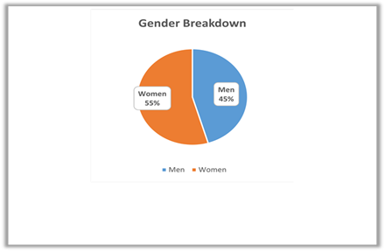
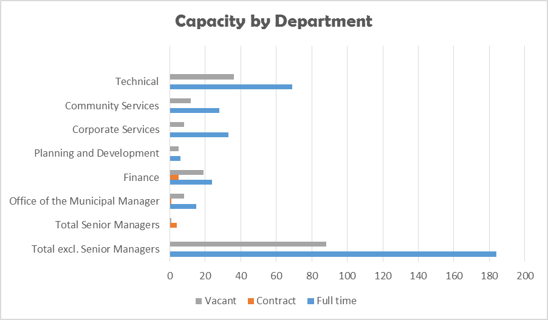
JOE MOROLONG
MUNICIPAL EMPLOYMENT 2018/2019
AUDIT OUTCOMES

Slide 5
MUNICIPAL OVERVIEW
Joe Morolong Local Municipality is located in the Northern Cape Province within the John Taolo Gaetsewe District, on the North eastern and western part of the District.
The Municipality covers 20, 172 km2 area of two semi-urban areas, 146 villages and a number of commercial farms.
The Municipality is characterized by rural establishments that are mostly connected through gravel and dirt roads.
The Municipality is accessible through the N14 which links North West and the Northern Cape Provinces.

Slide 6
MUNICIPAL OVERVIEW
Joe Morolong Local Municipality was established on the 6th December 2000 under the name “Moshaweng” which is now called Joe Morolong named after Taolo Joseph Morolong who was born at Ditshipeng Village on the 1st July 1927.
There are nine tribal authorities in our municipal jurisdiction with nine Paramount Chiefs.
Our population is 89 377 as per the Census Report of 2011.
Our population is 84 201 as per the Community Survey Report of 2016.
The Municipality has 146 villages and 2 small towns( Hotazel and VanZylsrus)
The Municipality has 168 schools, 4 police stations, 24 clinics and 3 community health centres.
Agriculture, Mining and Community Services are our primary economic sectors.

Slide 7
POLITICAL AND ADMINISTRATIVE GOVERNANCE
The Joe Morolong Local Municipality Council is the highest decision-making body and it governs the Municipality.
Council is responsible for development of policies and plays an oversight role over the implementation of those policies.
The Joe Morolong Council is constituted of 29 Councillors, 15 Ward Councilors and 14 Proportional Representation.
The administration of the Municipality is headed by the Municipal Manager who is the Accounting Officer. He was appointed during October 2017.

Slide 8
POLITICAL AND ADMINISTRATIVE GOVERNANCE
He is responsible for the day to day running of the Municipality and to ensure that the decisions of Council are implemented.
The administration is made up five departments headed by Directors. The departments are as follows: Corporate Services, Community Services, Planning and Development, Technical Services and Financial Services.
Employment contracts of the CFO and all Senior Managers ended in May 2017 and December 2018 respectively.
Council appointed acting CFO and Acting Directors until end of June 2019.
The CFO and Senior Managers were appointed in July 2019 except the Director: Technical Services.

Slide 9
AUDIT OPINION HISTORY
The municipality received the following audit opinions for the past 3 years.
2015/2016 - Disclaimer
2016/2017 - Disclaimer
2017/2018 - Disclaimer

Slide 10
AUDIT FINDINGS BY AG
FINANCIAL STATEMENT ITEM | FINDING | ROOT CAUSE
Property Plant and Equipment | Asset Register not agreeing to the Annual Financial Statements | Failure to update the Asset Register
INTERVENTIONS An extensive exercise was carried out in July 2019 to update the fixed asset register. This involved physically verifying all assets, retagging and geolocation of assets with a view to construct a new, more comprehensive fixed asset register. The exercise has been largely completed and now in the process of being finalised. The 2019 AFS will be adjusted to match the asset register.

Slide 11
AUDIT FINDINGS BY AG
FINANCIAL STATEMENT ITEM | FINDING | ROOT CAUSE
2. Receivables from exchange and non-exchange transactions | Overstatement of the receivables from exchange transactions. Understatement of the receivables for non-exchange transactions. | Incorrect classification of properties on the system for billing Incorrect tariffs used.
INTERVENTIONS A data cleansing operation for revenue and receivables will be conducted in the current financial year. This will involve verifying the existence of all customers on our receivables list to avoid billing non-existent customers, identifying all indigents to ensure that they are treated appropriately and, with council approval, writing off any accounts which will not be collectible (possibly due to non-existence of the debtor or errors in the database).

Slide 12
AUDIT FINDINGS BY AG
FINANCIAL STATEMENT ITEM | FINDING | ROOT CAUSE
3. Revenue from exchange and non-exchange transaction | Overstatement of the revenue from exchange transactions. Understatement of the revenue for non-exchange transactions. | Incorrect classification of properties on the system for billing Incorrect tariffs used.
INTERVENTIONS A data cleansing exercise will be conducted in the 2019/20 financial year. The purpose of the exercise is to ensure that: Every customer is billed for all services consumed, Every customer is billed accurately, Every customer is correctly classified in our system according to the valuation roll, and The correct tariffs are used in the system for billing purposes.

Slide 13
AUDIT FINDINGS BY AG
FINANCIAL STATEMENT ITEM | FINDING | ROOT CAUSE
4. Payables from exchange transactions | Understatement of payables | Monthly payable register not compiled. Supporting documents not provided.
INTERVENTIONS In the 2018/19 financial year, we identified all payables that were mis-stated and made necessary corrections. This exercise involved identifying suppliers who had outstanding balances but were not recorded, identifying transactions that were recorded in the wrong accounting period and reversing them to their financial years and identifying any invoices that were being held by staff members that had not been submitted to finance for the purpose of recording in the system. The internal controls around accounts payable will also be revamped to ensure that documents flow efficiently and are recorded timeously.

Slide 14
AUDIT FINDINGS BY AG
FINANCIAL STATEMENT ITEM | FINDING | ROOT CAUSE
5. Unspent Conditional Grants | Poor filing system | No system to account for unspent conditional grants
INTERVENTIONS The Municipality has greatly improved its filing and document management systems. All payment vouchers for are now scanned into a filing systems that enables documents to be available electronically on demand.

Slide 15
AUDIT FINDINGS BY AG
FINANCIAL STATEMENT ITEM | FINDING | ROOT CAUSE
6. Employee costs and councillors remuneration | Overstatement of costs due to overpayment of employees and councillors | Staff were paid more than contractual salaries Employee contracts and overtime information was not available to verify employee costs.
INTERVENTIONS Employee files have been updated with all relevant information regarding their remuneration. The Municipality will further improve its filing systems during the 2019/20 financial year.

Slide 16
AUDIT FINDINGS BY AG
FINANCIAL STATEMENT ITEM | FINDING | ROOT CAUSE
7. General Expenditure and Contracted Services | Unavailability of sufficient audit evidence to support expenditure | Poor record management systems
INTERVENTIONS The Municipality embarked on an electronic document management system which involves scanning all physical payment vouchers. This minimises the risk of losing physical documents while making retrieval of documentation more efficient. Going forward, all payment vouchers should be easily located on demand.

Slide 17
AUDIT FINDINGS BY AG
FINANCIAL STATEMENT ITEM | FINDING | ROOT CAUSE
8. Inventory | Water was not recognised as inventory in the financial statements. | The municipality did not have adequate systems in place to account for water inventory.
INTERVENTIONS Water was disclosed together with consumable stores under the same heading on prior year financial statements. In the current year and going forward, water inventory will be disclosed separately.

Slide 18
AUDIT FINDINGS BY AG
FINANCIAL STATEMENT ITEM | FINDING | ROOT CAUSE
9. Bank Overdraft | No sufficient appropriate audit evidence to support the overdraft. | Bank Reconciliations not conducted on a monthly basis.
INTERVENTIONS The municipality did not have an actual bank overdraft but payments that had not cleared at the bank. In the current financial year, transactions causing the cash book to be overdrawn were cleared and or cancelled. Automated monthly bank reconciliations are performed in the system on a monthly basis. They are reviewed and signed off by the CFO.

Slide 19
AUDIT FINDINGS BY AG
FINANCIAL STATEMENT ITEM | FINDING | ROOT CAUSE
10. Cash flow statement | Inability to verify the supporting evidence for figures reported on the cash flow statement | Unavailability of supporting documentation underlying the cashflow computations.
INTERVENTIONS A cash flow tool has been implemented and now in use to ensure that the correct balances are used in the preparation of the cash flow statement.

Slide 20
AUDIT FINDINGS BY AG
FINANCIAL STATEMENT ITEM | FINDING | ROOT CAUSE
11. Statement of comparison of budget and actual amounts | The financial statements did not disclose the statement of budget and actual amounts | The municipality did not disclose accurate figures as per the actual and approved budget.
INTERVENTIONS This has been improved in the current year and going forward, budget and actual amounts will be accurately on the financial statements.

Slide 21
REMEDIAL ACTION
Municipality developed an Action plan to address the recurring audit findings for improvement. The action plan include the following:
Limitation of Scope
A new system of scanning and filing soft copies of the supporting documents have been introduced.
A documents movement register is being used to keep track of the movement of the originals from the storeroom.
The storeroom is being locked at all times and a key kept by the Filing Clerk.

Slide 22
REMEDIAL ACTION
Asset Register vs General Ledger
Municipality has developed a new Asset Register from scratch with assistance of EMS Advisory.
The exercise involved collecting all information from as far back as the date the municipality was established and physical verification of all municipal assets for completeness.
Receivables and Revenue from exchange and non-exchange transactions
The municipality performed a recalculation of the expected revenue from the General Valuation Roll for testing the correctness of the billing by the system.

Slide 23
REMEDIAL ACTION
Reconciliation of the General Property valuation and the Financial System Rolls.
The supplementary valuation roll has been done to correct categories on the system.
The tariffs have been reviewed and corrected to match the approved tariffs on the system.
Currently the municipality is busy correcting historical errors on all the accounts.

Slide 24
REMEDIAL ACTION
Employees capacity and skills shortage
Employees are being sent for capacity building trainings and also through skills transfer by the consultants.
This is monitored through the report submitted by the consultants and verified by the official to whom the skill has been transferred.
The two critical BTO vacant posts were filled in March 2019, namely the Budget Manager and Revenue Manager to address capacity challenges.
The BTO structure was also reviewed to include critical posts for example the Deputy CFO and the Asset Manager posts.

Slide 25
WAY FORWARD
The Implementation of the Audit Action Plan to be closely monitored.
Meetings to be held constantly with the consultants and responsible officials to monitor the progress on the implementation of the Audit Action Plan.
The consultants are expected to provide the municipality with the report on the skills transferred to the employees. Two key staff from the finance department have been seconded to work with the consultants for purpose of skills transfer and continuity.
Training of employees to build capacity more particularly on the required minimum competencies.

Slide 26
THANK YOU.

