Slide 1
PORTFOLIO COMMITTEE:
Higher Education, Science and Technology
SERVICES SETA PRESENTATION
DATE: 10 SEPTEMBER 2019

Slide 2
Background and full details of the learnership and certificate programme

Slide 3
Background
The Services SETA had identified the need to prioritize and support a number of sectors eg.Real Estate, Hair and Beauty and the funeral industry.The intention and purpose was to ensure formalization and transformation of these sectors. As a result thereof had set aside funding for these sectors including the funeral industry for various interventions.
The project of Development, Training & Accreditation and Learning programmes for funeral services and medical hazardous waste management was conceptualized to close the gaps and formalizing the professional services as well as handling waste management within the funeral parlour industry.
Funeral parlour certificate in summary was to provide the Funeral industry with comprehensive Funeral Parlour industry programme that would equip the enrolled students with knowledge and understanding in Funeral Parlour Business Practice; Preparing, Handling and Transporting of Human Remains for Burial; Preparing the Funeral Site for Burial; Cremation or Memorial Services; Exhuming Human Remains and providing them with experience through Work Integrated Learning (WIL).

Slide 4
Background
Medical & Hazardous Waste Management certificate in summary was to cover the Introduction to medical waste management; Medical waste management systems; Regulation & procedures on medical waste management and assist the students obtain experience through Work Integrated Learning (WIL).
Each of the certificate programmes consists of 96 credits with the duration of six (6) months. Each of the certificate programmes has five modules.
All these modules have learner guides which were made available to the enrolled students.
The two short learning courses above result in 192 credits in total.

Slide 5
Although the qualifications are regarded as short learning programmes as per the university short courses guidelines however the qualifications are classified as learnership in terms of SETA learning programmes classification.
A learnership is defined as a vocational education and training programme to facilitate the linkage between structured learning and work experience in order to obtain a registered qualification. It combines theory and workplace practice into a qualification that is registered on the National Qualifications Framework (NQF).
The programme was approved as a learnership programme and was funded through SSETA bursary funding model as the learnership funding model was not sufficient to cover for all the needs and demands that came with the facilitating of this qualification ass a pilot.

Slide 6
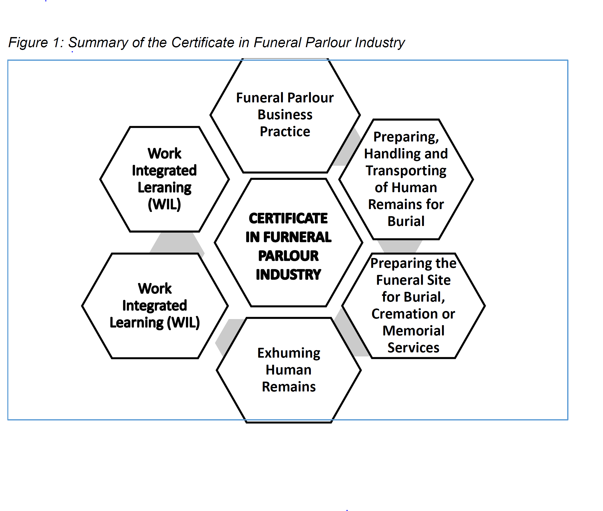

Slide 7
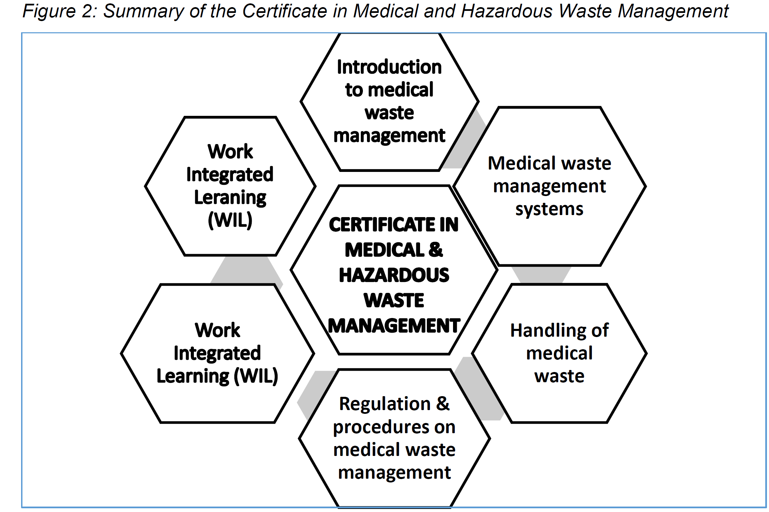

Slide 8
Process followed to award the contract to the UL

Slide 9
Special Projects process
This is supported by NSDS III which requires the SETAs to partner with higher learning institutions and was not a tender award.
SETA grants regulations allows the SETA to utilise 20% of its discretionary grants budget towards non-pivotal programmes.
Services SETA’s discretionary grants policy makes provision for such projects in paragraph 8 which states the following:
“Special projects are projects aimed at ensuring the participation of public institutions and non- profit making organisations in the Services SETA’S skills development work.
The purpose of these projects is to provide training in the priorities of government and/or the responsiveness to, amongst others, performance against its own objectives and to government pronouncements.
Special projects shall be addressed through special initiatives in line with Services SETA’s development requirements as approved by the Accounting Authority.
Approval of special projects rests with the Accounting Authority”.
Having due regard to the above, Services SETA allocated grants to the University of Limpopo to develop and implement qualifications in the funeral parlour to combat the challenges referred to above.

Slide 10
University of Limpopo Allocation
Services SETA’s Accounting Authority on the annual basis conducts stakeholder engagements workshops across the country.
On their visit to Limpopo, the Accounting Authority became aware of the university proposed new short courses relating to the funeral industry that were to be offered by the university. The SSETA AA with its plan to formalize the industry made an initial commitment of R20 000 000 towards the university for the funeral industry sector qualification development and piloting of same.
The university was requested to submit project implementation plan as well as the proposal that will outline how the university intends to utilise the funding which aligned to Services SETA needs within the funeral sector.
The programme was divided into two groups comprising of 50 learners each with the first group commencing in 2017 and second group in 2018 respectively.
The programme attracted media as well as large number of stakeholders as it was launched.
Both groups have completed the programme however there were number of delays experienced in issuance of the certificates
Upon successful implementation of the pilot based on enrolment of both groups, the Accounting Authority committed additional funds for National roll-out based on the outcome of the pilot.

Slide 11
Funding involved in the learnership programme

Slide 12
Funding model of the project:
Pilot project funding
Actual spent to date on the project, R16 969 500,00 of R19 059 000,00 over a period of 2016 to 2018
Completed learners are 72 (72%) as per University verification and certification process
Description | Funeral Parlour | Medical & Hazardous Waste Management
Development of qualifications | R3 964 500,00 | R3 884 500, 00
Training and Accreditation | R3 250 000,00 | R1 929 000,00
Bursaries for Learning programme | R2 370 000,00 | R3 661 000,00
Total | R9 584 500,00 | R9 474 500,00

Slide 13
National roll-out funding:
The Accounting Authority committed further funding for R97 010 000,00 for 1 500 learners.
University approvals processes are underway and the following activities have been delivered:
Actual spent on the pilot and national roll-out to date, R25 488 250,00.
Description | Activity | Amount
Full time learners | Study material | R915 000,00
Blended learning learners | Books and study material | R915 000,00
Blended online learning resources | Development of online blended learning resources | R3 344 375,00
 | National roll -out site resources | R3 344 375,00
Total |  | R8 518 750,00

Slide 14
Way-forward in assisting learners involved in the programme

Slide 15
Way-forward and Conclusion:
Pilot Certification and Impact in the industry
Learner information was verified by the university
Certificates were printed with errors where one certificate was printed for both qualifications instead of two certificates containing each qualification.
The incorrect certificates were given to the students which caused frustrations to the learners hence the media allegations.
The university has confirmed that the certificates have been printed and signed off and collection is in progress.
The Funeral Parlour Special Committee that was set up to participate in the pilot programme expressed their satisfaction with the programme.
The National Funeral Directors Association (NFDA) invited the Project Coordinator and two students from the Funeral Parlour programme to attend their Annual General meeting held in February 20th-21 of February 2019 in George to share their experience and highlights of the programme and lessons learnt.

Slide 16
Lessons learnt out of the pilot as advised by the university :
Learner information was verified by the university
Streamlining of the learning outcomes and assessment criteria for better assessment criteria for better cohesion and flow of the delivery
Usage of You Tube videos to enhance real-time practical stimulation
Use of guest speakers and facilitators from various associations
Management of silos in the modules
Review of the content material informed by the pilot programme
Real life simulation and other soft skills
Syndicate working groups and group presentations to assist in the development of a well-rounded and competent individuals.
National roll-out
The roll-out will continue upon final approvals by SENATE as per the University process including national implementation plan and turnaround strategy.

Slide 17
SSETA similar investments with other universities :
University of Cape Town
The Services SETA also funded the development of a curriculum for Advanced Diploma in Cosmetic Formulation Science, a first in Africa.
16 students are on the programme which is co-ordinated by Ms Ntombenhle Sishi a cosmetic chemist who has 25 years of industry experience.
The post-grad diploma creates a new career path for BSc (chemistry or equivalent) graduates to follow a career in cosmetics.
This is a one-year blended programme, allowing BSc graduates to spend two blocks (of seven and four weeks) at the university laboratory learning the scientific theory of cosmetic formulation, skin physiology, adverse effects of cosmetic ingredients, industry regulations and ethics.
The rest of the year is spent in laboratories of leading companies in the country for experiential training.

Slide 18
SSETA similar investments with other universities :
University of Johannesburg
The Services SETA also funded for learnerships
Over and above these types of investments ,SSETA does invest by way of bursaries to a number of universities and TVET colleges.

Slide 19
Thank you

