Slide 1
Introduction
A Section 12J Fund established and managed in line with the spirit and the letter of the law
Regulation: SARS approved, FSCA regulated, and directly licenced
Governance: 12Cape is a public company, has an external administrator, and is audited annually by a Top Auditor
Structure: Pooled Fund in line with market practice
People: Professional asset managers
Creating Hotelkeeping capacity
Focus on local manufacture
A proudly local but world class service for international tourists

Slide 2
Agenda
To demonstrate the effectiveness of the S12J incentive as a mechanism which
Shepherds private savings to tourism infrastructure by incentivising owners of private South African capital to invest in South Africa, specifically in South African Tourism capacity, as opposed to taking their capital out of the country
“Captures the Opportunity”: It is only with (1) that South Africa will be in a position to capture the opportunity and keep up with global growth in tourism
“Grows the Pie”: With (2), capture the large, growing surplus which was generated elsewhere and which is voluntarily brought to South Africa by international tourists
“Shares the Pie” : We will demonstrate the financial and social return on investment for the Government, for the unemployed (who become employed), and for owners of private capital via the S12J incentive, and the fairness and sustainability of the distribution from a risk and return perspective.

Slide 3
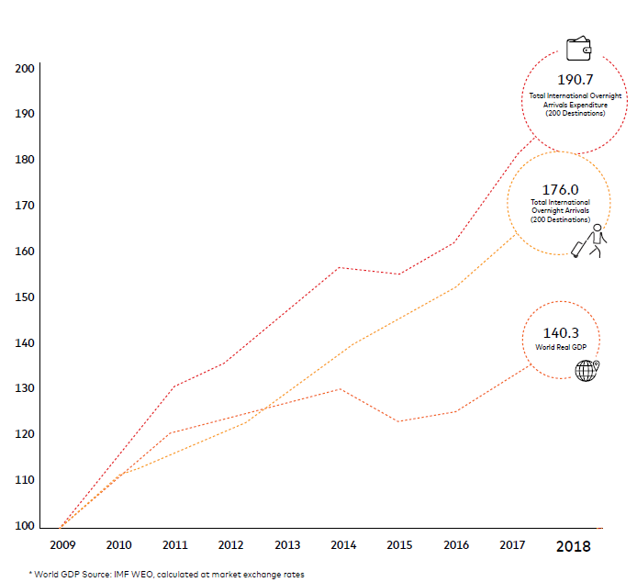
A global growth opportunity on our doorstep
The sector is responsible for 1 in 10 jobs globally where it fosters acceptance and tolerance and will continue its growth trajectory for decades

Slide 4
South Africa deserves to be part of it
Natural heritage of South Africa, our shared timeline with Europe and friendly people, South Africa deserves to be part of this growth trend for the long term.
Tourism provides an attractive and long-term hard-currency and externally funded solution to the high number of unskilled and unemployed people of our Country.
Demand is in place and will continue to grow for decades.
Participation in this global growth story is only limited by our ability to host tourists
Government’s stated objective to double tourism:
Progress on Visa requirements
International destination marketing
Focus on crime
Requires a concomitant doubling of tourist accommodation

Slide 5
12J Incentive to create tourism capacity
Every R50m raised by 12Cape is invested into a Qualifying Company which trades as a Hotelkeeper: 14% is allocated to locally manufactured furnishing and art, the remainder to a total of 16 newly built double rooms.
The sole focus of the hotelkeeper is to be a proudly local and a world class host to international tourists.
At an average occupancy rate of 80% , an average length of stay of 8 days, total bookings per annum for the hotelkeeper will equate to 584 bookings (365 x 80% = 292 nights / 8 days x 16 rooms) at 1.5 tourists per room 4,380 foreign tourists over five years (584 x 1.5 x 5)

Slide 6
Tax Revenues >> Tax benefit granted
Taxable Revenues in the Hotel: At an average rack rate per room of R1,200, taxable hotelkeeping revenues will amount to R28m over the period (16 x R1,200 x 292 x 5)
Taxable Revenues outside the Hotel: Tourists spend as much on their accommodation as they do on entertainment outside the hotelkeeper.: Eg: If 1.5 tourists spend R1,200 on their room, any given tourist should spend R800 on entertainment: Perhaps R150 for lunch, R200 for dinner, R100 for travel and R350 for experiences (a return ticket on the cable car costs R180).
Total Taxable Tourism Revenues: The original investment of R50m therefore catalyses an amount of R56m of Total Foreign Tourist spend in South Africa, which amounts to direct foreign currency investment in our economy over a five year period (Potential tax revenue over the period = R56m x 28% = R16m)
Other Taxable Revenues include: Dividend tax & Capital Gains Taxes at exit (R10m+)
Total Tax Revenue earned over five year > > Tax benefit granted

Slide 7
Job Creation
Tourism is a labour intensive industry: 12 Foreign Tourists can sustain one job.
Sense check: Using the tourist spend guidelines above, we know that our 12 foreign tourists could easily spend up to R19,200 per day (R1,200/1.5 on hotel, the same outside x 12). This amounts to 80 jobs at the minimum wage (hence, enough foreign currency available to compensate labour), and we also know that hosting 12 foreign international tourists for any given day is likely to keep more than 1 person busy on a full time basis (hence, enough demand to justify this number).
The cumulative 4,380 tourists will be responsible for creating 365 job years (4380/12) over the period. This is in addition to the c. 400 job years created in the construction phase of the building, and c. 40 job years in the local furnishing and local art (including its maintenance) over the period.
A grand total therefore of 805 job years, over the five year period, catalysed by the incentive over and above the financial benefits described above.
Given the structural nature of global tourism trends, it is likely that the tourism related employment would become permanent (e.g. the investment catalysed permanent employment and should be amortised over a lifetime of permanent working opportunities).

Slide 8
Win-Win
Over a five year period, National Treasury effectively
Made an investment equal to the difference between the initial tax allowance and the eventual recoupment by means of the zero based CGT payable
Attracted 4,380 international tourists
Catalysed up to 805 job years in the first five years only
Generated R56m of foreign direct investment in South Africa
Received tax revenue in excess of the investment
Created a long term earnings stream and job creation possibilities
Bolstered the fiscus for the long term

Slide 9
Conclusion
Section 12J “Hotelkeeping” funds are not the classic “risk-return trade-offs” expected from traditional Venture Capital
Are very effective in promoting tourism, job creation and foreign currency earnings which our country desperately needs.
Are essential if our country wants to create tourism infrastructure to share in the growth of the global tourism pie
These vehicles present a mechanism which allows the government, the unemployed and the investor to share in a large surplus generated offshore and voluntarily brought to South Africa by international tourists.
It is difficult to convince investors with liquid investable capital to invest in hotelkeeping property in South Africa vs. alternative international options.
The cost of managing a section 12J fund is high: Previously, it was possible to achieve scale with a few investors.
The proposed cap has increased the cost and administrative burden by at least 20x as a result of a potential minimum requirement of a 100 investors to achieve a sustainable size.
Given the major benefits and positive externalities resulting from S12J hospitality funds, we ask the National Treasury to continue to bolster investor confidence by addressing abuse where it occurs, and to review their position on the proposed changes to the bill in favour of a stable regulatory framework which will enhance long term planning, and position our fiscus to reap the long term benefits of an investment in tourism.

