Slide 1
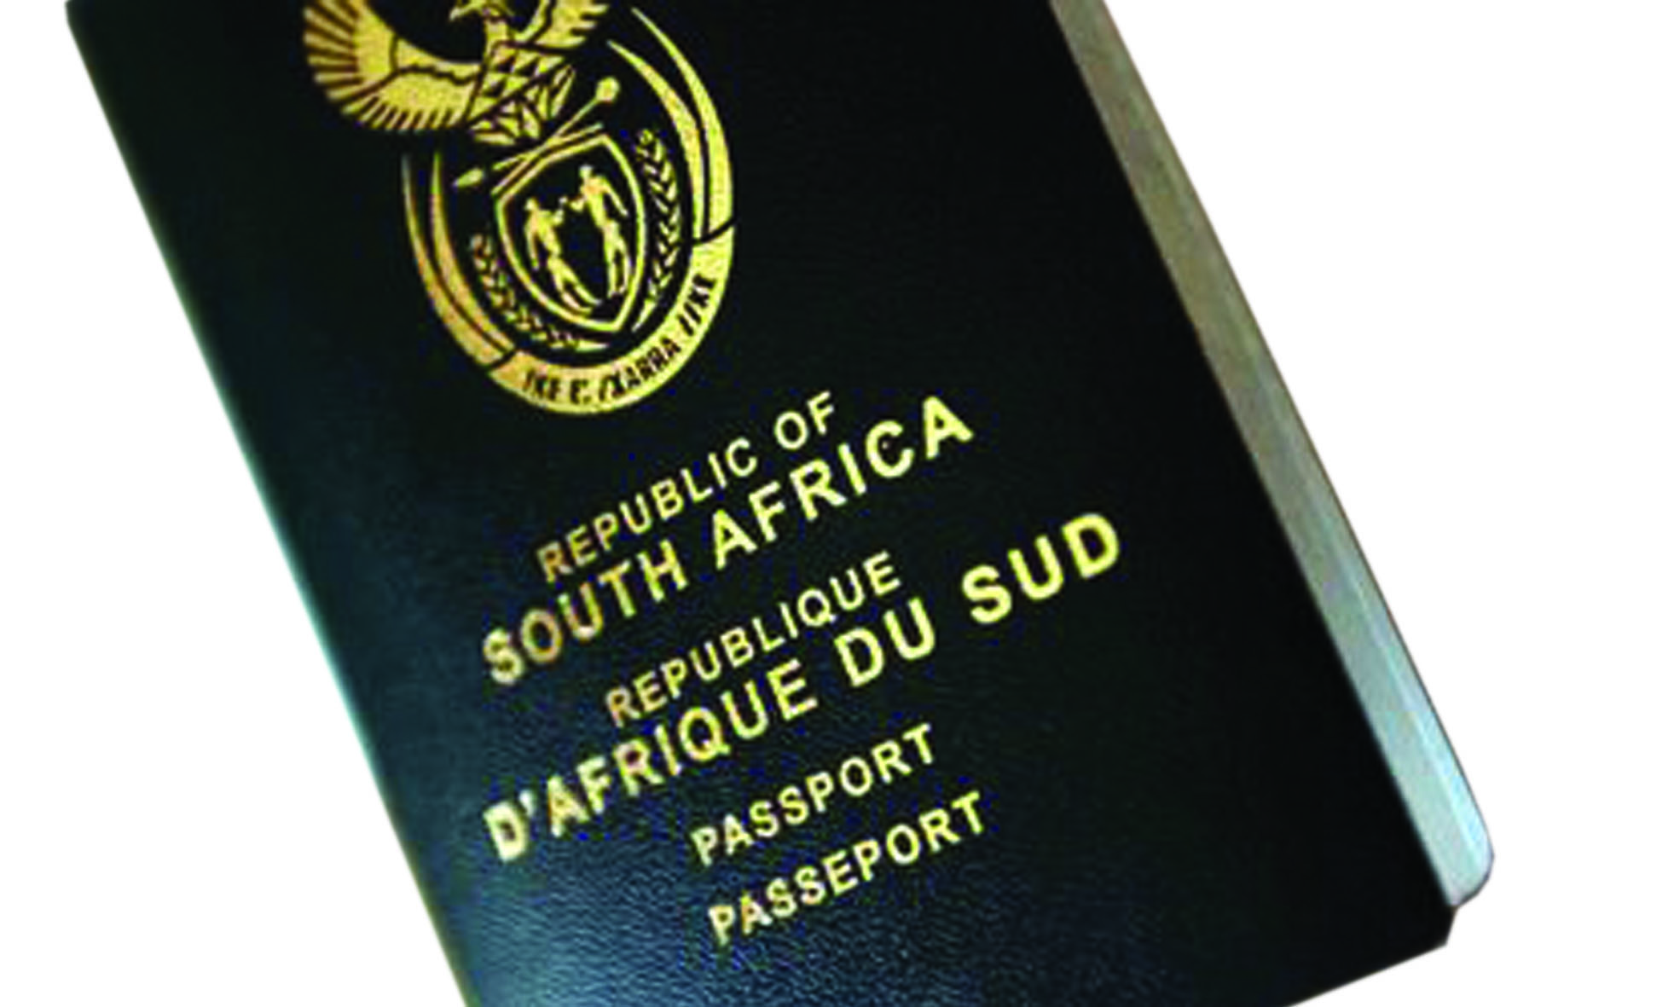
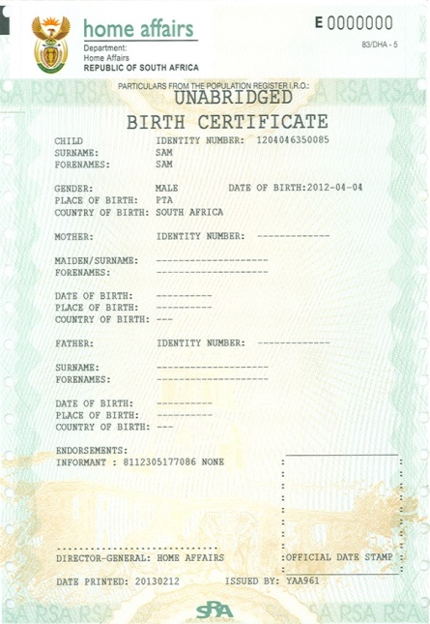
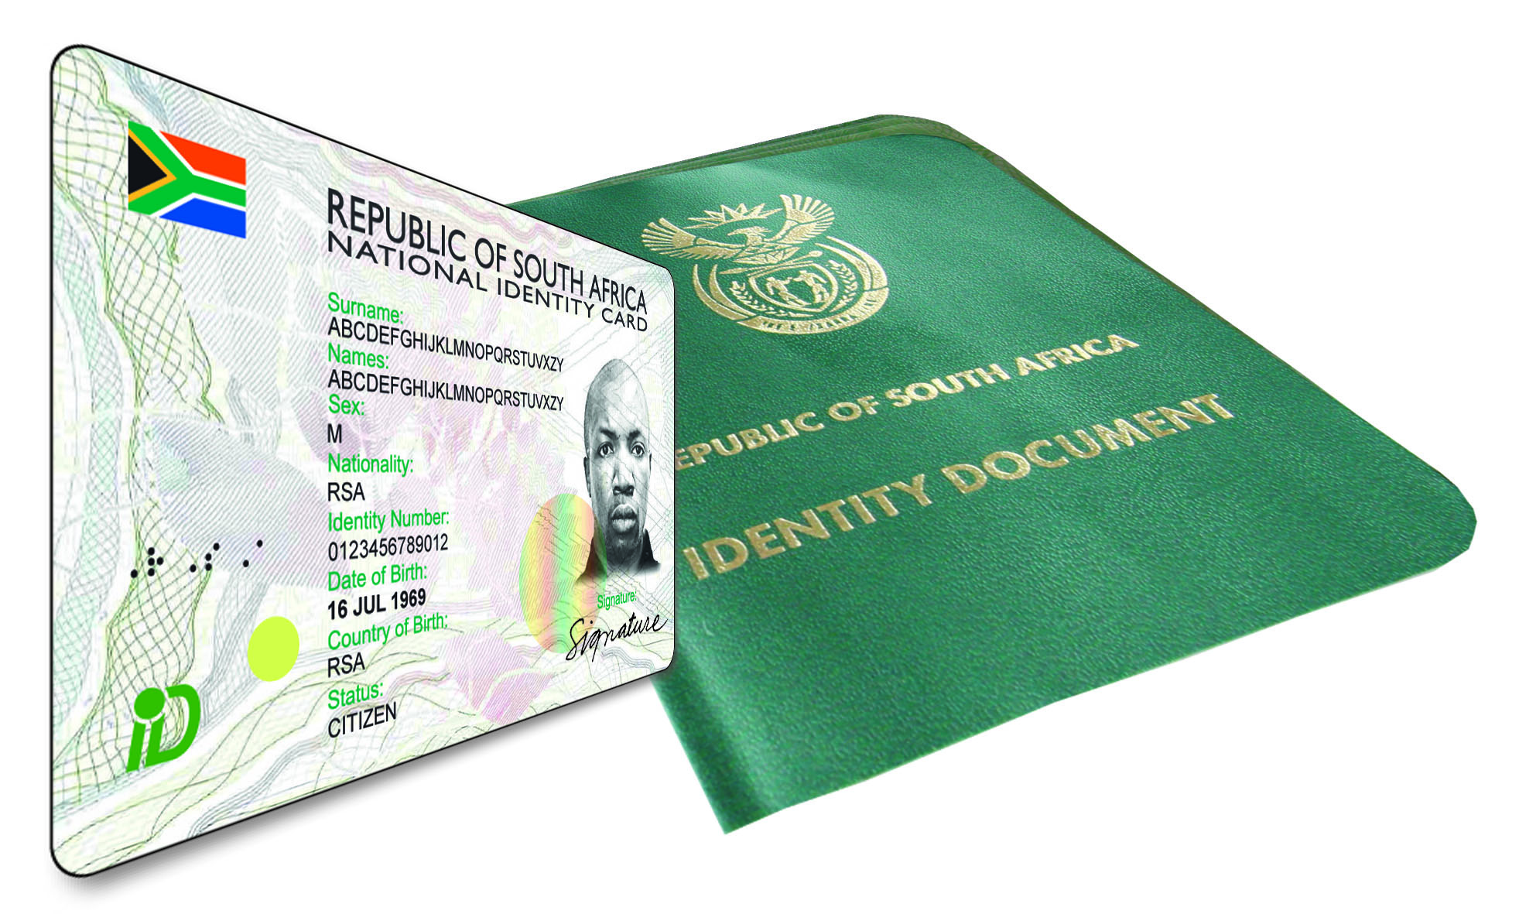
State of the Province Presentation
Portfolio Committee on Home Affairs
Presenter: N.C Shabalala
Acting Provincial Manager
North West Province
10 September 2019
Notes:
1

Slide 2
Table of Contents
CONTENT | SLIDE NO.
Provincial Overview and Footprint Introduction and Background Provincial Management and Demarcation Operating Model Summary of the current footprint of the North West Province | 5 6 7-15
Provincial Performance 2018/19 Birth Registration and Projected annual target 2013/14 – 2018/19 Overview Analysis Birth Registration within 30 days - 2018/19 Birth Registration within 30 days - 2019/20 Comparative Analysis of Birth Registration for Q1 : 2018/19 – 2019/20 ID Smart Card – 2018/19 ID Smartcard - 2019/20 Mobile Offices | 16 17 18 19 20 21 22 23

Slide 3
Table of Contents
CONTENT | SLIDE NO.
100% of detected employers charged 100% of detected transgressors of departmental legislation 100% of detected undocumented foreigners deported (direct deportations) 100% of detected undocumented foreigners transferred to Lindela 80% of detected fraudulent marriages & marriages of convenience cases finalised 100% of valid invoices settled within 30 days | 24 25 26 27 28 29

Slide 4
Table of Contents Continue
CONTENT | SLIDE NO.
Finance and Support Services Staff Profile Provincial Capacity and Recruitment & Selection Labour Relations Cases Budget Revenue Collected Fleet Management Asset Management Stakeholder Management | 30 31 32 33-34 35 36 37 38
Achievements Challenges | 39 40-41

Slide 5
INTRODUCTION & BACKGROUND
The total population of the North West Province is 4,0 million which constitute 6.9 % of the country's population.
The province has an estimated net migration of 131 081 (205 099 out-migrants & 336 180 in-migrants) as per the estimated provincial migration streams for the period 2016 – 2021.
There are four (4) districts and eighteen (18) local municipalities.
Mining is the major contributor to the provincial economy supported by cattle and mixed crop farming.
Source: StatsSA Mid Term Population Estimates 2019

Slide 6
PROVINCIAL MANAGEMENT AND DERMACATION
Provincial Manager
(Acting)
Mr. N C Shabalala
Director:
Finance & Support
Mr Stephen Tiley
Dr Kenneth Kaunda District
DMO:
Ms. M.E Dontso
(acting)
Bojanala District
DMO:
Mr. M. C. Rambuda
Ngaka Modiri District
DMO:
Mr. C.H Smit (acting)
Dr RS Mompati District
DMO:
Ms. M.E Dontso
(acting)
Office Managers
1 Large Office
2 Medium offices
1 Small office
Office Manager
1 Large office
3 Medium offices
1 Small office
1 Thusong Centre
Office Managers
1 Large office
5 Medium offices
2 Small office
Office Managers
0 Large office
3 Medium offices
1 Thusong Centre

Slide 7
NGAKA MODIRI MOLEMA DISTRICT
Local Municipality | DHA Presence
Mahikeng | (3) -Mahikeng Provincial Office, -Molopo MO & - Mmabatho LO
Ramotshere Moiloa | (1) Zeerust MO
Ditsobotla | (2) -Lichtenburg & -Itsoseng MOs
Tswaing | (1) Atamelang MO
Ratlou | Madibogo SO Tshidilamolomo SO
The District does not have proper office accommodation in Ratlou Local Municipality where we could have a modernization system. In terms of progress and possible registration of births and deaths in Ratlou Local Municipality, the Province acquired space at Madibogo and has a staff compliment of two officers servicing the public daily at the said small office as well as at Ratlou Community Health Centre.

Slide 8
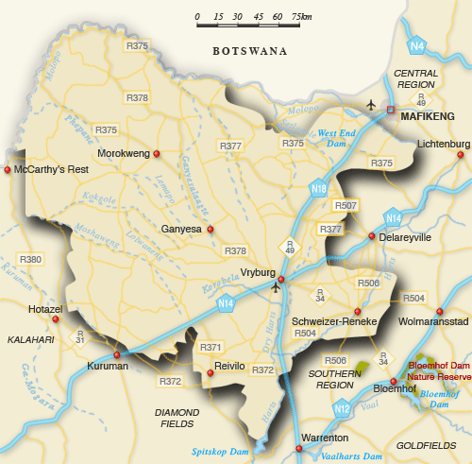
DR RUTH SEGOMOTSI MOMPATI DISTRICT
Local Municipality | DHA Presence
Naledi (Vryburg) | (1) Vryburg MO
Kagisano/Molopo | (2) -Ganyesa MO - Morokweng THC
Taung | (1) Taung MO
Lekwa -Teemane | (0)
Mamusa | (0)
This District Municipality is the most economically depressed in the Province and lacks DHA presence in two local municipalities. In order to establish DHA Foot Print in these Municipalities, we were able to connect online Birth Registration System at Bloemhof, Christiana and Sweizer-Reneke in Lekwa-Teemane and Mamusa Local Municipality respectively. The Province also make use of the Local Municipalities to ferry clients to apply for Smart Id cards at Vryburg or Wolmaranstad offices. Proposals have been made to connect Taung Office for modernization during the second quarter. Other necessary plans are in progress to make sure the server room is built .The District still remains a developmental node in the Province

Slide 9
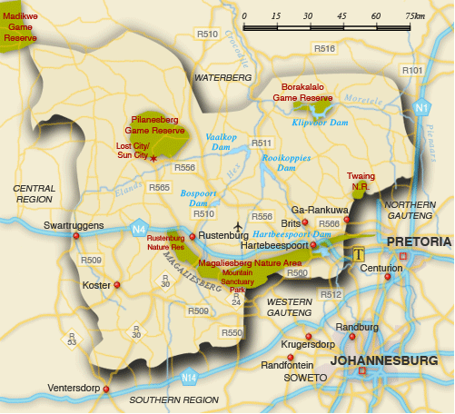
BOJANALA PLATINUM DISTRICT
Local Municipality | DHA Presence
Rustenburg | (1)Rustenburg LO
Moses Kotane | (2) -Mankwe & -Madikwe MO
Madibeng | (1)Brits MO
Moretele | (1) Leretlhabetse THC
Kgetleng river | (1)Swartruggens SO
The previous demarcation resulted in a gap of service delivery in Moretele Local Municipality. Space has been secured at Leretlhabetse/ Lebotlwane Thusong Centre. The Centre caters for birth registration. To address the problem of service accessibility in the Kgetleng River Local Municipality, the Province opened a small office in Swartruggens and five dedicated staff were appointed. This office is also taking care of the community living in and around Koster as well as surrounding farms. This office (Swartruggens) became live on 13th March 2019 and was officially opened by Dr. S Cwele, the then Minister of Home Affairs on the 30th April 2019.

Slide 10
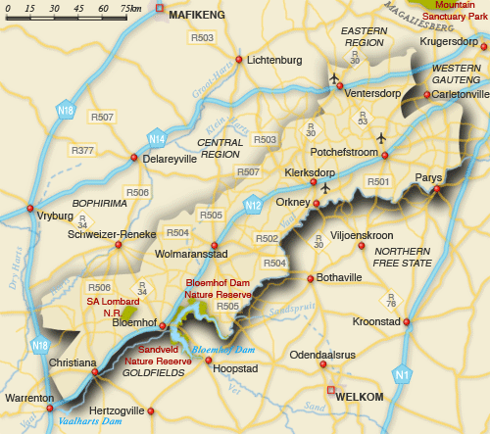
DR KENNETH KAUNDA DISTRICT
Local Municipality | DHA Presence
Matlosana | (1) Klerksdorp LO
JB Marks | (1)Potchefstroom MO (1)Ventersdorp SO
Maquassie Hills | (1)Wolmaransstad MO
The district is adequately covered and has an office in each local municipality.

Slide 11
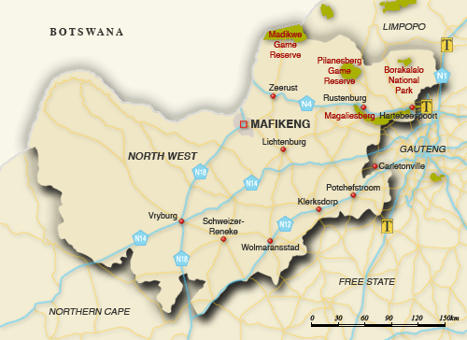
Online health facilities (registration of birth 0-30 days)
Dr Kenneth Kaunda District (11)
Klerksdorp Provincial Hospital
Anncron Private Hospital
Wilmedpark Private Hospital
Jouberton CHC
Botshabelo CHC
Ventersdorp Hospital
Potchefstroom Hospital
Potchefstroom Medi Clinic
Leeudoringstad CHC
Nic Bodenstein Hospital (equipment stolen)
Grace Mokgomo (equipment stolen)
Dr Ruth Segomotsi Mompati District (8)
Joe Morolong Hospital
Huhudi CHC
Stella CHC
Schweizer – Reneke Hospital
Bloemhof CHC
Ganyesa Hospital
Taung Hospital
Christiana CHC
Total = 19

Slide 12
Online health facilities (registration of birth 0-30 days)
Bojanala Platinum (7)
Job Shimankana Tabane Provincial Hospital
Moses Kotane Hospital
Swartruggens CHC
Pella CHC (equipment stolen)
Brits Hospital
Bapong CHC
Letlhabile CHC
Ngaka Modiri Molema (11)
Mahikeng Provincial Hospital
Victoria Private Hospital
Montshiwa Town Clinic
Unit 9 CHC
Ramatlabama CHC (Propose to move equipment to Montshiwa Stadt Clinic)
General De La Rey Hospital
Gelukspan Hospital
Itsoseng CHC
Atamelang CHC
Ratlou CHC
Lehurutshe Hospital
Total = 18
The Province managed to register 53 841 during the financial year 2018/19. The Annual target was 53 260 which the Province over achieved by 101% thus contributing positively to the National Population Register.

Slide 13
Manually serviced health facilities registering births 0 – 30 days
Bojanala Platinum (17)
Brits Medi Clinic
La Femme Private Hospital
Fencrest Hospital
Medicare Clinic
Tlhabane CHC
Phokeng CHC
Mogwase Clinic
Tlokweng Clinic
Sesobe Clinic
Molatedi Clinic
Mmatau Clinic
Oukasie Clinic
Mathibestad Clinic
Seutelong Clinic
Swartdam Clinic
Dikebu Clinic
Suiwerskuil Clinic
While awaiting connectivity to the rest of Health Facilities in the Province, offices continue to collect applications manually and process them at the offices.

Slide 14
Manually Serviced Health Facilities Registering births 0 – 30 days
Ngaka Modiri Molema (10)
Disaneng CHC
Makgobistad CHC
Montshioa Stad CHC
Ottosdal Hospital
Sannieshof Hospital
Delareyville Hospital
Dinokana CHC
Lehurutshe Clinic
Bodibe CHC
Coligny Clinic
Dr Ruth Segomotsi Mompati (10)
Vryburg Private Hospital
Mamusa CHC
Morokweng CHC
Tlakgameng CHC
Ganyesa CHC
While awaiting connectivity to the rest of Health Facilities in the Province, offices continue to collect applications manually and process them at the offices.

Slide 15
Manually Serviced Health Facilities Registering births 0 – 30 days
Dr Ruth Segomotsi Mompati (cont…)
Pudimoe CHC
Dryharts CHC
Magogong CHC
Manthe CHC
Cokonyane CHC
Dr Kenneth Kaunda (6)
Alabama Clinic
Tigane Clinic
Sunningdale Private Hospital
Boiki Tlhapi CHC
Promosa CHC
JB Marks CHC
Non connected health facilities mentioned above are visited daily or on call. Total health facilities serviced by DHA are 80, only 37 are connected.

Slide 16
PROVINCIAL PERFORMANCE 2018/19
Review Period | Total Quarterly Targets | Achieved | Not Achieved
Q 1 | 8 | 7 | 1
Q 2 | 8 | 8 | 0
Q3 | 8 | 6 | 2
Q4 | 8 | 7 | 1
Annual | 8 | 8 | 0
The Province achieved 8 out of the 8 targets (100%) during 2018/19
Birth Registration within 30 calendar days
Smart ID Cards issued (received at offices) to citizens
100% of detected employers in contravention of the Immigration Act (Act 13 of 2002) charged
100% of detected transgressors in contravention of the Immigration Act (Act 13 of 2002) charged
100% of undocumented foreigners deported within 30 calendar days
100% of detected undocumented foreigners transferred to Lindela within 20 calendar days
100% of detected fraudulent marriages & marriage of convenience cases finalised (investigation and recommendation submitted) within 60 days
100% of valid invoices settled within 30 days of certification

Slide 17
BIRTH REGISTRATION COMPARISON AND PROJECTED ANNUAL TARGET
 | Baseline projected Actual | % Contribution to the annual target | Projected annual target | Target | Actual performance | Achieved/not achieved
2013/14 |  | 3.5% | 33 139 | 33 139 | 38 129 | Achieved
2014/15 | 38 129 | 3.7% | 38 395 | 38 395 | 45 404 | Achieved
2015/16 | 45 404 | 6.3% | 47 261 | 47 261 | 45 121 | Not achieved
2016/17 | 45 121 | 4.5% | 46 653 | 46 653 | 48 681 | Achieved
2017/18 | 48 681 | 6.6% | 49 315 | 49 315 | 52 613 | Achieved
2018/19 | 50 944 | 6.3% | 53 260 | 53 260 | 53 841 | Achieved
The target for the province in this financial year (2019/20) is 49 777.

Slide 18
OVERVIEW ANALYSIS
DHA APP PLAN TARGETS 810 000
ANNUAL TARGET (APRIL 2018– MARCH 2019) | PERFORMANCE STATUS | PLANNED ACTIONS TO ACHIEVE THE TARGET
53 260 Births registered within 30 calendar days | Q1 Target = 13 436 Actual Performance = 13 375 Variance = (61) % achieved = 99% Q2 Target = 13 480 Actual Performance = 13 702 Variance = 222 % achieved = 102% Q3 Target = 13 029 Actual Performance = 12 897 Variance = (132) % achieved = 99% Q4 Target = 13 315 Actual Performance = 13 867 Variance = 552 % achieve = 104% Overall Provincial Performance = 101% | Awareness to pregnant women was conducted during pre-natal visit at HF’s. The Province used birth occurrence registers to follow-up on all unregistered babies at HF’s. High birth and LRB volume areas were identified to promote early birth registration. Officials attended to HF’s during weekends and public holidays on a voluntary basis. Unconnected HF’s were visited on weekly basis to register new born babies. .

Slide 19
OVERVIEW ANALYSIS
DHA APP PLAN TARGETS 810 000
ANNUAL TARGET (APRIL 2019 – MARCH 2020) | PERFORMANCE STATUS | PLANNED ACTIONS TO ACHIEVE THE TARGET
49 777 Births registered within 30 calendar days | Q1 Target = 12 656 Actual Performance = 13 558 Variance = 902 % achieved = 107% The province registered 183 more babies compared to the same period last year. | Awareness to pregnant women was conducted during pre-natal visits at HF’s. The Province used birth occurrence registers to follow-up on all unregistered babies at HF’s. High birth and LRB volume areas were identified to promote early birth registration. Officials attended to HF’s during weekends and public holidays on a voluntary basis. Unconnected HF’s were visited on weekly basis to register new born babies.

Slide 21
OVERVIEW ANALYSIS
DHA APP PLAN TARGETS 3000 000
ANNUAL TARGET (APRIL 2018– MAR 2019) | PERFORMANCE STATUS | PLANNED ACTIONS TO ACHIEVE THE TARGET
214 286 Smart ID Cards issued to citizens 16 years of age and older | Q1 Target = 55 714 Actual Performance = 67 477 Variance = 11 763 % achieved = 121% Q2 Target = 53 571 Actual Performance = 55 920 Variance = 2 349 % achieved = 104% Q3 Target = 49 286 Actual Performance = 46 379 Variance = (2 907) % achieved = 94% Q4 Target = 55 715 Actual Performance = 53 413 Variance = (2 302) % achieved = 96% Overall Provincial Achievement = 104% | Offices visited villages//churches through invitations and special arrangements for marketing. Opening of offices on certain weekends (special projects). Continued to invite schools learners turning 16 years and grade 12 learners for application of Smart ID Card on specific days. Intensified arrangements with SASSA, Old age homes and sector Departments, etc. Distributed pamphlets at strategic points. Effective utilization of stakeholder forums. Marketing through local media.

Slide 22
OVERVIEW ANALYSIS
DHA APP PLAN TARGETS 3000 000
ANNUAL TARGET (APRIL 2019– MAR 2020) | PERFORMANCE STATUS | PLANNED ACTIONS TO ACHIEVE THE TARGET
213 362 Smart ID Cards issued to citizens 16 years of age and older | Q1 Target = 55 474 Actual Performance = 49 647 Variance = (5 827) % achieved = 89% . | Offices visited Villages//churches through invitations and special arrangements for marketing. Distributed pamphlets at strategic points. Effective utilization of stakeholder forums. Marketing through local media (local radio stations & newspapers) although it is expensive. CHALLENGE Local radio stations no longer willing to provide free slots for marketing of the ID smartcard.

Slide 23
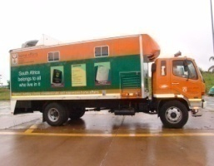
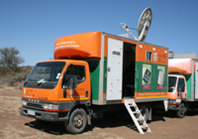
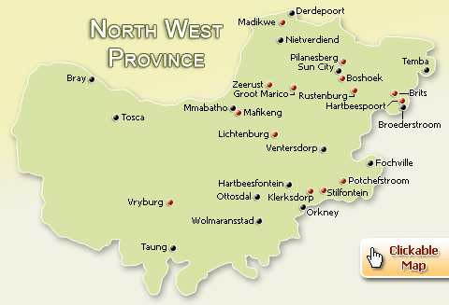
MOBILE OFFICES
The province has a total of 11 mobile units of which 5 have been refurbished for smart card capability. The remaining 6 are earmarked for disposal.

Slide 24
OVERVIEW ANALYSIS
DHA APP PLAN TARGETS
ANNUAL TARGET (APRIL 2018– MAR 2019) | PERFORMANCE STATUS | ANNUAL TARGET (APRIL 2019– MAR 2020) | PERFORMANCE STATUS
100% of detected employers in contravention of the Immigration Act (Act 13 of 2002) charged | Q1 Target = 100% Actual Performance = 36/36 Variance = 0 % achieved = 100% Q2 Target = 100% Actual Performance = 32/32 Variance = 0 % achieved = 100% Q3 Target = 100% Actual Performance = 68/68 Variance = 0 % achieved = 100% Q4 Target = 100% Actual Performance = 27/27 Variance = 0 % achieve = 100% Overall Provincial Performance = 163/163 (100%) | 100% of detected employers in contravention of the Immigration Act (Act 13 of 2002) charged | Q1 Target = 100% Actual Performance = 13/13 Variance = 0 % achieved = 100%
Notes:
Replicate for all IMS targets

Slide 25
OVERVIEW ANALYSIS
DHA APP PLAN TARGETS
ANNUAL TARGET (APRIL 2018– MAR 2019) | PERFORMANCE STATUS | ANNUAL TARGET (APRIL 2019– MAR 2020) | PERFORMANCE STATUS
100% of detected transgressors in contravention of the Immigration Act (Act 13 of 2002) charged | Q1Target = 100% Actual Performance = 495/495 Variance = 0 % achieved = 100% Q2 Target = 100% Actual Performance = 598/598 Variance = 0 % achieved = 100% Q3 Target = 100% Actual Performance = 592/592 Variance = 0 % achieved = 100% Q4 Target = 100% Actual Performance = 431/431 Variance = 0 % achieve = 100% Overall Provincial Performance = 2116/2116 (100%) | 100% of detected transgressors in contravention of the Immigration Act (Act 13 of 2002) charged | Q1 Target = 100% Actual Performance = 394/394 Variance = 0 % achieved = 100%
Notes:
Replicate for all IMS targets

Slide 26
OVERVIEW ANALYSIS
DHA APP PLAN TARGETS
ANNUAL TARGET (APRIL 2018– MAR 2019) | PERFORMANCE STATUS | ANNUAL TARGET (APRIL 2019– MAR 2020) | PERFORMANCE STATUS
100% of undocumented foreigners deported within 30 calendar days (Direct Deportations) | Q1Target = 100% Actual Performance = 41/41 Variance = 0 % achieved = 100% Q2 Target = 100% Actual Performance = 50/50 Variance = 0 % achieved = 100% Q3 Target = 100% Actual Performance = 55/55 Variance = 0 % achieved = 100% Q4 Target = 100% Actual Performance = 24/24 Variance = 0 % achieve = 100% Overall Provincial Performance = 170/170 (100%) | 100% of undocumented foreigners deported within 30 calendar days (Direct Deportations) | Q1Target = 100% Actual Performance = 55/55 Variance = 0 % achieved = 100%
Notes:
Replicate for all IMS targets

Slide 27
OVERVIEW ANALYSIS
DHA APP PLAN TARGETS
ANNUAL TARGET (APRIL 2018– MAR 2019) | PERFORMANCE STATUS | ANNUAL TARGET (APRIL 2019– MAR 2020) | PERFORMANCE STATUS
100% of detected undocumented foreigners transferred to Lindela within 20 calendar days | Q1Target = 100% Actual Performance = 261/261 Variance = 0 % achieved = 100% Q2 Target = 100% Actual Performance = 240/240 Variance = 0 % achieved = 100% Q3 Target = 100% Actual Performance = 332/332 Variance = 0 % achieved = 100% Q4 Target = 100% Actual Performance = 182/182 Variance = 0 % achieve = 100% Overall Provincial Performance = 1,015/1,015 (100%) | 100% Of Detected undocumented foreigners transferred to Lindela within 20 calendar days | Q1Target = 100% Actual Performance = 267/267 Variance = 0 % achieved = 100%
Notes:
Replicate for all IMS targets

Slide 28
OVERVIEW ANALYSIS
DHA APP PLAN TARGETS
ANNUAL TARGET (APRIL 2018– MAR 2019) | PERFORMANCE STATUS | ANNUAL TARGET (APRIL 2019– MAR 2020) | PERFORMANCE STATUS
80% of detected fraudulent marriages & marriage of convenience cases finalised (investigation and recommendation submitted) within 60 days | Q1Target = 80% Actual Performance = 0 Variance = 0 % achieved = NIL Q2 Target = 80% Actual Performance = 0 Variance = 0 % achieved = NIL Q3 Target = 80% Actual Performance = 1/1 Variance = 0 % achieved = 100% Q4 Target = 80% Actual Performance = 1/1 Variance = 0 % achieved = 100% Overall Provincial Performance = 2/2 (100%) | 80% of Detected fraudulent marriages & marriage of convenience cases finalised (investigation and recommendation submitted) within 60 days | Q1 Target = 80% Actual Performance = 0/0 Variance = 0 % achieved = NIL
Notes:
Replicate for all IMS targets

Slide 29
OVERVIEW ANALYSIS
DHA APP PLAN TARGETS
ANNUAL TARGET (APRIL 2018– MAR 2019) | PERFORMANCE STATUS | ANNUAL TARGET (APRIL 2019– MAR 2020) | PERFORMANCE STATUS
100% of valid invoices settled within 30 days of certification | Q1 Target = 100% Actual Performance = 134/134 Variance = 0 % achieved = 100% Q2 Target = 100% Actual Performance = 595/595 Variance = 0 % achieved = 100% Q3 Target = 100% Actual Performance = 408/408 Variance = 0 % achieved = 100% Q4 Target = 100% Actual Performance = 482/482 Variance = 0 % achieve = 100% Overall Provincial Performance = 1,619/1,619 (100%) | 100% of valid invoices settled within 30 days of certification | Q1Target = 100% Actual Performance = 253/253 Variance = 0 % achieved = 100%
Notes:
Replicate for all IMS targets

Slide 30
STAFF PROFILE
LEVEL | FEMALE | DISABILITY | MALE | DISABILITY | TOTAL
3 | 26 | 0 | 17 | 2 | 43
5 | 14 | 1 | 4 | 0 | 18
6 | 151 | 2 | 92 | 6 | 243
7 | 22 | 1 | 26 | 2 | 48
8 | 27 | 0 | 31 | 0 | 58
9 | 6 | 0 | 4 | 0 | 10
10 | 7 | 0 | 8 | 1 | 15
11 | 0 | 0 | 1 | 0 | 1
12 | 2 | 0 | 2 | 0 | 4
13 | 0 | 0 | 3 | 0 | 3
14 | 0 | 0 | 0 | 0 | 0
Total | 255 | 4 | 188 | 11 | 443
The province lost 29 posts since February 2018 (6 at management level and 23 front line officers).

Slide 31
PROVINCIAL CAPACITY – FILLED AND UNFILLED POSTS
Total Establishment | Filled as at 31 July 2019 | Vacant Funded
444 | 443 | 1
 | Capacity Rate: 99,8% | Vacancy Rate: 0,2%
Recruitment and Selection: No recruitment since February 2018 (Moratorium on posts).
(Early) Retirement : The province has a total number of 59 officials between the ages of 55-64.
17 officials have applied for early retirement.
Salary Level | Number of officials
3 | 6
6 | 24
7 | 4
8 | 16
10 | 6
12 | 2
13 | 1
TOTAL | 59

Slide 32
LABOUR RELATIONS CASES
KEY AREA | NUMBER OF CASES | OUTCOMES
Fraud & Corruption Wolmaransstad (alleged theft of state revenue) Zeerust (alleged fraudulent birth registration) | 2 | Still under investigation. No official was involved.
Improper Conduct Rustenburg | 1 | Case referred to Labour Relations for disciplinary action.
Unprotected strike Rustenburg | 20 | Cases referred to Labour Relations for disciplinary action.
SANCTIONS
3 months suspension without pay (under influence of alcohol while on duty) Dismissal (Fraud and corruption) Madikwe | 1 1 | Official appealed.

Slide 33
SUMMARY OF BUDGET 2018/19 FY Annual Performance
2018/19 FY Annual Performance
Item | Expenditure | Budget | Available Budget | Spending % | Ideal% | Variance %
Compensation Of Employees | 159 969 993,33 | 156 243 000,00 | -3 726 993,33 | 102% | 100% | -2%
Goods and Services | 11 323 604,75 | 12 260 000,00 | 936 395,25 | 92% | 100% | 8%
Provincial and local Governments | 89 180,00 | 90 000,00 | 820,00 | 99% | 100% | 1%
Departmental Agencies & Accounts | 1 325,00 | 6 000,00 | 4 675,00 | 22% | 100% | 78%
Households | 962 433,13 | 153 000,00 | -809 433,13 | 629% | 100% | -529%
Equipments | 5 118 915,61 | 5 152 000,00 | 19 158,21 | 99% | 100% | 1%
Total Good &Services | 17 495 458,49 | 17 661 000,00 | 151 615,33 | 99% | 100% | 1%
Overall Performance | 175 060 378,00 | 171 485 000,00 | 171 607 455,40 | 102% | 100% | -2%

Slide 34
SUMMARY OF BUDGET Q1 of 2019/20 FY Performance
Item | Expenditure | Budget | Available Budget | Spending % | Ideal% | Variance %
Compensation Of Employees | 41 360 396,90 | 166 479 000,00 | 125 118 603,10 | 25% | 25% | 0%
Goods & Services | 2 433 526,50 | 14 591 000,00 | 12 157 473,50 | 17% | 25% | 8%
Provincial and local Governments | 29 163,00 | 246 000,00 | 216 837,00 | 12% | 25% | 13%
Departmental Agencies & Accounts | 0 | 6 000,00 | 6 000,00 | 0% | 25% | 25%
Households | 169 635,10 | 167 000,00 | -2 635,10 | 102% | 25% | -77%
Equipments | 115 295,69 | 554 000,00 | 438 704,31 | 21% | 25% | 4%
Total Good &Services | 5 181 146,79 | 30 155 000,00 | 24 973 853,21 | 17% | 25% | 8%
Overall Performance | 44 108 017,19 | 182 043 000,00 | 137 934 982,81 | 24% | 25% | 1%

Slide 35
REVENUE COLLECTED
DISTRICT | Revenue Collected during financial year 2018/19 | Revenue Collected during Q1 of 2019/20
Bojanala Platinum District | R 19 187,170.00 | R 3 992,200.00
Dr Kenneth Kaunda District | R 10 932,010.00 | R 2 469,014.00
Dr Ruth Segomotsi Mompati District | R 2 922,460.00 | R 763,985.00
Ngaka Modiri Molema District | R 11 608,067.00 | R 2 853,485.00
Total Revenue Collected | R 44 649,707.00 | R 10 078,684.00

Slide 36
FLEET MANAGEMENT
KEY AREA | NUMBER | PERCENTAGE
Vehicles
Number of vehicles in the Province | 87 | 100%
New vehicles received | 12 | 14%
Number of functional vehicles | 80 | 92%
Number of vehicles involved in accidents | 4 | 5%
Mobile offices
Number of mobile offices | 11 | 100%
Number of dysfunctional mobile | 11 | 100%
Number of functional mobiles | 0 | 0%

Slide 37
ASSET MANAGEMENT
ASSET MANAGEMENT IN NORTH WEST
TOTAL NUMBER OF ASSETS | 10 956
TOTAL VALUE OF ASSETS | R 79 260 715.00
NUMBER OF VERIFIED ASSETS | 10 933
VALUE OF VERIFIED ASSETS | R 79 159 799.00
NUMBER OF UNVERIFIED ASSETS | 54
VALUE OF UNVERIFIED ASSETS | R 179 009.00
PERFORMANCE | 99.00%

Slide 38
STAKEHOLDER MANAGEMENT
Province | District | Functional/Not Functional | Chairperson
North West | Provincial Stakeholder Forum | Functional | Deputy Speaker Motsumi
North West | Bojanala Platinum District Stakeholder Forum | Functional | Cllr Tlhapi
North West | Dr Kenneth Kaunda District Stakeholder Forum | Functional | Cllr Masiu
North West | Dr Ruth Segomotsi Mompati District Stakeholder Forum | Functional | Cllr Maogwe
North West | Ngaka Modiri Molema District Stakeholder Forum | Functional | Cllr Sechoaro

Slide 39
ACHIEVEMENTS
Modernization programme for Swartruggens Small office was concluded in March 2019 and the office went live on 13th March 2019. The office was officially opened on the 30th March 2019.
Moetapele Excellence Awards successfully held at Potchefstroom on 07 June 2019.
Successful hosting of Trans Kalahari Joint Law Enforcement Operation along the N4 corridor in May 2019 (Botswana, Namibia and Republic South Africa).
Registration of birth over weekends and public holidays by officials including Youth Forum members.
Cordial relationship with the Magistrates which results in successful prosecutions.

Slide 40
CHALLENGES & POSSIBLE SOLUTIONS
There is a need for a second 3 ton truck for use by our Inspectorate units for detection, arrest and deportation especially during joint operations in the Province.
Lack of mobile solutions to reach out our clients in far flung areas. We have learned from the previous meeting of the 52 Countries that much has been done by some of those countries that attended “ID4Africa” e.g. Rwanda managed to issue Smart Id Cards to its 37 million citizens in 52 days because they make use of suite-case solution to reach out their clients in rural areas.
Inadequate bandwidth and poor network at health facilities. Upgrade to ADSL.
No online fingerprint scanners at connected health facilities. The department to fast track the deployment of scanners to health facilities.

Slide 41
CHALLENGES & POSSIBLE SOLUTIONS
No DHA footprint in two municipalities.
Connected health facilities not fully optimized (requires enhancement of IT equipment and network e.g. online verification system and ADSL
System instability in live capture offices. The department to secure a long lasting solution.
Acquisition of alternative office accommodation in general is very problematic in North West Province e.g. Rustenburg, Provincial offices
In the province there are only 5 government owned buildings that DHA occupies. Of the 22 offices, 17 are leased at a cost of R 39,780, 104.76 per annum (R 3,315,008.73 per month)
Slow pace in constructing office buildings for Home Affairs e.g. Taung, Christiana and Itsoseng offices. High level intervention required.

Slide 42
KE A LEBOGA
BAIE DANKIE
THANK YOU

