Slide 1
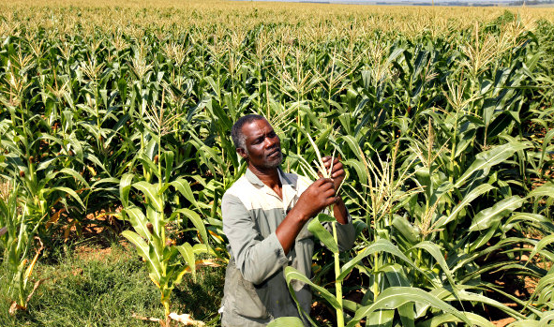
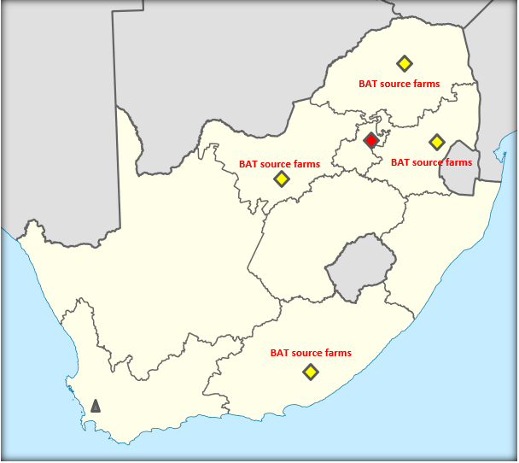
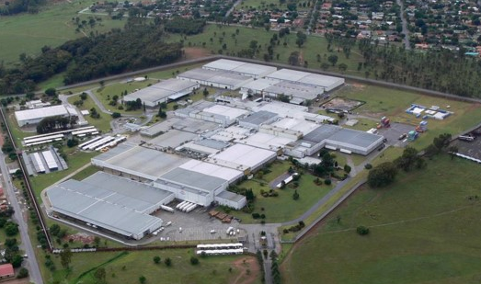
Tobacco Taxation in South Africa
>75% share of duty paid market
Using 90% South African Leaf,
Secures 10,000 jobs
30,000 dependents supported by tobacco jobs,
155 black farmers
353 HA under cultivation,
with 133 rotated for
food cultivation
National footprint
132 in Field force
216 jobs in Supply Chain
*2018 figures
BAT Factory - Heidelberg
726 staff, 4400 dependents
BATSAA HQ – Cape Town
262 workers
R11.97bn (R9.1bn Excise)Tax contribution to SARS in 2018

Slide 2
Tobacco Excise framework key findings and remarks
Recent experience shows that further excise rate increases will not result in higher tax revenues. Instead the stretched consumer, will continue to choose illicit product. Cigarettes can no longer carry the category alone and balancing of the category is needed, in order to allow cigarettes to effectively compete with illicit trade
1
Negative economic climate results in affordability issues and driving cigarettes consumer in cheap and illicit market offers.
Tobacco excise framework is out of balance and not delivering the full revenue potential. Drivers are over stretched DP Cigarettes, DNP illicit Cigarette trade and underrepresentation of Pipe Tobacco and THP.
Illicit traders manipulating market conditions, by managing pricing above MCT definitions. This price movement has not yielded any revenue uplift for Treasury. Latest price increases in the bottom end of the cigarette market have only served to increase profits of illicit traders, as they capitalize on the gulf between the cheapest legal product and illicit brands. In the past, Treasury has missed revenue targets by over proportional excise increases resulted in bigger space for illicit trade growth. Exemption last fiscal year, duty paid manufacturers did not pass on excise to assist consumer affordability. Further cigarettes excise increases will fuel duty none paid volume and will not lead to revenue increases, and will be contra dictionary to law enforcement activities. A new excise frame work design is required to meet targets in future.
2
3
4
5
6

Slide 3
Negative total tobacco Revenue will continue
Unbalanced excise framework will continuously follow the current trend of further growth of duty none paid and currently none excisable products like THP
Total Market in bn sticks, growth rate +0.7% yoy
37,0
37,3
37,6
35,3
35,9
35,0
36,1
35,8
35,9
36,5
36,7
Tobacco heated products
0,1
2.5
0,3
2.4
0,4
2.3
0,6
2.3
0,8
2.2
1,0
4,8
4,6
3,8
3,1
2,6
2,5
Pipe tobacco
DNP Cigarettes
7,3
8,1
9,4
13,7
13,9
14,5
16,5
18,1
19,6
21,0
22,3
DP Cigarettes
23,2
23,2
21,8
19,2
19,3
18,9
17.3
15.8
14.5
13.3
12.2
2014/2015
2015/2016
2016/2017
2017/2018
2018/2019
2019/2020
2020/2021
2021/2022
2022/2023
2023/2024
2024/2025
*Revenue forecast
13.2
14.2
14.3
13.5
14.8
16.3
16.1
16.0
15.8
15.6
15.4
Revenue loss
4.2
5.0
6.2
9.8
10.8
12.1
14.8
17.4
20.2
23.1
26.2
Population and smoker population growth of 1% yoy.
Macro economic conditions following current trend and consumer affordability remains stretched
Continued excise increase for duty paid cigarettes and pipe tobacco of 8% yoy
Continued unbalanced framework for tobacco category
No introduction of a THP sub category and applicable excise rate
Enforcement measures limited to SARS officials in the factory and retail audits
Track and Trace SCTV is introduced in 2022
Assumptions
* Source: National Treasury cigarette excise revenues (2014-2019) local manufacturing only + import excise, 20/21 onwards forecast based on assuptions

Slide 4
forecast for local cigarettes Revenue continuously missing target DNP growth benefits from over proportional Excise stretch on local duty paid manufactures
6.2% CAGR excise increase drives revenue loss of 24% CAGR
R15.52
R 16.66
R14.30
43.3%
Revenue in Rbn
R12.42
R13.24
39.2%
42.5%
R11.60
37.8%
R10.92
36.8%
37.6%
37.7%
14,194
15,039
14,201
14,800
12,555
12,602
12,931
13,007
12,120
11,915
12,091
12,800
11,461
10,911
11,067
10,864
9,085
9,920
5,848
3,988
4,680
Estimate
0
2013/14
2014/15
2015/16
2016/17
2017/18
2018/19
2019/20
Revenue in Rbn
Budget Estimate
Revenue Actuals
Revenue losses
Excise rates / 20sticks
Excise incidence/ MPPC
2018/19, Duty paid manufactures absorbed excise increase and enforcement activities started in the end of the budget year
40% excise incidence on MPPC policy is out of balance and additional driver for DNP growth
Sources: National Treasury local excise collections, Historic Budget Estimates vs Actual collections YoY 2013/14 – 2018 /19; MPPC on Peter Stuyvesant

Slide 5
The Current tobacco excise framework is unbalanced, …..
Based on the risk continuum model, pipe tobacco and tobacco heated products are under represented in excise revenue contribution despite similar harm effects
 | Tariff Code | Category description | Current excise/kg | Current index to to cigs. | Commentary
1. | 2402.2 | Cigarettes containing tobacco | 1,041.25 | 100% | Currently under performing due to a large illicit market
2. | 2403.19.10 | Pipe tobacco in immediate packings of a content of less than 5kg | 215.52 | 21% | Tarif description includes: Cigarette tobacco Roll your own Classic pipe tobacco Shisha aka Hubbly Bubbly Tobacco Heated Products and Carbon Tip Heated Products
 | 2403.19.20 | Other pipe Tobacco | 215.52 | 21%
 | 2403.19.30 | Cigarette tobacco | 374.58 | 36%
3. | 24.03.11 | Water pipe tobacco | 215.52 | 21%
4. | 24.03.91 | Other manufactured tobacco and manufactured tobacco substitute | - | 0%
5. | 3824.99.99 | (Other: Other) | - | - | All other types of nicotine delivery products unclassified
Risk Continuum Model
Harm
Cigarettes
High
Pipe Tobacco
Water Pipe
Tobacco Heated Products
Medium
Carbon Tip Heated Products
Low
Nicotine containing
chemical
preparations
Reduced Harm
Cigarettes containing tobacco are combustible products, main revenue contributor, however over stretched and suffered the largest volume decline
Pipe tobacco is a semi-finished combustible cigarette tobacco product and are under represented in excise revenue contribution
Tobacco heated products are tobacco products to heat but not to combust tobacco by using an electronical delivery system, but not contributing to excise revenue
Nicotine containing chemical preparations are not tobacco product, foreseen to inhale buy using an electronical delivery system
Sources: -Categories SARS website, Cigarette excise rate of R833/1000sticks, conversion rate 0.8g/1sick=R1041.25/Kg; Eur Addict Res 2014

Slide 6
Excise framework Recommendation

Slide 7
Implementation of Fiscal and enforcement solutions needed
An excise freeze on cigarettes is needed to allow consumer to buy legal cigarettes and bring duty none paid volume back to legal market. This should be supplemented with improved administration and enforcement to prevent fiscal leakages and to reduce the supply of illicit tobacco.
Definitive excise policy that stabilises revenues
FISCAL
Implementing a ‘short-term’ excise freeze on cigarettes to avoid further cigarette tax revenue erosion
Increased excise on pipe tobacco, new excise rate on heated tobacco to generate new tax revenues
After shifting duty none paid consumption into duty paid consumption, there should be scope for future tax rate adjustments that will reduce consumption and increase revenues
A framework of measures for efficient & effective enforcement of illicit cigarettes
Clear articulation of the drivers
Controls regime for tobacco products
No government reconciliation of imports into production cycle
Unknown total production volume (PMD & SMD)
Non existing effective factory controls
Loopholes in excise declaration (mismatch between production and declarations)
Border enforcement is a stretch
Non existent enforcement at wholesale
No aggressive punitive measures for illicit traders
Production counter implementation on each production line
Reconciliation of raw materials, domestic production and fiscal payments
Visible enforcement in factories with centralized CCTV support
Stronger and effective border controls mechanism
Knowledge hub with a dedicated task force – improve efficacy & physical inspections
Using a forensic laboratory to support product identification and prosecution
Harsher penalties for those engaging in illegal activity
ENFORCEMENT AND ADMINISTRATION
Technology to enable targeted enforcement measures to be deployed efficiently and effectively

Slide 8
Balanced Fiscal Framework package recommendation
Re-defining the fiscal framework with balanced revenue contribution, safeguard revenue from cigarettes, take advantage from other tobacco categories and increase or introduce sensitive rates according to the risk continuum model for new categories
Cigarettes containing tobacco 2402.2
3 year excise freeze of R833/1000sticks (R1,041.25/Kg) recommended
Pipe tobacco category: 2403.19.10; 2403.19.20; 2403.19.30; 24.03.11
Excise rate of R1,041.25/kg recommended
Remarks:
> 23 billion stick DP volume declaration = inflation based excise increase opportunity
Recovering 1bn stick from DNP= R833mn additional excise revenue
Consumer affordability already overstretched
Remarks:
Rate same as 2402.2, based on conversion rate of 0.8g/stick
Actually, Pipe tobacco is cheapest available product (R0.63 stick conversion)
Pipe tobacco is semi finished product but carries same harm risk as cigarettes
Tobacco Heated Products and Carbon Tip Heated Products 24.03.91
Excise rate of R416.50/1000sticks (50% incidence to 2402.2) recommended
Nicotine containing chemical preparations 3824.99.99
Excise rate of R0.14/ml recommended
Remarks:
THP do not contribute to excise revenue despite being tobacco products
THP carry a medium harm risk on the risk continuum
THP estimated to grow and capture 5% of tobacco products in the next 5 years
THP products competing with duty paid cigarettes on a per stick basis
Remarks:
Category used with an electronic delivery system for inhaling
95% less harmful than cigarettes
Category does not contain tobacco
Revenue collection due to local production counters and imports under tariff code

Slide 9
Effective ENFORCEMENT AND ADMINISTRATION framework package
A comprehensive approach is required to deal with the illicit trade challenges the Revenue Authority faces. A full value chain solution is required to intervene and disrupt the illicit trade in the short to medium term with specific long term solution needed
1
Step 1: Volume verification + customs presence 24/7 + CCTV control
Step 2: Digital Tax verification and data storage
Step 3: Track & Traceability to the first economic partner
Quick win
< 6month
Strengthen Factory Controls:
mid term
1-2 years
2
Wholesale Enforcement:
Consistently checks on sales below MCT price point
long term
>3 years
3
Retail Enforcement
Implement a suspicious retail price concept for RSP < R24/pack
4
Strengthen Border Controls:
Define fix entry/exit points for all tobacco related products +
power of destruction set in excise act
5
End to End Goods Reconciliation:
Step 1: For all tobacco related raw material and finished goods
Step 2: Implement Blockchain as a holistic solution
6
Forensic laboratory:
Supports product enforcement, identification and prosecution
for Counterfeit or DNP
7
Enforcement Training:
Strengthens capabilities of seizures and prosecution

Slide 10
Recommended framework will protect total revenue
Implementation of a fiscal and administrative framework solution will balance revenue contribution, manage consumer affordability and will be more effective in fighting illicit trade
Total Market in bn sticks, growth rate +0.7% yoy
36,5
36,7
37,0
37,3
37,6
35,3
35,9
35,0
36,1
35,8
35,9
0,8
1,0
Tobacco heated products
2,5
0,1
2,3
0,3
2,1
0,4
2,0
0,6
1,8
1,7
4,8
4,6
3,8
3,1
2,6
Pipe tobacco
7,0
7,0
11,0
10,0
8,0
DNP Cigarettes
7,3
8,1
9,4
13,7
13,9
14,0
23,9
26,1
27,3
27,4
DP Cigarettes
23,2
23,2
21,8
22,8
19,2
19,3
19,4
2014/2015
2015/2016
2016/2017
2017/2018
2018/2019
2019/2020
2020/2021
2021/2022
2022/2023
2023/2024
2024/2025
Revenue forecast Rbn
13.2
14.2
14.3
13.5
14.8
16.7
21.1
22.1
23.3
26.3
27.8
Revenue loss Rbn
4.2
5.0
6.2
9.8
10.8
11.7
9.2
8.3
6.7
6.2
6.5
Cigarette excise rate freeze for 3years
Pipe tobacco taxed at same rate as cigarettes
Tobacco heated products with excise rate 50% of Cigarettes
Population and smoker population growth of 1% yoy.
Duty paid product affordability recovers
360 Enforcement implemented – production counters in place, and borders policed effectively
Digital tax verification and product traceability implemented
Assumptions
* Source: National Treasury cigarette excise revenues (2014-2019) local manufacturing only + import excise

Slide 11
Thank you

