Slide 1
PORTFOLIO COMMITTEE ON AGRICULTURE, LAND REFORM AND RURAL DEVELOPMENT :
BRIEFING ON THE AVMP AND RVCP PROGRAMMES 2009-2019
10 September 2019

Slide 2
Table of Contents
Policy Imperatives
Defining the Animal and Veld Management (AVMP) and River Valley Catalytic (RVCP) Programmes;
High Level Progress Report on Implementation of the AVMP 2009-2019
AVMP Expenditure per Financial Year for the period 2012/13 – 2016/17;
Detailed list of projects per province per locality: Attached as Annexures A (AVMP) and B (RVCP), due to size;
Successes & Socio-Economic impact of the AVMP and RVCP programmes;
Challenges and Mitigation measures.

Slide 3
1. Policy Imperatives
The DRDLR’s Comprehensive Rural Development Programme (CRDP) framework document, which was adopted by Cabinet in 2009, focuses on empowering rural households to build “Vibrant, Equitable and Sustainable Rural Communities.” This vision is to be achieved through a three-pronged strategy of: coordinated and integrated broad-based agrarian transformation; strategically increasing rural development; and an improved land reform programme. The CRDP further emphasizes the need for improved intergovernmental coordination in realizing its vision.

Slide 4
Policy Imperatives (cont)
The CRDP’s vision and strategy is affirmed by the National Development Plan (NDP), which emphasizes that, “South Africa’s rural communities should have greater opportunities to participate fully in the economic, social and political life of the country.” This is to be achieved through a differentiated strategy that focuses on:
Agricultural development, based on successful land reform, employment creation and strong environmental safeguards.
Quality basic services, particularly education, health care and public transport. Well-functioning and supported communities enable people to seek economic opportunities.
In areas with greater economic potential, industries such as agro-processing, tourism, fisheries (in coastal areas) and small enterprise development should be developed with market support.

Slide 5
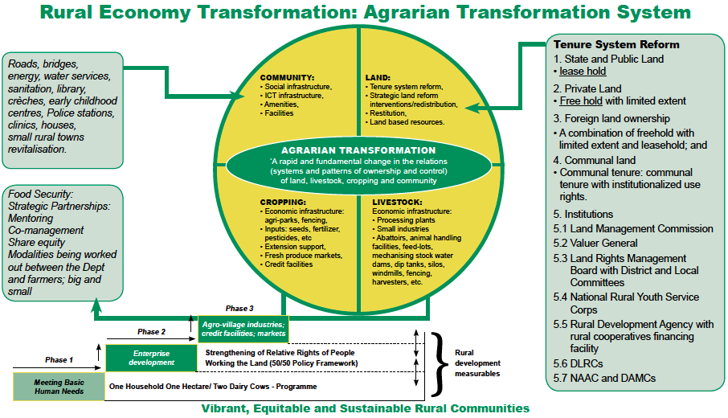
Policy Imperatives (cont)

Slide 6
2. Defining the Animal and Veld Management (AVMP) and River Valley Catalytic (RVCP) Programmes
Both programmes provide infrastructural support to commonages, communal areas, traditional areas and to farmers occupying state owned facilities (where requested by Land Reform), the differences, although slight, being the following:
The AVMP, focusses on bring arable and grazing land into production by providing all the required infrastructure like fencing, boreholes, irrigation systems, cattle handling and dipping facilities, dams etc. In addition the AVMP supported re-greening and soil rehabilitation.
The RVCP, focusses on the catalytic utilization of river systems to bring land into production and would typically develop irrigation schemes with all the associated infrastructure.
It must be noted that the Productions Support provided, through the two programmes above, contributes to the overarching objectives of the Agri-Parks Programme that has been implemented since the 2015/16 FY

Slide 7
3. High Level Progress Report on Implementation of the AVMP 2009-2019
Province | Actual Expenditure | Achievements (Projects Delivered)
EC | R211 736 338,55 | 69
FS | R65 997 804,30 | 67
GP | R49 151 157,38 | 44
KZN | R312 284 518,65 | 392
LP | R51 177 564,69 | 57
MP | R116 982 913,76 | 320
NC | R62 342 997,08 | 45
NW | R43 820 150,06 | 112
WC | R70 209 929,69 | 25
TOTAL | R983 703 374,00 | 1131

Slide 8
High Level Progress Report on Implementation of the RVCP 2009-2019
Province | Expenditure | Achievements (Projects Delivered)
EC | R7 196 065,96 | 14
FS | R13 872 755,19 | 4
GP | R0,00 | 0
KZN | R112 213 984,03 | 27
LP | R2 695 483,33 | 2
MP | R10 608 177,48 | 16
NC | R0,00 | 2
NW | R5 684 076,23 | 4
WC | R0,00 | 0
TOTAL | R152 270 542,00 | 69

Slide 9
Policy Alignment
4. AVMP Expenditure per Financial Year for the period 2012/13 – 2016/17
RESPONSIBILITY | AVMP 2012/13 | AVMP 2013/14 | AVMP 2014/15 | AVMP 2015/16 | AVMP 16/17
EASTERN CAPE | 0,00 | 24 580 804,23 | 12 275 300,00 | 136 193 634,89 | 24 854 477,46
FREE STATE | 2 675 455,75 | 9 735 791,15 | 7 865 008,20 | 13 010 045,00 | 15 792 336,29
GAUTENG | 2 362 099,64 | 12 537 983,06 | 6 622 490,26 | 5 992 962,95 | 13 458 974,93
KWAZULU NATAL | 3 809 479,34 | 43 626 416,32 | 39 204 019,31 | 51 990 544,69 | 53 150 739,86
LIMPOPO | 3 015 859,22 | 105 913,13 | 3 510 186,16 | 6 401 139,02 | 8 377 925,63
MPUMALANGA | 10 787 828,75 | 17 096 525,20 | 10 241 618,44 | 19 617 335,61 | 34 508 862,53
NORTHERN CAPE | 4 201 772,04 | 1 355 784,18 | 6 457 203,16 | 16 381 777,93 | 20 864 263,94
NORTH WEST | 1 405 075,94 | 12 378 888,59 | 4 321 322,52 | 5 691 874,16 | 13 326 495,15
WESTERN CAPE | 2 834 908,77 | 5 866 909,29 | 486 357,89 | 26 026 641,06 | 29 339 766,98
TOTAL | 31 092 479,45 | 127 285 015,15 | 90 983 505,94 | 281 305 955,31 | 213 673 842,77
AVMP only. No RVCP in this period

Slide 10
Policy Alignment
AVMP and RVCP Expenditure per Financial Year for the period 2017/18 – 2018/19
RESPONSIBILITY | AVMP 17/18 | RVCP 2017/18 | AVMP 2018/19 | RVCP 2018/19
EASTERN CAPE | 7 172 280,67 | 6 508 063,76 | 6 659 841 | 688 002
FREE STATE | 5 455 518,71 | 3 327 518,47 | 11 463 649 | 10 545 237
GAUTENG | 3 370 560,33 | 0,00 | 4 806 086 | 0,00
KWAZULU NATAL | 70 658 727,14 | 45 620 701,95 | 49 844 592 | 66 593 282
LIMPOPO | 8 235 274,04 | 1 546 267,00 | 21 531 267 | 1 149 216
MPUMALANGA | 16 158 993,39 | 0,00 | 8 571 750 | 10 608 177
NORTHERN CAPE | 12 800 286,73 | 0,00 | 281 909 | 0,00
NORTH WEST | 2 215 668,70 | 3 334 711,45 | 4 480 825 | 2 349 365
WESTERN CAPE | 1 513 170,94 | 0,00 | 4 142 175 | 0,00
TOTAL | 127 580 480,65 | 60 337 262,63 | 111 782 095,00 | 91 933 280,00

Slide 11
Policy Alignment
5. The detailed list of projects per province per locality is attached as Annexure A : AVMP and Annexure B: RVCP
This is due to size.

Slide 12
Policy Alignment
6. Successes & Socio-Economic impact of the AVMP and RVCP programmes;
Success
The DRDLR has the ability to procure and deliver services much faster than Agriculture as it doesn’t have concurrent functions. Department of Agriculture National makes allocations through DORA and has very little control on how and where the Provincial Departments of Agriculture utilize the funding.
The DRDLR has provided 263 stock water infrastructure facilities.
The DRDLR has provided 137 boreholes
The DRDLR has been able to fence 340 projects.
The DRDLR has been able to provide 47 animal handling facilities
The DRDLR has supported 20 irrigation schemes
Impact
Estimated number of over 2000Ha fenced
27 150 jobs have been created through construction
21 904 Households have benefited through rural development projects
21 904 Farmers supported with Infrastructure
Skills Developed: 11 430
Impact
Estimated number of over 2000Ha fenced
27 150 jobs have been created through construction
21 904 Households have benefited through rural development projects
21 904 Farmers supported with Infrastructure
Skills Developed: 11 430

Slide 13
Policy Alignment
7. Challenges and Mitigation measures
Challenge | Mitigation Measure
Farmer needs in communal, commonage and traditional areas far exceed the available allocations in government | DRDLR has since inception of these programmes consciously made a effort to set aside funding for support these farmers
Agriculture has from time to time indicated that the level of service provided by DRDLR sometimes exceeded the level that Agriculture could provide | DRDLR provincial infrastructure teams required to get Provincial Agriculture sign-off on the type and specification of the infrastructure being provided
Overlaps between Landcare programme and the AVMP & RVCP
Both Agriculture and DRDLR programmes work with farmers the biggest difference is how the spatial targeting and intervention programmes are packaged.

Slide 14
Policy Alignment
THANK YOU

