Slide 1

Employment, Labour and Unemployment
Stats SA

Slide 2
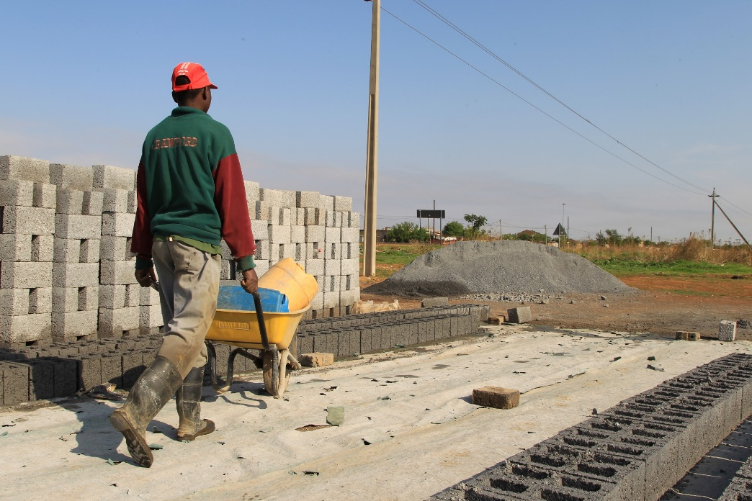

The Quarterly Labour Force Survey (QLFS)
The Quarterly Labour Force Survey (QLFS) is a household-based sample survey conducted by Statistics South Africa (Stats SA).
It collects data on the labour market activities of individuals aged 15 years and older who live in South Africa.

Slide 3
South Africa’s unemployment rate increased by 1,4 percentage points to 29,0% in Q2 of 2019. The highest unemployment rate since Q1 of 2008
Unemployment rate from
Q1:2008 to Q2:2019
Source: QLFS Q2 2019

Slide 4
The unemployment rate has remained stubbornly high over time. There has been 1,4 percentage points increase between Q1:2019 and Q2:2019.
Unemployment rate from
Q2:2009 to Q2:2019
10 Years
5 Years
1 Year
Q2
2009
Q2
2019
Q2
2014
Q2
2019
Q2
2018
Q2
2019
Unemployment rate increased by 5,8 percentage points between Q2:2009 and Q2:2019
Unemployment increased from 25,5% in Q2:2014 to 29,0% in Q2:2019 by 3,5 percentage points
Unemployment rate increased by 1,8 percentage points compared to the same period last year
Source: QLFS Q2 2019

Slide 5
The working age population (15-64 years) in Q2:2019 was 38,4 million
38,4 million
People of working age in South Africa (15 – 64 year olds)
Labour force
Not Economically Active
23,0 million
15,5 million
Employed
Unemployed
Discouraged
work seekers
M
M
M
M
Employed
Unemployed
South Africa’s official unemployment rate stands at
29,0%
ILO hierarchy – Employed first then unemployed and the remainder is NEA (including discouraged job-seekers). 3 mutually exclusive groups. Cannot be in two groups at the same time,
Source: QLFS Q2 2019

Slide 6
The working age population (15 – 64 years) increased by 150 000 people between Q1:2019 and Q2:2019
Thousands
Labour market indicators between Q1:2008 and Q2:2019
Changes between Q1:2019 and Q2:2019
Other Not Economically Active
-77 000 q/q
Not Economically Active
Discouraged work seekers
-248 000 q/q
Not Economically Active
Unemployed
+455 000 q/q
Unemployed
Labour Force
Employed
Employed
+21 000 q/q
2008
2019
Source: QLFS Q2 2019

Slide 7
QLFS
EMPLOYMENT
&
LABOUR MARKET RATES

Slide 8
The number of employed persons increased by 21 000 to 16,3 million in Q2:2019
Number of employed
From Q2:2009 to Q2:2019
10 Years
5 Years
1 Year
Q2:2009 Q2:2019
Q2:2014 Q2:2019
Q2:2018 Q2:2019
The number of employed people increased by 1,9 million from 14,4 million in Q2:2009 to 16,3 million in Q2:2019
The number of employed people increased by 1,2 million from 15,1 million in Q2:2014 to 16,3 million in Q2:2019
The number of employed people increased by 25 thousand from 16,29 million in Q2:2018 to 16,31 million in Q2:2019
Source: QLFS Q2 2019

Slide 9
The Labour force participation rate increased by 1,9 percentage points from 57,9% in Q2:2009 to 59,8% in Q2:2019
Labour force participation and absorption rate, 2009-2019
Labour force participation rate is the proportion of the working-age population that is either employed or unemployed.
13,4 % Points difference
17,4% Points difference
Absorption rate is the proportion of the working-age population that is employed.
Source: QLFS Q2 2019

Slide 10
Labour market rates vary significantly depending on education level
Labour market rates by education level, Q2:2019
Unemployment rate
Absorption rate
Participation rate
Source: QLFS Q2 2019

Slide 11
The unemployment rate for those aged 25-34 (35,6%) is more than double that of the 45-54 (17,2%) year olds.
Labour market rates by age group, Q2:2019
Unemployment rate
Absorption rate
Participation rate
Source: QLFS Q2 2019

Slide 12
The unemployment rate among the youth is higher irrespective of education level.
Unemployment rate by education level and age group, Q2:2019
15 – 24 years
25 – 34 years
35 – 64 years
Source: QLFS Q2 2019

Slide 13
QLFS
PROFILE OF THOSE NOT IN EMPLOYMENT, EDUCATION OR TRAINING
(NEET)

Slide 14


Not in employment, education or training (NEET)
NEET
Work
Education
Those young people (15-34 years) who are categorised as NEET are considered to be disengaged from both work and education.
?
Youth NEET rate is calculated as the total number of youth who are NEET as a proportion of the total youth-specific working-age population

Slide 15
Approximately 3,3 million (32,3%) out of 10,3 million young people aged 15-24 years were not in employment, education or training (NEET). The overall NEET rate increased by 0,7 of a percentage point in Q2:2019 compared to Q2:2018.
NEET (15-24 years) by sex
15-24 YEARS
Source: QLFS Q2 2019

Slide 16
NC recorded the highest rate of young people aged 15-24 years not in employment, education or training in Q2: 2019.
Provincial NEET rate (Year on Year Change Q2:2018 – Q2:2019)
( ) Y/Y Change
(-1,1)
(-3,4)
(+0,2)
(+0,5)
(-0,3)
(+4,7)
(+0,7)
(+1,8)
(+0,6)
(+1,4)
Source: QLFS Q2 2019

Slide 17
Approximately 8,2 million (40,3%) out of 20,4 million young people aged 15-34 years, were not in employment, education or training (NEET). The overall NEET rate increased by 1,0 percentage point y/y.
NEET (15-34 years) by sex
15-34 YEARS
Female NEET
Up by 0,3 of a percentage point
Male NEET
Up by 1,8 percentage points
Source: QLFS Q2 2019

Slide 18
The NW province had the highest rate of young people aged 15-34 years not in employment, education or training at 45,9%. The rate increased by 1,8 percentage points year-on-year.
( ) Y/Y Change
(+1,8)
(+0,7)
(+1,5)
(-0,3)
(+4,5)
(+1,3)
(+1,0)
(+1,5)
(+0,4)
(+1,9)
Provincial NEET rate (Year –on – Year Change Q2:2018 – Q2:2019)
Source: QLFS Q2 2019

Slide 19
QLFS
EMPLOYMENT

Slide 20
Trade, construction and agriculture have higher employment shares relative to their GDP contribution.
Employment and GDP share per industry
Share of Nominal GDP (Q1:2019)
24,7%
15,0%
20,3%
13,1%
3,9%
9,7%
1,9%
7,6%
3,8%
Employment shares, Q2: 2019
Source: QLFS Q2 2019

Slide 21
Close to a third (28,9%) of all people employed in Q2:2019 were employed in elementary and domestic work occupations.
Employment share by occupation, Q2:2019
Source: QLFS Q2 2019

Slide 22
The formal sector in South Africa accounts for 68,5% of total employment.
Formal sector employment
Formal sector employment has shown an upward trend, increasing from 10,1 million in Q2:2009 to 11,2 million in Q2:2019
Informal sector employment increased from
2,2 million in Q2:2009 to 3,0 million in Q2:2019
Informal sector employment
Q2:2009 Q2:2019
Source: QLFS Q2 2019

Slide 23
QLFS
Q2:2019
UNEMPLOYMENT

Slide 24
The number of unemployed people in South Africa increased from 4,3 million in Q2:2009 to 6,7 million in Q2:2019. The proportion of those in long-term unemployment increased from 60,8% in Q2:2009 to 71,5% in Q2:2019
Number of unemployed for one year or longer
M
28,5%
Number of unemployed
71,5%
39,2%
Short Term Unemployed
60,8%
Long Term Unemployed*
Q2
2009
Source: QLFS Q2 2019
Q2
2019
* Unemployed for a year or longer

Slide 25


Official Unemployment Rate
29,0% (+1,4 % Points Change Q/Q)
Expanded Unemployment Rate
38,5% (+0,5 % Point Change Q/Q)
42,5%
SA: 38,5%
31.3%
35,0%
SA: 29,0%
10,2 million
people were unemployed in Q2:2019
An increase of 232 000 q/q
27,1%
6,7 million
people were unemployed in Q2:2019
An increase of 455 000 q/q
Expanded Definition includes the following
- Official unemployment (searched and available) | 6,7 M
- Available to work but are/or
Discouraged work-seekers | 2,7 M
Have other reasons for not searching | 0,8 M
Source: QLFS Q2 2019

Slide 26
Black African women are the most vulnerable with an unemployment rate of over 30%.
Black women are the most vulnerable with unemployment rate of over 30%.
OFFICIAL unemployment rate by population group and sex
Source: QLFS Q2 2019

Slide 27
Irrespective of sex, the black African and coloured population groups remain vulnerable in the labour market
EXPANDED unemployment rate by population group and sex
Source: QLFS Q2 2019

Slide 28
Highest official unemployment rate recorded in EC and highest expanded unemployment rate recorded in NW. LP, KZN and NC provinces all have more than 15 % points difference between their expanded and official unemployment rates
Provincial unemployment rate: Official vs Expanded Q2:2019
Official
Expanded
15,4% points difference
16,0% points difference
20,8% points difference
Source: QLFS Q2 2019

Slide 29
QLFS
UNDERSTANDING
NON-ECONOMICALLY ACTIVE
(NEA)

Slide 30
15,5 million people aged 15 – 64 years were not economically active.
This is a decrease of 326 000 q/q
Reasons why – Not economically active (NEA)
5 main reasons for NEA
Q1:2019 to Q2:2019 % Change
Q1:2019 to Q2:2019 Change in levels
Down by 1,2 % points
Quarter-on-quarter changes
 | Thousand
Student | 143
Homemaker | -86
Illness/disability | -85
Too young/too old to work | -42
Discouraged work seekers | -248
Other | -7
Down by 0,1 of a % point
M
Down by 0,3 of a % point
M
Down by 0,2 of a % point
M
15,5 M
NEA
M
Up by 1,7 % points
Source: QLFS Q2 2019

Slide 31
Thank You

