Slide 1
Occupational Health and Workers’ Compensation
Briefing Portfolio Committee on Health: Background
Compensation Commissioner for Occupational Diseases (CCOD)
4 September 2019
Slide 1

Slide 2
Overview
Context
Some macro issues
Compensation & Services
Way forward

Slide 3
Context
Multiple policy and legal frameworks covering health, compensation & other social protection benefits (Health, Employment & Labour, Mineral Resources & Energy)
Migrant / Contract labour / within and cross-border / formal / informal economy
Fragmented services for workers and ex-workers
Diverse stakeholders & role-players (government, employers, trade unions, neighbouring countries)

Slide 4
Migrant Mine Workers
Year | RSA | Mozambique | Lesotho | Swaziland | % Non-RSA
1920 | 74 452 | 77 921 | 10 439 | 3 449 | 57
1940 | 178 708 | 74 883 | 52 044 | 7 152 | 49
1960 | 141 406 | 101 733 | 48 824 | 6 623 | 62
1980 | 233 055 | 39 636 | 96 308 | 5 050 | 44
1995 | 122 562 | 55 140 | 87 935 | 15 304 | 58
2000 | 99 575 | 57 034 | 58 224 | 9 360 | 57
2010* | 152 486 | 35 782 | 35 179 | 5 009 | 34
* Data from TEBA

Slide 5
Occupational Health Laws
Prevention & Enforcement
 | Occupational Health & Safety Act, 1993 (OHSA) | Mine Health and Safety Act, 1996 (MHSA)
Administration | Department of Employment & Labour | Department of Mineral Resources and Energy
Coverage | All workers except those under MHSA | All workers in mines except those under OHSA
Funding | DEL Budget | DMRE Budget
Organisation | Pretoria and regional offices | Pretoria and regional offices

Slide 6
Workers’ Compensation Laws
 | Occupational Diseases in Mines & Works Act , 1973 | Compensation for Occupational Injuries and Diseases Act, 1993
Administration | Department of Health - R4.8b Fund value | Department of Employment & Labour; Rand Mutual (RMA) & Federated Employers Mutual (FEMA) R53b fund value (~R70b)
Coverage | Mine workers for lung and heart diseases only | All workers in formal economy for injuries and diseases except mine workers under ODMWA
Funding | Levies on employers (risk-rated through Risk Committee) – 236 controlled mines & works | Levies on employers (risk-rated on claims record) – 400 000 employers
Organisation | Office in Johannesburg (Braamfontein) – CCOD, MBOD | Offices in Pretoria with some decentralisation through DEL regional offices; Rand Mutual and Federated Employees with some decentralised offices

Slide 7
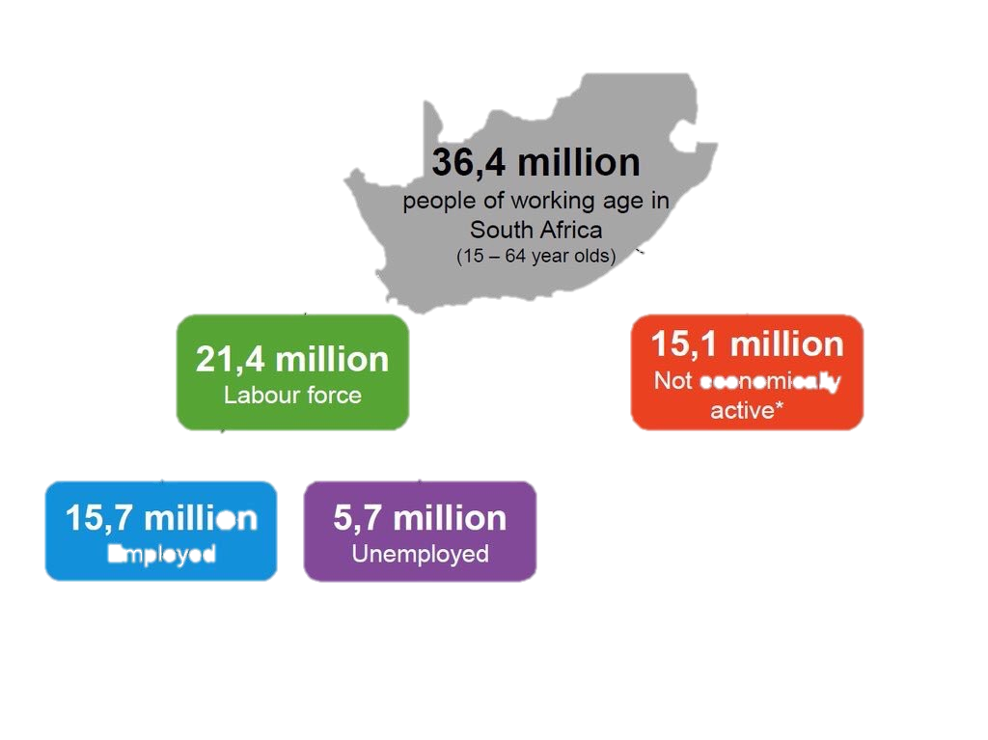
Demography of Workforce in South Africa
COIDA (DEL)
11 million (R70b)
ODMWA (DOH)
400 000 (R4.8b)
Slide 7

Slide 8
DME Database of Mines & Quarries
Province | Coal | Diamond | Gold | Platinum | Other | Total
Eastern Cape | 0 | 0 | 0 | 0 | 140 | 140
Free State | 2 | 2 | 6 | 0 | 40 | 61
Gauteng | 6 | 3 | 25 | 2 | 129 | 167
Kwazulu-Natal | 12 | 0 | 1 | 0 | 120 | 133
Limpopo | 3 | 0 | 1 | 12 | 134 | 156
Mpumalanga | 85 | 0 | 14 | 0 | 89 | 194
North West | 0 | 199 | 6 | 25 | 97 | 327
Northern Cape | 0 | 152 | 0 | 0 | 76 | 228
Western Cape | 0 | 20 | 0 | 0 | 177 | 197
Total | 108 | 395 | 53 | 45 | 1 002 | 1 603
236 active controlled mines & works

Slide 9
Problems and Issues
Difficulties in estimating numbers of workers and former workers
  Permanent & contract
  Turnover, movement between countries and companies, retrenchments
Tracking and tracing
Labour history
No surveillance system
Slide 9
Slide 9

Slide 10
Occupational Ill-health
hard to find data on occupational injuries & diseases in South Africa
if found, the data is difficult to interpret as it is mainly INCIDENCE data (cannot link the data to rates)
data is sitting in databases in different departments & agencies
Slide 10

Slide 11

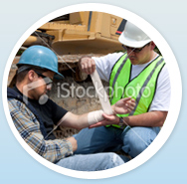
Occupational Injuries
  Abrupt break in …
  AGENT – HOST – ENVIRONMENT balance
  Cause established
Slide 11

Slide 12
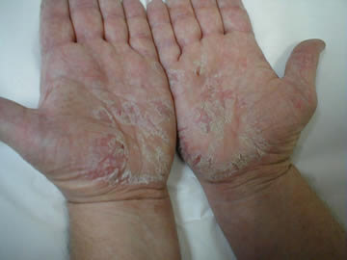
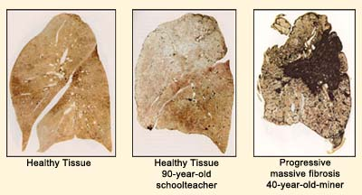
Occupational Diseases
  Not diagnosed / mis-diagnosed
  Lack of knowledge
  Masked by other diseases
  Long lag time
  Need special investigations
  Difficult to find cause
  Under-reporting
Slide 12

Slide 13

107-year-old History…
Miners’ Phthisis Act 19 of 1912
Occupational Diseases in Mines & Works Act, 78 of 1973
Slide 13

Slide 14
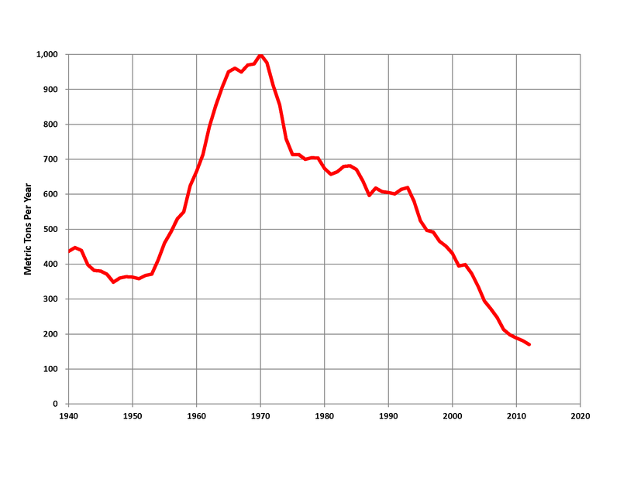
Occupational Diseases in Mineworkers
Legacy of 120 years
Mining sector + indirect services – almost 20% of economy
Mineral wealth of R25 trillion
Neglected group of ex-mineworkers
Challenge of deadly cocktail of HIV / Silicosis & Tuberculosis
Little data on injuries
1970 (1000 Metric Tons)
South Africa mined gold production, 1940-2011*
https://en.wikipedia.org/wiki/Mining_industry_of_South_Africa#/media/File:S_Africa_Gold_Production.png

Slide 15
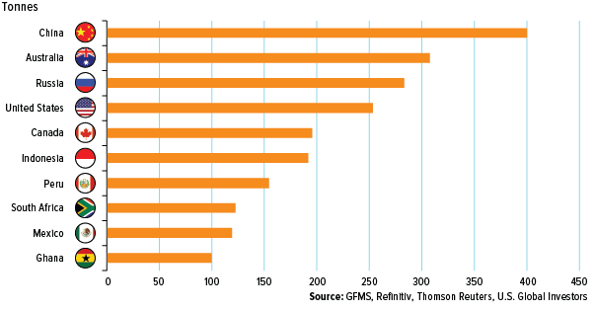
Top 10 Gold Mining Countries (2018)
http://www.usfunds.com/investor-library/frank-talk/top-10-gold-producing-countries/#.XWuuiigzbIU
Slide 15

Slide 16
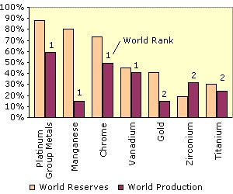
South Africa - Mineral Wealth
Valued at R25 trillion
Russia & Australia a distant second
http://www.southafrica.info/business/economy/sectors/mining.htm
Slide 16
Slide 16

Slide 17
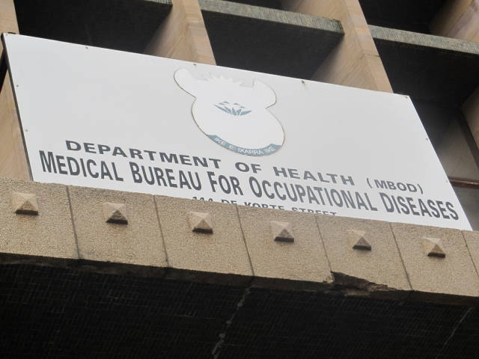

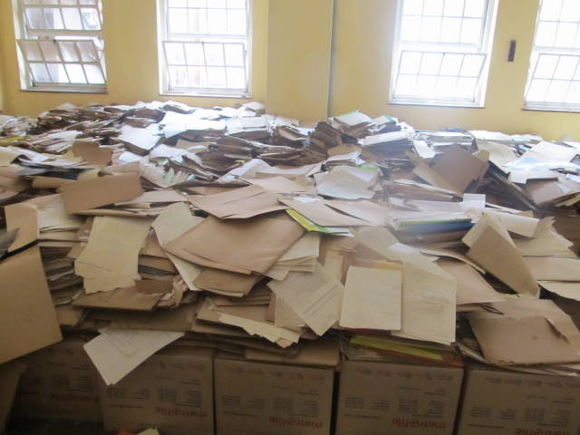
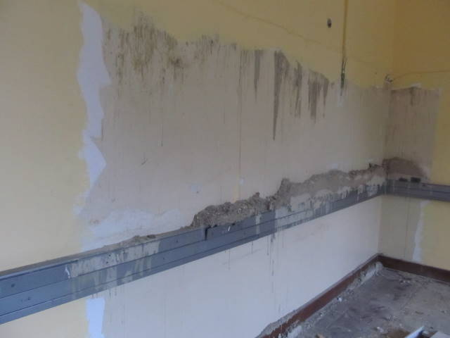
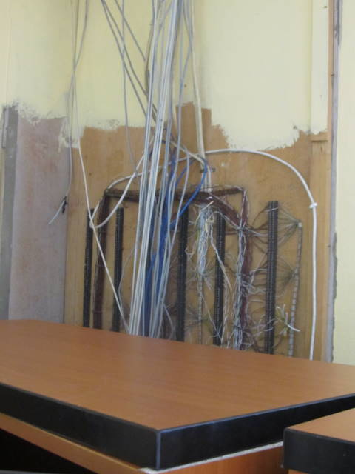
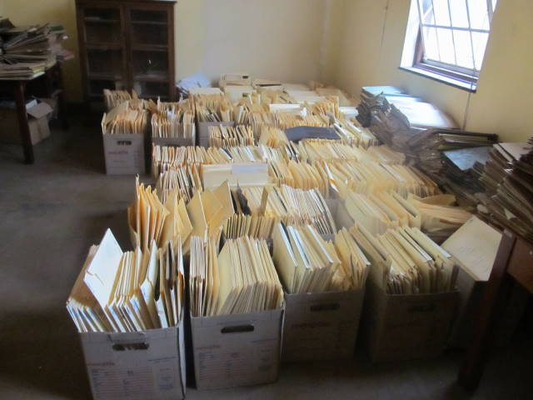
Legacy Problems (MBOD/CCOD)
Slide 17

Slide 18
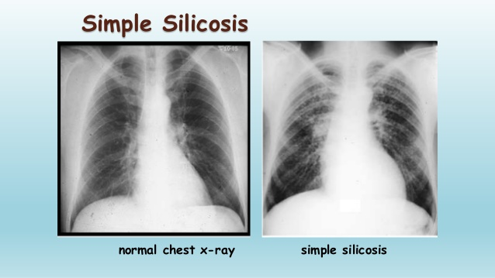
Mine Dust Exposures ~ Disease Burden
Slide 18

Slide 19
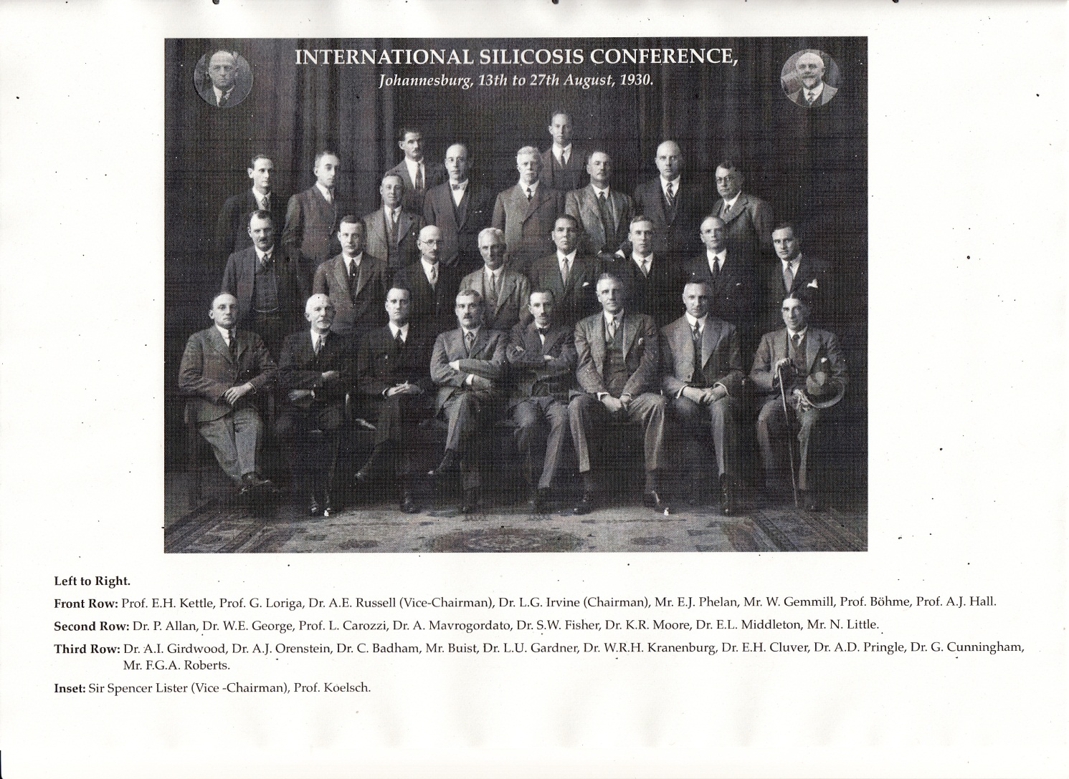
1930 Silicosis Conference
Slide 19

Slide 20
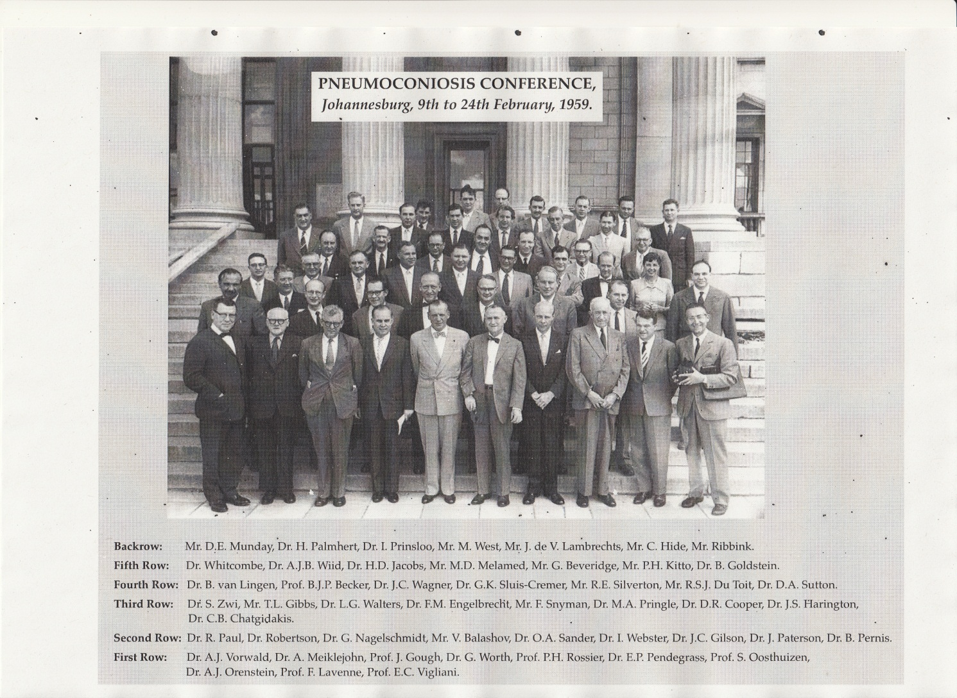
1959 Pneumoconiosis Conference
Slide 20

Slide 21
Legacy of Neglect / System Collapse
Backlog in audited financial statements and annual reports
30% of source documents not found
Outdated technical resources
Inadequate human resources and infrastructure
Centralised services in Johannesburg
MBOD- 400k files
CCOD
200k
??? Ex-workers
Mines ? 400k

Slide 22

Contestation
Cape PLC Asbestos settlement
2013
Silicosis claims settlement
2003
Chamber of Mines versus Compensation Commissioner & Dept of Health
Mr Thembekile Mankayi versus AngloGold Ashanti
2012
2011
Silicosis / TB Class Action - 2019

Slide 23
What we did?
Developed the evidence base
  Size, shape, scope & geographic distribution
  Piloted innovations in services
  Mobilised ex-mineworkers (outreach & awareness) – Rights Based Approach
  Monitored outputs
Built consensus on approach and interventions (mining companies, trade unions, governments, social partners)
Amendments to Occupational Diseases in Mines & Works Act, 1973

Slide 24
Certifications by Commodity

Slide 25
Payment Status
PAYMENT STATUS | No. | %
NOT PAID | 103465 | 50%
PAID | 104633 | 50%
Total | 208098

Slide 26
Ex-Mine Workers by Province
(1984 -2013)*
Province | Total | %
Eastern Cape | 281553 | 31
North West | 168171 | 18
Gauteng | 160530 | 17
Free State | 112077 | 12
KwaZulu-Natal | 92092 | 10
Limpopo | 75527 | 8
Mpumalanga | 27264 | 3
Northern Cape | 4987 | 1
Western Cape | 687
Total | 922888
*TEBA data
Slide 26

Slide 27
*Country & #Disease Burden in Ex-Mineworkers (30 years)
Country | Total | %
South Africa | 1 189 515 | 73%
Lesotho | 191 225 | 12%
Mozambique | 152 091 | 9%
Swaziland | 31 958 | 2%
Malawi | 29 741 | 2%
Botswana | 29 224 | 2%
Other | 1 184 | 0,1%
Total | 1 624 938
Compensable Disease | Total
Silicosis | 33 045
Tuberculosis | 108 883
Asbestos Related Diseases | 13 688
Obstructive Airways Disease | 5 084
Pneumoconiosis | 10 914
*TEBA data; Ehrlich. 2017
# Compensation Fund
Slide 27

Slide 28
Australia:
Senate Enquiry – Black Lung (2016)
The Senate
Select Committee on Health
Fifth interim report
Black Lung: "It has buggered my life"
April 2016
18 PERSONS WITH COAL WORKERS PNEUMOCONIOSIS
Slide 28

Slide 29
Occupational Exposure Limits for Silica (OEL)
Country / Province# | OEL (mg / m³)
Argentina | 0.05
#British Columbia | 0.025
Chile | 0.04
Ireland | 0.05
Italy | 0.05
Japan | 0.03
Portugal | 0.05
USA - ACGIH* | 0.025
USA - NIOSH* | 0.05
*Advisory organisation
Source: Maciejeska A. 2008. Int J of Occ Med & Env Health 21 (1): 1-23
Slide 29

Slide 30
TB in the Mining Sector
Mineworkers are exposed to multiple risk factors that compound their TB infection risk:
  Mineworkers have 2x the risk of the general population
  Mineworkers with HIV have 3x the risk
  Mineworkers with Silicosis have 6x the risk
  Mineworkers with HIV and Silicosis have 18x the risk
World Bank. 2014
Slide 30

Slide 31
Claimant Process – MBOD / CCOD

Slide 32
Innovations
  Database, IT system, www.health.gov.za/ccod
  Precision Mapping of claimants’ district
  Use of Computer Aided Diagnosis / Artificial Intelligence
  Defined minimum package of services that is sustainable (health, compensation, social protection)
  Cross border delivery of services and continuity of care
  One Stop Service under one roof (meets needs of mineworkers/ex-mineworkers and families)
  Use of unemployed graduates
  Link to financial services
  Multi-stakeholder involvement

Slide 33
Tracking & Tracing

Slide 34
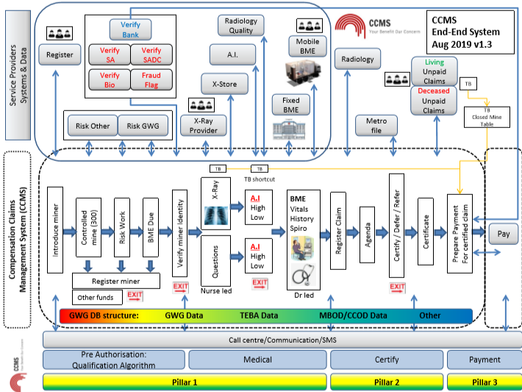
Information Technology System

Slide 35
Registration

Slide 36
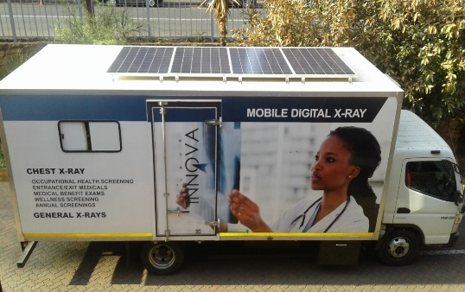
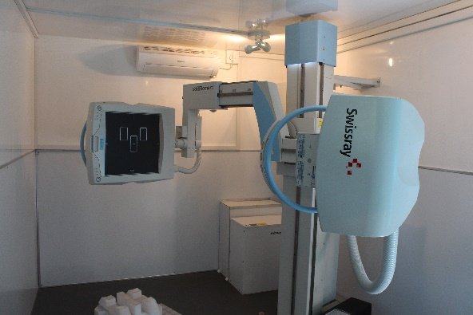
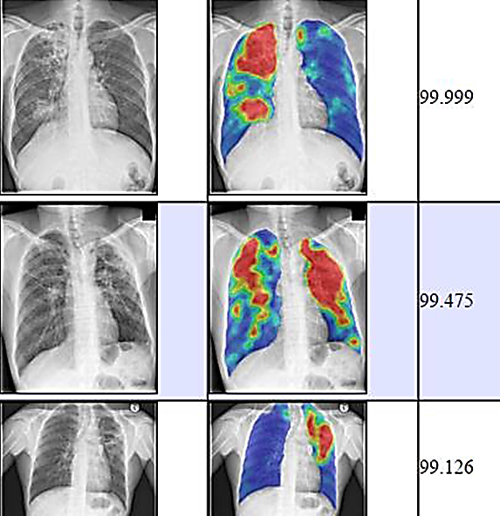
Computer Assisted Diagnostics

Slide 37
One Stop Service Centres (OSSC)
  Eastern Cape - Mthatha (NMAH)
  Gauteng - Carletonville (Hospital)
  Northern Cape – Kuruman
  Limpopo – Burgersfort
  Global Fund (10 OSSCs in neighbouring countries)
  Mobile units

Slide 38
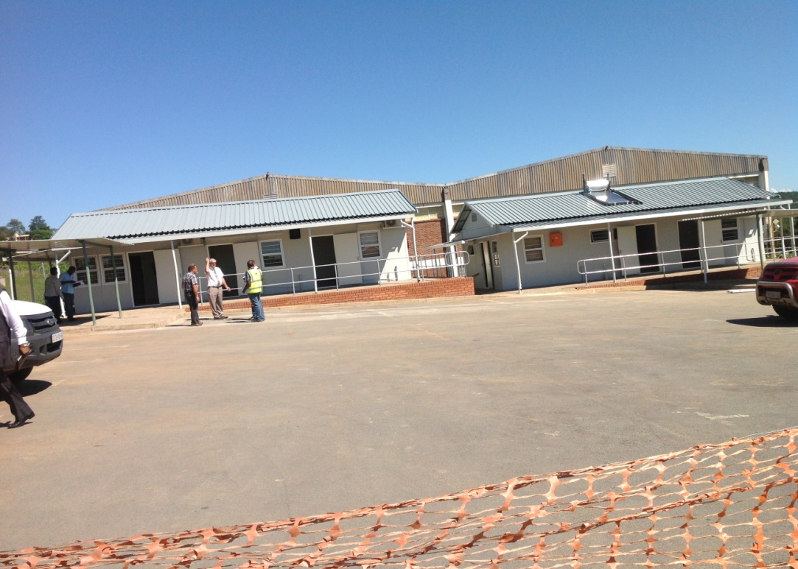
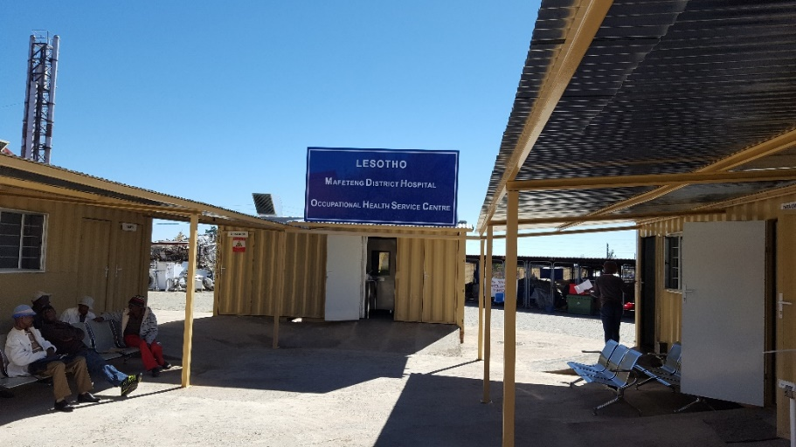
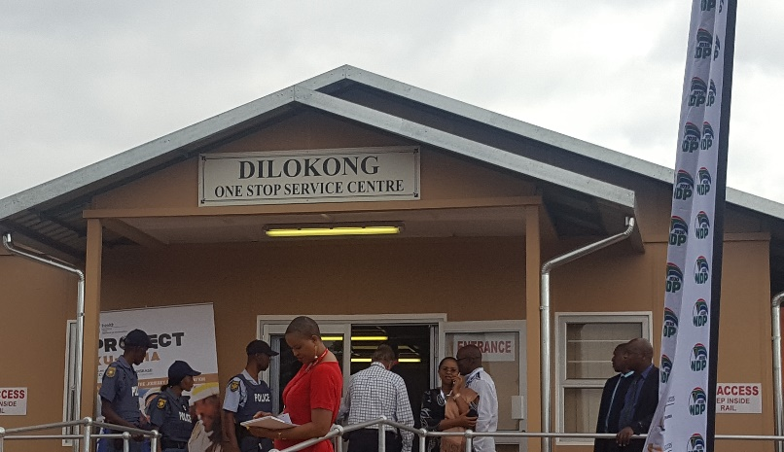
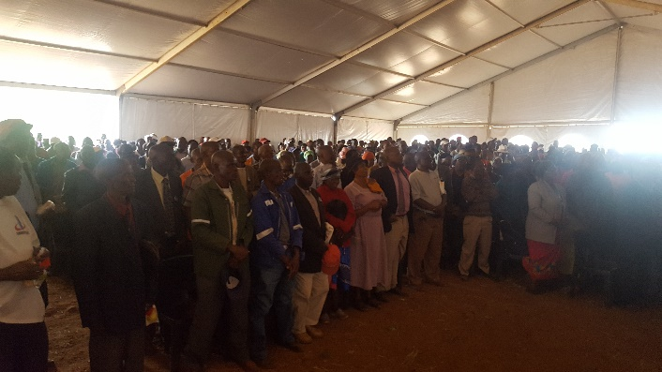
One Stop Service Centres
Mthatha (April 2014)
Mafeteng (Jan 2017)
Burgersfort (Oct 2017)

Slide 39
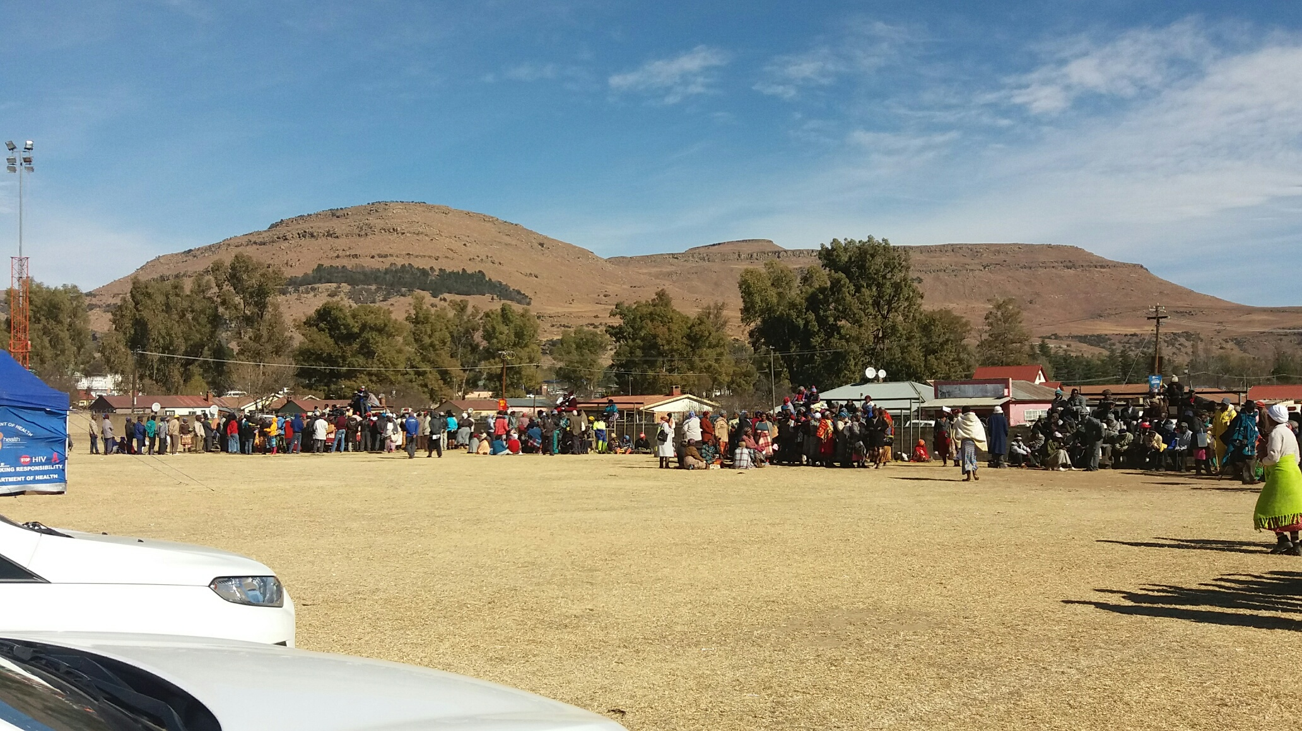
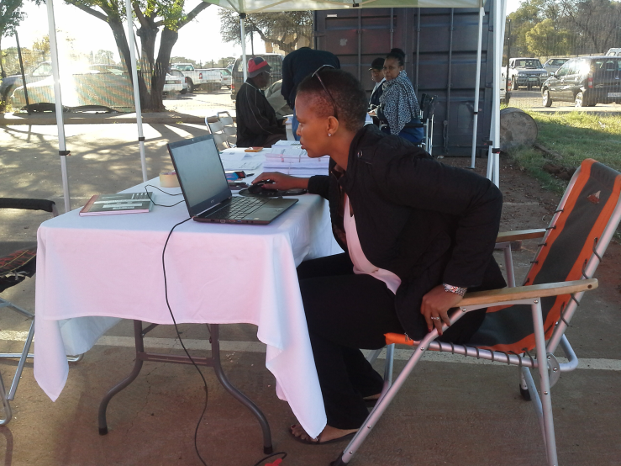
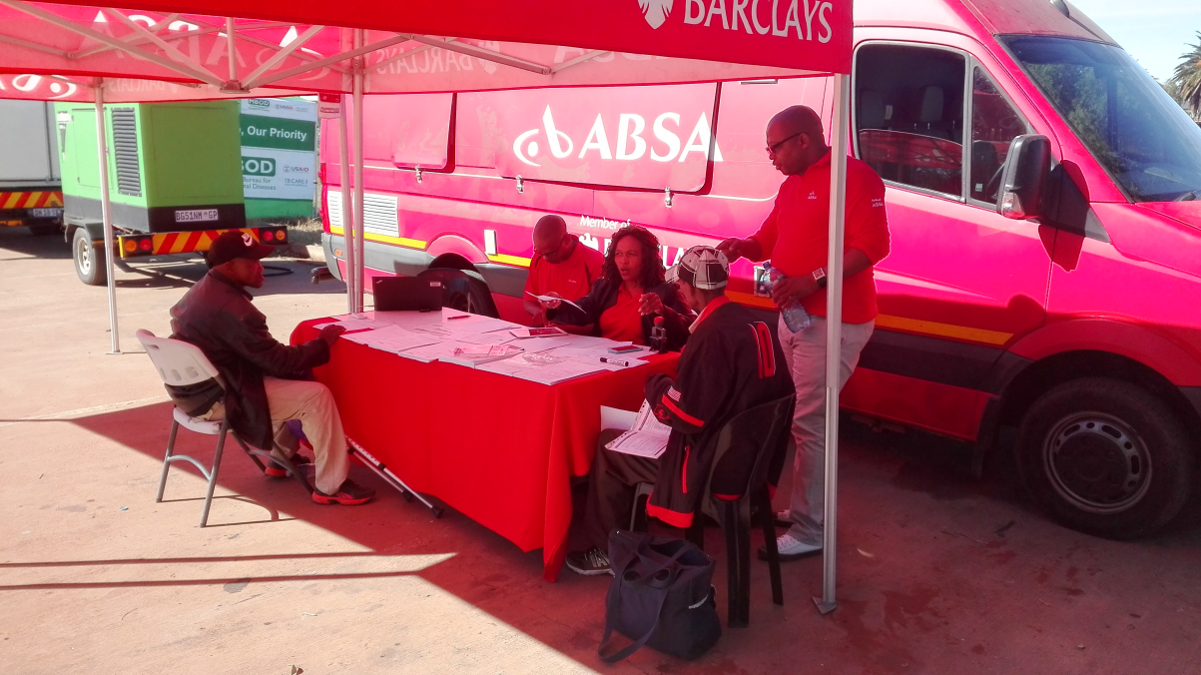
Mobile Services
Slide 39

Slide 40
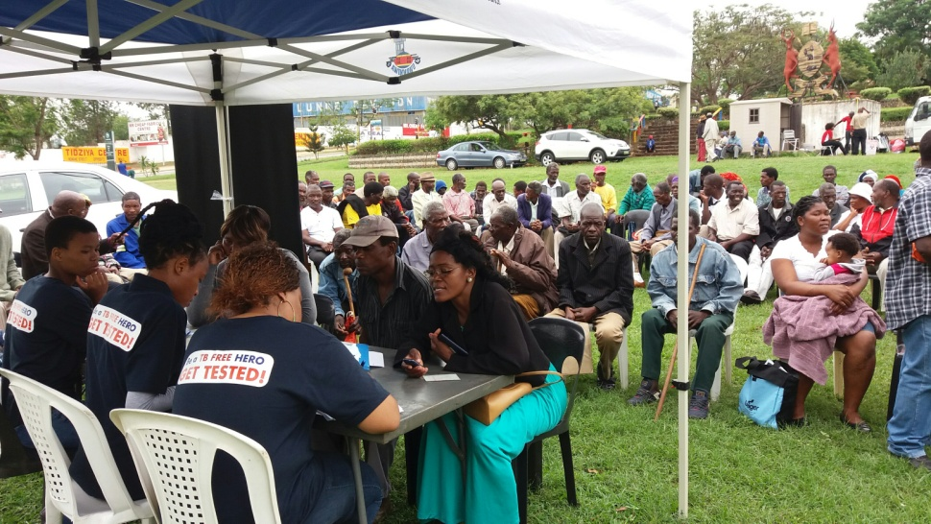
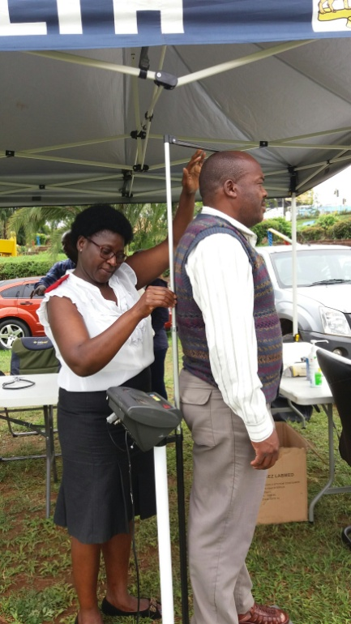
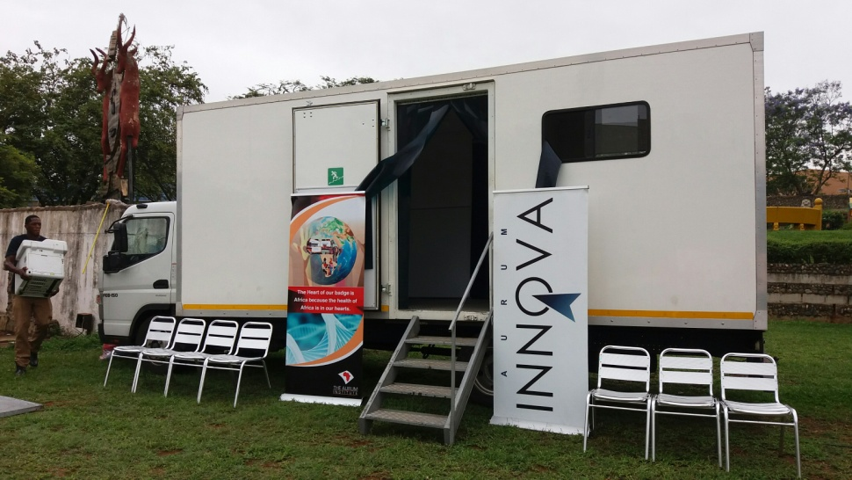
Mobile Services

Slide 41
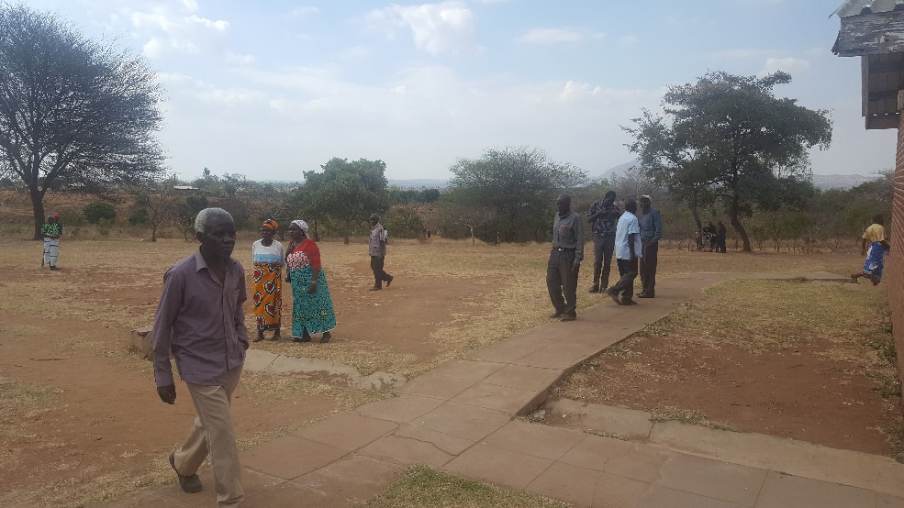
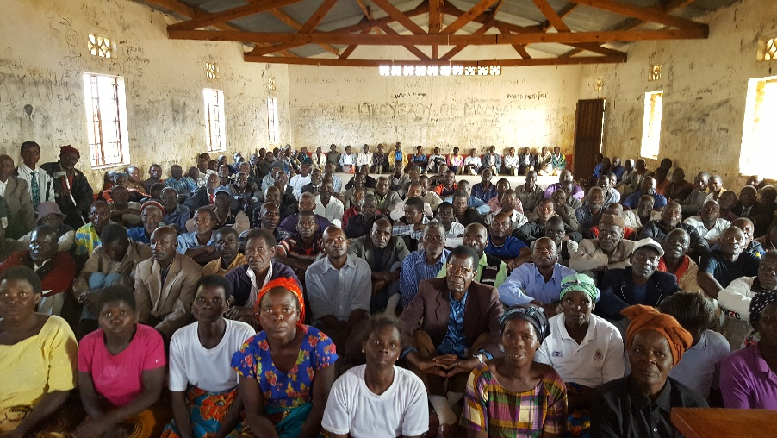
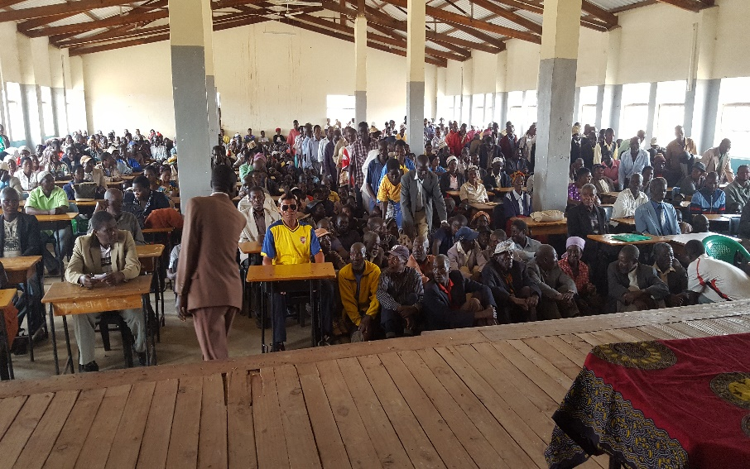
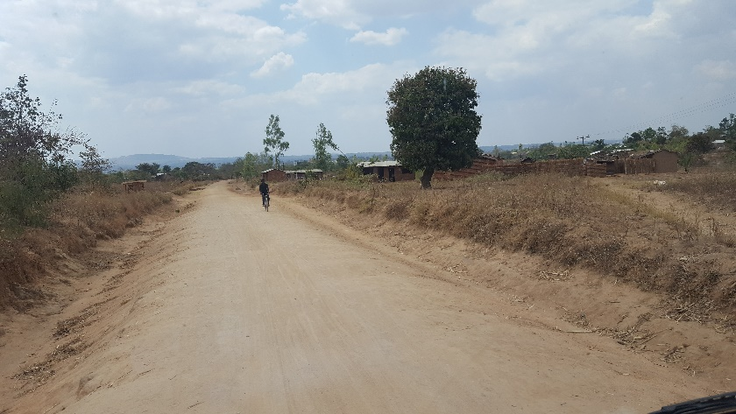
Malawi

Slide 42
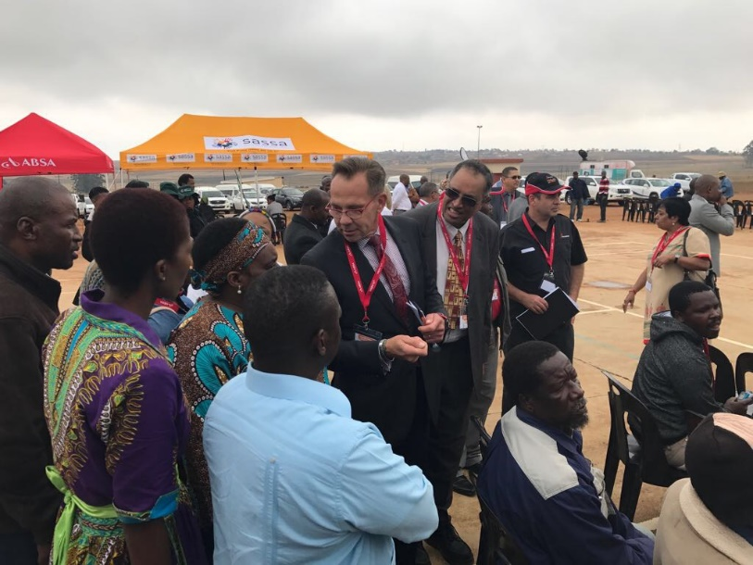
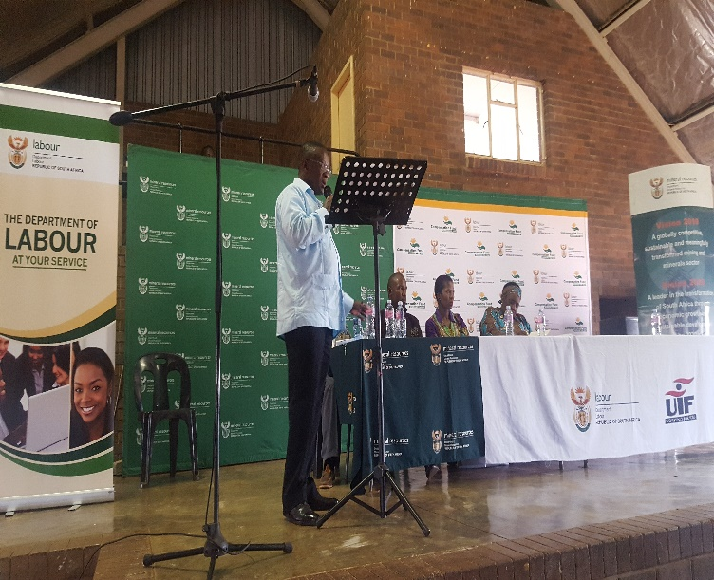
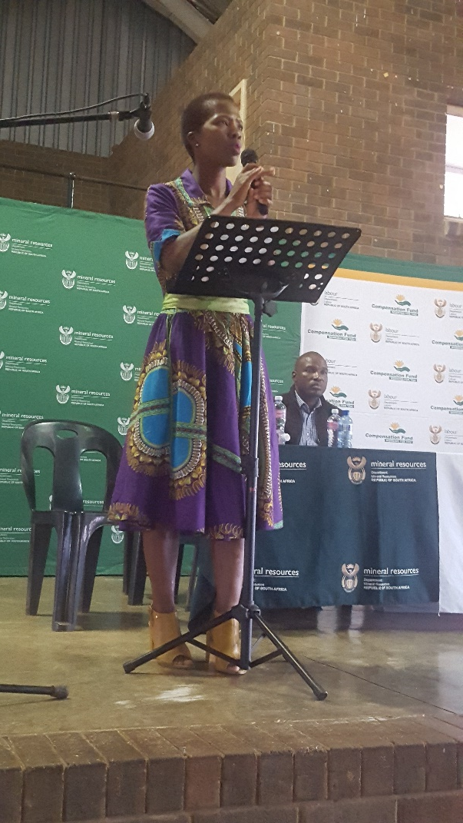
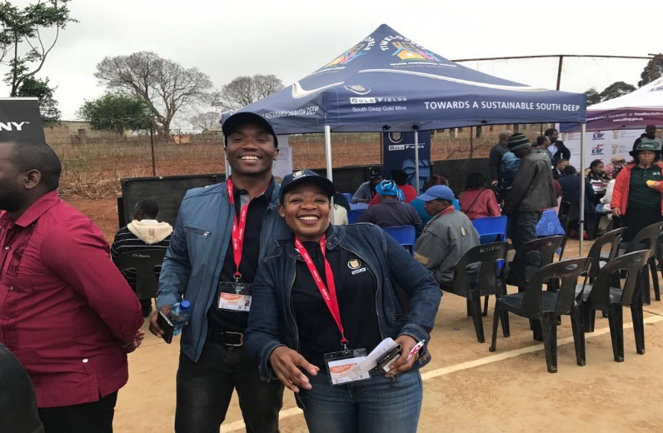
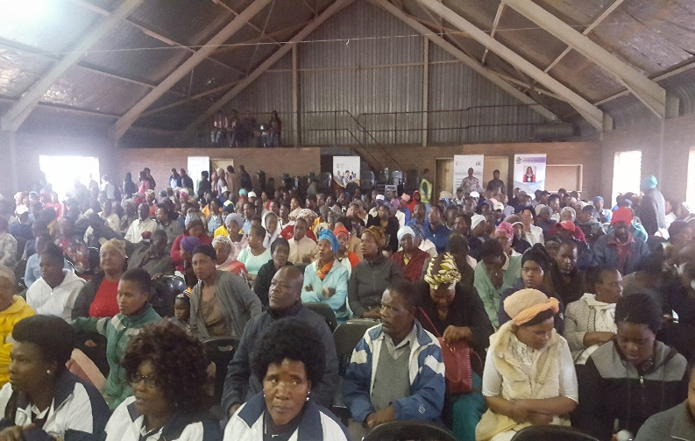
Pongola

Slide 43

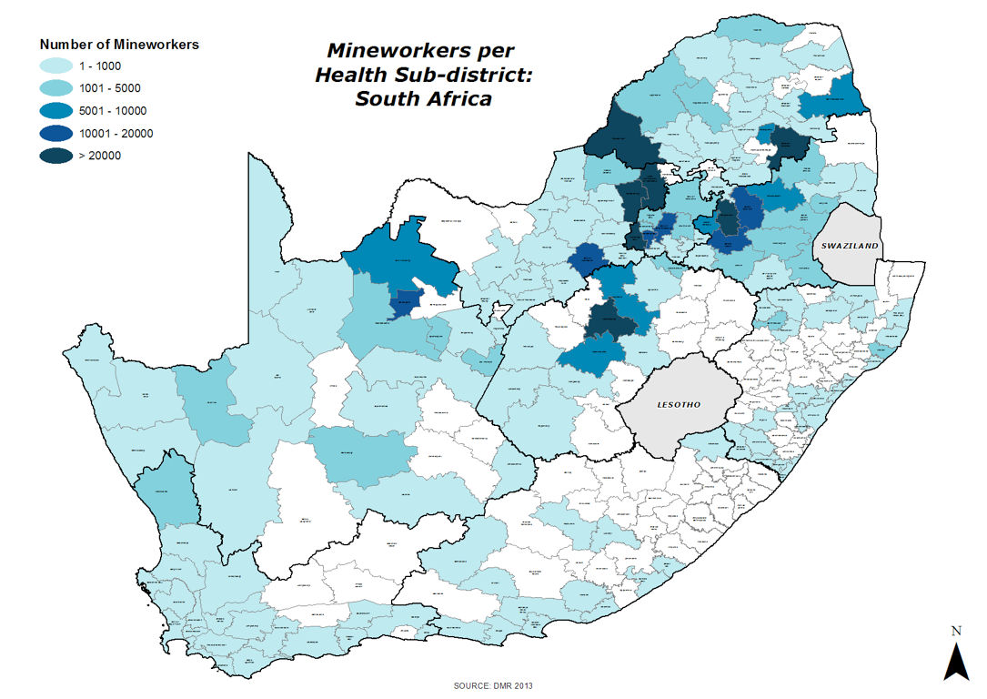
Mapping of Mines
Slide 43

Slide 44
Transport Corridors of Mineworkers

Slide 45
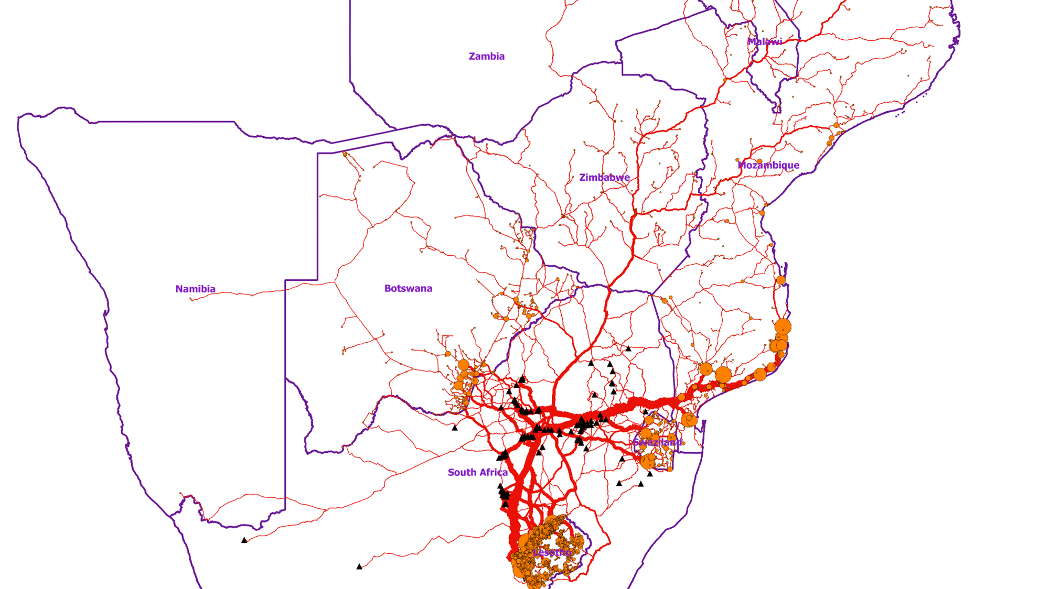
Neighbouring Countries
Location (homes)
Route of travel
Physical Barriers – rivers, mountains
Mines
Health Services

Slide 46
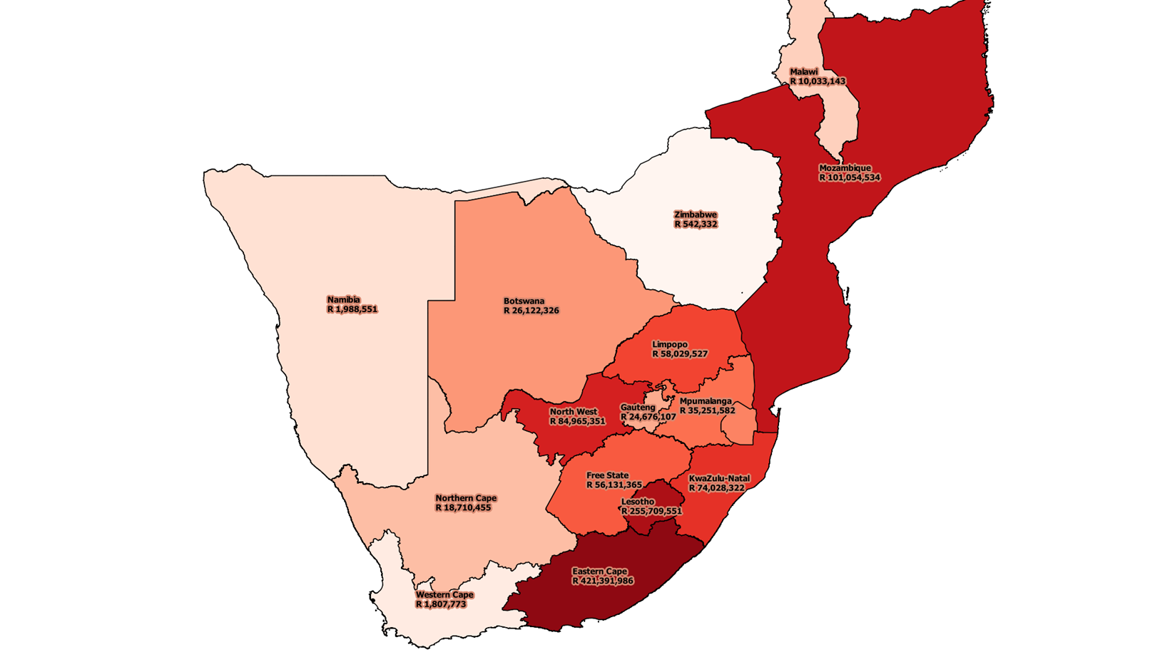
Mapped Flow of Money
(Unclaimed Benefits)

Slide 47
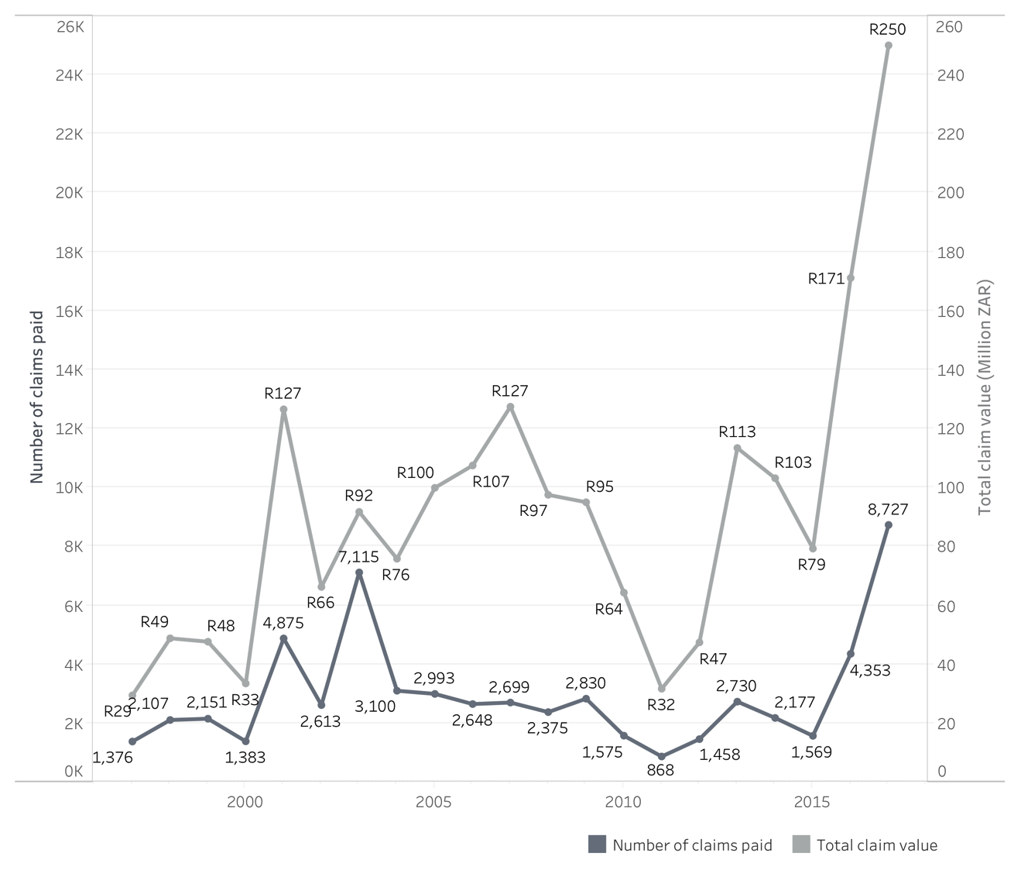
Claims Paid (1997 – 2017)
Slide 47

Slide 48
Legal Amendments
Compensation Fund (DOH) to cover current & ex-mineworkers
New workers to go to COIDA (‘clean-break’)
New governance and administration model
Levy to cover costs of administration, medical assessments & health care
Slide 48

Slide 49
Class Action Settlement R5b)
1965 to current
Covers Silicosis and Tuberculosis (TB)
Covers minimum 2 years working in mines for TB
Covers dependents
Ensure publicity, coverage and response to track and trace claimants
Benefits and amounts are finalised – 10 classes
Legal costs
Alignment to Dept of Health (MBOD/CCOD)
Covers services and medical assessments
Slide 49

Slide 50
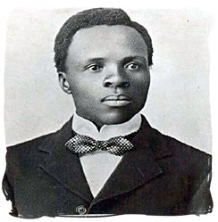
~One hundred years ago…
"Two hundred thousand subterranean heroes who, by day and by night, for a mere pittance, lay down their lives to the familiar 'fall of rock' and who, at deep levels, ranging from 1,000 to 3,000 feet in the bowels of the earth, sacrifice their lungs to the rock dust which develops miners' phthisis and pneumonia."
Sol Plaatje, first Secretary General of the African National Congress, describing the lives of miners in 1914

Slide 51
Working Together
Minerals Council / Gold Working Group
Trade Unions
Ex-mineworker associations
NDOH / Provinces / Local Govt / Trad Leaders
Neighbouring countries
Social partners
Inter- Ministerial Committee on Mining Sector
Slide 51

Slide 52
Thank You
Dr Barry Kistnasamy Compensation Commissioner Department of Health kistnb@health.gov.za 011-356 5602 0722200247
Slide 52

