Slide 1
Presentation TO THE PORTFOLIO COMMITTEE HUMAN SETTLEMENTS, WATER AND SANITATION
PROGRESS ON THE CONSOLIDATION
OF HUMAN SETTLEMENT DFIs (NHFC,RHLF,NURCHA)
3 SEPTEMBER 2019

Slide 2
TABLE OF CONTENTS
Establishment Road-Map envisages three key stages 2. HSDB Establishment & DFI consolidation milestones 3. Process undertaken to address critical milestones 4. Companies Act No 71 of 2008: NPC restrictions 5. Options considered 6. Implementation approach 7. Change management approach 8. Functionally structured 9. Organisational structure 10. Staff Complement Awards received in the current financial year 12. Merged balance sheets 13. Employees of the merged NHFC 14. Recommendation

Slide 3
HSDB: Mandate and Rationale
INCREASE SCALE OF IMPACT
DFIs are not realizing their developmental potential, as they operated at too small a scale
IMPROVE EFFECIENCIES
Mandates lack clarity in goals, are overly broad and lack focus resulting in overlap and duplication, and unserved areas
YEAR 2018
ONWARDS
HSDB
Merged
NHFC
NURCHA
RHLF
LONG TERM SUSTAINABILITY
Financial stability concerns are often used to justify reduced risk taking
Larger size enables more risk taking
Notes:
In order to meet the human settlements finance needs in a sustainable manner, a coordinated and integrated financial institutional structure is required that is able to effectively leverage government grants, wholesale and investment funding so as to maximise private sector funding, as well household contributions.
The core rationale for the HSDB resides in the need to provide effective government financing support to key segments of the housing market in the face of considerable market failure and significant need

Slide 4
Desired end state
Human Settlements Development Bank
Serves as a catalyst for change in the human settlements funding and financing role (redefinition)
Additionality:
“…Activities that HSDBis able to impact beyond that which would have occurred
Focus in addressing market failure thru innovative financing and effective risk mitigation instruments
Support the effective transformation of the human settlements sector
Notes:
In order to meet the human settlements finance needs in a sustainable manner, a coordinated and integrated financial institutional structure is required that is able to effectively leverage government grants, wholesale and investment funding so as to maximise private sector funding, as well household contributions.
The core rationale for the HSDB resides in the need to provide effective government financing support to key segments of the housing market in the face of considerable market failure and significant need

Slide 5
1. HUMAN SETTLEMENTS DEVELOPMENT BANK’S ESTABLISHMENT ROADMAP
Establishment Road-Map envisages three key stages ….stages 1&2 run in parallel…
1. Finalise Consolidation Transaction
PFMA Approvals
Establish Interim Board
Setup the Consolidated Organisational Structure
Commence with HSDB Draft Policy Business Case and Enabling Legislation
Secure Section 66 Approval
Consolidate Financials of Three DFIs
2. Establish HSDB
Business Case & Draft Legislation
Secure Approvals : Ministry & Joint Evaluation Panel
National Assembly Process
Promulgate Legislation (HSDB Act)
Operationalise Act
Secure Funding for HSDB
Finalise staffing
Implement new products and services
Deliver on mandate
3. Full Operations
1

Slide 6
2. HSDB ESTABLISHMENT & DFI CONSOLIDATION MILESTONES
PHASE 1: CONSOLIDATION - NHFC,NURCHA & RHLF
Tax Exemption for NHFC – approved effective April’16
Companies Tribunal Application – approved April’17
  3. PFMA Requirements
  Section 54 (2) - approved
  Section 66 (1) – approved
  Section 38 (1) (m) ; 51 (1) (g) – part Joint Evaluation Panel (JEP) process
  Funders (Capital providers) - approved
  AfD, EIB, PIC, DBSA/KfW
  5. Operational Integration
  Governance - Board Established
  Project Management Office (PMO) established
  Change Management facilitation
  Staff Migration to NHFC offices - finalised Oct’17
PHASE 2: ESTABLISHMENT OF HSDB
Policy for HSDB -
Business Case complete and is being Enhanced –
Drafting of Enabling Legislation/Act –
Approve and Capitalize HSDB
DONE
2. Quarter End 3
3. See point 4 below.
PHASE 3: OPTIMISATION
    Full integration of all systems and processes
    Implement new products / service lines
    Staff Migration
    4. The HSDB bill has been prioritised in the current financial year.
2

Slide 7
3. PROCESS UNDERTAKEN TO ADDRESS CRITICAL MILESTONES
  NHFC Tax Amendment Bill (Tax Exemption & Public Benefit Organisation status enablement), signed by the President - Jan 2017.
  Boards of NURCHA and RHLF passed the required resolutions to enable the donation of Assets and Liabilities to the NHFC.
  Shareholder passed resolution at the AGM in 24th November 2016 approving the merger
  NHFC to effect the transaction - RHLF and NURCHA (NPCs) to NHFC which is a for profit company.
  NHFC Board restructured , and establishment of Manco (includes executives of all three companies - 24th November 2016 ).
  HSDB integration project continues under Management Committee (MANCO) and Project Steering Committee (PSC).
  The overall timelines on Legislation, is done in partnership with the Department.
3

Slide 8
COMPANIES ACT NO 71 OF 2008: NON PROFIT COMPANY (NPC)
RESTRICTIONS
“The restrictions (the "NPC Restrictions") contained in item 1(4) of Schedule 1 to the Companies Act No 71 of 2008 state that non-profit companies, such as NURCHA and RHLF, are required, upon their winding-up or dissolution, to transfer their assets only to other non-profit entities – meaning that NHFC, as a profit company, would not be permitted to take transfer of the NURCHA and RHLF assets in terms of the proposed consolidation of RHLF and NURCHA into NHFC (the "Consolidation"), unless at fair value.”
4

Slide 9
5. FIVE OPTIONS WERE CONSIDERED…
 | IMPLICATIONS
NHFC converts to an NPC and takes transfer of the assets and liabilities of RHLF and NURCHA RHLF & NURCHA - both NPCs | This option however merely defers restrictions of the Companies Act of transfer of assets and liabilities of NPC to non NPC (NHFC to HSDB)
2. NHFC pays fair value for the assets and liabilities of RHLF and NURCHA, | The option still has similar, if not broader Companies Act, Public Finance and Management Act (“PFMA”) challenge Including cost and time implications, as well as all required permissions
3. A change to the Companies Act to allow the transfer of assets and liabilities of Not for Profit defined public entities, as part of a rationalization arrangement | The option has broader implication and it’s unlikely to succeed as it will need comment and input outside of the Human Settlements ambit
4. Special Enabling Act exempting the application | The option may still have Companies Act and PFMA challenges, time and required permissions approved
5. Application to the Companies Tribunal for an Administrative Order for a special exemption for the transaction, from the Companies Act | RECOMMENDED OPTION
5
Notes:
Short comings: Multitudes of funding frameworks but absence of coherence, Uneven value derived from developments targeting poor households

Slide 10
6. IMPLEMENTATION APPROACH
Overall approach envisaged …
  The existing three DFIs (NHFC, NURCHA and RHLF) will be merged into an expanded NHFC
  HSBD to be established in terms of the new enabling legislation (this will also convert the NHFC into the new HSDB)
  All Assets, Liabilities and Staff are transferred from NHFC to HSDB
  HSDB Board to be appointed by the Minister of Human Settlements
  Shareholder compact between HSDB and Human Settlements will incorporate the activities of the entity
6

Slide 11
7. CHANGE MANAGEMENT APPROACH
ADOPTED APPROACH WITH 4 PHASES
Insight phase
  Understanding of status quo
2. Design Phase
  Leadership workshop
  Developed leadership cohesion behaviors
  Appointment of change agents & champions (staff 3 entities)
  Employees
Meet & greet - introducing staff, change agent, change vision
  Focus groups - change agents and champions
3. Implementation Phase
  Leadership -Development of “To Be Culture Change Code”
  Leadership session on enabling change implementation
  Leadership change implementation & reinforcement review
  Change communication and dealing with resistance
  4. Monitoring and Closeout
7

Slide 12
HOW WE LOOK NOW
8

Slide 13
8. HOW ARE WE FUNCTIONALLY STRUCTURED?
Chief Executive Officer (CEO)
REVENUE GENERATING
Debt Lending and Subsidy Programmes
Incremental Lending Business
Project Finance
FINANCE
CORPORATE STRATEGY AND COMMUNICATIONS
SUPPORT SERVICES ENTITY-WIDE
CORPORATE SUPPORT SERVICES – IT, COMPANY SECRETERIAL
CREDIT RISK
CORPORATE SUPPORT SERVICES – COMPLIANCE & ENTERPRISE WIDE RISK
HUMAN RESOURCES
9

Slide 14
9. ORGANISATIONAL STRUCTURE
Chief Executive Officer
Samson Moraba
Company Secretary
Andrew Higgs
Acting Chief Financial Officer
Bruce Gordon
Incremental Lending Executive
Jabulani Fakazi
Strategic Relationships Executive
Viwe Gqwetha
Credit Executive
Zola Lupondwana
Human Resources Executive
Nomsa Ntshingila
Group Risk Executive
Sindisa Nxusani
Strategy Executive
Mandu Mamatela
Lending Executive
Lawrence Lehabe
10

Slide 15
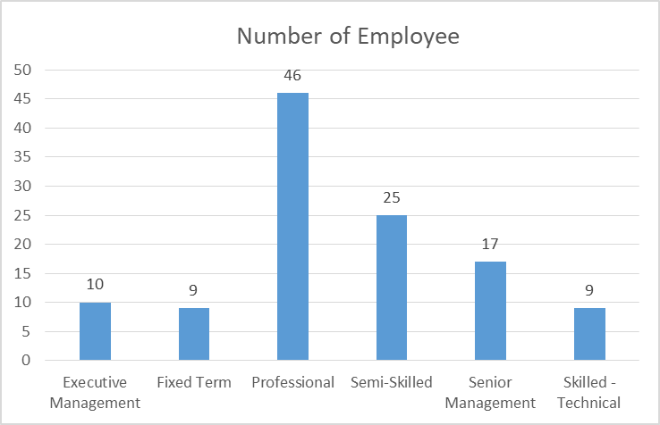
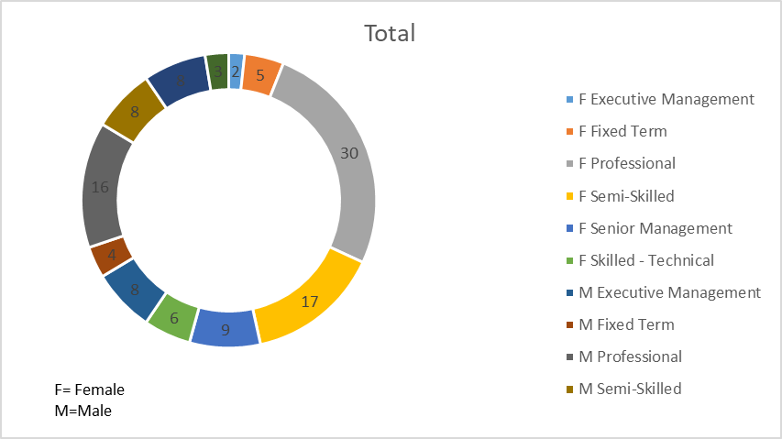
10. STAFF COMPLIMENT 116
11

Slide 16

11. AWARDS RECEIVED IN THIS FINANCIAL YEAR
12

Slide 17
12. MERGED BALANCE SHEETS
13

Slide 18

13. ONE MERGED NHFC
14

Slide 19
14. RECOMMENDATION…
The PORTFOLIO COMMITTEE OF HUMAN SETTLEMENTS, WATER AND SANITATION, IS ASKED TO NOTE THE UPDATE ON THE HUMAN SETTLEMENTS DFIs CONSOLIDATION (PHASE 1).
15

Slide 20
THANK YOU

