Slide 1
Strategic Management and
Governance
(SMG)
Presentation to the Joint Standing Committee
Strategic Management and Governance (SMG) August 2019

Slide 2
Contents
Objectives of the SMG Division
Introduction to the SMG Division
Purpose of the SMG Division
Function of the SMG Division
Services and products provided by SMG Division
Key business objectives and activities of SMG
SMG Divisional Operational Plan – Results Chain
Key performance areas
SMG Stakeholders
SMG Stakeholder Engagement Model
SMG Roles and Functional Areas
Comparative Operational Budget
Focus areas in support of the APP
Challenges and mitigating strategies

Slide 3
Objectives of the SMG division
The Strategic Management and Governance Division serves to:
enhance decision-making in the institution at both strategic and operational levels,
advocates and enhances good corporate governance,
facilitates strategy execution and change management, and
drives innovation through strategic initiatives and projects to ensure a more effective and efficient institution.

Slide 4
Introduction to the SMG division
The Strategic Management and Governance Division came together as a Division in 2016.
The components of SMG operated independently before. These components comprised of the:
Strategic Planning Office,
Enterprise Project Management Office,
Policy Monitoring Unit and
Risk Management Office.
There is a great need to emphasize teamwork and collaboration within the division so that there is an integrated approach to strategic management within the institution and to unlock synergies.

Slide 5
Purpose of the SMG division
The Financial Management of Parliament and Provincial Legislatures Act (FMPPLA), Act 10 of 2009 as amended, requires that the Accounting Officer (Secretary to Parliament) of Parliament:
submit a 5-year strategic plan;
submit a 3-year annual performance plan;
submit the annual budget;
appropriate and approve the use of money for each financial year;
facilitate tabling of the strategic plan, annual performance plan, and budget;
submit monthly financial statements;
submit quarterly performance reports;
submit a mid-year budget and performance assessment;
submit the annual report; and
facilitate tabling of the monthly, quarterly, mid-year and annual reports.

Slide 6
Function of the SMG Division
The Strategic Management and Governance Division offers advice and support for the strategic management of Parliament, by providing:
strategic planning and strategic advisory services to enhance decision-making,
facilitation of strategic and governance processes,
publication of governance documents
project and program management services
risk identification and risk management services
assurance services
business intelligence and analytical services
monitoring and evaluation of strategy implementation

Slide 7
Services and products provided by SMG Division
Strategic advisory services
Policies and Frameworks relating to strategic management and governance
Best practice processes and standard operating procedures
Process advisory
Facilitation sessions and workshops, co-ordination and collaboration
Strategic alignment
Programme and project management
Business case development
Strategic and business analysis
Decision support
Publication of institutional governance documents
Strategic plan
Annual performance plan
Strategic and operational risk registers
Quarterly performance reports
Mid-year performance report
Annual report
Assurance Services
Compliance
Evaluations

Slide 8
Key business objectives and activities of SMG
Outcomes envisaged for SMG include enhanced decision-making, improved governance and compliance, improved strategy execution, and a higher rate of change and transformation. These are required for increased institutional effectiveness and efficiency.
These outcomes are supported by strategic advice, facilitation services, assurance services and the publication and communication of governance documents.
Internal activities required include process advisory, facilitation and collaboration, co-ordination, publication and communication of strategy.
Key inputs include skills related to strategic management processes, facilitation, strategic communication; policy development and processes
This culminates in the following Value Chain for SMG. The outcomes depict the value created.

Slide 9
Better decisions result in value
Value Created by SMG

Slide 10
Key Performance areas
Performance indicator | 2018/19 | Medium term Targets
 |  | 2019/20 | 2020/21 | 2021/22
1. % compliance with FMPPLA governance prescripts | 100% | 100% | 100% | 100%
2.1 Number of governance documents prepared | 8 | 10 | 8 | 8
2.2 Quality of Governance Documents (client ratings) | - | 3 of 5 | 3.5 of 5 | 4 of 5
2.3 Quality of Decision Support (client ratings) | - | 3 | 3.5 | 4
3. Maturity level (new indicator) (outcome) | - | 2.2 of 5 | 2.8 of 5 | 3.3 of 5

Slide 11
SMG Stakeholders
The strategic management process at Parliament is conducted by means of institutional-wide processes, requiring engagement and involvement of several key stakeholders to fulfil institutional goals. A summary of stakeholder analysis for the SMG Division can be viewed in the table below.

Slide 12
SMG Stakeholder Engagement Model
Stakeholder | Method of engagement | Action
Secretary to Parliament | Continuous management | Provide services and assistance in strategic management process
Executive Authority | Active involvement | Provide support in process
Presiding Officers Chief Whips | Engagement | Include in process
Deputy Secretaries Division Managers | Involvement | Include in process
Managers Staff | Consult | Consult on contents
Organised Labour (Union Leadership) | Involve/Consult | Sometimes involve/mainly consult
Committees Provincial Legislatures | Consult | Consult on contents
Political parties Members | Consult | Include in process
General public | Inform | Provide information Tabling and publication of documents
Audit Committee Joint Standing Committee on FMMPLA Auditor General | Report | Provide reports and documents

Slide 13
SMG Roles and Functional Areas

Slide 14
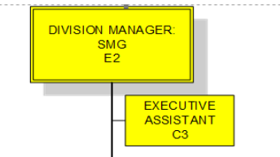
SMG Office
No Executive Secretary (C1) position due to budget constraints

Slide 15
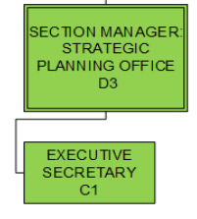
Strategic Planning Office
Facilitation and roll-out of operational planning to divisions, sections, units and committees is challenging due to capacity and budget constraints

Slide 16
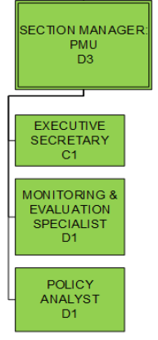
Policy Monitoring Unit

Slide 17
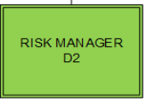
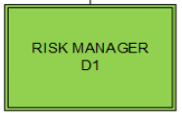
Risk Management Office
Specialist skills – forensic, fraud and disaster management skills lacking. No established Enterprise Wide Risk Management function. Emphasis on risk identification rather than risk management

Slide 18
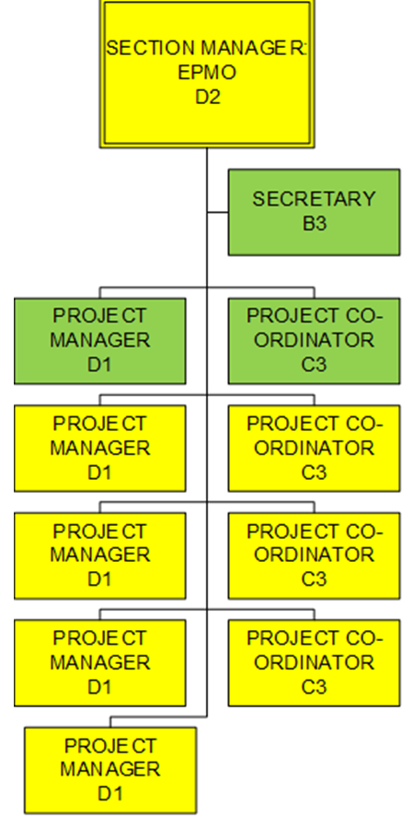
Project Management Office

Slide 19
Comparative Operational Budget
Section | 2014/2015 | 2015/2016 | 2016/2017 | 2017/2018 | 2018/2019 | 2019/2020
SMG Office | SMG was established in December 2016 |  |  | R91,176 | R250,100 | R195,000
Strategic Planning Office (SPO) | R1,560,000 | R117,000 | R50,000 | R30,000 | R23,000 | R 29,000
Policy Monitoring Unit (PMU) | R745,645 | R824,000 | R444,361 | R100,000 | R62,000 | R 80,000
Risk Management Office (RMO) | Formed part of the Office of the Secretary to Parliament |  |  | R49,000 | R14,000 | R 20,000
Enterprise Project Management Office (EPMO) | R1,383,393 | R1,740,998 | R1,144,549 | R649,242 | R400,900 | R305,000
Total Budget for SMG | R3,689,038 | R2,681,998 | R1,638,910 | R919,418 | R750,000 | R629,000
Downturn budget – optimisation of activities based on allocated budget rather than activities determining budget

Slide 20
Focus areas in support of the APP
Increasing strategic maturity of the institution
Frameworks and guidelines
Capacity development interventions
Increasing risk maturity of the institution
Frameworks and guidelines
Capacity development interventions
SMG client value proposition
Workshops
Team coaching interventions
Establish strategic execution capability
This is a priority under the Institutional Re-alignment Project
Establish holistic enterprise wide risk management function
This is a priority under the Institutional Re-alignment Project

Slide 21
Challenges and mitigating strategies
Low levels of strategic maturity in the institution – lots of managerial capacitation is required in the field of strategy
Weaknesses in strategic execution capabilities – emphasis is on planning and reporting rather than pro-active strategic execution – emphasis on what needs to be done – no focus on how to implement
Fragmented governance – conflation of authority and decision making due to many governance structures existing – overarching structure such as a Board does not exist.
Alignment between skills match and roles in SMG – not ideal
Risk maturity in the institution is low – managerial capacitation is required
Budget for SMG reduced over the last few years – a need for prioritisation
Structure for SMG – not ideal operating model
Some of the challenges in SMG need to be addressed via the Institutional Re-alignment Project.

Slide 22
Appendix

Slide 23
SMG new structure consideration
Merely a block. Does not imply a Head of SMG need exist or that Strategy and governance functions needs to reside with the same person
SMG
Strategy Functions
Not a position but a grouping
Risk, Governance and Compliance
EWRM position
Planning
EPMO
Strategic Execution and Enablement
Risk management
Policy and Compliance
Governance FORA Support
Centre led and decentralise.
Wider than administration
Business analysis.
Institutional projects.
Strategic initiatives
Monitoring and Evaluation.
Tracking of Strategic Execution through initiatives and management actions.
Change management and innovation.
Strategic Risks
Operational Risks
BCP
Fraud
Centralised Compliance
Institutional Policy
Governance Charter reworked.
Reworked to support the governance model
Push Functions
Pull functions

