Slide 1
SABC PRESENTATION TO SELECT COMMITTEE ON PUBLIC ENTERPRISES AND COMMUNICATIONS

Slide 2
TABLE OF CONTENTS
EXECUTIVE SUMMARY
FINANCIAL SUSTAINABILITY
HUMAN RESOURCES

Slide 3
EXECUTIVE SUMMARY
As the only national public broadcaster, the SABC must offer a range of informative, educational and entertainment programmes that showcase South African attitudes, opinions, ideas, values, talent and artistic creativity.
Programming must be in all the country’s official languages; offer a plurality of views and a variety of news, information and analyses from a South African perspective; and advance the national and public interest.
As a custodian of the country’s diverse cultural heritage and expressions, the SABC is a platform for the expression of the hopes, dreams and aspirations of South Africans, be these past, present or in the future.
The SABC must deliver on its public service mandate while operating in a rapidly changing business environment.
Factors – structural and symptomatic – have impacted on the SABC’s viability over the past years. These have led to the situation that the SABC is currently finding itself in.

Slide 4
EXECUTIVE SUMMARY
The following are some of the main contributors to the Corporation’s dire financial status:
Funding model of the SABC (over-reliance on commercial / advertising revenue);
Regulatory / legislative framework not keeping pace with growth of digital technology, the convergence of media, technology and telecommunications;
Changing media consumption and audience needs;
Global slowdown in economic growth and related foreign exchange fluctuations significantly affecting the core business of the SABC, as it needs to acquire content, sports rights and technology;
Multinational advertisers have reduced their industry-wide spending over the past 24 months;
SABC’s operating environment – having to compete with commercial broadcasters, while complying with public sector operating guidelines;
Cost of mandate (compounded by higher costs related to delivery on the mandate, especially for events of national importance of which sports is a major contributor, both planned and unplanned). – Cost of R6.5 billion over the next 3 years.

Slide 5
EXECUTIVE SUMMARY
In the last few years, the SABC has also faced many internal challenges, including a decline in audience and revenue, some decisions that were taken were detrimental to the SABC’s revenue and reputation, and leadership instability that prevented the timely implementation of policy and business decisions to stabilise the institution.
The above factors contributed to the SABC’s dire financial, operational and governance situation.
During July / August 2018, the SABC, under the leadership of the new Executive Directors, developed a Strategic Roadmap and Turnaround Plan aimed at guiding the Corporation’s turnaround to financial sustainability, ensuring that it could operate competitively in the evolving digital landscape whilst delivering on its mandate.
The three main elements of the turnaround strategy are: dealing with legacy and governance issues; addressing regulatory and policy constraints; and implementing mission-critical commercial and operational strategies.
The implementation of our strategic roadmap by the SABC employees has guided the SABC throughout the past and current financial years, and has helped in keeping the SABC afloat without any financial injection. It has helped the Corporation to fulfil its public mandate, drive revenue growth, ensure organisation wide cost cutting measures, launch OTT and develop a News app, drive operational efficiencies in the organisation, and deal with legacy governance matters.

Slide 6
EXECUTIVE SUMMARY
The SABC applied for Government Funding due to its severe liquidity crisis which is threatening the Corporation’s status as a going concern, as also highlighted by the Auditor General.
The applications were based on the Corporation’s dire financial situation, along with its Board approved Strategic Roadmap and turnaround plans designed to stabilise the SABC and return it to profitability whilst fulfilling its public mandate.
Engagements between the SABC, Department of Communications and National Treasury have been on-going since the SABC’s funding application.
As part of the application for government funding and to respond to the pre-conditions set by National Treasury, the Government Technical Advisory Centre (GTAC) was appointed by the Department of Communications to assist the SABC in bolstering its turnaround strategy and to ensure that pre-conditions for funding are met.
Several work sessions have taken place during the past months and good progress is being made in this regard.

Slide 7
EXECUTIVE SUMMARY
The SABC is also working with the Department of Communications on the following:
Receiving input from DoC and National Treasury’s GTAC team on the SABC’s existing, Board approved, strategic roadmap and turnaround strategy. The consolidated input into the turnaround strategy will be submitted to the Minister of Communications by September 2019.
The SABC’s funding model in a multimedia and multichannel environment.
Revenue enhancement initiatives i.e. commercial and sales business agreements.
Accelerating the implementation of digital migration.
A new institutional model.
Costing and funding of the SABC’s public service mandate.
Critical policy and regulatory amendments to be driven by DoC i.e. Broadcasting Amendment Bill, Must Carry Regulations, Sports Regulations.
On-going engagements are taking place with the Minister of Communications regarding the SABC’s immediate funding requirements. Funding needs up to the end of the financial year have been submitted to the Minister for consideration.

Slide 8
STRATEGIC ROADMAP

Slide 9
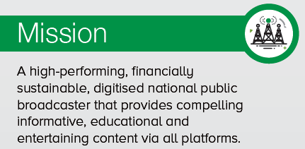
STRATEGIC ROADMAP

Slide 10
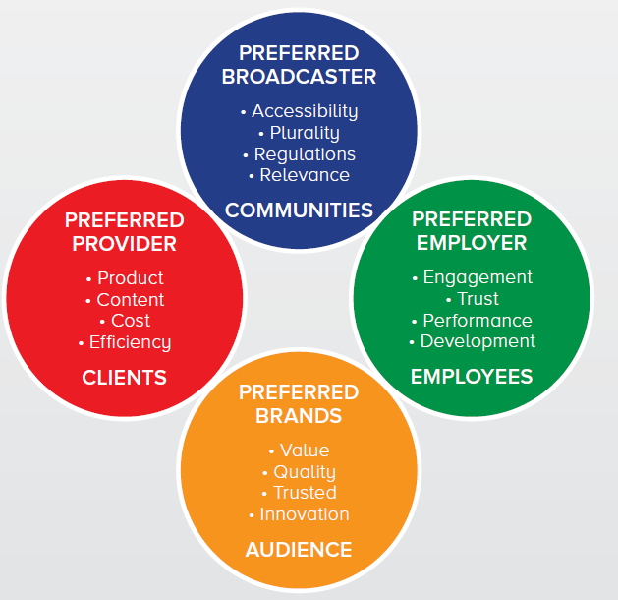
STRATEGIC ROADMAP

Slide 11
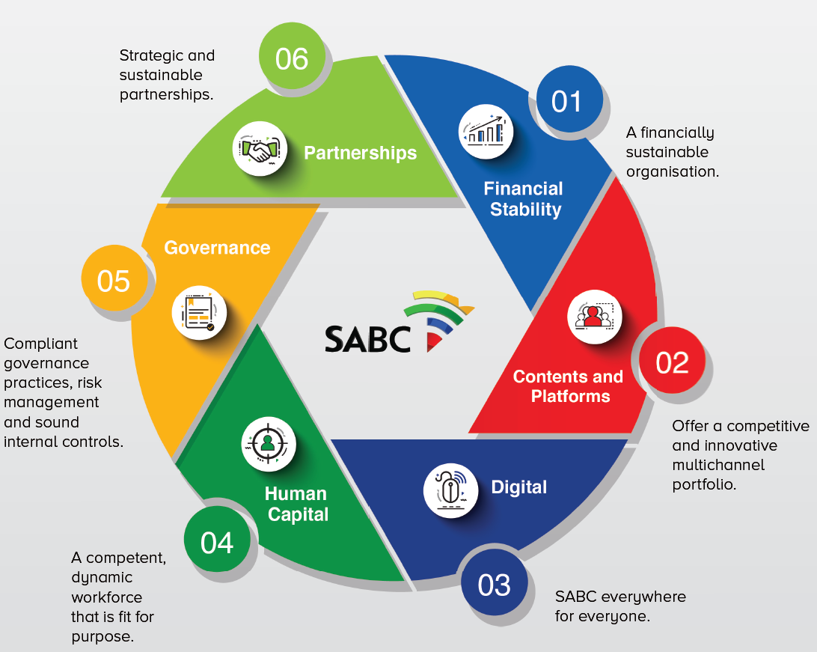
STRATEGIC ROADMAP

Slide 12
STRATEGIC ROADMAP
REVENUE
EXPENDITURE
WORKING CAPITAL
AUDIENCE SHARE
OPERATIONAL EFFICIENCIES
CORPORATE AND BRAND IMAGE
ORGANISATIONAL CLIMATE
COMPLIANCE

Slide 13
STRATEGIC ROADMAP
RESPECT
Respect will be our currency in our engagements internally and externally
TRUST
We will cultivate an environment of trust with each other
INTEGRITY
We will always do what is right
QUALITY
The quality of our work will be of the highest standard

Slide 14
STRATEGIC ROADMAP
RESPONSIBILITY
ATTITUDE
COMPETITIVENESS
EXECUTION
Be focussed
Be disciplined
Take ownership
Do what matters
Cross functional cooperation
Be positive
Be the agent of change
Be engaged
Knowledge-sharing
Take calculated risks
Have an entrepreneurial mind-set
Be innovative
Continue learning
Flawless and efficient delivery
Be effective
Deliver quality on time
Excellence in operations

Slide 15
FINANCIAL SUSTAINABILITY

Slide 16
FINANCIAL SUSTAINABILITY - SUMMARY
The SABC’s dire financial situation worsted further during the 2018/19 financial year and the Corporation ended March 2019 with a cash balance of only R72m.
Its cash flow is depleted and therefore the SABC cannot honour payments to service providers, adhere to its committed contracts, and commission local content productions.
The SABC ended FY2018/19 with an unaudited loss of Loss for the year of R483m.
Losses have decreased over the past number of years from R1 billion in 2016/17, to R622m in 2017/18, to an unaudited loss of R483m in FY2018/19 (as at May 2019, audit still in progress) – this is a 33% improvement. However, the SABC’s financial position remains severe.
The SABC applied for Government Funding as far back as November 2017 due to its severe liquidity crisis which is threatening the Corporation’s status as a going concern, as also highlighted by the Auditor General.
The applications were based on the Corporation’s dire financial situation, along with its Board approved Strategic Roadmap and turnaround plans designed to stabilise the SABC and return it to profitability whilst fulfilling its public mandate.
Feedback is still being awaited on the funding request.

Slide 17
WHERE WE CAME FROM – PAST 10 YEARS
Over the past 10 years the SABC has only made a profit in the three years from 2011/12 to 2013/14.
Those profit making years had the lowest investment in content as indicated by low amortisation of PFSR, averaging R1.3bn.
The biggest loss in FY2016/17 also carries the highest amortisation of content at R1.95bn.
Employee cost averaged 36% (R2.2bn) of revenue from 2011/12 to 2013/14.

Slide 18
WHERE WE CAME FROM – PAST 10 YEARS
Forecasted figure at the beginning of FY2018/19

Slide 19
IMPACT OF FINANCIAL CHALLENGES
The SABC’s is technically insolvent.
Cash flow is depleted and therefore the SABC cannot honour payments to service providers, adhere to its committed contracts, and commission local content productions.
Trade and other payables amount to R1.8 billion as at 30 June 2019.
Significant suppliers due and overdue are Sentech (R554million), Supersport (R259million), SAMRO (R135million) various providers of content (R174milion).
Several major content providers of key programming (e.g. ‘soapies’) have ceased production and are retaining content until outstanding payments have been received.
The public broadcaster relies heavily on these programmes to generate advertising revenue and the inability to invest in content negatively affects the financial sustainability of the SABC and the local production industry.
Should this crisis not be addressed as a matter of urgency, the SABC would be unable to operate and the “black-on-air” scenario is a real and highly possible threat.

Slide 20
IMPACT OF FINANCIAL CHALLENGES
Service providers that have successfully tendered for the upgrading or implementation of broadcast critical equipment are now declining tenders or demanding upfront payment. Many service providers have stopped bidding for tenders in totality.
Maintenance on the SABC’s infrastructure and buildings cannot be performed placing the Corporation in an extreme risky position in terms of health and safety matters.
Sports Rights cannot be acquired and the SABC is facing increased public pressure and outcry for the non-broadcasting of Sports of National Interest. The offers that the SABC is making to acquire Sports Rights are being rejected.
The SABC is not receiving any funding for the broadcasting of Events of National Interest and therefore some of these productions will have to be ceased.
On 13 December 2018, the Companies and Intellectual Property Commission (CIPC) issued a notice to the SABC in terms of section 22(2) of the Companies Act of 2008 to show cause regarding reckless trading or trading under insolvent circumstances. A response was provided to the Commission, however, the Commission indicated that the situation will be monitored closely. CIPC is following up on this matter on a monthly basis.

Slide 21
IMPACT OF FINANCIAL CHALLENGES
SOLVENCY AND RECKLESS TRADING
The Companies Act states that a company must not carry on its business recklessly, with gross negligence, with intent to defraud or trade under insolvent circumstances.
“Trading under insolvent circumstances” is accepted to mean that a company does not meet the “solvency and liquidity test” criteria. Currently SABC is unable to pay its debts as they fall due with some of them remaining unpaid for the past six months.
This will be directly contravening the Companies Act, and if that is the case, may lead to liability for the Directors.
Acquiring new debt may also increase the risk of negligence on the part of Directors. The Sections related to an organisation being financially distress – as defined – is also applicable.

Slide 22
MEASURES TAKEN TO ENSURE FINANCIAL SUSTAINABILITY
Cost containment and cash conservation measures are in place and as at 30 June 2019, the SABC through these initiatives managed to preserve an amount of R524m. It is worth noting that R230m of that relates to underspending in investment in content, while R57m is due to underspending in Marketing. This has a negative impact on future revenue generation efforts. Also, this amount is unfortunately not enough to address the current and projected losses of the Corporation.
Fit for purpose structure: A major focus area is the review of the SABC’s operating model and structure and good progress has been made is this regard. The SABC has to review its operating model to keep up with the shifting competitive landscape, customer needs, markets and competitive threats. The SABC’s employee costs is just over R3 billion which makes up close to 45% of all its expenditure. The fit-for-purpose structure is aimed at addressing this matter as well.
Entering into payment arrangements with major suppliers and service providers; these suppliers and service providers entered into new contractual relationships with the SABC with the full and public knowledge of the SABC’s financial position;
Business Relationship proposals and discussions / negotiations. Exploring the viability of entering into partnerships with Telco’s, Media Houses, etc on order to distribute content, increase revenue and save costs.
SABC Property Portfolio. Investigating the disposal of non-core assets (buildings, vacant land) as well as broadcasting assets (Channels and Stations).

Slide 23
MEASURES TAKEN TO ENSURE FINANCIAL SUSTAINABILITY
Acquisition of sports rights and broadcasting of sports of national interest: As part of the SABC’s turnaround strategy, all sports rights fees and costs are being reviewed and renegotiated on a clearly calculated, justifiable and commercially viable model, after years of exorbitant, escalating fees.
This strategy is receiving push-back from sports federations and associations, as well as the public. However, without funding from other avenues (e.g. the Department of Sport and Recreation) and/or changes to sports rights regulations, the SABC will have to continue as per above strategy to save costs.
MTEF submissions: The SABC has been submitting MTEF funding requests on an annual basis. These requests have always been aligned with Government’s National Development Plan, the Medium-Term Strategic Framework, and the Ministry of Communications’ priorities. Meetings with the National Treasury took place over the years to discuss the requests.
A consistent request that featured in all the applications was that of funding for national and local elections. The most recent submission included funding for capex, elections and broadcasting sporting events. None of the MTEF requests submitted over the years have been approved. Further discussions are taking place with National Treasury to discuss the latest submission.

Slide 24
MEASURES TAKEN TO ENSURE FINANCIAL SUSTAINABILITY
Review of regulatory framework: The SABC has been involved in various ongoing policy and regulatory processes that aim to culminate in new legislation, which will affect the SABC's revenue generation and business operations in future. Should the regulatory framework be amended, as per the SABC’s requests, it could have a major impact on both costs and revenue.
Amending Must Carry regulations would mean new and additional revenue from all subscription broadcasters, amending the DTT regulations would lower costs by allowing greater use of DTH, amending sports rights regulations would lower costs by allowing the public broadcaster to get cheaper and fairer access to rights, and TV licence fee amendments would increase revenue through higher tariffs plus better enforcement and collection.
The SABC estimates that these changes could contribute R500 million to R1 billion per year to its bottom line. However, any review and amendments to the Act could take 12–18 months. The SABC would not be able to realise the benefits of such changes soon.

Slide 25
FINANCIAL SUSTAINABILITY STRATEGIES
REVENUE GROWTH
Maximise the overall inventory of airtime on Television Maximise the overall inventory of airtime on Radio Bulk inventory trading deals to improve SABC’s trading reputation with clients High-volume, high-value, short-term trading Improve TV Licence collection model - Website enhancements to improve online payments; GIS-enabled new licences to identify unlicensed viewers Changes to TV Licence legislation and annual TV Licence tariff increases (Current tariff just over 70c per day) Government grant to be increased to cover events of national interest – elections, funerals, certain sporting codes Content exploitation and channel carry fees On-going policy and regulatory processes that aim to culminate in new legislation, which will affect revenue generation and business operations. Could have a major impact on both costs and revenue.
COST CONTAINMENT
Review the SABC’s operating model and structure Partnerships and sponsorship to assist with producing content Strategies to reduce programme, film and sports rights costs Strategies to reduce signal distribution and linkage cost

Slide 26
RECAPITALISATION AND WHAT THE MONEY WOULD BE USED FOR
TRADE AND OTHER PAYABLES
This area is central to the operations of the SABC. The withdrawal of these creditors has a direct impact on broadcasting services such as signal distribution, Sports Rights, content production and general service delivery to the SABC. Payment of outstanding creditors will ensure:
Production houses / producers can continue to produce content for the SABC’s platforms (currently production houses are withholding content or ceased production).
Schedule stability which in turn will attract advertisers / revenue. Less repeats will be broadcast.
The South African production industry will be revived and job losses in this environment reduced.
National signal distributor (Sentech) will receive outstanding amounts due for their strategic plans. Sentech would also be able ensure signal distribution to all its customers (including the SABC) thus eliminating the risk of ‘black on air’.
Goods and services to the SABC that were stopped will be reinstated and the SMME, sector in particular will be impacted positively.

Slide 27
RECAPITALISATION AND WHAT THE MONEY WOULD BE USED FOR
INVESTMENT IN CONTENT (PROGRAMME INVENTORY)
To fully commercialise content investment and ensure industry development, it is critical for the SABC TV to produce programme inventory. This requires a lead time of at least 18 months, and sales teams need to have material to sell nine months in advance. The SABC’s cash flow challenges negatively affected the production industry, as the SABC either delayed or did not pay obligations as they became due.
In order to fully commercialise content investment and grow industry development it is critical that SABC Television “produces to shelf” which requires a lead time of at least 18 months.
Will allow the SABC's Sales Team to have material to sell advertising at least nine months and in advance.
Allow for stable schedules and less repeat programming resulting in stable and increased revenues.
Attract and retain audiences which will have positive impact on revenue generation (advertising and TV licence fees).

Slide 28
RECAPITALISATION AND WHAT THE MONEY WOULD BE USED FOR
CAPITAL EXPENDITURE
The SABC’s cash constraints directly affected the replacement, upgrading and maintenance of broadcast-critical equipment. CAPEX projects had to be deferred as budgets were cut. System and equipment failures occur on an on-going basis, undermining the SABC’s ability to sustain quality broadcasts, retain audiences and generate revenue. The SABC’s buildings and infrastructure also do not fully comply with the requirements of the Department of Labour but upgrading and maintenance cannot be performed because of the lack of funds. CAPEX projects will ensure:
Improve operation efficiencies (lifts working, broadcasting equipment repaired, upgraded, buildings restored, fire hazards eliminated).
Comply with relevant legislation (OHSA).
Quality and uninterrupted broadcasting of programmes on TV and Radio.
Invest in latest technology and systems that will enable the SABC to compete with other media entities for audiences and revenue.

Slide 29
HUMAN RESOURCES

Slide 30
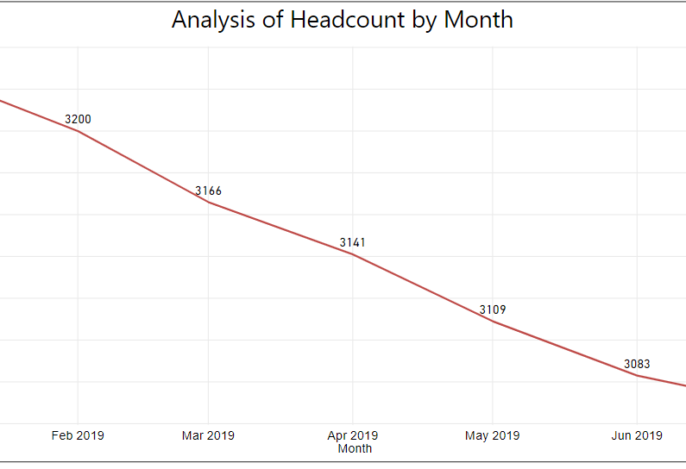
HUMAN RESOURCES MATTERS IMPACTING ON THE DELIVERY OF THE SABC MANDATE
RECRUITMENT
The SABC placed a moratorium on recruitment from September 2018. This reduced the headcount of the organisation considerably. The moratorium did, however, hamper operations. (A moratorium on the filling of vacancies was also placed by the DoC as temporary intervention to deal with the Department’s reconfiguration issues).
At the beginning of the financial year 127 positions were identified as critical to the organisation. These positions were included in the organisational budget at a cost of R105 million. In July 2019 the Department of Communications approved a partial upliftment of the moratorium and the filling of 91 critical vacancies at an annual cost of R94 882 662. All these positions are currently in a recruitment process.

Slide 31
HUMAN RESOURCES MATTERS IMPACTING ON THE DELIVERY OF THE SABC MANDATE
ACTING IN VACANT POSITIONS
Due to the moratorium on recruitment acting incumbents were appointed in vacant positions in order to ensure business continuity.
There is currently a total of 227 acting incumbents in positions across the organisation at a monthly cost of R1 806 660. This may indicate a saving to the SABC, but it is impeding effective operations as there is no stability within these positions and incumbents cannot discharge the full functionality of their acting roles.
ACTING LEVEL | NUMBER OF ACTING INCUMBENTS
Group Executive | 5
General Manager | 35
Middle Management | 105
Bargaining Unit | 112

Slide 32
HUMAN RESOURCES VISION
HUMAN RESOURCES MATTERS IMPACTING ON THE DELIVERY OF THE SABC MANDATE
NON-PAYMENT OF SALARIES
Due to the Corporation’s current financial situation, the potential inability to pay salaries is a constant threat to the workforce.
Employees are continuously disengaged due to insecurities around future salary payments by the corporation.
In the event Corporation reaches a point where salaries cannot be paid, employees may decide to embark upon industrial action, subsequent to having gone through the necessary dispute resolution processes, e.g. CCMA. This in turn may lead to a “black on air” situation which will be to the detriment of the whole country.

Slide 33
HUMAN RESOURCES MATTERS IMPACTING ON THE DELIVERY OF THE SABC MANDATE
HUMAN RESOURCES STRATEGY 2019/2020/2021
PERFORMANCE MANAGEMENT
Human Resources has been attempting to implement Performance Management in the SABC since 2012. An organisation with no performance management runs the risk of not achieving its business objectives.
In 2013 the SABC Board approved a Performance Management policy for the organisation. Organised Labour, however, opposed the policy citing that the previous SABC leadership promised that performance bonuses would be budgeted for. No evidence of a Board resolution to this effect could, however, be found. Various unsuccessful consultations between Management and Organised Labour have culminated in a dispute being lodged in 2018/2019.
After several attempts by HR and Management to resolve the dispute amicably, a resolution was taken by the current SABC Board that performance bonuses cannot be guaranteed and will be based on the profitability of the SABC.
Performance Management is currently being implemented at all levels within the organisation. Organised Labour has been informed of this decision and HR has commenced with Performance contracting across the SABC.

Slide 34
HUMAN RESOURCES VISION
HUMAN RESOURCES MATTERS IMPACTING ON THE DELIVERY OF THE SABC MANDATE
PERFORMANCE MANAGEMENT
From the statistics below it is evident that bargaining unit employees are still opposed to the implementation of performance management. The corporation is, however, going ahead with the roll-out.
1st quarter reviews are currently underway.
Performance Management Reviews per Scale Code
Level / scale code | Number of Employees | No. of performance contracts received | No. of Q4 performance contracts Reviewed | No. of performance contracts not Reviewed | Percentage of contracts reviewed % against the total staff complement % | Percentage of contracts reviewed against contract received%
Executive Directors | 2 | 2 | 0 | 2 | 0% | 0%
Group Executives (110 and 115) | 8 | 8 | 0 | 8 | 0% | 0%
GM’s (120) | 34 | 33 | 3 | 30 | 8% | 9%
Middle Management (125) | 148 | 119 | 31 | 88 | 21% | 26%
Middle Management (130) | 256 | 145 | 44 | 101 | 17% | 30%
200 | 1 | 0 | 0 | 0 | 0% | 0%
300 & Below | 2689 | 215 | 41 | 174 | 1.5% | 19%
Totals | 3137 | 522 | 119 | 403 | 3.7% | 22%
Performance Management Contracts Signed per Division
Business Unit | No. of Employees | No. of performance contracts received | No. of performance contracts not received | Percentage of contracts received %
Television | 241 | 0 | 241 | 0%
Radio | 326 | 29 | 297 | 8%
MTI | 646 | 42 | 604 | 5%
CE | 229 | 3 | 226 | 2%
News and Current Affairs | 834 | 0 | 0 | 0%
Group Services | 663 | 48 | 615 | 7%
Sport | 52 | 4 | 48 | 8%
Provincial Operations | 145 | 0 | 145 | 0%
Totals | 3136 | 126 | 3010 | 4%

Slide 35
HUMAN RESOURCES VISION
CONSEQUENCE MANAGEMENT
The SABC is managing a number of disciplinary cases emanating from more than 180 forensic reports with cases of wrongdoing by employees.
Some of these cases date back a number of years, others were left incomplete or abandoned without the allegations being tested and concluded and others are current. Most of these cases emanate from the past legacy of a total disregard of policies and procedures as well as a lapse in internal controls and governance.
The SABC will continue to implement the recommendations of the Ad Hoc Committee, the Public Protector’s remedial actions, pursue sexual harassment cases, irregular appointments, and irregular salary increases. In all these matters, due processes are followed.

Slide 36
THANK YOU

