Slide 1
PRESENTATION TO THE NCOP 28 AUGUST 2019

Slide 2
PRESENTATION OUTLINE
    Background
  Mandate
  Business Model
  Organisational Structure
    Performance Information
    Alignment to the 7 Apex Areas
    Strategic Objectives
    Financial Status
    Challenges and Mitigation
    Conclusion
    Annexure
      2019/2020 APP

Slide 3
BACKGROUND

Slide 4
MANDATE OF THE ENTITY
Corporate and Statutory Form
Road Accident Fund Act, 1996 (Act No. 56 of 1996) & RAF Amendment Act, 2005 (Act No. 19 of 2005)
National Public Entity (Schedule 3A of the PFMA).
Constitutional Court Rulings and legal precedents have shaped the mandate.
Objective of the Fund
    Section 3 of the RAF Act
    Payment of compensation for loss or damage wrongfully caused by the driving of motor vehicles
    Limited to bodily injury or death
    Excludes secondary emotional shock
    Material damages not covered (non personal damages)
    Section 17(4) of the RAF Act
    Provides support in respect of future treatment and rehabilitation (future medical expenses i.e. rehabilitation centre costs, assistive devices, home modification, treatment and other related goods and services)

Slide 5
Compensation
    :
    Section 17 of the RAF Act
    General damages (serious injury)
    Past medical expenses
    Future medical expenses (undertaking)
    Past loss of earnings / earning capacity
    Future loss of earnings / earning capacity
    Past loss of support
    Future loss of support
    Section 18 of the RAF Act
    Necessary actual costs of funeral / cremation
    (Coffin, Transportation, storage and the grave / cremation costs)

Slide 6
MANDATE OF THE ENTITY
    Section 21 of the RAF Act
    Indemnifies the wrongdoer (for as long as the RAF can pay claims)
    Indemnification limited to civil claims
The Fund is called on to:
    Indemnify the wrongdoer and compensate the injured and dependents of the deceased breadwinners.

Slide 7
BUSINESS MODEL

Slide 8
RAF Customer Engagement Model
Road Accident Fund Victims
F2F
Phone
Electronic
Hospital Service Centres
(97)
All nine Provinces
Customer Service Centres (5)
Free State
North West
Polokwane
Northern Cape
Mpumalanga
Community Service Centres
(5)
Vhembe
Port Elizabeth
Mamelodi
Beaufort West
New Castle
Contact Centre
(1)
Over 421 602 calls received
Mobile RAF
(3)
Cape Town
Kwazulu Natal
Johannesburg & Pretoria

Slide 9
STRATEGY OUTCOMES 2015 - 2020

Slide 10
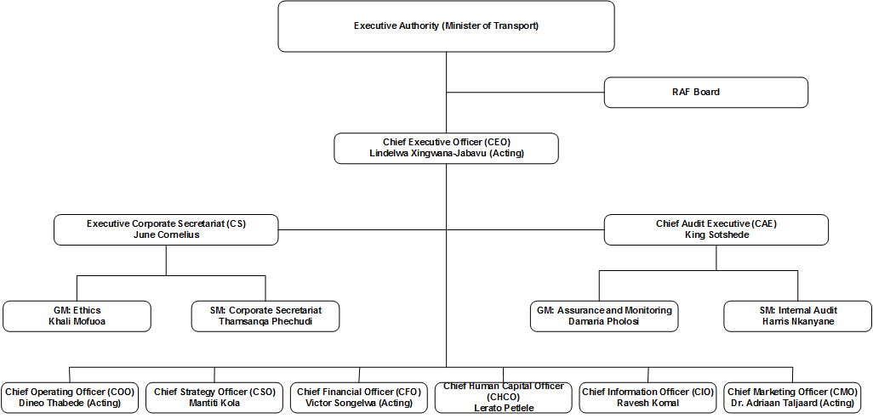
ORGANISATIONAL STRUCTURE

Slide 11
PERFORMANCE INFORMATION
2014 -2019

Slide 12
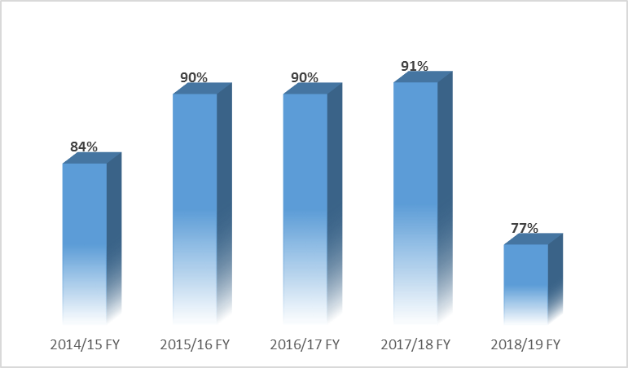
ENTITY ACHIEVEMENTS
2014/15 FY – 2018/19 FY
Notes:
7 0ut 0f 31 targets not meti.e. Reduce Claims older than 3 years; Increase direct claims settled; Reduce direct claims conversions; Increase matters settled bfore trial; reduce number of abandoned calls; implentation of ICT initiatives.

Slide 13
THE YEAR 2018/19 AT A GLANCE
Number of permanent employees ↑ from 2,754 to 2,776.
--Average value per claim ↑ by 3% from R111,072 to R114,008.
-Average RAF legal and other costs per claim ↑ by 16% from R32,613 to R37,974.
-Average claimant legal and other costs per claim ↑ by 11% from R139,282 to R154,774.
-Cost-to-income ratio for the financial year was 29% versus 28% in 2017/18.
-Registered 328,173 claims and finalised 229,534 claims.
-Number of open claims at 234,244 versus the target of 235,129.
-Direct claims originated ↑ by 26,6% to 40,986 versus 32,622 in 2017/18 FY.
-Personal direct claims settled ↓ by 29,8% to 14,323 versus 20,399 in 2017/18FY
-78,300 claimants engaged through ‘RAF on the Road’ community outreach programme and other RAF promotions and activations.
-421,602 calls were responded to by the Call Centre compared to 387,044 in 2017/18 FY
-Total revenue ↑ to R43.53 bn from R37.34 bn.
- Fuel Levy ↑ by 30 cents per litre (c/l) (currently 193 c/l); 13% of the total pump price.
-Amount of claims paid (incl. net effect of RNYP) ↑ by 21% to R41.96 bn from R34.6 bn.
-Claims liabilities ↑ by 27% to R272 bn from R215 bn in the previous financial year.
-Cash expenditure on claims amounted to 92% of the net RAF Fuel Levy

Slide 14
STRATEGIC ALIGNMENT AND 2019/20FY ANNUAL PERFORMANCE PLAN

Slide 15
ALIGNMENT TO THE 7 APEX AREAS

Slide 16
RAF ALIGNMENT TO 7 APEX PRIORITIES
PRIORITY AREA | STRATEGIC OBJECTIVE | INDICATORS
Economic transformation and job creation | Accessible services RAF Transformation | Community outreach campaigns (RAF on the Road). 2019/2020 19/20 targeted 86 210 claimants engaged. Transition from RAF to RABS 200 unemployed Youth afforded drivers’ licences and Public Driver Permits (PDP). 3500 Caregivers employed, for servicing injured claimants – R294 million in 2018/19 FY.
Education, skills and health | Efficient claims processing and Improve people management | Improve post-crash care management Learnerships (148) and Internships (57) – R44,3 million in 2018/19 FY. R15 million is budgeted in 2019/20 to train 192 young graduates. 80% of allocated budget spent on Skills Development. R25,8 million budgeted in 2019/20 FY training budget including bursaries. Treatment plans introduced for all serious injuries Increase active medical undertakings to provide free medical care for seriously injured beneficiaries
Notes:
– Economic transformation and job creation;
– Education, skills and health;
– Consolidating the social wage through reliable and quality basic services;
– Spatial integration, human settlements and local government;
– Social cohesion and safe communities;
– A capable, ethical and developmental state and
– A better Africa and World.

Slide 17
RAF ALIGNMENT TO 7 APEX PRIORITIES
PRIORITY AREA | STRATEGIC OBJECTIVE | INDICATORS
Social cohesion and safe communities | RAF Transformation Efficient claims processing and Improve people management | 90% of allocated CSR budget spent on Socio-Economic Development - R8, 5 million in 2018/19 FY and R8,9 million in 2019/20FY. Revamping Hospital Centeres Emergency Units to be accessible to people living with disabilities. Promotion of Child Restraint Program – providing car seats - approximately 480 seats in 2018/19 FY. Low cost Infrastructure in conjunction with Municipalities to promote pedestrian safety RABS Business Model - Transition RAF to RABS Manage the number of outstanding claims to compensate and rehabilitate victims of road crashes - 237 164 claims settled and 173 453 claims finalised Improve direct claims management to ensure full compensation goes to the accident victim Improve post-crash care management to ensure victims of road crashes are provided with medical care and re-integrated into the communities and are economically active citizens. Maintain EE targets in accordance with the National Economically Active People (NEAP) requirements.

Slide 18
RAF ALIGNMENT TO 7 APEX PRIORITIES
PRIORITY AREA | STRATEGIC OBJECTIVE | INDICATORS
A capable, ethical and developmental state | Assured control environment | 100% implementation of Ethics initiatives Improve fraud detection and management before undue payments are made - R1,4billion 18/19 FY Unqualified audit opinion Improve procurement outcomes

Slide 19
STRATEGIC OBJECTIVES

Slide 20
2019/20 FY ANNUAL PERFORMANCE PLAN
EFFICIENT CLAIMS PROCESSING | EFFECTIVE FINANCIAL MANAGEMENT | RAF TRANSFORMATION
KEY PERFORMANCE INDICATORS Manage the number of outstanding claims Increase efficiency of claims processing Claims fraud detection Improve direct claims management Improve post-crash care management | KEY PERFORMANCE INDICATORS Effective cash flow management Improve procurement outcomes | KEY PERFORMANCE INDICATORS RAF readiness for RABS
 | OPTIMAL ICT SERVICES | ASSURED CONTROL ENVIRONMENT
 | KEY PERFORMANCE INDICATORS Ensure optimal ICT availability Implement ICT Strategy Implement the information, cyber security and risk management strategy | KEY PERFORMANCE INDICATORS Raise ethical standards Improve combined assurance outcomes
PROVIDING ACCESSIBLE SERVICES
KEY PERFORMANCE INDICATORS Promote RAF services through outreach programmes and other events Improved Call Centre responsiveness
 | IMPROVED PEOPLE MANAGEMENT
 | KEY PERFORMANCE INDICATORS Improved people management RAF’s contribution towards government’s social and economic agenda

Slide 21
FINANCIAL STATUS

Slide 22
INCOME STATEMENT
YEAR ENDED 31 MARCH | 2019 R’m | 2018 R’m | 2017 R’m | 2016 R’m | 2015 R’m
INCOME | 43 239 | 37 341 | 33 342 | 33 206 | 22 680
1.1 Net Fuel Levies | 43 139 | 37 251 | 33 230 | 33 113 | 22 614
1.2 Investment Income | 99 | 90 | 109 | 89 | 66
1.3 Reinsurance Income | - | - | 1 | 1 | -
1.4 Other Income | 1 | - | 2 | 3 | -
2. EXPENDITURE | (99 019) | (63 692) | (68 083) | (68 164) | (42 132)
2.1 Claims Expenditure | (96 405) | (61 346) | (65 955) | (66 266) | (40 456)
2.2 Employee Costs | (1 735) | (1 605) | (1 435) | (1 280) | (1 164)
2.3 General Expenses | (515) | (454) | (420) | (398) | (377)
2.4 Reinsurance Premiums | (22) | (22) | (22) | (22) | (23)
2.5 Depreciation&Amortisation | (51) | (41) | (43) | (47) | (45)
2.6 Finance Costs | (291) | (224) | (209) | (151) | (67)
3. DEFICIT FOR THE YEAR | (55 780) | (26 351) | (34 741) | (34 958) | (19 452)

Slide 23
BALANCE SHEET
YEAR ENDED 31 MARCH | 2019 R’m | 2018 R’m | 2017 R’m | 2016 R’m | 2015 R’m
ASSETS
1.1 Current Assets | 10 947 | 9 563 | 8 982 | 9 569 | 7 085
1.2 Non-Current Assets | 273 | 243 | 216 | 227 | 282
Total Assets | 11 220 | 9 806 | 9 198 | 9 796 | 7 367
2. LIABILITIES AND RESERVES
2.1 Current Liabilities | 41 981 | 39 045 | 35 299 | 47 486 | 35 586
2.2 Non-Current Liabilities | 231 354 | 177 102 | 153 892 | 107 562 | 82 028
2.3 Reserves | (262 115) | (206 341) | (179 993) | (145 252) | (110 247)
Total Liabilities and Reserves | 11 220 | 9 806 | 9 198 | 9 796 | 7 367

Slide 24
CASH FLOW STATEMENT
FINANCIAL PERIOD ENDED 31 MARCH | 2019 R’m | 2018 R’m | 2017 R’m | 2016 R’m | 2015 R’m
OPERATING ACTIVITIES | (585) | (19) | (362) | 1 034 | (1 399)
2. INVESTING ACTIVITIES | (74) | (66) | (30) | (38) | (58)
3. FINANCING ACTIVITIES | - | - | - | - | -
4. NET INCREASE/(DECREASE) | (659) | (85) | (392) | 996 | (1 457)
5. AT THE BEGINNING OF PERIOD | 1 567 | 1 652 | 2 044 | 1 048 | 2 505
6. AT THE END OF PERIOD | 908 | 1 567 | 1 652 | 2 044 | 1 048

Slide 25
RAF FUNDING MODEL

Slide 26
CHALLENGES AND MITIGATIONS

Slide 27
CHALLENGES AND MITIGATIONS
    CHALLENGE :Inadequate Funding
    Cash constraints leading to non payment of finalised claims.
    Attachment of the RAF’s bank account and assets by Sheriffs.
    Mitigation Measures
    Stringent Cash Flow Management
    Improve efficiencies across business

Slide 28
CHALLENGES AND MITIGATIONS
    CHALLENGE :
  Continuation of the RAF dispensation based on unsustainable funding model
    Mitigation Measures:
  Support DoT with proposed policy changes

Slide 29
CONCLUSION
  Despite its challenges and limitation, the RAF continues to transform itself, to record successes and to drive the evolution of the business into a new dispensation which addresses the weaknesses of the present model and which will benefit considerably more South Africans for decades to come
  The 2015-2020 Strategic Plan and the 2019/2020 APP are focused on preparing for the future with a keen emphasis on:
  Processing claims, doing so in less time and enhancing the quality of claim processing
  Prudently managing available cash
  Ensuring good governance and management of the business
  Motivating for additional funding to meet real, current demand
  Great effort is and will be placed on:
  Fulfilling the Strategic Plan and APP deliverables;
  Addressing the challenges and risks;
  Preventing the catastrophic socio-economic effects of accidents in our society; and
  Continue supporting the transition from RAF to new sustainable dispensation.

Slide 30
THANK YOU

Slide 31
Annexure 1
Annual Targets For The 2019/20 Financial Year

Slide 32
OBJECTIVE 1: EFFICIENT CLAIMS PROCESSING
 | Performance Indicator | Annual Target 2019/2020 | 1st | 2nd | 3rd | 4th
1. | Manage the number of outstanding claims | increase number of personal claims with offers accepted | Increase by 10% | Increase by 10% | Increase by 10% | Increase by 10%
2. | Increase efficiency of claims processing | Improve personal claims processing turnaround time | Reduced by 10% | Reduced by 10% | Reduced by 10% | Reduced by 10%
3. |  | Improve supplier claims processing turnaround time | Reduce by 10% | Reduce by 10% | Reduce by 10% | Reduce by 10%

Slide 33
OBJECTIVE 1: EFFICIENT CLAIMS PROCESSING
CONTINUE…
 | Performance Indicator | Annual Target 2019/2020 | 1st | 2nd | 3rd | 4th
4. | Claims Fraud detection | Increase percentage of fraud detected before undue payments are made, based on number of files by 10% | Increase by 2.5% | Increase by 5 % | Increase by 7.5 % | Increase by 10%
5. |  | Increase percentage of fraud detected before undue payments are made, based on the value by 10% | Increase by 2.5% | Increase by 5 % | Increase by 7.5 % | Increase by 10%

Slide 34
OBJECTIVE 1: EFFICIENT CLAIMS PROCESSING
CONTINUE …
 | Performance Indicator | Annual Target 2019/2020 | 1st | 2nd | 3rd | 4th
6. | Improve direct claims management | % increase in direct personal claims originated by 15% | Increase by 15% | Increase by 15% | Increase by 15% | Increase by 15%
7. |  | Reduce % of direct personal claims converted to represented by 10% | Reduce by 10% | Reduce by 10% | Reduce by 10% | Reduce by 10%
8. | Improve Litigation Management | Increase % of offers made before trial date by 10 % | Increase by 2.5% | Increase by 5% | Increase by 7.5% | Increase by 10%

Slide 35
OBJECTIVE 1: EFFICIENT CLAIMS PROCESSING
CONTINUE
 | Performance Indicator | Annual Target 2019/2020 | 1st | 2nd | 3rd | 4th
9. | Improve post-crash care management | increase of active undertakings by 10% | Increase by 2.5% | Increase by 5% | Increase by 7.5% | Increase by 10%
10. |  | Treatment plans introduced for serious injuries increase by 100% | 100% | 100% | 100% | 100%

Slide 36
OBJECTIVE 2: PROVIDING ACCESSIBLE SERVICES
 | Performance Indicator | Annual Target 2019/2020 | 1st | 2nd | 3rd | 4th
11. | Promote RAF services through outreach programmes and other events | 10% increase in the number of potential claimants serviced during outreach programmes and other events | Increase by 10% | Increase by 10% | Increase by 10% | Increase by 10%
12. | Improved Call Centre responsiveness | Maintain % of abandoned calls to 2.8 % | Maintain abandoned calls to 2.8 % | Maintain abandoned calls to 2.8 % | Maintain abandoned calls to 2.8 % | Maintain abandoned calls to 2.8 %

Slide 37
OBJECTIVE 3: EFFECTIVE FINANCIAL MANAGEMENT
 | Performance Indicator | Annual Target 2019/2020 | 1st | 2nd | 3rd | 4th
13. | Effective cash flow management | Manage Claims Payment Average Days as per the cash management procedure | Manage Claims Payment Average Days as per the cash management procedure | Manage Claims Payment Average Days as per the cash management procedure | Manage Claims Payment Average Days as per the cash management procedure | Manage Claims Payment Average Days as per the cash management procedure
14. | Improve procurement outcomes | 100% success of all bids issued within 8 months | ANNUAL TARGET

Slide 38
OBJECTIVE 4: OPTIMISING ICT
 | Performance Indicator | Measure | 2019/20 | 1st | 2nd | 3rd | 4th
15. | Ensure optimal ICT availability | % availability of critical services | 98% availability of all services | 98% availability of all services | 98% availability of all services | 98% availability of all services | 98% availability of all services
16. | Implement ICT Strategy | Implement the ICT Strategic initiatives | Implement 2019/20 ICT Strategic initiatives | ANNUAL TARGET

Slide 39
OBJECTIVE 4: OPTIMISING ICT CONTINUE …
 | Performance Indicator | Measure | 2019/20 | 1st | 2nd | 3rd | 4th
17. | Implement ICT Strategy | Implement the Information, Cyber Security and Risk Management Strategy | Implement 2019/2020 initiatives | ANNUAL TARGET

Slide 40
OBJECTIVE 5: PEOPLE MANAGEMENT
 | Performance Indicator | Annual Target 2019/2020 | 1st | 2nd | 3rd | 4th
18. | Manage organisational performance | Maintain vacancy rate at 6% | Maintain vacancy rate at 6% | Maintain vacancy rate at 6% | Maintain vacancy rate at 6% | Maintain vacancy rate at 6%
19. | RAF’s contribution towards government’s social and economic agenda | Increase disability ratio to 2 % | Increase disability ratio to 2 % | Increase disability ratio to 2 % | Increase disability ratio to 2 % | Increase disability ratio to 2 %
 |  | 80 % of allocated budget spent on Skills Development | ANNUAL TARGET
20.

Slide 41
OBJECTIVE 5: PEOPLE MANAGEMENT CONTINUE …
 | Performance Indicator | Annual Target 2019/2020 | 1st | 2nd | 3rd | 4th
21. | RAF’s contribution towards government’s social and economic agenda | 90 % of allocated budget spent on Socio-Economic Development | ANNUAL TARGET
22. |  | 90 % of allocated budget spent on Enterprise Supplier Development
23. | Contribute to government priorities of youth unemployment and road safety | Increase to 275 | ANNUAL TARGET
 |  | Increase to 90% | ANNUAL TARGET
24.

Slide 42
OBJECTIVE 6: RAF TRANSFORMATION
 | Performance Indicator | Annual Target 2019/2020 | 1st | 2nd | 3rd | 4th
25. | RAF readiness for RABS | Approved RABS Business Model | ANNUAL TARGET
26. |  | Approved RABS Skills Transition Plan | ANNUAL TARGET

Slide 43
OBJECTIVE 7: ASSURED CONTROL ENVIRONMENT
 | Performance Indicator | Annual Target 2019/2020 | 1st | 2nd | 3rd | 4th
27. | Raise ethical standards | 100 % implementation of ethics initiatives | ANNUAL TARGET
28. | Improve Combined Assurance Outcomes | Unqualified audit opinion | ANNUAL TARGET

Slide 44
THANK YOU

