Slide 1
Access to diversified media for alla
QUARTER ONE REPORT
2019/2020

Slide 2
Constitutional Mandate
Section 15 (1)
“Everyone has the right to freedom of conscience, religion, thought, belief and opinion.”

Slide 3
National Development Plan
The National Development Plan - Vision 2030 (NDP) informs the MDDA’s -Long term goals, mandates and strategic objectives.
Outcome 12 relates to an efficient, effective and development orientated public service. Good corporate governance and internal processes.
Outcome 14 relates to nation building and social cohesion as it envisions a society where South Africans will be more conscious of what they have in common than their differences. It directs the MDDA’s approach when supporting and enabling content and production elements.
Outcome 6 relates to an efficient, competitive and responsive economic infrastructure network. Broadcast equipment roll-out.

Slide 4
MDDA Mandate
Encourage ownership of, and access to, media by HDGs as well as by historically diminished indigenous language and cultural groups
Encourage the development of human resources and training, and capacity building, within the media industry, especially amongst HDGs
Encourage the channeling of resources to the community media sectors
Raise public awareness with regard to media development & diversity issues
Support initiatives which promote literacy and a culture of reading
Encourage research regarding media development & diversity
Liaise with other statutory bodies such as ICASA and USAASA
Encourage ownership of, and access to, media by HDGs as well as by historically diminished indigenous language and cultural groups
Encourage the development of human resources and training, and capacity building, within the media industry, especially amongst HDGs
Encourage the channeling of resources to the community media sectors
Raise public awareness with regard to media development & diversity issues
Support initiatives which promote literacy and a culture of reading
Encourage research regarding media development & diversity
Liaise with other statutory bodies such as ICASA and USAASA
Section 16 & 32 of the Constitution provides for freedom of expression and access to information
MDDA Act no 14 of 2002

Slide 5
Vision, Mission, Values
Vision
An accessible, transformed and diversified media.
Mission
Leading media development, transformation and diversification in South Africa.
Values
Accountability, Inclusivity, Integrity, Ubuntu, Professionalism.

Slide 6
Strategic Objectives
To position the MDDA as an authoritative leader and voice on community and commercial media by proactive advocacy and lobbying interventions and established stakeholder relationships
To facilitate ownership, control and access to information and content
production of community broadcasting by historically advantaged
communities.
To expand our footprint as the MDDA by creating a positive image in
pursuance of the MDDA’s mandate to grow the community and small
commercial media.
To ensure compliance with applicable legislative requirements and sustainability of the Agency by 2019
To facilitate ownership, control and access to information and content
production of community and small commercial publications by historically
Advantaged
communities.
To monitor and evaluate input, output and compliance to MDDA grant-in-aid
contracts to measure the effectiveness and efficiency of the MDDA support

Slide 7
Organisational Environment
Challenge | Status | Interventions
Vacancy Rate | 12 out of 39 posts vacant. Four out of 9 Board members, vacant. Two temporal incapacity cases at management level | Nine vacancies advertised and closed on 18 August 2019. Recruitment process underway.
Financial Environment | More demand for MDDA support Sector’s historical debt (R180 million) The MDDA receives a grant of R31 795 000 for the year | Partnership meetings held: Caxton, Media24, Media Independent, Western Cape Media Engagement & action plan on solutions Partnerships with Telecommunications companies
Technological environment | MDDA Act outdated and not geared for digital or online platforms. | Digital literacy training roll-out. Review MDDA Act to cater for online or digital sound broadcasting. Digital/Online community print funded
Corporate Governance | Outdated policies and inadequate processes and processes. | Updated a suite of organizational policies, consulted on with staff during Quarter 4 of 2018/2019, covering ICT, Finance, SCM, Communications and Stakeholder Engagement, Risk, Anti Fraud and Corruption and Grant Funding. Ethics & Integrity management workshop by DPSA to all staff.

Slide 8
Human Resources Report – Staff Complement at end Q1
Permanent staff | 27
Fixed term (6) and seconded staff from the DoC (3) | 9
Total | 36
A total of 27 permanent staff in the Agency at the end of Quarter 1 is unchanged compared to Quarter 4 of 2018/2019
The high vacancy rate was as a result of the moratorium placed by the Minister of Communications on recruitment as a result of pending rationalisation of the entities
This moratorium has been lifted (in July 2019) with the transfer of the MDDA to reporting into the Presidency

Slide 9
MDDA Total Establishment
Total Establishment: 39
Number Of Filled Positions
27
(69.23%)
Number Of Vacant Positions
12
(30.7%)
Secondments
3
Fixed terms
6 - Former Interns
Incapacity (ill-health)
2 Managers
Vacant Management posts
5 out of 13

Slide 10
MDDA Organogram & Vacancies
Chief Executive Officer
Executive Secretary
Internal Audit Manager
Risk Specialist
Communications Manager
Company Secretary
Assistant Company Secretary
Knowledge Management Co-ordinator
HR Corporate Manager
Strategy, Monitoring & Evaluation Director
Project Director
Chief Financial Officer
Internal Audit Officer
Communications Officer
Travel & Events Co-ordinator
IT Manager
Human Resources Officer
Reception
Cleaner
Research & Capacity Building Manager
Monitoring & Evaluation Manager
Research & Capacity Building Co-ordinator X2
Monitoring & Evaluation Co-ordinator X2
Manager Broadcasting
Project Administrator
Manager Print
Broadcasting Development
Co-ordinator X2
Digital Media
Co-ordinator
Project Co-ordinator X2
Finance Manager
Disbursement Officer
Supply Chain Officer X2
Finance Administrator
MDDA Board of Directors
Legal and Compliance Officer
Blue: Filled position
Red: Vacant position
Orange: Prolonged sick leave/temporal incapacity

Slide 11
Occupational Level – Employment Equity
A=Africans, C=Coloureds, I=Indians and W=Whites
Occupational Levels | Male |  |  |  | Female |  |  |  | Disability | Foreign Nationals |  | Total
 | A | C | I | W | A | C | I | W | All | Male | Female
Top management |  | 0 | 1 | 0 | 1 | 0 | 0 | 0 | 0 | 0 | 0 | 2
Senior management | 5 |  | 0 | 0 | 2 | 0 | 0 | 1 | 0 | 0 | 0 | 8
Professionally qualified and experienced specialists and mid-management | 8 | 1 | 0 | 0 | 9 | 0 | 0 | 0 | 0 | 0 | 0 | 18
Semi-skilled and discretionary decision making | 0 | 0 | 0 | 0 | 2 | 0 | 0 | 0 | 0 | 0 | 0 | 2
Unskilled and defined decision making | 0 | 0 | 0 | 0 | 0 | 0 | 0 | 0 | 0 | 0 | 0 | 0
TOTAL PERMANENT | 10 | 1 | 1 | 0 | 14 | 0 | 0 | 1 | 0 | 0 | 0 | 30
TOTAL FIXED-TERM-EMPLOYEES | 4 | 0 | 0 | 0 | 2 | 0 | 0 | 0 | 0 | 0 | 0 | 6
GRAND TOTAL | 14 | 1 | 1 | 0 | 17 | 0 | 0 | 1 | 0 | 0 | 0 | 36

Slide 12
Vacancy Per Occupational Category
GENDER
RACE
AFRICAN:
Target: 75%
Current: 79.9 (+4,4%)
FEMALE:
Target: 50%
Current 43% (-7%)
COLOUREDS:
Target: 9%
Current: 2.5% (-6.5%)
MALE:
Target: 50%
Current: 35.9% (-14.1)
INDIANS:
Target : 5%
Current: 2.5% (-2.5%)
DISABILITY
Target: 2%
Current: (2.5%)
WHITES:
Target: 11%
Current: 2.5% (-8.5%)

Slide 13
MDDA Board of Directors
The MDDA Act states that the MDDA Board shall comprise nine members.
Six members are appointed by the President of the Republic on recommendation by the National Assembly.
Three members are appointed by the President, being a Shareholder Representative; Commercial Print Media Representative and Commercial Broadcast Media Representative.
Quarter One status:
MDDA Board had five members during Quarter 1 with four Board vacancies.
Filling of the vacancies is a matter reserved for the National Assembly.
Board vacancies are an ongoing risk for the MDDA.

Slide 14
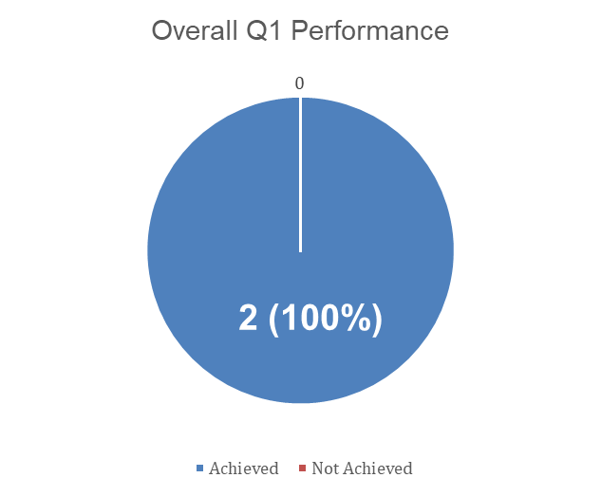
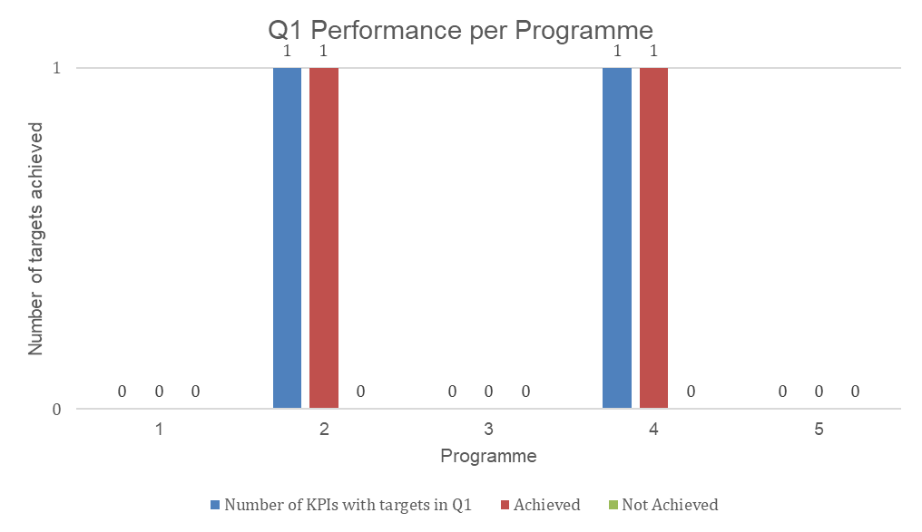
Q1 Overall Performance
MDDA 2019/2020 APP has 19 Strategic and Key Performance Indicators
Two KPIs with targets for Q1 of 2019/2020
“Number of monitoring reports produced on input, output and compliance to MDDA grant-in-aid contracts” (target 10) (Programme 2: Grant and Seed Funding – Sub Programme 2.3 Monitoring & Evaluation;
“Number of media literacy workshops conducted” (target 2) (Programme 4: Capacity Building and Sector Development)
Projects related targets moved to quarters 3 and 4 for new process.

Slide 15
Achieved Targets
Sub-Programme 2.3: Monitoring and Evaluation
Strategic Objective: To monitor and evaluate input, output and compliance to MDDA grant-in-aid contracts to measure the effectiveness and efficiency of MDDA support by 2019
Performance Indicator | Annual Target 2019/20 | Reporting Period | Cumulative | Q1 Performance |  | Variance for Q1 | Reason for Variance
 |  |  |  | Target | Actual
Number of monitoring reports produced on input, output and compliance to MDDA grant-in-aid contract | 80 | Quarterly | 10 | 10 | 10 | 0 | n/a
PROGRAMME 4: Capacity Building And Sector Development
Purpose: One of the objectives of the Agency outlined in the MDDA Act of 2002 is to “encourage the development of human resources, training and capacity building within the media industry, especially amongst historically disadvantaged groups”.
17. Number of media literacy workshops conducted | 3 | Quarterly | 2 | 2 | 2 | 0 | -

Slide 16
Highlights – Quarter 1
HighHighlight
New Grant Funding Policy – New applications open (06 Aug – 06 Oct 2019)
MDDA informing all applicants currently on waiting list that need to reapply
Application cut-off dates to be implemented from 2019/2020
- One call for applications in 2019/20 - Two calls for applications in following years
- To minimise the risk of insolvency from backlog, mal-
administration and misuse of funds. For fairness, equity and transparency.
Digital media literacy (Web Rangers) programme held for teachers and learners in Gauteng and the Western Cape in Q1.

Slide 17
Highlights – Quarter 1 (cont…)
Print Funders
Met with Media24 , Caxton and Independent Media for support (financial and non-financial)
Telecommunications
Met with MTN and Vodacom – receptive to partner MDDA on digital media pilot projects by year end.
Broadcast Funders
Concluded new 3-year contract with Multichoice at R40 million per annum.
Meeting all commercial broadcast companies who are not directing USAF levy to MDDA
Others
Approaching NPOs, eg KAS German media programme regarding partnering on research
Approaching corporates such as INBEV to lobby for support of community media, eg advertising revenue, sponsorships, etc.

Slide 18
Financial Report – Revenue Management
Operating Revenue
Description (R Values) | 2019/20 BUDGET |  | Actual 2019/20 Financial Year |  | Full Year Forecast
 | 2019/20 Budget | YTD Budget | YTD Actual | % Variance 2019
Broadcast Funders | 32 107 474 | 8 026 869 | 516 750 | -94% | 32 107 474
Grants income | 31 795 000 | 7 948 750 | 7 957 606 | 0% | 31 795 000
Other Income: Interest | 5 110 522 | 1 277 630 | 1 255 866 | -2% | 5 110 522
Total Income | 69 012 996 | 17 253 249 | 9 730 222 | -44% | 69 012 996
DoC transferred R7 957 606 first quarter tranche in June 2019 - first transfer of projected R31 795 000 in 2019/20 financial year.
Multichoice signed an agreement to contribute R40 million to MDDA in 2019/20 financial year. Funds are expected to be transferred in second quarter.
MDDA executive have been engaging media houses in first quarter of 2019/20 financial year with aim of lobbying industry contributions to MDDA.

Slide 19
Financial Report – Expenditure Management
Operating Expenditure
Description (R Values) | 2019/20 BUDGET |  | Actual 2019/20 Financial Year |  | Full Year Forecast
 | 2019/20 Budget | YTD Budget | YTD Actual | % Variance 2019
Grant Expenditure | 28 993 176 | 4 832 196 | 6 586 326 | -36% | 28 993 176
MDDA Board costs | 2 306 290 | 384 382 | 97 679 | 75% | 2 306 290
Administration Costs | 10 604 284 | 1 767 381 | 1 667 894 | 6% | 10 604 284
Employee Costs | 27 109 245 | 4 518 208 | 3 803 753 | 16% | 27 109 245
Total Expenditure | 69 012 996 | 11 502 166 | 12 155 652 | -6% | 69 012 996
Board approved new projects in March 2019. The disbursement in these new projects will improve spending on grant expenditure in 2019/20 financial year.
Application to roll over 2018/19 financial year unspent funds to be made to National Treasury in the Q2 of 2019/20 financial year.
Board meeting scheduled for Q1could not quorate - led to lower than budgeted spending on board fees for Q1.
Lower than budget spending on employee cost a result of unfilled vacant positions - to be advertised in Q2.

Slide 20
Financial Report – Investment Management
No | Description | Balance
1 | Absa - Main account | 9 057 882
2 | Absa - Special grants | 6 914 364
3 | Petty Cash | 469
4 | Reserve Bank | 87 899 984
Total |  | 103 872 699
MDDA call account is ringfenced to keep conditional grant received from the competition commission. Negotiations are underway with Competition Commission on scope of the conditional grant utilisation.
All invested funds have been moved to a Reserve Bank CPD bank account in April 2019. The CPD bank account yields an average interest of 7.24% per annum.

Slide 21
Way Forward
Focus on programme production (Agreement with Seda will allow use of their content hubs, capacity building, etc).
Partnerships with public and private sector – media buying.
Lobbying commercial print back for support – printing discounts, explore disbursing printing tranches directly to printers, mentorship
Investigate suitable audience measurement tool for the Sector
Prioritise marginalised languages including !Xun, Kwe and SA Sign Languages
Conclude details around Competition Commission’s economic empowerment development
Meeting and persuading other commercial broadcasters to pay USAF levies to MDDA to expand baseline
Review MDDA Act to take into account online and digital platforms. Its 15 years old.

Slide 22
Thank you.

