Slide 1
Presentation to the Joint Standing Committee on the Financial Management of Parliament by the Human Resources Executive

Slide 2
CONTENTS
Purpose of the division
Services delivered by the Human Resources Division
Unpacking Services delivered by the Human Resources Division
3.1 Wellness support to Members of Parliament and employees in the administration.
3.2 Human Resources Administration
3.3 The acquisition of talent that Parliament requires to implement its strategic plan
3.4 Employee growth and development
3.5 Creation of a conducive work environment
3.6 Organisational effectiveness
Challenges related to funding and possible solutions

Slide 3
Purpose of the division
To ensure that the institution is able to attract the required skills , develop current employees and retain employees whose competencies are critical to the organisation as well as to create a conducive environment for an engaged and productive workforce. The Human Resources Division also manages wellness support to Members of Parliament.

Slide 4
2. SERVICES DELIVERED BY THE HR DIVISION
Management of wellness support to Members of Parliament and employees in the administration, e.g on-site emergency medical services (clinic), comprehensive counselling service
Human Resources administration, e.g payment of salaries and benefits to employees, management of employee information and records
The acquisition of talent that Parliament requires to implement its Strategic Plan, e.g recruitment and selection, on-boarding of employees
The development of employees to ensure that Parliament has the skills it needs to successfully execute its plans, e.g awarding of bursaries, structured training in line with Personal Development Plans(PDPs)
The creation of a conducive environment to enable employees to achieve their performance goals and reach their potential, e.g implementation of a performance management system, maintaining good working relationship with organised labour, annual employee engagement surveys
The design and implementation of organisational development interventions to improve organisational effectiveness, e.g re-engineering of business processes

Slide 5
3. Unpacking SERVICES DELIVERED BY THE HR DIVISION
3.1 Wellness support to Members of Parliament and employees in the
administration
The Human Resources Division is tasked with the management of wellness programmes for both Members of Parliament and the employees of parliament. Members of Parliament and employees have access to all the programmes that will promote their health and wellbeing.The following Wellness Services are available:
Onsite Emergency Medical Services (Clinic)
Comprehensive Counselling Service
Various sport and recreational activities (20 sporting codes)
Wellness Days – twice a year
Onsite Emergency Medical Services(clinic) - assists Members of Parliament and employees when they are injured onsite by treating them and referring to hospitals where necessary. The clinic also monitors Members’ and employees’ chronic illnesses like diabetes and blood pressure.

Slide 6
3. Unpacking SERVICES DELIVERED BY THE HR DIVISION
3.1 Wellness support to Members of Parliament and employees in the
administration (cont..)
Comprehensive Counselling Service - Parliament offers through the Human Resources Division a comprehensive counselling service for the Members of Parliament and employees of Parliament as well as their immediate family members to deal with everyday situations.
This service provides face to face counselling, telephone counselling and trauma debriefing by qualified and accredited professionals.
The service covers:
Psychosocial Wellbeing (advice on conflict, depression, relationships, trauma, anxiety etc)
Health support (health information on diseases, symptoms and treatments)
Financial wellbeing (financial advice, budgeting and debt review)
Legal wellbeing (advice on contracts, fines, and other legal matters)

Slide 7
3. Unpacking SERVICES DELIVERED BY THE HR DIVISION
3.2 Human Resources Administration
The Human Resources Division is tasked with:
Payment of salaries and benefits to more than 1 300 existing employees, as well as post retirement medical benefits to former employees. All employees of Parliament are on a Total Cost Of Employment (TCOE) salary structure.
Management of employee information and records
Maintenance of Human Resources policies
3.3 The acquisition of talent that Parliament requires to implement its
Strategic Plan
The Human Resources Division is tasked with the identification, attraction and deployment of the right skills and competencies into the institution, in order to achieve institutional strategic objectives.
Parliament’s targeted vacancy rate for the 3 years to-date is 10% per annum.
For the 2017/2018 financial year Parliament’s vacancy rate was 9,9%.
For the 2018/2019 financial year the vacancy rate was 9,28%

Slide 8
3. Unpacking SERVICES DELIVERED BY THE HR DIVISION
The current vacancy rate at the end of July 2019 is 11,42%
Below is a breakdown of the vacancies and filled positions per division:
Some of the reasons for a higher vacancy rate to-date:
A number of employees taking early retirement, retirement due to ill health
End of Contracts of employment for employees attached to the term of office of the Presiding Officers in the 5th Parliament.
Resignations
Funding – deficit in compensation budget affecting the no. of posts to be filled
Scarcity and/or unavailability of skills in the market in certain roles/vacancies.
BRANCH | ACTIVE VACANT | FILLED | TOTAL FILLED & VACANT | VACANCY RATE
CORE BUSINESS BRANCH | 51 | 617 | 668 | 7.63%
SUPPORT SERVICES BRANCH | 85 | 506 | 591 | 14.38%
ADMINISTRATION BRANCH | 34 | 196 | 230 | 14.78%
TOTAL | 170 | 1319 | 1489 | 11.42%

Slide 9
3. UNPACKING THE SERVICES DELIVERED BY THE HR DIVISION
3.4 Employee Growth and Development
As part of the strategy to build required competencies, the Human Resources Division has been tasked with providing employees with financial assistance to pursue studies relevant to the institution’s needs. During the 5th Parliament, 247 bursaries were awarded as follows:
Other programmes
Internships
Management Development Programmes
Year | A-C (Junior & Professional Staff) | D (Middle Management) | E-F (Executive Management) | Total
2014 | 153 | 10 | 1 | 164
2015 | 42 | 0 | 0 | 42
2016 | 8 | 5 | 0 | 13
2017 | 24 | 2 | 2 | 28
2018 | 0 | 0 | 0 | 0
 | 227 | 17 | 3 | 247

Slide 10
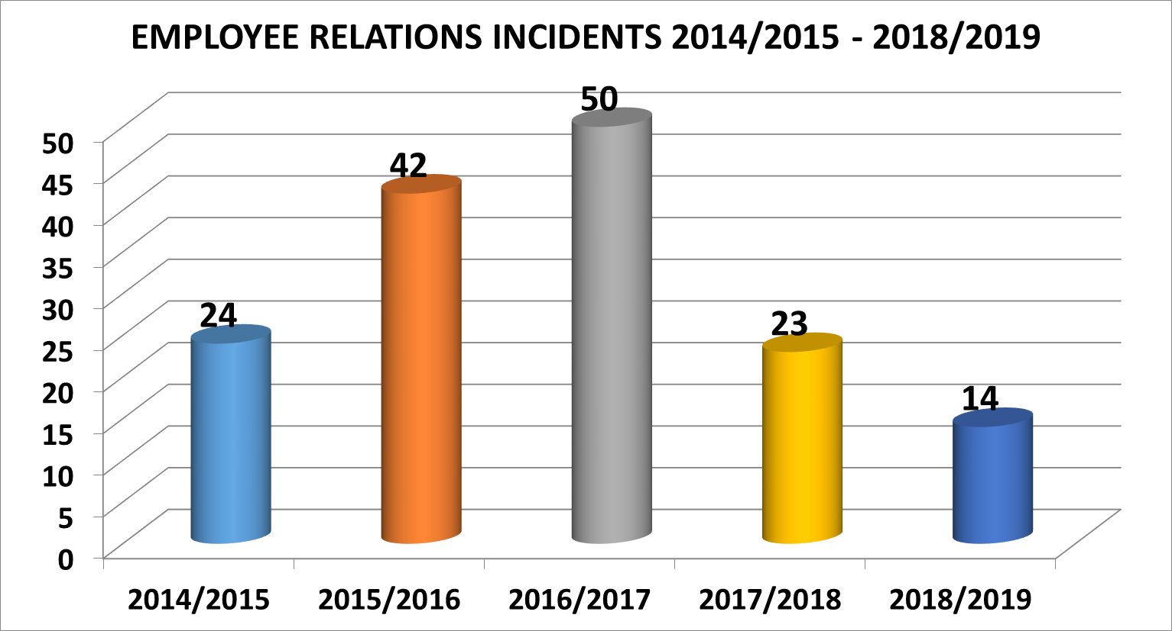
3. UNPACKING THE SERVICES DELIVERED BY THE HR DIVISION
3.5 Creation of a conducive work environment
The Human Resources Division is tasked with managing the labour relations climate in the institution. The current labour relations climate in the institution is stable. The number of disputes referred internally and externally to the CCMA has shown a steady decline in the recent few years. For example there were no cases referred to the CCMA in the 2018/2019 financial year.
This positive climate should continue as good working relationships are being built upon with regular and productive engagements between Management and organized labour on conditions of service and to resolve various employees’ issues.

Slide 11
3. UNPACKING THE SERVICES DELIVERED BY THE HR DIVISION
3.6 Organisational Effectiveness
The Human Resources Division is tasked with facilitating interventions to improve the effectiveness of the Institution. Some of these interventions include the following:
Provision of change management advice and support in the implementation of strategic institutional interventions;
Lead the development and implementation of organisational design initiatives in the institution,
Some examples of the recent projects include the following:
The Organisational Re-alignment Project,
I-Recruitment – automation of the recruitment processes of Parliament,
Performance Management System Automation,
HR support in the Integrated and Seamless Members Services Design Framework,
My Parliament App implementation – Change management process led by the HR division

Slide 12
4. CHALLENGES RELATED TO FUNDING AND POSSIBLE SOLUTIONS
Due to the deficit in budget allocation from National Treasury, Parliament is not able to fill all the vacant positions. As a result, Management took a decision to prioritise vacancies that are critical to the core business of the Institution.
In line with our government’s efforts to manage public sector wage bill, we are in the process of engaging with both National Treasury and the Department of Public Service and Administration (DPSA) to explore early retirement opportunities for some of our staff. Colleagues have already approached us through their union.
As part of the Organisational Realignment Project, instead of just growing the staff establishment and recruiting skills externally, we are first looking at how we can optimise our current human resources by incorporating development interventions to cross and multi skill employees to be able to operate within the new roles that will be more focussed on cross functional and collaborative work processes. Hence the introduction of a shared services approach.
Through the skills audit process that we are currently undertaking, we will further look at how we can optimise current underutilised skills and utilise these skills more effectively in a way that would benefit both the Institution as well as employees through opportunities of gaining different work experiences.

Slide 13
PRESENTATION ON THE HUMAN RESOURCES DIVISION
THANK YOU

