Slide 1

STRATEGIC OVERVIEW OF THE TOURISM PORTFOLIO
INCLUDING THE DEPARTMENTAL
2019/20 ANNUAL PERFORMANCE PLAN (APP)
Presentation to the Select Committee on Trade and Industry, Economic Development, Small Business Development, Tourism, Employment and Labour
27 AUGUST 2019

Slide 2
Contents
Introduction
  National Tourism Sector Strategy (NTSS): Overarching goal and five strategic pillars
  Policy and legislative mandate
  Focus of key strategies employed in implementing the mandate of the Department
  Focus areas for intervention on policy, people and places to realise change
  Departmental Strategic Objectives
  APP Project Distribution
Programmes:
  Programme 2: Tourism Research, Policy and International Relations
  Programme 3: Destination Development
  Programme 4: Tourism Sector Support Services
  Programme 1: Corporate Management
Estimates of National Expenditure: Details Per Programme:
Programme 2: Tourism Research, Policy and International Relations
Programme 3: Destination Development
Programme 4: Tourism Sector Support Services
Programme 1: Corporate Management
List of acronyms / abbreviations

Slide 3
Introduction

Slide 4
National Tourism Sector Strategy (NTSS) - Overarching goal and five strategic pillars
Inclusive and Quality Growth of the South African Tourism Economy
Facilitating Ease of Access
The Visitor Experience
Destination Management
Broad Based Benefits
Effective Marketing

Slide 5
NTSS Targets
Indicators / Measure of Performance | 2015 | 2024 Targets (Est.) | 2026 Targets (Est.)
Direct contribution to National GDP | R118 billion | R250 billion | R302 billion
Total contribution to National GDP | R375.502 billion | R778.988 billion | R941.222 billion
Number of direct jobs supported by the sector | 702 824 | 924 920 | 1 mil
Number of total jobs supported by the sector | 1 551 200 | 2 069 020 | 2 260 380
Increase tourism export earnings | R115 billion | R286 billion | R359 billion
Increase in capital investment | R64 billion | R122 billion | R148.681 billion
Source: World Travel and Tourism Council (WTTC)

Slide 6
Policy and Legislative Mandate
Tourism is a concurrent function for all three spheres of Government. At a National level, the Department of Tourism came into existence in 2009.
Overall legislative and policy direction for the Department of Tourism is provided for in the Tourism Act, 2014 (Act No 3 of 2014), the National Development Plan (NDP) and the National Tourism Sector Strategy (NTSS - 2017).
The Department’s mandate is to grow tourism to and within South Africa such that:
Its contribution to the Gross Domestic Product (GDP) and the economy is increased.
Its contribution to job creation in South Africa is increased.
Economic participation in the sector is inclusive.
Enjoyment of tourism is shared by all South Africans.
Quality tourism products and services are promoted.
The practice of responsible tourism is promoted.
The White Paper on the Development and Promotion of Tourism in South Africa, 1996 provides framework and guidelines for tourism development and promotion in South Africa. It envisions a tourism sector that is a national priority, developed in a sustainable and acceptable manner, so that it will contribute significantly to the improvement of the quality of life of every South African.

Slide 7
Policy and Legislative Mandate (cont.)
1996
White Paper on the Development and Promotion of Tourism in South Africa, 1996
2011
National Tourism Sector Strategy (NTSS)
2013
National Development Plan
2014
Tourism Act, 2014 (Act No 3 of 2014).
2015
Tourism Codes of Good Practice on Broad Based Black Economic Empowerment (Amended Tourism B-BBEE Sector Code)
2017
National Tourism Sector Strategy (revised from 2011)
2018
National Grading System for Tourism
2019
Tourism Draft Bill open for public comments
2019
Industrial Policy cites Tourism as one of ten key priority areas

Slide 8
Tourism Institutional Arrangements

Slide 9
MINMEC
MinMEC is a forum of Ministers and provincial Members of the Executive Councils (MECs) in functional areas or sector where they have concurrent responsibilities. (Section 9 IGR, Framework Act)
Functions of MINMEC include:
raising or consulting on matters of national interest within the sector under consideration with provincial governments and, if appropriate, local government around:
  the development and implementation of national policy and legislation relating to matters affecting the tourism, sector;
  the co-ordination and alignment within the sector of:
    strategic and performance plans;
    priorities, objectives and strategies across national, provincial and local spheres of government;
      Performance monitoring in the provision of services in order to detect failures and to initiate preventive or corrective action when necessary. (Section 11 IGR, Framework Act)

Slide 10
MINMEC
    MEMBERSHIP OF MINMEC ( Section 10 IGR, Framework Act)
MINMEC consists of :
Minister of the Department Tourism
Deputy Minister of the Department of Touism
MECs of the provincial departments responsible for Tourism
Supported by:-
DG of Tourism
CEO of SALGA
The Head of Departments responsible for Tourism
CEOs of the Marketing entities National and Provincial
DDGs in both National and Provincial Departments of Tourism
CD for Communication in DT

Slide 11
Governance & Development Working Groups
  Mandate
The Working Groups have a mandate to align and integrate national tourism policies and frameworks with government priorities. The Working Groups have a mandate to align and integrate national tourism policies and frameworks on product, service and enterprise development with government priorities.
  Composition
Heads of Units responsible for policy and planning, South African Local Government Association (SALGA), National Department of Tourism (NDT), Provincial Departments and Tourism Authorities.
South African Local Government Association (SALGA), Provincial Departments, South African Tourism (SAT), Culture, Arts, Tourism, Hospitality and Sport Sector Education and Training Authority (CATHSSETA).

Slide 12
Focus of Key Strategies Employed in Implementing the Mandate of the Department
Tourism Regulation
Destination Marketing
Destination Management
Destination Development
Tourism Planning
POLICY
Levelling the playing field through creating an enabling policy environment
Extracting the data that allows for targeted interventions that will contribute towards informed policy and regulatory instruments
Strengthening Monitoring and Evaluation (M&E) mechanisms to monitor progress, measure the effect and impact of programmes on individuals, communities, enterprises, society and the economy.
PEOPLE
Transformation
PLACES
Spatial Planning with a focus on township tourism, rural nodes and the oceans economy.
Investment facilitation
Training of Tour Operators to stimulate domestic consumption demand.
Enterprise Development Incubator Programme focussed on townships, villages and rural nodes).
Human Resource Development (HRD) – Expanding Expanded Public Works Programme (EPWP) Skills Development Programme and also initiating the RPL Programme
Tourism Incentive Programme.
Destination Enhancement Initiatives
Implementation of EPWP
Utilisation of state owned assets to support tourism growth

Slide 13
Focus Areas for Intervention on Policy, People and Places to Realise Change
Sector Transformation – to improve levels of transformation in the sector, promoting inclusivity.
Research and Knowledge Management – to enhanced decision making and availability of information for various users.
Skills Development for the sector - to improve supply of required levels of skills in the sector.
Destination Development incl Coastal and Marine Tourism (CMT) (Oceans Economy) – to enhance and diversity offering.
Enterprise Development – to expand participation and benefit by Small, Medium and Macro Enterprises (SMMEs) for transformation of the sector.
Responsible Tourism – to promote principles of responsible tourism and sustainability.
Regulatory Interventions – to create an enabling regulatory environment for the sector and promote policy harmonisation and integration.

Slide 14
Departmental Strategic Objectives
Strategic outcome-oriented goal | Organisational Strategic Objectives (SOs) | Responsible Programme
Achieve good corporate and cooperative governance. | SO 1: To ensure economic, efficient and effective use of departmental resources. | All strategic objectives are shared organisation wide with various programmes contributing to the objectives from their unique functional areas.
 | SO 2: To enhance understanding and awareness of the value of tourism and its opportunities.
 | SO 3: To create an enabling legislative and regulatory environment for tourism development and growth.
 | SO 4: To contribute to economic transformation in South Africa.
Increase the tourism sector’s contribution to inclusive economic growth. | SO 5: To accelerate the transformation of the tourism sector.
 | SO 6: To facilitate the development and growth of tourism enterprises to contribute to inclusive economic growth and job creation.
 | SO 7: To facilitate tourism capacity-building programmes.
 | SO 8: To diversify and enhance tourism offerings.
 | SO 9: To provide knowledge services to inform policy, planning and decision-making. | All strategic objectives are shared organisation wide with various programmes contributing to the objectives from their unique functional areas.
 | SO 10: To reduce barriers to tourism growth to enhance tourism competitiveness.
 | SO 11: To enhance regional tourism integration.
 | SO 12: To create employment opportunities by implementing tourism projects.

Slide 15
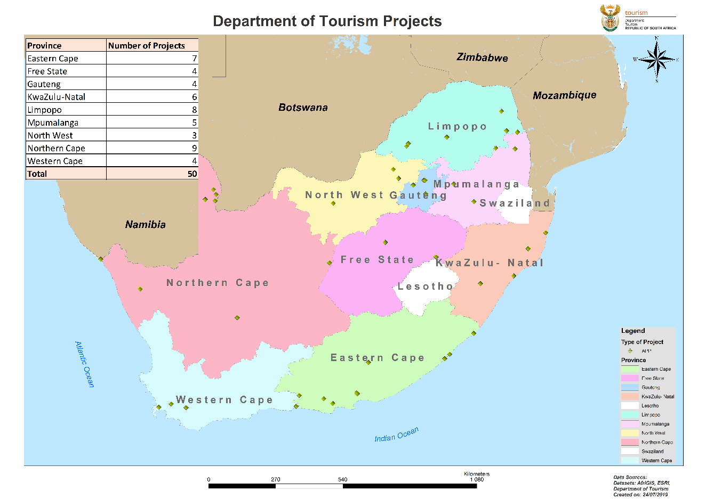
APP Project Distribution

Slide 16
Programmes

Slide 17
Programme 2: Tourism Research, Policy and
International Relations (TRP&IR)
Purpose: The Branch enhances strategic policy environment, monitors the tourism sector’s performance and enables stakeholder relations. Programme 2 focuses on the following:
Policy Development
Strategy Development
Research
Statistical Analysis
Knowledge Management
Monitoring and Evaluation
International Relations and Cooperation
Strategic Sector Partnerships
Public Entity Oversight
Strategic Outcome-oriented goal: Achieve good corporate and cooperative governance.

Slide 18
TRP&IR: Links on Strategic Objectives, Objective Statements and Programme Performance Indicators
Strategic Objective 3: To create enabling an enabling legislative and regulatory environment for tourism development and growth
Objective Statement | Programme Performance Indicator (PPI)
To develop a policy framework in order to ensure that South Africa’s network of SA Missions abroad is fully utilised to enhance South Africa’s tourism promotion and facilitation presence globally. | PPI 1: Development of Policy Framework to support SA missions for tourism development and promotion. Project: Policy Framework for the SA Missions tourism promotion and facilitation support developed.
Strategic Objective 9: To provide knowledge services to inform policy, planning and decision making
To develop and maintain knowledge management systems and ensure effective monitoring and evaluation of sector programmes. | PPI 2: Number of monitoring and evaluation reports on tourism projects and initiatives developed. Projects: Development of 7 M&E reports: 2018/19 NTSS Implementation Report developed. Publication of 2017/18 State of Tourism (STR) Report and development of Draft 2018/19 STR. . Development of Four Quarterly Tourism Performance Reports. Development of One Impact evaluation report on departmental capacity building programme.

Slide 19
TRP&IR: Links on Strategic Objectives, Objective Statements and Programme Performance Indicators
Strategic Objective 9: To provide knowledge services to inform policy, planning and decision making
Objective Statement | Programme Performance Indicator (PPI)
To develop and maintain knowledge management systems and ensure effective monitoring and evaluation of sector programmes. | PPI 3:. Number of sub-systems developed and maintained for the NTIMS. Projects: 2 sub-systems developed namely, Implementation of (“Go Live”) Database of black-owned products and services. Enterprise Development and Transformation Portal.
 | PPI 4: Number of information dissemination platforms hosted. Project: Hosting of one information dissemination platform: Tourism research seminar. (Research Seminar is a full-day event, held in March each year, in Gauteng Province as a central venue. To date, the Department has successfully hosted 7 Research Seminars, from 2013 to 2019).

Slide 20
TRP&IR: Links on Strategic Objectives, Objective Statements and Programme Performance Indicators
Strategic Objective 9: To provide knowledge services to inform policy, planning and decision making
Objective Statement | Programme Performance Indicator (PPI)
To develop and maintain knowledge management systems and ensure effective monitoring and evaluation of sector programmes. | PPI 5: Number of initiatives conducted to promote innovation in the tourism sector. Project: Development of the Digitalisation Framework for the tourism sector developed (to promote digitalisation in the tourism sector).
Strategic Objective 11: To enhance regional tourism integration
To implement programmes aimed at strengthening regional cooperation for sustainable tourism growth and development. | PPI 6: Number of initiatives facilitated for regional integration. Projects: Two initiatives facilitated for regional integration namely, Hosting of Best Practices Workshop targeting African countries and countries with whom Agreements were signed (Workshop is used as an implementation mechanism. South Africa hosts these. History: Limpopo (2017), Mpumalanga (2018) and KwaZulu-Natal (2019). Implementation of signed bilateral agreements and bilateral engagements.

Slide 21
Programme 3: Destination Development (DD)
Purpose: The Branch facilitates and coordinates tourism destination development. DD ensures coordination and development of amenities, facilities, products and infrastructure to deliver quality visitor experiences and enhance communities well-being. This is achieved through the provision of coherent destination planning, investment promotion, tourism product and infrastructure enhancement and development, experience development and job creation through the Working for Tourism (WfT)Programme. The following are the Programme focus areas:
Destination Planning and Investment Promotion.
Tourism Enhancement (which includes tourism product and infrastructure development and enhancement).
Working for Tourism.
Through DD Programme, the department plans to work with municipalities and communities to develop the underused public recreation facilities that they own into tourism destinations. The Programme aims to develop infrastructure for tourism to attract private-sector investment, counteract seasonality, and ensure that the economic value created through tourism and leisure activities is shared equitably among those involved in creating it.
Strategic Outcome-oriented goal:
Increase the tourism sector’s contribution to inclusive economic growth.

Slide 22
DD: Link on Strategic Objectives, Objective Statements and Programme Performance Indicators
Strategic Objective 8: To diversify and enhance tourism offerings.
Objective Statement | Programme Performance Indicator (PPI)
Implement destination enhancement and route development projects to diversify product offering and enhance visitor experience in identified priority areas. | PPI 1: Number of destination planning and investment coordination initiatives undertaken. Projects: Undertaking 7 destination planning and investment coordination initiatives, namely: Finalisation of tourism masterplans for the following: Port Nolloth to Hondeklipbaai, Sutherland to Carnarvon, Orange River Mouth to Vioolsdrift, and Port St Johns to Coffee Bay finalised. Development of Budget resort network and brand concept. Development of content and facilitation of a session per Province for the implementation of the niche (township/rural) tourism development methodology. Managing a pipeline of nationally prioritised tourism investment opportunities managed.

Slide 23
Destination Development: Link on Strategic Objectives, Objective Statements and Programme Performance Indicators
Strategic Objective 8: To diversify and enhance tourism offerings.
Objective Statement | Programme Performance Indicator (PPI)
Implement destination enhancement and route development projects to diversify product offering and enhance visitor experience in identified priority areas. | PPI 2: Number of destination enhancement initiatives supported. Projects: Supporting 15 destination enhancement initiatives, namely: Implementation of interpretative signage in Kruger National Park, Golden Gate Highlands National Park, Kgalagadi World Heritage Site (WHS), the Marakele National Park and in the Addo Elephant National Park. Construction of the Leopard Trail in Baviaanskloof (Cape Floral Region WHS) commenced. Appointment of contractor for the construction of the Visitor Interpretation Centre (VIC) in Baviaanskloof (Cape Floral Region WHS). Construction for the Dinosaur Interpretation Centre at the Golden Gate Highlands National Park continued. Appointment of contractor for Shangoni Gate. Input into the facilitation of statutory authorisation and approvals for the Phalaborwa Wild Activity Hub site. Finalisation of designs for the Harold Johnson Nature Reserve (KwaZulu-Natal), the Hole in the Wall (Eastern Cape, ) and Orange River Mouth (Northern Cape) as CMT initiative. Finalisation of designs for the Implementation of the infrastructure maintenance programme in two national parks (Golden Gate Highlands National Park, Kgalagadi National Park). Implementation of the Tourism Blue Flag Programme to enhance South African beaches.

Slide 24
DD: Link on Strategic Objectives, Objective Statements and Programme Performance Indicators
Strategic Objective 8: To diversify and enhance tourism offerings.
Objective Statement | Programme Performance Indicator (PPI)
Strategic Objective 12: To create employment opportunities by implementing tourism projects.
Implement EPWP funded projects intended to improve product offering and visitor experience as well as creating full time equivalent job opportunities. | PPI 3: Number of full time equivalent (FTEs) jobs created through Working for Tourism projects on the EPWP. Project: Creation of 4331 FTE Jobs.

Slide 25
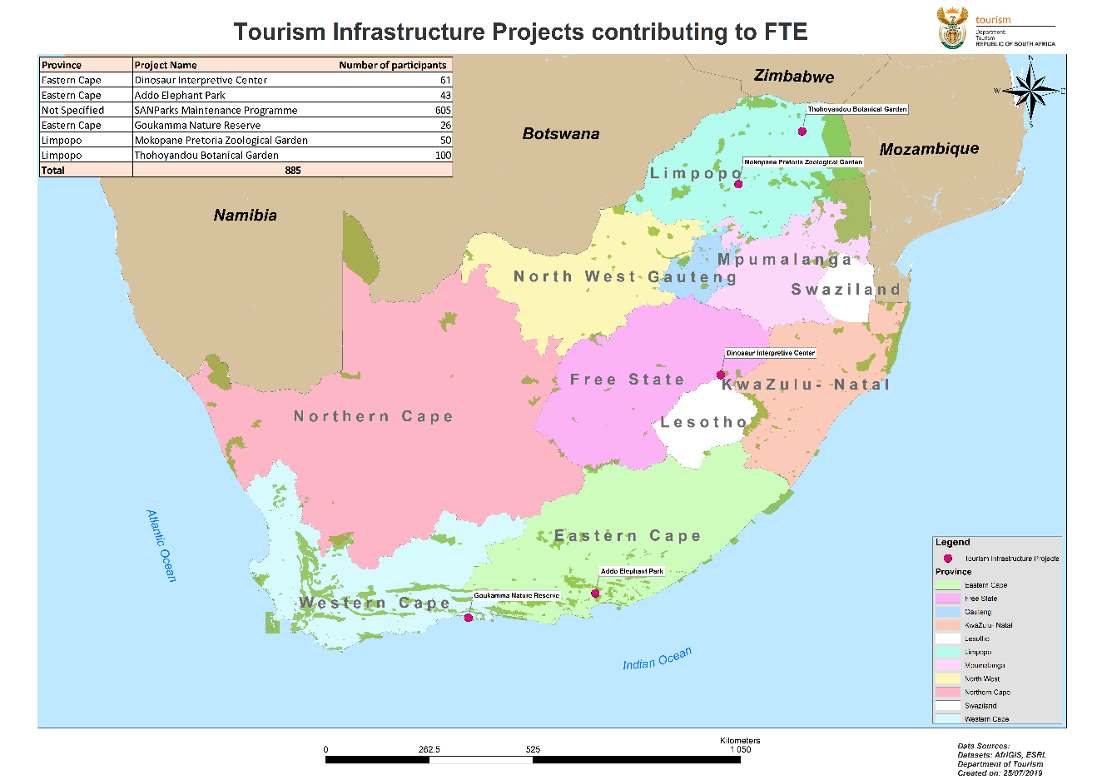
Tourism Infrastructure Projects

Slide 26
EPWP: Additional Notes - Projects Contributing to the FTEs – Skills Development Projects (Active) : 2 686 FTES
Project Name | Number of participants | Quarter 1: FTE’s | Quarter 2: FTE’S | Quarter 3: FTE’s | Quarter 4: FTE’s
EC-Hospitality Youth Programme (HYP) | 200 | 57 | 57 | 57 | 0
EC-Safety Monitors | 200 | 57 | 57 | 57 | 0
GP-HYP | 575 | 55 | 55 | 55 | 0
GP-Safety Monitors | 200 | 57 | 57 | 57 | 57
MP-HYP | 350 | 99 | 99 | 99 | 0
MP-Safety Monitors | 250 | 69 | 69 | 69 | 0
KZN-HYP | 575 | 165 | 165 | 165 | 0
NAT-Youth Chef Training Programme | 477 | 136 | 136 | 136 | 72
Green Coast | 110 | 32 | 32 | 32 | 32
Wine Service | 300 | 86 | 86 | 86 | 86
Grand Total | 3237 | 813 | 813 | 813 | 247
A FTE refers to one person-year of employment. One person-year is equivalent to 230 person days of paid work. Person-years of employment = total number of person days of employment created for targeted labour during the year divided by 230.

Slide 27
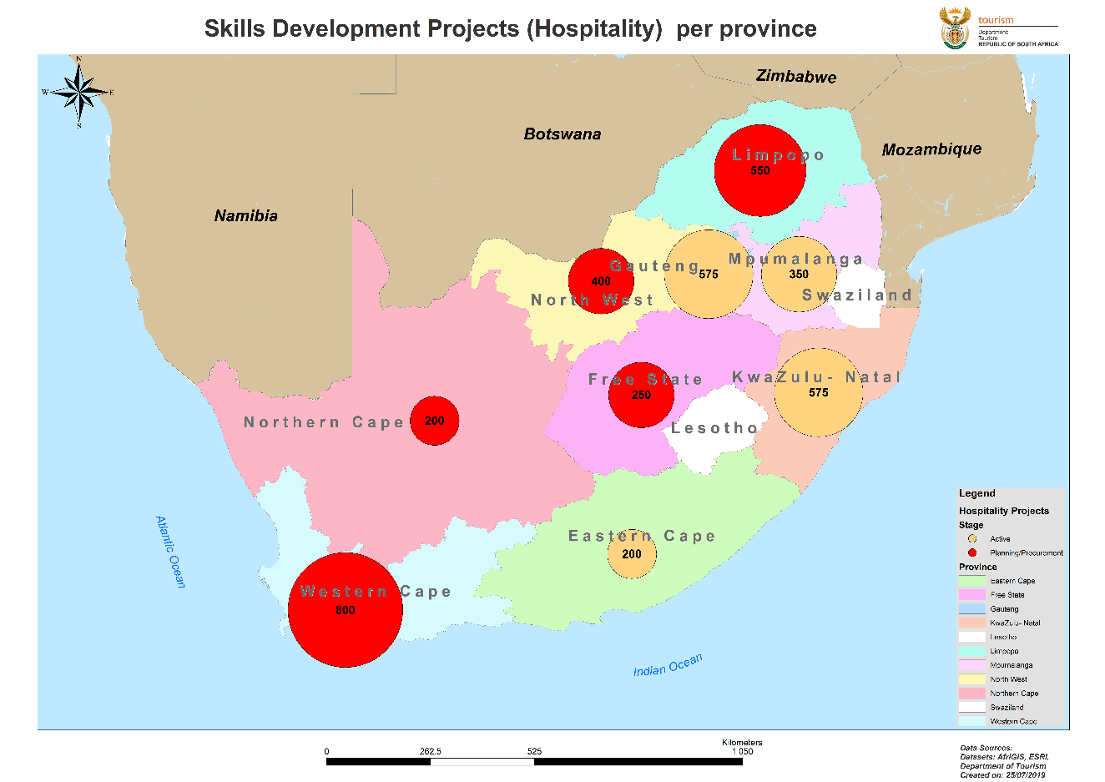
Skills Development Projects (Hospitality) Per province

Slide 28
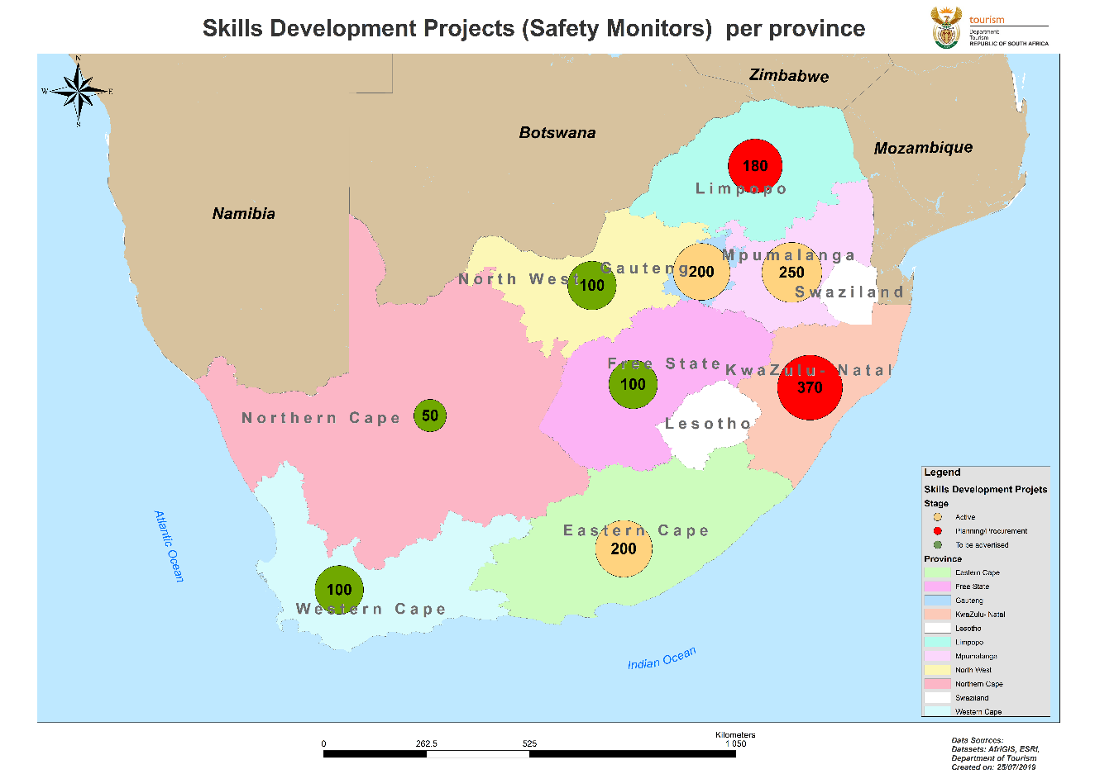
Skills Development Projects

Slide 29
Programme 4: Tourism Sector Support Services (TSSS)
Purpose: TSSS enhances transformation of the sector, increases skills levels and supports development to ensure that South Africa is a competitive tourism destination.
The Programme aims to accelerate the transformation of the tourism sector through implementation of programmes aimed at the empowerment of marginalised enterprises and individuals to promote inclusive growth of the sector. The Programme seeks to facilitate the development and growth of tourism enterprises to contribute to inclusive economic growth and job creation. This is done through creation of an enabling environment for tourism enterprises to grow, and contributes to job creation and the competitiveness of the destination, through the provision of business support services and tools. The Programme also implements prioritised programmes (capacity-building) that present opportunities for training and development for the growth of the sector.
Strategic Outcome-oriented goal:
Increase the tourism sector’s contribution to inclusive economic growth.

Slide 30
TSSS: Links on Strategic Objectives, Objective Statements and Programme Performance Indicators
Strategic Objective 2: To enhance understanding and awareness of the value of tourism and its opportunities
Objective Statement | Programme Performance Indicator (PPI)
To provide a platform for peer learning and information sharing about tourism development at local government level. | PPI 1: Number of awareness sessions hosted. Projects: Two awareness sessions hosted namely, Local Government Tourism Peer Learning Network sessions for municipal practitioners conducted in 4 provinces. Tourism Information sharing sessions on departmental programmes and services hosted in 4 provinces (Western Cape (WC ) Kwalulu-Natal (KZN), North West (NW) & Gauteng (GP).
Strategic Objective 5: To accelerate the transformation of the tourism sector.
To implement programmes aimed at the empowerment enterprises and individuals to promote inclusive growth of the sector. | PPI 2: Number of incentivised programmes implemented. Projects: Five incentive programmes implemented, namely: Market Access Support Programme (MASP) Tourism Grading Support Programme (TGSP) Green Tourism Incentive Programme (GTIP) Tourism Transformation Fund (TTF) Tourism Equity Fund (TEF)

Slide 31
TSSS: Links on Strategic Objectives, Objective Statements and Programme Performance Indicators
Strategic Objective 2: To enhance understanding and awareness of the value of tourism and its opportunities
Objective Statement | Programme Performance Indicator (PPI)
Strategic Objective 5: To accelerate the transformation of the tourism sector.
To implement programmes aimed at the empowerment enterprises and individuals to promote inclusive growth of the sector. | PPI 3: Number of initiatives implemented to support Domestic Tourism Growth Strategy. Projects: Three initiatives: Implementation of Domestic Tourism Incentive scheme to increase tourist numbers in partnership with SANParks at five National Parks: Kruger National Park (MP & LP), Golden Gate National Park (FS), Kgalagadi National Park (NC), Marakele National Park (LP) and Addo Elephant National Park (EC). Implementation of initiative targeted at supporting the increase in domestic tourism among designated groups (youth, elderly and people with disabilities). Tourism Month campaign implemented in conjunction with provinces and the sector.

Slide 32
Tourism Sector Support Services: Links on Strategic Objectives, Objective Statements and Programme Performance Indicators
Strategic Objective 6: To facilitate the development and growth of tourism enterprises to contribute to inclusive economic growth and job creation.
Objective Statement | Programme Performance Indicator (PPI)
To create an enabling environment for tourism enterprises to grow and contribute to job creation and the competitiveness of the destination, through the provision of business support services and tools. | PPI 4: Number of enterprises development initiatives implemented. Projects: Three initiatives: Support four existing incubators: Pilanesberg (NW), Manyeleti (MP), Phalaborwa (LP) and Mier (NC). Develop two new incubators off-site: Tour Operators Incubator and Innovation Incubator. Conduct a feasibility study of community based enterprises in communities within the proximity of the following five national parks: Kruger National Park (MP & LP), Golden Gate National Park ((FS), Kgalagadi WHS (NC), Marakele National Park (LP) and Addo Elephant National Park (EC).
Strategic Objective 8: To diversify and enhance tourism offerings
Implement prioritised programmes identified in the National Tourism Sector Strategy and Domestic Tourism Growth Strategy in order to enhance products and visitor experiences. | PPI 5: Number of initiatives for improving visitor services implemented. Projects: Two initiatives: Implementation of Tourism Monitors Programme in all provinces. 100% compliance with the service delivery charter in the management of tourist complaints.

Slide 33
Tourism Sector Support Services: Links on Strategic Objectives, Objective Statements and Programme Performance Indicators
Strategic Objective 6: To facilitate the development and growth of tourism enterprises to contribute to inclusive economic growth and job creation.
Objective Statement |  | Programme Performance Indicator (PPI)
Strategic Objective 7: Strategic Objective 7: To facilitate tourism capacity-building programmes
To implement prioritised programmes that present opportunities for training and development for the growth of the sector. | PPI 6: Number of capacity-building programmes implemented. Projects: Implementation of 10 capacity building programmes namely: Training of 20 Tourist Guides in Mandarin language. (EC, WC and GP). Hosting of 2019 National Tourism Careers Expo. Hospitality Youth Programme targeting 3900 unemployed youth. National Chefs Training Programme in all provinces targeting 540 youth. Wine Service Training Programme targeting 300 youth. Food Safety Quality Assurer Programme targeting 1500 youth. Training of 60 Youth on Resource Efficiency (NW, NC and MP). Four capacity building initiatives for the Women in Tourism (WiT) Programme: 1 Board Development training for WiT Chapter Executives and 3 Business Development and Training Sessions. Executive Development Programme (20 Black Women Trained). Mentorship pilot programme implemented in partnership with industry (GP and MP).

Slide 34
Additional Information on 10 Capacity Building Programmes for 2019/20
Four (4) APP targets for 2019/20 that are fully funded:
Hospitality Youth Training Programme (National Certificate: Fast Food Services National Qualification Framework (NQF): 3 and Food & Beverage Management: NQF: 4).
National Chefs Training Programme implemented in all provinces targeting 540 youth (National Certificate: Professional Cookery: NQF: 3).
Wine Services / Sommelier training implemented targeting 300 youth (Trained in various skills programmes).
Food Safety Quality Assurer Programme implemented targeting 1500 youth (Trained in various skills programmes to attain full qualification).

Slide 35
Project Name: Hospitality Youth Training Programme targeting 3900 unemployed youth
Growth and Development | Development of excellent tourism and hospitality skills to enable youth to gain knowledge and experience in the overall operations of the industry. Career advancement to enhance the level of employability.
Quality of Products and Services | Skilled workforce in the value chain with the ability to deliver the best possible experience
Location / Geographical spread: | All 9 Provinces: EC: (200), KZN (400), NW (400), FS (250), NC (200), MP (300), GP (575), LP (550), WC (800) Active Number as at June 2019 EC (181), KZN (652), NW (400), FS (250), NC (200), MP (302), GP (456), LP (550), WC (Cluster 1 - 400 & Cluster 2 – 400). Drop outs due to various reasons.
Criteria | SA citizens. Unemployed youth between 18 and 35 years of age. Proficiency in English and basic knowledge of Numeracy. Grade 11 / 12 (with Tourism as a school subject being an added advantage). Have a passion for Tourism and Hospitality.
Budget | R217 435 978

Slide 36
Project Name: National Chefs Training Programme implemented in all provinces targeting 540
Growth and Development | Development of excellent tourism and hospitality skills to enable youth to gain knowledge and experience in the overall operations of the industry. Career advancement to enhance the level of employability.
Quality of Products and Services | Skilled workforce in the value chain with the ability to deliver the best possible experience
Location / Geographical spread: | All 9 Provinces: EC (60), KZN: (72), NW (53), FS (27), NC (12), MP (30), GP (132), LP (122), WC (57) Initial target of 540 was exceeded to mitigate drop outs. Hence 565 enrolment
Criteria | SA citizens. Unemployed youth between 18 and 35 years of age. Proficiency in English and basic knowledge of Numeracy. Grade 12 (with Tourism as a school subject being an added advantage), Have a passion for Tourism and Hospitality.
Budget | R103 176 418

Slide 37
Project Name: Wine Services / Sommelier training implemented targeting 300 youth
Growth and Development | Development of excellent tourism and hospitality skills to enable youth to gain knowledge and experience in the overall operations of the industry. Career advancement to enhance the level of employability.
Quality of Products and Services | Skilled workforce in the value chain with the ability to deliver the best possible experience
Location / Geographical spread: | 4 Provinces: KZN (100), GP (30), WC (150) & NC (20) Active Number as at June 2019: KZN (75), GP (16), WC (175) Drop outs due to various reasons NC was discontinued due to lack of interest from enrolled learners
Criteria | SA citizens. Unemployed youth between 18 and 35 years of age. Proficiency in English and basic knowledge of Numeracy. Grade 12 (with Tourism as a school subject being an added advantage), Have a passion for Tourism and Hospitality.
Budget | R61 479 000

Slide 38
Project Name: Food Safety Quality Assurer Programme implemented targeting 1500 youth
Growth and Development | Development of excellent tourism and hospitality skills to enable youth to gain knowledge and experience in the overall operations of the industry. Career advancement to enhance the level of employability.
Quality of Products and Services | Skilled workforce in the value chain with the ability to deliver the best possible experience
Location/ Geographical spread: | All 9 Provinces: Cluster 1: 600 learners EC, WC & KZN Cluster 2: 500 learners MP & LP Cluster 3: 450 learners GP, NC, NW & FS
Criteria | SA citizens. Unemployed youth between 18 and 35 years of age. Proficiency in English and basic knowledge of Numeracy. Grade 12 (with Tourism as a school subject being an added advantage), Have a passion for Tourism and Hospitality.
Budget | (Funds not yet allocated)

Slide 39
Programme 1: Corporate Management (CM)
Purpose:
Programme 1 provides strategic leadership, management and support services to the department.
Strategic Outcome-oriented goal:
Achieve good corporate and cooperative governance.

Slide 40
CM: Links on Strategic Objectives, Objective Statements and Programme Performance Indicators
Strategic Objective 1: To ensure economic, efficient and effective use of departmental resources.
Objective Statement | Programme Performance Indicator (PPI)
To achieve clean administration through proper financial and performance management, as well as compliance with applicable laws and regulations. | PPI 1: Audit outcome on financial and non-financial performance. Project: Unqualified audit on financial and non-financial performance.
To attract, develop and retain a capable and skilled workforce in a caring work environment. | PPI 2: Vacancy rate. Project: Vacancy rate not to exceed 10% of the funded establishment.
 | PPI 3: Percentage compliance with equity targets in terms of departmental Employment Equity Plan. Projects: Maintain minimum of 50% women representation at SMS level. Maintain minimum of 3% people with disabilities representation. Maintain minimum of 91.5% Black representation.
 | PPI 4: Percentage implementation of Workplace Skills Plan (WSP) with defined targeted training interventions. Project: Development and 100% implementation of WSP.

Slide 41
CM: Links on Strategic Objectives, Objective Statements and Programme Performance Indicators … continued
Strategic Objective: To ensure economic, efficient and effective use of departmental resources
Objective Statement | Programme Performance Indicator (PPI)
To provide assurance through an internal audit service for good corporate governance. | PPI 5: Percentage implementation of the annual internal audit plan. Project: 100% implementation of the annual internal audit plan.
Strategic Objective 2: To enhance understanding and awareness of the value of tourism and its opportunities.
To implement a communication strategy that creates awareness about and enables access to departmental programmes. | PPI 6: Percentage implementation of the communication strategy. Project: Implement 2019/20 communications strategy targets as indicated in the implementation plan.
Strategic objective 4: To contribute to economic transformation in South Africa
To align departmental expenditure to contribute to the government’s economic transformation agenda. | PPI 7: Percentage procurement of goods and services from Broad-based Black Economic Empowerment (B-BBEE) compliant businesses and SMMEs. Projects: 100% of expenditure achieved on procurement from enterprises on B-BBEE contributor status levels 1 to 5. Minimum 30% expenditure achieved on procurement of goods and services from SMMEs.

Slide 42
Representativity Status
(as at 20 August 2019)
Total Establishment: 522
Total Filled Posts: 474
Vacancy Rate: 9.2%
Women at SMS Level: 46,5%
Disability: 4,4%

Slide 43
Vacancy Rate as at 26 August 2019
BRANCH | FILLED POSTS | VACANT POSTS | TOTAL POSTS | VACANCY RATE%
Ministry | 27 | 3 | 30 | 10%
Office of DG | 27 | 2 | 29 | 6.9%
CM | 192 | 18 | 210 | 8.6%
TRP&IR | 66 | 9 | 75 | 12.0%
DDD | 68 | 7 | 76 | 9.3%
TSSS | 94 | 9 | 103 | 8.7%
Grand Total | 474 | 48 | 522 | 9.2%

Slide 44
Representivity as at 20 Augustus 2019
BRANCH | TOTAL EST. | FILLED POSTS | VACANT POSTS | REPRESENTIVITY (%) | VACANCY RATE
All Levels |  | 474 | 48 | - | 9.2%
Female SMS |  | 33 | - | 46.5%
Male SMS |  | 43 |  | 53.5%
Female (All levels) |  | 267 | - | 56.3%
Male (All levels) |  | 207 |  | 43.7%
Grand Total | 522 | 474 | 48 | 100% | 9.2%

Slide 45
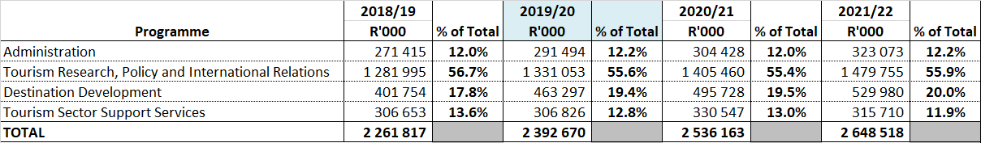
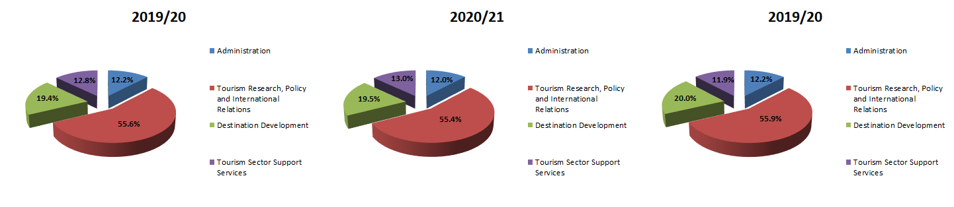
Departmental MTEF Baseline
(Per Programme)
2021/2022

Slide 46
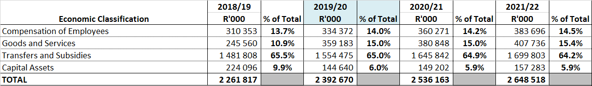
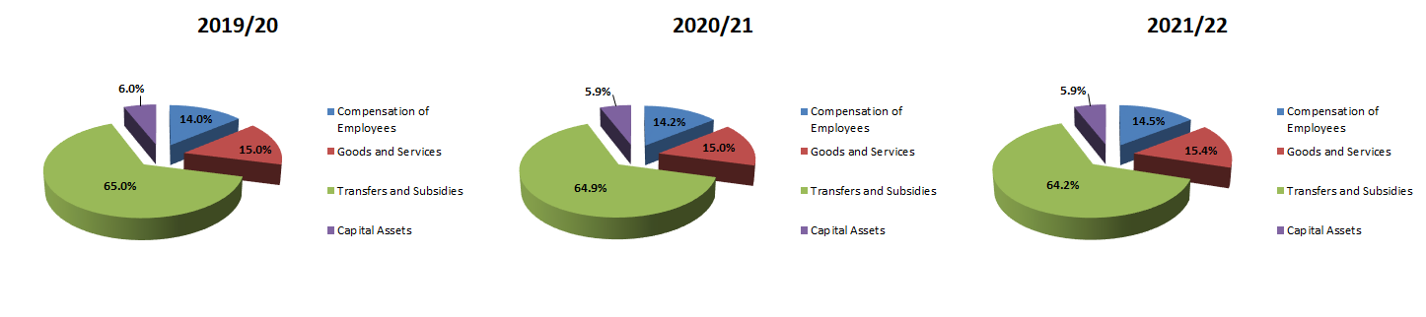
Departmental MTEF Baseline (Economic Classification)

Slide 47
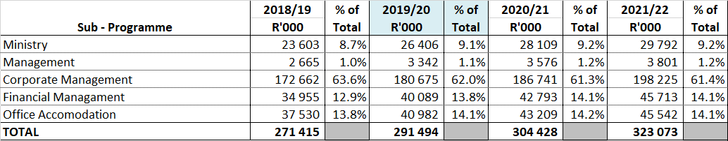
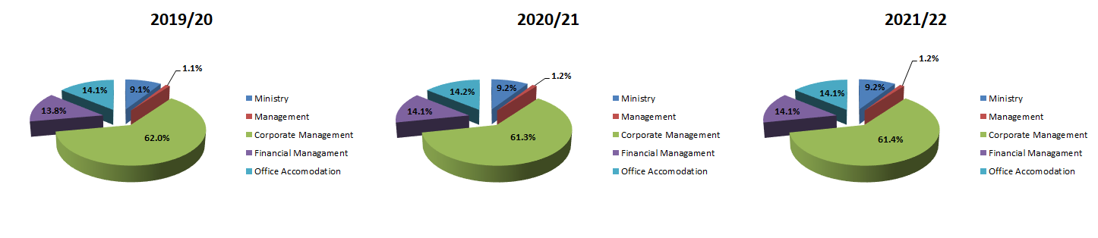
MTEF Baseline - Programme 1: Administration (Per Sub-Programme)

Slide 48
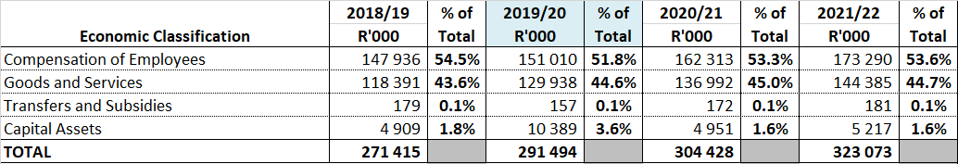
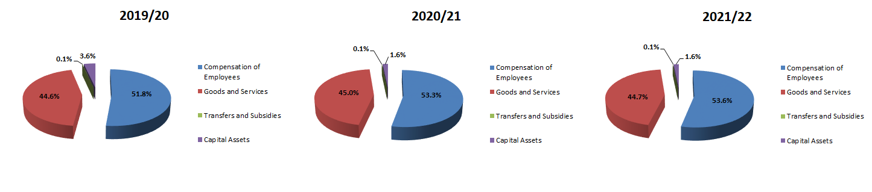
MTEF Baseline - Programme 1: Administration (Economic Classification)

Slide 49
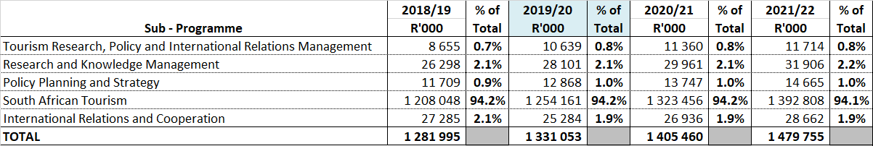
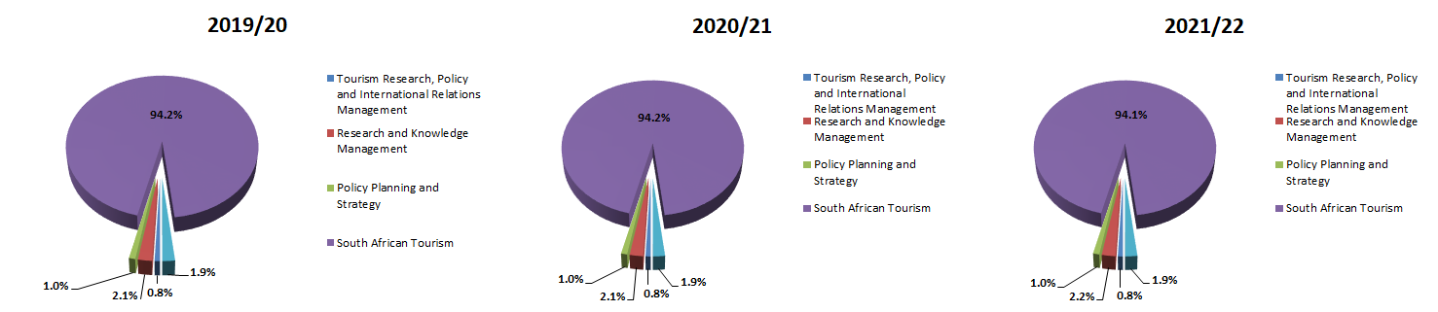
MTEF Baseline - Programme 2: TRP&IR (Per Sub-Programme)

Slide 50
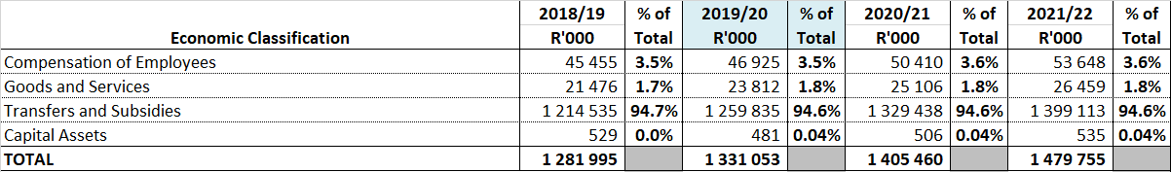
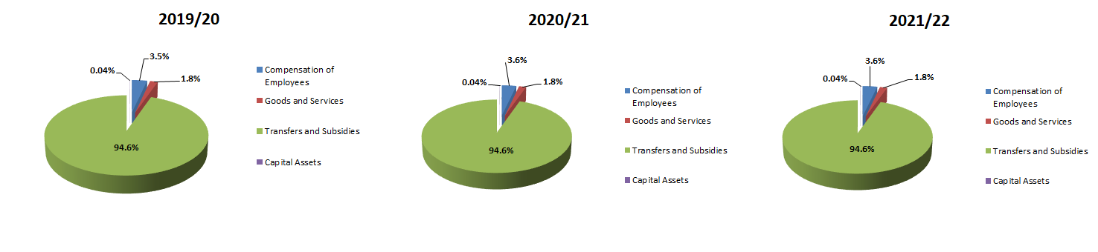
MTEF Baseline - Programme 2: TRP&IR (Economic Classification)

Slide 51
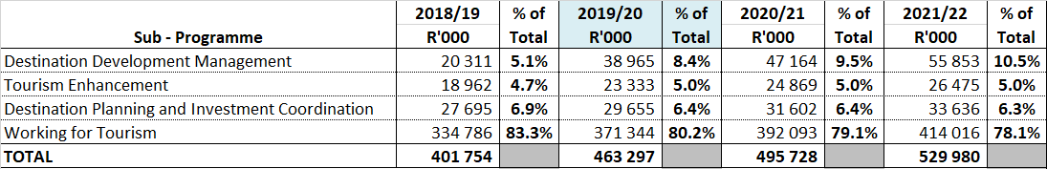
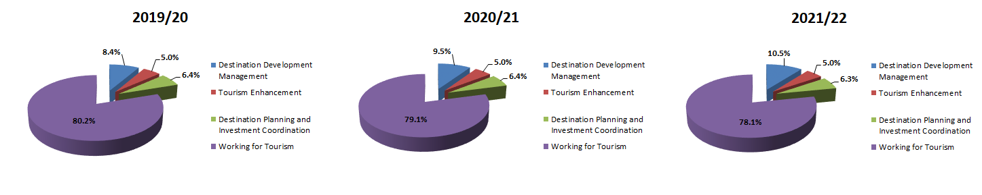
MTEF Baseline - Programme 3: DD (Per Sub-Programme)

Slide 52
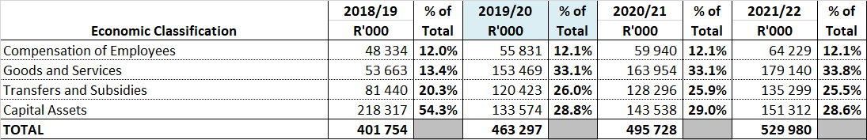
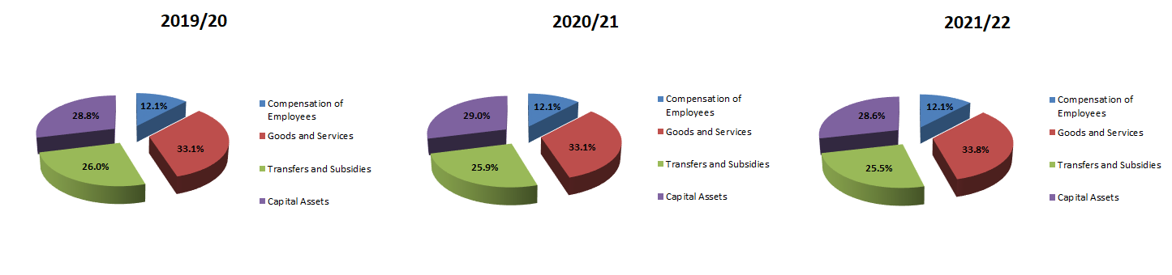
MTEF Baseline - Programme 3: DD (Economic Classification)

Slide 53
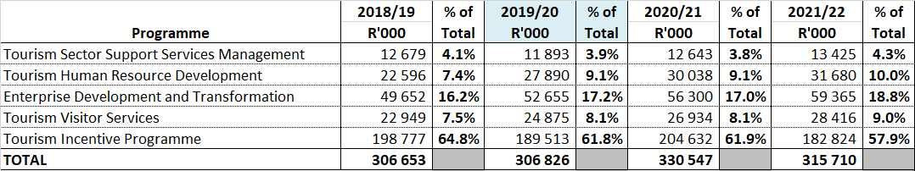
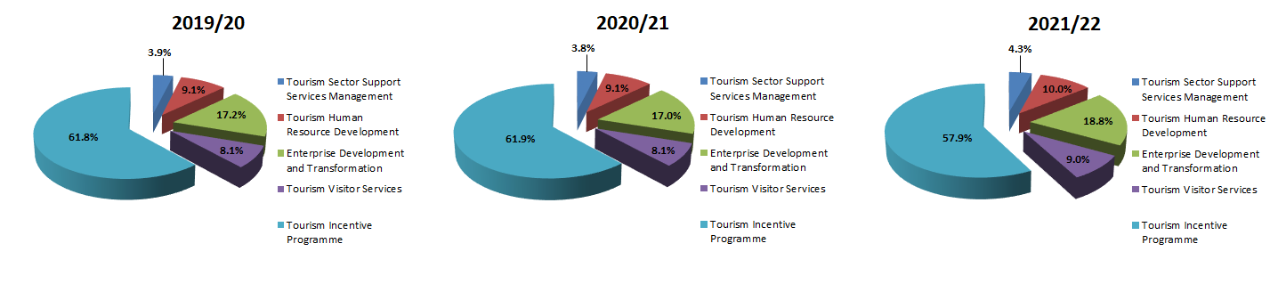
MTEF Baseline - Programme 4: TSSS (Per Sub-Programme)

Slide 54
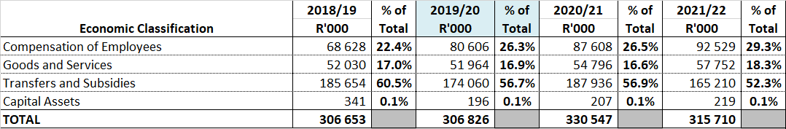
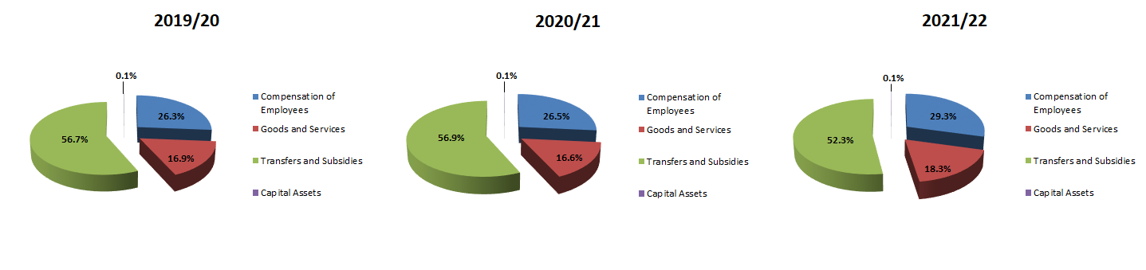
MTEF Baseline - Programme 4: TSSS (Economic Classification)

Slide 55
List of Acronyms / Abbreviations

Slide 56
  Thank You

