Slide 1
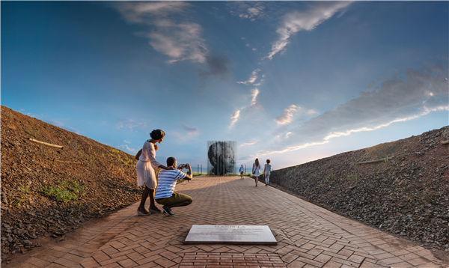
Presentation to Select Committee
SA Tourism Annual Performance Plan 2019 – 20
27 August 2019

Slide 2
CONTENTS
Strategic Overview
Collaboration with Provinces
Strategic focus areas 2019/20
Annual and Quarterly Targets
Finance
Abbreviations and Acronyms
Annexures
Performance Review 2018-19
Tourism Grading Council
Market access for SMMEs
South African Tourism Offices

Slide 3
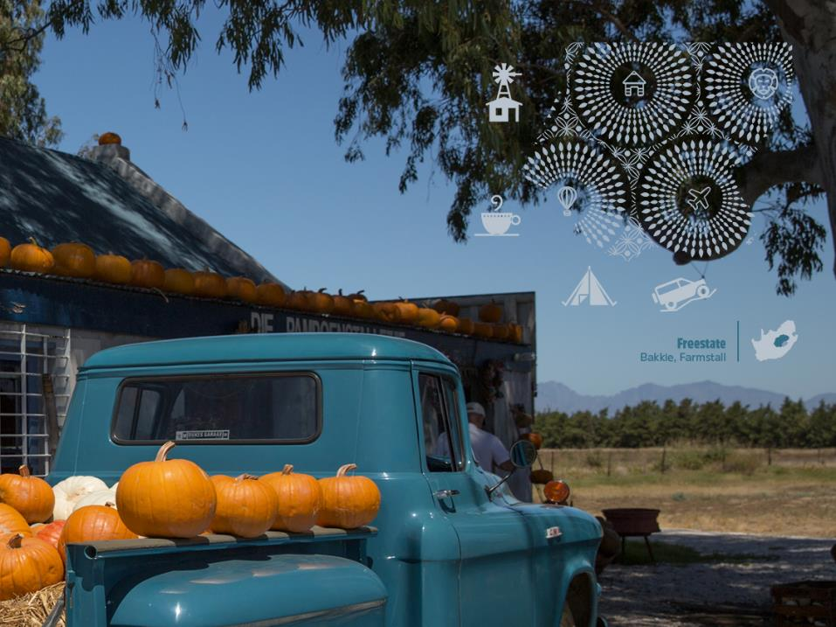
Strategic Overview

Slide 4
SA Tourism strategy and efforts are aligned with the development aspirations of the nation, and specifically the tourism sector
SA Tourism strategic plan is based on the objectives of the National Tourism Sector Strategy (NTSS). This strategy falls under the ambit of the National Development Plan, the overall development plan and aspirations set for the country
SA Tourism’s Position within the Country’s Development Aspirations
National Development Plan –
Vision 2030
According to the National Development Plan, tourism is identified as one of the six pillars in the country’s growth path framework
National Tourism Sector Strategy
The sector strategy was constituted to define a coordinated strategic approach for the tourism sector of South Africa
SA Tourism’s Strategic Plan
The SA Tourism Board was entrusted its responsibilities under the Tourism Act of 2014, primarily focusing on marketing South Africa as a domestic and international tourist destination (leisure) and as a business tourism destination

Slide 5
SA Tourism’s mandate set out in the Tourism Act makes it clear that it needs to make choices that will benefit all South Africans
The mandate to SA Tourism is ...
Inclusive Economic Growth
Sustainable job creation
Redistribution and transformation
Increase in tourist volume
Increase in tourist spend
Increase length of stay
. . . through six key outcomes* . . .
Improve geographic spread
Improve seasonality patterns
Promote transformation
Invest in prioritised markets and segments that will deliver both volume and value to achieve the defined goal.
Build a recognised, appealing, resilient and competitive tourism brand for South Africa.
Collaborate with partners to maximise synergies to enhance traveller experience and close sales
. . . by acting in a focused way to deliver 5 million more travelers in 5 years*
Drive operational efficiency.
Build an inspiring and energised organisation that delivers the defined goal.
*Note: This is for the MTSF period ending 2019/20

Slide 6
To contribute to the inclusive economic growth of South Africa, currently, SA Tourism operates across two areas, viz., Leisure Tourism and Business Events under pinned by our Quality Assurance or Brand experience
SA TOURISM’S VISION, MISSION, ROLES AND RESPONSIBILITIES
SA Tourism’s Vision
“To position South Africa as an exceptional tourist and business events destination that offers a value-for-money, quality tourist experience that is diverse and unique”
SA Tourism’s vision is refined through a clear, defined mission statement
SA Tourism’s Mission
“To contribute to inclusive economic growth by increasing the volume of tourists and the value contributed to the South African economy”
SA Tourism’s mission is set to be delivered through the following business focus areas
SA Tourism’s Business Focus Areas
Leisure Tourism
Business Events
Quality Assurance
Source: SA Tourism 2013-2021 Final Strategic Plan

Slide 7
Marketing Investment Choices: Leisure Tourism
United Kingdom
Netherlands
Belgium
Ireland
Norway
Denmark
Sweden
Finland
Germany
Switzerland
Austria
For international tourism, 44 markets have been shortlisted for dedicated in-market marketing investments, based on their tourism potential and SA Tourism’s ability to win in these markets
France
Canada
Portugal
Spain
United States
Italy
Turkey
China
UAE
India
Japan
Nigeria
Uganda
Ghana
Tanzania
Ethiopia
Malaysia
Kenya
Singapore
DRC
Angola
Mozambique
Malawi
Brazil
Zambia
Argentina
Zimbabwe
Namibia
Botswana
Holiday and MICE
Swaziland
Lesotho
Australia
VFR
Other
New Zealand

Slide 8
Marketing Investment Choices: International Business Events
Promote South Africa as Africa’s best staging place for product launches and user groups, organised by companies in the SADC, Europe, the US and Asia
Focus on incentive houses and corporate travel agencies in Europe and the US among the established markets, and Brazil and India among the shorter-haul markets
To bolster the business events market in South Africa, SANCB will focus on conventions and incentives, across the a set of priority economic sectors
MEETINGS
BUSINESS
EVENTS
INCENTIVES
Develop subvention for incubating and internationalising shows that have South African and SADC producers. Europe should be the focus for replicating titles
EXHIBITIONS
CONVENTIONS
Focus on European, American and regional associations for hosting conventions in South Africa
Priority Sectors for Business Tourism Growth
Manufacturing
Mining and Metals
Business Process Outsourcing
Creative Industries
Life Sciences
Information and Communication Technology

Slide 9
SA Tourism Owned Platforms

Slide 10
Visitor Experience
Sustainable Job Creation and Industry Transformation
Quality Visitor Experience in line with Brand promise
Inspiring commitment to Tourism
Quality /
Star Grading
Skills Development
Market Facilitation
Itinerary Engineering
Leverage new grading criteria to promote the benefits of grading to trade
Eliminate illegal use of stars
Communicate advantages of grading to consumers
Access funding to grow base
SME capacitation for market access
Service Excellence for different countries
Become a Host
Crisis Management
Information Provision
Global Trend preparedness
Indaba Speed Marketing
Mega Fam Speed marketing
Provincial Speed Marketing
Global Trade platform leverage
Market Access toolkit
Innovative brand relevant experiences and products
Addressing Geo Spread, LOS, seasonality
Creating and leveraging super hosts
Ensuring quality through usage of graded entities
Visitor Experience and Tourism Grading Council
Delivering the Brand Promise
Hygiene Factors: Welcoming, Friendly, Safe and Secure, Value for money
Brand Pillars: Wildlife, Adventure, Scenic Beauty, Culture, Authentic, People, Business Tourism , etc.

Slide 11
SA Tourism’s approved macro structure
Chief Executive Officer
Sisa Ntshona
Head: Internal Audit
Radikwena Phora
Head Governance Risk & Compliance/ Company Secretary
Maseapo Kganedi
Chief Operations Officer
Sthembiso Dlamini
Chief Finance Officer
Nombulelo Guliwe
(August 2019)
Chief Strategy Officer
Bashni Muthaya
Chief Marketing Officer
Themba Khumalo (September 2019)
Chief Quality Assurance Officer
Darryl Erasmus
Chief Convention Bureau Officer
Amanda Kotze-Nhlapo

Slide 12
South African Tourism has set a strategic goal of increasing the base of tourism by five million arrivals / trips during 2017-2021. This will ensure synergised efforts across the tourism sector towards contributing to inclusive economic growth
Goal
Increase tourism sector’s contribution to inclusive growth by increasing the base of tourism by five million arrivals /trips during 2017-2021
Strategic Objective 1:
To contribute to inclusive economic growth by increasing the number of international and domestic tourists
Strategic objective 2:
To contribute to an enhanced, recognised, appealing, resilient and competitive tourism and business events brand for South Africa across the target markets and segments
Strategic Objective 3:
To enhance stakeholder and partnership collaboration, both local and international, to improve delivery on South African Tourism’s mandate
Strategic Objective 4:
To contribute to an improved tourist experience in line with the brand promise
Strategic Objective 5:
To position South African Tourism’s corporate brand to be recognised as a tourism and business events industry leader in market intelligence, insights and analytics
Strategic Objective 6:
To achieve operational efficiencies in all activities, including human, marketing and other resources available to South African Tourism
Strategic Objectives
Annual Performance Plan: page 6

Slide 13
Collaboration with provinces

Slide 14
The tourism growth targets is jointly owned by SA Tourism and the Provincial Tourism Authorities. This drives strategic alignment, proportionate resource allocation and coordination of marketing activity
Source Markets
5-in-5 National Tourism Target Drives Resource Allocation
Distribution Markets
Success Factors:
Making 5-in-5 come alive and relevant in the provinces. APPs and Strategies need to link up
SAT and PTA become jointly accountable for the targets
Effort, resources and funding deployed according to targets e.g. hostings, APPs etc.
Elevate targets into provincial performance Grading targets included
PTA CVP:
Strategy formulation and market execution
Global and local market support and alignment
Ownership of local activities and activations + local capacity and tourist activities
India
SAT
Eastern Cape
Australia
Western Cape
Current
10m
+
5m
in
5yrs
Netherlands
Northern Cape
United Kingdom
Gauteng
Germany
North West
United States
Limpopo
China
Mpumalanga
Africa
Free State
Other
KwaZulu-Natal
7% of global target (eg)
Key source markets
SA Tourism signed MOUs with provincial tourism authorities to collaborate, commit and align strategic and tactical plans and resources to achieve the overall tourism targets

Slide 15
Integration with provinces on quality assurance
A number of Provincial Quality Assurance Specialists were relocated to Provincial Tourism Agency offices during the year
The TGCSA and South African Tourism now has physical representation in Limpopo, Kwa Zulu Natal, Eastern Cape, Western Cape and Gauteng
This is proving valuable as it allows for better alignment of Quality Assurance efforts with all Provincial stakeholders and in market Accredited Assessors
In addition to placing resources with our Provincial Tourism stakeholders, greater integration with a number of Provinces has been made possible through strategic agreements which allow for focus on quality assurance efforts in villages, smaller towns and rural areas to support geographic spread, transformation and enterprise support development.

Slide 17
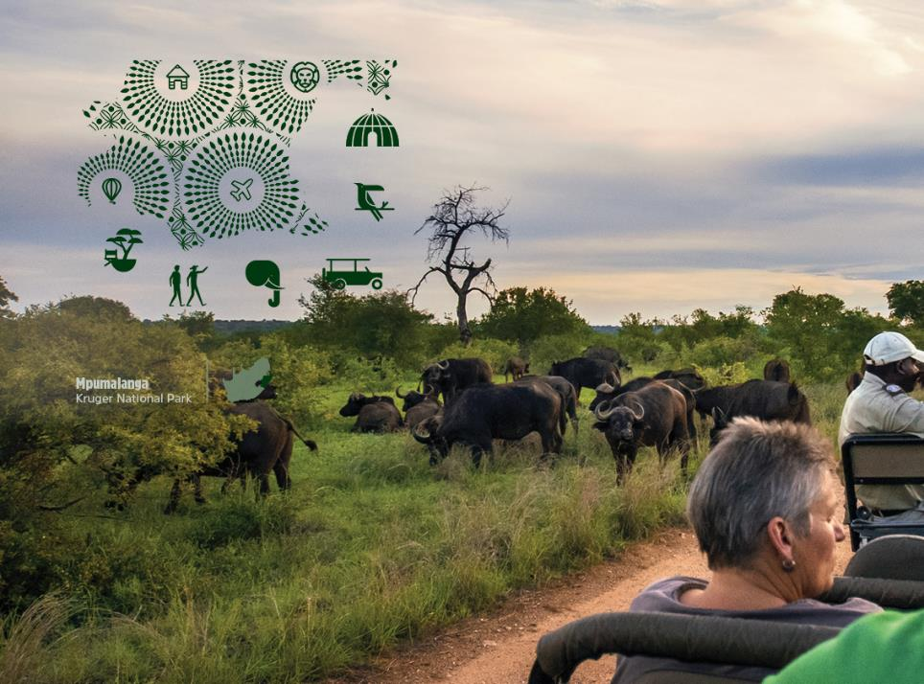
Strategic focus areas 2019/20

Slide 18
However, performance is below the required growth rates in terms of the 5-in-5 goal
5-in-5 goal
International Tourism
Target:
4 million more arrivals
Domestic Tourism
Target:
1 million more holiday trips
Actual performance 2016 to 2018:
0.5 million additional arrivals; approximately 10% of 5-year target
2.1% CAGR
Required growth 2018 to 2021:
CAGR of 6.4%
Actual performance 2016 to 2018:
0.2 million fewer holiday trips
-3.8% CAGR
Required growth 2018 to 2021:
CAGR of 3.8%
Note: Data represents calendar year
Source: SA Tourism Domestic Surveys; Statistics SA Tourism & Migration Reports; SA Tourism Departure Surveys

Slide 19
Key challenges to international tourism growth
Negative perceptions formed through information obtained through the media
Safety and security concerns
Prolonged drought in Cape Town
Inappropriate wildlife interaction
Regulatory challenges
Visa processing challenges
Other factors
Cost to get to South Africa
Another destination is more appealing

Slide 20
Key challenges to domestic tourism growth
Safety & security concerns
Economic constraints
Product development
Perceptions of lack of affordability
Lack of targeted marketing

Slide 21
Strategic focus for the financial year
Collaboration with other government departments:
Working closely with the Department of Tourism, SA Tourism will renew its efforts to better utilize existing platforms
Strengthen the relationship with Brand SA, Invest SA, DIRCO missions abroad, Statistics SA
Collaboration with provincial tourism authorities through the implementation and monitoring of the MOUs that have already been signed by provinces
“We Do Tourism”:
The “We Do Tourism” movement commenced initially as a marketing campaign in 2017/18 to illustrate to South Africans, in the industry, in business or even in the neighbourhoods, the value that tourism has on all South Africans
Refresh and execute the campaign with the aim of ultimately getting all South Africans to rally behind tourism
Campaign is being developed and will be launched later this fiscal
To reflect on the possible risk to tourism growth by cost containment measures that impact on the meetings, conferences and business events hosted by government departments, provinces and state companies
Positioning South African Tourism as a tourism and business events industry leader in market intelligence, insights and analytics:
Develop a business tool that delivers market intelligence and insights to relevant stakeholders
Launch phase one of performance dashboard
Enhance dashboard to include additional data and improved functionality that provides more insights
Annual Performance Plan: page 19

Slide 22
Strategic focus for the financial year
Implementing the Events Strategy :
SA Tourism developed an Events Strategy to assist in growing tourism and improving geographical spread and seasonality
Strategy focusses on key countrywide events that will be implemented through partnerships
For example, Cricket South Africa, Standard Bank Joy of Jazz, Soweto Marathon, Cape Town International Jazz Festival, National Arts Festival, etc.
Drive transformation within the tourism industry through enterprise and supplier development:
SA Tourism will implement its Enterprise and Supplier Development Framework
Framework guides SA Tourism’s efforts in providing support for the advancement of tourism enterprises
Framework assists in further enhancement of tourism enterprises and suppliers’ capability to enhance destination offerings
SA Tourism supply chain policies are institutionalised in line with the Preferential Procurement Policy Framework Act (PPPFA) and Broad Based Black Economic Empowerment Act (B-BBEE)
South African Tourism implements a prequalifying bid condition to advance designated groups on the basis of subcontracting a minimum of 30% of the entire bid with Exempted Micro Enterprises (EMEs) and Qualifying Small Enterprise (QSE) which are 51% owned by either of the following: Blacks; Black Youth; Black Women; Black people with disabilities; Black people living in rural or underdeveloped areas or townships; cooperatives owned by Black people; or Black people who are Military Veterans
Annual Performance Plan: page 20

Slide 23
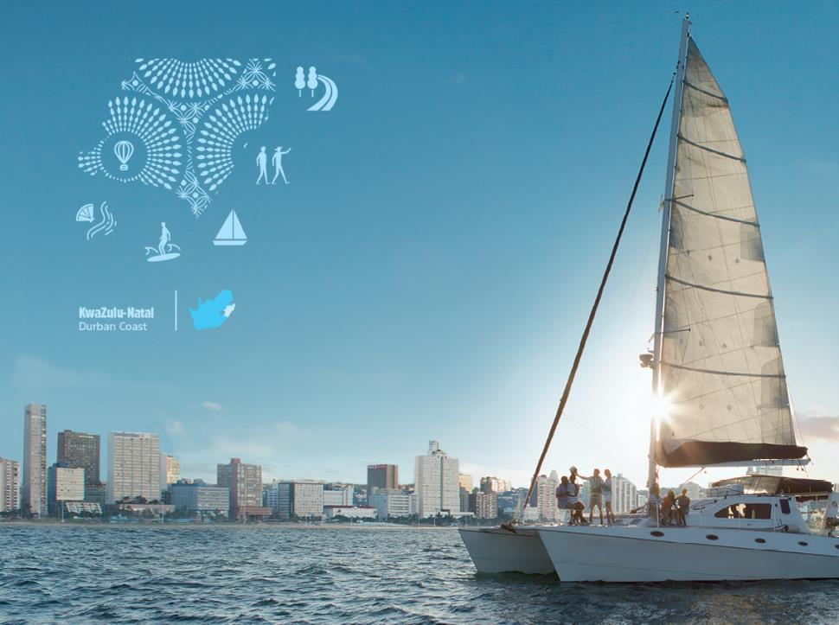
Annual and quarterly targets

Slide 24
A summary of the SA Tourism KPIs per programme as per the APP 2018/19 is illustrated below
PROGRAMME | STRATEGIC OBJECTIVE | KPI
1. Corporate Support | To achieve operational efficiencies in all activities, including human, marketing and other resources available to South African Tourism | Staff satisfaction score achieved Labour turnover rate Percentage vacancy rate maintained Compliance with Employment Equity Act Unqualified audit report achieved B-BBEE-level achieved
2. Business Enablement | To enhance stakeholder and partnership collaboration to better deliver on South African Tourism’s mandate To position South African Tourism to be recognised as a tourism and business events industry leader in market intelligence, insights and analytics | Quarterly stakeholder meetings Annual national stakeholder meeting Quarterly market insight reports Tourism performance dashboard
3. Leisure Tourism Marketing | To contribute to inclusive economic growth by increasing the number of international and domestic tourists To contribute to an enhanced, recognised, appealing, resilient and competitive tourism and business events brand for South Africa across the target markets and segments | Number of international tourist arrivals Total tourist foreign direct spend (TTFDS) Global impressions from digital channels Number of SA Specialist graduates Percentage geographic spread of international tourist arrivals achieved Seasonality index of international tourist arrivals Percentage brand positivity achieved Percentage brand awareness achieved Number of domestic holiday trips Domestic holiday revenue Reach of domestic campaign Click-through to domestic tourism packages Geographic spread of domestic tourists Seasonality index of domestic tourists SME attendance at SA Tourism Tradeshow Platforms SME participation for all SA Tourism hosting activities

Slide 25
A summary of the SA Tourism KPIs per programme as per the APP 2018/19 is illustrated below
PROGRAMME | STRATEGIC OBJECTIVE | KPI
4. Business Events | To contribute to inclusive economic growth by increasing the number of international and domestic tourists To contribute to an enhanced, recognised, appealing, resilient and competitive tourism and business events brand for South Africa across the target markets and segments | Number of business events hosted Number of international delegates hosted Number of bids supported Number of bids supported for international and regional business events Number of qualified leads generated Number of meetings held at Meetings Africa Number of meetings held at Indaba Number of international tourism market access platforms where SA Tourism participates
5. Tourist Experience | To contribute to an improved tourist experience in line with the brand promise | Number of graded accommodation establishments Number of graded rooms Number officials that attended the Welcome training Number of Speed Marketing sessions to promote tourism products and services

Slide 26
Programme 1: Corporate Support
STRATEGIC OBJECTIVE 6: To achieve operational efficiencies in all activities, including human, marketing and other resources available to South African Tourism
Key Performance Indicator | Reporting Period | Annual Target 2019/20 | Quarterly Target 2019/20
 |  |  | Quarter 1 | Quarter 2 | Quarter 3 | Quarter 4
Staff satisfaction score achieved | Annual | 3.57 | - | - | - | 3.57
Labour turnover rate | Annual | 8% | - | - | - | 8%
Percentage vacancy rate maintained | Annual | 7% | - | - | - | 7%
Compliance with Employment Equity Act | Annual | Compliance with Employment Equity Act | - | - | - | Compliance with Employment Equity Act
Unqualified report achieved | Annual | Unqualified Audit Report | - | - | - | Unqualified Audit Report
B-BBEE-level achieved | Annual | Level 4 | - | - | - | Level 4
Annual Performance Plan: page 25

Slide 27
Programme 2: Business enablement
STRATEGIC OBJECTIVE 3: To enhance stakeholder and partnership collaboration to better deliver on South African Tourism’s mandate
STRATEGIC OBJECTIVE 5: To position South African Tourism to be recognised as a tourism and business events industry leader in market intelligence, insights and analytics
Key Performance Indicator | Reporting Period | Annual Target 2019/20 | Quarterly Target 2019/20
 |  |  | Quarter 1 | Quarter 2 | Quarter 3 | Quarter 4
Quarterly stakeholder meetings | Quarterly | 4 | 1 | 1 | 1 | 1
Annual national stakeholder meeting | Annual | 1 | - | - | - | 1
Quarterly market insight reports | Quarterly | 4 | 1 | 1 | 1 | 1
Tourism performance dashboard | Quarterly | Develop and launch performance dashboard | Launch performance dashboard | 1 Enhancement implemented | 1 Enhancement implemented | 1 Enhancement implemented
Annual Performance Plan: page 26

Slide 28
Programme 3: Leisure Tourism Marketing
STRATEGIC OBJECTIVE 1: To contribute to inclusive economic growth by increasing the number of international and domestic tourists
STRATEGIC OBJECTIVE 2: To contribute to an enhanced, recognised, appealing, resilient and competitive tourism and business events brand for South Africa across the target markets and segments
Key Performance Indicator | Reporting Period | Annual Target 2019/20 | Quarterly Target 2019/20
 |  |  | Quarter 1 | Quarter 2 | Quarter 3 | Quarter 4
Number of international tourist arrivals (millions)* | Quarterly – financial year | 11.4 | 2.6 | 2.8 | 3.0 | 3.0
 | Quarterly – calendar year | 11.3 | 2.9 | 2.6 | 2.8 | 3.0
Total tourist foreign direct spend (TTFDS) (billion rand) * | Quarterly – financial year | R90.7 | R20.3 | R21.8 | R23.7 | R24.9
 | Quarterly – calendar year | R88.4 | R22.6 | R20.3 | R21.8 | R23.7
Number of impressions from digital channels (millions) | Quarterly | 9.0 | 2.2 | 2.4 | 2.9 | 1.4
Number of SA Specialist graduates | Quarterly | 750 | 262 | 112 | 264 | 112
*Note: these indicators are reported on a financial year, but tracked on a calendar year
Annual Performance Plan: page 27

Slide 29
Programme 3: Leisure Tourism Marketing
STRATEGIC OBJECTIVE 1: To contribute to inclusive economic growth by increasing the number of international and domestic tourists
STRATEGIC OBJECTIVE 2: To contribute to an enhanced, recognised, appealing, resilient and competitive tourism and business events brand for South Africa across the target markets and segments
Key Performance Indicator | Reporting Period | Annual Target 2019/20 | Quarterly Target 2019/20
 |  |  | Quarter 1 | Quarter 2 | Quarter 3 | Quarter 4
Percentage Geographic spread of international tourist arrivals achieved | Annual | 24% | - | - | - | 24%
Seasonality index of international tourist arrivals | Annual | 1.50% | - | - | - | 1.50%
Percentage brand positivity achieved | Annual | 40% | - | - | - | 40%
Percentage brand awareness achieved | Annual | 78% | - | - | - | 78%
*Note: these indicators are reported on a financial year, but tracked on a calendar year
Annual Performance Plan: page 27

Slide 30
Programme 3: Leisure Tourism Marketing
STRATEGIC OBJECTIVE 1: To contribute to inclusive economic growth by increasing the number of international and domestic tourists
STRATEGIC OBJECTIVE 2: To contribute to an enhanced, recognised, appealing, resilient and competitive tourism and business events brand for South Africa across the target markets and segments
Key Performance Indicator | Reporting Period | Annual Target 2019/20 | Quarterly Target 2019/20
 |  |  | Quarter 1 | Quarter 2 | Quarter 3 | Quarter 4
Number of domestic holiday trips (millions) achieved* | Quarterly – financial year | 2.7 | 0.6 | 0.3 | 1.0 | 0.8
 | Quarterly – calendar year | 2.6 | 0.7 | 0.6 | 0.3 | 1.0
Domestic holiday revenue (billion rand)* | Quarterly – financial year | R8.1 | R1.8 | R1.1 | R2.9 | R2.3
 | Quarterly – calendar year | R7.9 | R2.2 | R1.8 | R1.1 | R2.9
Reach of domestic campaign (millions) | Quarterly | 37.1 | 9.1 | 10.0 | 12.1 | 5.9
Click-through to domestic tourism packages | Quarterly | 150 000 | 28 500 | 63 700 | 34 600 | 23 200
Geographic spread of domestic tourists | Annual | 13% | - | - | - | 13%
Seasonality index of domestic tourists | Annual | 28.5% | - | - | - | 28.5%
*Note: these indicators are reported on a financial year, but tracked on a calendar year
Annual Performance Plan: page 28

Slide 31
Programme 3: Leisure Tourism Marketing
STRATEGIC OBJECTIVE 1: To contribute to inclusive economic growth by increasing the number of international and domestic tourists
STRATEGIC OBJECTIVE 2: To contribute to an enhanced, recognised, appealing, resilient and competitive tourism and business events brand for South Africa across the target markets and segments
Key Performance Indicator | Reporting Period | Annual Target 2019/20 | Quarterly Target 2019/20
 |  |  | Quarter 1 | Quarter 2 | Quarter 3 | Quarter 4
Number of SME participating at South African Tourism Tradeshow Platforms | Quarterly | 182 | 130 | - | 26 | 26
Number of SME included in all South African Tourism hosting activities | Quarterly | 37 | 9 | 9 | 10 | 9
Annual Performance Plan: page 28

Slide 32
Programme 4: Business Events
STRATEGIC OBJECTIVE 1: To contribute to inclusive economic growth by increasing the number of international and domestic tourists
STRATEGIC OBJECTIVE 2: To contribute to an enhanced, recognised, appealing, resilient and competitive tourism and business events brand for South Africa across the target markets and segments
Key Performance Indicator | Reporting Period | Annual Target 2019/20 | Quarterly Target 2019/20
 |  |  | Quarter 1 | Quarter 2 | Quarter 3 | Quarter 4
Number of business events hosted in South Africa | Annual | 168 | - | - | - | 168
Number of international delegates hosted in South Africa | Annual | 90 300 | - | - | - | 90 300
Number of bids supported for international and regional business events | Quarterly | 115 | 28 | 28 | 28 | 31
Number of qualified leads generated | Quarterly | 345 | 84 | 84 | 84 | 93
Number of meetings held at Meetings Africa | Annual | 13 700 | - | - | - | 13 700
Number of meetings held at Indaba | Annual | 20 000 | 20 000 | - | - | -
Number of international tourism market access platforms where SA Tourism participates | Quarterly | 6 | 1 | 1 | 2 | 2
Annual Performance Plan: page 29

Slide 33
Programme 5: Tourist experience
STRATEGIC OBJECTIVE 4: To contribute to an improved tourist experience in line with the brand promise
Key Performance Indicator | Reporting Period | Annual Target 2019/20 | Quarterly Target 2019/20
 |  |  | Quarter 1 | Quarter 2 | Quarter 3 | Quarter 4
Number of graded accommodation establishments achieved | Quarterly | 5 500 | 1 254 | 1 351 | 1 399 | 1 496
Number of graded rooms achieved | Quarterly | 133 140 | 30 841 | 32 360 | 34 068 | 35 871
Number officials/ frontline staff that attended the Welcome training | Quarterly | 800 | 200 | 200 | 200 | 200
Number of Speed Marketing sessions to promote tourism products and services | Quarterly | 7 | 4 | 1 | 1 | 1
Annual Performance Plan: page 30

Slide 34
Finance

Slide 35
Revenue estimates
Revenue | 2016/17 | 2017/18 | 2018/19 | 2018/19 | Variance analysis |  | 2019/20 | 2020/21 | 2021/22
(R’000) | *Audited | *Audited | Approved | Actual | R'000 | % | Estimates | Estimates | Estimates
Dept Tourism Allocation | 1 024 847 | 1 129 288 | 1 208 048 | 1 208 048 | - | 0% | 1 254 161 | 1 323 456 | 1 392 808
TOMSA levies | 137 578 | 116 841 | 130 815 | 121 516 | -9 299 | -7% | 137 356 | 144 224 | 152 156
Indaba, Meetings Africa & Other Exhibitions | 55 431 | 74 659 | 57 000 | 58 999 | 1 999 | 4% | 60 192 | 63 503 | 66 996
Grading fees | 20 569 | 20 646 | 22 561 | 21 739 | -822 | -4% | 23 824 | 25 134 | 26 516
Sundry revenue | 56 123 | 28 642 | 21 140 | 37 611 | 16 471 | 78% | 22 324 | 23 552 | 24 847
TOTAL | 1 294 548 | 1 370 076 | 1 439 564 | 1 447 913 | 8 349 | 1% | 1 497 857 | 1 579 869 | 1 663 323
Annual Performance Plan: page 21

Slide 36
Breakdown of budget per programme
Name of the Programme |  | 2016/17 | 2017/18 | 2018/19 |  |  |  | Reason for variance | 2019/20 | 2020/21 | 2021/22
 |  |  |  | Approved | Unaudited | Variance analysis
 |  | Audited (R’000) | Audited (R’000) | Budget (R’000) | Actual (R’000) | (R’000) | % |  | Budget (R’000) | Budget (R’000) | Budget (R’000)
1 | Corporate Support | 102 127 | 151 212 | 132 271 | 158 725 | -27 387 | -21% | Depreciation & Amortisation and Provisions. | 135 171 | 140 936 | 148 381
2 | Business Enablement | 99 907 | 60 926 | 85 929 | 85 929 | - | 0% |  | 89 700 | 94 710 | 99 714
3 | Leisure Tourism Marketing | 846 955 | 955 996 | 1 026 270 | 1 045 306 | -19 036 | -2% | Unrealised foreign exchange loss | 1 066 602 | 1 130 759 | 1 190 488
4 | Business Events | 154 552 | 172 123 | 129 287 | 129 287 | - | 0% |  | 137 689 | 140 932 | 148 377
5 | Visitor Experience | 54 035 | 49 596 | 65 807 | 65 807 | - | 0% |  | 68 695 | 72 532 | 76 363
Total |  | 1257 576 | 1 389 853 | 1 439 564 | 1 485 054 | -46 423 | -3% |  | 1 497 857 | 1 579 869 | 1 663 323
Annual Performance Plan: page 34

Slide 37
SA Tourism marketing execution budget per region
REGION | BUDGET | % ON TOTAL BUDGET
ASIA | R 156 604,29 | 10%
AMERICAS | R 111 074,67 | 7%
EUROPE | R 235 923,40 | 16%
AFRICA | R 86 214,97 | 6%
HEAD OFFICE COST | R 399 406,23 | 27%
TOTAL BUDGET | R 1 497 857,00
TOTAL PROGRAM COST | R 989 223,55 | 66%

Slide 38
Abbreviations and Acronyms
AENE Adjusted Estimates of National Expenditure
AGM Annual General Meeting
CAGR Compound Annual Growth Rate
EAP Economically Active Population (People from 15-64 years of age who are either employed or unemployed and seeking employment)
FNB-BER First National Bank & Bureau of Economic Research
MESE Meetings, Exhibitions & Special Events
MICE Meetings, Incentives, Conferencing and Exhibitions
SANCB South African National Convention Bureau
TDDS Total Domestic Direct Spend is the amount spent by South African residents on domestic trips excluding any prepaid amounts and reported in nominal terms
TGCSA Tourism Grading Council of South Africa
TOMSA Tourism Marketing South Africa
TTFDS Total Tourist Foreign Direct Spend is the total amount spent directly in South Africa by all foreign tourists and reported in nominal terms
UNWTO United Nations World Travel Organisation
VFR Visiting Friends and Relatives. VFR travel is largely not in the control of SA Tourism as this type of travel includes trips which are undertaken to see relatives and/or friends e.g. weddings, funerals, etc. The tourist need not have stayed at the friends and/or relatives house.
VFS Visa Facilitation Services

Slide 39
Definitions
Country of residence – If a person resides (or intends to reside) for more than one year in a given country and has there his/her centre of economic interest (e.g. his/her major source of income), he /she is considered as a resident of this country.
Visitor – A visitor is a traveler taking a trip to a main destination outside his/her usual environment, for less than a year, for any main reason other than to be employed by a resident entity in the county or place visited.
Same day visitor – A visitor is classified as same-day visitor if his/her trip does not include an overnight stay.
Tourist – A visitor who stays at least one night in the place visited.
International Tourist – An international visitor who stays at least one night in collective or private accommodation in the country visited.
Domestic visitor – A visitor is a traveler taking a trip to a main destination outside his/her usual environment, for less than a year, for any main purpose other than to be employed by a resident entity in the country or place visited.
Domestic Tourist – A resident visitor who visits within the economic territory of the country of reference.
Trip – A trip refers to the travel by a person from the time of departure from his/her usual residence until he/she returns: it thus refers to a round trip. Trips taken by visitors are tourism trips.
Usual environment – The usual environment of an individual, a key concept in tourism, is defined as the geographical area within which an individual conducts his/her regular life routines. To be outside the usual environment the person should travel more than 40 kilometers from his/her place of residence (one-way) AND the place should NOT be visited more than once a week. This includes place of work and place of study. Leisure and recreational trips are included irrespective of frequency.

Slide 41
ANNEXURES

Slide 42
The Tourism Grading Council (TGCSA)

Slide 43
Strategic overview of the Tourism Grading Council
TGCSA’S MANDATE, VISION AND MISSION
TGCSA mandate
“The establishment of one or more schemes in terms of which tourism Services, Facilities and Products are graded and classified” - Tourism Act 3 of 2014
SA Tourism’s Vision
To be an internationally recognized, credible and predictable brand that stands for quality and enriched tourist experiences
SA Tourism’s Mission
Strengthen the SA Tourism Brand by implementing a recognisable and credible globally bench-marked system of quality assurance for tourism experiences which can be relied upon.

Slide 44
Overview of the grading process
Online Application Process on *QiT
Payment of Invoice
Visit by Assessor
Pre-screening by PMA
Award of Certificate and Plaque
Monthly Property Approvals Exco Meeting
Voluntary and Annual Process

Slide 45
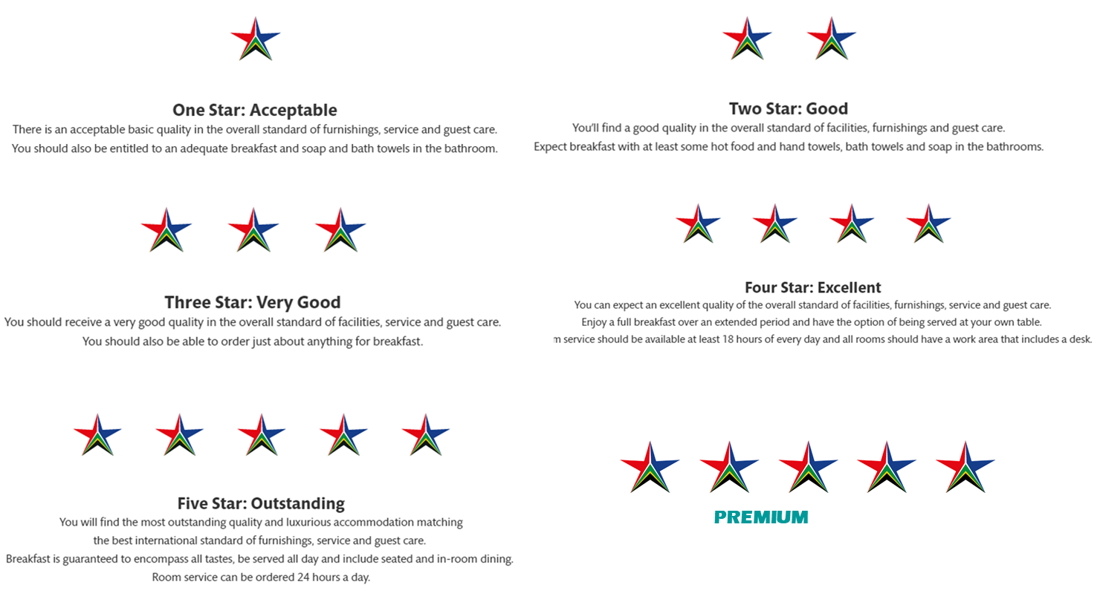
Star grading levels
Categories of establishments that are graded
Hotels
Apartment Hotels
Small Hotels
Boutique Hotels
Bed and Breakfasts
Guesthouse
Country House
Game Lodge / Nature Lodge
Backpackers
Hostel
Self-Catering
Exclusive
Shared
Caravan and Camping
Campsite
Venues

Slide 46
The introduction of “Accolades” provides recognition for achievements/ distinguishing features of graded establishments
Under this system the establishment would need to meet typically 3 to 6 clear minimum requirements to achieve an accolade or “badge” of recognition.
Seventeen (17) accolade categories have been proposed such as: Wedding Venue, Cycling Tourism, Resort, Child Friendly, etc.

Slide 47
Background on Lilizela Tourism Awards
Launched in 2013 by the Minister of Tourism. The event is South Africa’s premier travel and tourism awards. The aim of the awards is to recognize and celebrate tourism businesses for tourism excellence, for their contribution to South Africa’s global competitiveness, and for growing tourism’s contribution towards GDP and job creation.

Slide 48
2019 Lilizela Tourism Awards – 8 categories
FOCUS AREA | CATEGORIES | Sub-Categories
MINISTER | We/I Do Tourism Award | None
SERVICE EXCELLENCE | Accommodation | Backpacker & Hostelling, Bed & Breakfast, Caravan & Camping, Country House, Game Lodge, Nature Reserve, Guest House, Hotel, Lodge, Self catering: Exclusive Use, Self Catering: Shared vacation
 | Venues | Meetings, Exhibitions, and Special Events venues
 | Tourist Guides | Nature Guides, Culture Guides and Adventure Guides
 | Tour Operators | Emerging and Established
 | Visitor Experience | Roots & Culture, Culture & Lifestyle, Action & Adventure, Wildlife Encounters, Lap of Luxury, Beach Experience, Scenic Beauty, Marine Adventures
SUSTAINABLE DEVELOPMENT | Universal Accessibility (Experience and Accommodation) | Mobility, Communicative and Visual
ENTREPRENEURSHIP | ETEYA | Winner, 1st 2nd 3rd Runner Ups

Slide 49
Lilizela Tourism Awards 2019 Key Deliverables
Entries opened on the 15th April 2019. Minister of Tourism announced this during Meeting’s Africa 2019. Media release was deployed following the official opening of the entries to media houses, tourism associations, already existing tourism grading database and provincial tourism authorities. Conducted media round table at ATI this year with several media interviews. Date for entries was extended to the 14th of June 2018.
Voting opened at the same time as entries and closed on the 18th of June 2019.
Call for judges ad was disseminated by the provinces as well on our different communication platform, during the month of April and May 2019. Provinces deployed the advert to their respective industry players. A total of 38 applications were received and we had a final approved list of 30 judges for this year.
Request for Proposal and costs to auditing firms was conducted by SA Tourism procurement unit for Lilizela Award 2019. Nexia SAB&T Auditors were awarded the job as the Lilizela auditing firm for 2019. The firm is a majority blacked owned and has been in operation since 1994 with offices in all 9 Provinces.
Adjudication process commenced from the 8th of July to the 26th of July 2019. Provincial winners and National winners will be drawn from the outcome of these adjudications.
The deliberated 2019 Lilizela entrants have been consolidated and verified by the auditors and the final provincial lists have been provided to each province in preparation for the their provincial event. NDT has led the tour guide Lilizela process and they have been adjudicated and approved by the auditors.
The I/We Do Tourism award will be drawn from the provincial MEC nominations and criteria for this process was agreed upon in the Provincial Lilizela Steering Committee meeting.

Slide 50
Judges and Auditors for Lilizela 2019
South African Tourism appointed 28-judges which covered the vast landscape of the local travel and tourism industry and were tasked to selecting the best of the best in the local travel industry across a range of categories.
Nexia SAB&T Auditors have been awarded the a majority blacked owned and has been job as the Lilizela auditing firm for 2018 as well.The firm is in operation since 1994 with offices in all 9 Provinces.

Slide 51
Total entries by province
Eastern Cape | 225
Free State | 45
Gauteng | 137
KwaZulu-Natal | 180
Limpopo | 111
Mpumalanga | 73
North West | 44
Northern Cape | 35
Western Cape | 198
Grand Total | 1048

Slide 52
Provincial Event Details
The National Convention Bureau as mandated by the business will execute the national Lilizela tourism awards event and support the provincial partners with tools and branding to execute their respective events.
Provincial events are all scheduled to take place in the month of September as follows:
Eastern Cape Venue: Dan’s Country Lodge in Mthatha Date: 19 September 2019 | Free State Venue: Imvelo Date: 13 September 2019
KwaZulu-Natal Venue: The Zunguness in Midlands Date: 26 September 2019 | Limpopo Venue: Protea Hotel Ranch Resort Date: 17 September 2019
Northern Cape Venue: The Flamingo Date: 05 September 2019 | North West Venue-TBC Date:25 September 2019
Mpumalanga Venue: Ingwenya Lodge Date:06 September 2019 | Western Cape Venue: TBC Date:13 September 2019
Gauteng Outstanding

Slide 53
National Lilizela Award Event
The national event will take place on the 9th of November at the Sun Time Square, City of Tshwane.
The 2019 Event concept is Cradle of Excellence. The concept emphasises Lilizela’s brand positioning as the tourism award show of all shows. It pushes the idea of honouring the best of the best in hospitality to its limits by showcasing the South African landscape as the bedrock of excellence. It aims to recognise and celebrate individuals of the same calibre. As a country, we’ve come a long way in the past 25 years and we’ve achieved the remarkable together. Coining the Lilizela awards as the cradle of excellence is not only fitting to what the awards stand for – it’s to say that greatness is our standard measure of achievement. It’s to acknowledge that excellence is in fact inherent to who we are.
The Event Theme is Black and Gold: Our colour choice is inspired by the classic Lilizela black and gold. The venue’s floor space is inspired by the atmosphere of an art gallery. This will also be evident in how the look & feel lives on every element. Art galleries are synonymous with elegance, class, prestige and history. Those same characteristics are of importance to Lilizela.

Slide 54
SA TOURISM OFFICES
The Netherlands
South African Tourism
Jozef Israelskade 48A
Amsterdam 1072 SB
Telephone: (+31) 20 471 3181
Fax: (+31) 20 662 9761
Email: info@southafrica.net
Website: www.mijnzuidafrika.nl
Germany
South African Tourism
Friedensstr. 6-10
Frankfurt 60311
Telephone: (+49) 800 118 9118
Email: info.de@southafrica.net
Website: www.dein-suedafrika.de
United Kingdom and Ireland
South African Tourism
2nd Floor, 1 and 2 Castle Lane
London SW1E6DR
Telephone: (+44) 20 897 19350
Fax: (+44) 20 894 46705
Email: information.uk@southafrica.net
Website: www.southafrica.net
Australia
South African Tourism
Suite 302, Level 3, 117 York Street
Sydney NSW 2000
Telephone: (+61) 2 926 15000
Fax: (+61) 2 926 12000
Email: info@southafrica.net
Website: www.southafrica.net
Japan
South African Tourism
Akasaka Lions Building 2F 1-1-2
Moto Akasaka Minato Ku, Tokyo 107-0051
Telephone: (+81) 3 347 87601
Fax: (+81) 3 347 87605
Email: info@southafrica.net
Website: www.south-africa.jp
China
South African Tourism
Suite 2606, Zhongyu Plaza, 6 Gong Ti North Road, Chaoyang
Beijing 100027
Telephone: (+86) 10 852 36881
Fax: (+86) 10 852 36897
Email: info@southafrica.net
Website: www.southafricantourism.cn

Slide 55
SA TOURISM OFFICES
India
South African Tourism
Unit 3, Ground Floor TCG Financial Centre, C-53 “G” Block
Bandra-Kurla Complex, Bandra (E) Mumbai 400 051
Maharashtra
Telephone: (+91) 22 615 85100
Fax: (+91) 22 615 86101
Email: india@southafrica.net
Website: www.southafrica.net
United States
South African Tourism
Suite 2200, 500 Fifth Avenue
New York 10110
Telephone: (+1) 212 471 2929
Fax: (+1) 212 764 1980
Email: info.us@southafrica.net
Website: www.southafrica.net
Brazil
South African Tourism
Av. Paulista, 1159, conj. 413
São Paulo
Telephone: (+55) 11 250 66884
Fax: (+55) 11 250 66884
Email: info@southafrica.net
Website: www.southafrica.net
Nigeria
South African Tourism
8th Floor Church Gate Towers 2, Plot PC 31, Church Gate Street, Victoria Island
Lagos
Telephone: (+234) 01 270 0219 20
Email: info@southafrica.net
Website: www.southafrica.net
France
South African Tourism moved out of its Paris office accommodation due to the high cost of rental. The offices were then housed in virtual offices in Paris while suitable offices were being sought.

