Slide 1

ANNUAL PERFORMANCE PLAN 2019/2020
PORTFOLIO COMMITTEE ON ENVIRONMENT, FORESTRY AND FISHERIES (PCEFF)
27 AUGUST 2019
Ms Carmel Mbizvo
Acting Chief Executive Officer

Slide 2
SANBI DELEGATION
Mrs Beryl Ferguson, SANBI Board Member
Ms Carmel Mbizvo, Acting Chief Executive Officer
Ms Lorato Sithole, Chief Financial Officer
Mr Thompson Mutshinyalo, Acting Managing Director: NZG
Ms Portia Mpolaise, Acting Chief Corporate Officer

Slide 3
PRESENTATION OUTLINE
SANBI background and key information
Legislative, policy and mandate
SANBI’s role in brief
Mission, Vision and Goal
High-level Structure
SANBI’s Programmes (CSP 2019 - 2024 and APP 2019/20)
Strategic Objectives, Performance Indicators and Targets
Budget Estimates 2019/20
Key Strategic Risks and Mitigation Plan 2019/20

Slide 4


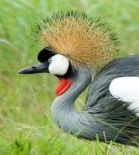
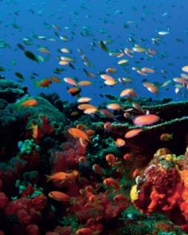
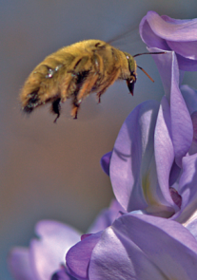
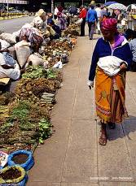
SANBI Vision
Biodiversity richness for all South Africans

Slide 5
POLICY and LEGAL FRAMEWORK (source of mandate)
National Environmental Management: Biodiversity Act NEMBA (Act No 10 of 2004) | Gazetted
SANBI role in NEMBA Regulations: Threatened or Protected Species; CITES including the National Scientific Authority; Alien and Invasive Species | Gazetted
Obligations in the National Biodiversity Framework (NBF) -the five year plan from Cabinet approved 20 year vision the National Biodiversity Strategic Action Plan (NBSAP) | Gazetted
Obligations in Minister’s Delivery Agreement – in Outcome 10 / in the MTSF targets | Published / Parliamentary approved
The Climate Change Response White Paper – SANBI role in delivering Long Term Adaptation Scenarios for the bio-natural resources / designated National Implementing Entity (NIE) for the Global Adaptation Fund | Published/ Ministerial approved

Slide 6
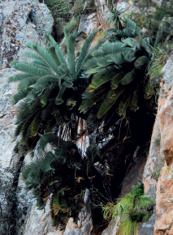
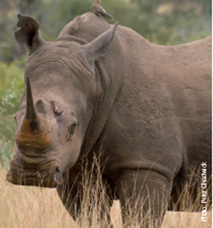
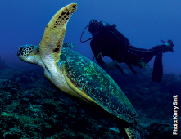
REPORTING ON DELIVERY OF MANDATE
Key mandate deliverables are reflected in the 5 year Corporate Strategic Plan (CSP), Annual Performance Plan (APP) and achievements are documented in Annual Report.
Governance Protocol agreement with DEA.
Progress report on APP is done quarterly and analysed and approved by DEA.

Slide 7
human wellbeing
improved service delivery
job creation
harnessing biodiversity value
investment in ecological infrastructure
ecosystem-based adaptation to climate change
streamlined environmental decision-making
WHAT WE INFLUENCE
SCIENCE INTO POLICY / ACTION:
information | planning | policy advice | models | tools
BUILDING BIODIVERSITY KNOWLEDGE:
assessments | status | trends | monitoring | modelling
GARDENS
windows on biodiversity
HUMAN CAPITAL DEVELOPMENT
WHAT WE DO
FOUNDATIONS OF BIODIVERSITY:
collections| taxonomy | inventory | maps | classification of ecosystems and species

Slide 8
SANBI’s contribution DEFF’outcomes
National Development Plan (NDP) desired 2030 outcome
Transition to a society & economy which is internationally competitive, equitable, job creating & sustainable
Medium Term Strategic Framework (MTSF) Sub-outcomes
ENVIRONMENTAL ECONOMIC CONTRIBUTION OPTIMISED
Facilitate sustainable Socio- economic Growth & Development by catalysing, optimising & scaling up the contribution of the environmental sector to economic prosperity
ECOLOGICAL INTEGRITY
SAFEGUARDED & ENHANCED
Provide leadership in promoting & ensuring environmental sustainability through the management, utilisation, conservation, protection & valuing
of our natural resources
SOCIALLY TRANSFORMED & TRANSITIONED COMMUNITIES
Drive socio-economic transformation & transition by optimising the fair & equitable sharing of benefits & enabling Social Development
GLOBAL AGENDA INFLUENCED & GLOBAL/LOCAL OBLIGATIONS MET
Enhanced international cooperation supportive of SA environmental /Social Development priorities
DEA Outcomes
GARDENS AS WINDOWS ON BIODIVERSITY
FOUNDATIONS OF BIODIVERSITY SCIENCE
BUILDING BIODIVERSITY KNOWLEDGE
SCIENCE INTO POLICY/ ACTION
HUMAN CAPITAL DEVELOPMENT
SANBI’s Contribution

Slide 9
SANBI contribution to Sustainable Development Goals (SDGs), international obligations & national priorities
SDGs
MTSF
DEA Outcomes
SANBI Prog’s
NDP
International agreements

Slide 10
SANBI’s High-level Organisational Structure
Minister of Environmental Affairs
SANBI Board
Chief Executive Officer
Executive Committee (EXCO)
Head of Branch
Chief Financial Officer
Chief Corporate Officer
Chief Directors
Management Committee
Directors

Slide 11
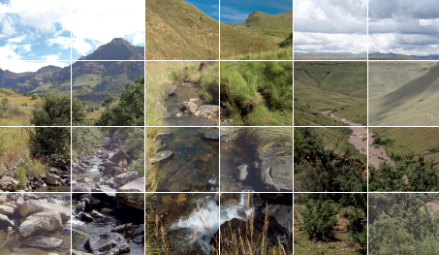
SANBI’s Strategic Goal
SANBI contributes to South Africa’s sustainable development by facilitating access to biodiversity data, generating information and knowledge, building capacity, providing policy advice, showcasing and conserving biodiversity in its national botanical and zoological gardens

Slide 12
SANBI’s Programmes
1: Render effective and efficient corporate services
2: Manage and unlock benefits of the network of National Botanical
Gardens as windows into South Africa’s biodiversity
3: Develop foundational biodiversity information through describing and classifying species and ecosystems in South Africa
4: Assess, monitor and report on the state of biodiversity and increase knowledge for decision making
5: Provide biodiversity policy advice and access to biodiversity information, and support climate resilience
6: Provide human capital development, education and awareness in response to SANBI’s mandate
7: Manage and unlock the biodiversity conservation contributions and benefits of the National Zoological Gardens

Slide 13
PROGRAMME 1 : ADMINISTRATION
1.1: SANBI is positioned as an employer of choice in the biodiversity sector
Performance indicator | Baseline 2017/18 | 2019/20 target | 5 year target 2023/24
Percentage of payroll allocated and spent on staff development | 1% of payroll allocated and spent on staff development. | 1% of payroll allocated and spent on staff development. | 1% of payroll spent on staff development
Percentage compliance to the Employment Equity targets | 43.77% female staff on permanent and contract employment. | 47% female staff in full-time employment. | 50% female staff in full-time employment
 | 59% of female staff in top and senior management. | 50% female staff in top and senior management. | 50% female staff in top and senior management
 | 86% black staff on permanent and contract employment. | 90% black staff in full-time employment. | 90% black staff in full-time employment
 | 3% People with disabilities on permanent and contract employment. | 2% People with disabilities in full-time employment | 2% people with disabilities in full-time employment

Slide 14
PROGRAMME 1 : ADMINISTRATION (cont.)
1.2: Implement an effective, efficient and transparent supply chain and financial management system as regulated by PFMA
Performance indicator | Baseline 2017/18 | Annual target 2019/20 | 5 year target 2023/24
GRAP and PFMA compliant annual financial statements | Qualified Annual Financial Statements | Unqualified external audit opinion | Unqualified external audit opinion
1.3: Improved financial sustainability of the Institute
Percentage increase of own income generated | 2% increase on own income in plant sales, rental, admissions and other income. | 4% year-on-year increase on own income generated | 15% increase in income generated

Slide 15
PROGRAMME 1 : ADMINISTRATION (cont.)
1.4: Effective corporate services rendered to achieve the mandate of SANBI
Performance indicator | Baseline 2017/18 | Annual target 2019/20 | 5 year target 2023/24
Percentage availability/uptime of ICT systems for internal and external customers | 90% of ICT network and business services are available for internal and external customer. | 90% of ICT uptime for internal and external customers. | 90% availability/uptime of ICT systems for internal and external customers
Percentage of planned risk mitigation actions implemented | 100% of risk action plans/ mitigation plans implemented | 100% of risk action plans/ mitigation plans implemented. | All Strategic risks mitigated and monitored according to the risk management framework and policy
Percentage compliance with key legislative and Corporate Governance requirements | 100% compliance. Quarterly Performance report is monitored against the approved APP including PFMA, Cash and ENE reports on a quarterly basis by DEA according to specified time frames set out by the Department. | 100% compliance as per the compliance schedule. | Compliance with all relevant Acts and SANBI/DEA protocol through implementation of Compliance Framework

Slide 16
PROGRAMME 1 : ADMINISTRATION(cont.)
1.5: Building a compelling brand to position SANBI as a leading biodiversity institution
Performance indicator | Baseline 2017/18 | Annual target 2019/20 | 5 year target 2023/24
Number of marketing and brand communication platforms and initiatives identified and utilised for SANBI marketing and promotion. | 44 marketing activities arranged | 20 marketing platforms | 20 marketing platforms
Rand value of Advertising Value Equivalent (AVE) (Cumulative target) | Advertising value equivalent of R20 m | R35 m AVE | R60 m AVE
Percentage result of stakeholder satisfaction survey | New | Overall stakeholder satisfaction rating of 55% | Overall stakeholder satisfaction rating of 60%

Slide 17

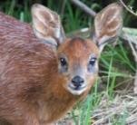
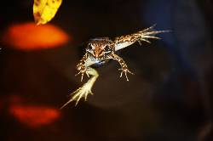
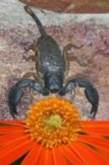
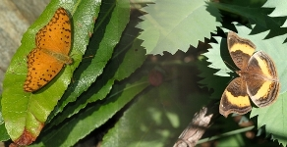
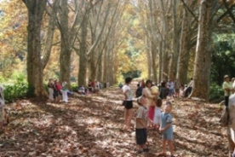
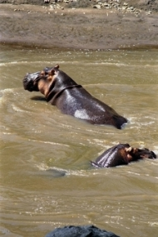
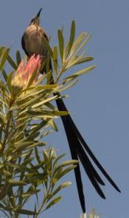
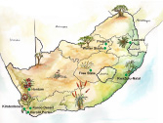
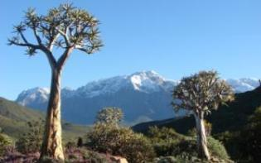
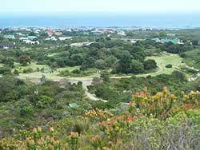
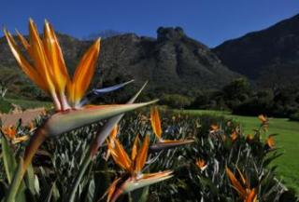
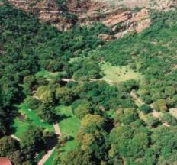
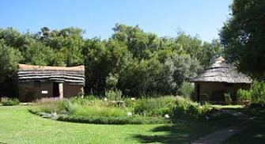
Windows to biodiversity

Slide 18
PROGRAMME 2: National Botanical Gardens
2.1: A network of National Botanical Gardens are managed and maintained in order to realise benefits to SANBI, civil society and other relevant stakeholders
Performance indicator | Baseline 2017/18 | Annual target 2019/20 | 5 year target 2023/24
Number of indigenous plant species added to the living collections of SANBI’s NBGs and/or the Millennium Seed Bank Partnership (MSBP) | 20 indigenous plant species added to the living collections of the combined network of NBGs and/or the Millennium Seed Bank Partnership per annum Signed MoA with the Royal Botanic Gardens, Kew’s (UK) international MSBP (2011 to 2015; extended to March 2019) which contributes towards the implementation of specific targets (particularly Target 8) of the GSPC | 20 indigenous plant species added to the living collections of the combined network of NBGs and/or the Millennium Seed Bank Partnership | At least 100 indigenous South African plant species incorporated into the living collections represented in SANBI’s network of NBGs and/or Millennium Seed Bank Partnership

Slide 19
PROGRAMME 2: National Botanical Gardens (cont.)
2.1: A network of National Botanical Gardens are managed and maintained in order to realise benefits to SANBI, civil society and other relevant stakeholders
Performance indicator | Baseline 2017/18 | Annual target 2019/20 | 5 year target 2023/24
Number of new NBGs established and operational | Thohoyandou (Limpopo) Implementation plan developed for the upgrade and improvement of existing buildings in the Garden (Plan) Landscape design plan for the cultivated portion of the garden approved by SANBI for implementation Signed MoA and Services Agreement between SANBI and LEDET for the management by SANBI of the Thohoyandou Botanical Garden in the Limpopo Province. | Basic Assessment Report (BAR) compiled for the planned infrastructural developments in the Thohoyandou Botanical Garden | Landscape design implemented for the cultivated portion of the Thohoyandou Botanical Garden
 | Kwelera (Eastern Cape) Four (4) management plans for the 160ha natural portion of the Garden finalised and approved by the joint SANBI/ECPTA Steering Committee Landscape design plan for the cultivated portion of the garden approved by SANBI for implementation | Planned boundary fence for 10 ha portion of the Kwelera NBG completed | Landscape design implemented for the cultivated portion of the Kwelera National Botanical Garden

Slide 20
PROGRAMME 2: National Botanical Gardens (cont.)
2.1: A network of National Botanical Gardens are managed and maintained in order to realise benefits to SANBI, Civil society and stakeholders (cont.)
Performance indicator | Baseline 2017/18 | Annual target 2019/20 | 5 year target 2023/24
Number of maintenance, development and capital infrastructure projects completed across SANBI’s NBGs | 45 maintenance/ development projects and 2 SANBI capital infrastructure projects completed annually. | 45 maintenance/ development projects and 2 SANBI capital infrastructure projects completed | 225 maintenance and/or development projects and 10 SANBI capital infrastructure projects completed in SANBI’s NBGs
2.2:Nature-based tourism and recreational activities are strengthened in all National Botanical Gardens in order to contribute to and support SANBI’s sustainability (cont.)
Performance indicator | Baseline 2017/18 | Annual target 2019/20 | 5 year target 2023/24
Percentage visitor numbers increased | 1,222,816 verifiable visitors received in 2017/18 across SANBI NBGs | Minimum of 5% annual increase in visitor numbers | 25% cumulative increase in visitor numbers from verifiable baseline in 2017/18 received by NBGs

Slide 21
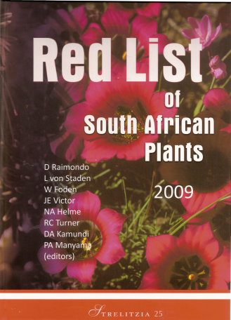
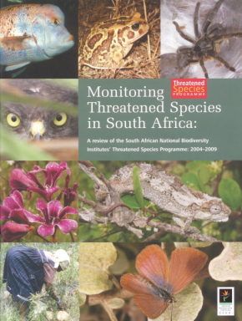

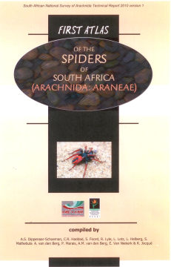
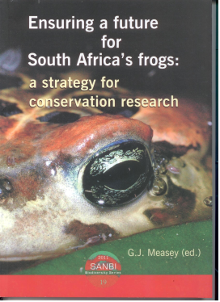
Science-based evidence

Slide 22
PROGRAMME 3: Foundational Biodiversity Science
3.1: Foundational biodiversity information is developed through describing and classifying species and ecosystems in South Africa
Performance indicator | Baseline 2017/18 | Annual target 2019/20 | 5 year target 2023/24
Number of plant and animal species for which descriptive and classification information has been compiled | Information on 4,422 South African plant and 1,040 animal species compiled | Information on 3,200 South African species compiled | e-Flora (constituting species descriptions and classification information) completed and launched
Number of version releases for ecosystem classifications and maps | 4 Ecosystem classification and maps released as part of the NBA development (with version numbers) | 1 version release for an ecosystem classification and map (terrestrial) | 8 Version releases for the combination of terrestrial, marine, estuarine and inland aquatic ecosystems
Number of quality controlled records for plant specimens in SANBI’s herbaria, and for animal specimens in museums or based on observations, added to databases | 21,000 records added to plant database; 35,000 records added to animal database. | 56,000 biodiversity records added to the database. | 280,000 biodiversity records added to database

Slide 23
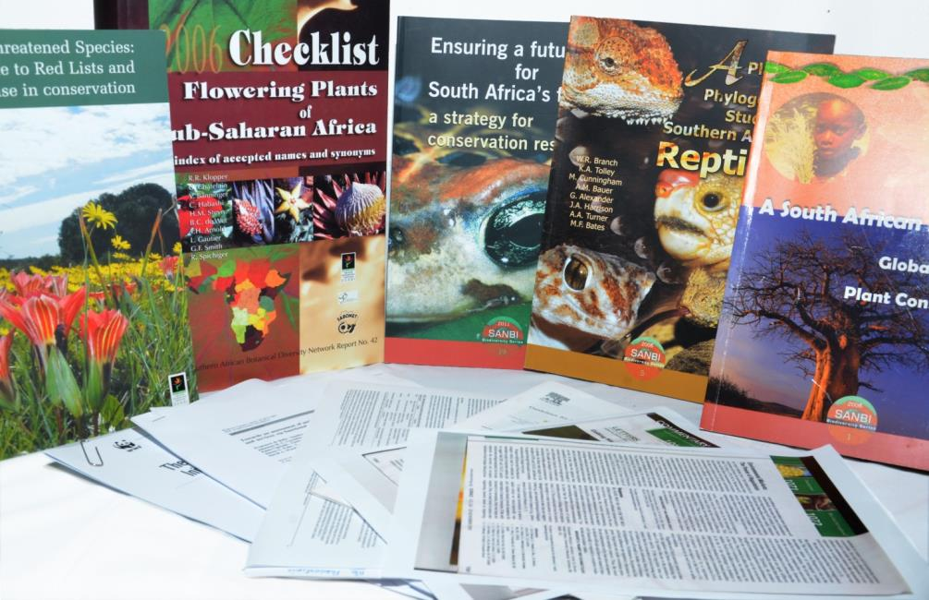


Access to biodiversity information
Since 2004, SANBI has produced 2700 articles, including 1115 peer reviewed papers, 81 books, and >1000 popular articles

Slide 24
PROGRAMME 4: Biodiversity Assessment And Knowledge Generation
4.1: New biodiversity knowledge created for decision making
Performance indicator | Baseline 2017/18 | Annual target 2019/20 | 5 year target 2023/24
Number of research papers published in journals accredited by the Department of Higher Education (DHET) | 85 additional publications | 85 papers published in DHET accredited journals | 425 papers published in DHET accredited journals
Number of Invasive Species project plans developed | None (new indicator) | 45 invasive species project plans (plans submitted) | 175 invasive species project plans
Number of risk analyses conducted for invasive species | None (new indicator) | 70 risk analyses for invasive species | 581 Risk Analyses for Invasive alien species
Number of cooperative research networks established to generate knowledge linked to SANBI ‘s mandate | 2 networks operational (BioGAPS & Deep Secrets) and one new one established (wildlife economy) | 2 cooperative research networks (marine, biodiversity economy) | 4 cooperative research networks (biodiversity economy, marine, freshwater, biological invasions)

Slide 25
PROGRAMME 4: Biodiversity Assessment And Knowledge Generation (cont.)
4.2: The State of Biodiversity is assessed and reported on a regular basis
Performance indicator | Baseline 2017/18 | Annual target 2019/20 | 5 year target 2023/24
Number of national biodiversity syntheses or assessments produced | 1 assessment completed (National Status Report on Biological Invasions) 3 assessments meet annual progress targets (reports for NBA, GMOs and Red Lists) | 1 assessment completed and report compiled ( GMOs) | 5 national assessments completed and reports compiled (NBA, Invasions x 2, GMOs, sustainable use)
Number of annual updates of species to support NEMBA regulations | 1 update for Non-Detriment Findings for the Scientific authority | 1 update for Non-Detriment Findings for the Scientific Authority | 5 annual updates (one per year) for Non Detriment Findings for the Scientific Authority

Slide 26
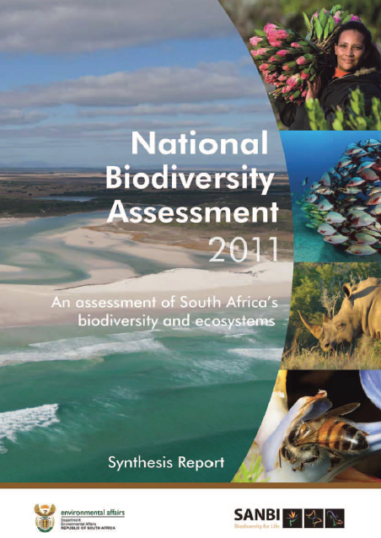
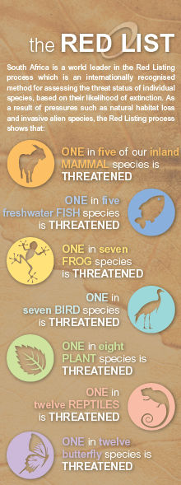

Provide policy tools and advice

Slide 27
PROGRAMME 5: Biodiversity Policy Advice, Climate Resilience and Access to Information
5.1: Tools to support management and conservation of biodiversity developed and applied
Performance indicator | Baseline 2017/18 | Annual target 2019/20 | 5 year target 2023/24
Number of tools and knowledge resources developed to support mainstreaming of biodiversity assets and ecological infrastructure in production sectors and natural resource management | 2 tools produced: an environmental decision support tool and an online user tool for South African species information and Red Lists. | 2 decision support tools developed. | 10 tools and 15 knowledge resources developed.
 | 3 knowledge resources developed and disseminated: Technical Guideline for Maps of Critical Biodiversity Areas; guidance note on financial and legal aspects of biodiversity offsets; and case studies on biodiversity offsets. | 3 knowledge resources to support biodiversity mainstreaming developed and disseminated.

Slide 28
PROGRAMME 5: Biodiversity Policy Advice, Climate Resilience and Access to Information
5.1: Tools to support management and conservation of biodiversity developed and applied(continue)
Performance indicator | Baseline 2017/18 | Annual target 2019/20 | 5 year target 2023/24
Number of coordination or learning mechanisms convened to share lessons and build capacity among provincial, municipal or other relevant decision makers. | 4 learning or coordination events convened: Biodiversity Planning Forum; Freshwater Ecosystem Network; joint BIM/FBIP Forum; and National Biodiversity Stewardship Conference. | 4 learning or coordination events convened for provincial, municipal or other relevant decision makers. | 40 training, learning or co-ordination mechanisms convened for provincial, municipal or other relevant decision makers and 10 coordination mechanism convened, in collaboration with DEA, to support the implementation of the EbA strategy
 | 3 training sessions convened: Biodiversity GIS (BGIS) website; biodiversity georeferencing; and biodiversity offsets. | 4 training sessions convened for provincial, municipal or other relevant decision makers.
 | Let’s Respond Toolkit identified as biodiversity sector tool into which Climate Change Adaptation will be mainstreamed. | 2 coordination mechanism convened, in collaboration with DEA, to support the implementation of the EbA strategy.

Slide 29
PROGRAMME 5: Biodiversity Policy Advice, Climate Resilience and Access to Information (cont.)
5.2: Access to biodiversity data, information and knowledge provided
Performance indicator | Baseline 2017/18 | Annual target 2019/20 | 5 year target 2023/24
Number of biodiversity records published | 58,000 biodiversity records published. | 59,400 biodiversity data records published. | An increase of 297,000 biodiversity data records published.
5.3: Scientific advice to support national and international policy processes provided
Percentage of policy requests from DEA and other organs of state responded to within timeframe stipulated in the request | 100% of relevant written requests from DEA and other organs of state responded to within timeframe stipulated: Draft Biodiversity Offsets Policy; IPBES regional assessment for Africa and IPBES land degradation and restoration assessment; draft Regulations of Agricultural Holdings Bill; second draft of NBF; draft Vhembe District Bioregional Plan; proposed national guideline on minimum information requirements for preparing EIAs for mining activities; proposed draft alien and invasive species regulations & proposed draft amendments to alien and invasive species lists; and proposal for establishment of a single Catchment Management Agency. | 100% of relevant written requests from DEA and other organs of state responded to within timeframe stipulated. | 100% of relevant written requests from DEA and other organs of state responded to within timeframe stipulated.

Slide 30
PROGRAMME 5: Provide Biodiversity Policy Advice and Access to Biodiversity Information and Support for Climate Change Adaptation (cont.)
5.4: An effective national accredited entity of global climate funds builds resilience and provides national and international policy support
Performance indicator | Baseline 2017/18 | Annual target 2019/20 | 5 year target 2023/24
Number and value of Adaptation Fund and Green Climate Fund projects approved for implementation | 2 Adaptation Fund projects with a value of USD 10 million approved for implementation. | 2 first stage proposals with a total value of at least USD 20 million submitted to the GCF for consideration. | 3 Green Climate Fund projects with a value of at least USD 30 million approved for implementation.

Slide 31
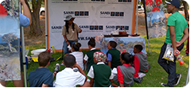
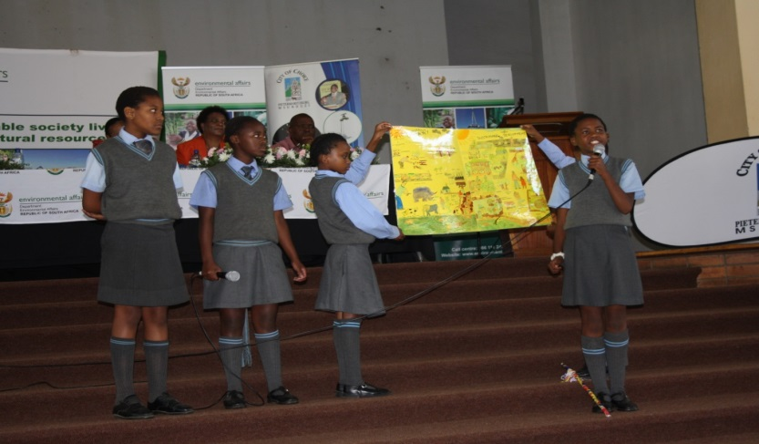
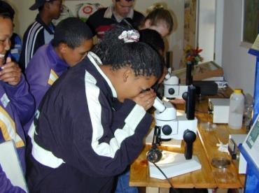




Slide 32
PROGRAMME 6: Biodiversity Human Capital Development and Education
6.1: A transformed and suitably skilled workforce for the biodiversity sector is developed
Performance indicator | Baseline 2017/18 | Annual target 2019/20 | 5 year target 2023/24
Number of HCD interventions implemented in SANBI for black biodiversity professionals | 73 black biodiversity professionals participate in structured internships and postgraduate studentships | 24 WIL student placements 72 interns and Groen Sebenza pioneers hosted 19 Honours, Masters and Doctoral degrees completed 25 postgraduate student bursaries awarded | 140 WIL student placements 250 interns and Groen Sebenza pioneer placements 80 post graduate degrees completed 130 postgraduate student bursaries awarded
Number of universities participating in the University Biodiversity Careers Programme aimed at attracting young people in to the biodiversity sector | 15 universities | 15 universities | 23 universities participate in University Biodiversity Careers

Slide 33
PROGRAMME 6: Biodiversity Human Capital Development and Education (cont.)
6.2: All national botanical gardens are promoted and used as platforms for biodiversity awareness, education and recreation.
Performance indicator | Baseline 2017/18 | Annual target 2019/20 | 5 year target 2023/24
Number of beneficiaries participating in ‘Kids in Gardens’ Programme to promote biodiversity awareness, education and recreation | 44,856 beneficiaries of garden and school-based have been reached. | 56,000 beneficiaries participated in ‘Kids in Gardens’ Programme | 64,000 beneficiaries participating in ‘Kids in Gardens’
6.3: Civil society is engaged to contribute to science, monitoring and biodiversity conservation.
Number of citizen science platforms implemented | 2 existing platforms maintained. Scoping report for one Youth Citizen Science Platform | 3 citizen science platforms (CREW, iNaturalist, Bird atlas) | 4 citizen science platforms (CREW, iNaturalist, Bird Atlas, Rural Youth)

Slide 34
PROGRAMME 7: National Zoological Gardens
7.1: Build a centre of research/training excellence and an authoritative source of scientific information on the biodiversity of wild animals and their ecosystems
Performance indicator | Baseline 2016/17 | Annual target 2019/20 | 5 year target 2023/24
Number of research papers published in journals accredited by the Dept of Higher Education (DPHE) | 31 research papers | 30 research papers and journals accredited by DPHE | 30 research papers published in journals accredited by the Dept of Higher Education
7.2: Create a dynamic platform for engaging the public on the Science of Life (awareness, education & communication)
Number of general visitors reached through visits to the NZG | 362,871 general visitors | 454,000 general visitors to Zoo | 476,000 general visitors to the NZG
Number of learners reached through visits to/by the NZG | 160,000 learners | 160,000 learners reached through Zoo visits | 160,000 learners reached through visits to/by the NZG
7.3: Develop a zoological garden with a conservation focus
Number of studbooks published under PAAZA | 5 studbooks published | 5 studbooks published | 5 studbooks published under PAAZA

Slide 35

BUDGET ESTIMATES OVERVIEW
2019/20

Slide 36
Budget Estimates Overview
 | R’000
Operational MTEF | 423 851
Infrastructure MTEF | 70 180
Projects Income | 119 174
Internally Generated Income* | 190 727
Expenses | -803 932
Surplus/ (Deficit) | NIL
* Internally generated income: Primarily gate admission fees, venue hire and rental of premises.

Slide 37
Budget Estimates
Spending Allocations

Slide 38
Budget Estimates
Employee Costs
* Group: Long service and merit awards, notch increases, career ladder, job evaluations and performance bonus (capped at 1.5% of employee costs)

Slide 39
Budget Estimates
Operating Expenditure
* Group costs: Insurance and Audit Expenses

Slide 40
Budget Estimates
Overall Spending
* Group costs: Long service and merit awards, notch increases, career ladder, job evaluations and performance bonus (capped at 1.5% of employee costs), insurance, audit expenses

Slide 41

Strategic Risks & Mitigation Plan

Slide 42
PROGRAMME 1: ADMINISTRATION
STRATEGIC OBJECTIVES | STRATEGIC RISK | RISK CONSEQUENCE | MITIGATION PLAN
SO 1.1 | Inability to attract and retain critical skills, shortage of science based skills. | Inability to contribute to the achievement of the mandate of SANBI. | Implementing the following policies on an ongoing basis: Employee attraction and retention, Learning and Development, further studies part-time, Internship and post-graduate studentship, SANBI Fellows network and career ladders.
 | Low staff morale and negative employment relations. | Resistance in the implementation of Department of Environmental Forestry and Fisheries (DEFF) Pay Scale. | Consultation internally within SANBI.

Slide 43
PROGRAMME 1: ADMINISTRATION(Continues)
STRATEGIC OBJECTIVES | STRATEGIC RISK | RISK CONSEQUENCE | MITIGATION PLAN
SO 1.2 | Non-compliance with GRAP and procurement legislation requirements | Qualified audit opinion Ineffective internal controls systems Ineffective legal contract review Poor internal contract review/tracking Lack of expenditure management on contracts Ineffective demand management and procurement planning Insufficient professional advice for specialised procurement Inefficient contract management system. | Review of all policies and practices to align to GRAP and PFMA; Regular training provided to SCM and Procurement Committees; Annual legal review; annual contract performance appraisals; SOPs; contract management register (electronic and manual); SLA reviews; Monthly review of compliance of all procurement activities; revised effective and efficient procurement (iQual) system; SCM work-study to determine required human capacity; compliance review of demand management and procurement plans; risk management review of procurement activities.
 | Loss of assets due to ineffective asset management system resulting in poor on return on investment | Non-compliance with the asset management policy; Ineffective asset management system; inadequate security systems; inadequate human capacity in the asset management unit. | Implementation of the ARC approved asset management turnaround plan.

Slide 44
PROGRAMME 1: ADMINISTRATION (CONTINUE)
STRATEGIC OBJECTIVES | STRATEGIC RISK | RISK CONSEQUENCE | MITIGATION PLAN
SO 1.2 | Ineffective and inefficient procurement management system and inadequate human capacity resulting in failure to execute operational requirements | Constantly changing regulatory environment Limited pool of service providers geographically Insufficient human capacity in the SCM unit Ineffective internal communication between SCM and various campuses Inefficient contract management system. | Improve communication between SCM officials and gardens administrative personnel, improve response time for RFQs’ and Tenders, more frequent BSC and BAC meetings.

Slide 45
PROGRAMME 1: ADMINISTRATION (CONTINUE)
STRATEGIC OBJECTIVES | STRATEGIC RISK | RISK CONSEQUENCE | MITIGATION PLAN
SO 1.3 | Revenue growth lagging behind costs growth resulting in limited initiatives to grow own revenue resulting in inability to meet all operational requirements | Inability to implement SANBI mandate; Lack of new initiatives and developments attracting customers; aging infrastructure; gardens maintenance budgets being severely cut; MTEF budget cuts and cost containment pressures resulting in severe cuts in some areas such as marketing against competing legislative/compliance; Pressures (e.g. OHSA); high unemployment rate and decreasing personal disposable income leading to a reduction in garden entrance fees. | Infrastructure plans to install more green technology thus saving operational costs; annual revenue generation plan Review adequacy of MTEF funding annually; Submit proposal for donor funding whenever an opportunity arises; Quarterly monitoring of the implementation of the financial sustainability plan; monthly review of budgeted own income against actuals.

Slide 46
PROGRAMME 1: ADMINISTRATION (CONTINUE)
STRATEGIC OBJECTIVES | STRATEGIC RISK | RISK CONSEQUENCE | MITIGATION PLAN
SO 1.4 | Cyber attack / crime | Inability to support strategic business processes and ICT infrastructure Several isolated databases Inadequate IT infrastructure (e.g. servers, network storage, etc.) Inadequate back-up capacity and procedures Inadequate data management controls and procedures (e.g. too little human capacity to manage systems, insufficient segregation of duties, untrained users who cause problems) Scope of service provider contracts was designed for needs of Corporate Services and not biodiversity information systems support. Current IT service provider is unable to provide adequate user support for biodiversity information management systems. | Implement internal patching and lifecycle policy; All servers to be regularly evaluated and patched Microsoft Patch to be installed and Regular penetration testing to conducted .
 | Ineffective information and Knowledge Management System resulting in data insecurity and challenges in accessing information
 |  |  | Maintain systems uptime at 90% overall; Implement automatic system monitoring device that alerts ICT Division real-time of any application downtime; Expand scope of terms of reference for IT support service provider; Engage 3rd party service providers on SLA issues; and Installation of Fiber Optic Cable across the Centers to enhance bandwidth.
 | Ineffective corporate and IT governance.
 |  |  | Board and sub-committees, EXCO oversight; Reports submission to DEA/National Treasury & PCEA, governance self-assessment checklists; ICT Steering Committee, IT policies, IT audits, ICT framework implementation plan; and Reporting to Audit and Risk Committee, EXCO and Board on IT matters.

Slide 47
PROGRAMME 1: ADMINISTRATION (CONTINUE)
STRATEGIC OBJECTIVES | STRATEGIC RISK | RISK CONSEQUENCE | MITIGATION PLAN
SO 1.4 | Ineffective Disaster Recovery Plan(DRP) resulting in inability to implement Business Continuity Plan for critical business systems | Misalignment between DRP and BCP inadequate ICT infrastructure. | Ensure alignment between DRP and BCP

Slide 48
PROGRAMME 1: ADMINISTRATION (CONTINUE)
STRATEGIC OBJECTIVES | STRATEGIC RISK | RISK CONSEQUENCE | MITIGATION PLAN
SO 1.5 | Negative media reporting due to visitors poor hospitality experience and safety concerns in the NBGs and NZG may lead to a negative perception of the organisation which may culminate into a reduced footfall into the facilities and reputational risk | Negative media reporting Lack of clear communication (internal and external) Perceived negative public perception Poor branding Misrepresentation by staff Drop in visitor numbers resulting in drop of own income SANBI invisibility | Monitor implementation of approved social media and communication policy; Build strong media relations; Update staff through intranet, email, CEOs letter and staff newsletter; Brand SANBI material as per SANBI Brand CI ; Partner with key stakeholders for brand association ; Conduct media monitoring to monitor news reporting on SANBI Conduct surveys on customer satisfaction; Attend interviews on radio and television; and Plan activations for SANBI awareness and visibility.
 | Poor engagement with stakeholders due to lack of a communication protocol between SANBI and stakeholders resulting in stakeholder interest and expectations not being met | Poor service delivery to stakeholders Poor strategic engagement with organised labour. Inadequate engagement with stakeholders | Implement the Stakeholder Engagement Framework Implement SANBI Communication strategy Engage and conclude contracts, MoUs, agreements etc. with identified key stakeholders Develop and implement key Stakeholder Engagement Matrix Implement and monitor implementation of Integrated Marketing and Corporate Communication Strategy Implement and monitor implementation of Stakeholder engagement plan.

Slide 49
PROGRAMME 1: ADMINISTRATION (CONTINUE)
STRATEGIC OBJECTIVES | STRATEGIC RISK | RISK CONSEQUENCE | MITIGATION PLAN
SO 1.5 | Inadequate information control which may lead to ineffective Integrated Marketing, Corporate Communication and Stakeholder Relations Strategy | Failure to communicate Unclear communication roles Inconsistent messaging Lack of proper internal communication Unauthorised use of trademarks Misuse and mismanagement of communication tools | Implement and monitor implementation of Integrated Marketing and Corporate Communication Strategy; Implement and monitor implementation of Communication Policy; Distribution of CEO staff letter, Staff Newsletter, Intranet and Website Update; Enforce and monitor application of the logo; and Implement and monitor use of the social media policy.

Slide 50
PROGRAMME 2:NATIONAL BOTANICAL GARDENS
STRATEGIC OBJECTIVES | STRATEGIC RISK | RISK CONSEQUENCE | MITIGATION PLAN
SO 2.1 | Inability to implement the National Gardens Expansion Strategy (2016 to 2030) | SANBI is expected to establish and develop two new gardens, one in each of the Eastern Cape and Limpopo Provinces. Additional project funds have been allocated and committed to SANBI by DEA through their infrastructure grants to establish and develop these two new gardens, but there is a risk that sufficient personnel and operating funds are not available in the long term to ensure these new gardens are adequately maintained and resourced and able to generate income. | It is critical that the DEA’s gardens expansion project funds (including dedicated EPIP funds) are allocated annually to support the establishment of new NBGs in the Eastern Cape and Limpopo Provinces.
 | Lack of sufficient resources to manage the existing network of NBGs and their associated living collections | With current funding constraints, the inability to fill key vacant and new posts in SANBI’s network of NBGs, the risks to SANBI’s ability to manage these gardens optimally, with fewer human and financial resources available, to an acceptable international standard, are possible. | DEFF’s allocation of funding to SANBI’s existing and new NBGs is required in order to ensure the maintenance of high standards and enable them to meet their required own income targets. SANBI’s strategic relationship with the Millennium Seed Bank Partnership, will need to be supported by SANBI in terms of resources made available to undertake essential field work and maintain the gardens’ living plant collections.

Slide 51
PROGRAMME 2:NATIONAL BOTANICAL GARDENS(Continues)
STRATEGIC OBJECTIVES | STRATEGIC RISK | RISK CONSEQUENCE | MITIGATION PLAN
SO 2.1 | Underutilisation of existing Garden based infrastructure which weakens SANBI's potential to generate income resulting in poor visitor experience/ attraction | Poor management and maintenance of existing infrastructure due to insufficient funding or inability to source suitable tenants | Consider need for additional internal commercialization capacity in SANBI to manage tenants and source additional own income through commercial operations; improved SCM systems and processes to enable implementation of planned building maintenance projects
 | Loss of diversity in living collections due to impact of climate change, invasive alien species or over utilisation of National Botanical Gardens (NBGs) for commercial uses/events, resulting in landscape degradation | Floods, fire, invasive species and drought, pests and diseases. No dedicated SANBI-developed Garden Records Database used to monitor living collections in NBGs. | Monitoring of living collections; sourcing support from strategic partners (local municipalities, FPAs, FABI, Working for Water, Working for Wetlands, Working on Fire; international botanical garden associations) for maintenance and conservation of living collections; dedicated and functional Garden Records Database to be developed within SANBI (BIM) for use by gardens to monitor living collections.

Slide 52
PROGRAMME 2. NATIONAL BOTANICAL GARDENS(CONTINUE)
STRATEGIC OBJECTIVES | STRATEGIC RISK | RISK CONSEQUENCE | MITIGATION PLAN
SO 2.2 | Lack of sufficient business skills amongst Curators | Inability to generate additional income and have fully functional outsourced commercial tenants within their estates. | Sharing of skills and implementation of relevant business skills training previously provided to the Curators, and new training opportunities provided for managers, will improve their ability to effectively manage their gardens as nature-based tourism facilities and commercial enterprises.

Slide 53
PROGRAMME 3: FOUNDATIONAL BIODIVERSITY INFORMATION
STRATEGIC OBJECTIVES | STRATEGIC RISK | RISK CONSEQUENCE | MITIGATION PLAN
SO 3.1 | Inability to attract and retain critical skills. Shortage of professional staff in key areas of the SANBI mandate, especially relating to research and data management, and ecosystem mapping and classification (particularly for freshwater ecosystems). | Skills and competency erosion and non-delivery on core SANBI mandate. | Development of more formal networks with partner organisations, skilling young scientists from designated groups to fill some of these key roles, and outsourcing some functions where funding permits. Identify funding opportunities within DEA and funders. Develop an internal HCD Strategy to enhance the talent and skills pipeline within the Institute Enhance the talent and skills pipeline within the Institute. Establish partnership with higher education institutions. Implement the Biodiversity Human Capital Development Strategy.
SO 3.1 | Limited funding available for expansion of mandate to include animals. | Non-delivery on the zoological biodiversity biosystematics mandate. | Applying for funding through various external sources, and by harnessing the resources of other organisations.

Slide 54
PROGRAMME 3: FOUNDATIONAL BIODIVERSITY INFORMATION(continues)
STRATEGIC OBJECTIVES | STRATEGIC RISK | RISK CONSEQUENCE | MITIGATION PLAN
SO 3.1 | Over reliance on partner organisations and external funding resulting in delays in transfer of funds from DST and non – delivery by grant recipients . | Non-availability of foundational biodiversity data | Ongoing engagement with DST and NRF (which disperses the grants), and regular engagement and communication with grant holders so that the value of the data and its use is understood.
SO 3.1 | Hazards to reference collections (herbaria, museums, biobanks) in-house and with partners resulting in loss of biodiversity assets and related information | Physical deterioration and destruction of specimens | Installation of climate control systems where these do not exist; improved physical security measures; controlled access to collections; improved signage on handling of collections; develop and implement maintenance plan for collections

Slide 55
PROGRAMME 4: BIODIVERSITY ASSESSMENT AND KNOWLEDGE GENERATION
STRATEGIC OBJECTIVES | STRATEGIC RISK | RISK CONSEQUENCE | MITIGATION PLAN
SO 4.1, 4.2 | Inability to attract and retain critical skills. The breadth of work required under Programme 4 to fulfill SANBI’s mandate means that there is an ongoing challenge to ensure sufficient capacity and depth to cover different science areas, to provide robust analytical skills and to provide continuity in the event of staff turnover. | SANBI may be unable to provide robust evidence and support in key areas. Areas where capacity is lacking in order to improve evidence for decision making are: impacts of GMOs, assessments of plants in trade, the biodiversity economy, assessments of freshwater ecosystems, high level science policy issues and statistical expertise. | Fill vacant posts to address some skills (statistical ecology; high level science policy issues). These posts to be filled by Q2 Structure existing posts to better address gaps, specifically issues such as plants in trade and the biodiversity economy. Development of more formal networks with partner organisations particularly for impacts of GMOs, freshwater assessments and the biodiversity economy. Development of project proposals to obtain additional funds and to improve skills in key areas. Proposals related to the biodiversity economy to be submitted by Q3
SO 4.1, 4.2 | Capacity of the Network of Partners to fulfill SANBI’s mandate in respect of deliverables under Programme 4. Key deliverables such as the National Biodiversity Assessment and National Status Report on Biological Invasions rely on voluntary inputs from other organizations where target dates may not be included in their annual plans | SANBI’s ability to deliver key projects on time could be compromised, especially if budget cuts mean that there are no financial contracts in place to manage deliverables. The quality of products can be compromised if inputs from other organisations has to be left out of analyses and assessments. | Review the outputs that are required from the managed network in order for SANBI to meet its targets (Q1). Identify key organisations where partner agreements need to be developed or amended. Formalize agreements with identified partners to ensure the delivery of these outputs. Submit budget proposals for areas where funding is essential to obtain key data and expertise

Slide 56
PROGRAMME 4: BIODIVERSITY ASSESSMENT AND KNOWLEDGE GENERATION
STRATEGIC OBJECTIVES | STRATEGIC RISK | RISK CONSEQUENCE | MITIGATION PLAN
SO 4.1, 4.2 | Dependence on short term funding for key areas of the SANBI’s mandate. | Reliance on project funding to deliver core mandate functions means that certain deliverables are at risk if funding is not available. Project funding is also typically short term and this presents problems with developing and retaining core skills and competencies. | Identify risks associated with the current set of donor funded projects. Identify funding opportunities to ensure continuance of key projects. Motivate for core SANBI funding for those critical areas where donor funding is not appropriate.
SO 4.1, 4.2 | Dependence on short term funding for key areas of the SANBI’s mandate. | Reliance on project funding to deliver core mandate functions means that certain deliverables are at risk if funding is not available. Project funding is also typically short term and this presents problems with developing and retaining core skills and competencies. | Identify risks associated with the current set of donor funded projects. Identify funding opportunities to ensure continuance of key projects. Motivate for core SANBI funding for those critical areas where donor funding is not appropriate.

Slide 57
PROGRAMME 5: BIODIVERSITY POLICY ADVICE, CLIMATE RESILIENCE AND ACCESS TO INFORMATION
STRATEGIC OBJECTIVES | STRATEGIC RISK | RISK CONSEQUENCE | MITIGATION PLAN
SO 5.2 | Inadequate ICT infrastructure, including network capabilities and storage capacity. | The lack of a robust backbone ICT infrastructure to accommodate the new systems and bandwidth requirements is a risk for maintaining core SANBI functions, and limits the opportunity to scale-up reliable and free access to biodiversity information. Investment in the ICT backbone infrastructure is a prerequisite for successful biodiversity information management and for ensuring that SANBI provides a one-stop-shop for biodiversity knowledge for policy and decision-making. | IT requirements for new systems will be scoped collaboratively with SANBI IT services. The National Biodiversity Information System project is underway to scope and implement a new biodiversity information management architecture, including related infrastructure requirements.
SO 5.1, 5.2, 5.3 and 5.4 | Inadequate IT support for scientific systems. IT support currently focuses on corporate systems, not scientific systems (such as biodiversity information management systems). | Users of scientific systems (both internal users and users in partner organisations) do not receive adequate support to resolve technical problems related to access to biodiversity information. This prevents SANBI from fulfilling potential as a one-stop-shop for biodiversity knowledge, and has reputational risks as external partners rely on access to SANBI data. There are also implications for large strategic projects such as the National Science Collections Facility and the National Biodiversity Assessment. | There is a need for dedicated IT support for scientific systems, including a systems administrator for scientific systems. This need has been recognised and should be addressed urgently.

Slide 58
PROGRAMME 5: BIODIVERSITY POLICY ADVICE, CLIMATE RESILIENCE AND ACCESS TO INFORMATION
STRATEGIC OBJECTIVES | STRATEGIC RISK | RISK CONSEQUENCE | MITIGATION PLAN
SO 5.1, 5.2, 5.3 and 5.4 | Shortage of skills in key areas, including biodiversity information management, spatial biodiversity planning, science-policy interface, and mainstreaming biodiversity into a range of strategic sectors. | Shortage of skills in key areas can result in inability to continue to provide current levels of service (e.g. when staff resign and are difficult to replace), delayed work and delivery due to long recruitment processes and additional time required to build the skills (this is a risk particularly for donor-funded programmes), and/or need for external consultants to provide the required capacity. | Careful scoping of the required skills will be done through the SANBI workforce planning process. The skills pipeline will be strengthened through interventions such as internships, training and development, mentorship and further studies, and ensuring that wherever possible external consultants work closely with relevant staff to transfer skills. This risk will be further mitigated through ensuring that posts are evaluated and remunerated appropriately. In addition, skills within the network of partners will be accessed where appropriate and possible.

Slide 59
PROGRAMME 6: BIODIVERSITY HUMAN CAPITAL DEVELOPMENT AND EDUCATION
SO 5.1, 5.2, 5.3 and 5.4 | Reliance on external donors for funding | Key components of Programme 5 rely heavily on donor funding, despite being core elements of SANBI’s mandate. This can result in inconsistent ability to fulfil the mandate, and potential inability to maintain investment in work and skills developed in key areas (e.g. when contract positions come to an end). | A strategic approach will be taken to new funding opportunities, and applications for new donor grants will be sought timeously as risk mitigation strategies. Furthermore SANBI will focus on identifying where it is appropriate to embed current donor-funded work in partner organisations
STRATEGIC OBJECTIVES | STRATEGIC RISK | RISK CONSEQUENCE | MITIGATION PLAN
SO 6.1 & SO 6.2 | Failure to deliver on its mandate to lead the development and implementation of HCD for the biodiversity sector. | Loss of leadership Reduced stakeholders support and relevance. | Developing a clear programme to be delivered in line with the mandate and resourcing it.
SO 6.1 & SO 6.2 | Inadequate human and financial resources for BEE | Programmes and functions at risk as they cannot be implemented nor sustained. | Approve and resource BEE Work-Study Implementation Plan.
SO 6.3 | Lack of funding to support citizen science projects | Reduced number of citizen science projects and loss of support and data . | Source funding from new initiatives such as youth programmes; and Linked to other areas such as invasive species.

Slide 60
PROGRAMME 7: NATIONAL ZOOLOGICAL GARDENS
STRATEGIC OBJECTIVES | STRATEGIC RISK | RISK CONSEQUENCE | MITIGATION PLAN
SO 7.1 | Insufficient funds to maintain infrastructure and equipment as well as recruiting PDPs. | The inability to attract PDPS and poorly maintained equipment, that compromises the NZG’s ability to conduct research will have a negative impact on the NZG’s research output. | Secure competitive funding for infrastructure, student recruitment and strict management of existing maintenance / service contracts.
SO 7.2 | Lack of sufficient funding for science engagement | Reduction in learner attendance numbers. | Continued pursuit of DST accreditation as a Science Centre and sourcing project funding from agencies including SAASTA.
SO 7.2 | Insufficient funding for platform upgrades and innovation Inability to meet utilisation numbers / visitor numbers in National Zoological Garden (NZG) due to failure to attract more visitors resulting in reduced footfall into the facilities and loss of income | Continued deterioration of infrastructure base and negative feedback from public thereby have a negative impact on the visitor numbers. | Adoption of the existing SANBI business model. Regular engagement with law enforcement agencies to promote security. Identifying opportunities for infrastructure funding from DEA, DPW, NDT and other sources as well as the implementation of the sustainability strategy. Leveraging of partnerships to enhance the animal collection.
SO 7.3 | Loss of industry recognition. | Inability to provide industry leadership within the ex situ conservation fraternity. | Maintain the NZG’s PAAZA accreditation and participation on various platforms.

Slide 61
Thank You

