Slide 1

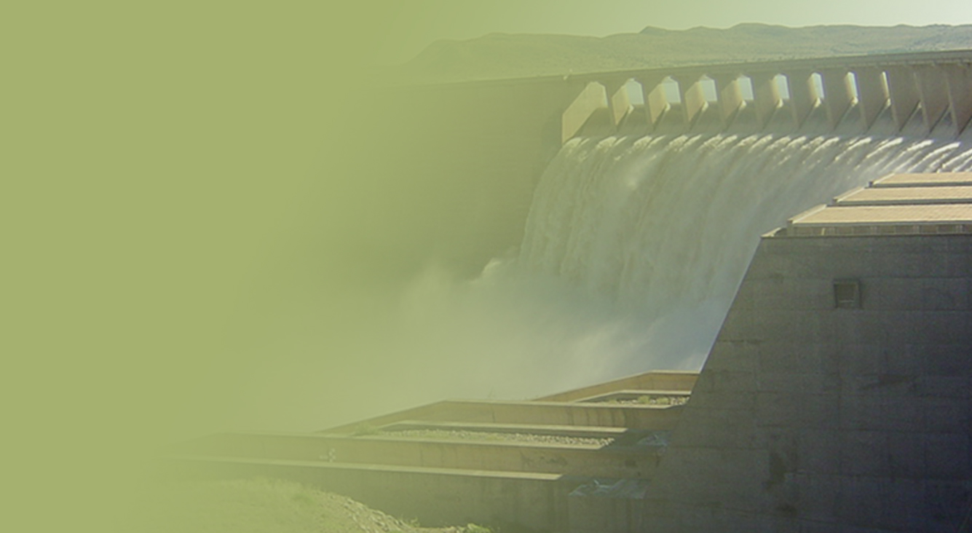
PRESENTATION TITLE
Presented by:
Name Surname
Directorate
Date
FIRST QUARTER REPORT FOR THE 2019/20 FINANCIAL YEAR
Financial Performance
Presented by:
Mr. Frans Moatshe
Acting Chief Financial Officer
Date: 23 August 2019

Slide 2
Outline
Part A: Financial Performance: Main Account
  Consolidated Departmental Expenditure per Programme / per Infrastructure Programme
Part B: Financial Performance: Water Trading Account
  Challenges
  Income and Expenditure
  Augmentation funded projects
  Analysis of financial performance
  debtors age analysis
Part C: Detailed Notes
  Detailed Financial Performance per programme

Slide 3
  Part A
  Consolidated Departmental Expenditure
  Per Programme / per Infrastructure Programme

Slide 4
Departmental Spending as at 30 June 2019
Overall Departmental Performance | Amounts (R’000)
2019 ENE/ Original Budget | 16 440 372
Departmental Expenditure | 2 584 096
% Spent | 16%
Available | 13 856 276

Slide 5
Q 1 Financial Performance: Per Programme / Economic Classification

Slide 6
Consolidated Departmental Expenditure: Per Programme and Economic Classification

Slide 7
Month to Month Expenditure Trends

Slide 8
Infrastructure Grants Financial Performance

Slide 9
    Infrastructure Grants Financial Performance as at 30 June 2019

Slide 12
Reasons for Over / Under expenditure
Compensation of Employees (Under-spending)
The Department projected to spend R447.542 million on compensation of employees; however, only R415.712 million was spent. This indicates that the Department has spent R31.830 million, seven percent (7%) less than the planned expenditure/ approved drawings.
The lower than anticipated spending is due to vacant posts within the Department across all programmes that are in various stages of recruitment.
The Department is in the process of filling critical prioritised vacancies with due consideration of the baseline allocation over the Medium Term Expenditure Framework (MTEF).
Goods and Services
The Department has now spent R318.422 million of the total planned expenditure/ approved drawings of R320.896 million on goods and services as at 30 June 2019. This indicates that the Department has spent R2.474 million (1%) less than planned expenditure/ approved drawings. This indicates that the Department’s spending was in line with the projected drawings/ planned expenditure for the period under review.

Slide 13
Reasons for Over / Under expenditure ( Cont…)
  Transfers and Subsidies (Over-spending)
  The Department spent R1.613 billion of the total approved drawings/ planned expenditure of R1.598 billion on transfers and subsidies as at 30 June 2019. This indicates that the Department has spent R14.877 million more than projected, which equates to one percent (1%) higher than anticipated spending.
  The higher than projected spending of R14.877 million is largely due to, amongst others, the payment of R10.237 million made towards Intellimali (Pty) Ltd for the previous academic year external bursaries.
Payments for Capital Assets (Under-spending)
  The variance of R570.047 million is attributable to the invoices certified, verified and approved for payment of work done on the Indirect (Schedule 6B) Regional Bulk Infrastructure and Water Services Infrastructure Grants to be paid by the Provinces.
  The Department has finalised and issued infrastructure grants allocation letters to the regions, Water Boards and Implementing Agents (IAs). The expenditure is anticipated to improve during the coming months

Slide 14
Reasons for Over / Under expenditure ( Cont…)
Payments for Financial Assets (Over-spending)
  The Department has during the reporting period under review incurred the amount of R0.490 million as payments for financial assets.
  The expenditure incurred without the budget is attributable to debts that are long outstanding and uneconomical to recover which were written-off against the Department in terms of Treasury Regulations 11.6 read in conjunction with sections 76(1)(e) and 76(4)(a) of the PFMA.
  The budget will be made available during the mid-term budget adjustment/ review process.

Slide 15
  Part B
  Water Trading Entity

Slide 16
Income and Expenditure for Water Trading Entity for the period ending 30 June 2019
ECONOMIC CLASSIFICATION | BUDGET (R'000) | YTD ACTUAL (R'000) | % SPENT
Revenue from exchange transactions | 10 347 654 | 2 663 385 | 26%
Revenue from non-exchange transactions | 2 437 036 | 739 621 | 30%
TOTAL INCOME | 12 784 690 | 3 470 003 | 27%
Operating Expenditure | 9 498 410 | 2 331 736 | 31%
Projects Expenditure | 2 538 279 | 39 546 | 2%
Reduction in overdrawn account | 748 001
TOTAL EXPENDITURE | 12 784 690 | 2 371 282 | 20%

Slide 17
EXPENDITURE FOR AUGMENTATION FUNDED PROJECTS
FOR THE PERIOD ENDING 30 JUNE 2019
 | ANNUAL
PROJECT NAME | ANNUAL BUDGET | YTD ACTUAL | % SPENT
 | R'000 | R'000
Dam Safety Rehabilitation Programme (DSRP) | 130 435 | 4 181 | 3%
Olifants-Doorn River Water Resources Project: Raising of Clanwilliam Dam | 220 936 | 1 781 | 1%
Mdloti River Development Project: Raising of Hazelmere Dam | 95 652 | 0 | 0%
Mzimvubu Water Project | 117 391 | 0 | 0%
Acid Mine Drainage | 260 869 | 0 | 0%
Mokolo Crocodile Water Augmentation Project | 217 391 | 0 | 0%
Goedetrouw Transfer Scheme | 104 348 | 0 | 0%
SUBTOTAL | 1 424 529 | 5 963 | 0%
VAT @15% | 213 679 | 894 | 0%
TOTAL | 1 638 208 | 6 857 | 0%

Slide 18
Analysis of Financial Performance
The revenue billing performance to date reflects 26% against the annual revenue target (R10 billion) and the augmentation revenue of R739 million (100% of the year to date budget) has been claimed from the Vote and received by the Entity.
The augmentation has been claimed and received from the Vote/ Main Account .
The operating expenditure reflects a spending of 30% against the annual budget due to TCTA expenditure for financing and investing in raw water infrastructure. Financing and investment in raw water infrastructure objective reflects an amount of 1.7 billion against the annual budget of R5.8 billion.
An amount of R58 million incurred by construction sites is non recoverable due few order book and increases fruitless and wasteful expenditure.
The project expenditure reflects a spending of 0% due contractual disputes, delays in internal procurement processes.
Dam Safety rehabilitation reflects a spending of R4 million against the annual budget of R130 million. This can be attributed to delays in internal procurement processes.

Slide 20
The debtors’ age analysis as at 30 June 2019 amount to R14.824 billion.
The outstanding balance for water boards amount to R5.348 billion which accounts for 36% of the total outstanding debt while municipalities’ amount to R5,330 billion which is 36% of the total debt.
The in-house capacity is currently being evaluated to ensure optimum performance.
The Entity is currently developing Enhanced Debt Collection Strategy to improved debt collection. The implementation of these will improve debt collection and that will directly improve the cash flow issues faced by the Entity
Analysis of Debtors Ageing

Slide 21
Part C
Detailed Notes

Slide 22
Programme 1: Administration

Slide 23
Programme 1 :Administration

Slide 24
Reasons for Over and Under expenditure
Compensation of Employees (Under-spending)
  The programme projected to spend R211.043 million on compensation of employees; however, only R190.785 million was spent. This indicates that the programme has spent R20.258 million, ten percent (10%) less than the projected drawings/ planned expenditure.
  The lower than anticipated spending is due to vacant posts within the programme across all the Sub-programmes that are in various stages of recruitment.
Goods and Services (Under-spending)
  As at 30 June 2019, the Administration programme has spent R191.619 million of the approved drawings of R221.808 million. The less than projected spending of R30.189 million is largely due to the planned activities and projects which are mostly at various procurement and implementation planning stages. The expenditure is anticipated to improve as the financial year progresses.

Slide 25
Reasons for Over and Under expenditure
Transfers and Subsidies (Over-spending)
  The programme projected to spend R5.858 million on transfers and subsidies; however, R20.176 million was spent. The higher than projected spending of R14.318 million is largely due to the payment of R10.237 million and R9.023 million made towards Intellimali (Pty) Ltd for the previous and current academic year respectively for the external bursaries awarded to qualifying students.
Payments for Capital Assets (Under-spending)
  As at 30 June 2019, the Administration programme has spent R1.984 million of the approved drawings of R10.147 million. The slower than projected spending of R8.163 million is largely due to the delayed spending on office furniture, equipment and desktops/ laptops which are mostly at various procurement stages.
Payments for Financial Assets (Over-spending)
  The programme has during the reporting period under review incurred the amount of R0.473 million as payments for financial assets.
  The expenditure incurred without the budget is attributable to debts that are long outstanding and uneconomical to recover which were written-off against the Department in terms of Treasury Regulations 11.6 read in conjunction with sections 76(1)(e) and 76(4)(a) of the PFMA.
  The budget will be made available during the mid-term budget adjustment/ review process.

Slide 26
Programme 2 : Water Planning and Information Management

Slide 27
Programme 2 : Water Planning and Information Management

Slide 28
Reasons for Over and Under expenditure
Compensation of Employees (Under-spending)
  The programme projected to spend R118.526 million on compensation of employees; however, only R114.646 million was spent. This indicates that the programme has spent R3.880 million, three percent (3%) less than the projected drawings/ planned expenditure.
  The lower than anticipated spending is due to vacant posts within the programme across all the Sub-programmes that are in various stages of recruitment.

Slide 29
Reasons for Over and Under expenditure
Goods and Services (Under-spending)
  As at 30 June 2019, the Water Planning and Information Management programme has spent R33.304 million of the approved drawings of R60.157 million. The delayed spending of R26.853 million is largely due to, amongst others, the following projects which are mostly at the procurement and implementation planning stages and the expenditure on goods and services is anticipated to increase in the next quarters:
    Operating rules and Decision Support System (DSS) for stand-alone dams/schemes (South, East and Central);
    Conduct studies to develop and/or update reconciliation strategies to ensure water security for water supply systems for the Central, East, North and South Planning Areas;
    Conduct study to develop reconciliation strategies to ensure national water security - National water balances perspective;
    Conduct joint study between the Republic of South Africa (RSA) and Zimbabwe Joint Water Commission (JWC) to access of water from Zimbabwe to the RSA; and
    Conduct study to determine water availability and allocable water in the Kouga, Baviaans, Gamtoos and Kromme river catchments.

Slide 30
Reasons for Over and Under expenditure
Transfers and Subsidies (Over-spending)
  The higher than projected spending of R0.115 million is largely due to the amounts paid out to ex-employees as leave gratuities/ post retirement benefits.
Payments for Capital Assets (Under-spending)
  The expenditure on this standard item is mainly construction of weirs which is implemented by the Chief Directorate: Construction Management under Water Trading Entity (WTE), hydrological measuring instruments and office equipment. The spending on capital payments was R2.976 million compared to the projection of R15.072 million. The under spending of R12.096 million is largely due to the slow progress in the construction of weirs and procurement of office furniture, equipment and desktops/ laptops which are mostly at various procurement stages.
Payments for Financial Assets (Over-spending)
  The programme has during the reporting period under review incurred the amount of R0.010 million as payments for financial assets.
  The expenditure incurred without the budget is attributable to debts that are long outstanding and uneconomical to recover which were written-off against the Department in terms of Treasury Regulations 11.6 read in conjunction with sections 76(1)(e) and 76(4)(a) of the PFMA.
  The budget will be made available during the mid-term budget adjustment/ review process.

Slide 31
Programme 3: Water Infrastructure Development

Slide 32
Programme 3: Water Infrastructure Development

Slide 33
Reasons for Over / Under expenditure
Compensation of Employees (Under-spending)
  The programme projected to spend R61.796 million on compensation of employees; however, R53.634 million was spent. The actual expenditure reflects a lower than anticipated expenditure by R8.162 million (3%) against the projected drawings.
  The lower than planned/ projected spending is due to vacant posts within the programme across all the Sub-programmes that are in various stages of recruitment.
Goods and Services (Over-spending)
As at 30 June 2019, the programme has spent R86.853 million of the approved drawings of R19.502 million. The higher than anticipated expenditure of R67.351 million is largely due to the payment of R71.399 million made without budget to Rand Water for the War on Leaks (WoL) National Strategic Training Programme.
  Transfers and Subsidies (Over-spending)
  The Water Infrastructure Development programme has now spent R1.591 billion of the approved drawings of R1.590 billion as at 30 June 2019. This indicates that the programme’s spending was in line with the projected drawings/ planned expenditure for the period under review.

Slide 34
Reasons for Over / Under expenditure (Cont…)
  Payments for Capital Assets (Under-spending)
  The Water Infrastructure Development programme has now spent R231.126 million of the approved drawings of R779.413 million for payments for capital assets as at 30 June 2019. The programme is therefore behind on spending by R548.287 million. The lower than anticipated spending is attributable to the invoices certified, verified and approved for payment of work done on the Indirect (Schedule 6B) Regional Bulk Infrastructure and Water Services Infrastructure Grants to be paid by the Provinces.
  The Department has finalised and issued infrastructure grants revised allocation letters to the regions, Water Boards and Implementing Agents (IAs). The regions have started processing the invoices and it is anticipated that the delayed expenditure will improve.
Payments for Financial Assets (Over-spending)
  The programme has during the reporting period under review incurred the amount of R0.007 million as payments for financial assets.
  The expenditure incurred without the budget is attributable to debts that are long outstanding and uneconomical to recover which were written-off against the Department in terms of Treasury Regulations 11.6 read in conjunction with sections 76(1)(e) and 76(4)(a) of the PFMA.
  The budget will be made available during the mid-term budget adjustment/ review process.

Slide 35
Programme 4: Water Sector Regulation

Slide 36
Programme 4: Water Sector Regulation

Slide 37
Reasons for Over / Under expenditure
Compensation of Employees (Under-spending)
  The programme projected to spend R56.177 million on compensation of employees; however, R56.647 million was spent. This indicates that the programme’s spending was in line with the projected drawings/ planned expenditure for the period under review.
The lower than planned/ projected spending is due to vacant posts within the programme across all the Sub-programmes that are in various stages of recruitment.
Goods and Services (Under-spending)
The programme has spent R6.646 million of the approved drawings of R19.429 million as at 30 2019 on goods and services. The delayed spending of R12.783 million is largely due to, amongst others, the following projects which are mostly at the procurement and implementation planning stages and the expenditure on goods and services is anticipated to increase in the next quarters:
The launching of the Electronic Water Use License Application and Authorisation System (E-WULAAS);
Mine water management feasibility study to proactively predict mining impacts;
National evaluation of mine waste facilities to quantify impacts and propose remedial interventions;
The Green/ Blue Drop project; and
The establishment of a single Catchment Management Agency (CMA).

Slide 38
Reasons for Over / Under expenditure
  Transfers and Subsidies
No planned expenditure/ drawings.
Payments for Capital Assets (Under-spending)
  The Water Sector Regulation programme has now spent R0.599 million of the approved drawings of R2.100 million for payments for capital assets as at 30 June 2019. This indicates that the programme has spent R1.501 million less than projected. The lower than anticipated spending is attributable to the delayed spending on office furniture, equipment and desktops/ laptops which are mostly at various procurement stages.

Slide 39
      Infrastructure Grants Financial Performance per Province

Slide 40
    Regional Bulk (Direct Transfers)

Slide 41
    Regional Bulk (Indirect Grant)

Slide 42
    Regional Bulk (Water Boards)

Slide 43
    Water Services Infrastructure Grant (Direct Transfers)

Slide 44
    Water Services Infrastructure Grant (WSIG): Indirect Grant

Slide 45
    Bucket Eradication Programme (BEP): Indirect Grant

Slide 46
End

Slide 47

Thank you …
Thank you

