Slide 1


THE COMPENSATION FUND
2018/19 QUARTER 3: PERFORMANCE REPORT
PREPARED FOR THE PORTFOLIO COMMITTEE
21 August 2019

Slide 2
PRESENTATION CONTENT
Introduction
Vision and Mission
Footprint
Strategic Focus and Service Offerings
Link to Government Outcomes
Quarter Performance
Interventions to Address Under Performance
Budget Versus Expenditure
Analysis of Performance Per Sector

Slide 3
INTRODUCTION
- The Constitutional Mandate of the CF
- The Policy Mandate of the CF

Slide 4
INTRODUCTION: THE MANDATE OF THE CF
Constitutional Mandate
The mandate of the Compensation Fund is derived from Section 27 (1) (c) of the Constitution of the Republic of South Africa. In terms of this Act, specifically the mentioned Section, all South Africans have a right to social security. The Compensation Fund is mandated to provide social security to all injured and diseased employees.
Legislative Mandate
The Compensation Fund is established in terms of section 15 of the Compensation for Occupational Injuries and Diseases Act as amended. The main objective of the Act is to provide compensation for disablement caused by occupational injuries or diseases sustained or contracted by employees or for death resulting from such injuries or diseases and provide for matters connected therewith.

Slide 5
VISION AND MISSION
  VISION
  To be a world class provider of sustainable compensation for occupational injuries and diseases, rehabilitation and reintegration services
  MISSION
The Mission of the Compensation Fund is to:
  Provide efficient, quality, client centric and accessible COID service
  Sustain financial viability
  Ensure an organisation which takes care of the needs of its staff for effective service delivery

Slide 6
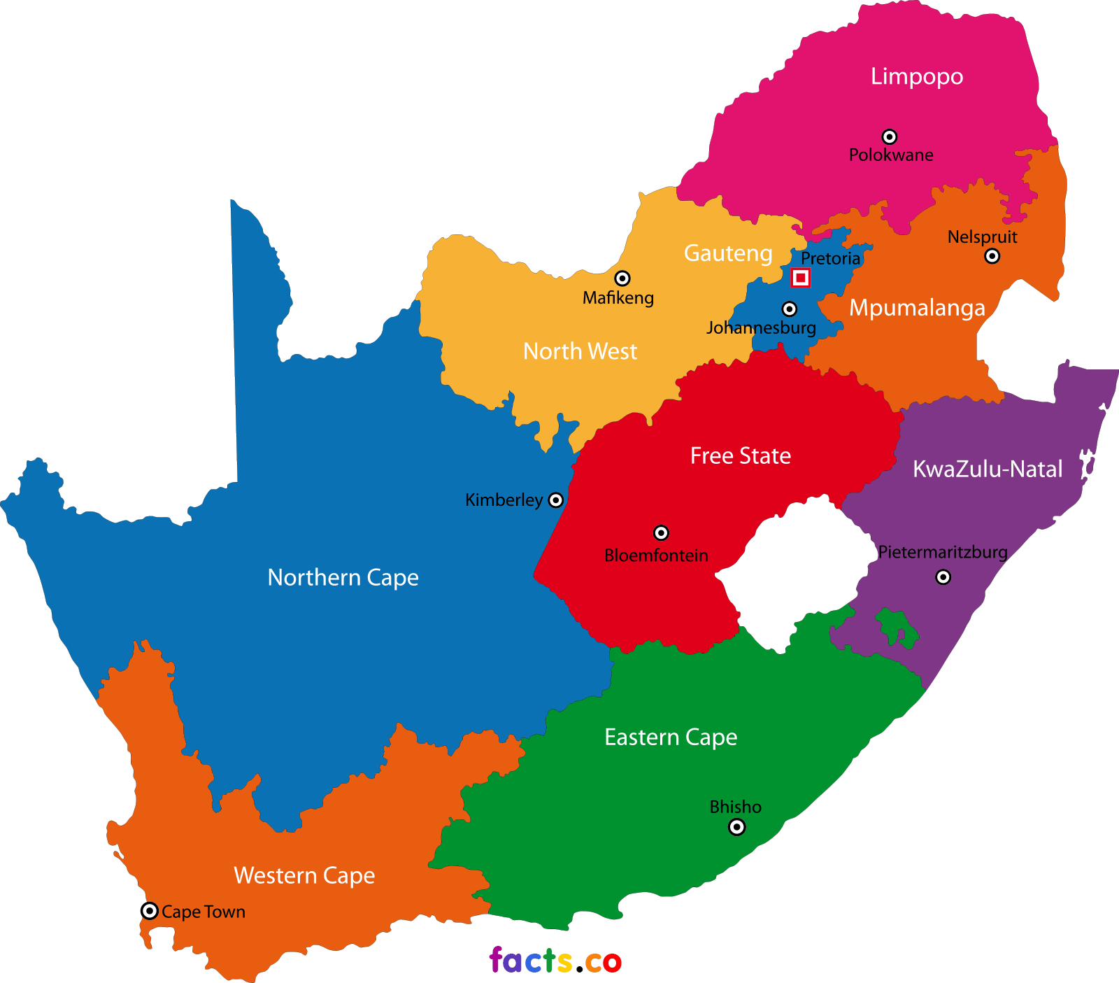
FOOTPRINT
126 LABOUR CENTRES
3
33 LABOUR CENTRES WITH COID FUNCTIONS
3
3
9
2
3
3
4
3

Slide 7




STRATEGIC FOCUS
The Strategy of the Fund is comprised of two strategic priorities or areas of focus for the success and sustainability
 | Quality Medical Care | Client Centered Care | People | Performance
Strategic Priorities | To provide faster, reliable and accessible COID Services by 2020 |  | To provide an effective and efficient client oriented support services
Flagship Projects | Integrated Online Platform for Employer Registration and compliance management Online Claims Management System Hospital Care Management Program Disability Care Management Integration of data from e-claims. ICM and umehluko systems or better Review of medical services function in the Fund Chronic Medication Dispensing |  | Improved capacity through Human Resource Development Increase in the asset base of the Fund through investments Contribute to employment creation through investments and training programmes

Slide 8
SERVICE OFFERING
GOVERNANCE
Compensation and Pension Benefits
Medical Benefits
Disability Care & Rehabilitation
COMPLIANCE
CORPORATE SUPPORT

Slide 9
LINK TO OUTCOMES
Government Service Delivery Outcomes | DOL Strategic Objectives | CF Strategic Outcomes | CF Strategic Objectives
Outcome 4: Decent Employment through inclusive economic growth | KRA 3: Protecting vulnerable workers, | Strengthening of Social Security through compensating for occupational injuries and diseases | Provide faster, reliable and accessible COID Services by 2020
 | KRA 5: Strengthening social protection
Outcome 13: A comprehensive, responsive and sustainable social protection system
Outcome 12: An efficient, effective and development oriented public service | KRA 8: Strengthening the institutional capacity of the Department | Strengthening the institutional capacity of the Fund | Provide an effective and efficient client oriented support services.

Slide 10
LEGEND
Implication: ACHIEVED
Performance Indicator is on track or reflects complete implementation. Target achieved
100% + Complete
Implication: NOT ACHIEVED
Performance Indicator behind schedule. Target not achieved
0% - 99% Complete

Slide 11
QUARTER 3 OVERALL PERFORMANCE
Overall achievement per Strategic Objective and per Programme during QUARTER 3
October to December 2018-19
Cumulative Performance from Quarter 1 and Quarter 2.

Slide 12
QUARTER 3 PERFORMANCE PER STRATEGIC OBJECTIVE 2018/19
Strategic Objectives | Annual Planned Indictors | Indicators with targets reporting in Q3 | Achieved | Not Achieved | Overall Achievement %
Provide an effective and efficient client oriented support services. | 3 | 1 | 1 | 0 | 100%
Provide faster, reliable and accessible COID Services by 2020. | 6 | 6 | 5 | 1 | 83%
Total number of Indicators | 9 | 7 | 6 | 1 | 86%
Overall Performance |  |  | 86% | 14%

Slide 13
QUARTER 3 PERFORMANCE PER PROGRAMME 2018/19
Programme | Annual Planned Indicators | Indicators with targets reporting in Quarter 3 | Achieved | Not Achieved | Overall % Achievement
Programme 1: Administration | 3 | 1 | 1 | 0 | 100%
Programme 2: Compensation for occupational injuries and diseases Services operations | 3 | 3 | 2 | 1 | 67%
Programme 3: Medical Services | 2 | 2 | 2 | 0 | 100%
Programme 4: Orthotic and Rehabilitation | 1 | 1 | 1 | 0 | 100%
Total number of Indicators | 9 | 7 | 6 | 1 | 86%
Overall Performance |  |  | 86% | 14%

Slide 14
COMPARATIVE ANALYSIS PER PROGRAMME FOR Q1. Q2 & Q3 2018/19
Programmes | QUARTER 1 |  |  | QUARTER 2 |  |  | QUARTER 3
 | Quarter1 Planned targets | Overall Achieved | % | Quarter2 Planned targets | Overall Achieved | % | Quarter3 Planned targets | Overall Achieved | %
Programme 1: Administration | 2 | 1 | 100% | 2 | 1 | 100% | 2 | 1 | 100%
Programme 2: Compensation for occupational injuries and diseases Services operations | 3 | 2 | 67% | 3 | 2 | 67% | 3 | 2 | 67%
Programme 3: Medical Services | 2 | 2 | 100% | 2 | 2 | 100% | 2 | 2 | 100%
Programme 4: Orthotic and Rehabilitation | 1 | 1 | 100% | 1 | 1 | 100% | 1 | 1 | 100%
Total | 7 | 6 | 86% | 7 | 6 | 86% | 7 | 6 | 86%
The Programmes during 2018/19 Financial Year are based on the Reviewed CF Structure

Slide 15
PERFORMANCE TRENDS

Slide 16

QUARTER 1 & 2 & 3
PERFORMANCE PER INDICATOR
# | PERFORMANCE INDICATORS FOR THE FINANCIAL YEAR 2018/19 | Annual Target | Quarter 1 Target | Q1 Achieve | Quarter 2 Target | Q2 Achieve | Quarter 3 Target | Q3 Achieve | LEGEND | TREND
1.2 | Percentage implementation of the approved annual risk-based audit plan | 85% | 15% | 25% | 45% | 60% | 60% | 60% | A
2.1 | Percentage of approved benefits paid within 5 working days | 98% | 98% | 100% | 98% | 100% | 98% | 98% | A
2.2 | Percentage of active registered employers assessed annually by 31 March 2019 (excl exempted employers) | 75% | 40% | 35% | 55% | 38% | 65% | 39% | NA
**2.3 | Percentage of claims adjudicated within 40 working days of receipt | 90% | 90% | 92% | 90% | 95% | 90% | 94% | A
**3.1 | Percentage of medical invoices finalised within 60 working days of receipt | 85% | 85% | 99% | 85% | 94% | 85% | 95% | A
**3.2 | Percentage of pre-authorisation requests responded to within 10 working days | 85% | 85% | 87% | 85% | 90% | 85% | 90% | A
**4.1 | Percentage of compliant requests for assistive devices responded to within 15 working days of receipt | 85% | 85% | 91% | 85% | 89% | 85% | 95% | A
5%
17%
26%
**Indicators with Provincial Performance breakdown
A – Achieved NA – Not Achieved

Slide 17


QUARTER 3
PROGRAMME 2 PERFORMANCE PER PROVINCE
90% of registered compensation claims adjudicated within 40 working days
Province | Total claims registered | Total claims adjudicated | Percentage of Total claims adjudicated | Claims adjudicated within 40 working day | Percentage of Total claims adjudicated within 40 working days
Eastern Cape | 7452 | 7254 | 97% | 6882 | 92%
Free State | 2844 | 2745 | 97% | 2692 | 95%
Gauteng | 26840 | 25197 | 94% | 24327 | 91%
Kwa-Zulu Natal | 12374 | 11594 | 94% | 11397 | 92%
Limpopo | 18683 | 18267 | 98% | 17901 | 96%
Mpumalanga | 4320 | 4257 | 99% | 4212 | 98%
North West | 5126 | 4945 | 96% | 4887 | 95%
Northern Cape | 1491 | 1457 | 98% | 1411 | 95%
Western Cape | 34290 | 33591 | 98% | 32948 | 96%
Grand Total Q3 | 113420 | 109307 | 96% | 106657 | 94%
Grand Total Q2 | 70214 | 68301 | 97% | 66976 | 95%
Grand Total Q1 | 31076 | 28946 | 93% | 28737 | 92%

Slide 18
QUARTER 3
PROGRAMME 3 PERFORMANCE PER PROVINCE
85% of medical invoices finalised within 60 working days of receipt
Province | Total Received | Total Finalised | Percentage of Total Finalised | Finalised within 60 working days | Percentage of Total Finalised within 60 working days
Eastern Cape | 42647 | 42477 | 99.6% | 41797 | 98%
Freestate | 24801 | 24695 | 99.6% | 23935 | 97%
Gauteng | 423978 | 423060 | 99.8% | 402681 | 95%
Kwa-Zulu Natal | 29221 | 29039 | 99.4% | 26762 | 92%
Limpopo | 58340 | 58053 | 99.5% | 56443 | 97%
Mpumalanga | 22855 | 22797 | 99.7% | 22073 | 97%
North West | 24974 | 24884 | 99.6% | 24335 | 97%
Northern Cape | 9375 | 9349 | 99.7% | 9014 | 96%
Western Cape | 55432 | 55226 | 99.6% | 52629 | 95%
Auto-Pay | 3431 | 3413 | 99.7% | 3196 | 93%
Grand Total – Q3 | 695054 | 692993 | 99.7% | 662865 | 95%
Grand Total – Q2 | 332442 | 317546 | 96% | 311069 | 94%
Grand Total – Q1 | 146154 | 145281 | 99% | 145232 | 99%

Slide 19
QUARTER 2
PROGRAMME 3 PERFORMANCE PER PROVINCE
85% of pre-authorisations responded to within 10 working days on previously finalised cases
Province | Received | Achieved |  | Percentage
EC | 145 | 126 |  | 86%
FS | 76 | 74 |  | 97%
GP | 350 | 323 |  | 92%
KZN | 151 | 140 |  | 93%
LP | 109 | 106 |  | 97%
MP | 72 | 68 |  | 94%
NC | 21 | 20 |  | 95%
NW | 3 | 3 |  | 100%
WC | 146 | 139 |  | 95%
Total Pre-Authorization's
 |  | Q1 | Q2 |  | Q3
Received |  | 473 | 549 |  | 1073
Achieved |  | 412 | 490 |  | 999
Percentage |  | 87% | 89% |  | 93%

Slide 20

QUARTER 3
PROGRAMME 4 PERFORMANCE PER PROVINCE
85% of compliant requests for assistive devices responded within 15 working days
Province | Received | Achieved | Percentage
Eastern Cape | 28 | 20 | 71%
Free State | 59 | 59 | 100%
Gauteng | 283 | 267 | 94%
Kwa-Zulu Natal | 163 | 160 | 98%
Limpopo | 122 | 107 | 88%
Mpumalanga | 118 | 114 | 97%
North Cape | 20 | 17 | 85%
Northern West | 51 | 38 | 75%
Western Cape | 49 | 40 | 82%
Total – Q3 | 893 | 882 | 92%
Total – Q2 | 650 | 581 | 89%
Total – Q1 | 231 | 210 | 91%

Slide 21
ANNUAL PERFORMANCE PLAN (APP) 2018/19
QUARTER 3
OCTOBER 2018 – DECEMBER 2018
PROGRESS AND MAJOR PERFORMANCE CHALLENGES ENCOUNTERED DURING REPORTING PERIOD
With a special focus on NOT ACHIEVED Targets

Slide 22
PROGRAMME 2
PROGRAMME PERFORMANCE INDICATOR | QUARTER 2 TARGET | ACTUAL PERFORMANCE | REASON FOR VARIANCE |  | REMEDIAL ACTION
STRATEGIC GOAL 8: STRENGTHENING SOCIAL PROTECTION (MTSF OUTCOME 13: A COMPREHENSIVE, RESPONSIVE AND SUSTAINABLE SOCIAL PROTECTION SYSTEM)
1.1 Percentage of active registered employers assessed annually by 31 March 2019 (excl exempted employers) Note: IES has indicated that they have capacity constraints, therefore they are unable to attend to cases referred. | 65% of active registered employers assessed by 30 December 2018 | NOT ACHIEVED 39% of active registered employers were assessed by 30 December 2018 As at the end of March 2018, there were a total of 401 536 active registered employers on the database. Of the total active registered employers, 156 599 (39%) were assessed by 31 December 2018 (2018/19 Q3). 39% is lower than the planned 65% by 26% point difference. | 26%: Employer’s non submission of ROE’s The recruitment process of appointing Employers Compliance and Statutory Services not finalised to ensure employers' compliance and enforcement Capacity Constraints | Issue final reminder for submission of outstanding returns of earnings Referral of non-submitting employers to IES Review of 2019/20 APP to support full implementation of the definition of Active Registered Employers Estimation of non-submitted ROE’s by Q4. Clear credit balances of less than R100.00 COID training Secondment of ASD Compliance.

Slide 23
REGARDING UNDER PERFORMANCE BY PROVINCES
TARGET NOT ACHIEVED | PROVINCE | ACTUAL PERFORMANCE BY PROVINCE | REASON FOR VARIANCE | REMEDIAL ACTION
85% of compliant requests for assistive devices responded within 15 working days | Eastern Cape | 71% | Non compliance to letters and a process to load POE on the Y-Drive. | The POE requirement to be discussed at workshops with provinces emphasising the audit outcome. Constant communication and training with the provinces. Conduct provincial visit to provide support on performance information and reporting. Compiled and sent non-compliance notices to CDPOS of provinces where POE is not being submitted
 | North West | 75%
 | Northern Cape | 82%

Slide 24
2018-19 REVENUE SUMMARY

Slide 25
2018-19 EXEPENDITURE PER PROGRAMME

Slide 26
ECONOMIC CLASSIFICATION

Slide 27
2018-19 REVENUE AND EXPENDITURE SUMMARY

Slide 28
VARIANCES
Compensation of Employees:
Compensation of employees is at 41% spending, which reflect under spending for the period under review, this is mainly due to outstanding December claim for Department of Labour.
Goods and Services:
Goods and services is currently at 33%, which reflects an under spend for a period under review. This is also mainly due to the outstanding DoL claim for December period.
A contract for the new claims system was signed end of August 2018 , the project started on the third September 2018 and this will impact positively on the expenditure movements for the following reporting periods.
Phase 2 of the CF filing project has been delayed due to lack of SAP resources.
Case ware software licence is still pending supply chain processes and therefore affecting the expenditure movements for the period under review.

Slide 29
VARIANCES
The unwinding of interests also contribute to slow movement of expenditure as it will only reflect once actuaries have made their year end valuation.
Expenditure on travelling activities that occurred for various purposes within the current reporting period will only reflect in the expenditure information for January 2019 due to outstanding Travel with Flair invoices.
The process for budgeting for medical and compensation benefits has been reviewed based on prior period actual expenditure. This has resulted in the compensation benefits budget amount being significantly reduced, as part of budget adjustments process.
The pension payments are not reflecting on the actual expenditure as the amounts are set off against the current liabilities.

Slide 30
ANALYSIS OF PERFORMANCE PER SECTOR
The purpose of this report is to :
  articulate the number of injuries registered with Compensation Fund per province.
  show the role players in the working class by gender and citizenship.
  indicate most incurred injuries by workers.
  reflect top 20 industry sectors and companies which injuries are sustained.
  Types of diseases and top five companies

Slide 31
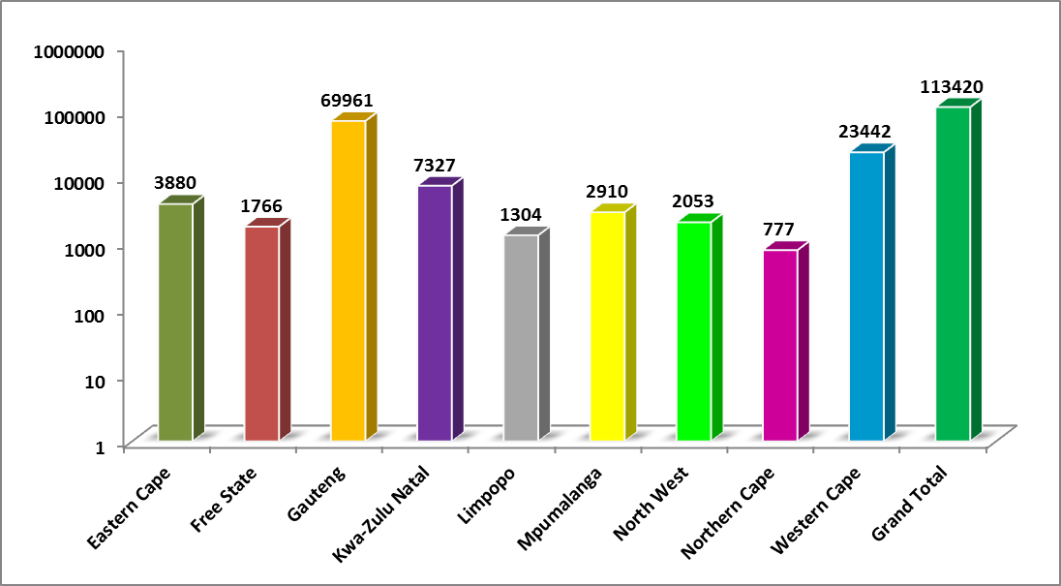
INJURIES PER PROVINCE

Slide 32
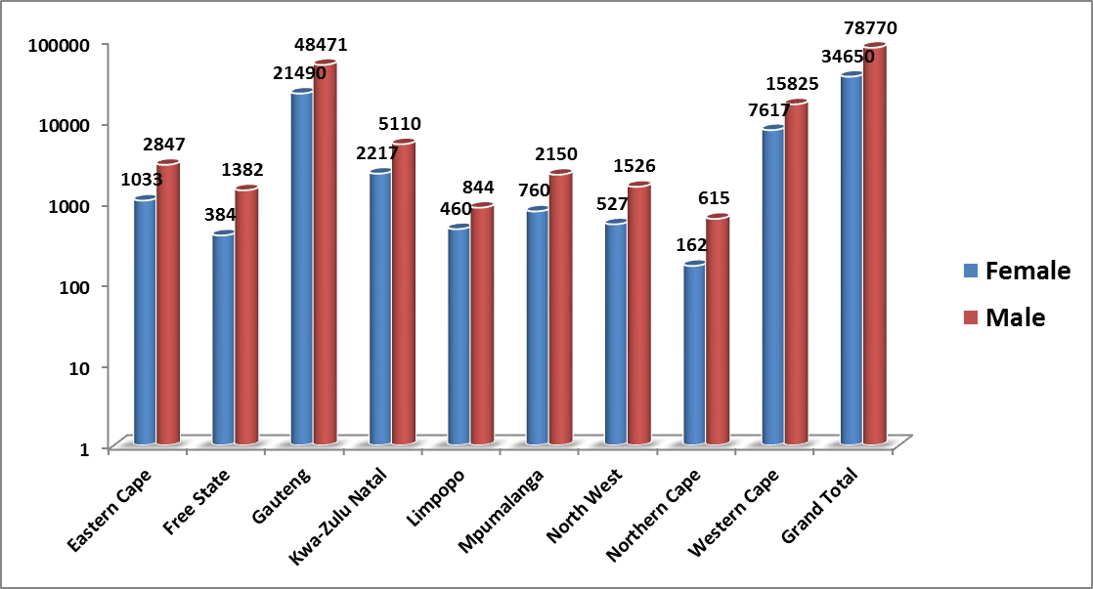
MALES AND FEMALES

Slide 33
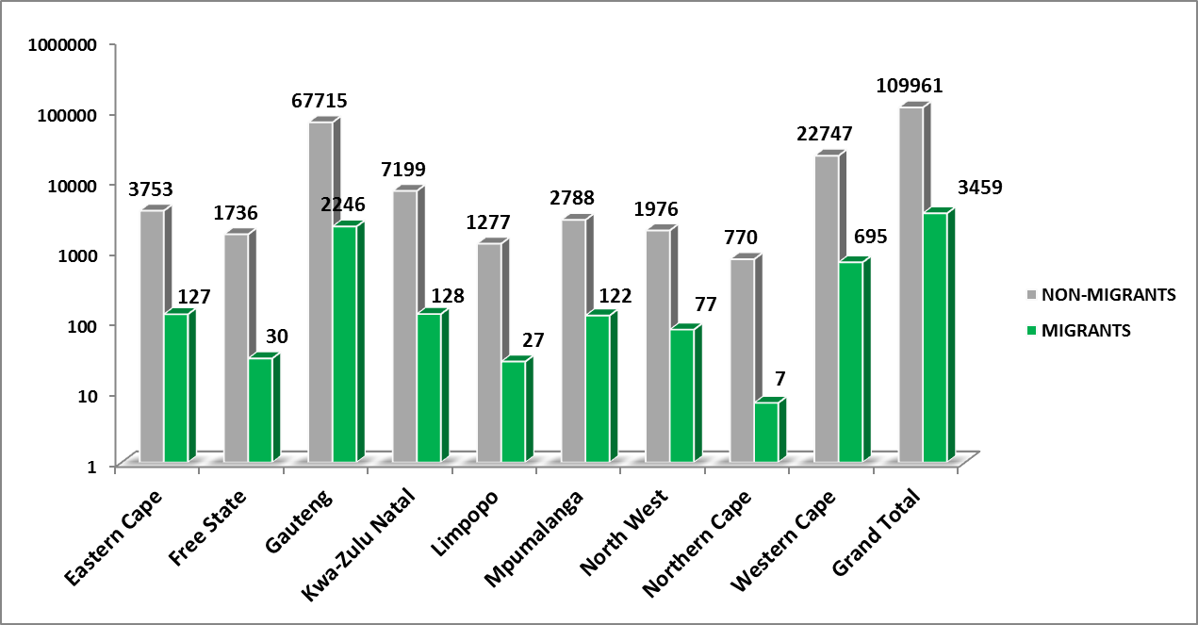
MIGRANTS AND NON MIGRANTS

Slide 34
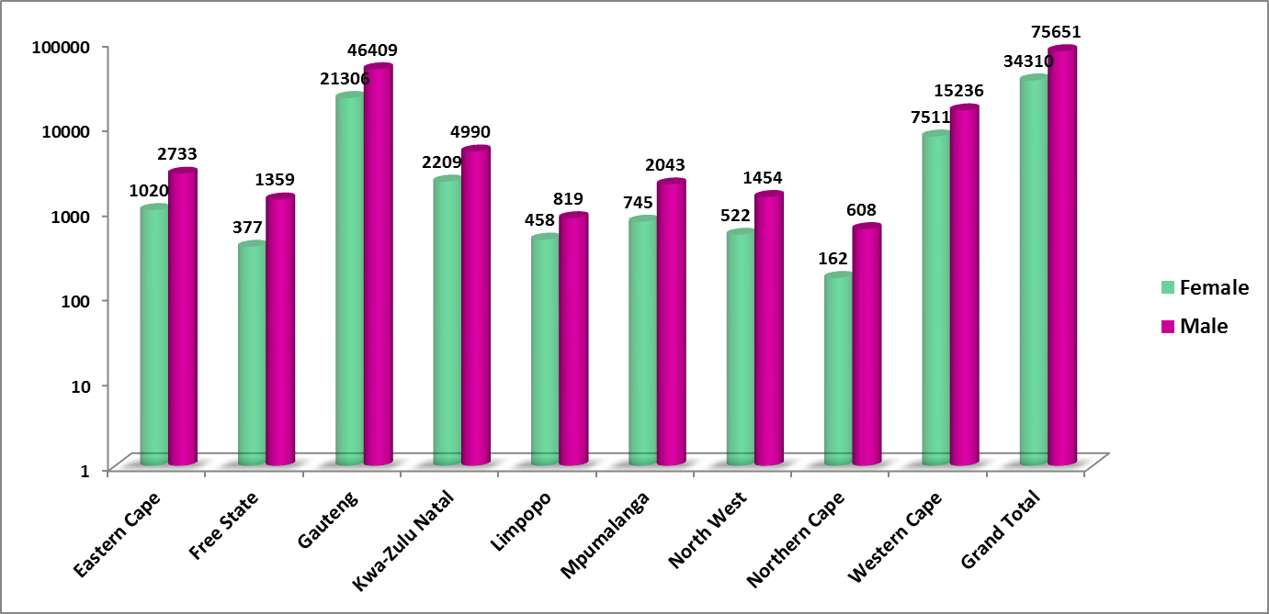
NON MIGRANTS: GENDER

Slide 35
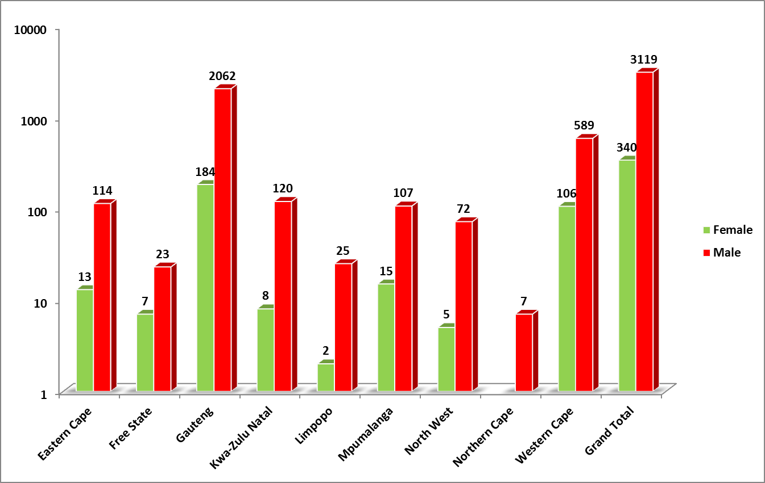
MIGRANTS: GENDER

Slide 36
Top 20 Injuries, Industry Sector and Companies
The report shows top 20 injuries and in which industry sector and company the injuries are mostly incurred.
The report reflects Multiple Superficial Injuries as the most suffered injury by workers at workplace.
The nature of injury contemplate that the working class of citizens are working at food and retail sector (at Shoprite checkers and Pick N Pay).
The report will assist in reducing number of injuries suffered by workers by:
  Visiting the companies with higher number of injuries.
  Eliminating claims of registered with CF.
  Reinforce compliance with OHS.

Slide 37
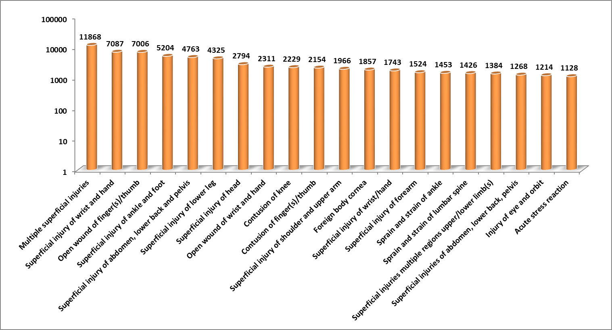
TOP 20 INJURIES

Slide 38
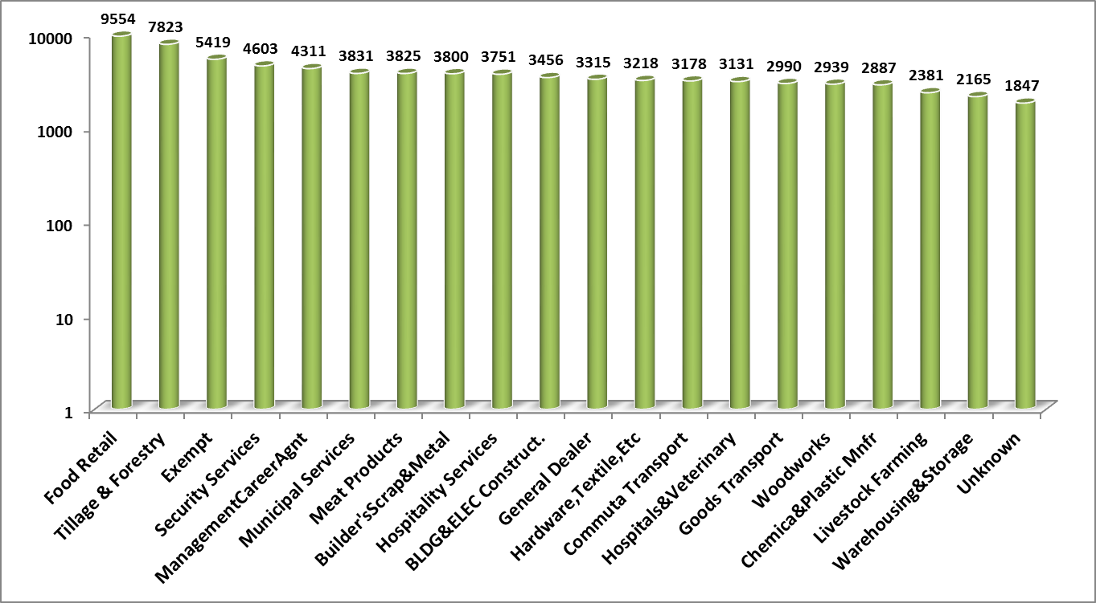
TOP 20 INDUSTRY SECTOR

Slide 39
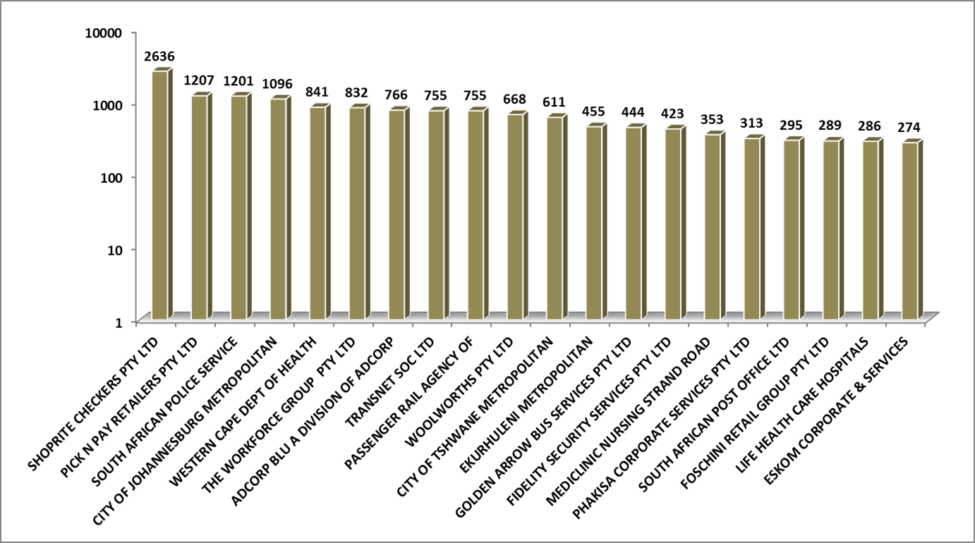
TOP 20 COMPANIES

Slide 40
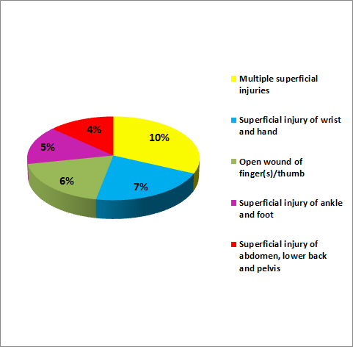
TOP 5 INJURIES
The pie chart reflects contribution of injuries registered and incurred in industries and companies.
The multiple superficial injuries contributes 11% and superficial injuries of wrist and hand constitutes 7% of the population of claims registered for financial year 2018/19.
The population of workers in the working class suffer injuries mostly on their wrist and hand.

Slide 41
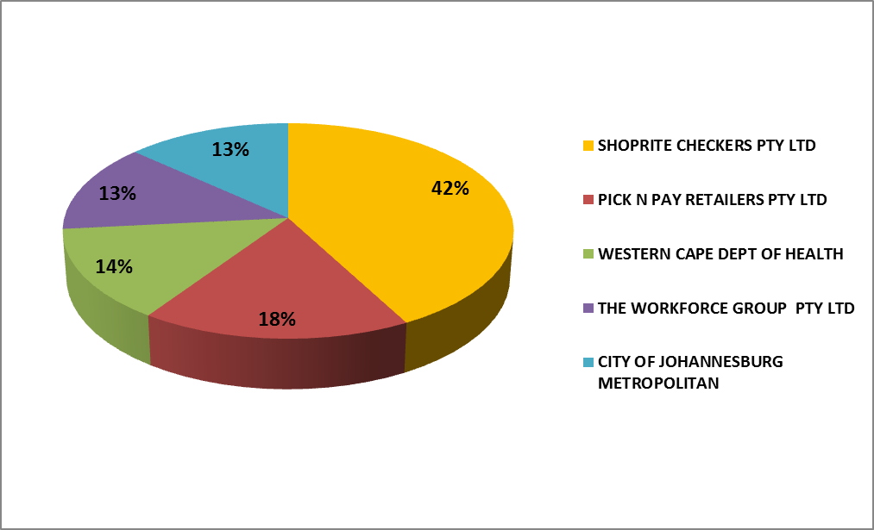
TOP 5 COMPANIES
The pie chats shows Shoprite Checkers contributing 42%

Slide 42
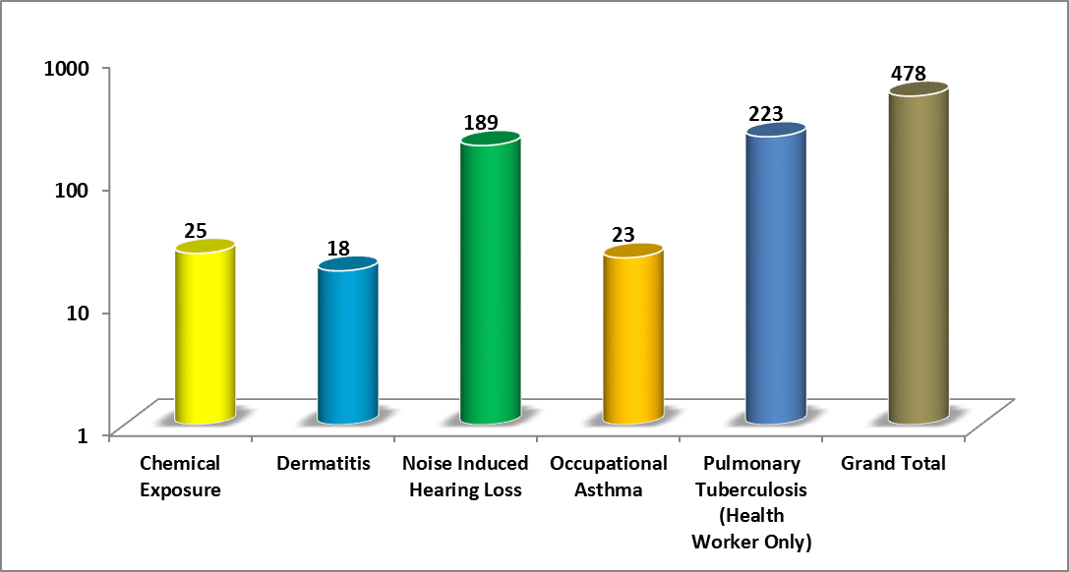
TYPES OF DISEASES
The graph shows types of diseases registered with Compensation Fund

Slide 43
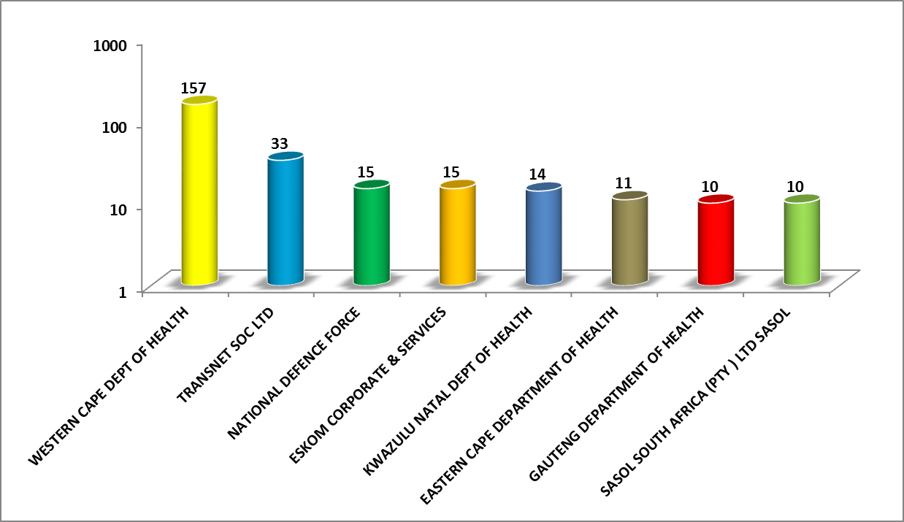
TOP 7 COMPANIES

Slide 44

Compensation Commissioner
Thank You…

