Slide 1

Presentation to
SCOPA
As presented by Adv. A Mothibi
21 August 2019
Date: January 2019

Slide 2

TABLE OF CONTENTS
SIU Mandate
Case Assessment Phase
SIU Delivery Model
SIU Outcomes
Summary of a Case for Change
SIU Value Chain
Governance Improvement
Operational Performance Improvement Information
International Work
Anti-Corruption Task Team Work
Strategic Framework
Stakeholder Survey
Market Data Analytics
Update on SABC and Department of Water Affairs Investigation
Possible Collaboration with SCOPA

Slide 3
SIU MANDATE

Slide 4
THE MANDATE OF THE SIU
The SIU
In terms of the Special Investigating Units and Special Tribunals Act, 1996 (Act No. 74 of 1996) (“SIU Act”). The current Special Investigating Unit (“SIU”) was established by Proclamation No. R118 of 2001
The SIU is a public entity that conducts investigations that have been mandated by a proclamation from the president, once the investigation is complete the President receives a final report with the findings
Mission
“With integrity, we investigate serious malpractices or maladministration in the administration of the State as well as any conduct which may seriously harm the interests of the public and instituting and conducting civil proceedings in any court of law or a Special Tribunal in its own name or on behalf of State institutions.”
Vision
“The State’s preferred and trusted anti-corruption, forensic investigation and litigation agency.”
Major Functions
Investigate corruption, malpractice and maladministration
Institute civil proceedings
SIU Powers
Able to subpoena, search and seize evidence, and interrogate witnesses under oath (once a proclamation has been issued)
Institute civil litigation to recover state funds lost or to prevent future losses
Out of SIU Mandate
Arrest or prosecute offenders
Implement disciplinary actions
Works closely with other relevant agencies where its powers fall short
The State’s Preferred And Trusted Forensic Investigation And Litigation Agency

Slide 5

THE MANDATE OF THE SIU
  THE MANDATE OF SIU IS TO INVESTIGATE THE FOLLOWING:
    Serious maladministration in connection with the affairs of the State Institution;
    Improper or unlawful conduct by employees of the State Institution;
    Unlawful appropriation or expenditure of public money or property;
    Unlawful, irregular or unapproved acquisitive act, transaction, measure or practice having a bearing upon State Property;
    Intentional or negligent loss of public money or damage to public property;
    CORRUPTION in connection with the affairs of the State Institution; or
    Unlawful or improper conduct by any person that has caused or may cause
    Serious harm to the interests of the public or any category thereof.

Slide 6
CASE ASSESSMENT

Slide 7
CASE ASSESSMENT PHASE
  The SIU follows up on and/or receives allegations;
  We assess and verify the allegations and any evidence available;
  Gather additional information as needed to support a motivation for proclamation;
  Draft the motivation for the proclamation and schedule to the proclamation which sets out the scope of the SIU investigation and submit to the Presidency via the DoJ;
  Whilst the proclamation approval process is underway, the team continues with the desktop analysis of the available documentation, project set up and investigation planning;
  The SIU’s powers cannot be used during the case assessment phase; and
  On publication of the proclamation, the team is ready to commence with the investigation.

Slide 8

SIU DELIVERY MODEL
Proclamation published
Produce project plan & LoE
Collect and analyse Evidence
Conduct interviews and obtain affidavits
Refer matters to relevant authorities
Reports presented to the Office of the President
Civil Litigation
Follow-ups
Allegation received
The SIU is in regular contact with Accounting Authorities of State Institutions to follow up on recommendations. Regular updates are also done with the NPA and the Presidency.

Slide 9
SIU OUTCOMES

Slide 10
INVESTIGATION OUTCOMES
CIVIL LITIGATION
Institute civil proceedings where there are potential recoveries of assets.
DISCIPLINARY ACTION REFERRALS
PROSECUTION REFERRALS TO THE
NPA
REFERRAL TO OTHER REGULATORY AUTHORITIES
SARS
Apply for preservation orders at an early stage of investigation where there is prima facie evidence.
FIC
SYSTEMIC RECOMMENDATIONS

Slide 11

SUMMARY OF A CASE FOR CHANGE

Slide 12
Case for Change
Key Challenges as at June 2017
SIU financial model is unsustainable
Poor turn-around times
Current ICT environment is not sustainable
Inadequate individual and organisational Performance management system
Anti-corruption agencies are regulated by several pieces of legislation with potential for duplication
Lack of engagement between the SIU and stakeholders perpetuating limited trust and perception of the organisation’s limited capabilities

Slide 13
OVERVIEW OF STRATEGIC FOCUS
“Our strategic focus is to achieve appropriate legal outcomes against perpetrators of maladministration, malpractice and corruption and to influence proactively the systemic and behavioural root causes of administrative irregularities and corruption.”
Strategic focus
This year’s APP outlines specific activities for the SIU to also become more proactive and to ensure greater preventative measures, which addresses the causes of maladministration, malpractice and corruption.
In order to achieve our goals, the following strategic interventions should support our focus:
Define the SIU Value-chain;
accelerate the conversion of allegations into proclamations;
establish capacity for corruption, maladministration and malpractice prevention through public education, data analytics and scenario analysis;
monitor and evaluate the impact of SIU objectives;
standardise the manner in which cases are scoped through Standard Operations Procedures (SOP);
improve the quality and turnaround times of investigations;
expand on the monitoring and evaluation of case management, including a central case registration system;
ensure the long term financial stability of the SIU, by revising and improving the SIU funding model;
create and publish sector data intelligence;
create advisory capacity to prevent the re-occurrence of corruption, maladministration and malpractice;
monitor the implementation of the SIU remedial actions;
Amendment of the SIU Act;
Improve governance.

Slide 14
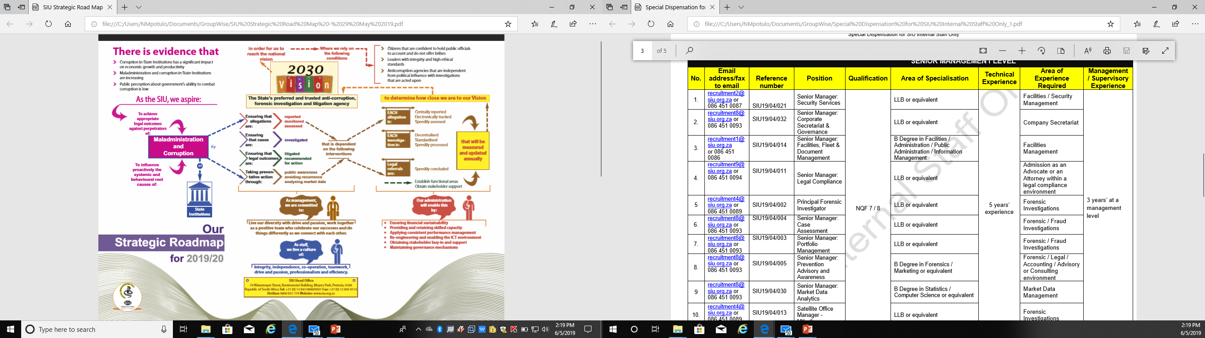
SIU Strategic Focus Areas

Slide 15
SIU VALUE CHAIN

Slide 16
Receive an allegation
Register
Feasibility
Scoping
Proclamation
Planning of investigation
The Value Chain 1/3
Remedial Action
Reporting
Evaluate investigation
Prevent reoccurrence
Monitor remedial action
High Level Value Chain
Functional Areas
Case Registration and Monitoring
Case Assessment
Case Management
Forensic Legal Assessment
Investigation
Civil Litigation Assessment
Forensic Analysis
Market Data Analytics
Prevention and Advisory

Slide 17
The Value Chain 2/3
All allegations are controlled and monitored
Increase number of allegations that are converted into cases
Case Management
Forensic General
New targeted capacity to educate the public

Slide 18
The Value Chain 3/3
Monitor SIU impact
Total transformation in scoping of cases
Case Management
Improve quality and turnaround time of investigations
Forensic General
Expand monitoring and evaluation of case management
Create and publish sector intelligence
Create advisory capacity to prevent re-occurrences

Slide 19

The Operating Model
1
Create ring-fenced unit for national cases
2
Standardise the quality of service delivery
3
Empower provincial accountability and business development

Slide 20
Governance Improvement

Slide 21
Organisational Structure

Slide 22
Governance Model
Governance Roles
Accountabilities
Business area mandates
Governance committee terms
of reference (mandate)
Committee
membership
Job descriptions
Delegation of authority by the HoU to Executives
Decision making rights
Compliance to the approved governance framework
Continues review of the framework
Structure
Major organisational components,
Organisational dimensions - spans of control and layers
of management
Business areas
Standing governance committees
Key reporting lines
Coordinating
Mechanisms
Performance
Management
Committees and task forces
Policies & procedures
Governance process owner
Decision-making mechanisms
Compliance & risk
Corporate Secretariat documents minutes of meetings
Strategies, goal and target-setting
Business Performance contracts & incentives
Reporting, feedback & monitoring

Slide 23
SIU Governance Advisory Committees
Audit Committee
Chaired by Independent external Chairperson
Governed by the Audit Charter
All EXCO members and permanent invitees
Performance
Strategy &
Direction
Governance Compliance and Control
Risk Management Committee
(RiskCo)
Chaired by Independent external Chairperson
I As per the approved ToR
Performance
Governed by Terms of reference
As per the approved ToR
IT Committee
Chaired by Independent external Chairperson
Governed by Terms of reference
As per the approved ToR
HC Committee
Chaired by Independent external Chairperson
Governed by Terms of reference
Delivery
Notes:
23

Slide 24
SIU Governance Structures
Executive
Committee
(EXCO)
Chaired by HoU
Mandate
Strategy Development
Budget
Business Performance
HoU, DHoU, All Executives and Heads of Departments
Performance
Strategy &
Direction
Governance Compliance and Control
IEXCO & Provincial Heads
Performance
Management Committee
(MANCO) Extended EXCO
Chaired by HoU/DHoU
Strategy Execution
Business Plans
Resources
Issue & Risk Management
DHoU, CRO, CPPO, CNIO, Provincial Heads all senior operations personnel
Operations Management Meeting across Operations (OMM)
Chaired by DHoU
Review Ops Bus Plans
Projects status updates
Risk & issues
Finances, IT, HR issues
Functional/Business Unit/Regional
Meetings
Chaired by Responsible Executives
Operational plans
Control performance
Budget
Per Business Unit Management
Notes:
24

Slide 25
SIU Governance Structures
Case Assessment Committee
Chaired by DHoU
Review cases for business development
HoU, DHoU, CPPO, CNIO, CGO and members as per ToR
Performance
Strategy &
Direction
Governance Compliance and Control
IAs per the Terms of Reference
Performance
Review and update policies before they serve on NCF & approval by HoU
Policy Committee (PolCom)
Chaired by CLC
Governance Committee to review State Capture matters and interface with State Capture Commission and other Commission
Review outcomes of any commission of enquiry for business development
AS per HoU nomination
AS per the Terms of Reference
National Projects Review Board
Chaired By HoU
Review all active SIU investigations projects
Notes:
25

Slide 26
SIU Governance Structures
Pre-Proclamations Planning Committee
National proc Chair CNIO
Provincial proc Chair the Prov Head or Head of Investigations
Discuss and plan pro-actively matters pertaining to the investigation on that proclamation
Strategy &
Direction
As per the approved ToR
Performance
Governance Compliance and Control
Loss Control Committee
(LCC)
Chaired by CFO
I As per the approved ToR
Performance
Review Fruitless & wasteful expenditure, irregular and internal investigations outcomes
As per the approved ToR
Security Committee
Chaired by Senior Manager Security
Regional Chairpersons
Review security strategies and security improvements
As per the approved ToR
HC Subcommittee: Skills Development & Employment Equity Committees
Chaired CHCO
Governed by Terms of reference
Delivery
Notes:
26

Slide 27
Audit outcomes
SIU Audit outcomes
Types of audit outcomes
Unqualified with no findings
Unqualified with findings
Unqualified with findings
Unqualified with findings
Unqualified with findings
2018-19
2017-18
2016-17

Slide 28
AG Audit Opinion: 2016/17, 2017/18 & 2018/19 FY’s
GOOD GOVERNANCE: UPHOLDING THE “CLEAN” AUDIT OPINION - For 2016/17, 2017/18 & 2018/19 THE SIU HAS ACHIEVED A “CLEAN AUDIT” STATUS
A CLEAN AUDIT OPINION CONSISTS OUT OF 4 ELEMENTS:
  Audit opinion on the Financial Statements ”In my opinion, the financial statements present fairly, in all material respects, the financial position of the SIU as at 31 March 2018, and its financial performance and cash flows for the year then ended…”
  Performance information: “I did not identify any material findings on the usefulness and reliability of the reported performance information….”
  Compliance to legislation: “I did not identify any instances of material non-compliance with specific matters in key legislation set out in the general notice issued in terms of the Public Audit Act.”
  Internal control deficiencies : “I did not identify any significant deficiencies in internal control”

Slide 29
Operational Performance Improvement Information

Slide 30
Operational Performance: Year on Year Comparism - Financial Year 2015/2016
SIU Business Operations | ACTUAL PERFORMANCE
Core Mandate Combatting Corruption | 2015/2016
Key Performance Indicator | Actuals | Annual Target | Deviation
Number of Proclamations Issued | 5 | 12 | -58%
Percentage of Issued Proclamations Finalised | 0% | 60% | -100%
Potential Value of Cash and/or Assets Recoverable | 73,026,879 | 220,000,000 | -67%
Actual Value of Cash and/or Assets Recovered | 52,016,396 | 120,000,000 | -57%
Number of Civil Matters Instituted in Court or the Special Tribunal | 5 | 15 | -67%
Number of Referrals made to the National Prosecuting Authority (NPA) | 307 | 45 | 582%
Number of instances where potential disciplinary matters were bought to the attention of the relevant State Institution | 68 | 60 | 13%

Slide 31
Operational Performance: Year on Year Comparism - Financial Year2016/2017
SIU Business Operations | ESTIMATED PERFORMANCE
Core Mandate Combatting Corruption | 2016/2017
Key Performance Indicator | Actuals | Annual Target | Deviation
The number of investigations closed out | 1,186 | 800 | 48%
The number of reports submitted to the Presidency | 6 | 5 | 20%
The value of money and/or assets potentially recoverable | 126,920,485 | 240,000,000 | -47%
The actual value of money and/or assets recovered | 43,500,706 | 140,000,000 | -69%
The value of potential loss prevented | 106,527,223 | 18,000,000 | 492%
The value of contract(s) and/or administrative decision(s) / action(s) set aside or deemed invalid | 4,014,630,241 | 600,000,000 | 569%
The value of matters in respect of which evidence was referred for the institution or defence/opposition of civil proceedings (including arbitration or counter civil proceedings) | 3,816,540,390 | 1,200,000,000 | 218%
The number of referrals made to the relevant Prosecuting Authority | 108 | 60 | 80%
The number of referrals made for disciplinary, executive and/or administrative action | 137 | 75 | 83%
The number of SIU member(s) participating in Joint Operation(s) or seconded to assist State Institutions | 54 | 30 | 80%

Slide 32
Operational Performance: Year on Year Comparism - Financial Year 2017/2018
SIU Business Operations | ACTUAL PERFORMANCE
Core Mandate Combatting Corruption | 2017/2018
Key Performance Indicator | Actuals | Annual Target | Deviation
The number of investigations closed out under a published proclamation | 1,556 | 1000 | 56%
The number of reports submitted to the Presidency | 15 | 8 | 88%
The value of money and/or assets potentially recoverable | 298,680,864 | 200,000,000 | 49%
The actual value of money and/or assets recovered | 33,517,475 | 120,000,000 | -72%
The value of potential loss prevented | 406,698,804 | 21,000,000 | 1837%
The value of contract(s) and/or administrative decision(s) / action(s) set aside or deemed invalid | 797,134,053 | 660,000,000 | 21%
The value of matters in respect of which evidence was referred for the institution or defence/opposition of civil proceedings (including arbitration or counter civil proceedings) | 2,677,088,547 | 1,300,000,000 | 106%
The number of referrals made to the relevant Prosecuting Authority | 148 | 75 | 97%
The number of referrals made for disciplinary, executive and/or administrative action | 319 | 75 | 325%

Slide 33
Operational Performance: Year on Year Comparism - Financial Year 2018/2019
SIU Business Operations | ACTUAL PERFORMANCE
Core Mandate Combatting Corruption | 2018/2019
Key Performance Indicator | Actuals | Annual Target | Deviation
The percentage of allegations that were electronically tracked according to predetermined standards | 100% | 100% | 0%
The percentage of centrally registered allegations received that are assessed in accordance with predetermined standards | 100% | 100% | 0%
The number of investigations closed out under a published proclamation | 3,430 | 1,200 | 185%
The number of reports submitted to the Presidency | 20 | 12 | 67%
The number of referrals made to the relevant Prosecuting Authority | 331 | 75 | 341%
The number of referrals made for disciplinary, executive and/or administrative action | 335 | 100 | 235%
The value of potential loss prevented | 53,381,608 | 24,000,000 | 122%
The value of cash recoveries | 136,832,112 | 120,000,000 | 14%
The value of contract(s) and/or administrative decision(s) / action(s) set aside or deemed invalid | 999,283,482 | 730,000,000 | 37%
The value of matters in respect of which evidence was referred for the institution or defence/opposition of civil proceedings (including arbitration or counter civil proceedings) | 7,956,080,037 | 1,400,000,000 | 468%

Slide 34
Budget and MTEF Estimates
Overview of 2019/2020 budget and MTEF estimates

Slide 35
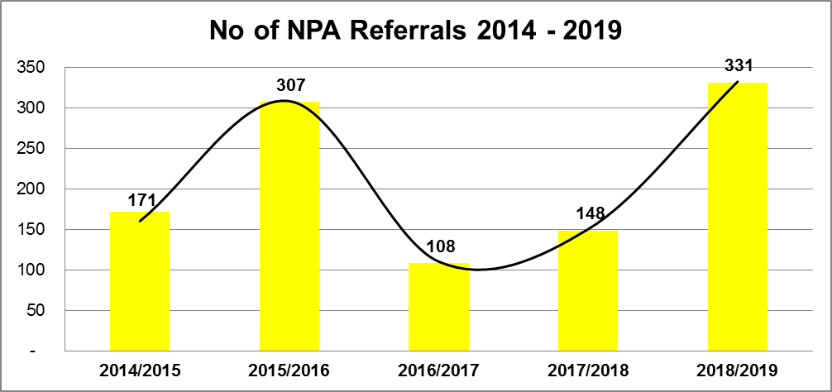
REFERRALS
The graph below represents the total number of referrals that have been made to the Relevant Prosecuting Authority for the period 1 April 2014 to 31 March 2019

Slide 36
REFERRALS
NPA Referrals
Engagements are ongoing in order to follow-up and action all the referrals.
MOU has been signed with NPA and we are in the process of reviewing it with NDPP.
We are in the process of prioritising some of the referrals in order to speed up priority cases.

Slide 37
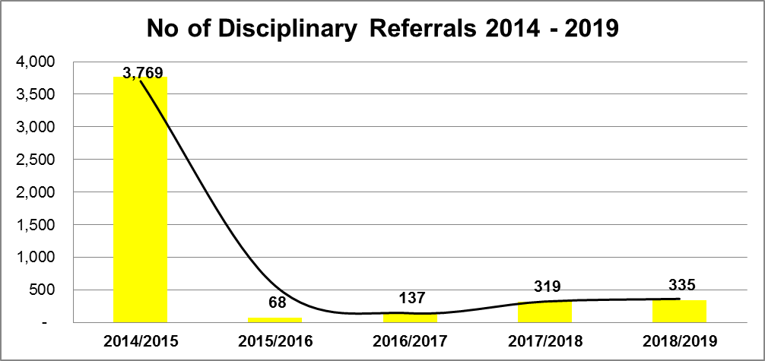
DISCIPLINARY REFERRALS
The graph below represents the total number of referrals that have been made to State Institutions for disciplinary, executive and/or administrative action for the period 1 April 2014 to 31 March 2019
Notes:
The 3769 disciplinary referrals were in respect of the conflict of interest investigation for Eskom, Proclamation R2 of 2012

Slide 38
FOLLOW-UP ON DISCIPLINARY REFERRALS
Ensure consequence management.
Release of SIU Presidential reports to the Executive and Accounting Authorities be the Presidency.
Feedback required regarding implementation of SIU referrals.

Slide 39
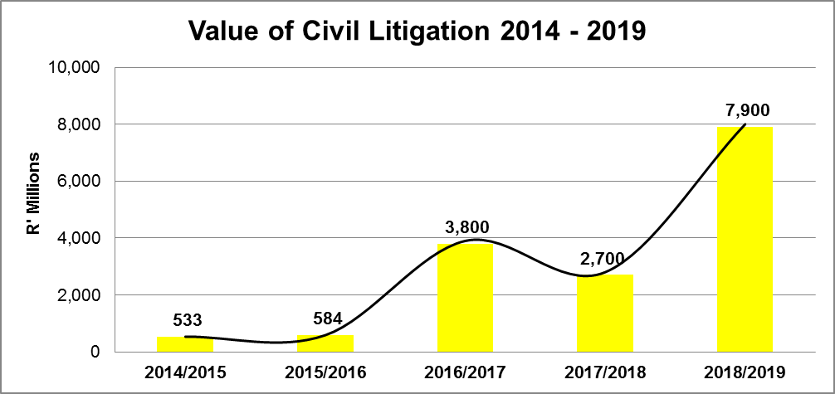
CIVIL LITIGATION
The graph below represents the total value of the matters in respect of which evidence was referred for the institution or Defence/Opposition of Civil Proceedings for the period 1 April 2014 to 31 March 2019
Notes:
The 3769 disciplinary referrals were in respect of the conflict of interest investigation for Eskom, Proclamation R2 of 2012

Slide 40
Status on Establishment of Special Tribunal
The President in and during February 2019 established the Special Tribunal (ST) and appointed Makhanya J as the Tribunal President
Judges from the various provincial divisions were also appointed to the ST
The SIU, Makhanya J and DoJ&CD officials met and resolved the following:
  The seat of the ST
  The Regulations to the SIU Act to be promulgated
  The Rules of practice applicable to the ST to be drafted
ST anticipated to be operational in or before October 2019.
Overall value of the civil litigation is estimated at R14.7 billion

Slide 41
International Work

Slide 42
International Anti-Corruption Work
SIU participates in the following:
African Union Anti-Corruption Working Group.
SADC Anti-Corruption Working Group.
Commonwealth Africa Head of Anti-Corruption Agencies Forum.
Commonwealth Secretariat Anti-Corruption Initiatives.
BRICS Anti-Corruption Working Group.
G20 Anti-Corruption Working Group.
United Nations Office on Drugs and Crime.
United Nations Conventions Anti-Corruption Implementation Working Groups.
From time to time there are initiatives in the African Continent and International Anti-Corruption Initiatives where SIU is invited.
SIU works closely with DPSA,DIRCO and ACTT on the above work.

Slide 43
Anti-Corruption Task Team Work

Slide 44

CORRUPTION PREVENTION MEASURES
The Special Investigating Unit (SIU), is the Convener of Programme 4. It collaborate and work closely with other ACTT stakeholders to ensure that it delivers on its mandate.
The ACTT Strategy mandate Prog 4 to execute on the following:
1.
Vulnerability Sector Assessment
2.
Pro-active interventions
3.
Conduct Investigations
4.
Civil Litigation

Slide 45
CORRUPTION PREVENTION MEASURES
      SIU as the Convener of Programme 4 has identified vulnerable sectors to fraud and corruption through collaboration with other ACTT stakeholders, informed by AG and SCOPA reports.
Vulnerable Sectors to incidents of fraud and corruption
1) Health
6) Energy (e.g IPP)
11) Education
2) Construction
7) Mining
12) ICT
3) SOEs
8) Water
13) SMMEs
4) Finance
9) Transport
14) Border Mngt
5) Local Government
10) Real Estate
15) Defense/Armaments
Key:
Completed Project
Current Project
Next Project

Slide 46
CORRUPTION PREVENTION MEASURES
Prioritised Sectors
Proc Number | Category | Dept/State Institution | NPA referrals | Disciplinary referrals | Civil litigation ('R)
R11 of 2018 | SOE | Eskom Holdings SOC Ltd | 34 | 14 | 3 700 000 000
R29 of 2017 R19 of 2018 | SOE | South African Broadcasting Corporation (SABC) | 16 | 17 | 467 987 656
R53 of 2014 | SOE | State Information Technology Agency (Pty) Ltd (“SITA”) - IBM and iFirm | 6 | 3 | 265 000 000
R18 of 2019 | Health | National Health Laboratory Service | - | - | -
R23 of 2017 R6 of 2019 | Health | Gauteng Provincial Department of Health (Mental health care facilities – Life Esidimeni) | 35 | 94 | Default judgement obtained on one matter to the value of R663,275. Awaiting judgment on another matter to the value of R681,113 To institute civil litigation to the value of R5 006 628.49 on other 9 NGOs
R23 of 2019 | Health | Health Professions Council of South Africa (HPCSA) | - | - | -
R19 of 2016 | Construction | Construction Industry Board (CIDB) | 126 | 210 | 1 100 000 000

Slide 47
Annual Performance Plan (APP) Review

Slide 48

Strategic Framework
The State’s preferred and trusted anti-corruption, forensic investigation and litigation agency
Vision
With integrity, we investigate serious malpractices or maladministration in the administration of the State as well as any conduct which may seriously harm the interests of the public and of instituting and conducting civil proceedings in any court of law or a Special Tribunal in its own name or on behalf of State institutions.
Mission
Independence
Drive and passion
Values
Co-operation
Integrity
Professionalism
Teamwork
Efficiency

Slide 49
Strategic Framework
How will we make an impact?
Strategic Goals
To enable core services to perform optimally
(PROGRAMME 1)
To achieve appropriate legal outcomes against perpetrators of maladministration and corruption
(PROGRAMME 2)
To influence proactively the systemic and behavioural root causes of maladministration and corruption
(PROGRAMME 3)

Slide 50

Strategic Framework
To enable core services to perform optimally
To provide a compliant and sustainable financial service in accordance with service delivery standards
To attract a skilled workforce that is managed within a performance driven environment
To provide appropriate ICT services in accordance with set standards
To collaborate with stakeholders in support of enhanced service delivery and core business objectives
To provide support for strategic and organisational performance management
To protect the SIU from potential legal risks
To protect the SIU integrity from internal and external threats
To assess internal controls through internal audits
To enable the unit to become risk intelligent
Strategic Objectives

Slide 51
Strategic Framework
To achieve appropriate legal outcomes against perpetrators of maladministration and corruption
  To proactively influence the systemic and behavioural root causes of maladministration and corruption
To ensure that each case is centrally reported and monitored
To ensure that each allegation is assessed in accordance with standardised criteria
To conduct forensic investigations according to predetermined standards
To initiate the implementation of legal recommendations
To increase legal outcomes based on civil and other proceedings
To direct internal and influence external strategic decision-making processes through data analysis
To assist State institutions with the prevention of the reoccurrence of reported cases
To increase public awareness about targeted anti-corruption behaviour
Strategic Objectives

Slide 52
Stakeholder Survey

Slide 53
Internal Situational Analysis: Stakeholder
Management….(1/6)
The SIU referrals to be implemented to achieve impact.
Our focus during the 2019/20 year is to accelerate the interaction with stakeholders to assist with the integration of inter-governmental business processes to proactively combat and prevent corruption.
This integration includes the continuous monitoring of remedial actions that were recommended by the SIU to ensure that impact is achieved.
The focus in 2019/20 is to ensure that adequate governance structures are created with key stakeholders to enable the full implementation of the strategy by 2020/21.

Slide 54
Stakeholder Management: SIU Stakeholder
Survey….(2/6
SIU conducted an external stakeholder survey, the objectives of the survey were to:
  Gauge stakeholders’ opinions of the SIU in the fight against corruption.
  Measure satisfaction in relation to SIU systems and processes when conducting investigations.
  Provide baseline data to improve service and measure progress.

Slide 55

Partner Survey
Highest | Score
The SIU is responsive when you communicate with them. | 91
The SIU team shows commitment to their task. | 88
The SIU’s turnaround times are sufficient. | 81
The SIU team can be trusted to use the information they obtain in the proper manner. | 81
The level of Interaction between your institution and the SIU is sufficient | 78
The obligations referred to in the MOU between your institution and the SIU are adhered to. | 78
The SIU collaborates effectively with you. | 78

Slide 56
Partner Survey
Lowest | Score
The SIU team collaborates effectively with each other. | 69
The SIU team collaborates effectively with other role players. | 69
The SIU is highly effective at forensic data analysis | 69
The SIU is highly effective at civil litigation. | 69
The SIU is highly effective at legals. | 69
The SIU is highly effective at cyber forensics. | 66
The SIU team operates effectively in a diverse environment. | 66

Slide 57
Breakdown of the respondents by demographics (3/6)
Stakeholder survey: Level of government of investigation

Slide 58
Breakdown of the respondents by demographics (4/6
Stakeholder survey: Year of proclamation of investigation

Slide 59
Operations – Stakeholders….(5/6)

Slide 60
Stakeholder survey – Effectiveness (6/6)

Slide 61
Market Data Analytics

Slide 62
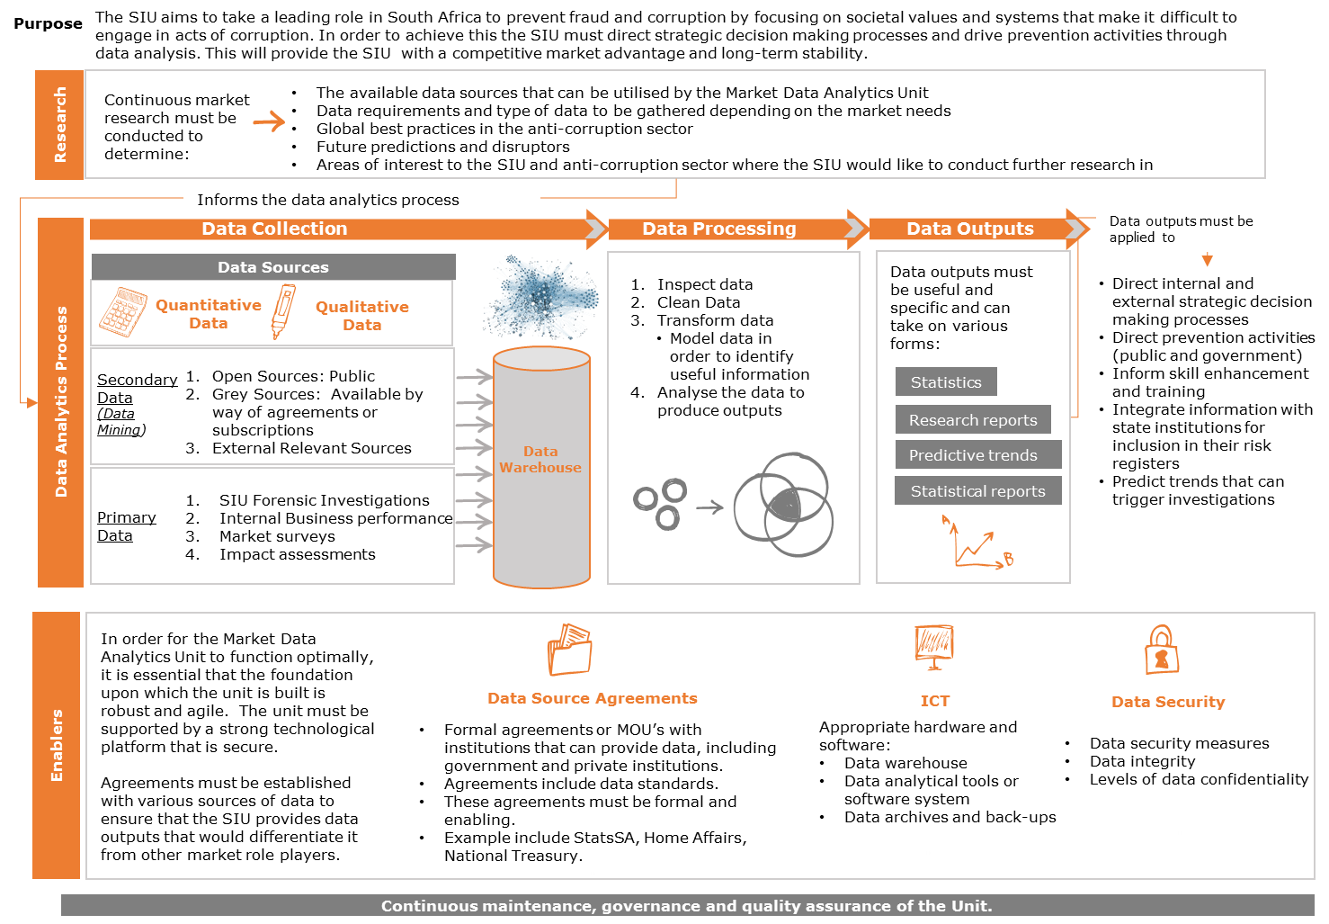
Conceptual Model: Market Data Analytics

Slide 63
UPDATE on SABC and DWA

Slide 64

SPECIAL INVESTIGATING UNIT
Presentation
Department of Water and Sanitation

Slide 65

Proclamations Under Discussion
The SIU previously presented to a joint sitting of SCOPA and the Portfolio Committee on Water and Sanitation on 27 march 2018. This presentation focuses on progress made since the previous engagement. The proclamations discussed in the presentation are;
Proclamation No R35 of 2008: Allegations at the Mhlathuze Water Board
Proclamation No R54 of 2012: Various allegations at the Department of Water Affairs
Proclamation No R22 of 2016: The awarding of contracts to LTE Consulting by the Lepelle Northern Water and Gauteng Department of Human Settlements extended by R27 of 2019
Proclamation No R27 of 2018: The awarding of a contract by the DWS to SAP (SA) extended by Proclamation No R44 of 2019

Slide 66
Overview of outcomes on
SIU proclamations
Presidential Report presented to the Office of the President
Evidence of any other transgressions referred to relevant authorities (Institute of Directors, IRBA, SARS, various regulatory bodies, Financial Intelligence Centre)
Evidence of misconduct referred to the Accounting Officer
Evidence of criminality referred to National Prosecuting Authority and Asset Forfeiture Unit
Civil litigation instituted in SIU’s name
7 AFU Referrals
36 NPA Referrals
23 Disciplinary referrals
  3 officials dismissed
  1 final written warning
  4 officials resigned
21 SARS Referrals
3 CIDB Referrals
Procl R35 of 2008
1) Final Report 30/04/2013
Procl R54 of 2012
  2) Final Report 15/12/2016
  3) Supplementary Report on Vuwani 28/10/2018
Procl R22 of 2016
  4) Final Report GDHS 21/9/2018
  5) Interim Report LNW 31/10/2018
Vuwani R95 million
GDHS R108 million
LNW R2,2 billion
Litigation against SAP to be instituted soon, brief with SC

Slide 67

SIU’s investigations at SABC
Proclamations No R29 of 2017 extended by R19 of 2018

Slide 68
SIU Proclamations for SABC
Proclamations No R29 of 2017 extended by R19 of 2018
Proclamation No R29 of 2017
  Interim Presidential Report: Submitted on 21 September 2018
  Final Presidential Report: Estimated to be finalized by
  30 November 2019
Proclamation No R19 of 2018 (SABC Security Contract)
  Interim Presidential Report: Submitted on 30 November 2018
  Final Presidential Report: Submitted on 13 June 2019

Slide 69
Status of the SIU phase 1
Investigation at SABC
In phase 1 of the investigation, the SIU investigated the following:
Eight contracts awarded by SABC.
The awarding of the success fee.
confirm the outcome of the Public Protector report on irregular appoints.
summary the SIU found evidence that indicated that there were irregularities in the awarding of the eight contracts awarded by SABC.

Slide 70
Status of the SIU phase 1
Investigation at SABC
As a result of the investigation conducted by the SIU, the following outcomes were achieved:
Civil litigation was instituted in seven matters, with an additional three at Senior Counsel who are drafting the court papers;
the provision of evidence to the SABC to assist in defending one civil matter;
Six criminal referrals; and
23 disciplinary referrals.
SIU found evidence that indicated that there were irregularities in the awarding of the eight contracts awarded by SABC.

Slide 71
Referrals to date
The investigation has produced evidence to initiate the civil litigation instituted in the name of the SIU and SABC in five High Court matters to the value of just over R166 million and
We have referred 3 matters to the value of R200 million to Counsel who are preparing court papers.
The SIU also provided evidence to defend one claim for R350 000 on 19 March 2018.
In respect of the other 5 matters they involve private companies who contracted with SABC, it’s Director and a 3 former SABC Executives, the combined value of the cases is approximately R82 million. The charges are fraud and contravention of the Companies Act and the PFMA.

Slide 72
Outcomes of referrals
5 SABC Executives no longer with the SABC:
1 found guilty of disciplinary charges and dismissed;
1 found guilty of disciplinary charges; final written warning issued and then resigned;
2 resigned in the face of SIU disciplinary; and
1 contract expired and not renewed.
2 SABC Officials dismissed:
2 found guilty of disciplinary charges and dismissed.

Slide 73
Phase 2 of investigations
Phase 2 of the investigation is ongoing and it is expected to be finalized on November 2019. The investigation covers some of the following focus areas.
TNA;
SABC Security tender;
Irregular appointments of 7 SABC Officials;
Irregular payment of bonuses:
  13th cheques to Senior Managers; and
  R31 million paid for the R10 000 to 3124 staff.
Irregular Expenditure:
  R5 million SARS penalty; and
  Validity of a sample of Tax Clearance Certificates.
Conflicts of Interest.
Irregularities relating to procurement of a building

Slide 74
PHASE 2 INVESTIGATIONS
SABC Security Contract
The amendment to the SABC Proclamation No R29 of 2017 was published on 6 July 2018, proclamation No R19 of 2018 refers.
SIU was then able to access it’s powers in terms of the SIU Act to investigate the award of this contract valued at R185 519 425.67 as well as the allegations of corruption.
The SIU has found that:
  The contract was awarded irregularly;
  There was financial misconduct and contravention of section 86(2) of the PFMA and contravention of sections 50 and 51 of the PFMA for failing to act in the best interest of the SABC;
  The allegations of gratification and corrupt payments could not be proven.
On 19 February 2019 SIU succeeded in bringing an application to join in the proceedings. Counsel is preparing an answering affidavit to Mjayeli’s application.
The investigation is finalized and the Final Presidential Report was submitted.

Slide 75
Possible Collaboration With
SCOPA

Slide 76
Possible collaboration with SCOPA
Support for proposed amendments to the SIU Act (funding model, preliminary investigations);
Assistance with the implementation of the SIU’s recommendations for remedial action (systemic recommendations, recommendations for disciplinary/administrative action);
Assistance with the recovery of outstanding debt owed to the SIU by state institutions;
Assistance with securing additional funding to capacitate the SIU;
SCOPA can refer matters to the SIU for investigation;
SCOPA should encourage that all state institutions to refer matters to the SIU for investigation and litigation services

Slide 77

Thank You
REPORT FRAUD AND CORRUPTION ON 0800 701 701 (NATIONAL ANTI- CORRUPTION HOTLINE)

