Slide 1
PRESENTATION TO MEMBERS OF THE PORTFOLIO COMMITTEE ON DEFENCE AND MILITARY VETERANS
Independent and Impartial
Presenter: Adv D. Dube / Mr M.A. Makhalemele
Date: 21 August 2019

Slide 2
SCOPE
Aim
Introduction
Mandate of the Office
Vision and Mission of the Office
Structure of the Office
Role of an Ombudsman
Powers and Functions of the Military Ombud
Modus Operandi
Core Business Performance Information
Outreach
Memorandum of Understanding
Conditions of Service (Defence Act)
Timeframes for Lodging of Complaints
Example of Finalised Cases
Challenges / Conclusion
How to contact Us

Slide 3
AIM
To introduce the members of the Portfolio Committee on Defence and Military Veterans on the legislation and operations (Modus Operandi) of the Office of the Military Ombud.

Slide 4
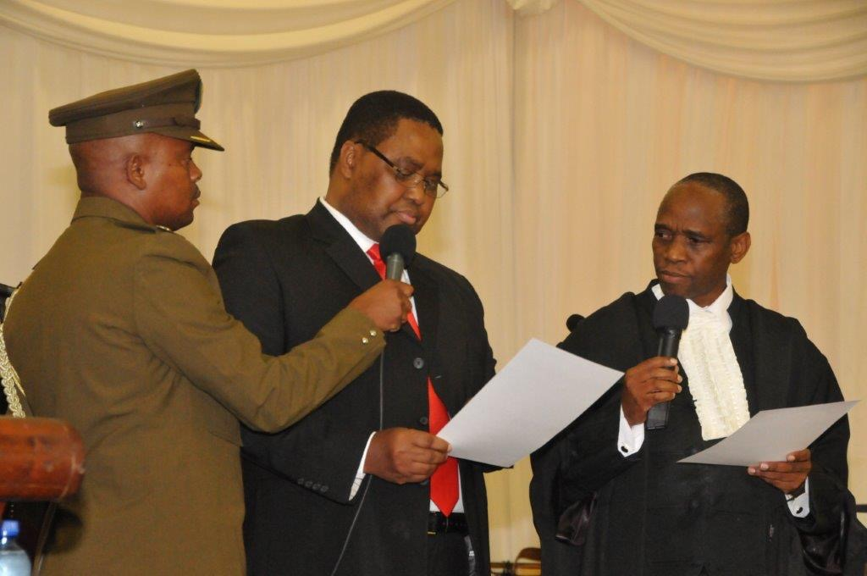
INTRODUCTION
The Military Ombud concept was first contemplated in the late 1990’s by the House, as an independent external mechanism to deal with soldiers’ complaints and grievances as well as a place for the public to lodge complaints about actions of soldiers.
White Paper on Defence (May 1996) advocated for the creation of the post of Military Ombud.
Minutes of proceedings of the Joint Standing Committee of Defence of June 1998, show a premium was placed on the urgency of establishing such an Office.
In April 2006, a Bill titled “South African Military Ombud” was tabled and withdrawn.
A Military Ombudsman Bill was introduced to the National Assembly in January 2011 the amended Bill in its present form was again introduced in September 2011.
The Office was established with the promulgation of the Military Ombud Act 4 of 2012 and the swearing in of the first Military Ombud Lt Gen (Ret) T.T. Matanzima.

Slide 5
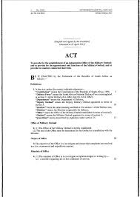
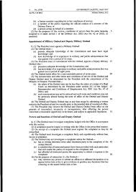
MANDATE
According to the Military Ombud Act 4 of 2012, Section 4.1
The mandate of the Office is to investigate complaints lodged in writing by:
A member regarding his or her conditions of service;
A former member regarding his or her conditions of service;
A member of the public regarding the official conduct of member of the Defence Force; or
A person acting on behalf of a member.
In addition, the MOD & MV may direct or instruct the MO to investigate any matter related to the above.
Independent and Impartial
Military Ombud Act 4 of 2012

Slide 6
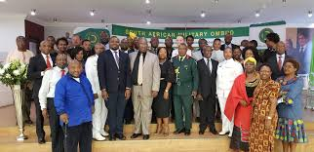
VISION AND MISSION
VISION
A World Leading Independent and Impartial Military Ombud Institution
MISSION
To provide an Independent, Impartial and Expeditious Complaints Resolution Process for Serving and Former Members of the SANDF and the Public to Promote Good Governance

Slide 7
STRUCTURE OF THE OFFICE
Total number of posts as approved by the Minister of Defence and Military Veterans during June 2012 is 89
Office of the Military Ombud
Office of the Deputy Military Ombud
Corporate Operations
Corporate Support
Operations
Legal Support
Communication
Policy, Strategy & Planning
Human Resources
Logistics
Finance
Intake & Analysis
Information, Communication & Technology
Facility, Security & Reception Management
Investigations
Research & Development

Slide 8
STRUCTURE OF THE OFFICE
Office of the Military Ombud
Total number of approved posts within the Executive Office is 5
Office of the Deputy Military Ombud
Total number of approved posts within the Deputy Military Ombuds Office is 4
Corporate Operations
Corporate Support
Operations
Legal Support
Communication
Policy, Strategy & Planning
Human Resources
Logistics
Finance
Intake & Analysis
Information, Communication & Technology
Facility, Security & Reception Management
Investigations
Research & Development

Slide 9
STRUCTURE OF THE OFFICE
Office of the Military Ombud
Total number of approved posts within Corporate Operations is 59
Office of the Deputy Military Ombud
Corporate Operations
Corporate Support
Operations
Legal Support
Communication
Policy, Strategy & Planning
Human Resources
Logistics
Finance
Intake & Analysis
Information, Communication & Technology
Facility, Security & Reception Management
Investigations
Research & Development

Slide 10
STRUCTURE OF THE OFFICE
Office of the Military Ombud
Total number of approved posts within Corporate Support is 21
Office of the Deputy Military Ombud
Corporate Operations
Corporate Support
Operations
Legal Support
Communication
Policy, Strategy & Planning
Human Resources
Logistics
Finance
Intake & Analysis
Information, Communication & Technology
Facility, Security & Reception Management
Investigations
Research & Development

Slide 11
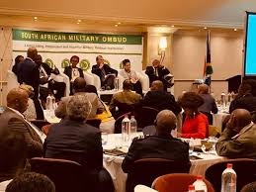
ROLE OF THE MILITARY OMBUD
The role of an ombudsman is to gather facts in order to understand the merits of a complaint and thereafter to consult with the relevant parties to the complaint to either settle the complaint or to make a recommendation to resolve the complaint.

Slide 12
POWERS AND FUNCTIONS
Military Ombud Act 4 of 2012, Section 6
“ The Ombud must investigate complaints lodged with the Office in accordance with this section.
A complaint must be lodged in writing with the Office in the prescribed manner.
On receipt of a complaint the Ombud must register the complaint as may be prescribed.
The Ombud must investigate a complaint fairly and expeditiously without fear, favour or prejudice.
The Ombud may not investigate a complaint unless the Ombud –
has in writing informed every other interested party to the complaint of the receipt thereof;
is satisfied that all interested parties have been provided with such particulars that will enable the parties to respond to the complaint; and
has afforded all interested parties the opportunity to submit a response to the complaint.
For the purpose of subsection1, the Ombud-
may summon any person to submit an affidavit or affirmed declaration or to appear before him or her to give evidence or produce any document that has a bearing on the matter before him or her;
may resolve any dispute by means of mediation, conciliation or negotiations or in any other expedient manner; and
must promote the observance of the fundamental rights of the members of the Defence Force.

Slide 13
POWERS AND FUNCTIONS
Military Ombud Act 4 of 2012, Section 6 (continue)
After investigating a complaint, the Ombud must –
uphold or dismiss the complaint, or issue an alternative resolution;
recommend an alternative resolution to the Minister; or
refer the complaint to the appropriate public institution for finalisation, if the matter falls outside his or her jurisdiction.
If the Ombud upholds the complaint the Ombud must recommend the appropriate relief for implementation to the Minister
The Ombud must immediately after finalisation of the investigation, and in writing, advise the complainant and any other affected person of the outcome of the investigation.
The Ombud must perform any other function allocated
to him or her under this Act
The Minister may assign to the Ombud any other additional
functions which are not inconsistent with this Act.
The Deputy Ombud must perform any functions assigned
to him or her by the Ombud.
The Deputy Ombud must perform the functions of the
Ombud if the Ombud is for any reason unable to perform
his or her functions.”

Slide 14
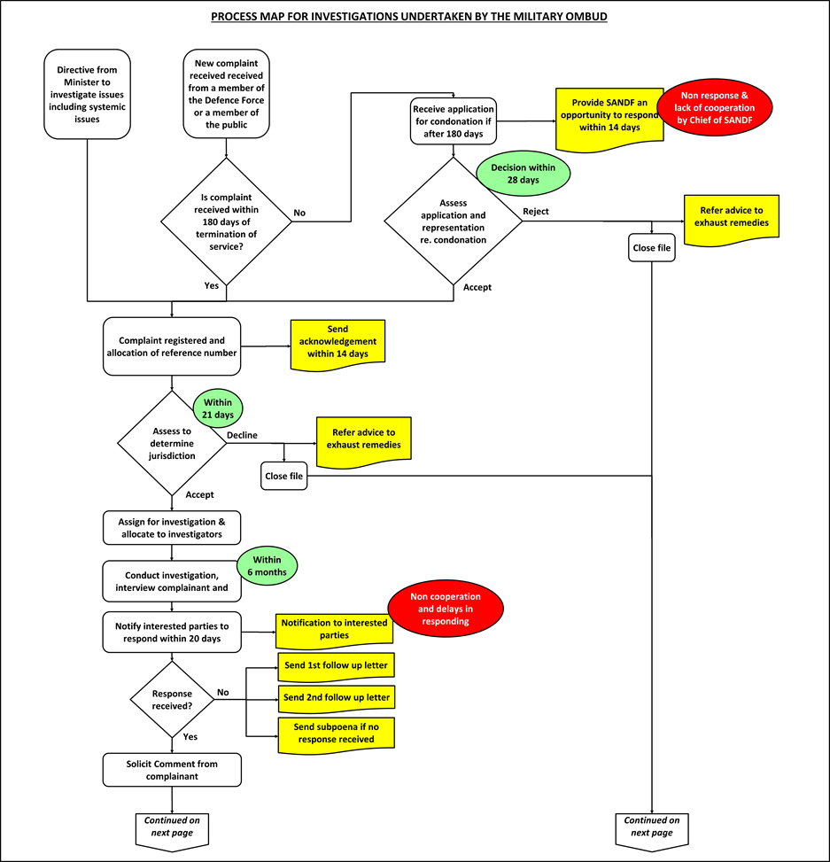
MODUS OPERANDI
Process Map for Investigations undertaken by the Military Ombud
Receive, register & allocate a reference number to the complaint.
Assess to determine jurisdiction.
Assign Intake Officer/Analyst or Investigator.
Interview complainant.
Notify interested parties.
Solicit comment from complainant.
Set matter down for conciliation with 20 days notice.
Conduct ADR/conciliation/mediation.
If successful draft a settlement agreement.
Submit report to MOD&ML.

Slide 15
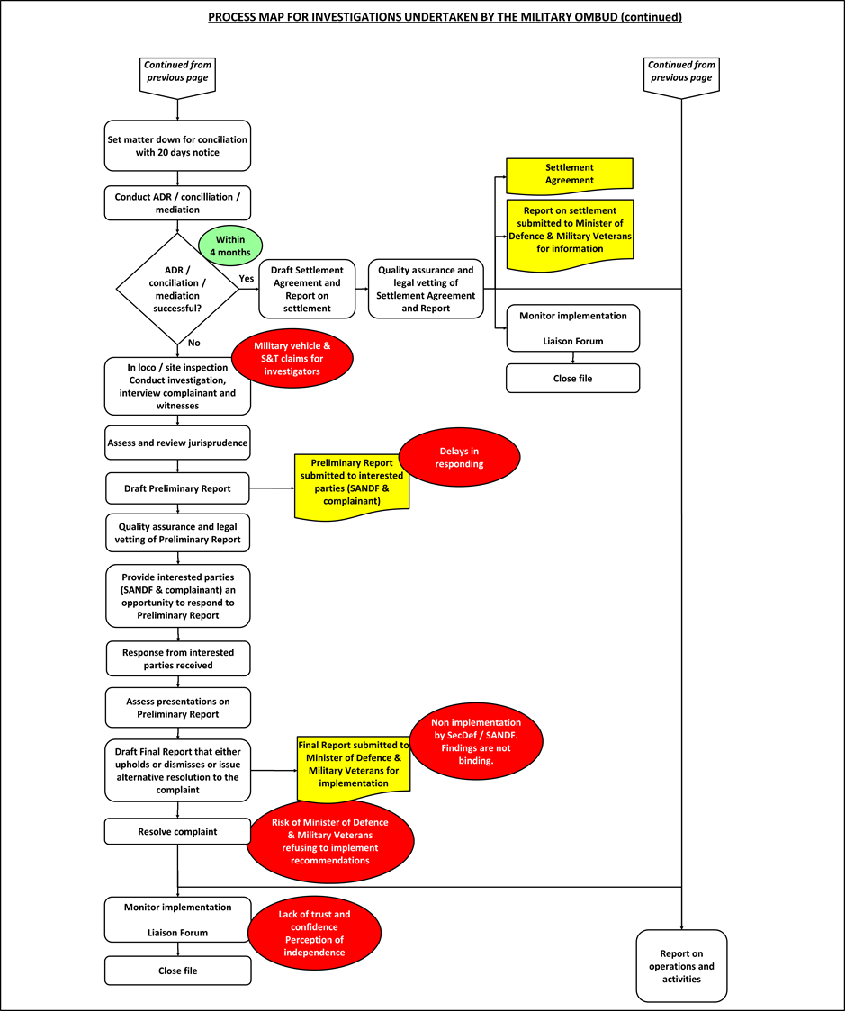
MODUS OPERANDI
ADR / Conciliation / Mediation Unsuccessful
Conduct investigations, interview complainant and witnesses.
Assess and review jurisprudence.
Preliminary report submitted to interested parties.
Final report send to MOD&MV
Resolve complaint.
Monitor implementation.

Slide 16
PERFORMANCE INFORMATION
Performance Indicator | Audited/Actual Performance |  |  | Estimated Performance | Medium-Term Projections and Sources of Verification
 | 2015/16 | 2016/17 | 2017/18 | 2018/19 | 2019/20 | 2020/21 | 2021/22
a. | b. | c. | d. | e. | f. | g. | h.
Percentage of written complaints finalised within the Office of the Military Ombud. | 50% | 60% | 83% | 75% | 75% | 75% | 75%
Total Carried Over Cases – 233
Total Cases Received in the FY – 250
Total Number of Cases – 483
Total Number Finalised - 365
Complaints Submitted per Category
Promotion, Demotion and Career Intervention – 71
Utilisation and Placement – 97
Service Benefits and Working Environment - 75
Education, Training and Development – 13
Remuneration – 122
Grievance/Disciplinary Procedures - 21
Service Terminations – 100
Other – 13
Official Conduct of Member of the SANDF - 13
Total Carried Over Cases – 192
Total Cases Received in the FY – 607
Total Number of Cases – 799
Total Number Finalised - 664
Total Carried Over Cases – 118
Total Cases Received in the FY – 310
Total Number of Cases – 428
Total Number Finalised - 236
Total Carried Over Cases – 135
Total Cases Received in the FY – 390
Total Number of Cases – 525
Total Number Finalised - 246

Slide 17
PERFORMANCE INFORMATION
FINANCIAL YEAR (FY) | COMPLAINTS RECEIVED IN FY | TOTAL CASELOAD | TOTAL FINALISED | ACTIVE CASES AT FY END
2012-2013 | 307 | 307 | 117 | 190
2013-2014 | 301 | 491 | 219 | 272
2014-2015 | 279 | 551 | 318 | 233
2015-2016 | 250 | 483 | 365 | 118
2016-2017 | 310 | 428 | 236 | 192
2017-2018 | 607 | 799 | 664 | 135
2018-2019 | 390 | 525 | 246 | 279
2019-2020 | 120 | 399 | 116 | 283*
* NB= These depicts figures as at 14 August 2019 of the current financial year.

Slide 18
PERFORMANCE INFORMATION
FINANCIAL YEAR (FY) | COMPLAINTS RECEIVED IN FY | TOTAL CASELOAD | TOTAL FINALISED | ACTIVE CASES AT FY END
2012-2013 | 307 | 307 | 117 | 190
2013-2014 | 301 | 491 | 219 | 272
2014-2015 | 279 | 551 | 318 | 233
2015-2016 | 250 | 483 | 365 | 118
2016-2017 | 310 | 428 | 236 | 192
2017-2018 | 607 | 799 | 664 | 135
2018-2019 | 390 | 525 | 246 | 279
2019-2020 | 120 | 399 | 116 | 283*
* NB= These depicts figures as at 14 August 2019 of the current financial year.

Slide 19
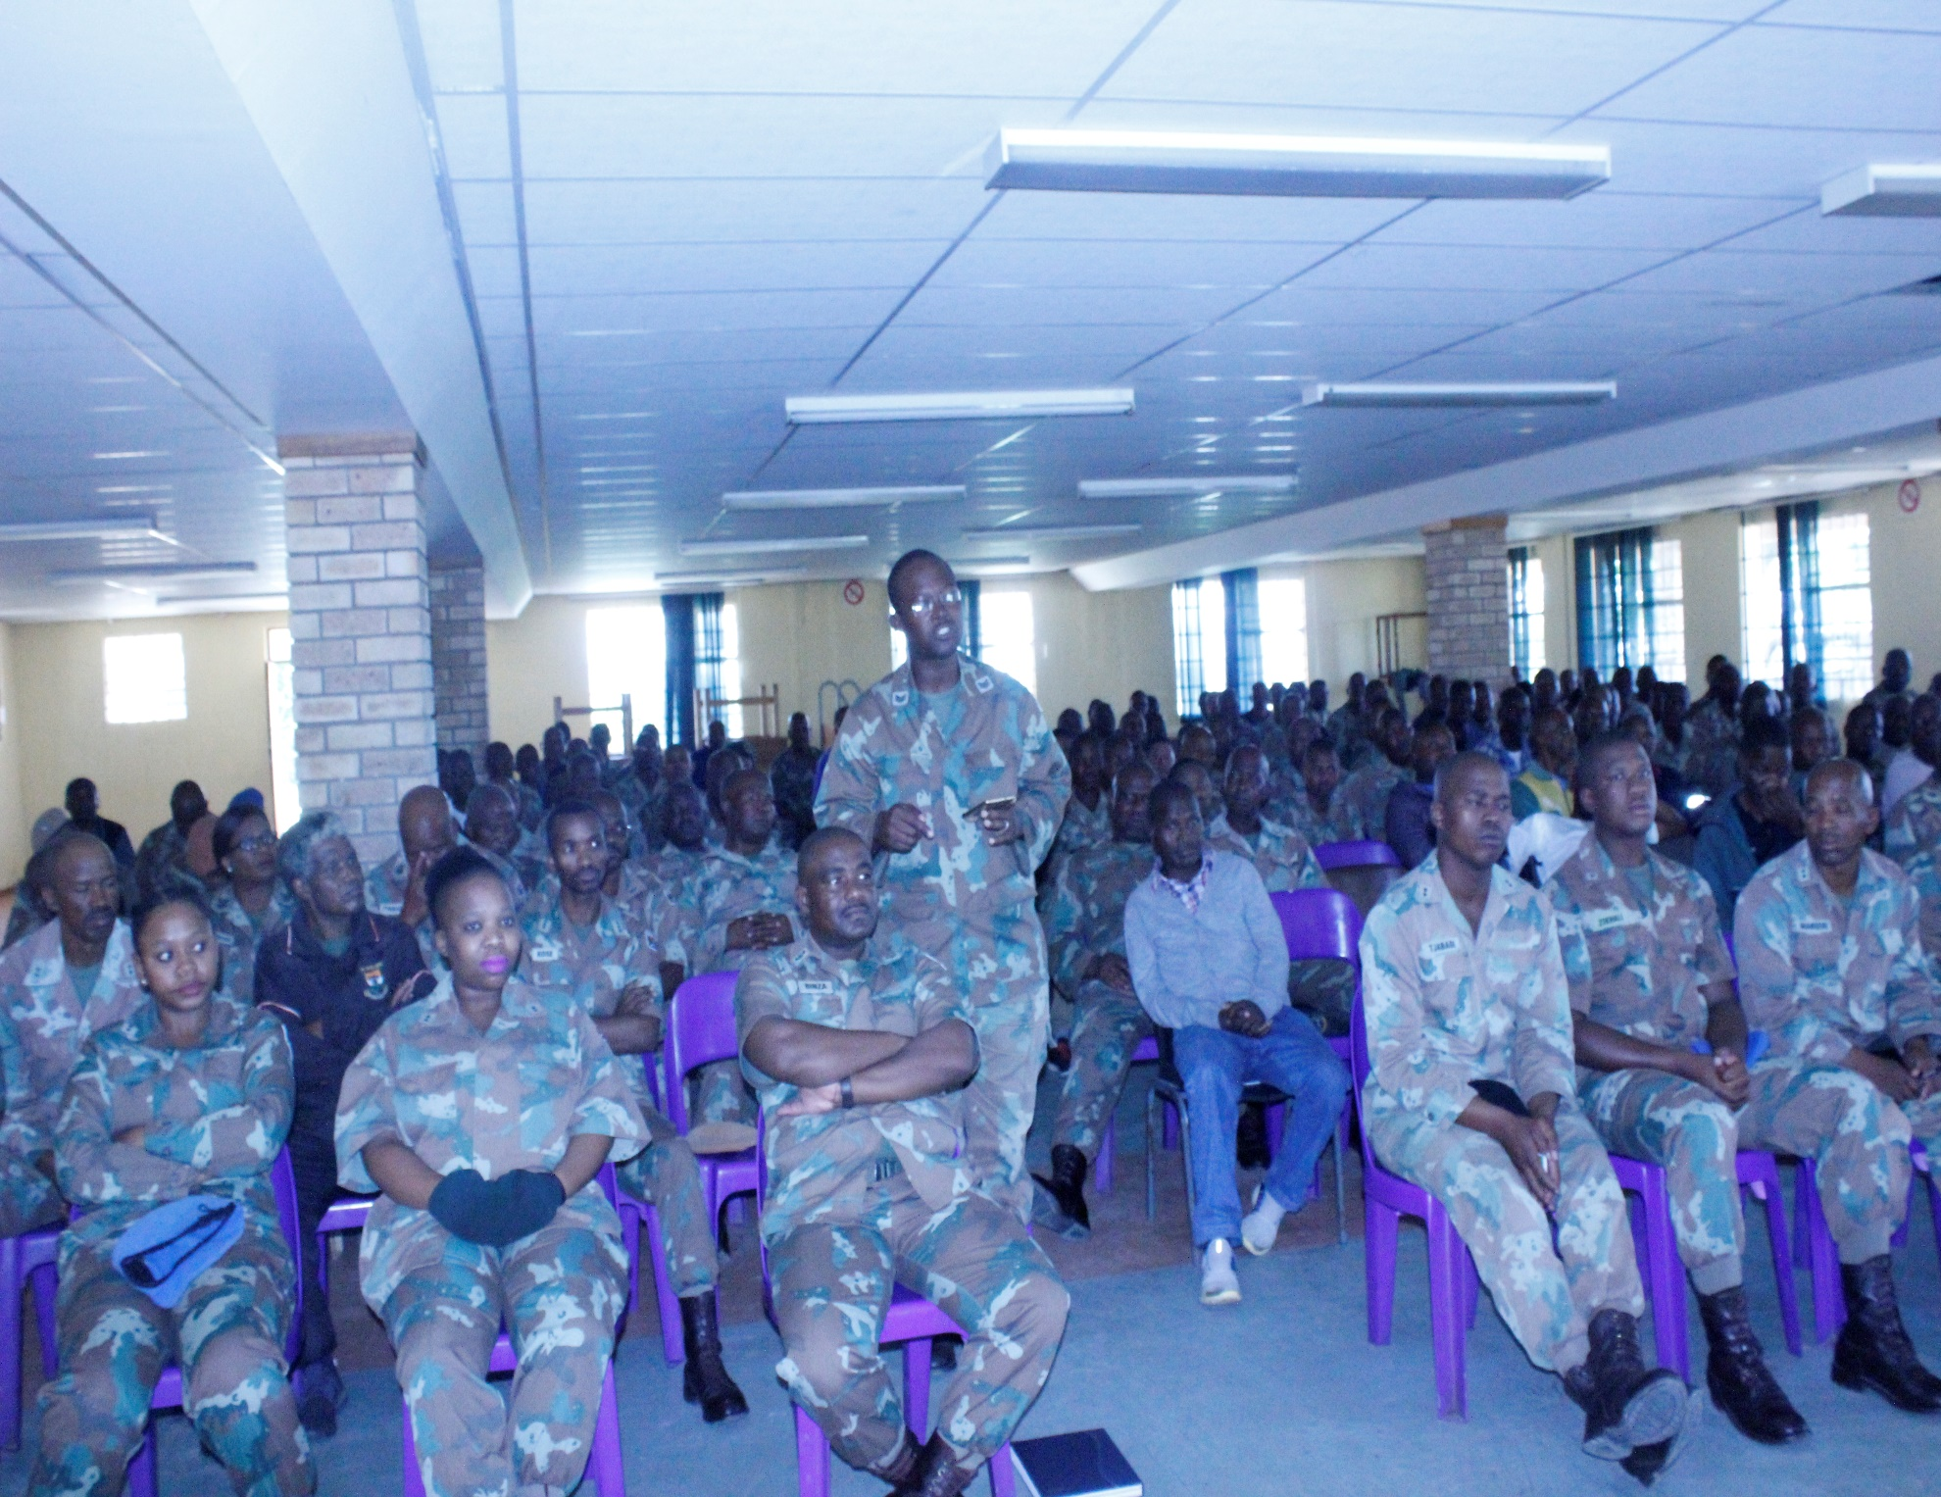
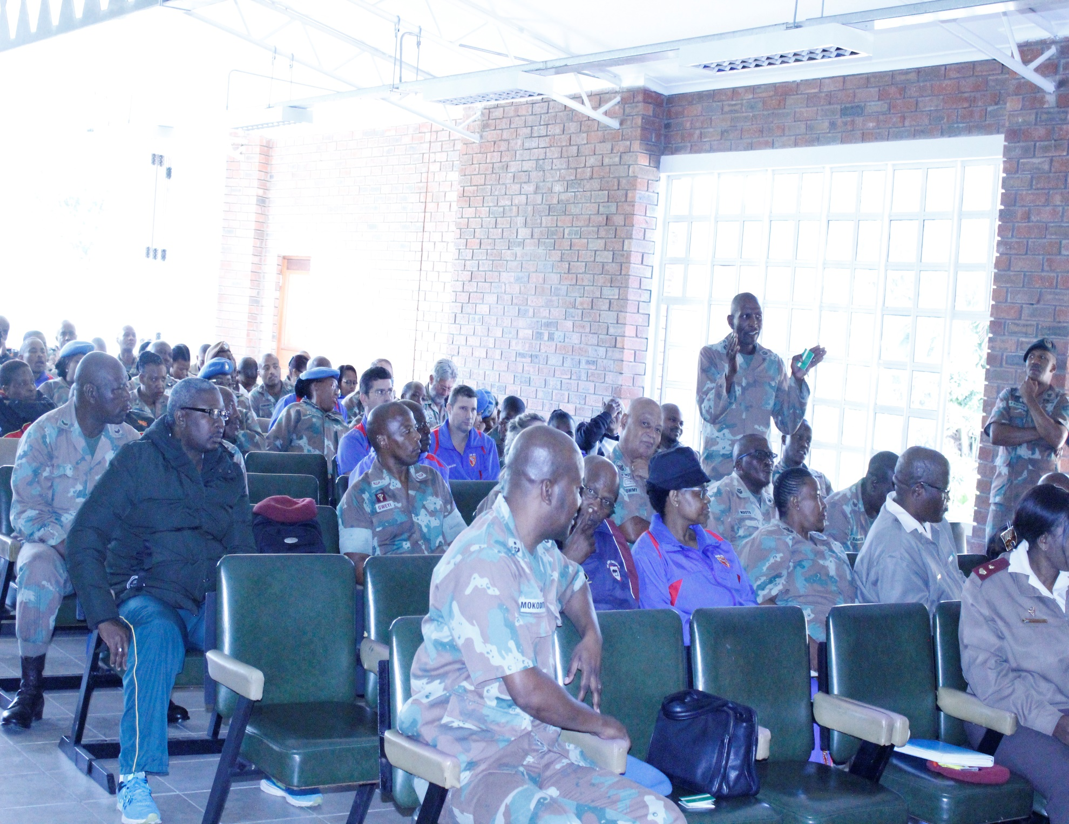
OUTREACH
The Military Ombud has conducted a number of outreach to members over the 7 year period covering a number of military bases across all regions

Slide 20
MEMORANDUM OF UNDERSTANDING (MOU)
MOUS WITH RELEVANT STAKEHOLDERS
The Military has to date concluded a number of MOUs with relevant stakeholders in order to facilitate co operation and collaboration e.g
CSANDF and SecDef
Defence Service Commission
Public Protector South Africa
Public Service Commission
South African Human Rights Commission
Commission for Gender Equality
South African Police Services
Commission for Rights of Cultural, Religious & Linguistic Communities
Government Pension Administration Agency
South African Health Ombud

Slide 21
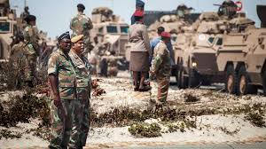
CONDITIONS OF SERVICE
Conditions of service bear the same meaning assigned to it under section 1 of the Defence Act No, 42 of 2002 as amended.
Section 1 of the Defence Act defines Conditions of Service to include the following:
Recruitment procedures, advertising and selection criteria;
Appointment and appointment processes;
Job classification and grading;
Salaries, allowances and service benefits;
Job assignments;
Working environment and facilities;
Education, training and development;
Performance evaluation systems;
Promotion;
Transfers;
Demotion;
Grievance and grievance procedures;
Dismissal;
Scarce skills:
Pay progression;
Deployment benefits;
Tools of trade;
Accommodation; and
Any other matter pertaining to conditions of service.

Slide 22
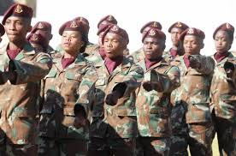
TIMEFRAMES FOR LODGING OF COMPLAINTS
A complaint must be lodged with the Ombud:
By a member/representative within a period of 180 days from the date on which the Grievance Board made its decision regarding his or her grievance known;
By a former member, within a period of 180 days from the date on which he or she became aware of the issue that gave rise to the complaint; and
By a member of the public who wishes to complain about the official conduct of a member of the Defence Force, within a period of 90 days from the date on which he or she became aware of the act or omission concerned.
Adhere to the Internal Grievance Regulations (IGR).

Slide 23
TIMEFRAMES FOR LODGING OF COMPLAINTS
Unit OC: 20 days (40 working days exceeded);
Formation Officer Commanding: 10 days (20 working days);
Chief of Service: 20 days (40 working days);
Grievance Board: 30 days (60 working days exceeded);
The Secretary for Defence or the Chief of the SA National Defence Force must, within 10 working days after receipt of the recommendation of the Grievance Board from the secretariat, take a decision whether or not to ratify the recommendation of the Grievance Board.
The Military Ombud Office has developed the following criteria to assume jurisdiction over complaints that are not finalised within timeframes as provided for by the Individual Grievance Regulations 2010 as amended:
NB: Total number of days is 80 for the grievance to be finalised.

Slide 24
TIMEFRAMES FOR LODGING OF COMPLAINTS
The Ombud may condone the late submission of a complaint after consideration of the information and taking into account reasons of late submission.
The Office must inform the Complainant of the outcome of their application within 28 days of receipt thereof.

Slide 25
CASE STUDY
TERMINATION OF SERVICE
The Complainant is a former member of the SANDF. He lodged his complaint with the Military Ombud requesting to be re-instated and he was also questioning the manner in which his court case was trialled.
He alleged that he was arrested on 09 March 2004 at Waterkloof Air Force Base by the Military Police with 16 pairs of stolen shoes worth R4000.00. He further alleged that he was detained in SAPS police cells instead of Military Detention Barracks.
He was sentenced by the magistrate court to 3 years direct imprisonment and was subsequently released in July 2015 on parole.
He alleged that he served his sentence with dangerous criminals as a result of being trialled by a magistrate instead of a Military Judge.
He then requested the Military Ombud to assist him in obtaining appointment in the SANDF, as he has not committed any crime during the past 10 years.
The Complaint was assessed and it was established that his case was dealt with by a civilian court.
The complaint was dismissed in terms of section 7 (1)(c) of the Military Ombud Act 4 of 2012
Independent and Impartial

Slide 26
CASE STUDY
SALARY PAY-OUT
Complainant was a member of the Defence Force who retired as a Lieutenant Colonel (Lt Col).
While on service she was placed as a deputy manager nurse (PN-B4) from 01/02/2011 until at the time of her retirement on 31/10/2013. She retired on salary level PN-B4.
The investigation conducted found that the Complainant was supposed to be placed on salary level PN-A1, when the OSD Policy was introduced or came into effect. As such, her pension benefits pay-out were affected upon her retirement.
A commitment was received from SAMHS for the rectification and payment of the Complainant the OSD difference, as per the findings. On 06/09/2018, the Complainant was paid the difference of her OSD remuneration for the period 01/07/2007 to 31/10/2013.
As such, the complaint was resolved in terms of section 6 (6) (b) of the Military Ombud act 4 of 2012.
The complainant was paid in excess of over a million.
Independent and Impartial

Slide 27
CHALLENGES / CONCLUSION
The Office of the Military Ombud has identified the following challenges:
The Military Ombud Act remains a challenge due to the absence of addressing the governance and accountability framework.
Non-compliance to the Military Ombud Act wrt the “monies appropriated by Parliament”
Independence of the Office is at risk, due to the current placement of the Office.
Funding remains a challenge as the Office is still in establishment mode and therefore requires additional funds.

Slide 28
HOW TO
CONTACT US
Physical Address: Block C4, Eco Origin, 349 Witch-Hazel Ave, Highveld Centurion
Postal Address: SA Military Ombud, Private Bag X163, 0046
Tel: +27 12 676 3800
Fax: +27 12 661 2091
Toll Free: 080 726 6283 (080 SA OMBUD)
E-mail: intake@milombud.org

Slide 29
FIND US ON
SOCIAL MEDIA PLATFORMS
South African Military Ombud
South African Military Ombud
@Mil_OmbudSA
Independent and Impartial

