Slide 1

Portfolio Committee on Communications
A Presentation on 5th Parliament Legacy Reports
20 August 2019

Slide 2
Contents
Economic Outlook
Legacy
  Emerging Challenges
  Issues for Follow-up
  Going Forward
4th Industrial Revolution (Video)
Country ICT Statistics

Slide 3
Economic Outlook
South Africa's unemployment rate has increased by 1.4% in the second quarter of 2019 to 29%, the highest level since the first quarter of 2008,
The unemployment rate for females was 31,3% and remains higher than that of males

Slide 4
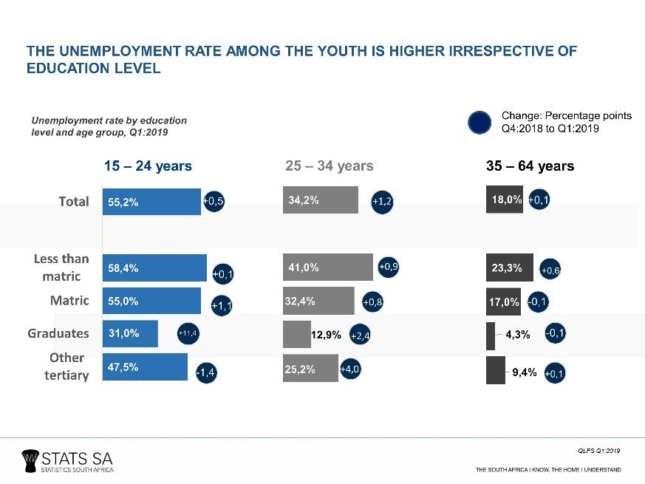
Economic Outlook
Notes:
The youth aged 15–24 years are the most vulnerable in the South African labour market. In the 1st quarter of 2019, the unemployment rate among this age group was 55,2%
Youth aged 15–34 years account for 63,4% of the total number of unemployed persons

Slide 5
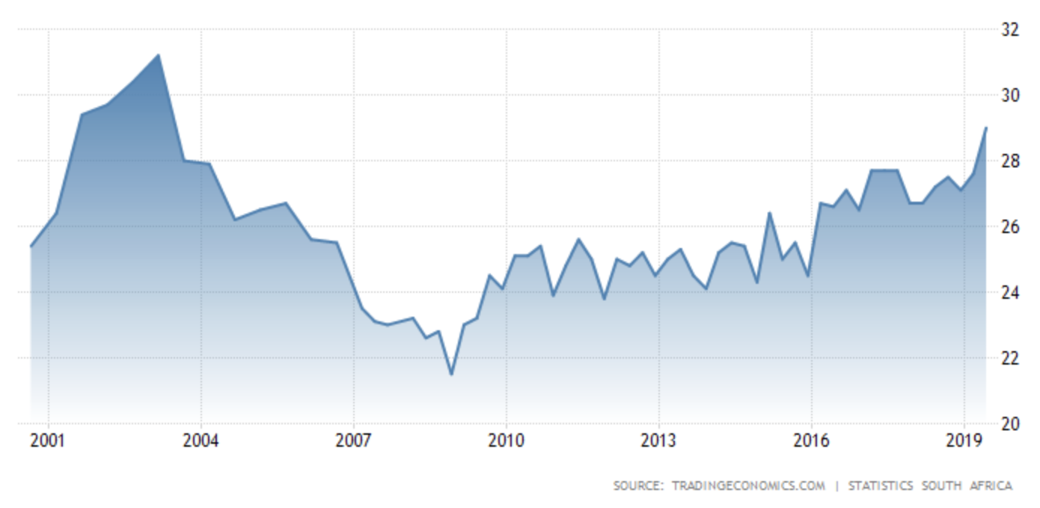
Unemployment
‘the economy is generally absorbing only one in two potential workers (52.5%), if the economy’s current malaise persists, the unemployment rate will continue to rise’ (Adcorp CEO, Innocent Dutiro)
Notes:
Unemployment rate last hit over 28% in 2003. An unemployment rate of 27.1%, which is one of the highest rates in the world (2018)
What must the country do more to absorb young people into the workforce?
Is the country prepared for a technology-driven world?
There is a need for a significant revaluation of the current education system to ensure necessary skills are produced for a 4IR economy.
The labour force is currently growing by around 101,000 people per quarter, whereas the economy is creating on average 53,000 jobs per quarter.

Slide 6
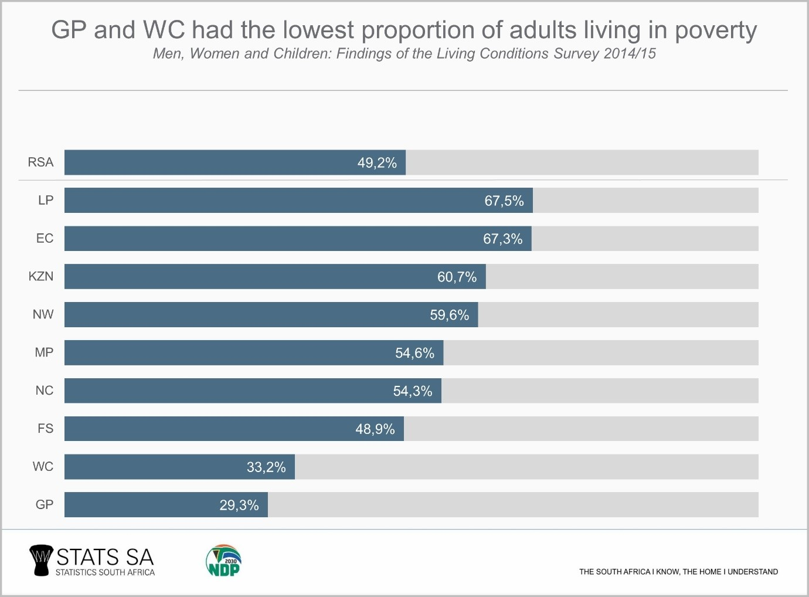
Unemployment
Notes:
Approximately half (49,2%) of the adult population are living below the upper-bound poverty line (Statistics South Africa, 2019). That is 1 in 3 South Africans that live in poverty. Severity of poverty measures were larger for female-headed households compared to households headed by males. This is despite that women make up a larger percentage of RSA population. The value of diversity is even more important aside from this statistic.

Slide 7
Economic Downturn
Greater political stability under the leadership of Cyril Ramaphosa and his reforms coupled with strong global growth is expected to grow the local economy to almost 3%
The South African economy slumped sharply in the first three months of 2019, contracting by 3,2%.
RECESSION???
Notes:
BusinessTech Article January 2019: (https://businesstech.co.za/news/business/292530/south-africas-economic-forecast-for-2019-and-whats-driving-the-rand-right-now/)

Slide 8
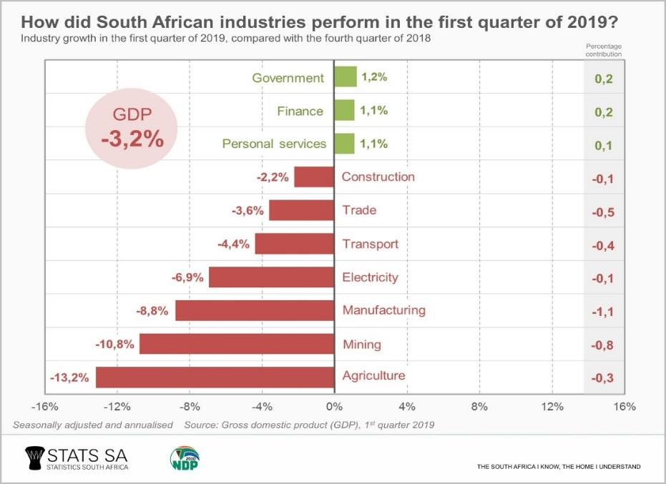
Economic Downturn

Slide 9
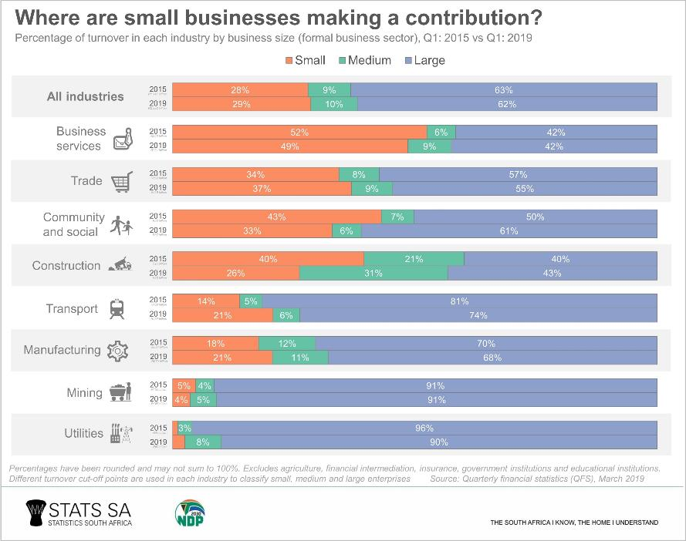
Economic Downturn
Notes:
The entire formal business sector generated R2,39 trillion in turnover in Q1: 2019. Out of this amount, large businesses contributed 62%, followed by small (29%) and medium sized businesses (10%)

Slide 10
Global Competitive Index
Notes:
According to National Treasury, policy inertia, poor implementation capacity and a deterioration in the relationship between government and the private sector have reduced South Africa’s global competitiveness.
South Africa has fallen from 44th (2007) to 67th (2018) on the Global Competitiveness Index. And between 2008 and 2018, South Africa’s ranking fell from 35th to 82nd in the World Bank’s Ease of Doing Business report.
Rapid Reforms are key and for RSA it is a reflection of the inability to implement key reforms, i.e. spectrum policy

Slide 11
Economic Downturn
In the last few years‚ the South African economy has significantly underperformed
Growth has lagged behind global and other emerging markets
GDP has grown slower than the population growth for five consecutive years

Slide 12
Economic Downturn
The South African economy experienced sharpest quarterly decline since Q1 2009 mainly reflecting the effects of Eskom's power cuts on manufacturing and mining
Weak economic growth and uncertain revenue collection
Notes:
worst performance in a decade
Source: Stats SA and South African Reserve Bank
National Treasury said in its 2019/20 annual performance report

Slide 13
Economic Downturn
State-owned companies including power utility Eskom, arms-maker Denel, SABC and airline SAA have asked the government for additional bailouts to ensure they can continue operating

Slide 14
Economic Downturn
"Inefficient and poor-quality service delivery‚ poor education outcomes‚ poor productivity‚ inequality and unemployment. The recent economic performance requires an acceleration of government's efforts to address constraints to growth."
Finance Minister Tito Mboweni
Notes:
Budget Vote Speech by Minister of Finance Mr Tito Mboweni, 11 July 2019

Slide 15
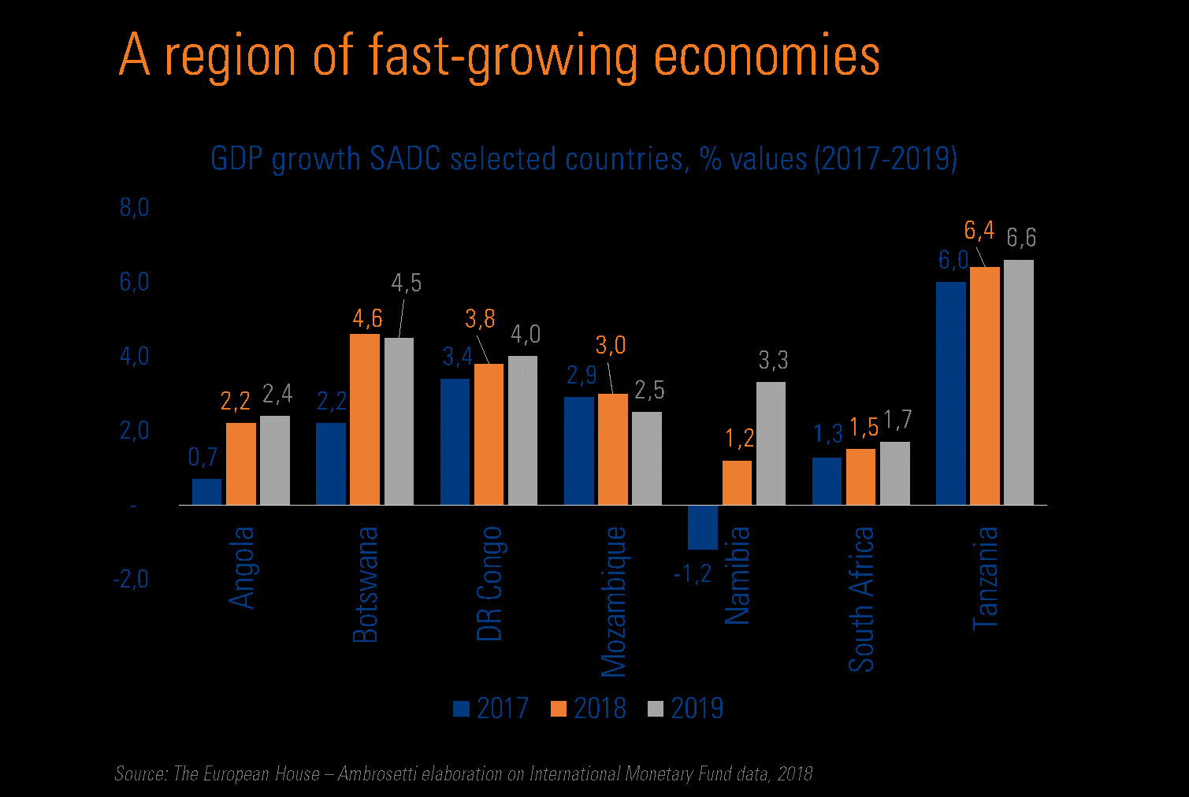
Economic Downturn
Economic and employment growth rates compared to National Development Plan targets (2000 to 2016)
The South African economy experienced sharpest quarterly decline since Q1 2009mainly reflecting the effects of Eskom's power cuts on manufacturing and mining
‘an annualized 3.2% on quarter in the three months to March of 2019.’
Notes:
While it is the largest economy of the region, South Africa lags far behind other countries in terms of GDP growth in the selected SADC countries

Slide 16
PCC 5th Parliament
Proclamation No. 43 of 8 July 2014 gave effect to the establishment of the new Department of Communications;
Proclamation No. 47 of 15 July 2014 to transfer the administration of legislation and entities from one Minister to another in terms of section 97 of the Constitution; and
The new Department was established or formed predominantly out of the old GCIS
Notes:
Following the general elections in May 2014, President Jacob Zuma announced the establishment of a new Ministry of Communications.
The proclamation also referred to the reshuffling of the entities that historically reported to one Department while other entities reported different Departments during 4th Parliament.
DoC was to be responsible for overarching communications policy and strategy, information dissemination and publicity as well as the branding of the country abroad. Improved communication and marketing will promote an informed citizenry and also assist the country to promote investments, economic growth and job creation

Slide 17
Sector During 5th Parliament
GCIS (Department of Communications) | Department of Telecommunications and Postal Services
South African Broadcasting Corporation (SABC) | SAPO
Film and Publications Board (FPB) | SENTECH
Media Development and Diversity Agency (MDDA) (MDDA) | USAASA
Independent Communications Authority of South Africa (ICASA) | Ikamva e-Skills Institute
 | SITA
BrandSA (BSA) | .ZDNA
Notes:
Effected in April 2015
In terms of the Proclamation DoC assumed the functions and budget vote of the former Government Communications and Information Systems (GCIS)
GCIS was re-established as a schedule 1 national Department from 1 April 2015
Film and Publications Board (FPB) which formerly reported to the Department of Home Affairs and was under Budget Vote Four (4)
Brand SA (BSA) which was located in the Presidency under Budget Vote One (1), were integrated to form part of the new Department of Communications (DoC)
SITA reported to the DPSA

Slide 18
PCC Key Highlights
The Committee held an inquiry and resolved that Ms Tshabalala be removed as a member and Chairperson of the SABC Board. Ms Tshabalala resigned as a Board member on 17 December 2014

Slide 19
PCC Key Highlights
Concluded the Films and Publications Amendment Bill (2016/17)
Established the SABC Adhoc Committee
The Committee recommended that Mr Mohlaloga be removed as a Councillor and Council Chairperson of ICASA and he was accordingly removed on 19 March 2019

Slide 20
PCTPS Key Highlights
Convention of African Telecommunications Union (ATU)
Final Acts of the Plenipotentiary Conference on the International Telecommunications Union (ITU) (2017)
Notes:
The committee adopted the following two international agreements on 24 January 2017

Slide 21
PCTPS Key Highlights
Electronic Communications Amendment Bill (2018) (withdrawn)
Postal Services Amendment Bill (2018) (not completed)
The Committee processed the iKamva National e-Skills Institute Bill (2018)

Slide 22
PCC Key Emerging Challenges
Parliament tight programming
The Ad hoc Committee into the Fitness of the SABC Board
Digital Terrestrial Television (DTT)
Leadership instability at both departments
Notes:
Made it difficult for the Committees to conduct thorough oversight of all the entities albeit that for the PCC, the SABC received far more attention than other entities because of their dire financial position.
was a culmination of extensive engagement between the Department, SABC and the Committee. To this end, and even after the successful inquiry, the SABC remains in a compromised state to deliver on its mandate. For 6th Parliament, it will be important that the recommendations stemming from the inquiry are responded to in full so that the Committee can report back to National Assembly.
Only 2 Joint Committee Meetings were hosted during the Term

Slide 23
PCC Key Emerging Challenges
Tools of Trade
Effective tracking of Committee recommendations
Change of Committee Members
Study Tour
Notes:
A challenging period of operating without adequate tools of trade and support staff such as a researcher, a dedicated communications officer and a dedicated Law Advisor made it difficult for the committees to conduct their work, PCTPS did not have a CAD for a long period
The PCC had a total 5 Chairpersons during 5th Parliament, an indication reflective of the instability of leadership. PCTPS had 3 in total of which 1 was in acting capacity for a very long time
The South African legislative and regulatory environment need to be responsive to the ICT sector. And the legislative burden will continue to grow as the sector evolves. It is important for members to evaluate how Parliament can be conducive to supporting the growth of this important sector, especially with 4IR as a future economic driver. The purpose of a Study Tour therefore would be to gain further insight on how to transform legislative environment to be efficiently responsive to the ever-evolving sector such as the ICT.

Slide 24
Issues for Follow-up
Monitoring of the change in institutional arrangements of the Department and its entities and the impact to sector legislative, policy and regulatory instruments.
Review of the Broadcasting policy for the country (in support of public broadcasting)
Notes:
On 6 and 7 September 2018 the Department of Communications hosted the South African public broadcasting policy review colloquium, bringing together government stakeholders, public and private sector interest groups and civil society organisations to engage on issues impacting the SABC and provide insights into policy recommendations ahead of planned changes to the SABC.

Slide 25
Issues for Follow-up
Oversight on the review of the Digital Terrestrial Television Policy for South Africa
Oversight on general review of the sector policy and regulatory regime in light of the ongoing disruptive technologies

Slide 26
Issues for Follow-up
The ECA Bill has many technical issues
  Workshops and a study tour to ensure that members are familiar with the content.
Oversight on Broadband For All policy targets
Oversight on Audio-visual and digital content strategy
Adequate support staff, including a Researcher, dedicated Communications Officer and Legal Adviser
Notes:
Particular focus on Oversight visits at USAASA project sites by PCTPS during 5th Parliament (Uptake and Usage)
Study tour among other priorities to support Parliament’s state of readiness towards stimulating 4IR

Slide 27
PCC Going Forward
Systematization of Tracking
Recommendations must always be time-bound
Programming of PCCDT meetings must include presentation of responses to Committee recommendations in a systematic manner

Slide 28
PCC Going Forward
Systematization of Tracking
Department must provide extensive reporting on recommendations of Committee oversight trips
Development of an ICT-based tracking system
Extend invite to Committee on all public hearings of Department

Slide 29
Oversee the implementation of the Spectrum policy directives
Protect the independence of the Regulator, (efficiency and funding)
Strive for a clean audits
PCC Going Forward
7 auditees
6 auditees
6 auditees

Slide 30
Education, re-education and skills development, reskilling
Pooling of State resources
Promote entrepreneurship to promote innovation
Gender balance in the sector
Encourage (incentivize) corporate investment in rural areas
PCC Going Forward
7 auditees
6 auditees
6 auditees
Notes:
Entrepreneurship is fundamental to 4IR in as far as creativity, innovation, localisation and adoption of technological solutions. Thereby developing a localised digital ecosystem. This will require our government and policy makers to be both innovative and experimental in order to navigate between opportunities and challenges of the digital age .
‘The growth and influence of the open source community have driven software to the centre of global innovation. Africa should invest more in open source software expertise and skills. India and China employed this strategy and have been catapulted into the global technology ecosystem.’ https://www.ee.co.za/article/south-africa-must-reorganise-for-future-world-radio-conferences.html. South Africa is part of the Brics, and has reputable bilateral agreements with countries such as Brazil with a strong focus on promoting FOSS technologies. Fully interoperability and open systems to foster innovation is paramount. Also to avoid incompatibility as an indirect benefit.
According the Institute of Information Technology Professionals South Africa (IITPSA) only 20% of the overall number of employees working across all levels of the ICT sector are women

Slide 31
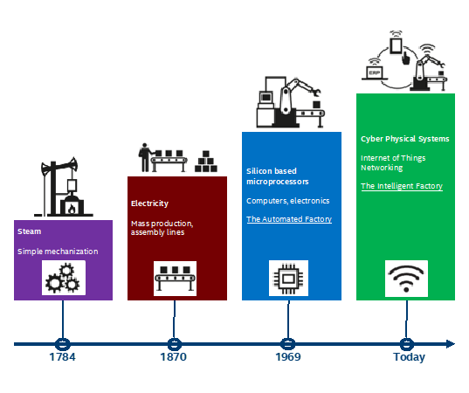
What is 4IR?
7 auditees
6 auditees
6 auditees

Slide 32
What is 4IR?
African policymakers must therefore strike a balance between managing the impact of new technologies in order to benefit as much as possible from traditional manufacturing-based development models, and embracing the new opportunities that stem from technological advances. Identifying the right mix of policies for each country will be critical, particularly in view of Africa’s economic, political, and demographic diversity.
Notes:
Wealth inequality is worsening, and new technologies threaten to aggravate that trend.
The Fourth Industrial Revolution represents a fundamental change in the way we live, work, and relate to one another.
https://www.project-syndicate.org/commentary/africa-digital-revolution-adaptive-government-by-kartik-akileswaran-1-and-georgina-hutchinson-1-2019-08
Policy intended effects in practice is difficult because the problems are complex in nature and policy implementation cannot be preceded by uncertainty.

Slide 33

What is 4IR?
7 auditees
6 auditees
6 auditees

Slide 34
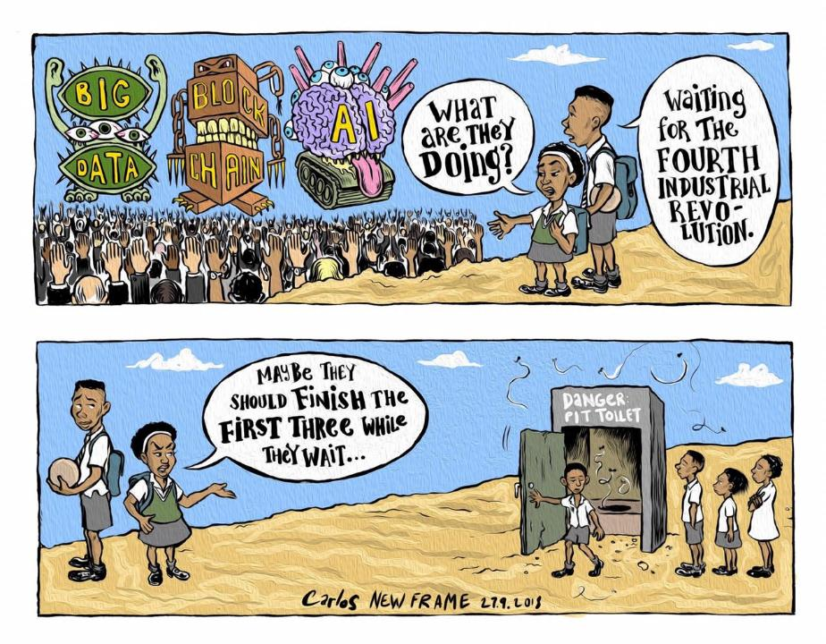
Corporate investment in rural areas
7 auditees
6 auditees
6 auditees
Notes:
https://www.newframe.com/writer/carlos-amato/

Slide 35
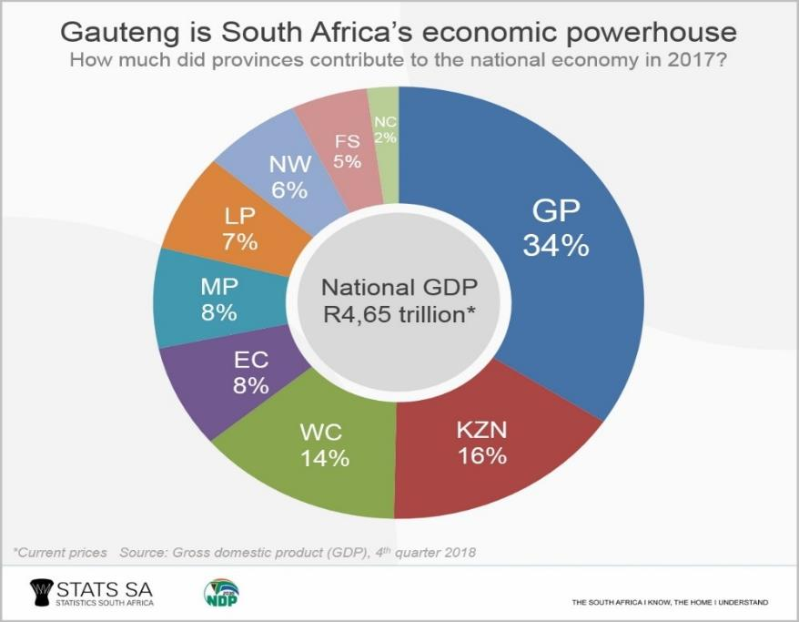
7 auditees
6 auditees
6 auditees
Notes:
Local economic reality

Slide 36
Source: GHS 2019
7 auditees
6 auditees
6 auditees
Notes:
Rural provinces are taking a backdrop in ICT adoption

Slide 37
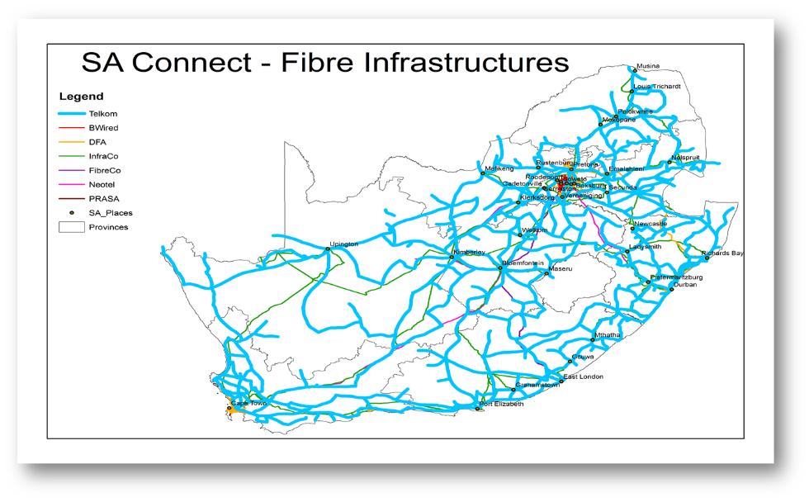
Source: DTPS, 2018
7 auditees
6 auditees
6 auditees
Notes:
In terms of Broadband Infrastructure (BBI), there is 4 692km of fibre layout across South Africa

Slide 38
Percentage of Households with Access to the Internet at Home, or for Which at Least One Member has Access to, or Used the Internet by Province, 2017
Source: GHS, 2018
7 auditees
6 auditees
6 auditees
Notes:
For one thing, any attempt to embrace new technologies requires super-fast, reliable, and affordable connectivity – including for those at the bottom of the pyramid, (https://www.project-syndicate.org/commentary/africa-digital-revolution-adaptive-government-by-kartik-akileswaran-1-and-georgina-hutchinson-1-2019-08)

Slide 39
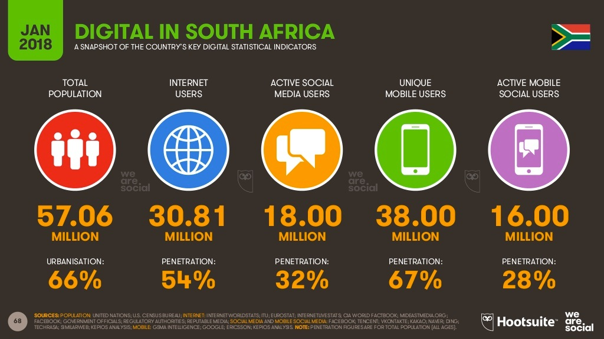
Source: StatsSA 2017
7 auditees
6 auditees
6 auditees
Notes:
MyBroadband, Internet penetration in South Africa, 9 February 2018

Slide 40
Notes:
2018 Study by ITU: Economic contribution of broadband, digitization and ICT regulation Econometric modelling for Africa
Corporación Andina de Fomento (CAF) Development Bank of Latin America

Slide 41
7 auditees
6 auditees
6 auditees
Notes:
With approximately over 26 000 schools in South Africa, this number of school connected is not significant enough to can have an impact. It is evident that there needs to be a concerted effort to connect more schools, especially those located in rural areas

Slide 42
SA’s cheapest prepaid mobile 1GB baskets compared to Africa’s top performers (USD)
7 auditees
6 auditees
6 auditees
Notes:
Source: RAMP Index, 2018: According to State of ICT in South Africa Report by Gilwald, South Africa performed poorly in prepaid mobile 1GB data prices, coming 35th out of 49 African countries in Q1 2018, five spots lower than its ranking in Q3 2017

Slide 43
Percentage of individuals who do not have access to the Internet, by income group (ZAR)
7 auditees
6 auditees
6 auditees
Notes:
The price to communicate in South Africa, is not affordable to the majority and is divided along income. Even those with access are limited to use the Internet because of the costs associated with Internet access, (Gilwald et al., 2018).
There is a significand and direct correlation between smartphones and the Internet; and individuals from wealthy households are more likely to own and use ICT devices. It is clear from the Table on next page that inequality continues to be fueled by income disparities with the poor being the hardest. (Gilwald 2018)

Slide 44
7 auditees
6 auditees
6 auditees
Notes:
Furthermore, there exists a gap between individuals in rural and urban areas in terms of Internet Activities with urban dwellers dominating use. There is also a gender gap in Internet related activities with more females using the Internet for social networking and job searching, (Gilwald, 2018).
Only 20% of the overall number of employees working across all levels of the ICT sector are women, according the Institute of Information Technology Professionals South Africa (IITPSA), (Sibahle Malinga, ITWeb 08 August 2019)

Slide 45
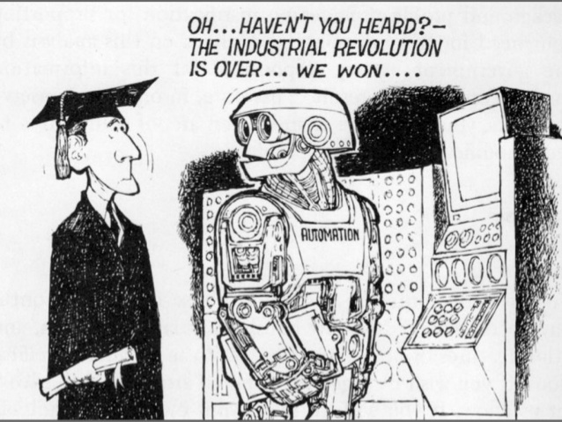
7 auditees
6 auditees
6 auditees

Slide 46
Disrupted Industries
Automotive: Uber/Taxify/In-Driver/driverless cars
Financial: Bitcoin/Libra/TurboTax/PayPal
Human travel agents: Expedia
Print Media: digital media i.e. blogs as new form of journalism, Wikipedia etc.
Health

Slide 47
Cryptocurrency
an online payment system
The bitcoin system works without a central repository or single administrator, so is the worlds first decentralized digital currency, and it is the largest of its kind in terms of total market value. There is no company or entity controlling bitcoin.
Facebook promises that the Libra system will be able to process 1,000 transactions per second, be user-friendly, and have a transaction cost of virtually zero. Run by a corporation, not a central bank
Notes:
The past four years have seen cryptocurrencies become ubiquitous, prompting more national and regional authorities to grapple with their regulation especially when considering opportunities that cryptocurrencies may create for illegal activities, such as money laundering and terrorism
Globally, about 1.7 billion adults remain unbanked, technology firms are in the driver’s seat now, policymakers and regulators should prepare accordingly and use digital currencies to bank the poor

Slide 48
Mbombo Maleka (CAD)
mmaleka@parliament.gov.za
7 auditees
6 auditees
6 auditees

