Slide 1
OVERBERG EDUCATION DISTRICT PRESENTATION TO
STANDING COMMITTEE
Heléne van Zyl
2019.08.20

Slide 2
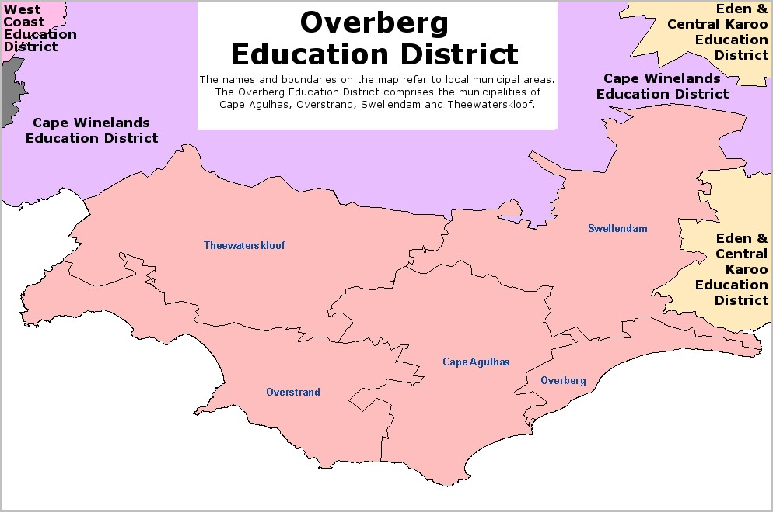
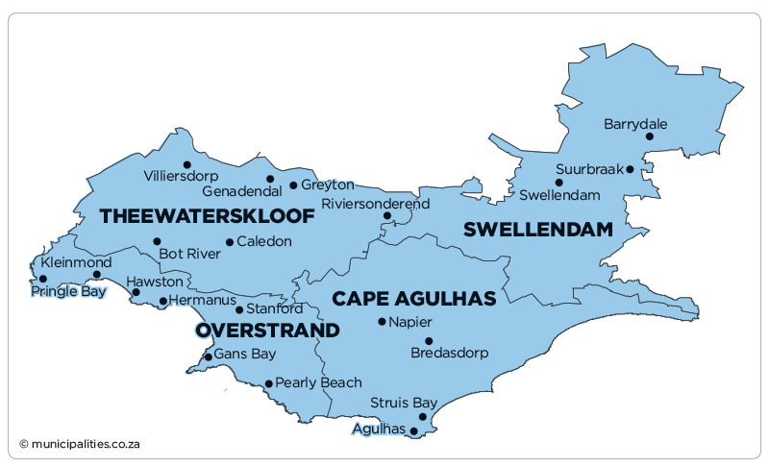
OVERBERG EDUCATION DISTRICT (OED) 3 CIRCUITS
The Overberg Municipal District cover approximately 12,241 square kilometres (4,726 sq mi) of the Western Cape Province. Examples of distances between Caledon to Barrydale (302 km return), Caledon to Gansbaai (144.4km return), and Caledon to L’ Agulhas (220.4km return)

Slide 3
OED: ACADEMIC RESULTS
 | 2016 |  |  | 2017 |  |  | 2018
GR | Wrote | Achieved | Pass Percentage | Wrote | Achieved | Pass Percentage | Wrote | Achieved | Pass Percentage
Gr 1 | 4410 | 3780 | 85.7 | 4330 | 3719 | 85.9 | 4242 | 3502 | 82.6
Gr 3 | 4004 | 3742 | 93.5 | 4178 | 3933 | 94.1 | 4204 | 3931 | 93.5
Gr 9 | 2700 | 2402 | 89.0 | 2743 | 2516 | 91.7 | 2758 | 2416 | 87.6
Gr 11 | 1963 | 1796 | 91.5 | 2192 | 1974 | 90.1 | 2263 | 1980 | 87.5
Gr 12 | 1698 | 1574 | 92.7 | 1769 | 1552 | 87.7 | 1899 | 1565 | 82.4
3

Slide 5
Learner : Teacher Ratio Public Ordinary
Total Schools 82 | Type of School | Small | Learner: Teacher Ratio | Medium | Learner: Teacher Ratio | Large | Learner: Teacher Ratio | Extra-Large | Learner: Teacher Ratio
20 | Multi-grade schools (Primary Schools) | 18 | 23.84 | 1 | 41.75 | 1 | 33.75
4 | Combined Schools |  |  | 2 | 33.74 | 2 | 34.64
38 | Primary Schools | 10 | 31.21 | 11 | 32.65 | 3 | 36.98 | 14 | 38.72
15 | Secondary Schools |  |  | 5 | 32.77 | 3 | 34.89 | 7 | 36.21
5 | Intermediate Schools | 1 | 21.5 | 1 | 30.67 | 2 | 33.09 | 1 | 35.10

Slide 6
OED: Infrastructure and Maintenance
Planned Scheduled maintenance (07 projects in current MTEF) | Planned New schools (10 projects over the next 10years) | Replacement schools (Over the next 10 years) | Identified hotspots & challenges | Other infrastructure projects
2019/20: Die Bron Prim. Greyton Prim. Vleiplaas NGK Prim. Bredasdorp Prim. 2020/21 De Villiers Graaff Prim. · Emil Weder Sek. Okkie Smuts Prim. | Umyezo Wama Apile SS (Grabouw SS) · Grabouw PS Zwelihle New PS (HERMANUS) · Caledon PS · Bredasdorp PS · Villiersdorp PS · Dennegeur PS · · Grabouw (PS2) · New High School in Hermanus Area · New Primary School in Fisherhaven · Kleinmond- New high School (To be Placed on UAMP | Replacement schools (5 Schools identified) Umyezo Wama Apile PS(In construction) · Qhayiya SS (Completed) · Swartberg PS · Struisbaai PS | Identified hotspots & challenges Grabouw & Hermanus: Extreme pressure No room for additional numbers in admissions 2020 in PS -Urgent need for new PS & HS – sites needed Talks with TWK and Overstrand Municipalities Grabouw: Upon completion of the replacement of UWA PS the school will split in 2 with half of the learners staying behind at the mobile decanting school. | Additions and Upgrades Agulhas SOS Gansbaai Academia Mount Pleasant PS Bredasdorp HS De Bron PS Upgrade of ablutions, Fencing Swellendam SS and Mount Pleasant PS , Grade R classrooms Replacement of Mispah LSEN with new facility that is centrally situated in the District. Purchase of leased schools: De Rust Futura Academia – Agriculture focus school with Hostel

Slide 7
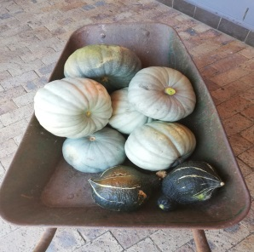
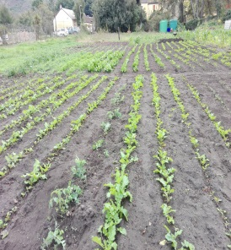
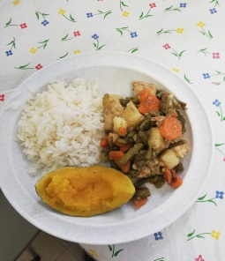
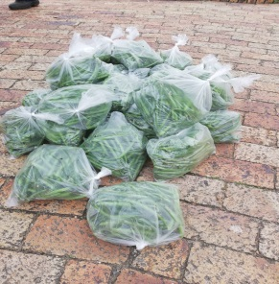
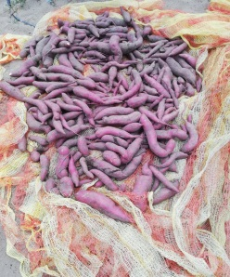
National School Nutrition Programme
Success
Learners at 69 schools receive nutrition on a daily basis.
Access to nutrition increased: 2017 – 20 431; 2018 – 20 860; 2019 – 22 348
50 new stoves were delivered. 19 remaining stoves scheduled for this term.
NSNP administration has improved after 6 NSNP assistants were allocated to assist selected schools from October 2018 to April 2019.
Gardens are in a very good condition and are being used for supplement feeding, teaching aids, etc.
Challenges
Shortages of plates and spoons – schools to use N&S funding to supplement.
24 gardener contracts terminated due to lack of EPWP funding.

Slide 8
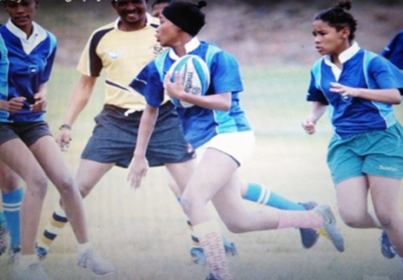
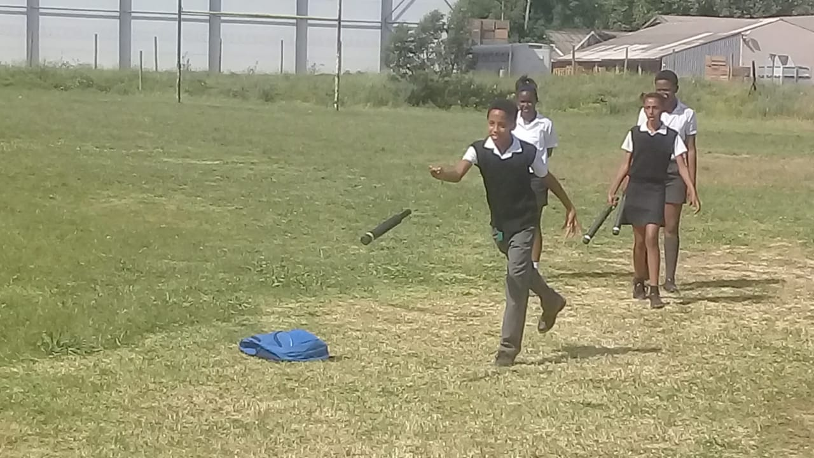
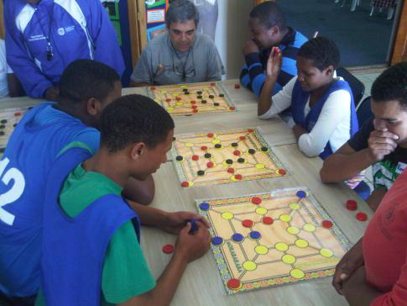
16 MOD Centres
Successes:
All MOD centres participate in at least 2 traditional and 1 DCAS focus code
MOD centre focus codes to schools participating in those code leagues
Good collaboration between DCAS MOD staff and relevant OED officials in the district
School | Circuit | Town | Municipality | DCAS Focus codes | *Average daily attendance
 |  |  |  |  | 2018 | Jan-June 2019
Barrydale HS | 1 | Barrydale | Swellendam | Chess / Volleyball / Cricket / Rugby. | 75 | 109 (585)
BF Oosthuizen PS | 1 |  |  |  | 100 (296) | 104 (275)
Bontebok PS | 1 | Swellendam |  |  | 350 | 347
Swellendam Sec | 1 |  |  |  | 146 | 99
De Heide PS | 1 | Bredasdorp | Cape Agulhas |  | 95 | 81
Albert Myburgh Sec | 1 |  |  |  | 66 | 48
Gansbaai Academia | 2 | Gansbaai | Overstrand | Baseball / Hockey / Softball / Football | 48 | 80
Gansbaai PS | 2 |  |  |  | 62 | 78
Zwelihle PS | 2 | Hermanus |  | Tennis / Basketball / Athletics/ Cross Country. | 154 | 133
Qhayiya Sec | 2 |  |  |  | 138 | 86
Kathleen Murray PS | 2 | Grabouw | Theewaterskloof | Aquatics / Netball / Gymnastics / Table Tennis. | 240 | 150
Groenberg Sec | 2 |  |  |  | 283 | 224
Kosie de Wet PS | 3 | Villiersdorp |  |  | 115 | 128
Villiersdorp Sec | 3 |  |  |  | 25 | 29
LR Schmidt | 3 | Genadendal |  | Baseball / Hockey / Softball / Football. | 144 | 130
Emil Weder Sec | 3 |  |  |  | 59 | 57
Challenges:
Lack of school ownership of the program at some schools affects learner participation negatively
Lack of code facilities in some areas.
Learner transport arrangements impacts negatively on the program
Access to administrative, storage and indoor to coaching space due to need for classrooms is becoming a growing concern
High turnover in young coaching staff hampers stability
Annual equipment delivery leads to neglect and theft

Slide 9
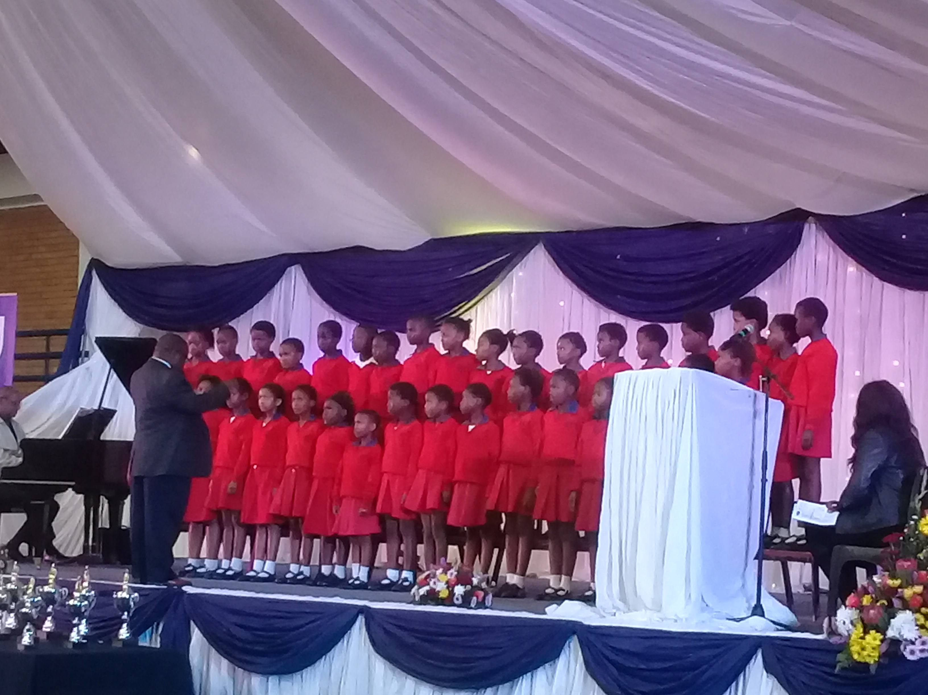
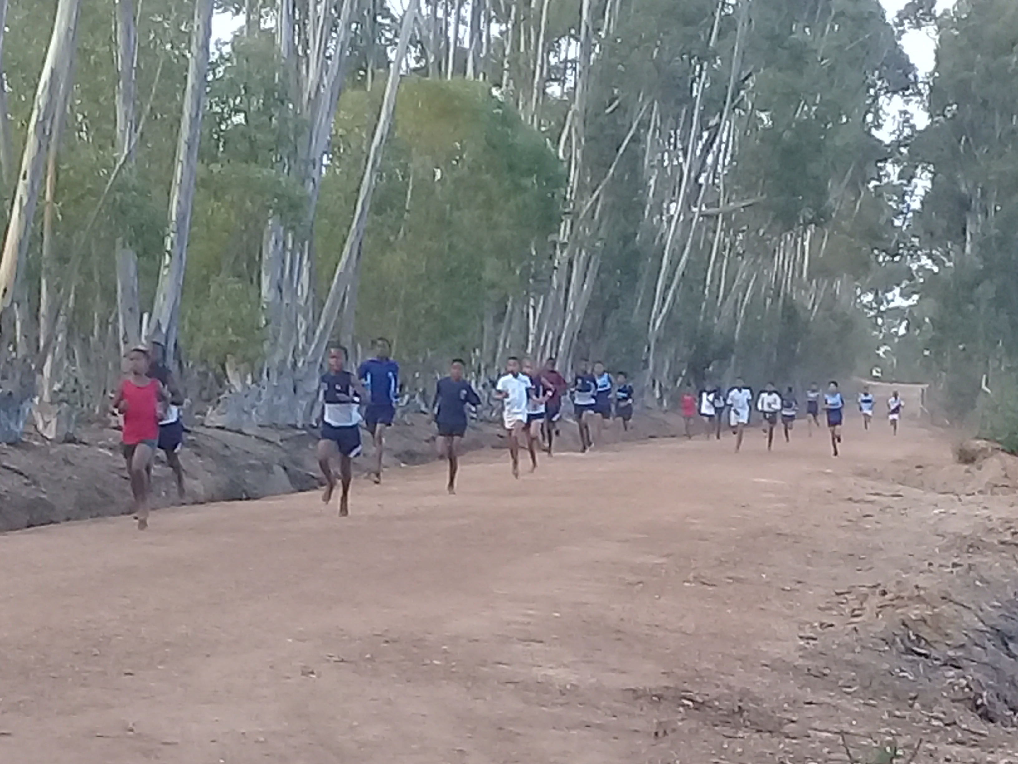
After School Game Changer: School Enrichment Programme
School sport: Participation in either or both winter and summer league programs | 2017 | 2018 | 2019
 | 87 schools | 86 schools | 85 schools
2 and more intra- interschool sport codes | 64 | 71 | 72
1 intra- interschool sport code ( Farm schools - in athletics mainly) | 16 | 10 | 9
0 sport codes (Mostly multi-grade) | 7 | 5 | 4
Successes:
Steady increase in schools offering and participating in school sport league programs
Codes such as softball, table tennis, cross country and girls rugby finding good traction in the district
Arts & culture: Participation in afterschool performance programs/ competitions. | 2017 | 2018 | 2019
Performance arts ( Dance/ Drama / Instrumental/ Singing) | 17 | 14 | 15
Challenges:
Distance and high transport costs curbs offering and expansion of afterschool activities at no- and low fee schools.
Very small district budget for afterschool program implementation
Lack of qualified/ skilled arts and culture teachers in no- and low fee schools
LTS arrangements negatively affects learner participation in afterschool programs
Civic education & youth leadership: Participation in civic education programs in mainly high and intermediate schools | 2017 | 2018 | 2019
 | 24 schools | 24 schools | 24 schools
MOOT COURT, Public Speaking, and Project Citizen. | 11 | 9 | 8
Youth leadership through RCL development | 16 | 18 | 19

Slide 10
Transport of learners
Total distance covered by all routes in district = 5307.9 km return per month
No of Learners Involved | No of Gr R Learners | No of Mainstream Learners
4780 | 180 | 4600
No of schools with routes | No of Contracted Routes | No of Devolved Routes
57 | 74 | 11
Total busses used: 165
(33 x Mini-busses – 16 seaters)
( 36 x Midi Busses – 22-35 seater)
(96 x Busses - 37 – 81 )
Expenditure (Current Financial Year)
Mainstream: R12 975 624.69
Grade R: R519 241.81
Safety of learners paramount – Frequent meetings with principals and service providers
Collaboration between OED and District Road Traffic Management Coordinating Committee (DRTMCC), Traffic Authorities and SAPS
No current challenges - complaints promptly addressed trough intervention of district and head office personnel
10

Slide 11
School Safety
CHALLENGES | DISTRICT INTERVENTIONS / ACTIONS
Political protests in Grabouw and Zwelihle prohibited children to go to school. Some children joined the protest actions. | Emergency security has been provided to the affected schools.
Gang violence in the Gansbaai area threatened learners and prevented school functions to continue. | Temporary security, metal detectors and drug testing kits were provided. SLES officials provided counselling and addressed behavioural issues.
SUCCESSES
Schools provided with safety infrastructure: 2017/18 – 20 schools at cost of R867 335.85 2018/19 – 15 schools at cost of R777 838.98
Holiday Security provided for 15 high risk schools per holiday: 2017/18 - R609 178.10 2018/19 - R330 000.00
Various training sessions were presented for teachers and learners: OHSA; CCAC; NSSF; First Aid.
Focused monitoring and support visits by district officials led to an increased awareness of school safety.
Decrease in incidents of Vandalism, burglary and abuse reported to the call centre.
After school program support to learners at identified schools had a positive impact on their behaviour.

Slide 12
OED: Hostels
SCHOOL | NAME OF HOSTEL | NEEDS
Bredasdorp HS | Heldersig | Minor repairs required for the Buildings and the Equipment. Scheduled maintenance in 2027/28. Condition assessment 3.4
De Villiers Graaff HS | Graaffsaal | Upgrades are being done by WCED in partnership with a Donor
De Villiers Graaff HS | Huis Malherbe
De Villiers Graaff HS | Huis Du Raan
De Villiers Graaff HS | Huis Theresa
Swellendam HS | Excelsior | Roofs, Ceilings and Bathrooms need attention. Major equipment needs. Scheduled maintenance for 2025/26. Conditioning assessment: 3.58
Emil Weder SS | Emil Weder Koshuis | Recently upgraded and refurbished. Completed in 2017. Equipment needs replacement
Overberg HS | Huis Van den Berg | Maintenance scheduled for 2027/28
Overberg HS | Nerina | Maintenance scheduled for 2027/28
Riviersonderend HS | Riviersonderend Boys/Girls | Buildings and the equipment are in a good state. Scheduled for Maintenance in 2028/29. Condition assessment:
Okkie Smuts PS | Stanford Koshuis | Hostel upgrades currently underway – 2018/19
Barrydale HS | Huis Tradouw | Painting and Minor repairs required. Scheduled for2025/26. Equipment in a bad state Cond assessment: 3.57
Bredasdorp PS | Huis Eloff | Minor repairs scheduled for 2025/26. Major needs Identified Cond Ass: 3.49
Swellendam SS | Swellendam SS Hostel | Recently upgraded and refurbished. Completed in 2018
Augulhas School of Skills | Nepgen Oord | Maintenance scheduled for 2021/22
NEW PLANNED HOSTELS
**Gansbaai Academia | New Proposed Hostel (2023/24) | Hostel is required to eliminate the need for Learner transport and the introduction of Marine focussed subjects.
**De Rust Futura Academia | New Proposed Hostel (2023/24) | School converting to an agriculture focus school. Building of the hostel is subject to the purchase of the leased facility.

Slide 13
OED: Hostels
Ordinary Schools | No of Residents | Special Schools | No of Residents
9 | 656 | 1 | 115
Hostel policies include Codes of Conduct (Serves as rules by which learners and parents must abide)
Hostel guidelines and management encourage a balanced learning environment and infrastructure and safety of learners are key drivers
Advantages of hostels:
Improved Learner Attendance
Higher Pass rates as a result of more controlled environment
Increased participation in sport, cultural and social activities

Slide 14
Support to Farm Schools
20 Farm schools in operation that are also multi-grade schools.
Support is rendered as follows:
School visits, rendering subject specific, in-class support;
Professional developmental sessions per subject, in their geographical area, per subject dealing with the difficult and challenging content;
Are invited and attend Departmental Heads meeting with Curriculum Management as standing agenda point amongst others;
The Subject Advisors of the OED played a huge role in writing the provincial Multi-grade Resource, which was launch recently by the province. The MG resource was distributed and mediated and supported with the schools by Subject Advisors;
The GET curriculum section have two engagements with MG / farm schools regarding MG teaching practices; ICT usage in MG schools and successes of using the MG resources (mentioned in 4) on 4 May 2019 and 31 August 2019, all teachers of MG / farm schools are invited.
More favourable post provisioning

Slide 15
Achievements

Slide 16
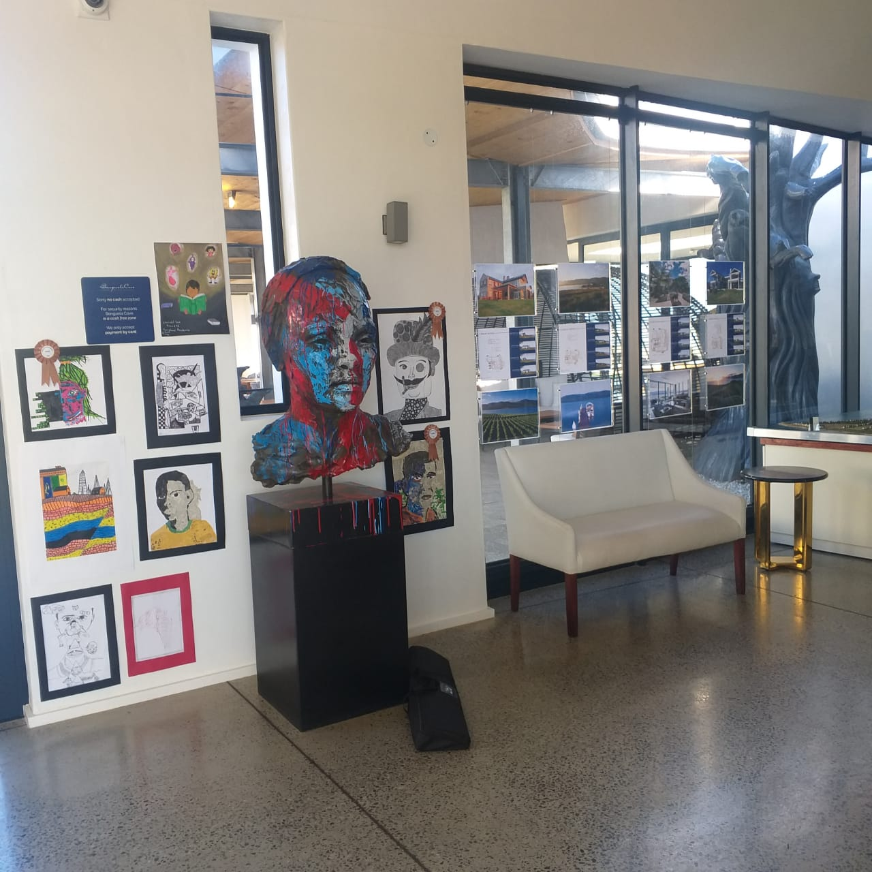
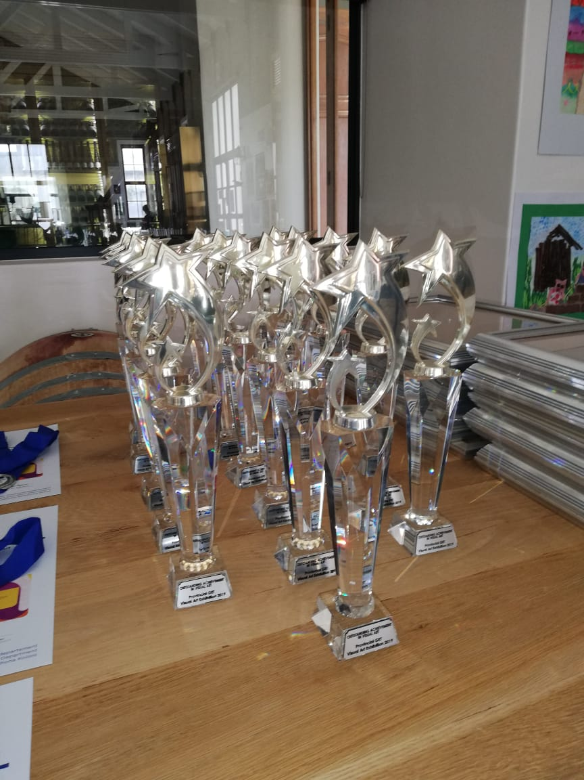
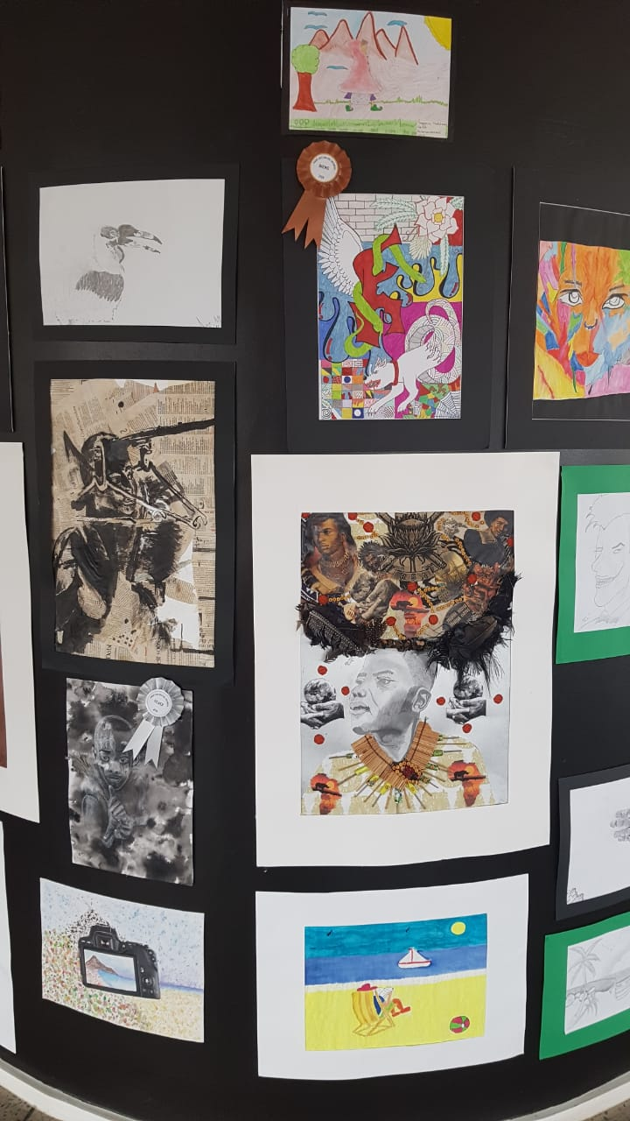
Achievements

Slide 17
Challenges and solutions
CHALLENGE | SOLUTION
Large geographical area to cover; increased expenditure i.t.o. traveling costs and time resources | Effective use of technology (e.g. Skype, video-conferencing, Telematics, Google Docs, WA Groups, etc. Employ multi-functional approach when visiting schools far from Caledon (e.g. subject advisors and other district staff will travel together and service the school on the same date)
Poor quality of network connectivity in some rural areas for roll out of iCT development in region | Hard copy submission of documents allowed Access to Internet made available through envisioned optic fibre
Influx and land claim protests in Villiersdorp,Grabouw, Hermanus area. | Ongoing discussions and meetings with principals, leaders and community members. Pro active requests for accommodation provisioning.
Online Admissions: Lack of technological knowledge of parents | Excellent assistance and support from district officials and school clerks
CHALLENGES | ACHIEVEMENTS

Slide 18
Contact details
District Director: Helene.VanZyl@westerncape.gov.za
Circuit Manager – C1: Joaniel.Pieterse@westerncape.gov.za
Circuit Manager – C2: Wendy.Colyn@westerncape.gov.za
Circuit Manager – C3: Yolanda.Bailey@westerncape.gov.za
Curriculum Support: Jenny.Bridgeman@westerncape.gov.za
Foundation Phase and ECD(Gr R to Gr 3): Lynn.LeGrance@westerncape.gov.za
GET(Gr 4 to Gr 9): James.Daniels@westerncape.gov.za
SEN/FET(Gr 10 to Gr 12): Venetia.Cavernelis@westerncape.gov.za
Special Learner Education Services: Annelien.Crous@westerncape.gov.za
Infrastructure: Hillary.Smith@westerncape.gov.za
Head: Management & Governance: Japie.Bailey@westerncape.gov.za
Management and Governance Support: Edward.Kies@westerncape.gov.za
People Management: Ferlin.Beukes@westerncape.gov.za
Planning and Information Management: Andy.Coetzee@westerncape.gov.za
Safe Schools: Dawid.Fiellies@westerncape.gov.za
School Enrichment Officer/T2P: Kobus.Mike@westerncape.gov.za
Corporate Services: Ilse.vanNiekerk@westerncape.gov.za

Slide 19
Thank You

