Slide 1
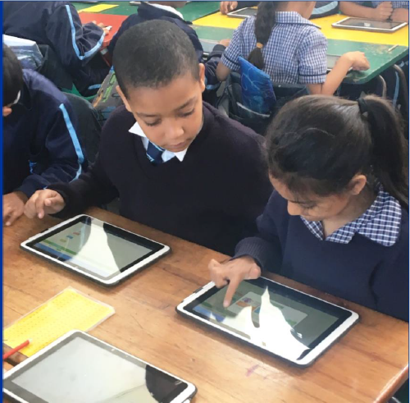
eLEARNING
6 August 2019
WCED: Clinton Walker

Slide 2
QUALITY EDUCATION FOR EVERY CHILD IN EVERY CLASS OF EVERY SCHOOL IN THE PROVINCE

Slide 4
SIX INTEGRATED WORKSTREAMS
SUPPORT THE GOAL STATEMENT
6 Integrated work streams support the goal statement
Improve teaching and assessment to enhance learning and learners’ life chances
Across 3 Evolving categories

Slide 5
3 x Evolving categories of Roll-out across 6 x streams
X number of Schools
UNIVERSAL
1. WAN
2. SLIM LABs
3. Access Point for wi-fi connectivity for teachers
4. Other benefactor projects e.g USO technology
6. Appropriate Teacher Development Pathway
5. Focus on developing eLearning Leadership
MODEL
1. WAN
8. Appropriate Teacher Development translates into ICT integrated into lessons
X Number Schools
2. SLIM LABs
3. LAN (Wi-Fi)
4. Smart classrooms
100%
5. Learner devices
6. Excellent Leadership and innovation in place
7. Must serve as a example/ inspiration to other schools.
ENHANCED
1. WAN
X number of Schools
2. SLIM LABs
3. LAN (Wi-Fi)
4. Smart classrooms
5. Focus on developing eLearning Leadership
6. Appropriate Teacher Development translates into ICT integrated into lessons
Notes:
Roll out of Game Changer will be done according to 3 categories of schools.
The slide summarises the main characteristics of the 3 school categories as well as the number of schools contained in each of the three categories
In essence, the universal school receives the smallest ICT offering whereas a very small set of 16 model schools receive the full suite of solutions.
The intent is to move schools along the trajectory as the E-Vision is implemented over the 20 years. This also implies synergy between primary & secondary i.e. If you are a Primary School learner in a model school then you have to move over to a Secondary School in the same category – similar for Universal & Enhanced categories
Will also have to consider how we Incentivise schools to move across the categories and those that perform well
Prioritise Grade R – 3 as Model or Universal.
Investigate ways to secure access to LABs after hours to maximise impact.
The three categories of roll out will allow for testing to be done – i.e. which type of offering renders the most results?

Slide 6
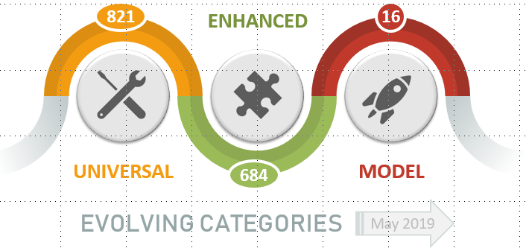
THREE EVOLVING CATEGORIES
August 2019
Notes:
The Game Changer brings with it a focus for a three year period which will be transformational and irreversible in initiating the process of effecting eLearning in all Western Cape schools.
Over the period of the Game Changer, every school, every learner and every teacher benefits.
Three Categories of Schools:
Universal schools: Provide teachers and learners with access to digital resources through WAN via LABs and central Wi-fi Access Points leveraging pathway to broadband
Enhanced schools: Provide for maximising teacher technology in order to introduce and develop eLearning concepts; opportunities to expand direct access to learners
Model schools: Opportunity to showcase full eLearning environment for all role-players, building eCulture and developing leaders in the field

Slide 7
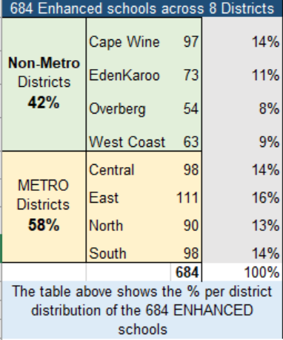
Distribution across Districts

Slide 8
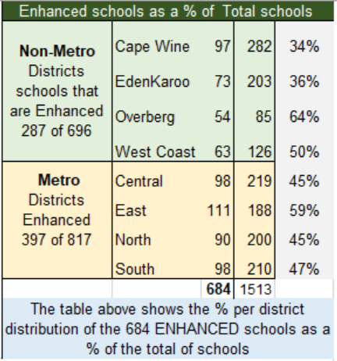
Distribution across Districts

Slide 9
Overall progress on eLearning Strategy
ACCEPTANCE
Positive attitude to eLearning overall
Learner experience must remain a focus
ACCESS
Infrastructure and Technology gains, but connectivity-challenge remains
USE
Progress in tracking WAN use
Teacher integration to be advocated
INSTITUTIONAL
WCED prioritizes e-Education
WCG BroadBand reaches 84% of schools
9

Slide 10
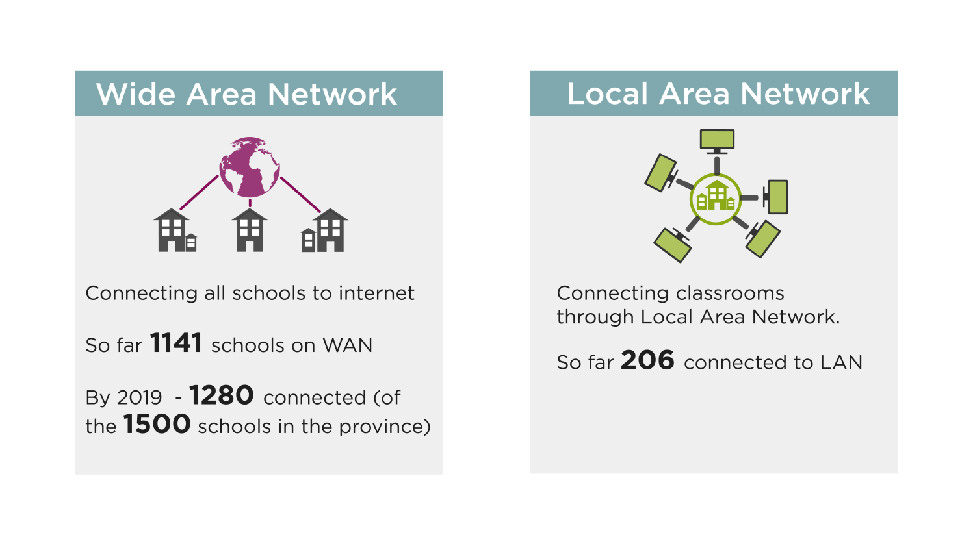
To date: Infrastructure to schools
Target: 1 500+ schools
To date 1 273 schools on WCG WAN
573 on 100mbps
45 scoped for next phase
191 scoped for alternative/s
Target: 1500+ schools
To date 490 connected to full Wi-Fi LAN
By end 2019 – 560 target
Also, 759 have Mini Wi-fi LANs to access Broadband

Slide 11
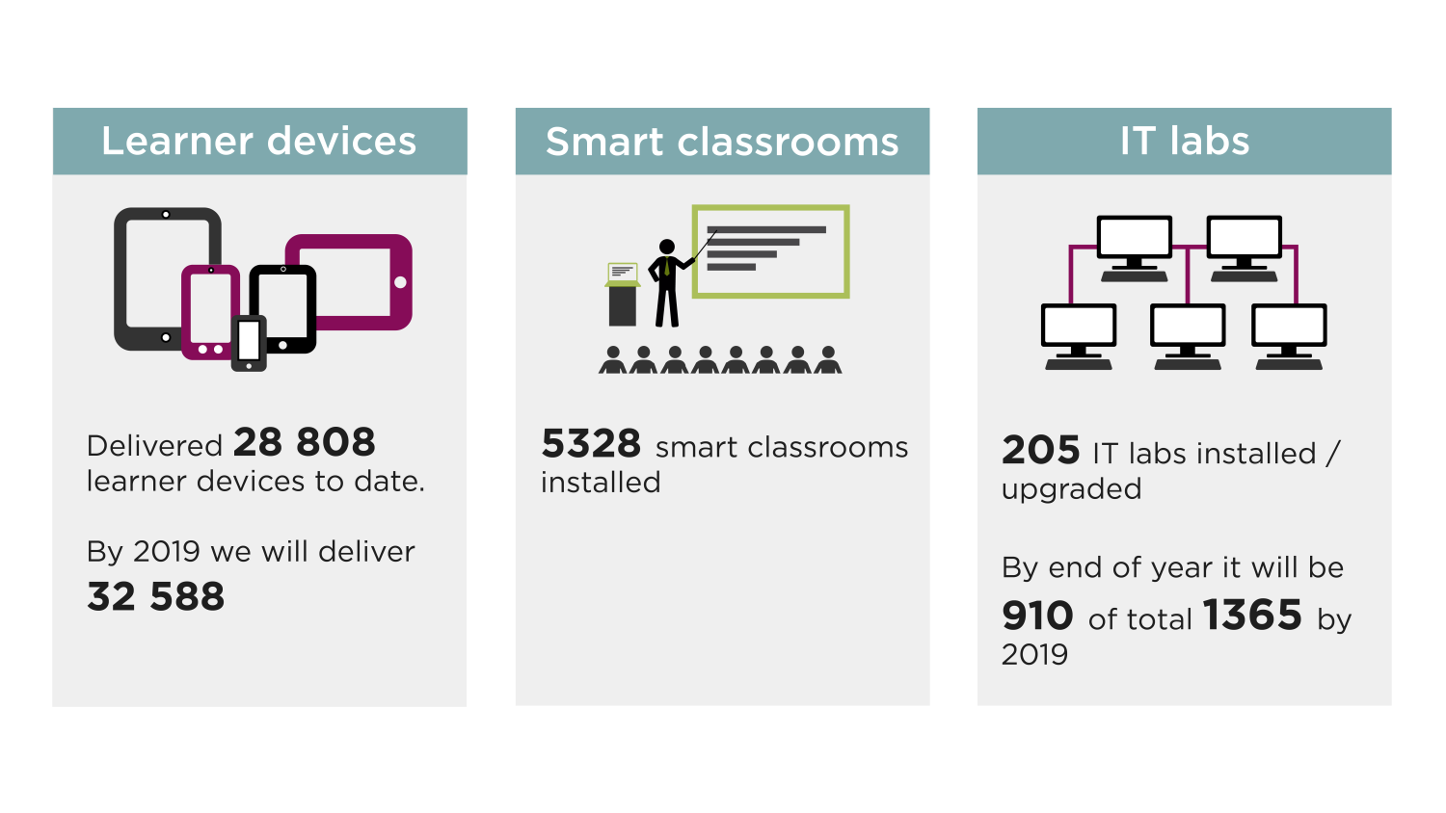
Technology in the classroom
28 871
7 778
1 161 Refreshed ICT
suites (23 000 w/stations)
…166 scoped for 2019/20
------------------------------
333 Subject-Specific ICT suites; 10 900 workstations
26% Classrooms across 596 schools (39%)
1 000 scoped across 100 schools for 2019/20
Other than this schools have/are also procuring own-funded technologies and BOYD

Slide 12
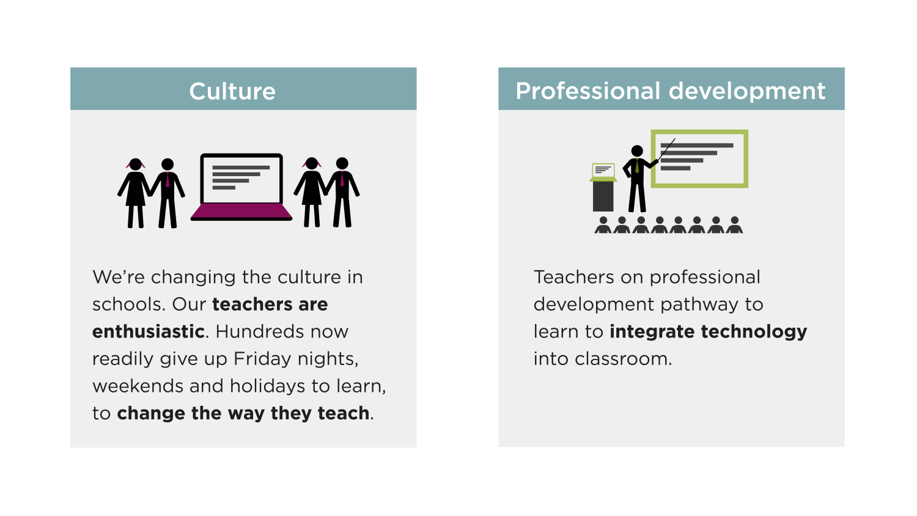
Culture change at schools
____________________________
This stream is an additional one
not generally part of projects;
deals with systemic change
Focus #1: Classroom and school ICT Change and Adoption
Focus #2: Cyber-Safety/ Wellness
Focus #3: Responsible citizenry
______________________________________________
Proficiency Assessment Tool provides data to inform TProfDev courses
Targeted Teacher ProfDev approach vs a wide net of invitational-training
ICT Skills and integration training reaches 70% of teachers
Trainer network of teachers established

Slide 13
eTeacher Professional Development (2015-2018)
Pre-2015 = 13 747
Teachers participated in eTPD
Post 2015 = 13 952
Teachers participated in eTPD
 | DISTRICTS |  |  | CTLI |  |  | CEI |  |  | TOTAL
FinYear | Instances | Unique |  | Instances | Unique |  | Instances | Unique |  | Instances | Unique
2015_16 | 4976 | 2067 |  | 507 | 226 |  | 2678 | 1354 |  | 8161 | 3647
2016_17 | 7378 | 2106 |  | 636 | 239 |  | 2376 | 1612 |  | 10390 | 3957
2017_18 | 2514 | 946 |  | 861 | 181 |  | 1254 | 982 |  | 4629 | 2109
2018_19 | 3778 | 2679 |  | 634 | 634 |  | 1178 | 926 |  | 5590 | 4239
TOTAL | 18646 | 7798 |  | 2638 | 1280 |  | 7486 | 4874 |  | 28770 | 13952
The data includes Basic ICT Skills Training and ICT Integration Training

Slide 14
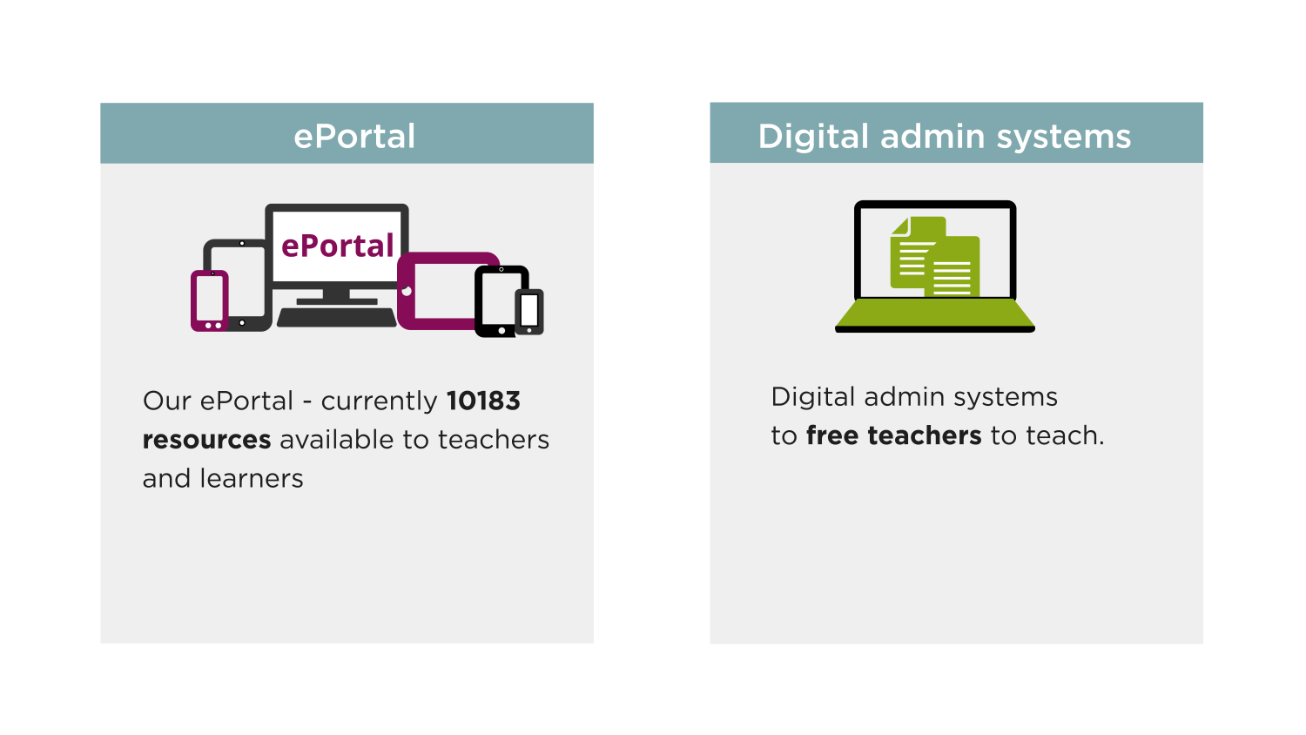
Administration
Ecosystem/ ePortal
Digital admin systems
WCED ePortal Cloud content – currently 11 000+ multi-linked resources available to teachers and learners
---------------------------------------------
Scoping in phases as budget allows
___________________________
Current:
Learner Management
Learning Management
Classroom Management
Integrated School Administration (Dashboards for Schools)
Initiating National (DBE) Cloud with curriculum content via the WCED ePortal
WCED Telematics program via Broadband set for growth
This area is receiving attention; provides opportunity to ALL learners and teachers…

Slide 15
Support: Curriculum Integration and ICT Technical
District Advisory Support
ICT Technical Support
___________________________
ELEARNING ADVISORY TEAMS
Component in support at district level
Coordinating team at head office level
Creation of School-level support through ICT Champions network
Assimilation of Curriculum Advisory teams to support the eLearning goals
Embracing Service Providers in support
___________________________
CENTRALISED SUPPORT DESK
One-Call service to schools
Re-routing and Escalation as needs be
Service Provider network
Contractual agreement/s concluded
Additional support negotiated for the Provincial IT Support teams (CeI)
___________________________
* Current trials:
Learner Management
Learning Management
Classroom Management
Integrated School Administration

Slide 16
Challenges
Delayed landing of technologies
Connectivity QoS
requires attention
eContent not readily available
eTeachers slow in
assimilating eLearning
CHALLENGES and
RISKS
Technical Support
Desired irreversible
change at trickle pace
Security concerns
Utilization of services
needs to be addressed
Sustainability challenges
Universal Access is
an infrastructural
challenge
Notes:
Appetite for digital
Conceptualisation of program design
Learner devices OWN
Utilisation not just about access
Social media tools not automatically effective
Be clear on expectations of educational support via apps

Slide 17
Assessing the AS IS ‘Stage of Delivery’
Stage 1: Policy development
At this stage the organization has embraced the Transformation agenda and the major steps towards implementation have commenced
Stage 2: Implementation
The key drivers are in place and significant implementation is underway. Systemic communication of the objectives are underway (SG champions)
Stage 3: Embedding change
Implementation is now systemic-wide:
Enhanced active schools represent (39%) of Broadband active schools
Schools with Wi-Fi access via the WCG Bband = 91% (1 161 of 1 273 schools)
Stage 4: Irreversibility
Implementation is now reaching more than 50% of schools
© Western Cape Government 2012 | eLearning Game Changer
17

Slide 18
What worked vs What did not work
eLearning Game Changer

Slide 19
A - Directorate eLearning
WHAT WORKED?
WHAT WORKED | REASON FOR SUCCESS | FUTURE STRATEGY FOR 2019
Creating the eEducation enabling environment/s | Project target-setting methodology approach fully-supported by WCG/WCED as a focus: Game Changer Data-Centric approach programme | The institutionalization of the e-Education structure and methodology,
Broadband Connectivity penetration reaching 98% of WCED public school learners | Aspirational yet realistic goals set with necessary resources identified and clearly scoped Committed government | Ensuring that the quality of service (QoS) is within the range expected and extended to cover all learners/ schools.
Connectedness within schools through wi-fi into classrooms | A measured approach ensured that previous and other projects dove-tail with this major project. Committed people and efforts acknowledged. | Growth beyond the initial third of schools that have full wi-fi. Expand the two-thirds of schools that have partial wi-fi to full wi-fi. Maintain the base and refine processes of sustainability
Technology provisioning and sustainability modelling | Careful planning and execution in collaboration with other state agencies and industry. Ensuring that landed technology works in sync with existing systems. | Collaboration with state agencies; ensuring that procurement turn-around is quicker with no challenges from industry. Subject-specific tech are on a cyclical refresh program

Slide 20
WHAT WORKED?
WHAT WORKED | REASON FOR SUCCESS | FUTURE STRATEGY FOR 2019
Enabled Classrooms for digitally-supported teaching and learning | Listening to what schools identify as the critical classroom enabling needs. Cognizant of the environmental challenges. Effective R&D and SCM processes | Redefine the scope and extent of classroom technologies for teachers and learners towards greater mobility between classrooms. Learner-focused strategy.
Change management and ICT-in curriculum embrace | Schools commit to MOUs and MOAs as part of the eLearning thrust at schools Champion Networks established | Bring greater value, purpose and engagement to the Change- Champions networks (PLCs) Provide Cyber-Safety focus for teachers/learners Transform to Perform initiative supported
Provision of online and offline digital content | Providing CAPS-aligned eContent at no cost to schools through the “IDEA Teach” partnership. Learner mobi-site developed Curriculum delivery dashboard to push content to learners developed | Populate digital repository and link to other relevant repositories e.g. Telematics Build the other aspects of the eportal e.g. The Classroom and Curriculum support sections
Supporting structures to schools | District Advisory teams having own-agency to support schools Pro-active vs reactive methodology in support of technical challenges | Refine the ease of self-help access for teachers/ schools Ensure the QoS and better communication between stakeholders
eTeacher Professional Development | ICT Skills and integration training reaches 70% of teachers in total ICT proficiency tool that provides a systemic gauge for WCED Trainer network established within districts and a specialised unit at CTLI Targeted approach vs a machine gun hit and miss approach. | Accelerated TPD program that incorporates the new Digital Skills framework Blended and Online offering of TPD courses Integrated TPD dynamic database

Slide 21
WHAT WORKED?
WHAT WORKED | REASON FOR SUCCESS | FUTURE STRATEGY FOR 2019
Supporting structures to schools | District Advisory teams having own-agency to support schools Pro-active vs reactive methodology in support of technical challenges | Refine the ease of self-help access for teachers/ schools Ensure the QoS and better communication between stakeholders
eTeacher Professional Development | ICT Skills and integration training reaches 70% of teachers in total ICT proficiency tool that provides a systemic gauge for WCED Trainer network established within districts and a specialised unit at CTLI Targeted approach vs a machine gun hit and miss approach. | Accelerated TPD program that incorporates the new Digital Skills framework Blended and Online offering of TPD courses Integrated TPD dynamic database

Slide 22
WHAT DID NOT WORK?
WHAT DID NOT WORK | REASON FOR LIMITED SUCCESS | FUTURE STRATEGY FOR 2019
Infrastructure and Network issues | Broadband Quality and Stability of Services in question Coordination challenges between various state entities Out-dated product, processes and practices | Apply Service Improvement Plan (CeI) to address slow and inconsistent Bband. Establish a team that addresses transversal challenges Architectural review initiated to identify and suggest necessary changes
Classroom transformation at all schools and related eLTSM resources | The compounding technical challenges affect: the pace of integrating skills to changed classroom practice being a measured one Inadequate attention to sourcing quality off-line digital content which would allow schools to implement eLearning Adoption and assimilation of changed teaching practices is slower than envisaged | Simplifying, then amplifying the TPD courses offered with follow-through from advisory teams Enable greater appropriate and available digital resources; ePortal; Buy-in resources Re-energized Adoption and Change Management campaign
Data-Driven management and leadership | The requisite systems not being in place that best provides real-time granular data The data access to facilitate work of SPs needs address | Initiate data integration of projects and programmes

Slide 23
Thank you

