Slide 1
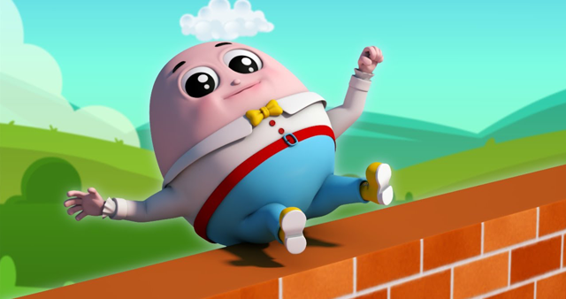
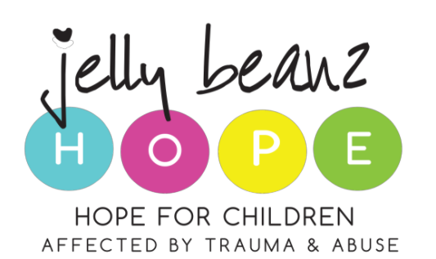
And all the kings horses,
And all the kings men,
Couldn’t put humpty together again
The impact of CHILD MURDERS
Presented by Edith Kriel

Slide 2
CHILD MURDER DOES NOT HAPPEN IN A VACUUM

Slide 3
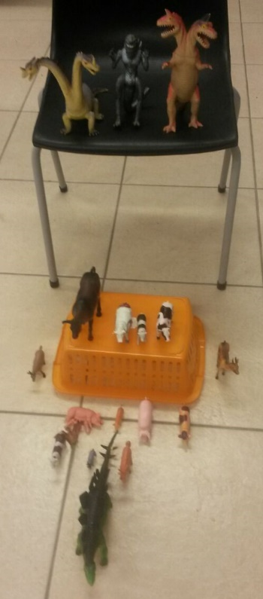
Violence against children – crime statistics
Crime statistics were released in September 2018, in parliament, Cape Town.
These revealed that 985 children had been murdered across the country - 695 of those were boys and 294 were girls.
More boys were murdered than girls.
The majority (279) of the children were killed in the Western Cape (Over 25% of all murdered children) followed by KwaZulu-Natal (221) and the Eastern Cape (180).

Slide 4
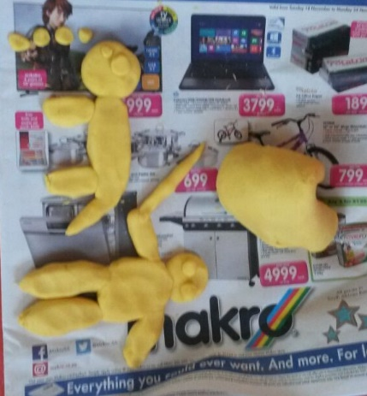
This does not tell the whole story of crimes against children…..
Furthermore, children were the victims in 41% of the 124 526 rapes reported in the three year period last released.
Research tells us further that only 1 in 9 children report a crime against them (www.cjcp.org.za)
Over a lifetime:
1/3 of children experience some form of sexual abuse during childhood (boys slightly more than girls.) (Optimus Foundation 2016)
12% of children experience neglect. (Optimus Foundation 2016)
18% of children have experienced physical abuse (Optimus Foundation 2016)
26% of children have experienced emotional abuse.
Significant numbers of children experience violence in the home either as direct victims or as witnesses of domestic violence.

Slide 5
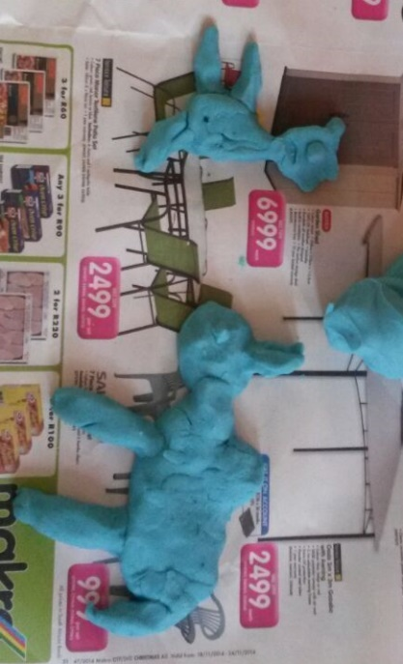
Violence against children costs
A report by Save the Children: Violence Unwrapped — The Social and Economic Burden of Violence Against Children in South Africa, says that the estimated economic value of disability-adjusted life years lost due to violence against children (including fatal and non-fatal) in 2015 totalled R202 billion. This accounted for 3,3% of SA’s GDP in 2015.

Slide 6
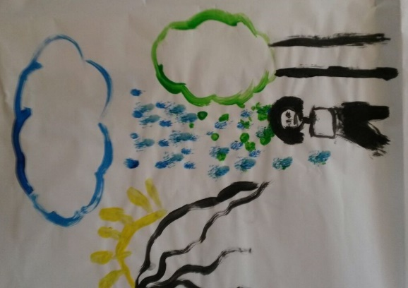
The failure to invest in children
The saying “Children are our future” is trite when seen in the light of failure to invest in children.
Many reports note the failure to invest in evidence based primary, secondary and tertiary violence prevention programmes.
NGO’s which have the responsibility to prevent and respond to violence against children are seriously underfunded, compared to the magnitude of their challenges.

Slide 7
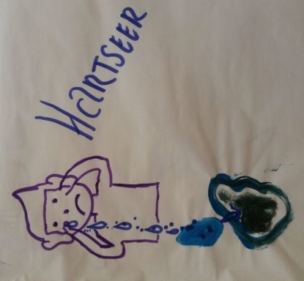
Prevention, prevention, prevention
There is no “magic bullet” – many patterns of violence are repeated across generations
We need to accept that the prevention of violence involves long, medium and short term evidence based strategies and plans in order to make a meaningful contribution to the prevention of violence against children.

Slide 8
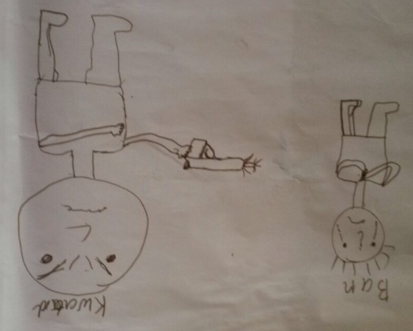
Primary prevention
Make all forms of violence against children illegal – including the use of physical and humiliating punishment. We need to afford children the same level of protection afforded to adults.
Help parents parent effectively discipline without violence. Parenting programmes should be integrated into life skills programmes at schools, ante-natal and well-baby clinics and inclusive of boys, men and fathers.
Life skills programmes from Grade R upwards should teach non-violent ways of dealing with anger, frustration and bullying.
These programmes must be taught by educators who are appropriate role models.

Slide 9
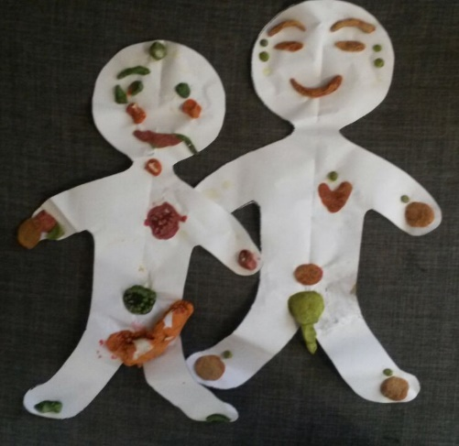
Secondary prevention
Protect children from exposure to domestic and community violence
Protect children from exposure in gratuitous violence through visual and other media
Respond promptly and appropriately to child victims of abuse and trauma – both girls (who internalise trauma) and boys (who are more likely to externalise trauma)

Slide 10
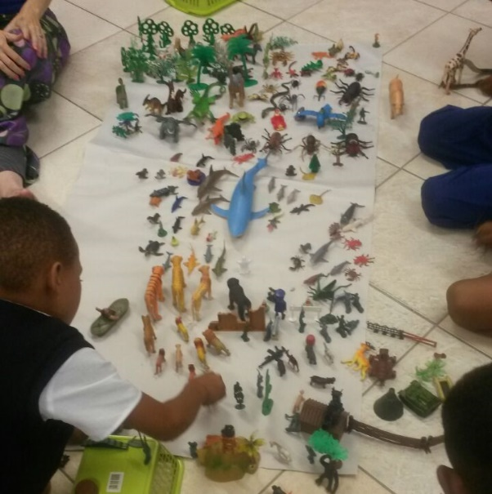
Tertiary prevention
Respond appropriately and promptly to offenders
Ensure that potential for rehabilitation is appropriately assessed and rehabilitation programmes are offered when able to be used.
Ensure that children and communities are protected from those who perpetrate violence, through responsive policing (including the defence force in extreme patterns of community violence), refusal of bail or stringent bail conditions and imprisonment when offenders have been apprehended and convicted.

Slide 11
Ensure that ….
Role-players who work in violence prevention and response are adequately funded and resourced.
Role-players who work in violence prevention and response, especially those in a policing capacity are offered the opportunity of trauma debriefing.

Slide 12
And they all rolled over and the one fell out,
There were 9 in the bed and the little one said, roll over,
And they all rolled over and the one fell out

Slide 13
THE IMPACT ON CHILDREN

Slide 14
THE EFFECTS ON THE BRAIN
Growing up in violence…
Adrenalin and cortisol levels are increased
Neurobiological impact on the developing brain
Baseline functioning of the child changes
Flight or Fight System is activated
Attachment is affected

Slide 15
THE EFFECTS OF VIOLENCE ON THE PHYSIOLOGY OF A PERSON
Hypervigilant
Fatigue
Loss of Concentration

Slide 16
THE EFFECT OF CHILD MURDERS ON THE EMOTIONAL WELLBEING OF OTHERS
Guilt
Fear that they are also at risk
Sadness
Loss
Grief

Slide 17
Aggressive
Desensitised
Act out what they witness
Nightmares
May present as ADHD
May seek out unhealthy coping mechanisms
THE EFFECT OF CHILD MURDERS ON BEHAVIOUR

Slide 18
INTERGENERATIONAL TRAUMA

