Slide 1

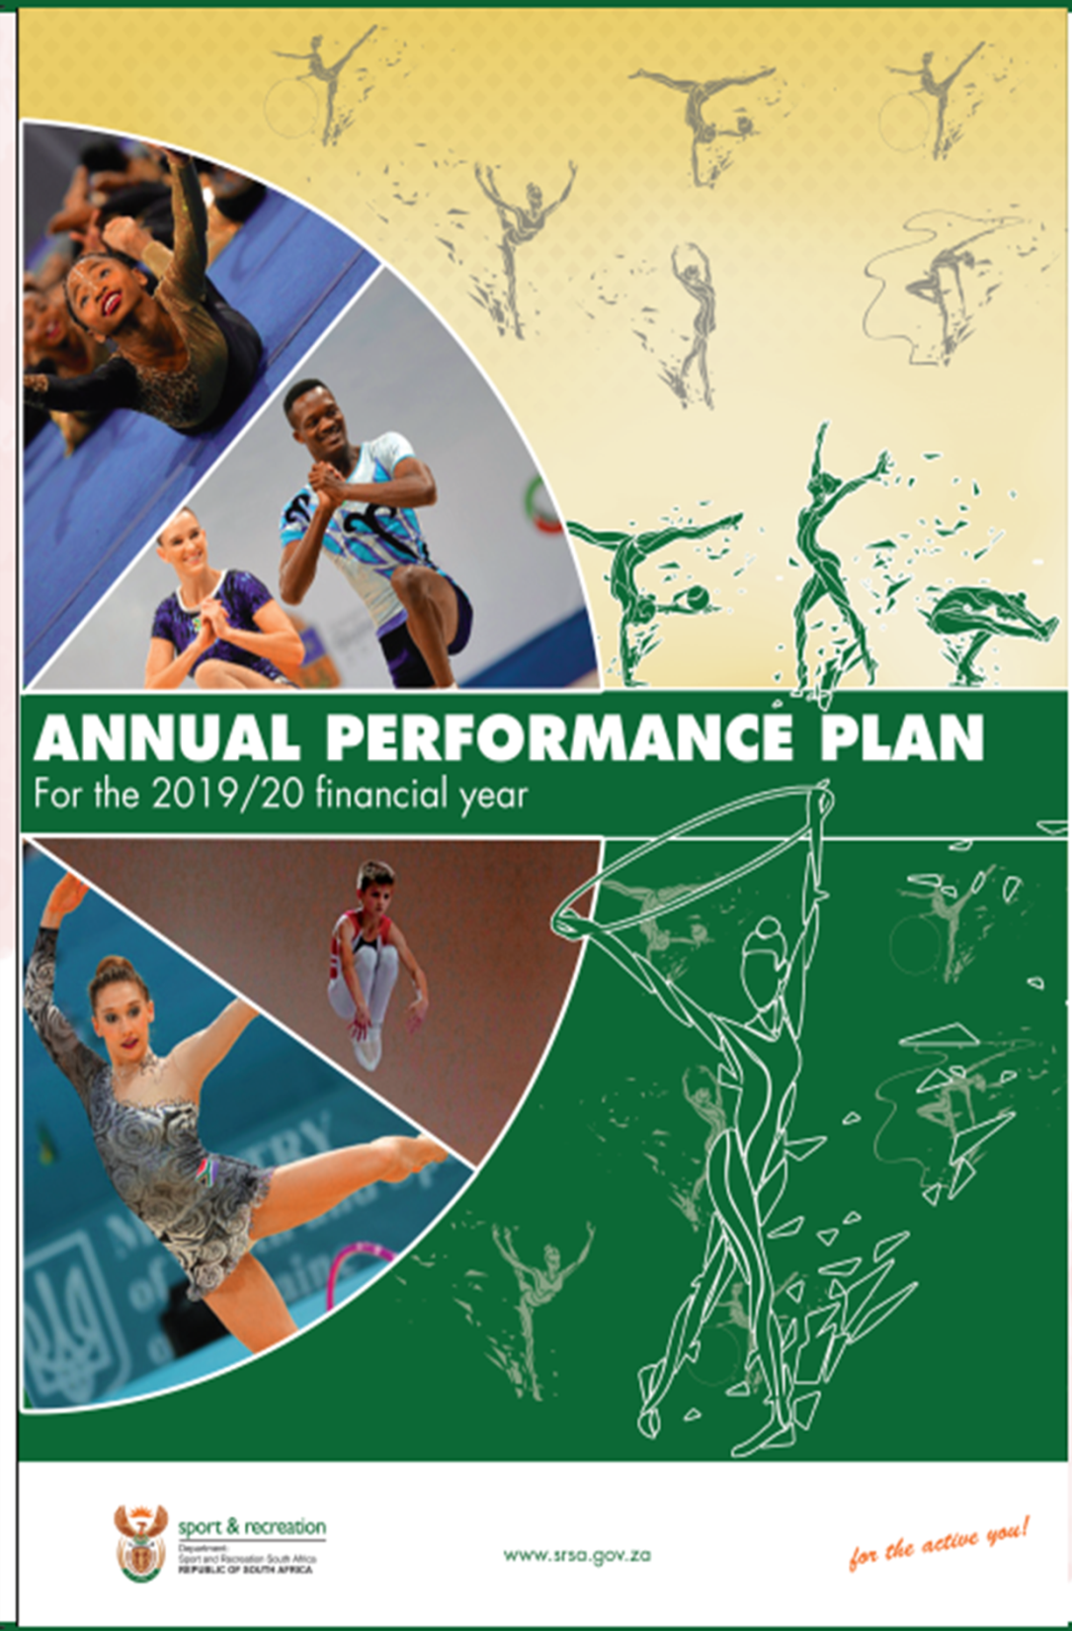

Slide 2

2019 20 Annual Performance Plan
National Development Plan
Medium Term Strategic Framework
Programme of Action
Outcome 14
Strategic Plan
Medium Term Expenditure Framework
White Paper
Legislation
National Sport and Recreation Plan
3 July 2019
Transformation Charter
Performance Reports
Committee Brief

Slide 3
White Paper
National Sport and Recreation Plan
Sector Retreats
MINMEC / HEADCOM
Strategic Sessions
National Development Plan
Medium Term Strategic Framework
Programme of Action (Outcome 14)
SONA
SP
APP
Operational Plans
Performance Agreements

Slide 4


NATIONAL DEVELOPMENT PLAN
NDP Goals for 2030
The NDP sets out five long-term nation building imperatives for South Africa. These are as follows:
• Fostering constitutional values
• Equal opportunities, inclusion and redress
• Promoting social cohesion across society
• Active citizenry and leadership
• Fostering a social compact

Slide 5

Promote the sharing of public spaces and common experiences.
Ensure that the demographics of each sporting code approximates the demographics of the country.
Adequately resource school sport.
Provide adequate facilities and ensure that these are maintained.
Encourage communities to organise sporting events, leagues and championships.
Encourage corporate investments in grassroots sports.

Slide 6
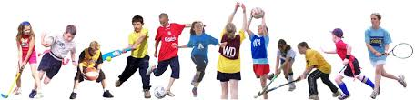

Medium Term Strategic Framework

Slide 7
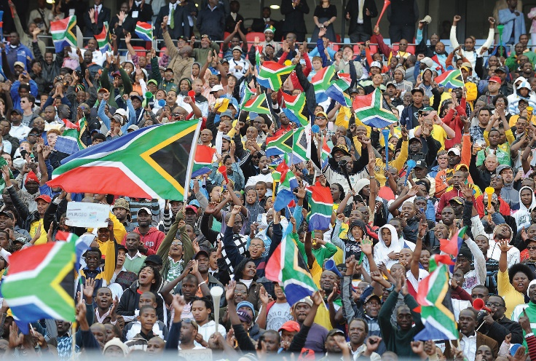

Medium Term Strategic Framework
Key impacts expected from the interventions of the nation building and social cohesion sector during 2014-2019.
Nation Building Pillar | Impact Indicator | Minister responsible | Baselines 2011 | 2019 targets
Promoting social cohesion across society | Pride in our national sporting teams | Sport and Recreation (via GCIS) | New indicator | 66% of South Africans proud of our national sporting teams

Slide 8
Promoting social cohesion across society through increased interaction across race and class
Promote participation in sport and recreation
Advocate transformation in sport and recreation
Develop talented athletes by providing them with opportunities to excel
Support high performance athletes to achieve success in international sport

Slide 9

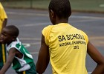
Medium Term Strategic Framework
Priority interventions by SRSA to promote social cohesion. Revised in 2016; 2019 Revision also possible
Promote participation in sport and recreation
Number of people actively participating in organized sport and active recreation events.
Number of people actively participating in sport and recreation promotion campaigns and events per year.
Number of sport and recreation promotional campaigns and events implemented per year.
Number of schools, hubs and clubs provided with equipment and/or attire as per the established norms and standards per year.
Advocate transformation in sport and recreation
Number of sport and recreation bodies receiving financial and non-financial support in an effort to assist them in meeting their transformation targets.
Develop talented athletes by providing them with opportunities to excel
Number of athletes supported by the sports academies.
Number of participants in national school sport championships per year.
Support high performance athletes to achieve success in international sport
Number of athletes supported through the scientific support programme.

Slide 10


Slide 11

active nation
winning nation
enabling environment
transversal issues
sport as a tool

Slide 12

Minor technical adjustments have been made to the Strategic Plan 2015-2020.
These do not change the intent of the plan but rather improve the indicators and targets.
In some instances the adjustment is purely to adhere more strictly to the SMART principle of indicator development.
The comments of the A-G on the 2018/19 APP were also considered warranting adjustments.
As no policy shifts have been made it is not necessary to re-table the 2015-2020 Strategic Plan.
It remains valid for the period.

Slide 13
LEGAL FRAMEWORK
National Sport and Recreation Act
South African Boxing Act
South African Institute for Drug-free Sport Act
Safety at Sports and Recreational Events Act
Occupational Health and Safety Act
Public Service Act
Public Finance Management Act
Promotion of Access to Information Act
Preferential Procurement Policy Framework Act
Skills Develop. Act
Broad Based Black Economic Empower-ment Act
Division of Revenue Act
Inter-governmental Relations Framework Act

Slide 14
LEGAL FRAMEWORK
Legislation | Status | Action | Implementation
National Sports and Recreation Amendment Bill | The Bill has been introduced in Parliament. | Bill to pass through Cabinet Committees. | Once passed
South African Institutes for Drug – Free Sport Amendment Bill | The Bill has been placed on hold. | The Bill has been placed on hold. | The Bill has been placed on hold.
Combat Sports Bill | The Bill has been drafted and is being placed on hold. | The Bill will be submitted to Clusters during 2019/20. | The Bill has been placed on hold until after promulgation of both National Sport and Recreation Amendment Bill and South African Institute for Drug–free Sport amendment Bill
Fitness Industry Regulatory Bill | The Bill has been drafted and is being placed on hold. | The Bill will be submitted to Clusters during 2019/20. | The Bill has been placed on hold until after promulgation of both National Sport and Recreation Amendment Bill and South African Institute for Drug–free Sport Amendment Bill
Recognition of Sport or Recreation Bodies Amendment Regulations | The regulation has been drafted but is being put on hold until the promulgation of National Sport and Recreation Amendment Bill | The draft regulations will be processed for public consultations | The draft regulations have been put on hold until the promulgation of the National Sport and Recreation Amendment Bill
Bidding and Hosting of International Sport or Recreation Event Amendment Regulations | The regulation has been drafted but is being put on hold until the promulgation of National Sport and Recreation Amendment Bill | The draft regulations will be processed for public consultations | The draft regulations have been put on hold until the promulgation of the National Sport and Recreation Amendment Bill

Slide 15
STRATEGIC INFLUENCES
International
United Nations / UNESCO
WADA
Continental
African Union Sports Council: Sport Development Region Five Agenda 2063
South African Government
National Development Plan
Medium Term Strategic Framework
National
White Paper on Sport and Recreation
National Sport and Recreation Plan

Slide 16



Slide 17
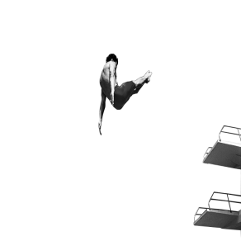

2019 20 Considerations
No strategic/policy changes
No budget increases
Last year of MTSF implementation
Opportunity later in 2019 to re-table policy changes
DPME busy with 5 year NDP plan

Slide 18
STRATEGIC VISION 2015 - 2020
Vision:
An active and winning nation
Mission:
Transform the delivery of sport and recreation by ensuring equitable access, development and excellence at all levels of participation, thereby improving social cohesion, nation building and the quality of life of all South Africans

Slide 19
STRATEGIC GOALS
Strategic goal 1 | Citizens access sport and recreation activities
Goal statement | Citizens access sport and recreation activities such that there is an increase of 10% in sport and recreation participation of citizens in selected activities by 2020.
Strategic Objectives | Active recreation programmes implemented. Sports participation opportunities provided to communities. School sport programmes supported. Provincial sports development programmes supported. Access to sport and recreation facilities optimised. Technical and management support provided.
Strategic goal 2 | Sport and recreation sector adequately transformed
Goal statement | Foster transformation within the sport and recreation sector such that selected National Federations achieve their transformation commitments by 2020.
Strategic Objectives | Active recreation programmes implemented. Sports participation opportunities provided to communities. School sport programmes supported. Provincial sports development programmes supported. Transformation of South African Sport adequately addressed.(Revised) Access to sport and recreation facilities optimised. Technical and management support provided.
Strategic goal 3 | Athletes achieve international success
Goal statement | Athletes and teams achieve success at international events as a result of them being supported by high-performance interventions. Success is qualified as an improvement in South Africa’s performance at selected multi-coded events; or an improvement and/or maintenance of world rankings in selected sports codes by 2020.
Strategic Objectives | Scientific support services coordinated for athletes. Major events supported. Sports Tourism to South Africa promoted. Achievements in the sport and recreation sector acknowledged.

Slide 20
STRATEGIC GOALS
Strategic goal 4 | Enabling mechanisms to support sport and recreation
Goal statement | An integrated system of enablers (i.e.: facilities; sports confederations; an academy system; a sports house; a sports information centre; beneficial international relations and supportive sports broadcasting and sponsorships) established and fully operational by 2020.
Strategic Objectives | Provincial sports development programmes supported Good governance supported Sport and recreation bodies supported Strategic bilateral relations managed and strengthened Participation in strategic multilateral relations managed Access to sport and recreation facilities optimised. Technical and management support provided.
Strategic goal 5 | Sport used as a tool to support SA Government and global priorities
Goal statement | 5% increase by 2020 in the perception of sport being recognised by the South African population as contributing to nation building. Sport used as a tool to contribute to a minimum of four global priorities by 2020.
Strategic Objectives | Strategic leadership, management and support services provided. Government responsibility towards anti-doping supported.
Strategic goal 6 | An efficient and effective organisation
Goal statement | Implement internal processes to ensure that SRSA annually receives an unqualified audit report and an MPAT rating of 4 within 5 years.
Strategic Objectives | Strategic leadership, management and support services provided.

Slide 22
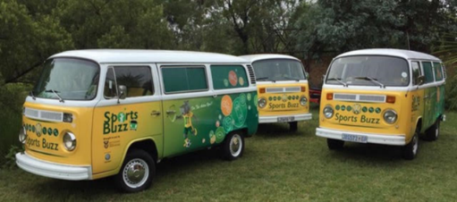
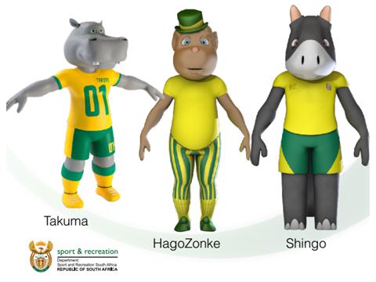


Prog. 1: ADMINISTRATION

Slide 24
Administration
Compliance / Strategic interventions
Sports Promotion
Hagozonke
Takuma
Shingo
Sports Buzz
Event support
MPAT
Women & Sport Policy
Performance Information
ICT Strategy Implementation Plan
Satisfaction Surveys
SDIP
# Ichoose2Bactive
HEADCOM
Inquiries (SASCOC & FNB)
Compulsory Induction Programme
Intellectual Property
Prog. 1 Key outputs

Slide 25
Programme Performance Indicator | Quarterly Biannual Annual | Annual Target 2019/20 | Cumulative/ Non-cumulative Quarter to Date | Quarter One | Quarter Two | Quarter Three | Quarter Four
1.1 Performance assessments moderated for the previous financial year. | A | 100% | NC | - | - | 100% | -
1.2 Number of employees trained. | Q | 60 | C | 10 | 20 | 20 | 10
1.3 Number of client satisfaction survey reports adopted at MANCO. | A | 1 Internal Client Satisfaction Survey Report adopted | C | - | - | 1 Internal Client Satisfaction Survey report adopted | -
1.4 Percentage of invoices paid within 30 days. | Q | 100% | NC | 100% | 100% | 100% | 100%
1.5 Number of Information and Communication Technology (ICT) Strategy Implementation Plan Status Reports adopted at MANCO. | Q | 4 Status reports adopted at MANCO | C | 1 Status report adopted at MANCO | 1 Status report adopted at MANCO | 1 Status report adopted at MANCO | 1 Status report adopted at MANCO

Slide 26

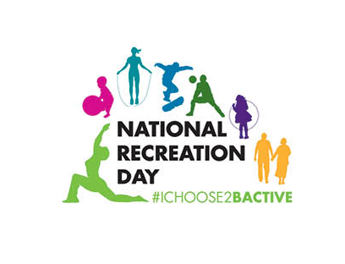





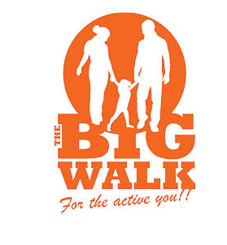

Prog. 2: ACTIVE NATION

Slide 28
Active Nation
School Sport
Active Recreation
National Youth Camp
Big Walk
National Recreation Day
Indigenous Games Festival
Rural Sport Development Programme
Ministerial Outreach Programme
National School Sport Championships - 4 segments
Provincial Sport Support
School Sport
Community Sport
Sport Academies
National Training Centre
Move for Health Day
Golden Games
Community Sport
loveLife funding
Club Development
SRSA-DBE MOU
UNITE campaign
Prog. 2 Key outputs

Slide 29
Programme Performance Indicators | Quarterly/ Biannual/ Annual | Annual Target 2019/20 | Cumulative/ Non-cumulative Quarter to Date | Quarter One | Quarter Two | Quarter Three | Quarter Four
Sub-programme: Active Recreation.
Active recreation programmes implemented.
2.1 Number of recreation promotional campaigns and events implemented per year. | Q | 5 Youth Camp Big Walk National Recreation Day UNITE Campaign Move for Health | C | 1 Move for Health | 1 UNITE Campaign | 3 Youth Camp Big Walk National Recreation Day | -
2.2 Number of people actively participating in recreation promotion campaigns and events per year | Q | 42 864 Participants in the Youth Camp (2 250) Big Walk (28 614) National Recreation Day (10 000) UNITE Campaign (1 000) Move for Health (1 000) | C | 1 000 Move for Health | 1 000 UNITE Campaign | 40 864 Youth Camp (2 250) Big Walk (28 614) National Recreation Day (10 000) | -

Slide 30
Programme Performance Indicators | Quarterly/ Biannual/ Annual | Annual Target 2019/20 | Cumulative/ Non-cumulative Quarter to Date | Quarter One | Quarter Two | Quarter Three | Quarter Four
Sub-programme: Community Sport.
Sport participation opportunities provided to communities.
2.3 Number of sport promotion campaigns and events implemented per year. | Q | 3 Indigenous Games Rural Sport Development Programme Ministerial Outreaches | C | - | 1 Rural Sport Development Programme | 1 Indigenous Games | 1 Ministerial Outreaches
2.4 Number of people actively participating in sport promotion campaigns and events per year. | Q | 4 864 Indigenous Games Festival (1 364) Rural Sport Development Programme (1 100) Ministerial Outreaches (2 400) | C | - | 1 100 Rural Sport Development Programme | 1 364 Indigenous Games Festival | 2 400 Ministerial Outreaches

Slide 31
Programme Performance Indicators | Quarterly/ Biannual/ Annual | Annual Target 2019/20 | Cumulative/ Non-cumulative Quarter to Date | Quarter One | Quarter Two | Quarter Three | Quarter Four
Sub-programme: School Sport.
School sport programmes supported.
2.5 Number of National School Sport Championships supported per year.¹ | Q | 1 National School Sport Championship | NC | Autumn Championships | Winter Championships | Summer Championships Indigenous Games Festival
2.6 Number of learners supported to participate in the National School Sport Championships per year. | Q | 5 000 | C | - | - | - | 5 000

Slide 32
Programme Performance Indicators | Quarterly/ Biannual/ Annual | Annual Target 2019/20 | Cumulative/ Non-cumulative Quarter to Date | Quarter One | Quarter Two | Quarter Three | Quarter Four
Sub-programme: Provincial sport support and coordinaton.
Provincial sport development programmes supported.
Funded from Conditional Grant:
2.7Number of people actively participating in organised sport and active recreation events. | Q | 350 000 | C | 50 000 | 50 000 | 200 000 | 50 000
2.8 Number of learners participating in school sport tournaments at a district level. | Q | 50 000 | C | 5 000 | 15 000 | 20 000 | 10 000
2.9 Number of schools, hubs and clubs provided with equipment and/or attire as per the established norms and standards per year. | Q | 2 500 | C | 250 | 1000 | 1000 | 250
2.10Number of athletes supported by the sports academies per year. | Q | 3 700 | C | 700 | 1 000 | 1 000 | 1 000
2.11 Number of sport academies supported. | Q | 35 | C | 10 | 10 | 10 | 5

Slide 33






Prog. 3: WINNING NATION

Slide 35
Programme Performance Indicator | Quarterly Biannual Annual | Annual Target 2019/20 | Cumulative/ Non-cumulative Quarter to Date | Quarter One | Quarter Two | Quarter Three | Quarter Four
Sub-programme: Scientific Support.
Scientific support services coordinated for athletes.
3.1 Number of SASCOC MOU progress reports evaluated. | Q | 4 | C | 1 | 1 | 1 | 1
3.2 Number of athletes supported through the Ministerial Sports Bursary Programme | Q | 50 | C | 0 | 10 | 20 | 20
3.3 Number of athletes supported through the scientific support programme per year. | Q | 80 | C | 20 | 20 | 20 | 20
Government responsibility towards anti-doping supported.
3.4 Number of drug-free sport support agencies supported. | Q | 4 RADO WADA CDA SAIDS | C | 1 | 1 | 1 | 1

Slide 36
Programme Performance Indicator | Quarterly Biannual Annual | Annual Target 2019/20 | Cumulative/ Non-cumulative Quarter to Date | Quarter One | Quarter Two | Quarter Three | Quarter Four
Sub-programme: Major Events Support.
Major events supported.
3.5 Number of major international events receiving intra-Governmental support per year. | Q | 4 | C | 1 | 1 | 1 | 1
Sport Tourism to South Africa promoted.
3.6 Number of status reports detailing national & international sporting events, exhibitions or conferences used to showcase SA as a sports tourist destination. | A | 1 Status Report | C | - | - | - | 1 Status Report
Sub-programme: Recognition Systems.
Achievements in the sport and recreation sector acknowledged.
3.7 Number of recognition and honouring events. | Q | 4 South African Sports Awards; Ministerial Outstanding Sports Performance Accolades; Andrew Mlangeni Green Jacket Awards; Honouring Women in Sport Awards | C |  | 1 Honouring Women in Sport Awards | 2 South African Sports Awards Andrew Mlangeni Green Jacket Awards | 1 Ministerial Outstanding Sports Performance Accolades

Slide 37










Prog. 4: SPORT SUPPORT

Slide 39
Sport & Recreation Service Providers
National sport and recreation financial and non-financial support framework
Priority codes policy
Code of Conduct
Federation of the Year
Gymnastics
Boxing South Africa
Sports Trust - Multi-purpose courts sports facilities at schools
SCORE
Transformation
Transformation Charter and Scorecard
Transformation barometer
Eminent Persons Group
International Relations
African Union Sports Council Sport Development Region Five
Status reports detailing multilateral engagements
Sport Support
Bilateral engagements
EPG Audit Report
Phil Masinga Training Programme
Train teachers as coaches
Prog. 4 Key outputs

Slide 40
Programme Performance Indicators | Quarterly Biannual Annual | Annual Target 2019/20 | Cumulative/ Non-cumulative Quarter to Date | Quarter One | Quarter Two | Quarter Three | Quarter Four
Sub-programme: Sport and Recreation Service Providers.
Good governance supported
4.1 Number of good governance monitoring reports generated. | Q | 2 | C | - | 1 | - | 1
Sport and recreation bodies supported.
4.2 Number of sport and recreation bodies receiving financial and non-financial support in an effort to assist them in meeting their transformation targets per year. | Q | 60 | C | 1 | 10 | 49 | -
4.3 Number of Sport Trust MOU progress reports evaluated. | Q | 2 | C | - | 1 | - | 1
4.4 Number of multi-purpose sports courts built | A | 10 | C | - | - | - | 10

Slide 41
Programme Performance Indicators | Quarterly Biannual Annual | Annual Target 2019/20 | Cumulative/ Non-cumulative Quarter to Date | Quarter One | Quarter Two | Quarter Three | Quarter Four
Sub-programme: Sport and Recreation Service Providers.
Transformation of South African sport adequately addressed.
4.5 Number of EPG audit reports with comparative and NF specific charter and barometer performance outcomes | A | 1 | C | - | - | - | 1
4.6 Number of NFs submitting completed data sheets on their transformation status | A | 19 | C | - | - | 19 | -
Sub-programme: International relations.
Strategic bilateral relations managed and strengthened.
4.7 Number of bilateral engagements implemented. | Q | 3 | C | - | 1 | 1 | 1
Participation in strategic multilateral relations managed.
4.8 Number of status reports detailing multilateral engagements supported. | Q | 4 | C | 1 | 1 | 1 | 1

Slide 42

Prog. 5: INFRASTRUCTURE SUPPORT

Slide 44
Sport Infrastructure Support
Facility planning
Facilities classification framework
Municipal Infrastructure Grant (MIG) allocations
World Cup stadia reports – status report
Facility management
NASREC precinct
Community gyms
Children’s play parks
Greening of open space (partner project)
Technical assistance to local authorities
"The home of......"priority codes
Prog. 5 Key outputs

Slide 45
Programme Performance Indicator | Quarterly Biannual Annual | Annual Target 2019/20 | Cumulative/ Non-cumulative Quarter to Date | Quarter One | Quarter Two | Quarter Three | Quarter Four
Sub-programme: Sport and Recreation facility planning.
Access to sport and recreation facilities optimised.
5.1 Number of community gyms and children’s play parks constructed. | Q | 10 | C | - | 3 | 3 | 4
Sub-programme: Sport and recreation facility management.
Technical and management support provided.
5.2 Number of municipalities provided with technical and management support. | Q | 40 | NC | 40 | 40 | 40 | 40

Slide 46
PUBLIC ENTITIES
The South African Institute for Drug-Free Sport promotes participation in sport without the use of prohibited performance enhancing substances and methods, and educates sportspeople on fair play and the harmful effects of doping.
Boxing South Africa administers professional boxing, recognises amateur boxing, creates synergy between professional and amateur boxing, and promotes interaction between associations of boxers, managers, promoters, trainers.

Slide 47



