Slide 1
ANNUAL performance PLAN (2019/20) Portfolio Committee on social development

Slide 2
PURPOSE
The purpose is to present to the Portfolio Committee on Social Development the NDA’s Annual Performance Plan for the 2019/20 Financial Year

Slide 3
VISION OF THE NDA
Vision: A society free from poverty
Mission: Facilitate sustainable development by strengthening CSOs involved in poverty eradication through enhanced capacity building with grant funding and research
Integrity
Dignity
Empowerment
Accountability
Transparency
Excellence
Partnering
ORGANISATIONAL VALUES

Slide 4
LEGISLATIVE MANDATE
NDA is a Schedule 3A Entity administratively reporting to DSD but operationally attached to all departments
Primary Mandate | Secondary Mandate
To contribute towards the eradication of poverty and its causes by granting funds to civil society organisations for the purpose of: | To promote consultation, dialogue and sharing of development experience between the CSOs and relevance organs of state through:
Carrying out programmes and projects aimed at meeting development needs of the poor Strengthening the institutional capacity of other civil society organisations involved in direct service provision to the poor communities | Debating development policy Undertaking research and publication aimed at proving basis for development policy
Further, the Agency is required by section 4 of the Act to implement programmes that respond to the following areas of responsibilities:
Act as a key conduit for funding from the Government of the Republic, foreign governments and other national and international donors for development work to be carried out by CSOs.
Contribute towards building the capacity of CSOs to enable them to carry out development work effectively.
Create and maintain a database of CSOs, including, but not limited to, the scope and subject matter of their work and their geographical distribution, and share the information in that database with relevant organs of state and other stakeholders.

Slide 5
LEGISLATIVE MANDATE
Legislative Instruments
RSA Constitution;
PFMA;
NDA Act;
NPO Act;
Cooperatives Act;
White Paper on ECD etc.
International Instruments
Sustainable Development Goals;
Agenda 2063
Multilateral agreements;
Bilateral agreements;
Memoranda of Understanding, etc.
NDA
MANDATE
Guiding Documents
NDP;
MTSF;
SONA;
National Budget Speech;
Minister’s Budget Vote Speech;
Sector specific strategies, etc.
Policies and Frameworks
Population Development policy;
National Integrated ECD Policy;
National Plan of Action for Children
Government Wide Monitoring & Evaluation Framework, etc.

Slide 6
INTEGRATION AND ALIGNMENT
 | MTSF OUTCOME | SECTORAL INTEGRATION
1 | JOB CREATION AND ECONOMIC GROWTH | SASSA SRD Programme referrals of cooperatives & income generation CSOs DSD (CNDC) programme referrals of cooperatives and agricultural income generation CSOs to supply vegetables to the market
2 | YOUTH DEVELOPMENT | DSD (Community Dev, NPOs directorate, Welfare, Disability branches)
3 | WOMEN PARTICIPATION | DSD (Community Dev, NPOs directorate, Welfare, Disability branches) on reporting on youth owned CSOs supported by NDA
4 | EDUCATION | DSD ( Welfare, Disability branches) on ECDs and children benefitting from NDA support
5 | HEALTH | DSD Food Security Unit
6 | INTERNATIONAL WORK | DSD international relations Unit – Implementation of bilateral and Multilateral Agreements and other international instruments

Slide 7
ORGANISATIONAL STRUCTURE
MINISTER FOR SOCIAL DEVELOPMENT
NDA BOARD
CHIEF EXECUTIVE OFFICER
INTERNAL AUDIT
COMPANY SECRETARY
LEGAL AND RISK
CORPORATE PERFORMANCE
,
MANAGEMENT
PLANNING
,
MONITORING AND
REPORTING
STAKEHOLDER RELATIONS
DEVELOPMENT
,
MANAGEMENT AND
CORE OPERATIONS
FINANCE
CORPORATE SUPPORT
RESEARCH
SERVICES
DEVELOPMENT
GRANT FUNDING
,
FINANCIAL MANAGEMENT
COMMUNICATIONS AND
(
PRODUCT
RESOURCE MOBILISATION
MARKETING
DEVELOPMENT
)
AND CSO CAPACITY
BUILDING
SUPPLY CHAIN
INFORMATION
RESEARCH
MANAGEMENT
COMMUNICATION AND
OPERATIONS
TECHNOLOGY
MANAGEMENT
MONITORING
,
HUMAN CAPITAL
EVALUATION
,
MANAGEMENT
REPORTING AND
9
X PROVINCE
LEARNING
SUPPORT SERVICES
Dotted Line=
*Operationally Report to Board
*Administratively Report to CEO
9
X DISTRICT

Slide 8
NDA CSO DEVELOPMENT MODEL

Slide 9
Programme 1 - Governance and Administration

Slide 10
Strategic Statement & Objective
Performance Indicators and Targets
Quarterly Targets
STRATEGIC STATEMENT | Implement financial management, information technology, human resource and communications systems and processes to achieve good governance by 2020/21
Strategic Objective | Estimated performance 2018/19 | Medium-Term Targets
 |  | 2019/20 | 2020/21 | 2021/22
To develop and strengthen internal systems, processes and human capability to deliver efficiently and effectively on the NDA mandate | Unqualified Audit Opinion with findings | Unqualified Audit Opinion without findings | Unqualified Audit Opinion without findings | Unqualified Audit Opinion without findings

Slide 11
Strategic Statement & Objective
Performance Indicators and Targets
Quarterly Targets
Performance Indicator |  | Estimated Performance 2018/19 | Medium-Term Targets
 |  |  | 2019/20 | 2020/21 | 2021/22
KPI-01 | Integrated HRM&D System | HRM&D Strategy Approved | Approval and Implementation of the Salary Key Scale / Notch System for the NDA | Conduct Skills Audit and Competency Framework for NDA | Conduct Employee Climate Survey
KPI-02 | Integrated ICT system | Appointed Service provider for development of the CSO Database & Information Management System | CSO Database & Information Management System developed | Integrated Portal developed | Data Warehouse and Business Intelligence System developed
KPI-03 | % compliance to legislative and regulatory requirements | 100% | 100% | 100% | 100%
Notes:
What happens beyond full implementation of the HRM&D strategy?
Do we have enough money to implement the ICT strategy? Is

Slide 12
Strategic Statement & Objective
Performance Indicators and Targets
Quarterly Targets
Performance Indicator |  | Annual Target 2019/20 | Quarterly Targets
 |  |  | 1st | 2nd | 3rd | 4th
KPI-01 | Integrated HRM&D System | Approval and Implementation of the Key Salary Scale / Notch System for the NDA | -Development & Approval of Progressive Key Salary Scale -Costing of the implementation of Key Salary | Reconfiguration of Pay-Roll to align with the Key Salary Scale -Placement of all NDA Staff into the Salary Key Scale Model/ Notch System | Conduct an Audit of Implementation of the Key Salary Scale | Monitoring of Implementation of the Salary Key Scale System
KPI-02 | Integrated ICT system | CSO Database & Information Management System developed | System analysis & requirements for CSOs Master Database & IMS completed | Development of CSOs Master Database & IMS completed | CSO Database & IMS tested for functionality | CSO Database & IMS systems deployed live
KPI-03 | % compliance to legislative and regulatory requirements | 100% | 100% | Compliance framework approved | 100% | 100%

Slide 13
Programme 2 - CSO Development

Slide 14
Strategic Statement & Objective
Performance Indicators and Targets
Quarterly Targets
STRATEGIC STATEMENT | Conduct engagements, dialogues, assessments and needs analysis for CSOs to identify the type of development interventions required by CSOs including facilitating formalisation of the organisations to ensure increase number of CSOs provided with CSO development interventions including registration by 2020/21
STRATEGIC OBJECTIVE | Estimated performance 2018/19 | Medium-Term Targets
 |  | 2019/20 | 2020/21 | 2021/22
To increase the number of CSOs that have access to development interventions aimed at developing their capabilities to efficiently manage, mobilise resources and sustain themselves | 8 500 | 9 500 | 10 500 | 11 500

Slide 15
Strategic Statement & Objective
Performance Indicators and Targets
Quarterly Targets
Performance Indicator |  | Estimated Performance 2018/19 | Medium-Term Targets
 |  |  | 2019/20 | 2020/21 | 2021/22
CSO Mobilisation & Formalisation
KPI-04 | Number of CSOs participated in CSOs mobilisation programmes per year | 8500 | 9500 | 10500 | 11 500
KPI-05 | Number of CSOs assisted to formalise their structures per year | 940 | 1000 | 1200 | 1350
CSO Institutional Capacity Building
KPI-06 | Number of CSOs capacitated to comply with registration legislations per year | 4000 | 5000 | 6000 | 6500
KPI-07 | Number of CSOs capacitated in civil society organisational management per year | 5000 | 5500 | 6000 | 6500
CSO Grant Funding & Resource Mobilisation
KPI-08 | Number of CSOs that receive grant funding per year | 250 | 90 | 90 | 90
KPI-09 | Rand Value of resources raised per year | R50m | R55m | R60m | R65m
CSO Linkages for sustainability
KPI-10 | Number of CSOs referred to sustainable resource opportunities per year | 1500 | 2000 | 2500 | 2750

Slide 16
Strategic Statement & Objective
Performance Indicators and Targets
Quarterly Targets
Performance Indicator |  | Annual Target 2019/20 | Quarterly Targets
 |  |  | 1st | 2nd | 3rd | 4th
CSO Mobilisation & Formalisation
KPI-05 | Number of CSOs participated in CSOs mobilisation programme per year | 9500 | 950 | 3800 | 6650 | 9500
KPI-06 | Number of CSOs assisted to formalise their structures per year | 1000 | 100 | 400 | 700 | 1000
CSO Institutional Capacity Building
KPI-07 | Number of CSOs capacitated to comply with registration legislations per year | 5000 | 500 | 2000 | 3500 | 5000
KPI-08 | Number of CSOs capacitated in civil society organisational management per year | 5500 | 550 | 2200 | 3850 | 5500
CSO Grant Funding & Resource Mobilisation
KPI-09 | Number of CSOs that receive grant funding per year | 90 | 20 | 45 | 65 | 90
KPI-04 | Rand Value of resources raised per year | R55m | R5m | R20m | R35m | R55m
CSO Linkages for sustainability
KPI-11 | Number of CSOs referred to sustainable resource opportunities per year | 2000 | 200 | 800 | 1400 | 2000

Slide 17
Programme 3 - Research

Slide 18
Strategic Statement & Objective
Performance Indicators and Targets
Quarterly Targets
STRATEGIC STATEMENT | Increase the number of research and evaluation publications, engagements and debates that inform the formulation of national development policies and programs focusing on poverty eradication initiatives.
Strategic Objective | Estimated performance 2018/19 | Medium-Term Targets
 |  | 2019/20 | 2020/21 | 2021/22
To provide empirical information from research and evaluation studies to inform national development policy formulation, debates and engagements between the CSO, public and private sectors | 35 reports | 40 reports | 46 reports | 52 reports

Slide 19
Strategic Statement & Objective
Performance Indicators and Targets
Quarterly Targets
Performance Indicator |  | Estimated performance 2018/19 | Medium-Term Targets
 |  |  | 2019/20 | 2020/21 | 2021/22
KPI-11 | Number of research reports and policy briefs produced per year | 15 | 16 | 18 | 18
KPI-12 | Number of Evaluation reports produced per year | 8 | 9 | 10 | 10
KPI-13 | Number of knowledge management publications produced per year | 12 | 15 | 18 | 20
KPI-14 | Number of development policy dialogues and consultation sessions held per year | 10 | 12 | 14 | 16

Slide 20
Strategic Statement & Objective
Performance Indicators and Targets
Quarterly Targets
Performance Indicator |  | Annual Target 2019/20 | Quarterly Targets
 |  |  | 1st | 2nd | 3rd | 4th
KPI-11 | Number of research reports and policy briefs produced per year | 16 | 4 | 8 | 12 | 16
KPI-12 | Number of evaluation reports produced per year | 9 | 2 | 4 | 7 | 9
KPI-13 | Number of knowledge management publications produced per year | 15 | 3 | 7 | 11 | 15
KPI-14 | Number of development policy dialogues and consultation sessions held per year | 12 | 2 | 6 | 8 | 12

Slide 21
MEDIUM TERM EXPENDITURE FRAMEWORK BUDGET

Slide 22
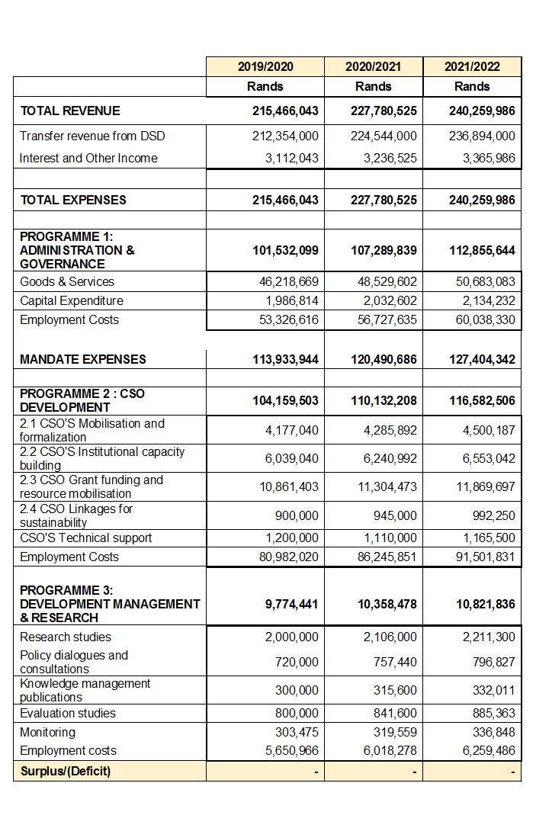
NDA BUDGET FOR THE MTEF PERIOD 2019/20 – 2021/22

Slide 23
NARRATIVE TO MTEF BUDGET
REVENUE OVER THE MTEF period 2019/20 – 2021-2022
The main source of funding , being the allocation from DSD is increasing by an average of 5,3% over the MTEF.
While the allocation is increasing by the above increases, the main costs drivers, being employment costs and operating overheads such as rentals for offices and ICT infrastructure costs are increasing at a rate above CPI.
Employment costs over the period are expected to increase by an average of 6.5% to 7% over the MTEF per wage agreement signed with labour while office rentals increase by an average of 8% per annum. The costs of doing business is increasing at an average of 7.2%.

Slide 24
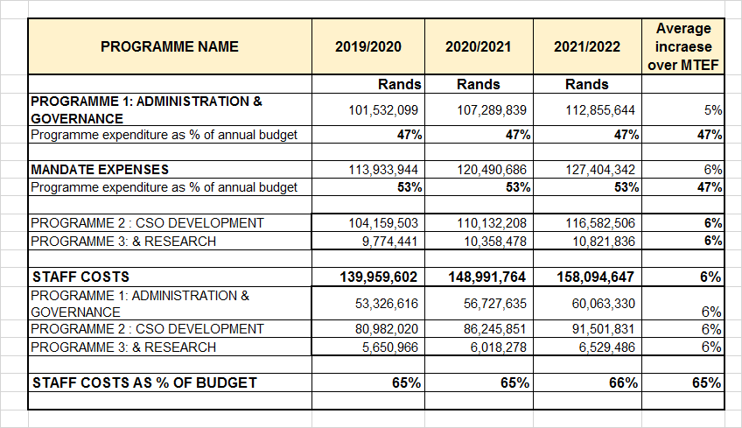
EXPENSES OVER THE MTEF PERIOD

Slide 25
RECOMMENDATION
It is recommended that the Portfolio Committee approves the 2019/20 Annual Performance Plan for NDA

Slide 26
Thank you
THANK YOU

