Slide 1
Access to diversified media for alla
PRESENTATION TO PORTFOLIO COMMITTEE
Acting CEO, Zuki Potye
Wednesday, 03 July 2019

Slide 2
PRESENTATION OVERVIEW
Topic
1. Strategic Overview
2. Current Sector Environment
3. What is Community Media?
4. Media Landscape
5. MDDA Support
6. MDDA Performance
7. MDDA 2019/2020 Annual Performance Plan
8. Concluding Remarks
7. The New Head Office

Slide 3
1. Strategic Overview
Government Priorities 2019/25
Accelerate inclusive economic
growth and create jobs.
MDDA funds stipends and projects salaries, thereby creating direct and indirect jobs. Civic engagement, informed citizenship and the fundamental right to freedom of expression and information can, in any democracy, only be guaranteed through media freedom and pluralism. Capacity building initiatives for the sector and internally.
2. Improving the education system to
ensure that the country could develop
the skills it needed.
3. Improve the conditions of life for all
South Africans, especially the poor.
4. Step up the fight against corruption and
state capture.
5. Strengthen the capacity of the state to
address the needs of the people.

Slide 4
National Development Plan
The National Development Plan - Vision 2030 (NDP) informs the MDDA’s -Long term goals, mandates and strategic objectives.
Outcome 12 relates to an efficient, effective and development orientated public service. Good corporate governance and internal processes.
Outcome 14 relates to nation building and social cohesion as it envisions a society where South Africans will be more conscious of what they have in common than their differences. It directs the MDDA’s approach when supporting and enabling content and production elements.
Outcome 6 relates to an efficient, competitive and responsive economic infrastructure network. Broadcast equipment roll-out.

Slide 5
Constitutional Mandate
Section 15 (1)
“Everyone has the right to freedom of conscience, religion, thought, belief and opinion.”

Slide 6
MDDA Mandate
Encourage ownership of, and access to, media by HDGs as well as by historically diminished indigenous language and cultural groups
Encourage the development of human resources and training, and capacity building, within the media industry, especially amongst HDGs
Encourage the channeling of resources to the community media sectors
Raise public awareness with regard to media development & diversity issues
Support initiatives which promote literacy and a culture of reading
Encourage research regarding media development & diversity
Liaise with other statutory bodies such as ICASA and USAASA
Encourage ownership of, and access to, media by HDGs as well as by historically diminished indigenous language and cultural groups
Encourage the development of human resources and training, and capacity building, within the media industry, especially amongst HDGs
Encourage the channeling of resources to the community media sectors
Raise public awareness with regard to media development & diversity issues
Support initiatives which promote literacy and a culture of reading
Encourage research regarding media development & diversity
Liaise with other statutory bodies such as ICASA and USAASA
Section 16 & 32 of the Constitution provides for freedom of expression and access to information
MDDA Act no 14 of 2002

Slide 7
Vision, Mission, Values
Vision
An accessible, transformed and diversified media.
Mission
Leading media development, transformation and diversification in South Africa.
Values
Accountability, Inclusivity, Integrity, Ubuntu, Professionalism.

Slide 8
Strategic Objectives
To position the MDDA as an authoritative leader and voice on community and commercial media by proactive advocacy and lobbying interventions and established stakeholder relationships
To facilitate ownership, control and access to information and content
production of community broadcasting by historically advantaged
communities.
To expand our footprint as the MDDA by creating a positive image in
pursuance of the MDDA’s mandate to grow the community and small
commercial media.
To ensure compliance with applicable legislative requirements and sustainability of the Agency by 2019
To facilitate ownership, control and access to information and content
production of community and small commercial publications by historically
disadvantaged
communities.
To monitor and evaluate input, output and compliance to MDDA grant-in-aid
contracts to measure the effectiveness and efficiency of the MDDA support

Slide 9
MDDA Structure
Board
Chief Executive Officer
Programme 1 - Governance and Administration
Programme 2 - Grant and Seed Funding
Programme 3 - Partnerships, Public Awareness and Advocacy
Programme 4 - Capacity Building and Sector Development
Programme 5 - Innovation, Research and Development

Slide 10
2. Current Sector Environment
Challenge | Interventions
Sustainability | Implement interventions to ensure Commercial Print media funding Enforce 30% government advertising spend to community media Find sustainable solutions on transmission costs Redesign funding model for more developmental approach to sector - to accommodate projects in severely depressed areas
Governance | Board Governance trainings On-site capacity building interventions in critical skills Monitoring and Evaluation
Technological environment | Broadcast equipment support for digital broadcasting readiness Partner with DoC on digital broadcasting awareness Print publications capacity building on online news and e-commerce
Untransformed mainstream media | Enforce regulations against unfair competition (Competition Commission)
Content Generation | Capacity building interventions Funding for content generation Redesign and increase capacity building interventions

Slide 11
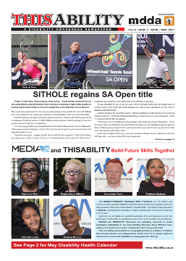
3. What is Community Media?
MDDA Act defines Community Media as:
A geographically founded community or any group of persons or sector of the public having a specific ascertainable common interest.
And, Small Commercial Media as “independent media enterprises or initiatives that are run for personal gain as micro, very small or small business as classified in the National Small Business Act, 1996.
The Act uses three indicators: Number of people employed, turnover and assets of the business.

Slide 12
Why Community Media?
Active Citizenship: Community Media, as with the mainstream media, plays a core role in the dissemination of information;
Empowerment of grassroots communities by establishing a platform for social dialogue, formation of political opinion and to civic education.
Cornerstone for public participation and active citizenship, promoting transparency, encouraging openness in government, and building ownership of development decisions.
Social Cohesion: Community media plays a predominant role in strengthening and building communities.
Cementing the ties between the various sectors of the community and in the building and reconstruction of the social fabric of the communities in which it operates.
12

Slide 13
Why Community Media? (Cont.)
Voice for the voiceless: Community media is first and foremost participatory giving the communities the opportunity to add their views and aspirations to the public discourse in the country.
Transformation of the media: The need for a vibrant community media and small commercial media sector is an essential component of the transformation of the media in South Africa as, historically, the rural and poorer communities have been underserviced if not completely marginalised by large-scale commercial media.
13

Slide 14
4. Media Landscape Then & Now
- Media industry highly monopolised,
- Limited or no diversity of news or opinion,
- Voice of black people in media was suppressed.
- Limited alternative media, e.g. Bush radio and Vrye Weekblad, funded by international donors
Three tier system of private, public and community broadcast media in place
More than 200 community radio stations are in existence. Some 150 are or have been funded by the MDDA.
More than ever before, all languages of South Africa are being actively used in the media
Over 200 independent publications; some 90 funded by MDDA.
MDDA Act promulgated
MDDA funds its first projects in 2004

Slide 15
Community Broadcast Today
Licensed community radios | 285
Community radio listenership | 8 million
Number of stations on air | 212
Number of Community Radio Stations Funded by MDDA | 156
Number of Community TV Stations Funded by MDDA | 6 (including 2 initiatives)
Broadcast language | Full spectrum of South African languages can be heard - each station broadcasts in range of languages reflecting what is spoken by communities More focus on !Xu, Kwe and SA Sign Language

Slide 16
Community Print Today
No of publications | 180 87 weekly 38 fortnightly 55 monthly
Circulation | 7 million per month
Readership | +20 million per month
Publishing language | 97 publish in indigenous languages or combination of indigenous and English/Afrikaans
Black ownership | >60%
Women ownership | 18%
MDDA funded publications | 88

Slide 17
Community Broadcast - MDDA National Footprint
20
16
13
13
8
19
5
12
18

Slide 18
MDDA Funded Community Broadcast Projects – Station Managers by Gender

Slide 19
Location of MDDA Funded Community Broadcast Projects

Slide 20
Community TV – MDDA Geographic Footprint
Total number of licensed operating stations: 4 Total number of funded stations: 6
*Only FOUR (4) of the SIX (6) stations are licensed.
The other two are initiatives.

Slide 21
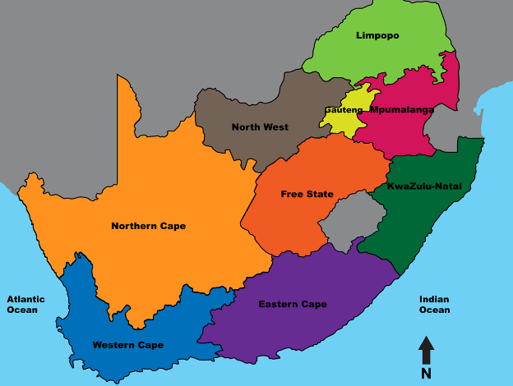
Small Commercial Print: MDDA footprint
Funding and non financial support to 45 Small Commercial Media Print Projects owned and managed by HDI.
6
3
2
8
3
5
5
6
7

Slide 22
Community Print – MDDA footprint
Funding and non financial support to 33 Community Print Projects owned and managed by NGOs (Government supported).
3
9
1
2
7
3
8

Slide 23
5. MDDA Support
Financial Support
Start up projects
Strengthen existing projects towards sustainability
Grant Funding
Lobbying and linkages with stakeholders
Non-financial Support
E.g. advertisers and government departments
Training and capacity Building
E.g. financial management, marketing, content generation
Mentorship to assist with, setting up governance, financial and administration systems

Slide 24
6. MDDA Performance
2016/2017 | 2017/2018 | 2018/2019
67 % of 61 KPIs 77% (10 of 13) KPIs in Core programme achieved (Funding of community media) | 45% (20) of the annual targets for its 44 key performance indicators for 2017/2018. | 80 % of 20 KPIs achievable - Unaudited
Funding targets exceeded in core programme as a result of rollover of funds 24 print projects funded | Non-achievement of targets largely due to vacancies at Board level, which meant that Board could not form a quorum for significant part of year to approve projects. | Two KPIs not be achieved Number of community television stations funded Number of reviews of Community Media digital migration
Unqualified Audit | Unqualified Audit | Unqualified Audit

Slide 25
2018/2019 Targets Not Achieved
Programme | KPI not achieved | Comment
Governance and Administration | Number of reviewed IT strategies and plans, approved by Board within 1st quarter of financial year | IT strategy and plan developed but referred by Board to ARC for review and recommendation.
Community Broadcast Media | Number of community radio stations approved by Board for funding | Some of projects selected for Board approval were non-compliant or were not innovative, etc. Projects went to Board and Committee five times in 2018. A draft funding policy to strengthen selection and funding criteria is before the Board.
 | Number of community television stations approved by Board for financial support
Strategic Programmes | Number of reviews of Community Media digital migration strategy approved by Board in last quarter of each year. | Development of strategy delayed as MDDA is initiating research into state of digital readiness of community media prior to working on digital migration strategy. This information is essential to meaningful strategy.

Slide 26
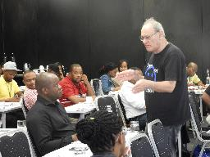
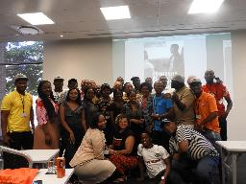
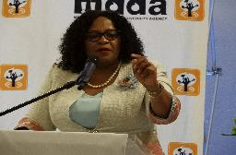
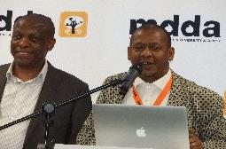
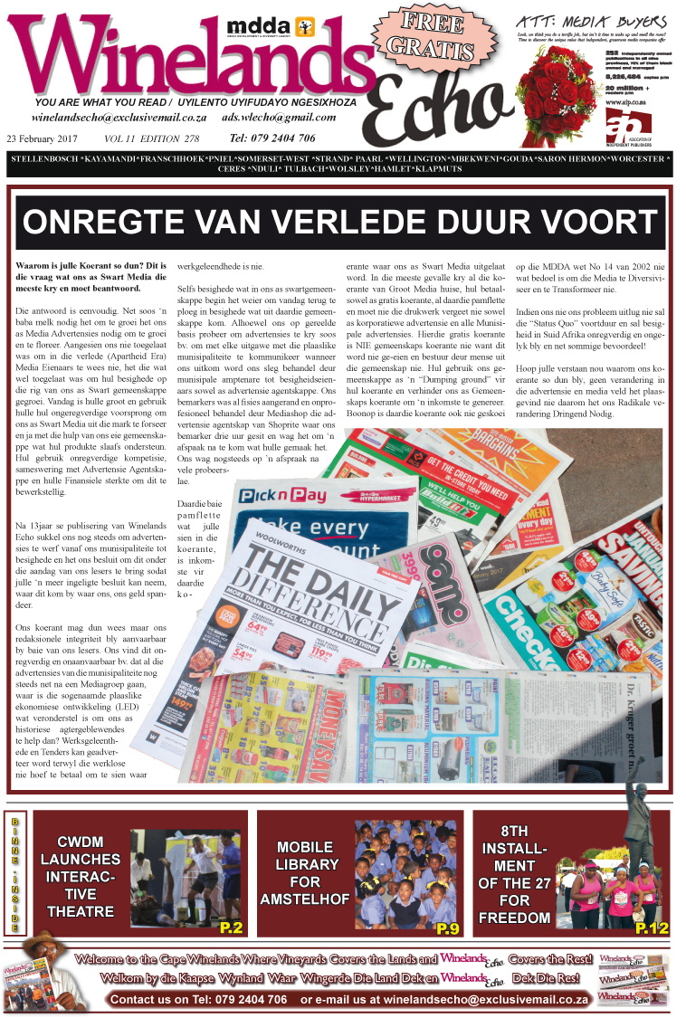
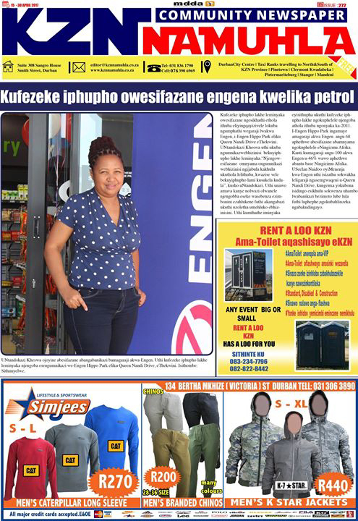
2018/2019 Highlights
Election reporting Community print and broadcast projects across all nine provinces. 8 workshops across 4 provincial clusters, 4 for broadcast and 4 for print.
Community Media Summit Attended by more than 200 stakeholders across the sector. Action plan drafted.
Project Funding approvals 20 Broadcast Projects approved 12 Community and SCM print projects

Slide 27
New Application Process
New Grant Funding Policy – Before Board
MDDA informing all applicants currently on waiting list that need to reapply
Application cut-off dates to be implemented from 2019/2020
- One call for applications in 2019/20
- Two calls for applications in following years
Call for applications to list criteria against which projects will be selected, eg focus on specific (underserved) municipalities/ provinces/ interest groups

Slide 28
Corporate Governance –
2018/19 Highlights
2018 status of MDDA policies: policy suite out of date (some last updated 2012) and incomplete
Comprehensive policy review and development process in Q4 2018/2019
Staff engaged in more than 50 policies covering HR, ICT, Finance, Communications and Stakeholder Engagement, Conflict of Interest, Supply Chain Management.
New financial year commenced with the majority of reviewed and newly developed policies approved by Board in place. Remainder (HR and IT) before the Board for approval in June 2019.
New policies developed for Risk Management, Anti-Fraud, Anti Corruption and Grant Funding.

Slide 29
Improved Employment Conditions 2018/19 Financial Year
HUMAN RESOURCES
Increase in medical aid subsidy – effective from end April 2019
Wage negotiations with staff - 7% salary increase effective from end April 2019
Job grading process completed – results to be presented to Board

Slide 30
MDDA Financial Environment

Slide 31
Financial Performance
Broadcast contributions have increased by 7% compared to 2017/18 financial year as a result of continued support from Multichoice.
MoU with Multichoice has expired during 2018/19 and management is still in the process of negotiating the new funding agreement.
Print industry is still not contributing to the MDDA, engagements are underway to persuade their contribution.
Grants from DoC have only increased by 2% which is below inflation.
Other income include interest from investments and R20 000 donations.

Slide 32
Financial Performance
Employee cost has increased by 25% as a result of positions filled in the 2018/19 financial year.
The entity also has three officials seconded from DoC and GCIS.
Grant cost expenditure has decreased by 14% - This is mainly as result of reduced level of compliance by the beneficiaries and stringent controls implemented before payments are made. In some cases, where projects have misspent MDDA funds, these projects have subsequently repaid these deviations, after MDDA intervention.
Administrative expenditure have decreased by 20% as a result of cost containment measures implementation.
Finance costs have decreased by 36% since the lease hold improvement of the MDDA building is nearing the end and resulting in lesser finance cost.

Slide 33
Financial Performance
Board Costs
Decreased from R2.7 million to R1.8 million which resulted in 34% ( or R938 249) savings on board costs.
Travelling costs
Decreased by 11% (or R412 623) from 2017/18 to 2018/19 financial year.
The reduction in board cost was mainly as a result of lesser planned board activities and lesser involvement of board members on operations.
A new travel policy has been approved by the board and is being used in the 2019/20 financial year.
MDDA is making used of shared travelling service provider with Brand SA which will result in synergies.

Slide 34
Financial Performance
The entity has not incurred fruitless and wasteful expenditure in 2018/19 financial year.
MDDA has identified supply chain management irregularities and disclosed R39 million irregular expenditure in the 2018/19 financial year. This as a result of non compliance identified in broadcast equipment centralisation tender.
The entity has cancelled all historical “evergreen” contracts with exception of one (Copying machines) where request for quotations has already been issued.

Slide 35
Financial Performance
Management has reviewed all projects included on commitments register.
Review of register complete and all old fully disbursed projects removed.
Report sent to board in May 2019 to recommend write backs in all old redundant projects to free financial resources for new projects.

Slide 36
MDDA Funders
National
Department of Communications
Broadcast Funders
South African Broadcasting Corporation
Multichoice
ODM t/a StarSat
Capricon FM
Yired FM
AME (OFM)
Kagiso Media (East Cost Radio)
Kagiso Media (Jacaranda FM)
Electronic media
Kaya FM
Algoa FM
Primedia
Radio Heart
36

Slide 37
7. MDDA 2019/20 Annual Performance Plan
Programme 2 - Grant and Seed Funding (Core Programme)
Strategic Objective: To facilitate ownership, control and access to information and content production of community broadcasting by historically advantaged communities.
High Level Indicator | Performance Indicators | Targets 2019/2020 | Targets 2020/2021 | Targets 2021/2022
Change in percentage of historically disadvantaged communities with ownership of community broadcast projects. | Number of community broadcast project funding proposals submitted to the Board for approval | 18 | 20 | 20

Slide 38
Programme 2 - Grant and Seed Funding (cont..)
Strategic Objective: To facilitate ownership, control and access to information and content production of community and small commercial publications by historically disadvantaged communities
High Level Indicator | Performance Indicators | Targets 2019/2020 | Targets 2020/2021 | Targets 2021/2022
Change in percentage of historically disadvantaged communities with ownership and control of community and small commercial publications | Number of funding proposals for Small Commercial Media projects submitted to the Board for approval | 2 | 3 | 4
 | Number of funding proposals for Community print projects submitted to the Board for approval | 2 | 3 | 3
Annual evaluation of funded projects to identify thematic findings from M&E reports submitted to Board for approval | Number of monitoring reports produced on input, output and compliance to MDDA grant-in-aid contracts | 80 | 90 | 90
 | Number of evaluation reports produced | 2 | 2 | 2

Slide 39
Programme 3 - Partnerships, Public Awareness and Advocacy
Strategic Objective: To position the MDDA as an authoritative leader and voice on community and small commercial media by proactive advocacy and lobbying interventions and established stakeholder relationships by 2020
High Level Indicator | Performance Indicators | Targets 2019/2020 | Targets 2020/2021 | Targets 2021/2022
Stakeholder engagement policy reviewed and submitted to Board for approval | Stakeholder engagement strategy reviewed and submitted to Board for approval | Reviewed stakeholder engagement strategy submitted to Board for approval | Reviewed stakeholder engagement strategy submitted to Board for approval | Reviewed stakeholder engagement strategy submitted to Board for approval
 | Community Media digital migration strategy reviewed and submitted to Board for approval | Community Media digital migration strategy commissioned | Community Media digital migration strategy submitted to Board for approval | Reviewed community Media digital migration strategy submitted to Board for approval
Communications policy reviewed and submitted to Board for approval | Communications strategy reviewed and submitted to Board for approval | Reviewed communications strategy submitted to Board for approval | Reviewed communications strategy submitted to Board for approval | Reviewed communications strategy submitted to Board for approval

Slide 40
Programme 4: Capacity Building and Sector Development
Strategic Objective: To encourage the development of human resources in community-based media projects through capacity building and media literacy training by 2020
High Level Indicator | Performance Indicators | Targets 2019/2020 | Targets 2020/2021 | Targets 2021/2022
Percentage improvement in skills assessment of community media | Number of training interventions aimed at capacitating the community media with skills aligned to sector specific needs | 6 | 6 | 6
 | Number of media literacy workshops conducted | 3 | 3 | 3

Slide 41
Programme 5 - Innovation, Research and Development
Strategic Objective: To champion research, development and innovation to create a media development and diversity body of knowledge by 2019
High Level Indicator | Performance Indicators | Targets 2019/2020 | Targets 2020/2021 | Targets 2021/2022
Research strategy implemented to address key issues impacting on sustainability of community media sector | Number of Research projects funded on key trends/developments impacting on community media sector | 3 | 3 | 3

Slide 42
2019/20 – 2020/22 Budget
MDDA 2019/20 budget is funded from three sources:
Broadcast funders – R31 million.
Department of Communications – R30 million.
Interest on invested funds – R5 million.
Management has initiated funding lobbying campaign where private sector entities are engaged on contributing to MDDA.

Slide 43
2019/20 – 2020/22 Budget

Slide 44
2019/20 – 2020/22 Budget

Slide 45
2019/20 – 2020/22 Budget

Slide 46
2019/20 – 2020/22 Budget
2019/20 Budgeted broadcasters contributions did not include Multichoice discretionary allocation since their agreement had lapsed.
Grant expenditure budget has not taken into account the roll over projects (Adjustment budget will be passed after roll over approval)
All posts that were vacant in the 2018/19 financial year are anticipated to be filled in the 2019/20

Slide 47
8. Concluding Remarks: Fundraising Activities
Print Funders
Met with Media24 – unwilling to fund at present due to own financial constraints and reputational damage to MDDA
Meet with Caxton on 26 June 2019. Willing to partner
Telecommunications
Met with MTN – receptive to partner MDDA on digital media pilot study
Broadcast Funders
Concluded new 3-year contract with Multichoice at R40 million per annum.
Meeting all commercial broadcast companies who are not directing USAF levy to MDDA
Others
Approaching NPOs, eg KAS German media programme regarding partnering on research
Approaching corporates such as INBEV to lobby for support of community media, eg advertising revenue, sponsorships, etc.
Meeting Vodacom on 02 July 2019

Slide 48
Sector Challenges
LACK OF CAPACITY - Reliant on volunteers - High staff turnover - Missing key skills ranging from governance and financial management to advertising and marketing skills - Content generation
FINANCIAL CONSTRAINTS
- Lack of advertising revenue
- Untransformed advertising agencies
- Economically distressed communities
- Unreliable readership figures - Competition for resources
SUSTAINABILITY
ADVENT OF 4IR Mainstream and community media in turmoil, grappling with adapting to rapidly changing technology and business models, and their impact on the way we gather, produce, present, distribute, sell and consume news.
COMPLIANCE & GOVERNANCE - Financial management - Community participation - Board governance
- Non compliance with MDDA reporting requirements delaying tranche disbursement
- Misuse of MDDA funds

Slide 49
Internal Challenges
Board Vacancies: The Board consists 9 members. Four vacancies. Parliament advertised and closed in December 2018. Vacancies not filled by end of 5th Parliament.
Executive Management Vacancies: Despite progress in latter 2018 in filling posts, the MDDA still has high vacancy rate.
Moratorium on vacant positions – 03 January 2019
12 vacancies – 4 in key Executive positions (CEO, Projects Director, Strategy & M&E Director and Projects Manager).
DoC leading MDDA Amendment Bill to address 4IR and other sector developments.

Slide 50
Way Forward: Community Media & 4IR Disruptive change hit newsrooms in 2012- 2013, resulting in traditional & digital media jostling for space.
MDDA DIGITAL MIGRATION STRATEGY
MDDA challenge: how to roll out affordable technology platforms to impact on diversified alternative media.
Digital migration increases access to information at reduced cost and facilitates pluralism and diversity.
Currently some communities do not have access to proper network in which digital services can be accessed
Coverage will increase and data costs will fall - community media needs to transition to and position themselves to meet the demands of the evolving media landscape
Community media – like their mainstream colleagues – need business models to sustain new forms of storytelling

Slide 51
Asante Sana

