Slide 1
Analysis of the 2019/20 Budget (Vote 29) of the Department of Mineral Resources
02 July 2019

Slide 2
Outline
Mining Context (South Africa).
Budget Structure of the DMR.
Budget Allocation.
Risks to Performance of the DMR

Slide 3
Introduction
Mining industry account for about 7% of GDP.
Employs about 0.45 million employees.
Major Commodities, Coal, Gold and Platinum.
Country hosts largest reserves of Platinum, Chromium and Manganese.
About 1700 operating mines.
Notes:
In 2002 there were 11 445 woman employed.
By 2017 about 56 000 females were in the industry ( mainly due to chatter).

Slide 4
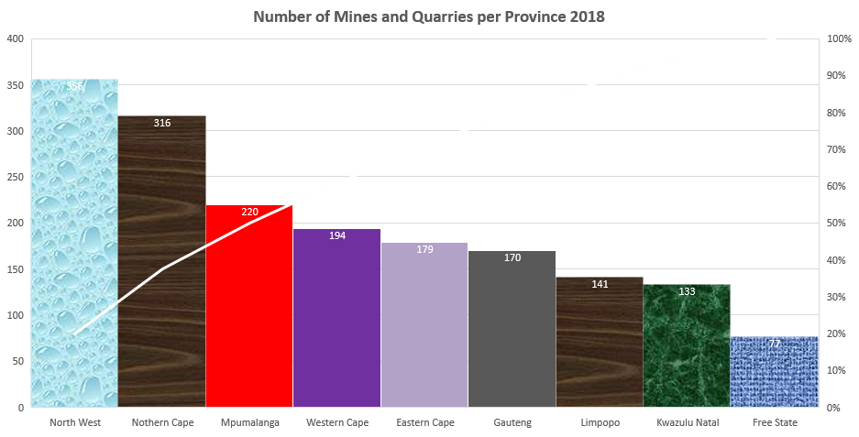
Mines and Quarries in South Africa

Slide 5
Structure of the DMR Budget (Vote 29) DMR
Purpose:
Promote and regulate minerals for transformation, growth and development.
Ensure all South Africans derive sustainable benefits from the country’s mineral wealth.
Four Programmes; Administration, Mine Health and Safety, Mineral Regulation, Mineral Policy and Promotion.
Notes:
Admin: Ministry, Corporate Services, Department Management, Financial Administration.
Mine Health and Safety: Governance and Policy Oversight, Mine Health and Safety Regions, Mine Health and Safety Council.
Mineral Regulation: Min Regulation and Administration, Management Mineral Regulation, SADPMR, PASA
Mineral Policy and Promotion: Min Policy, Min Promotion and International Co-ordination, Council for Geoscience, Mintek

Slide 6
Budget Allocation 2019/20
Notes:
Total Budget - R 2,005 billion
50% is allocated to Mineral Policy and Promotion (Programme 4)
Transfers and Subsidies to CGS and Mintek
22% allocated to Mineral Regulation (Programme 3)
Included Transfers and Subsidies to SADPMR and PASA

Slide 7
Historical Operational and Financial Performance 13/14 – 17/18
Audit Outcome Trends 2013/14 - 2017/18 Financial Years
 | 17/18 | 16/17 | 15/16 | 14/15 | 13/14
DMR | 2 | 1 | 2 | 2 | 2
SDT | 2 | 1 | 2 | 1 | 2
Mintek | 1 | 1 | 1 | 1 | 2
MHSC | 1 | 1 | 2 | 2 | 2
SADPMR | 2 | 2 | 1 | 2 | 2
CGS | 2 | 2 | 2 | 2 | 2
Notes:
Green - Unqualified with no Audit Finding
Orange - Unqualified with Findings

Slide 8
Issues Impacting Performance
Despite good financial and operational performance.
Disturbing trends in fatalities.
The Department yet to table legislation.
Which contributes to uncertainty in the industry.
Challenging of the Mining Charter 3 not helpful.
However some mines are already implementing .
Important to secure commitments regarding legislative agenda, early in the term.

Slide 9
Possible Questions
What is the current ratio of inspector to mine, and what is the ideal ratio? Is the ratio equal across all provinces?
How will the court challenge to the Mining Charter three impact on its implementation?
What additional initiatives have been undertaken by the Department to deal with fall of ground related fatalities in mines?
What is being done to address high fatality rates in gold mines?
How will the current IRP impact the Department’s vision on the coal industry going forward. Are there plans in place to deal such impacts?
How will the budget be used to assist emerging miners, are there specific programmes dedicated to develop emerging miners?

Slide 10
Thank you
Mr Nkosinathi Kweyama
Content Advisor Mineral Resources
Parliament of South Africa
021 403 8727 (Tel)
(Fax)
(Cell) 072 1477485
Office location:

